Slide 1


Data Cube Application Algorithms for the United Nation Sustainable Development Goals (UN-SDGS)
IEEE IGARSS 2020
Authors:
¹Syed R Rizvi, ²Brian Killough, ¹Andrew Cherry, ¹John Rattz, ¹Andrew Lubawy, ¹Sanjay Gowda
¹Analytical Mechanics Associates, Hampton, VA
²NASA Langley Research Center, Hampton, VA
Presenter: Syed R Rizvi
Notes:
Hello my name is Syed Rizvi and I work for Analytical Mechanics Associates, Hampton, VA. I am going to briefly present our work on Data Cube Application Algorithms for the United Nation Sustainable Development Goals.

Slide 2


UN SDG 6.6.1
Change in the extent of water-related ecosystems over time
Notes:
So let’s first see the UN SDG 6.6.1 – i.e., Change in the extent of water-related ecosystems over time

Slide 3
Structure
Analyze Single Time Period
  Load Landsat data from the Data Cube
  Get water classifications (WOfS)
  Visualize the minimum and maximum water extents
  Visualize water extent change
Analyze Two Time Periods
  Load Landsat data from the Data Cube
  Get water classifications (WOfS)
  Visualize water extent change between the two time periods
Notes:
Here is the structure of our analysis. I will briefly discuss the items in blue here.

Slide 4
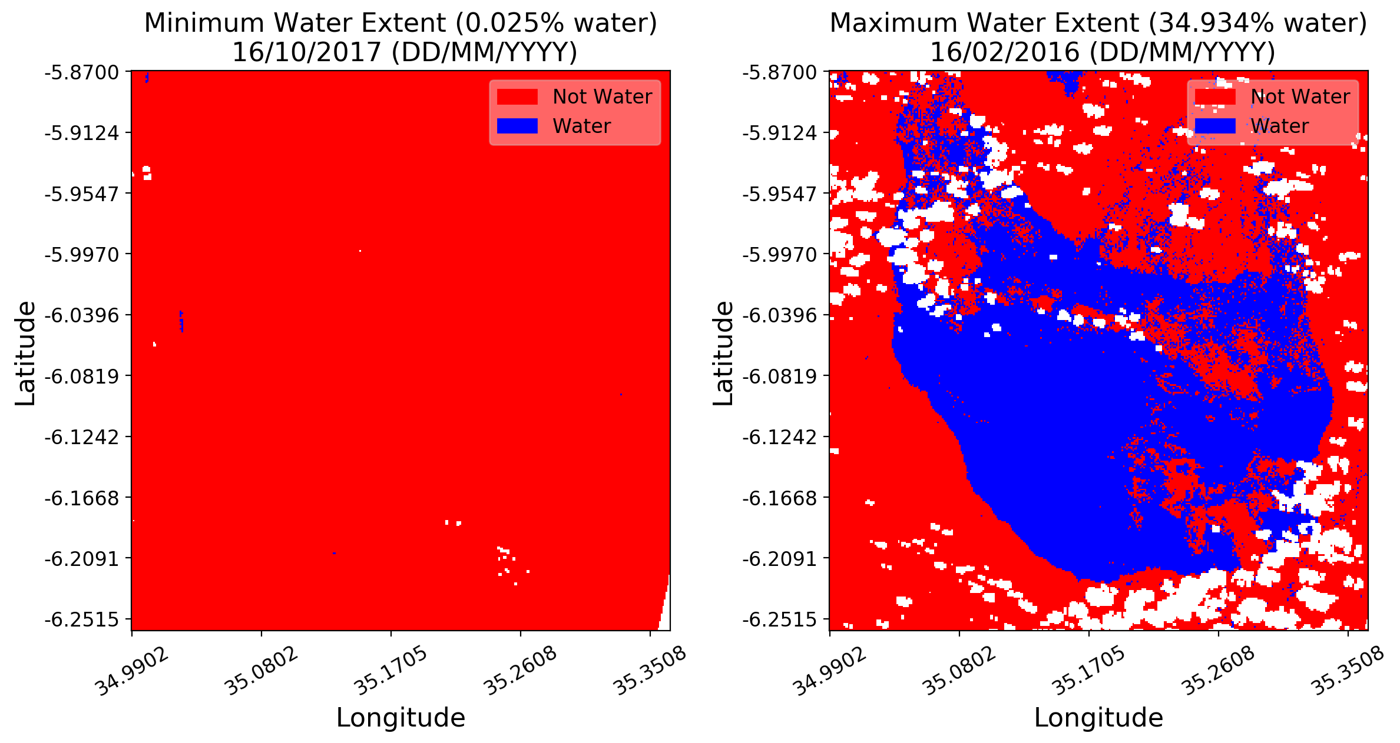
Single Time Period Minimum and Maximum Water Extents
(Lake Sulunga, Tanzania, 2016-2017)
Notes:
Between 2016 and 2017, Lake Sulunga was at its maximum and minimum water extents during February 2016 and October 2017, respectively. This dramatic difference in minimum and maximum water extent is normal for Lake Sulunga, which often dries up during dry years. The white areas are clouds that have been masked out.

Slide 5
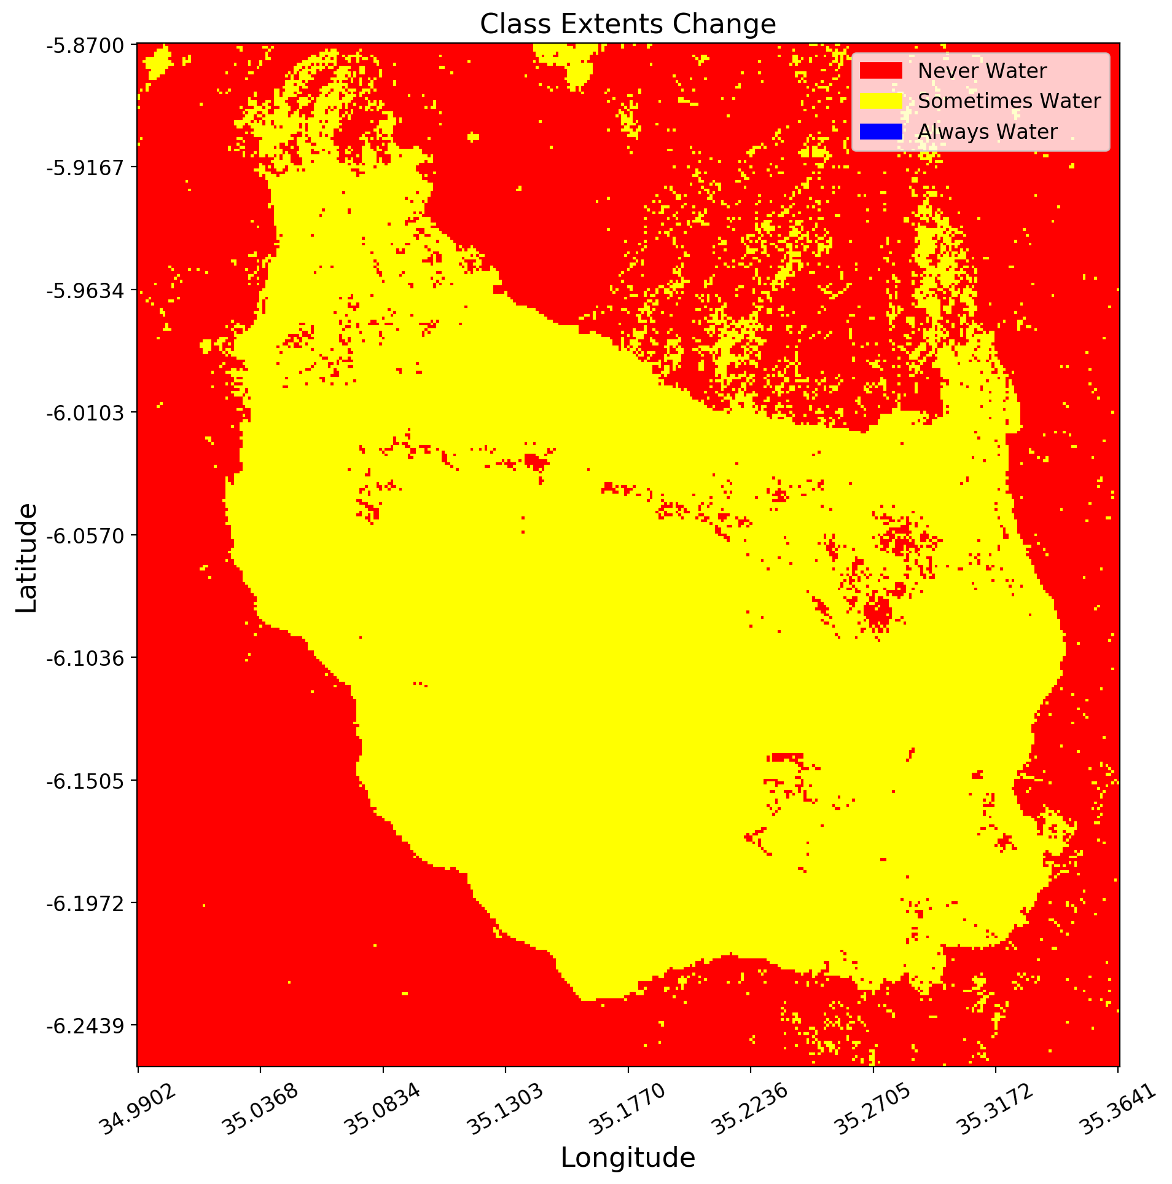
Single Time Period Water Extent Change
(Lake Sulunga, Tanzania, 2016-2017)
Notes:
This visualization also shows that Lake Sulunga changed in extent quite significantly throughout 2016-2017.

Slide 6
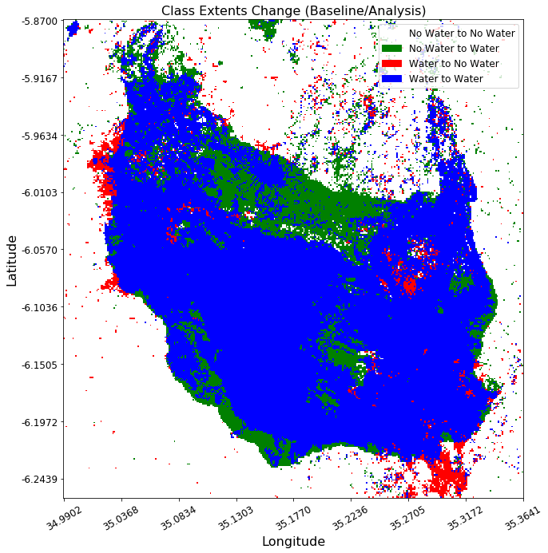
Multiple Time Period Water Extent Change (Lake Sulunga, Tanzania, 2014-2015 - 2016-2017)
Notes:
In this visualization, if a pixel was ever considered water during a time period, it is considered water. The legend entries denote changes from the baseline time period to the analysis time period. In this case, Lake Sulunga appears to have fairly similar extents between the baseline time period 2014-2015 and the analysis time period 2016-2017.

Slide 7

UN SDG 11.3.1
Ratio of land consumption rate to population growth rate
Notes:
Next, let’s see the UN SDG 11.3.1 – i.e., Ratio of land consumption rate to population growth rate

Slide 8
Structure
Population
  Load a population shapefile
  Visualize a specific region
  Visualize national population growth rate
Land Consumption
  Load data from Data Cube
  Create median composite
  Visualize the composites as false color
  Mask composites with shapefile
  Calculate the Normalized Difference Built-up Index (NDBI)
  Show urbanization extent
Calculate SDG Indicator
Notes:
Here is the structure of our analysis. I will briefly discuss the items in blue here.

Slide 9
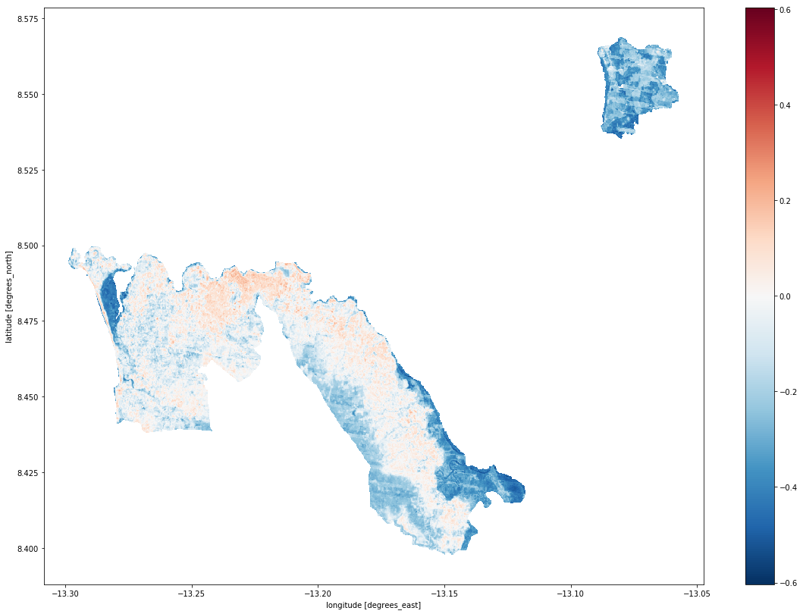
NDBI = (SWIR1 – NIR) / (SWIR1 + NIR)
Land
Consumption:
Calculate NDBI
(Western Sierra Leone, 2005)
Notes:
We calculated NDBI on the Western Sierra Leone for the year 2005

Slide 10
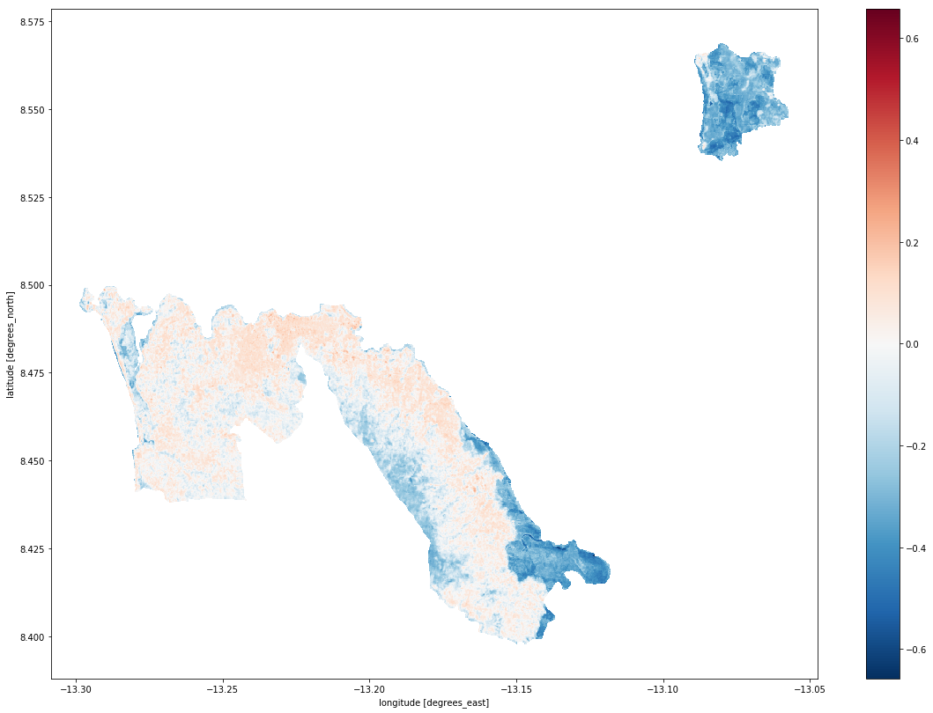
NDBI = (SWIR1 – NIR) / (SWIR1 + NIR)
Land
Consumption:
Calculate NDBI
(Western Sierra Leone, 2015)
Notes:
According to NDBI, urbanization has increased from 2005 to 2015 in this section of Western Sierra Leone.

Slide 11
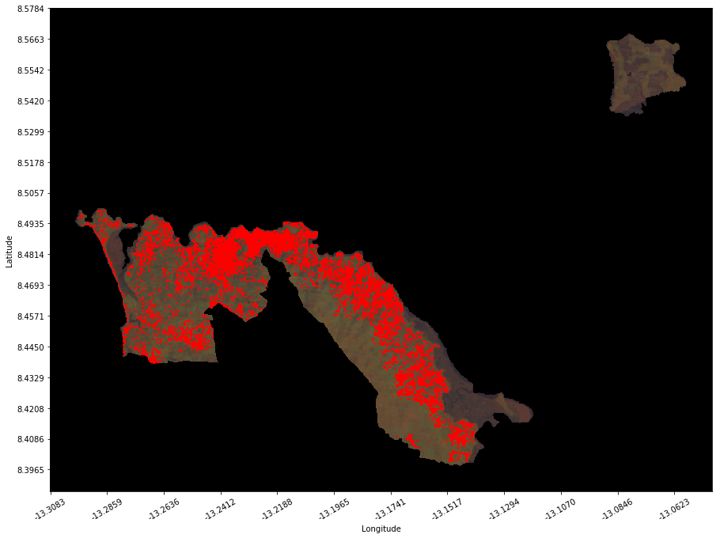
NDBI > 0
Land
Consumption:
Show Urbanization Extent
(Western Sierra Leone, 2005)
Notes:
Here is the NDBI greater than 0 for 2005

Slide 12
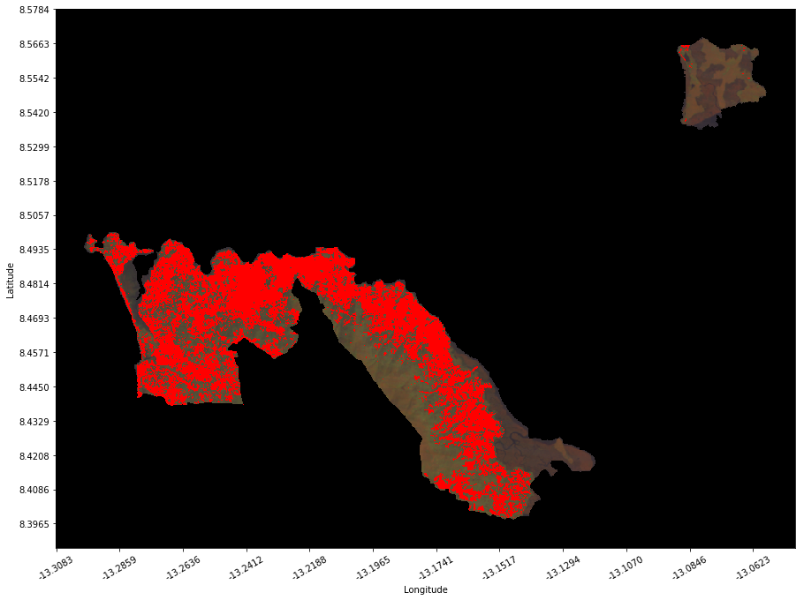
NDBI > 0
Land
Consumption:
Show Urbanization Extent
(Western Sierra Leone, 2015)
Notes:
Here is the NDBI greater than 0 for 2015

Slide 13
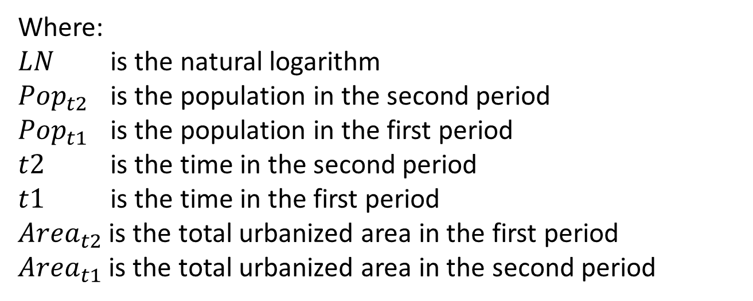


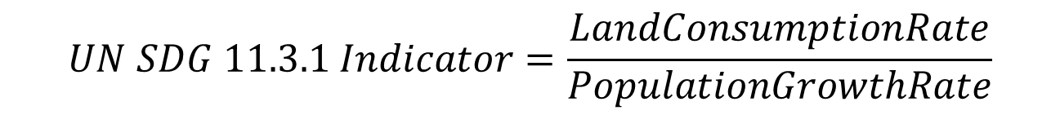
Calculate SDG Indicator
(Western Sierra Leone)
$$UN SDG 11.3.1 Indicator=\frac{LandConsumptionRate}{PopulationGrowthRate}$$
$$PopulationGrowthRate=\frac{LN({Pop}_{t2}/{Pop}_{t1})}{t2−t1}$$
$$LandConsumptionRate=\frac{LN({Area}_{t2}/{Area}_{t1})}{t2−t1}$$
Where:
$LN$ is the natural logarithm
${Pop}_{t2}$ is the population in the second period
${Pop}_{t1}$ is the population in the first period
$t2$ is the time in the second period
$t1$ is the time in the first period
${Area}_{t2}$ is the total urbanized area in the first period
${Area}_{t1}$ is the total urbanized area in the second period

Slide 14

UN SDG 15.3.1
Proportion of land that is degraded over total land area
Notes:
Finally, let’s see the UN SDG 15.3.1 – i.e., Proportion of land that is degraded over total land area

Slide 15
Structure
Load Data
  Load ESA Climate Change Initiative (CCI) land classification data
  Load Landsat (30m X 30m) data from Data Cube
Train Classifier
  Train a Random Forest Classifier to predict land classifications from the Landsat data
  Visualize ESA CCI data for the beginning and end of the time range
  Visualize the Predicted Land Classes and the True Land Classes
Visualize Land Change Frequency
Create Change Matrix
Notes:
Here is the structure of our analysis. I will briefly discuss the items in blue here.

Slide 16
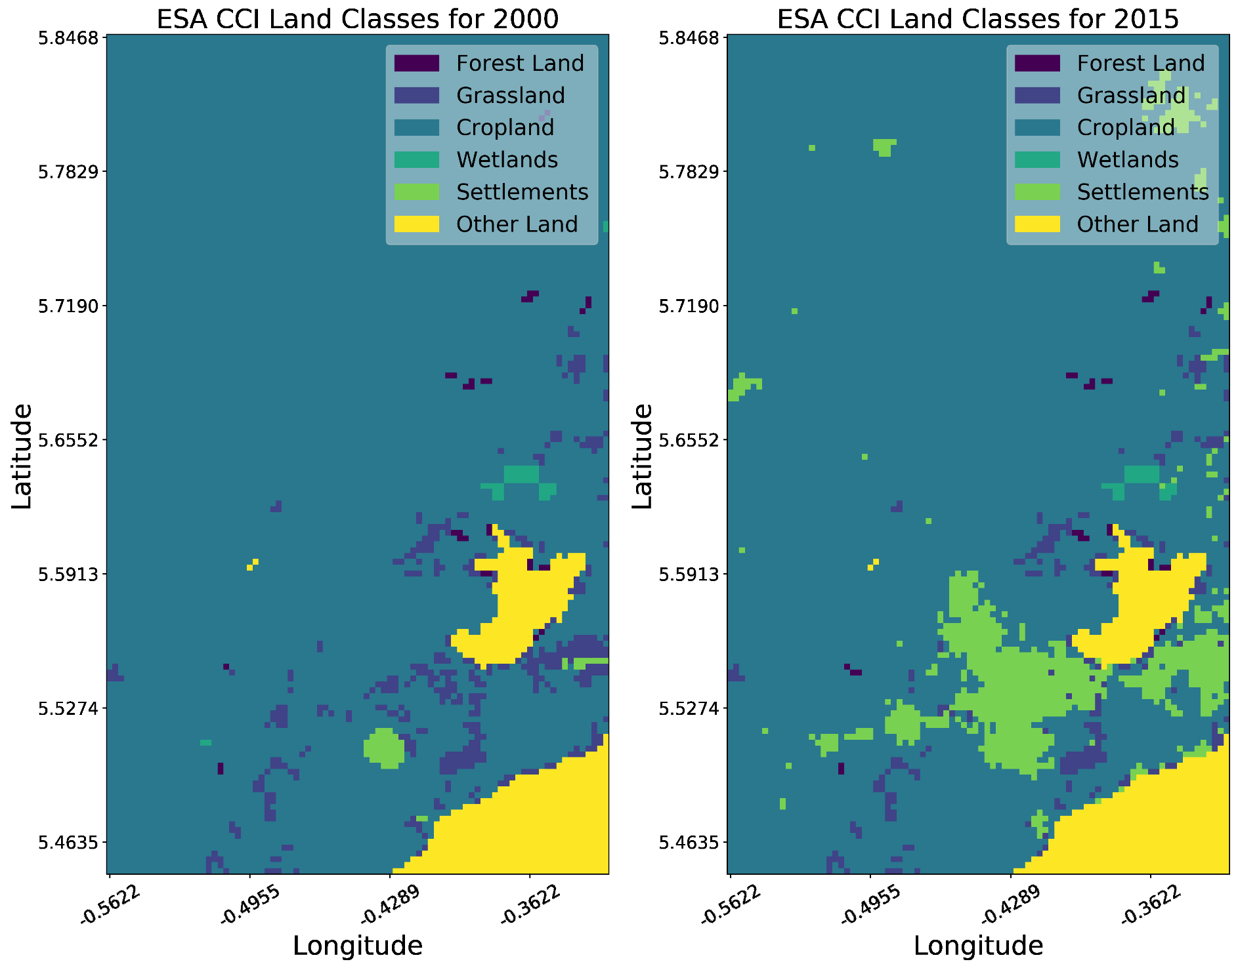
Train Classifier:
Visualize Data at
Beginning and End of Time Range
(Kasoa, Ghana,
2000-2015)
Notes:
Between 2000 and 2015, the most notable change in the Kasoa region is an increase in urbanization (“Settlements”).

Slide 17
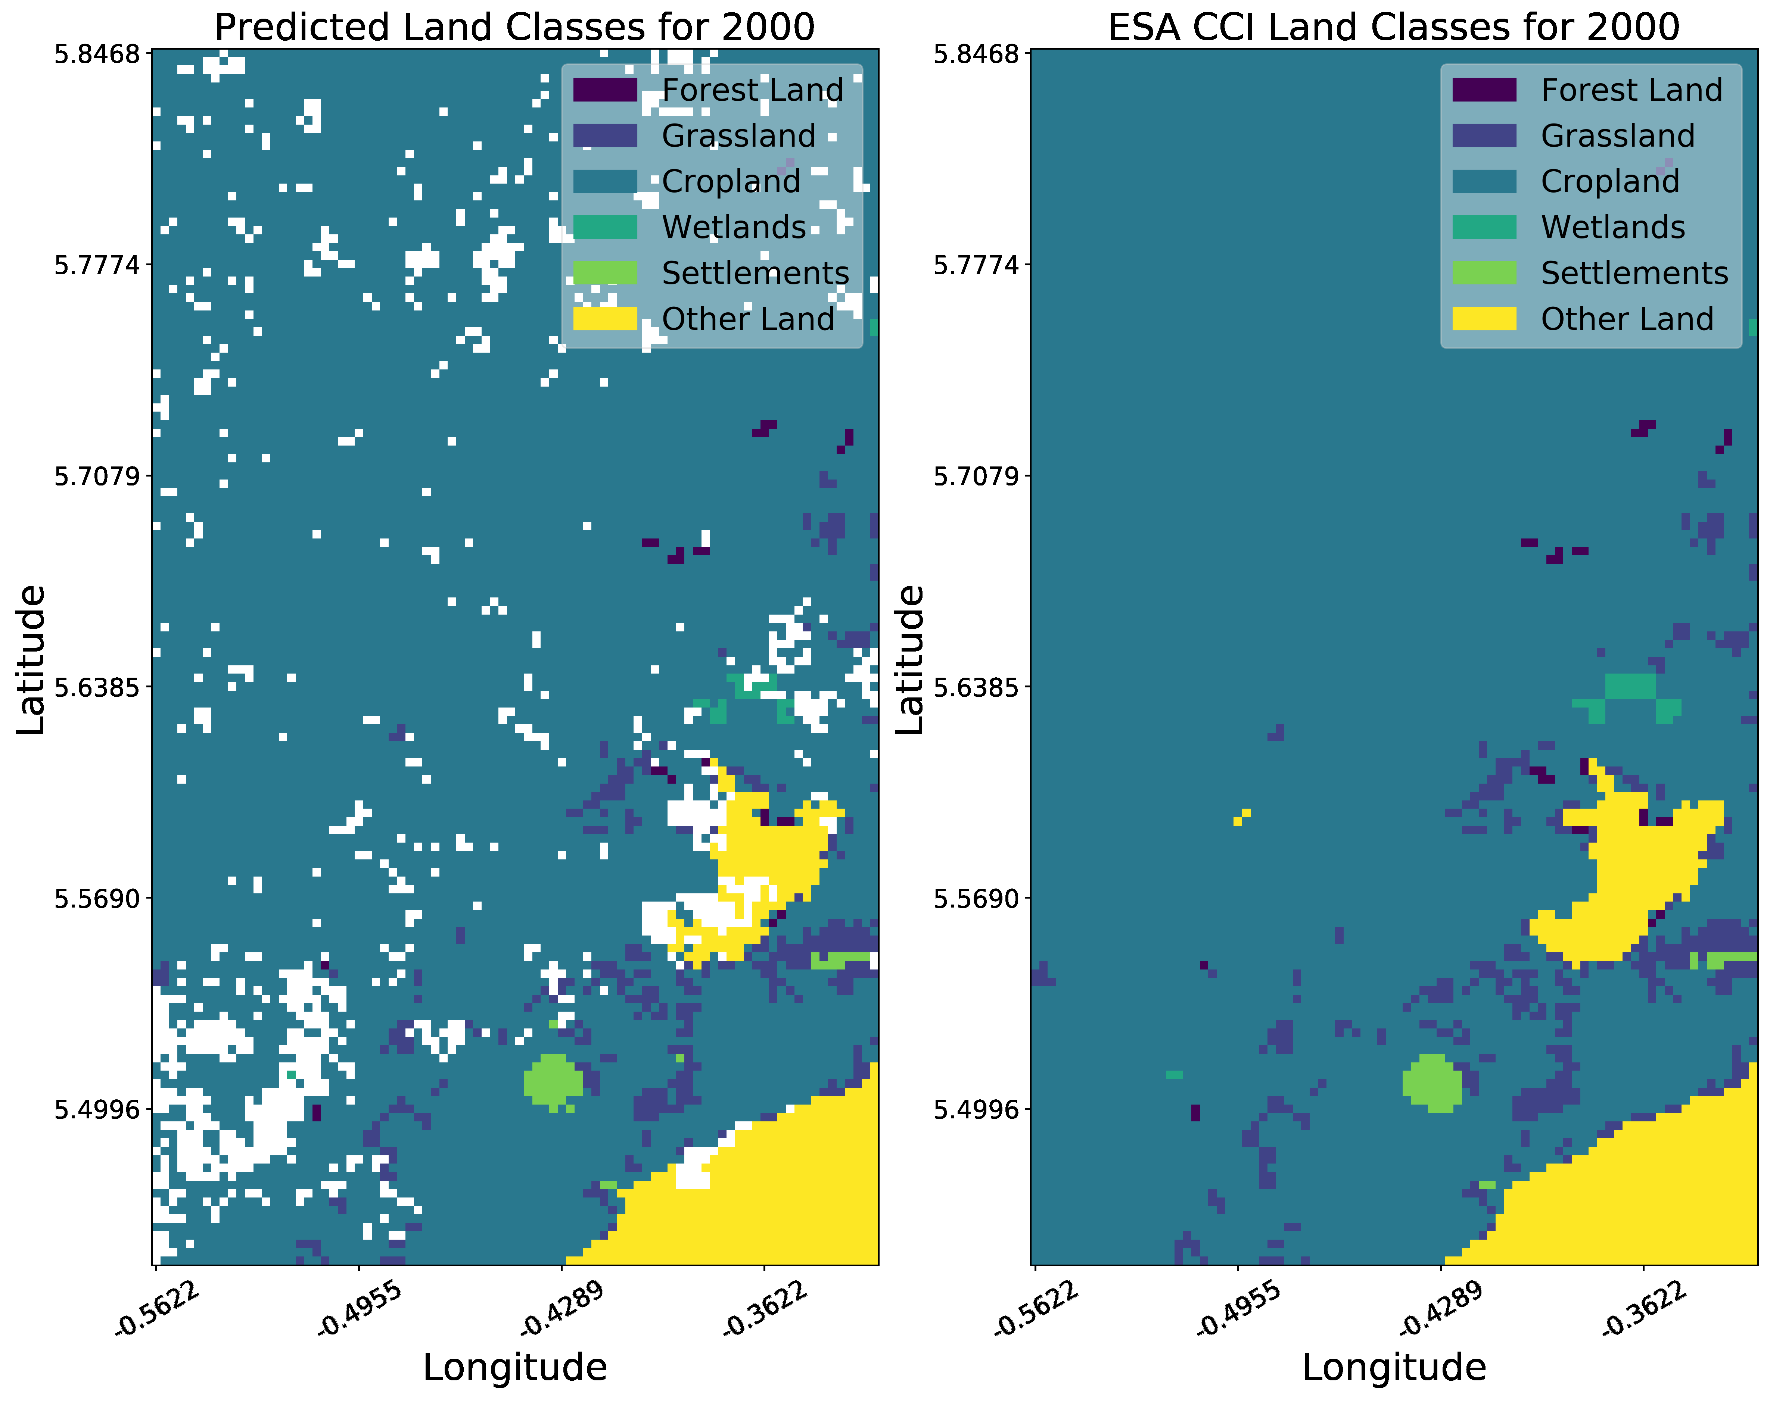
Train Classifier:
Visualize Predicted and True
Land Classes
(Kasoa, Ghana,
2000)
Notes:
This is data for the year 2000. The first figure is predicted land classes. The second figure is true land classes (according to ESA CCI). The white pixels in the predicted land classes images are pixels with no data.

Slide 18
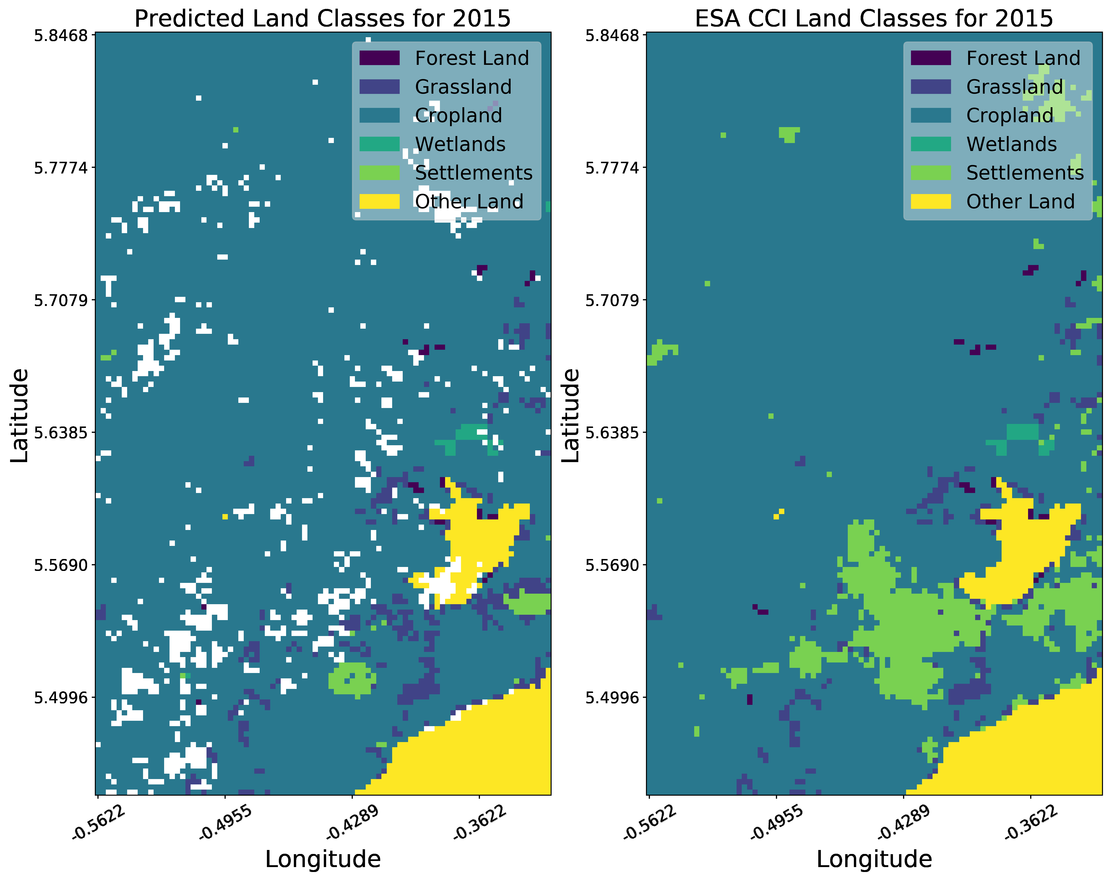
Train Classifier:
Visualize Predicted and True
Land Classes
(Kasoa, Ghana,
2015)
Notes:
Similarly, we have for 2015.

Slide 19
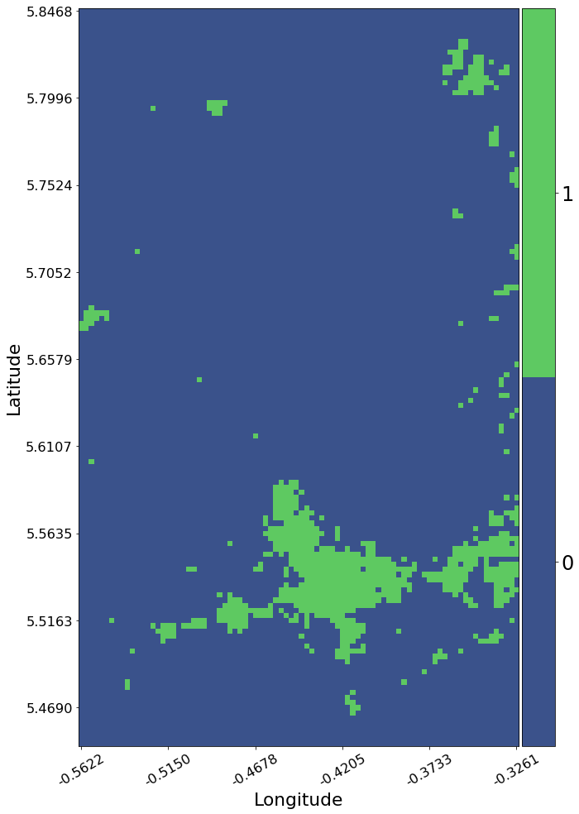
Visualize Land Change Frequency
(Kasoa, Ghana, 2000-2015)
Notes:
This figure shows that most pixels had no land class changes between 2000 and 2015, and most land class changes were due to urbanization in and around Kasoa.

Slide 20
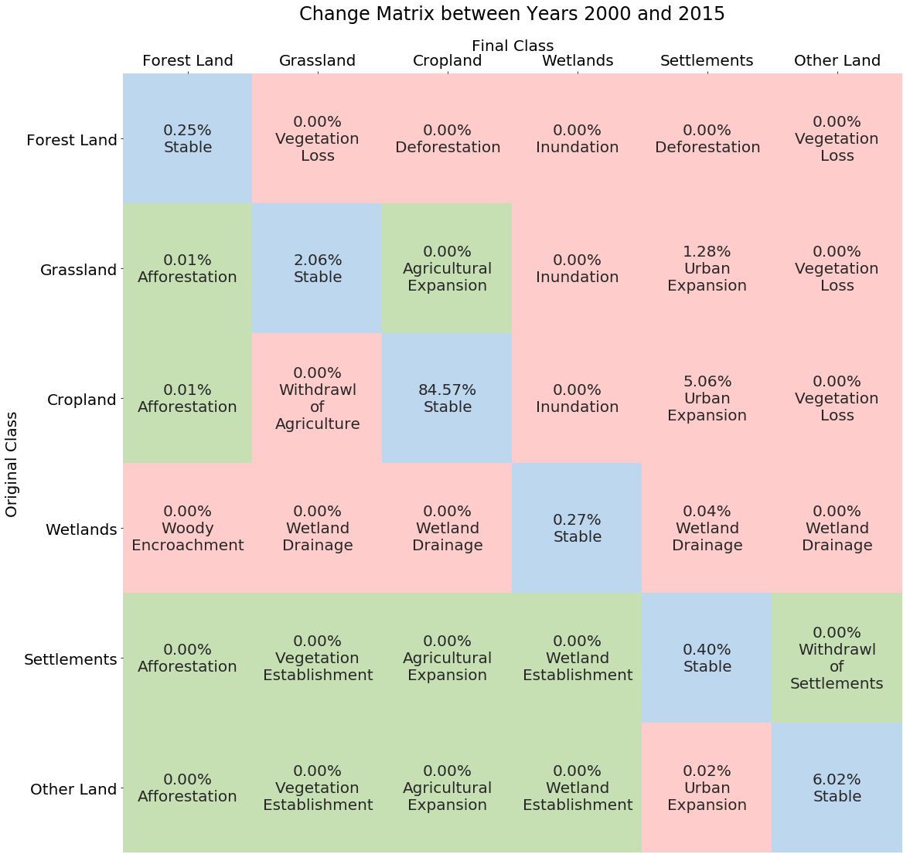
Change Matrix
(Kasoa, Ghana, 2000-2015)
Notes:
At the suggestion of the UN SDG 15.3.1 Good Practice Guidance document, we created a matrix of the amount of change from each IPCC land class to every other IPCC land class – coloring positive changes green, neutral changes blue, and negative changes red. A given transition will be either positive or negative depending on the context of the region, so the mapping of transitions to sentiment (positive, neutral, or negative) may vary between regions.
Here we can see that most of the terrain in this scene is cropland, and the most significant transitions were “Urban Expansion” (Grassland -> Settlements, Cropland -> Settlements).

Slide 21
Important Links
Relevant Links:
Open Data Cube:www.opendatacube.org/
Github: www.github.com/opendatacube
Documents: www.github.com/ceos-seo/data_cube_ui/tree/master/docs
Notebooks: www.github.com/ceos-seo/data_cube_notebooks
User Interface: www.tinyurl.com/datacubeui

