Slide 1
Full-sun Ultraviolet Rocket SpecTrometer (FURST) Calibration
NPP Research Update
Genevieve Vigil
Advisor: Amy Winebarger

Slide 2
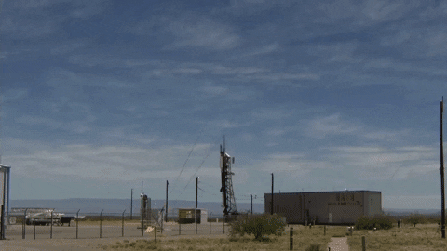
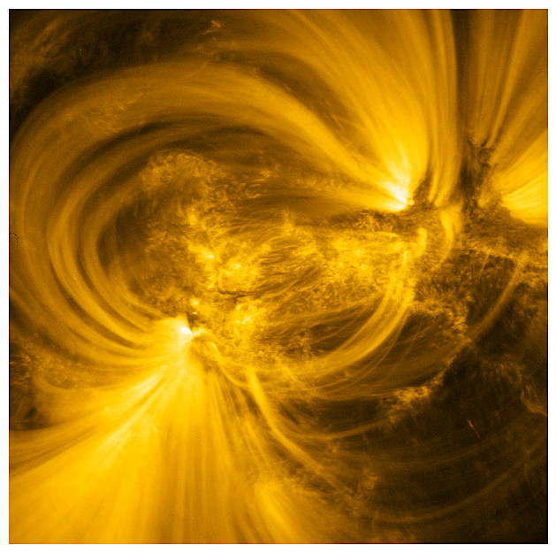
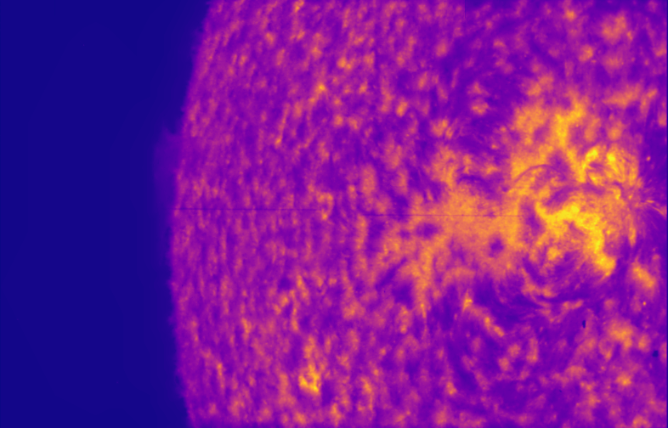
Sounding Rockets
Small experimental payloads
Launched into space for short duration flights.
5 minutes of data
Testing platform for novel instruments
Important science can be done from such launches
Hi-C 2.1
CLASPII
Slitjaw Stitched

Slide 3
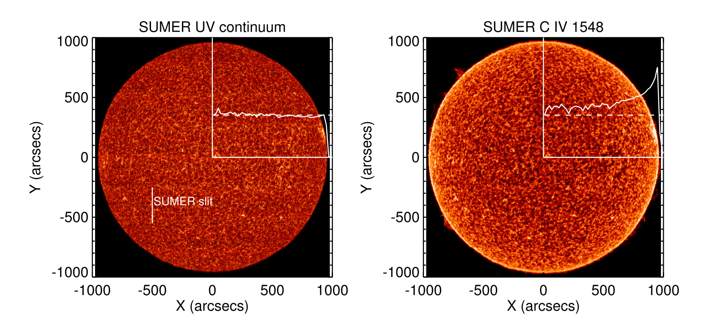
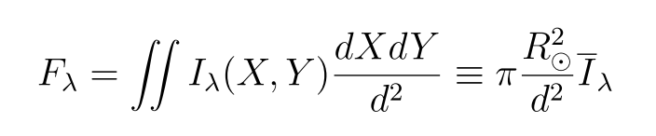
Full-sun UV Rocket SpecTrometer (FURST)
First high quality UV sun-as-star spectra
Spectral irradiance over time in the VUV
  Flares, active regions, other features modify irradiance and spectral line shape
﻿Full disk UV spectra we have is insufficient to reconstruct typical solar UV irradiance spectrum
Put the Sun’s UV activity in stellar context compared to high quality spectra, E.G. Hubble Space Telescope Imaging Spectrograph (STIS)
Additionally a broad range of solar system studies that can be enabled with high quality VUV spectral data
  magnetic field generation and dissipation in the Sun’s atmosphere
  the physics of comets
  Jovian and Saturnian satellites
  new exo-planet studies
FURST proposal, Kankelborg 2017

Slide 4
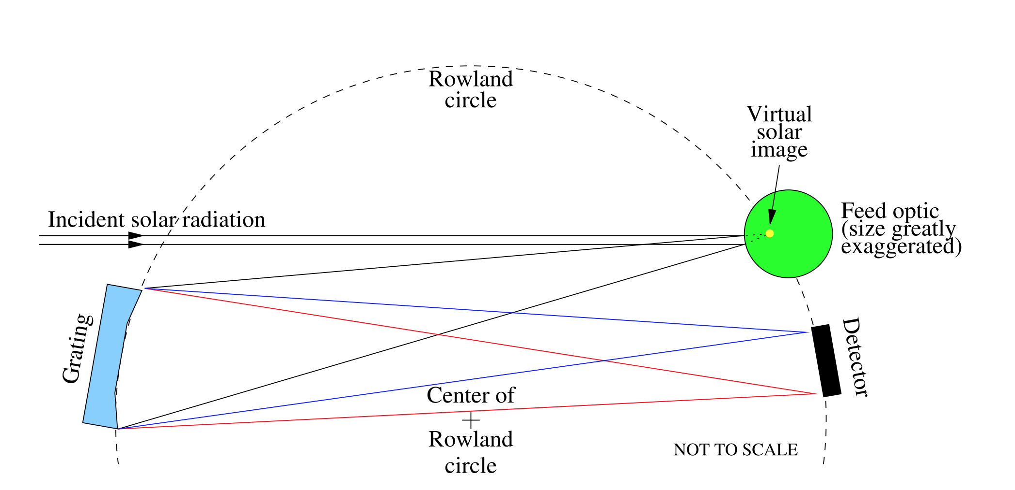
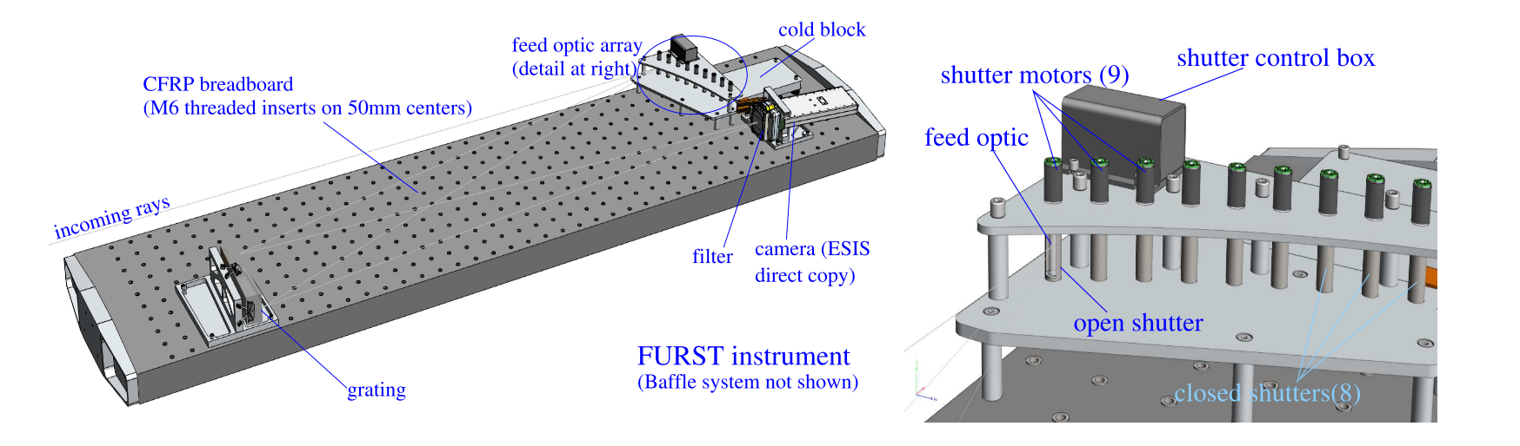
FURST instrument overview
Collapses light from the extended Solar source with a cylindrical feed optic
A curved grating focuses and diffracts light
Full-disk spectra captured on camera on Rowland circle
7 channels to cover full spectra range with high resolution
FURST proposal, Kankelborg 2017

Slide 5
Calibration Goals
Achieve absolute calibration comparable to Hubble
  Radiometric ~5%
  Wavelength +/- 3 km/s
Ambitious goals, especially without well defined radiometric calibration references
  STIS uses white dwarf models
  Original plan to use Synchrotron radiation at NIST SURFIII facility
    Instrument design decisions made this option less practical
Build portable calibration infostructure at MSFC which can approach these calibration targets and monitor FURST before and after launch
  Forward compatibility for future UV and SXR instrument testing

Slide 6
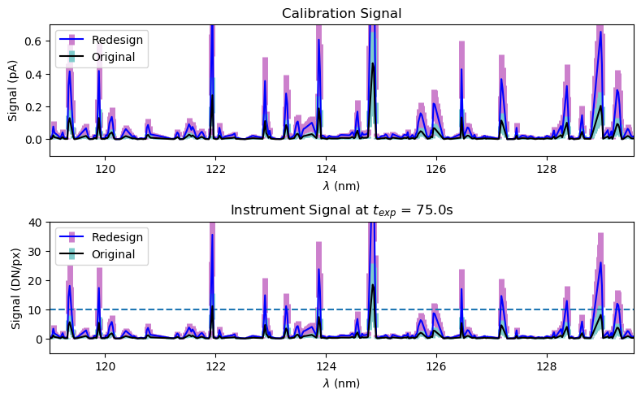
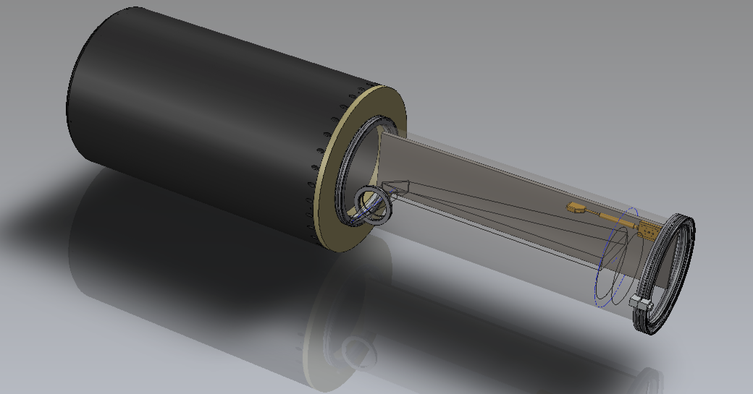
Calibration Plan
Calibration system
  Outputs VUV light from an excited Pt source containing hundreds of well calibrated spectral lines
  Quantify radiometrically through use of calibrated detectors
Begun design of this system
  Anticipating expected throughput and performance by accounting for
    Vacuum
    Contamination
    Lamp irradiance
    Optical system throughput
    Alignment
    Detector sensitivity
  Flexibility for adapting to future instrument testing needs

Slide 7
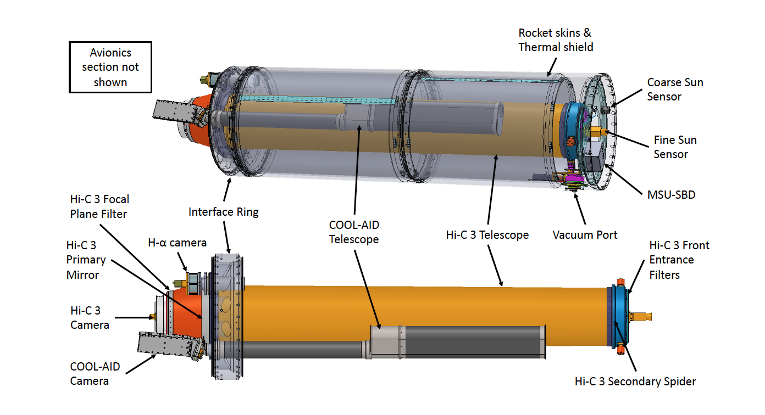
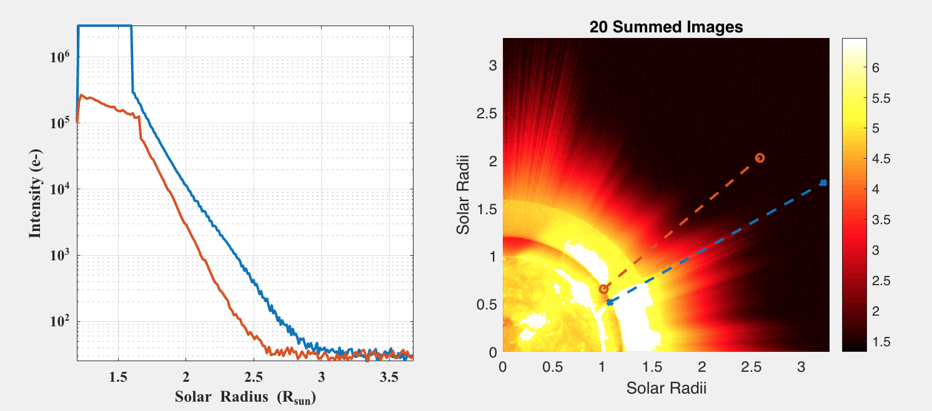
Future work
MAGIXS and CLASPIII launches
High resolution Coronal Imager (Hi-C) Flare campaign
  Launch during transient flare event
  Assembly of instruments including HI-C, a slitless imaging spectrometer (COOL-AID) and an Xray detector (MSU-SBD)
Cubesat mission based on COSIE-C
  Mission that would integrate a coronagraph with a slitless imaging spectrometer aboard the ISS
  Continuation of the corograph aboard a cubesat
Hi-C Flare
COSIE-C simulated image
HI-C Flare proposal, Winebarger 2019

