Slide 1
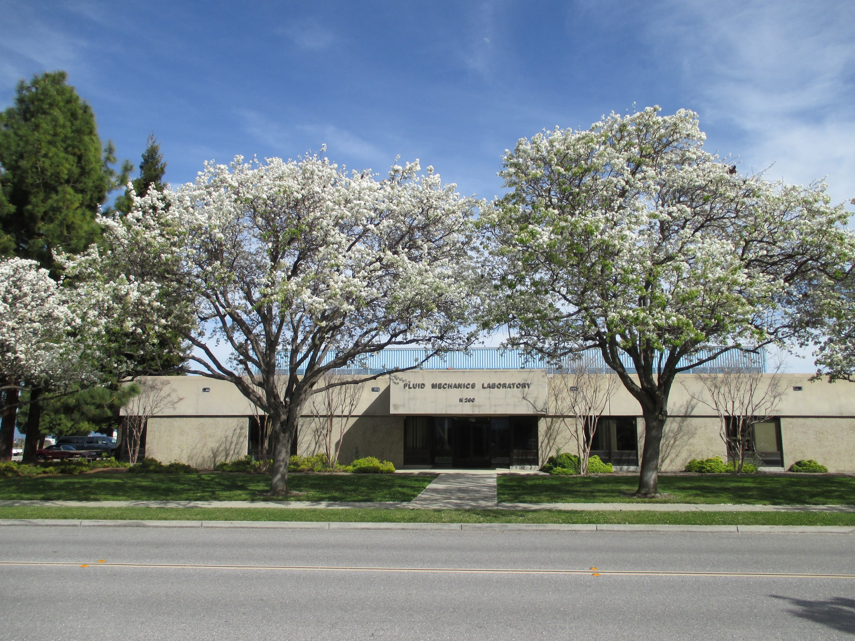
Experimental Aero-Physics Branch
(NASA Ames Code AOX)
Fluid Mechanics Laboratory

Slide 2
Experimental Aero-Physics Branch
Organizational Overview
  NASA Ames Research Center, Moffett Field, CA
  Code AOX (Aeronautics/Wind Tunnel Ops/Experimental Aero- Physics)
Two Main Locations at NASA Ames
  N260 Complex (23,300 sq ft total, 12,800 sq ft labs)
    Fluid Mechanics Lab (FML), Compressor Bldg, Tunnel Manifold
  N221 Complex (3,000 sq ft total)
    Anechoic Chamber, Anechoic Wind Tunnel, Acoustics Lab (Rooms 154A/B/C)
  Experimental Facilities
  Eight Wind Tunnels, Two Water Flow Facilities, Anechoic Tunnel,
  Laser Optics Lab, Instrumentation Lab, Acoustics Lab, Electronics Lab,
  Machine Shop
Main Goals
Experimental Research in Aerodynamics and Fluid Mechanics
  Small-scale, low-cost, high-availability, easy to operate facilities
  Participate in testing at other facilities at Ames and other centers
  Develop, optimize, evaluate advanced flow instrumentation/techniques
  Field those techniques and instrumentation at all NASA facilities

Slide 3

NASA Ames Fluid Mechanics Lab (FML)
Experimental Flow Facilities
4” x 4” Probe Calibration Facility
12” x 12” Research Tunnel
14” x 14” Indraft Tunnel
15” x 15” Blue Indraft Tunnel
24” x 24” Blower Tunnel
  48” x 24” Test Section
48” x 32” Indraft Facility
17” Water Channel Facility
12” Pipe Flow Facility
Anechoic Wind Tunnel

Slide 4
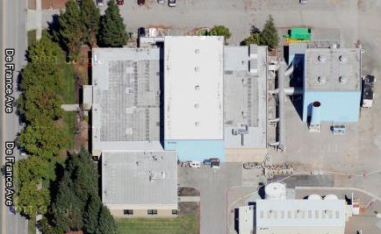
Fluid Mechanics Laboratory

Slide 5
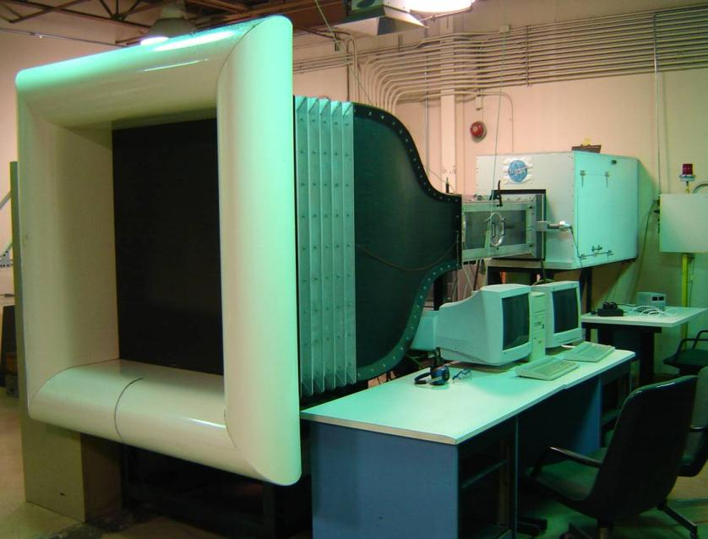
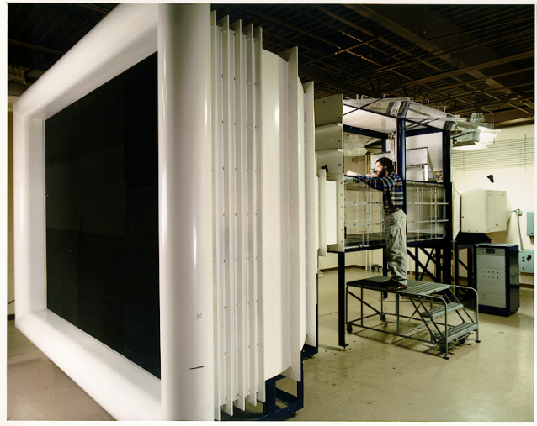
FML Indraft Facilities
48” X 32” Wind Tunnel
14” X 14” Wind Tunnel

Slide 6
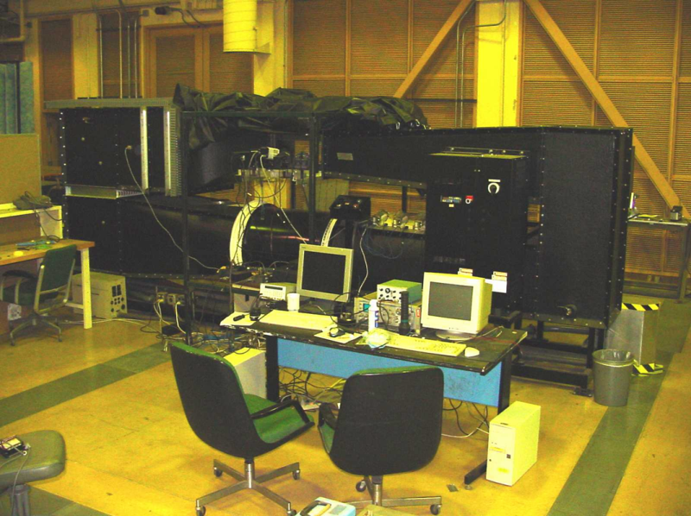
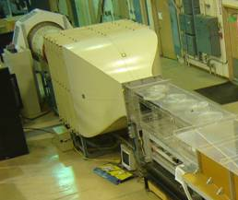
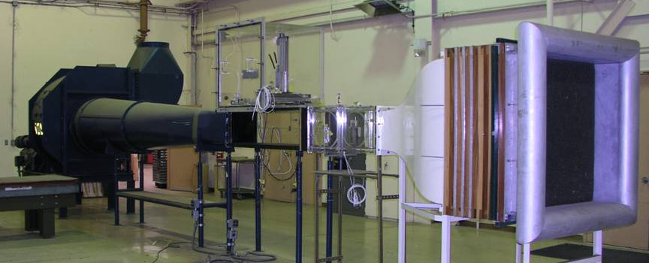
12” X 12” Return-Circuit Wind Tunnel
24” X 24” Blower Wind Tunnel
14” X 14” Indraft Wind Tunnel
FML Stand Alone
Facilities

Slide 7
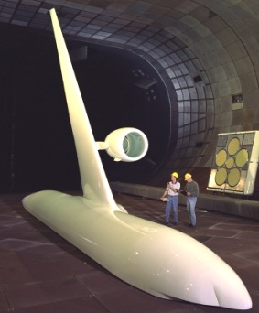
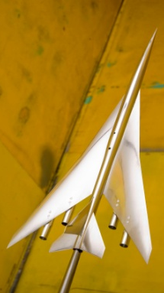
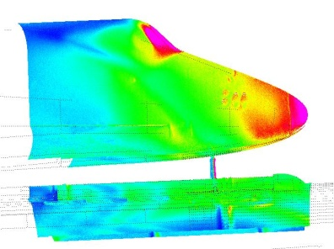
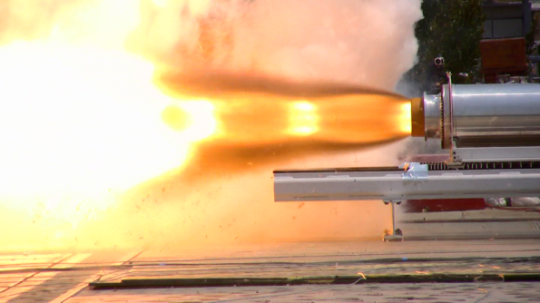
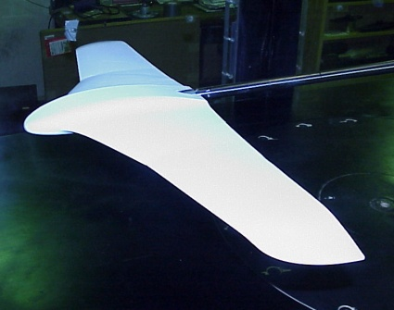
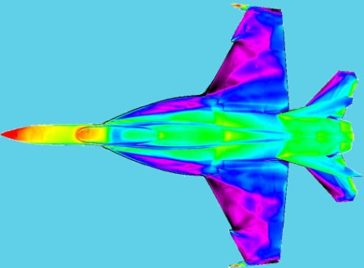
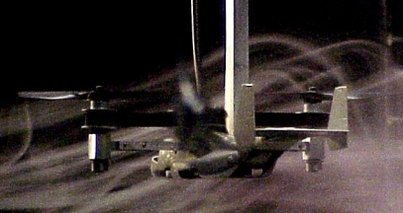
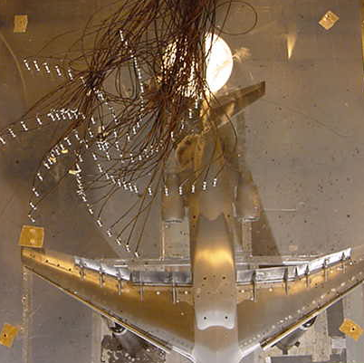
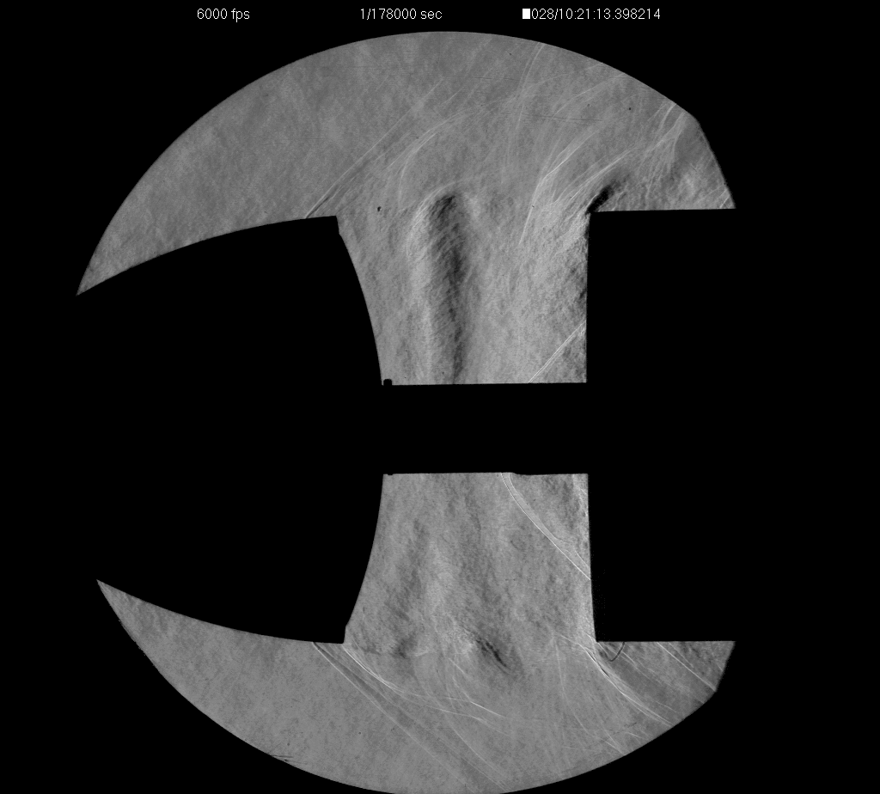
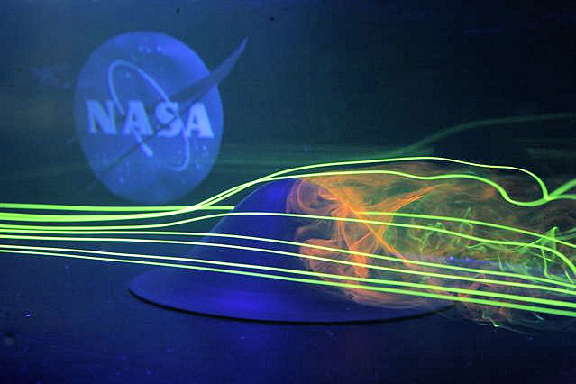
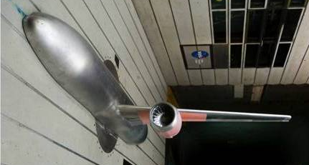
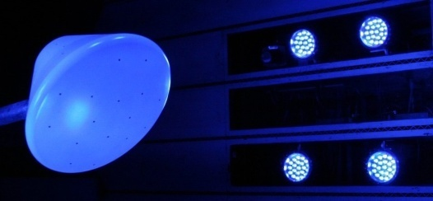
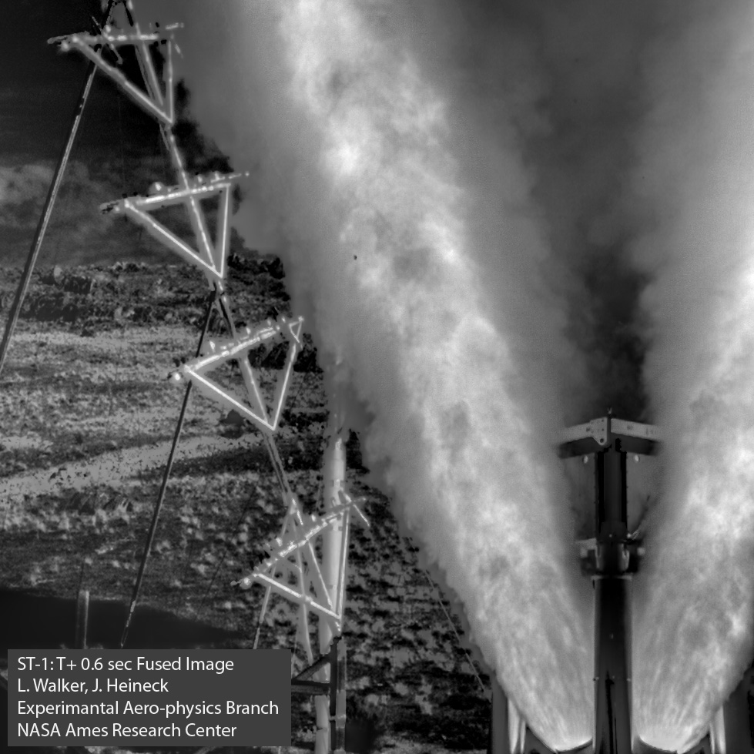
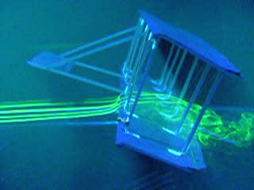
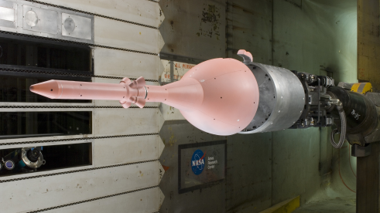
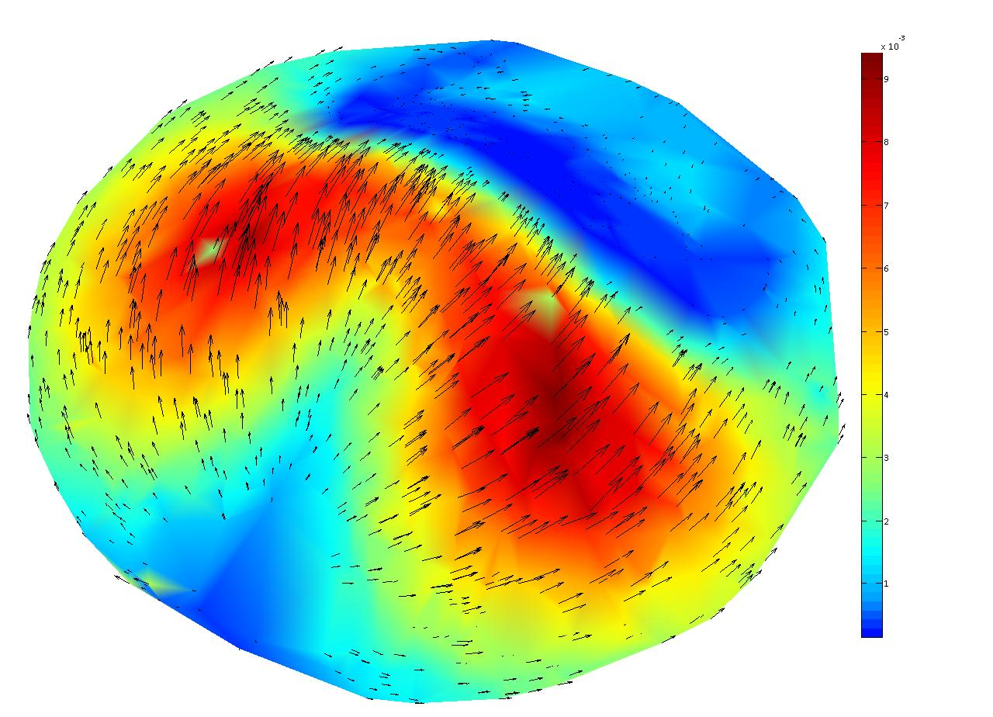
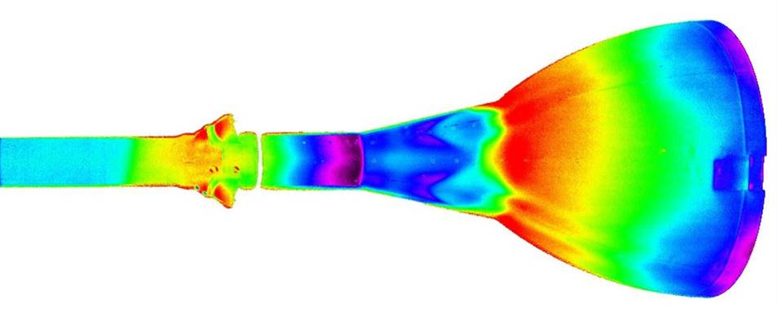
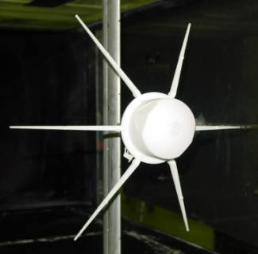
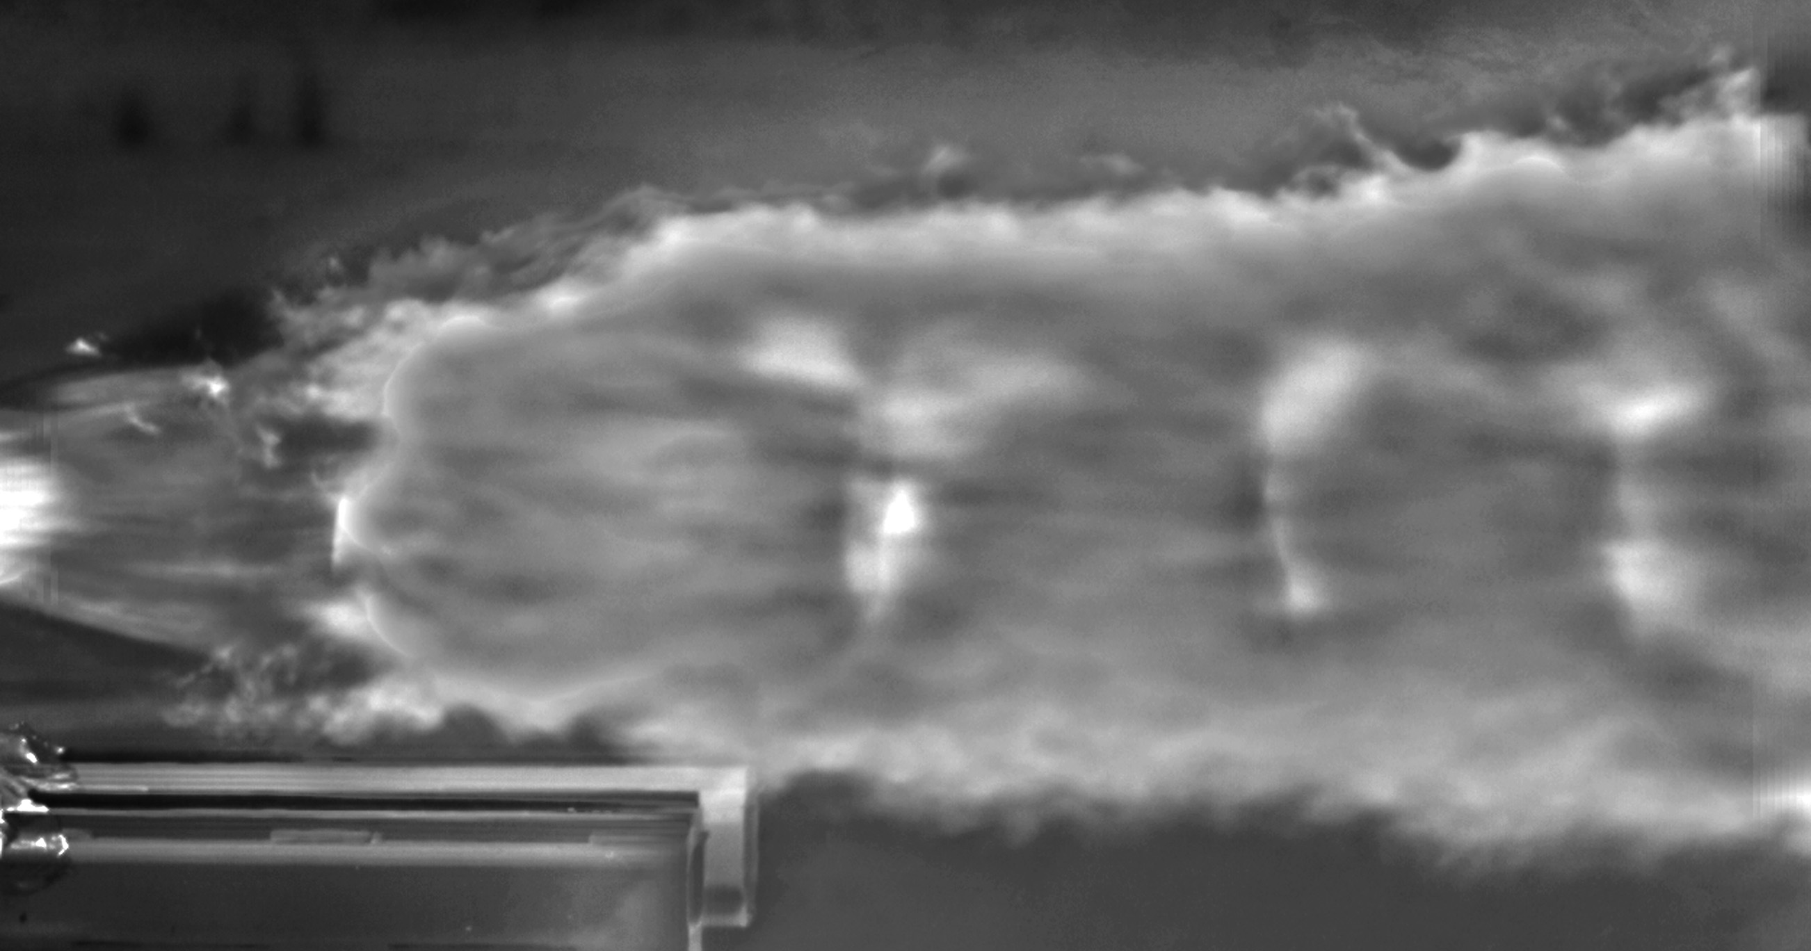
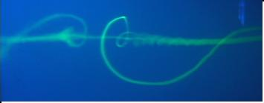
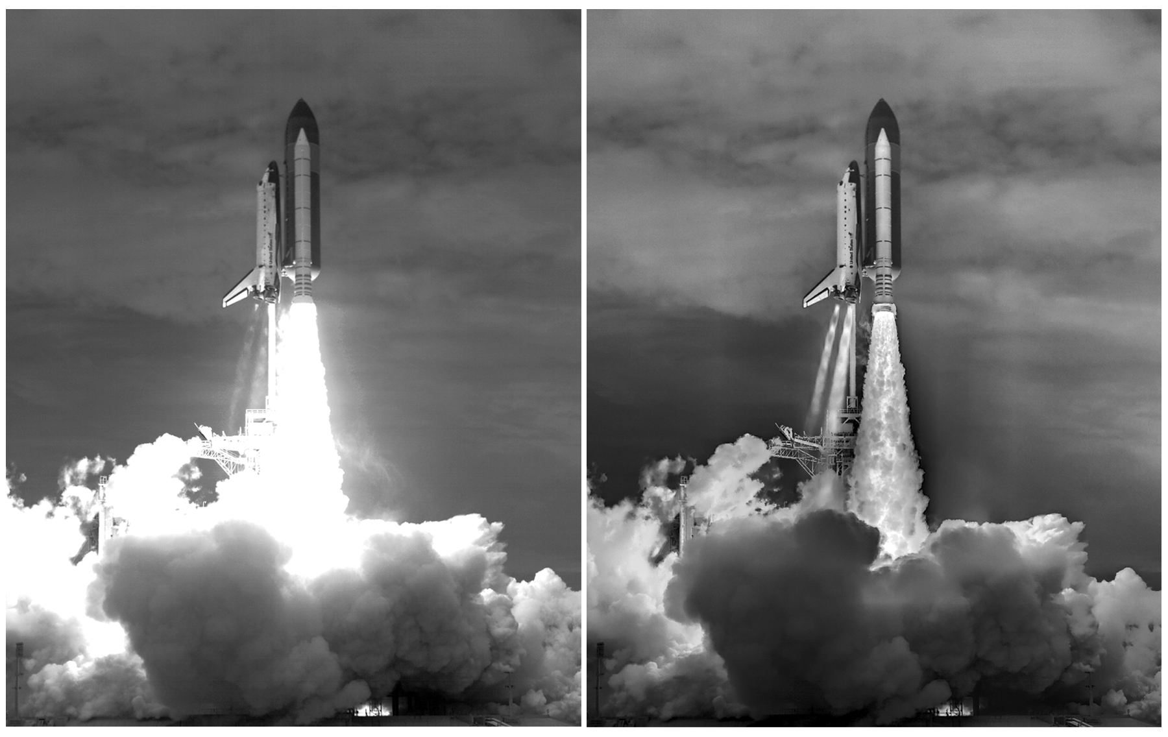
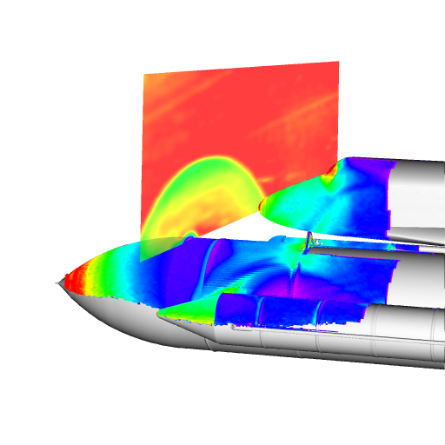
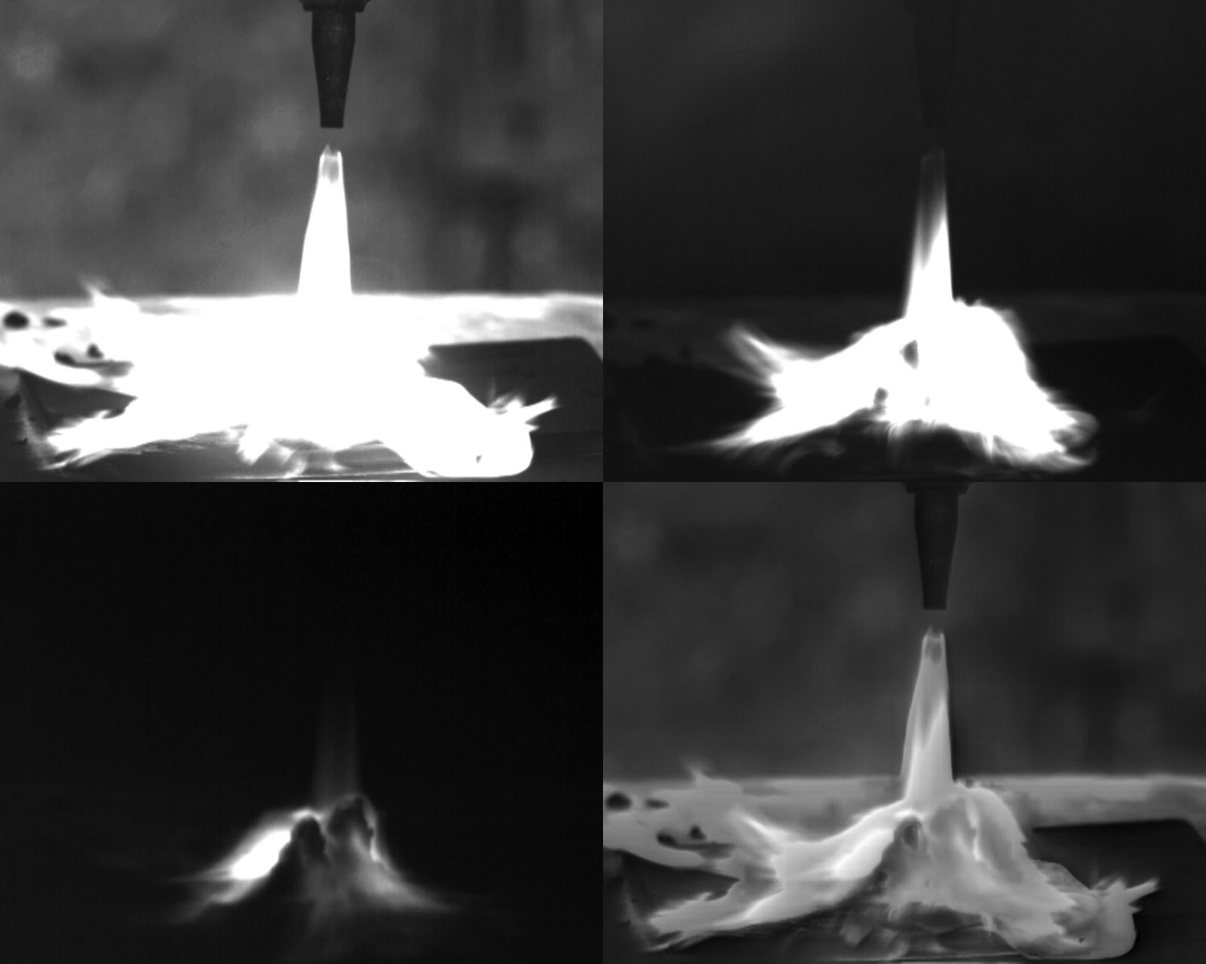
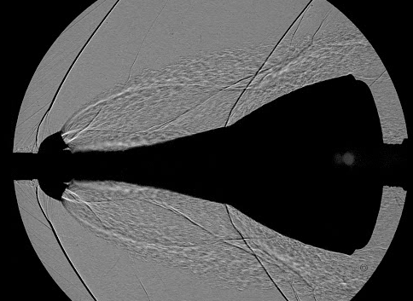
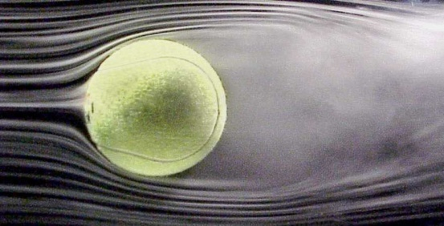
Experimental Aero-Physics Branch (AOX)
NASA Ames Research Center
Advanced Instrumentation Systems Overview

Slide 8
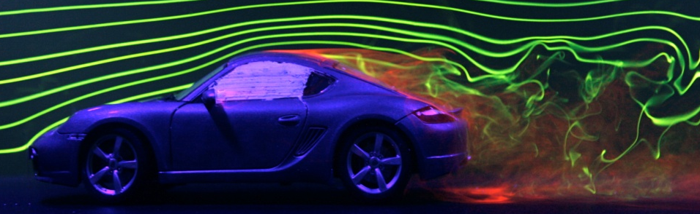
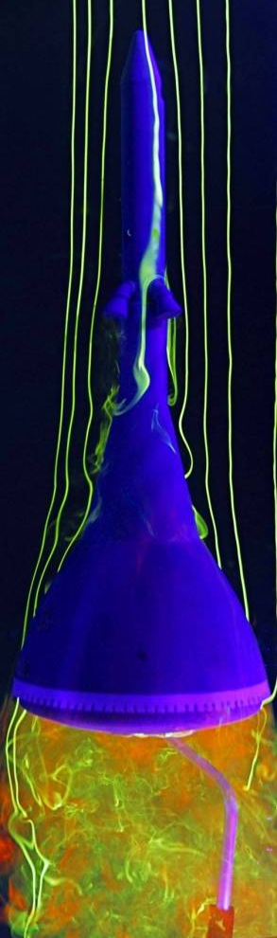
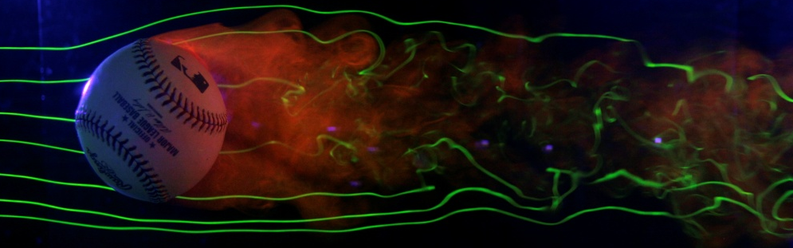
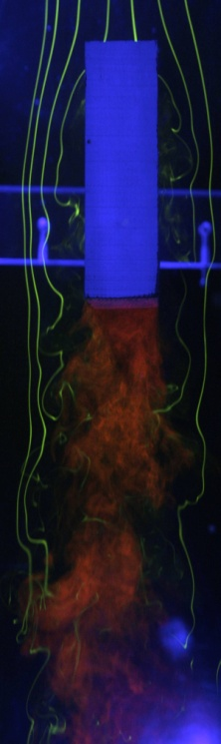
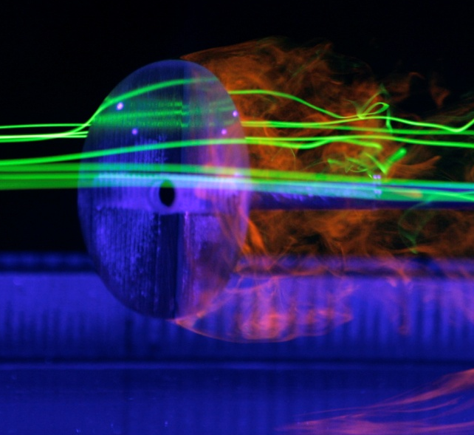
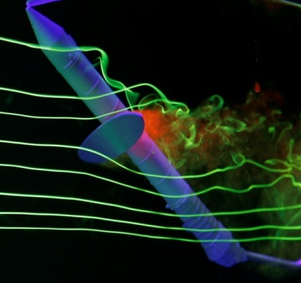
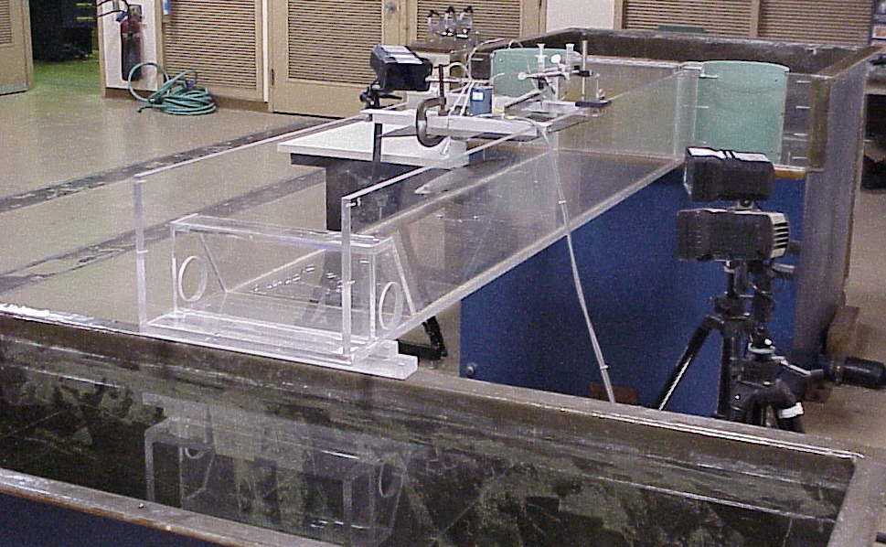
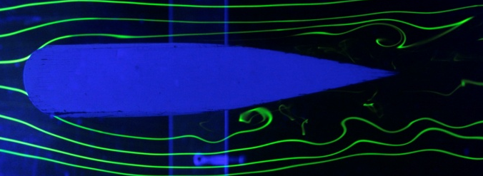
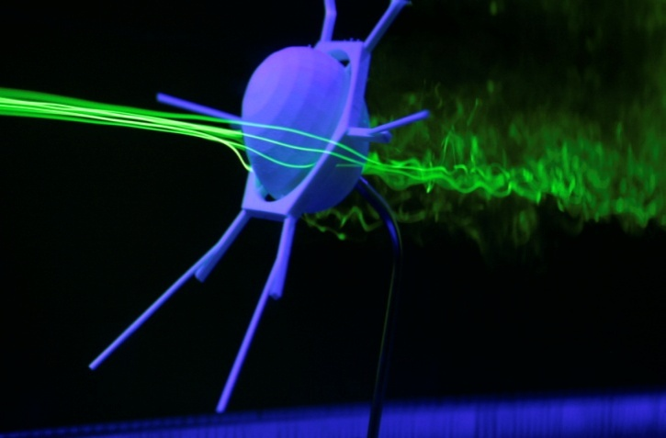
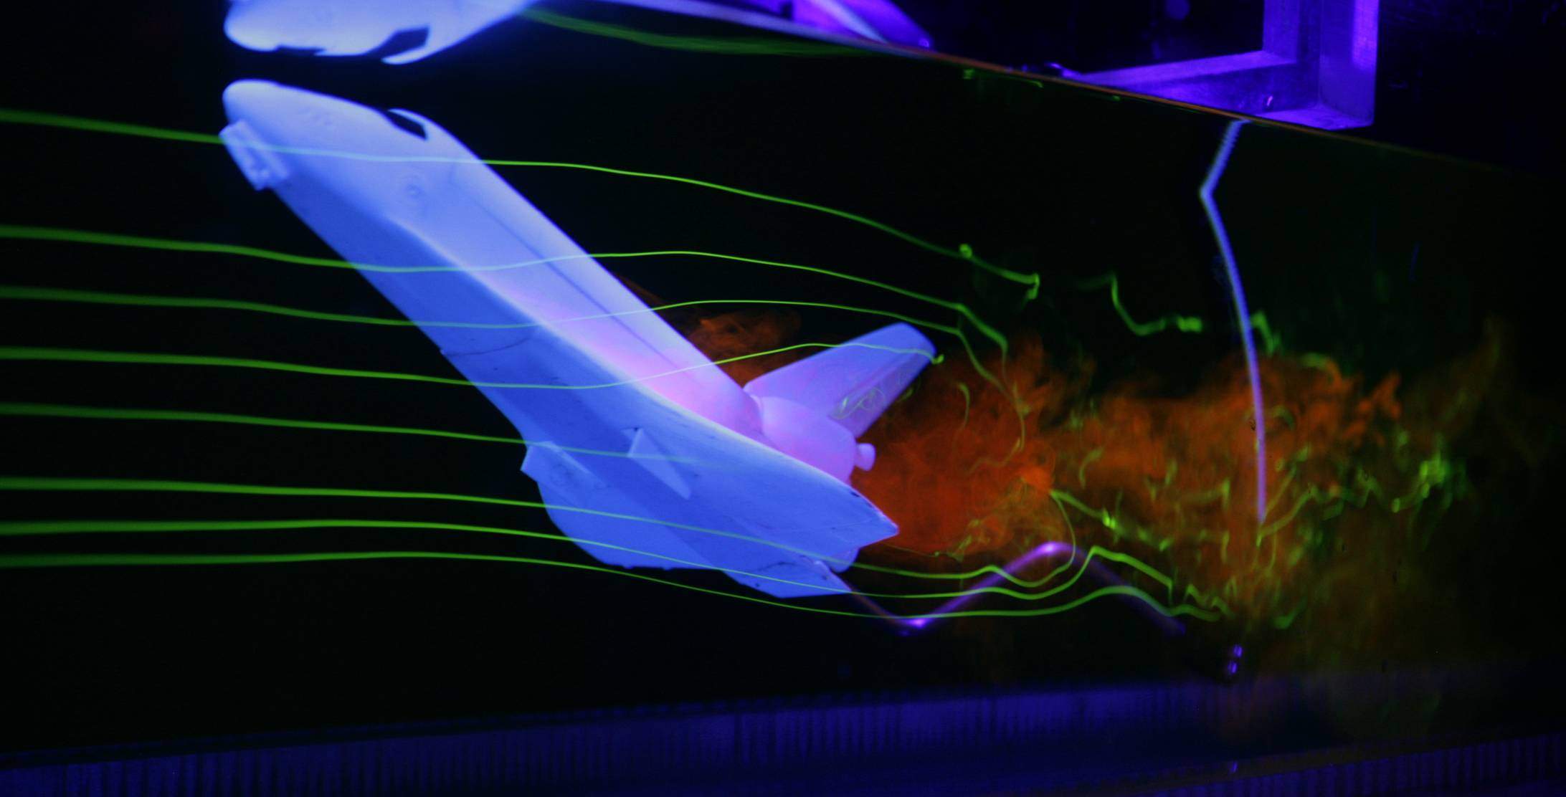
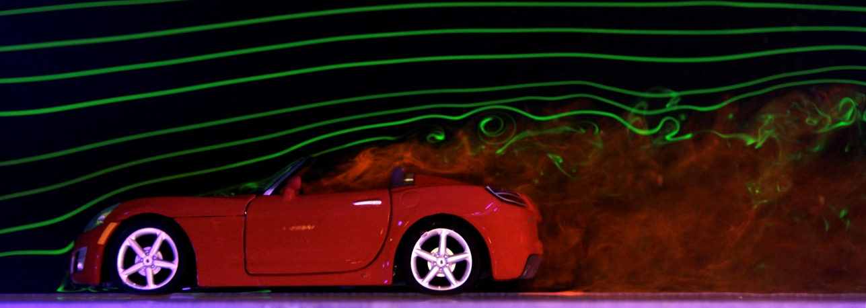
Flow Visualization
Using Fluorescent Dyes
Water Channel

Slide 9
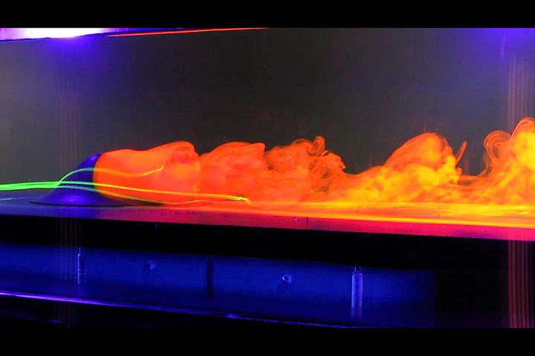
FAITH: Water Channel Flow Visualization
Experiments

Slide 10
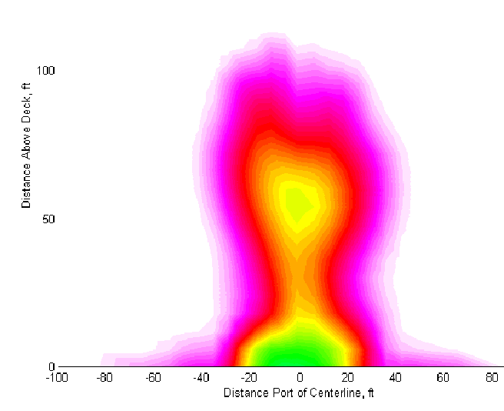
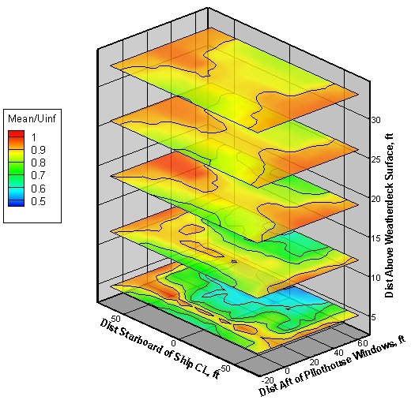
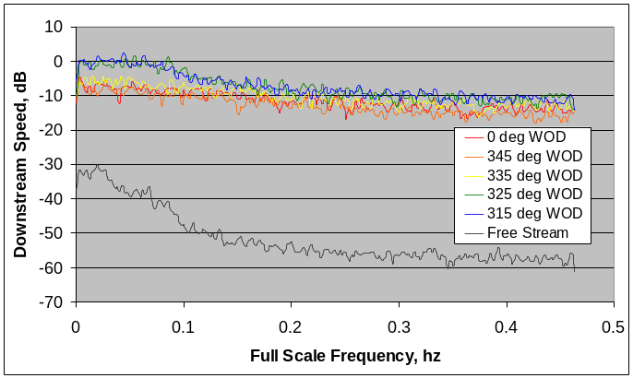
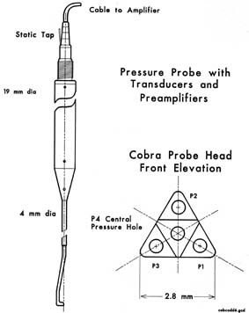
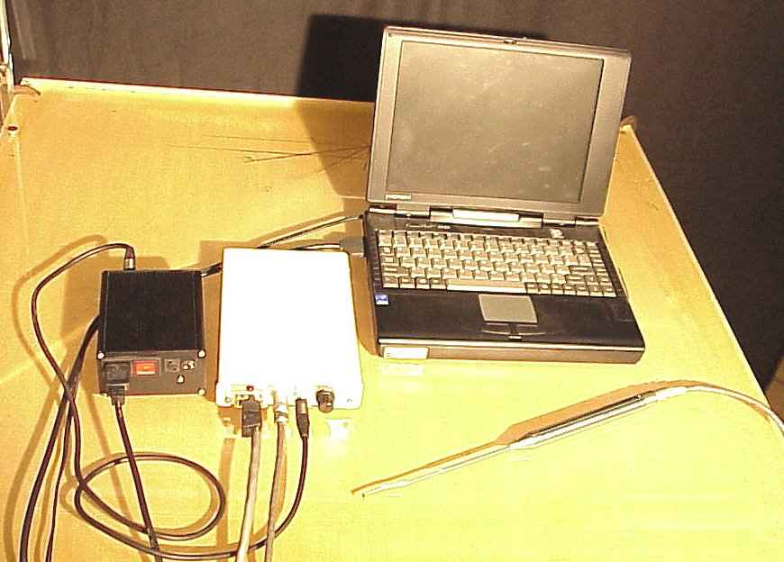
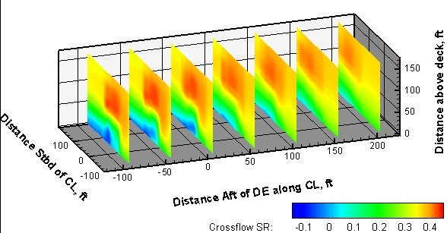
“Cobra” Probe
Mean Downstream Speed
(1000 measurements)
4-Hole Unsteady Pressure Probe
3-D Unsteady (<1 Khz) Velocity
Attached to 3-D Traversing Mechanism
Distance Above Waterline, ft

Slide 11


Pressure Sensitive Paint (PSP) Technique
  Model Covered with Pressure Sensitive Paint
  PSP Excited with UV Light
  Excited PSP Molecules Return to Base State via Oxygen Quenching
  Higher Pressure (more oxygen) = More Quenching = Less Luminescence
Luminophor
Oxygen
Camera
Lamp
PSP Coating
Model

Slide 12

PSP Measurements on an F-16 Model
Supersonic Mach Number with Increasing Angle of Attack

Slide 13


Skin Friction Measurement Technique (FISF)
FISF (Fringe Imaging Skin Friction)
  Apply Oil (Drops/Lines) of Known Viscosity
  Run Wind Tunnel to Create Fringes
  Illuminate with Extended Monochromatic Light Source
  Measure Fringe Direction and Spacing to get Skin Friction Vector
13

Slide 14
“FAITH” Surface Skin Friction Measurements
Cf
Notes:
For the aeroacoustic and and vent assemblies design slides, please put information into the format shown above, showing general technical capabilities, tools used, and technical accomplishments performed.
Thanks!

Slide 15

Particle Image Velocimetry (PIV)
  Non-intrusive flow field measurement using lasers, cameras and flow seeding
  Three components of velocity in a plane
  Commonly used for CFD validation and turbulence measurements
I
In-flow to Space Shuttle Bipod
Contour of Stream-wise velocity
M = 2.5

Slide 16

FAITH: 3-D Particle Image Velocimetry (PIV)
Mean Velocity
Streamwise Velocity (U) Contours
Vertical (V) and Spanwise (W) Velocity Vectors
In-flow to Space Shuttle Bipod
Contour of Stream-wise velocity
M = 2.5

Slide 17



Model Deformation Measurements (MDM)
  Two models of supersonic airplanes were tested in Ames 9x7 foot Wind Tunnel. These airplanes have thin, flexible wings which will bend under aerodynamic loads. This deformation may be determined by measuring and comparing the spatial coordinates of many points distributed over the surface of the model at wind-off and wind-on conditions. A speckle pattern was applied to the wing and tail to measure the model motion. Bending-induced twist and displacement were then calculated.
  Average bending displacement of wing versus span.
Notes:
For the aeroacoustic and and vent assemblies design slides, please put information into the format shown above, showing general technical capabilities, tools used, and technical accomplishments performed.
Thanks!

Slide 18



AirBOS: Full-Scale In-Flight Schlerien
The reference image is registered to each image with the aircraft. Image processing determines the amount of apparent shift a shock or a vortex causes. Then the amount of movement of the aircraft is measured. The next image processed is then shifted the same amount. The resulting schlieren image is a contour plot of the averaged local shifts.

Slide 19
Final Shuttle Launch (July 8th 2011): Image Fusion
Fused Original Images Re-Fused with Infrared (IR) image

Slide 20








Aeroacoustics Research
Airframe Noise Measurements
777 Landing Gear
1st large- scale gear noise data in U.S.
Flap Tip Fence
ARC patented noise control device for flap/slat tips
26%-Scale B-777
Large-scale application of microphone arrays in a wind tunnel
Space Station Noise Control
Jet Noise Collaborative Study
Anechoic Chamber Measurements
Enables flight qualification of ARC science experiments for ISS
Jet Noise Reduction Program
Investigation of jet noise reduction through micro-jet injection (in collaboration with Florida State University and ONR)

Slide 21

ANTARES Launch: NASA Wallops, April 21st 2013
AOX Microphone Phased Array in the Foreground

