Slide 1


Surface Atmosphere Radiation Budget (SARB) working group update
Seiji Kato¹, Fred G. Rose², David A. Rutan²,
Alexander Radkevich², Seung Hee Ham², Tyler J. Thorsen¹
Thomas E. Caldwell², Antonio Viudez-Mora², Ryan C. Scott²,
David Fillmore³, and Xianglei Huang⁴
¹NASA Langley Research Center
²Science System & Applications Inc.
³NCAR
⁴University of Michigan
CERES Science Team Meeting
September 15-17, 2020

Slide 2
Outline of this presentation
MATCH aerosol transport model
Surface downward shortwave irradiance anomalies during COVID-19 period (January, February, and March 2020).
Effect of Australia fire on radiation budget in January 2020
Level 3 surface radiation data product (SYN1deg) after Terra starts to drift in 2021.
  Edition 4.1: (Terra+Aqua+GEOs ->) Aqua+GEOs -> NOAA-20(+Aqua)+GEOs
  Edition 5: TBD
    Quantify GEO artifacts and diurnal cycle of surface irradiances

Slide 3
Work done after the 2020 spring meeting
Edition 4.1 EBAF and SYN1deg
Extended through March 2020
Fu-liou code k-distribution and CKDMIP
MATCH aerosol validation
    Processing (the first day of the month) issue
    COVID-19
    January 2020 Australian fires
  MATCH AOD under partly cloudy conditions
  Dust aerosols in the no-assimilation run (March 2020).
Aqua only SYN run
  A Bug in the MATCH input preparation code leads to a problem in 2004 (July through December).
    Documented in SYN1deg Data Quality Summary
  Comparison of 201907 5 cases: Ed4.1. vs. Aqua+GEO vs. Aqua with no GEO vs. Terra with no GEO etc.
SYN1deg Aqua only (Ed 4.1) versus SYN1deg NOAA-20 (Edition 1)
  Polar night clouds
  Thin cirrus over tropics
MOSAiC data analysis
GMAO telecon
Edition 5 SYN (produced the list of variables to be included in TSI)
C3M revision (Seung-Hee Ham’s presentation)
CRS (Ryan Scott’s presentation)
Fingerprinting

Slide 4
MATCH uses
Climatological aerosol source from the surface
  Sea salt and dust might depend on surface wind speed
Anomalies (deviation from the climatology) of aerosol loading come from MODIS aerosols
Time to take MATCH to learn aerosol anomalies depends on individual case.
Wind vectors determine spatial distribution of aerosols
Precipitation is needed for aerosol sink (scavenging)
Some chemistry modeling (e.g. oxidize sulfur to produce sulfate)

Slide 5
Aerosol optical thickness sources
Satellites | Retrieval algorithm | Starting periods
Terra | Dark target + Deep blue | March 2000
Aqua | Dark target + Deep blue | July 2002 (begins JD 185)
Terra+Aqua | Dark target + Deep blue | July 2002 (begins JD 185)
NPP | Dark target or Deep blue | February 2012 (begins JD 019)
NOAA-20 | Depending on availability of VIIRS aerosol products | February 2018

Slide 6
MATCH assimilation of MODIS aerosol optical depth

Slide 7
Match Modis Assimilation
(Modis Preprocessing)
1)Terra and Aqua Deep Blue and Dark Target hourly data are extracted and
gridded into 192lon x 94lat daily files.
2) The four AOT fields are merged into a single daily gridded file.
3) The merged daily field is sliced in to hourly 15 degree longitude bands
Modis data is not directly assimilated at the overpass time
Instead it is gridded averaged an assimilated at near Local Solar Noon
GMT: 0 1 2 3 4 5 6 7 8 9 10 11 12 13 14 15 16 17 18 19 20 21 22 23
LON0: 180 165 150 135 120 105 90 75 60 45 30 15 0 -15 -30 -45 -60 -75 -90 -105 -120 -135 -150 -165
LON1: 165 150 135 120 105 90 75 60 45 30 15 0 -15 -30 -45 -60 -75 -90 -105 -120 -135 -150 -165 -180

Slide 8
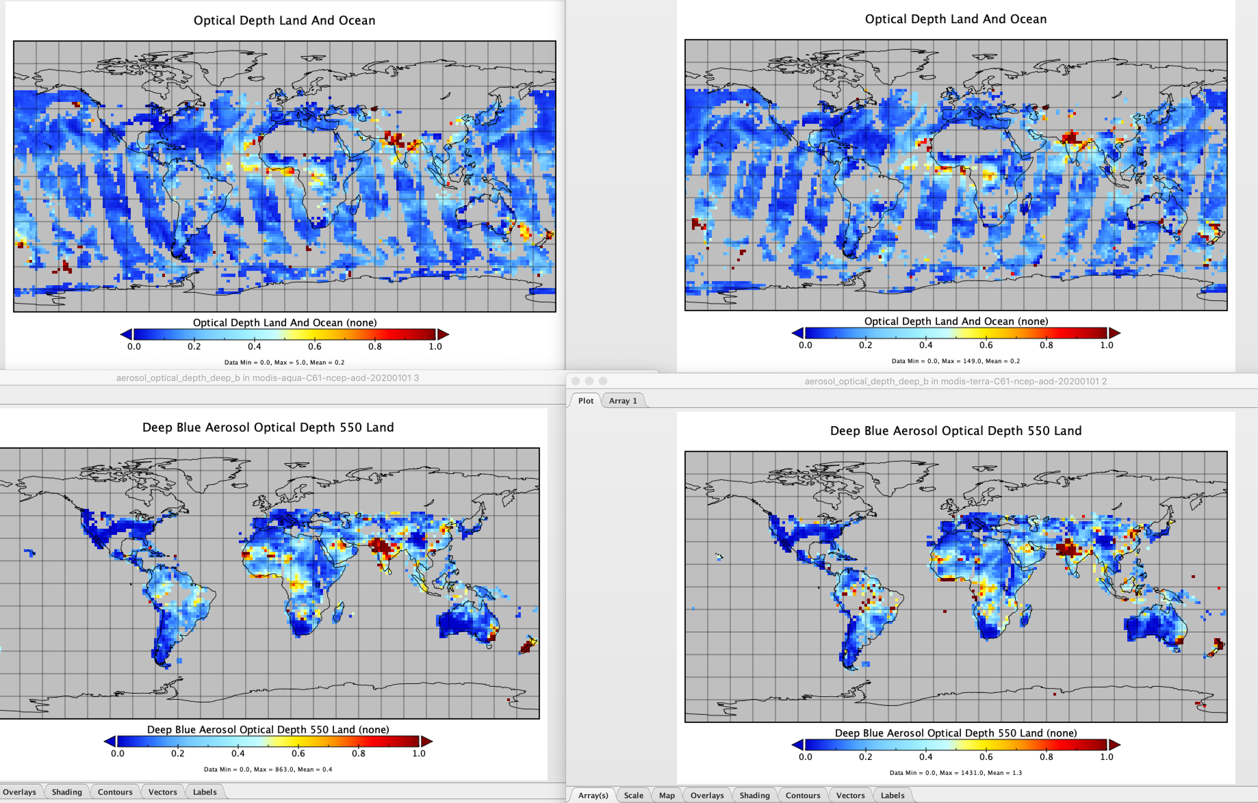
Jan 1 2020 Aqua (Dark Target)
Jan 1 2020 Terra (Dark Target)
MATCH pre-processed level2 hourly MOD04 into four Daily gridded fields( 192x94)
Jan 1 2020 Aqua (Deep Blue)
Jan 1 2020 Terra (Deep Blue)

Slide 9
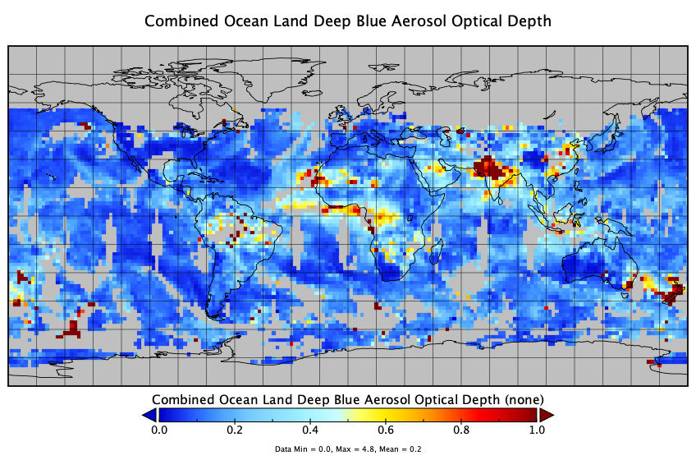
MATCH merges these 4 fields into a single Daily gridded AOT field ( 192x94)

Slide 10
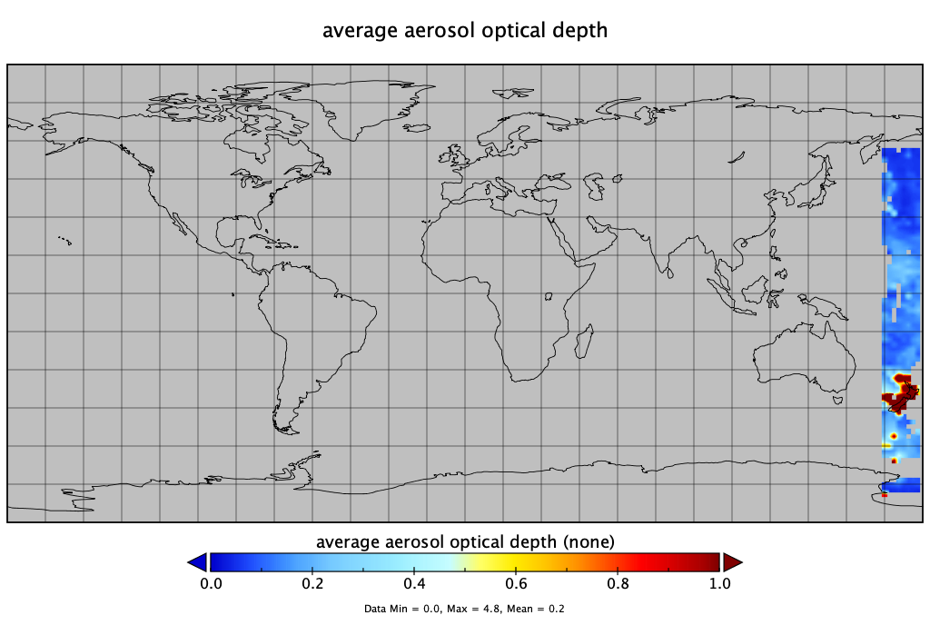
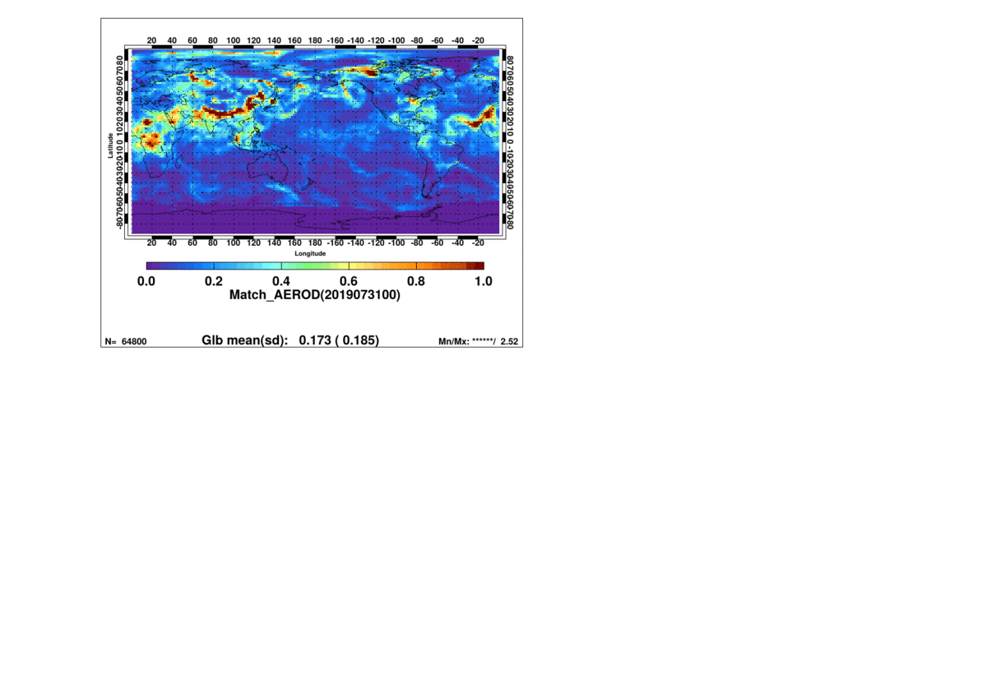
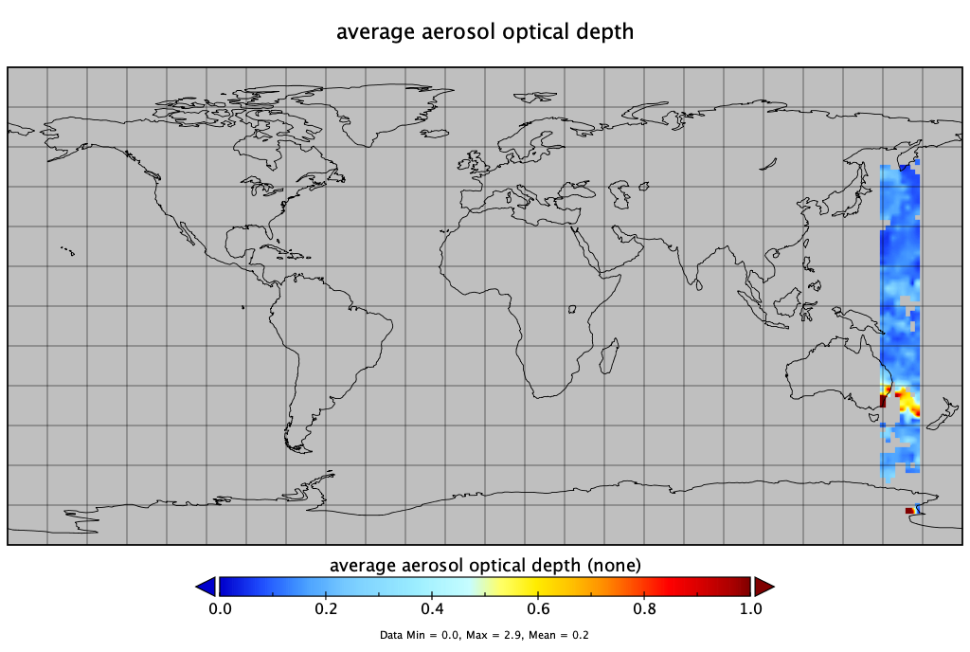
The daily field is then sliced up by longitude band into hourly AOT fields ( 192x94)
That are the input for the hourly Match assimilation
Jan 1 2020 00-01Z
Jan 1 2020 01-02Z
Note: Animation is for July 31 2019
This is just to illustrate the assimilation
Hourly bands moving across the globe.

Slide 11
Surface downward shortwave clear-sky irradiance anomalies (Jan. Feb. March 2020)

Slide 12
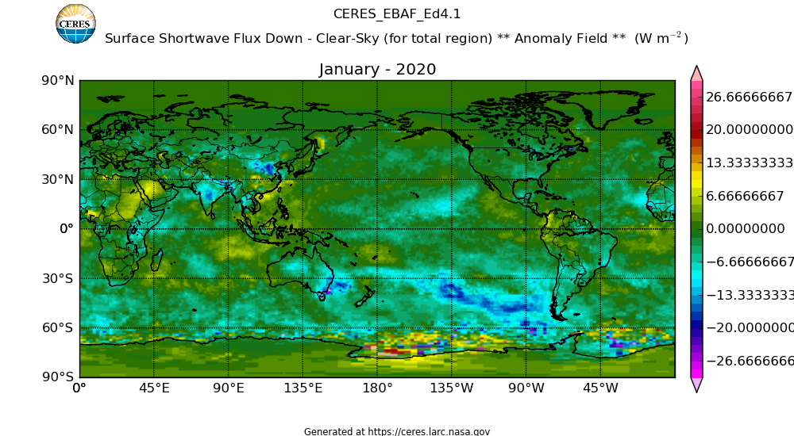
EBAF surface downward shortwave irradiance anomalies January 2020 Clear-sky total region
AOD anomalies
All-sky anomalies
Clear-sky anomalies

Slide 13
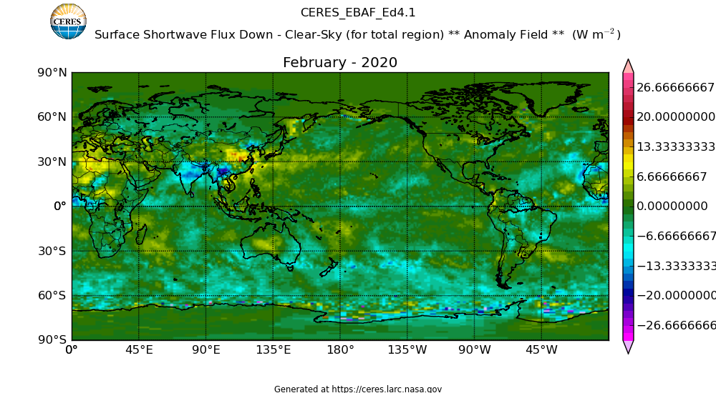
EBAF surface downward shortwave irradiance anomalies February 2020 Clear-sky total region
AOD anomalies
Al-sky anomalies
Clear-sky anomalies

Slide 14
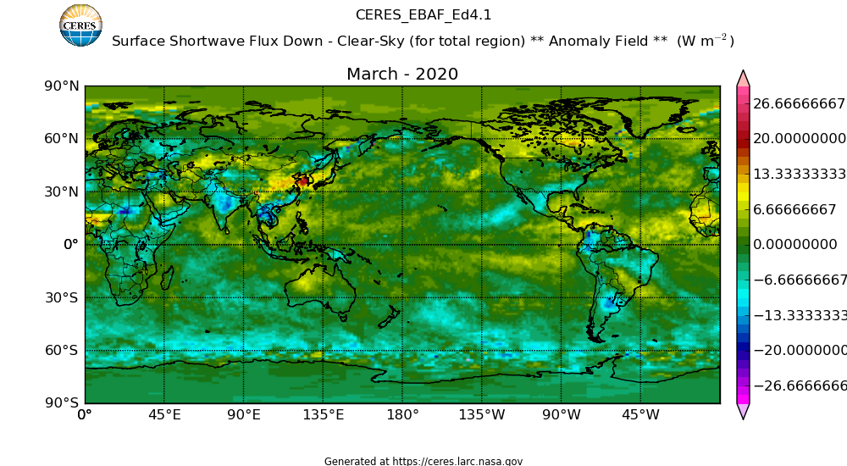
EBAF surface downward shortwave irradiance anomalies March 2020 clear-sky total region
AOD anomalies
All-sky anomalies
Clear-sky anomalies
Anomaly is ~10Wm-2 over land but water vapor anomalies affect the downward shortwave irradiance

Slide 15
Comparison with AERONET: Beijing China, March 2018

Slide 16
Comparison with AERONET: Beijing China, June 2011

Slide 17
Comparison with AERONET: Beijing China, February 2012

Slide 18
Aerosol optical thickness anomalies in 2020

Slide 19
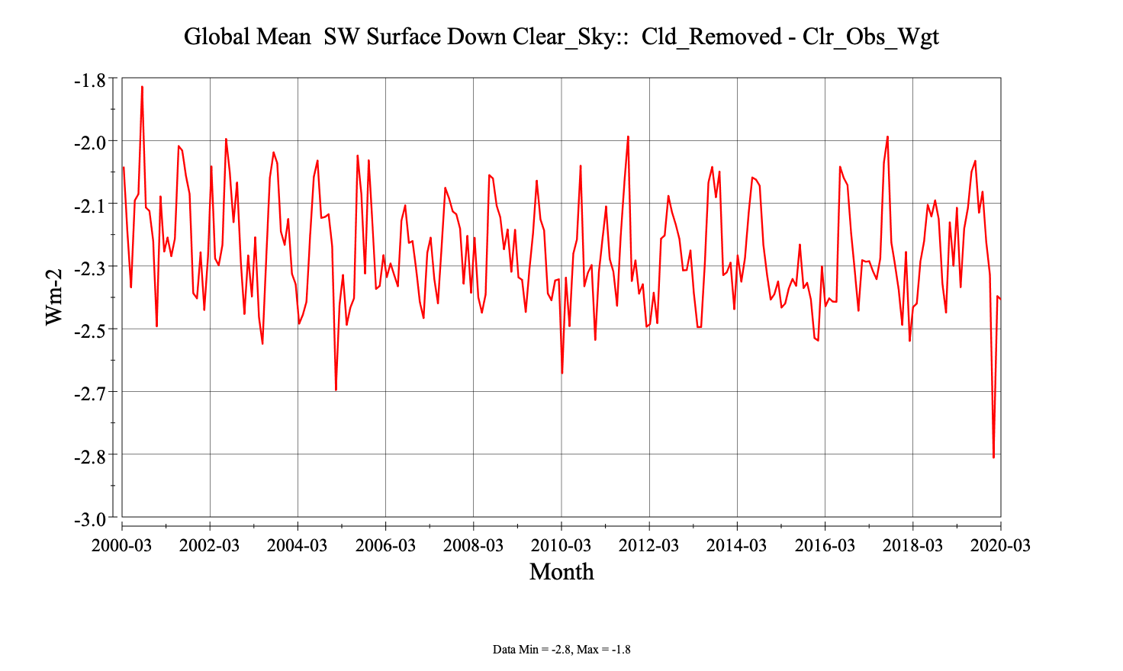
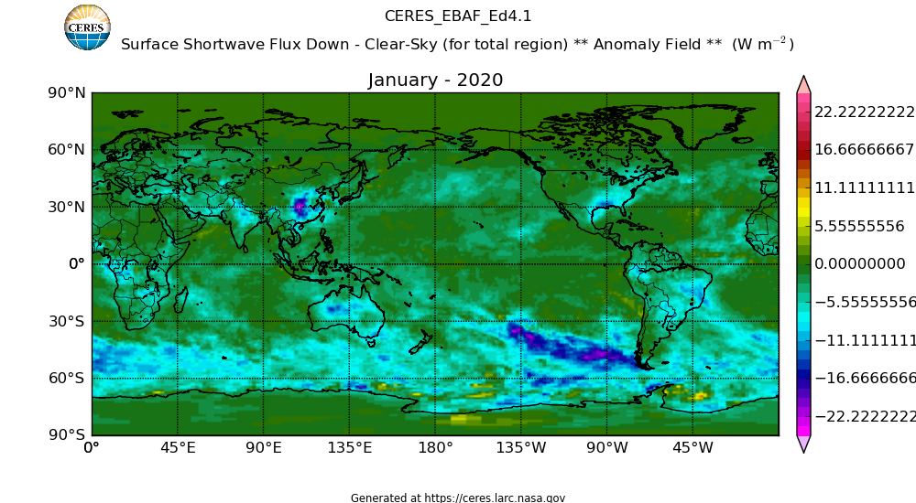
Aerosol anomalies in January 2020
Clear-sky correction applied to clear-sly downward shortwave with observed sampling is ~20% larger than a mean correction
Aerosol under cloudy conditions largely come from MATCH model
i.e. need validation by surface aerosol optical depth observations

Slide 20
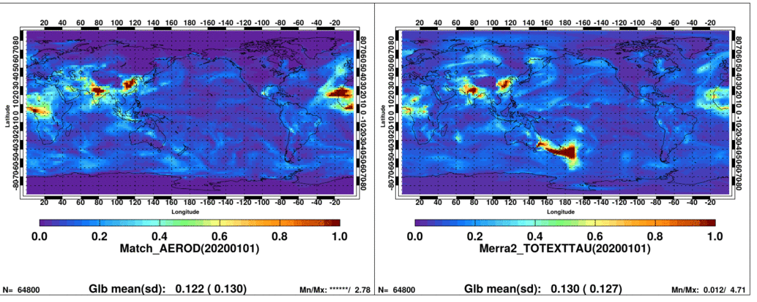
January 2020 Australian fires
Notes:
Look MODIS AOD for December and January

Slide 21
Comparison with AERONET AOD: January 2020
Tumbarumba, Australia

Slide 22
Comparison with AERONET AOD: January 2020
CEILAP Rio Gallegos, Argentina

Slide 23
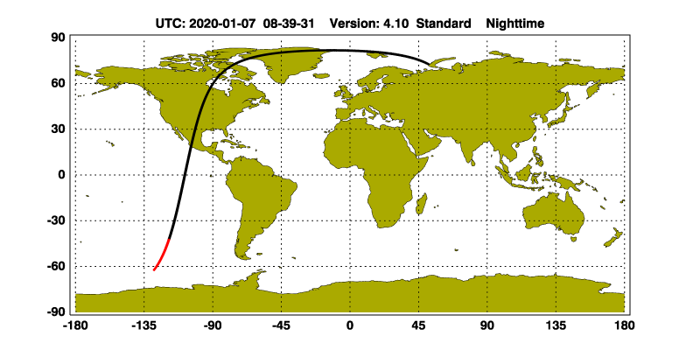

Slide 24
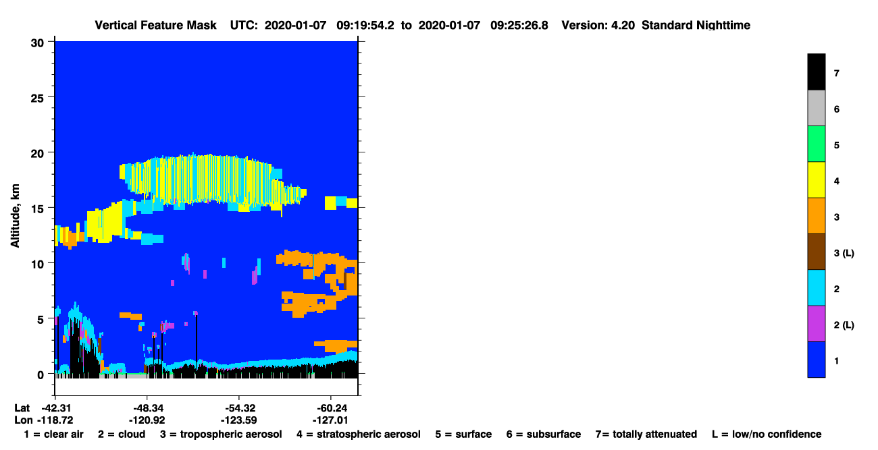

Slide 25


Slide 26
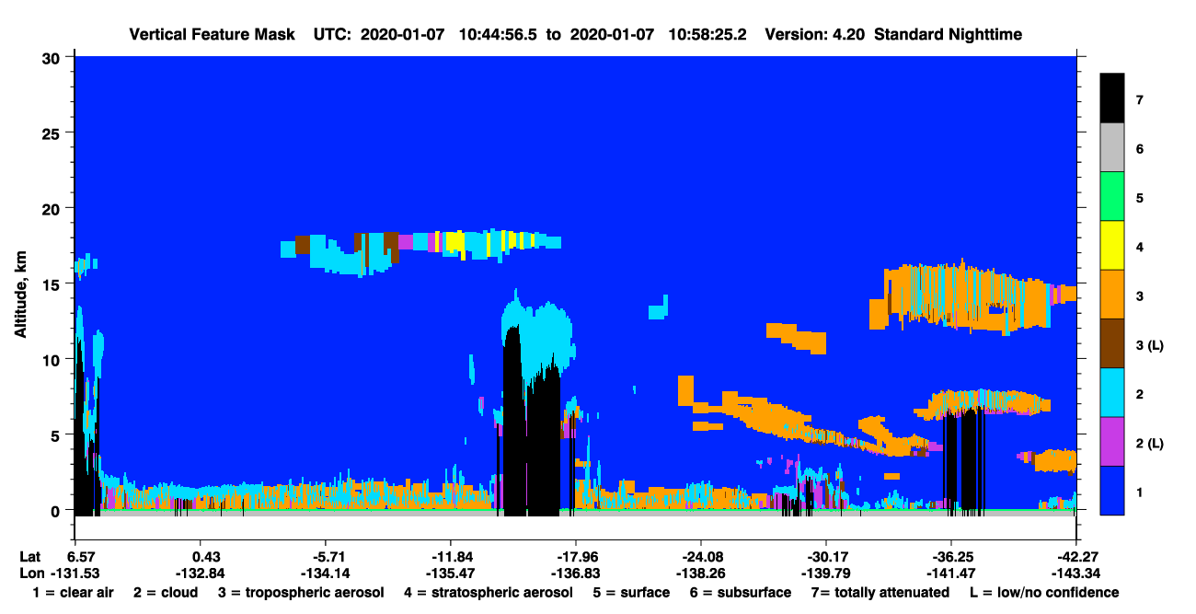

Slide 27
Plans for SYN after Terra starts to drift

Slide 28
Testing Aqua+ GEO (no Terra) SYN (to form radiation budget timeseries with NOAA-20 + GEO)
Mean local time for equator crossing
(Loeb and Doelling 2020)
Global mean TOA reflected shortwave
Aqua only climatological mean is within 0.01 Wm⁻² of Terra+Aqua with a standard deviation of 0.13 Wm⁻²
Regional mean TOA reflected shortwave
Aqua only climatological mean is within 1.0 to 1.5Wm⁻² and local differences can reach 5 Wm⁻².
Whether Aqua only Edition 4 SYN needs to be produced depends on the schedule of MODIS Collection 7 and new GMAO reanalysis perodcut.

Slide 29
Aqua only SYN1deg (July 2019)
SYN1deg-Aqua EXP#1
  TSI-Aqua only with current code
  GGEO where cloud code used MATCH Terra+Aqua
  Surface Albedo History map, Aqua-only
  MATCH Aqua-only
SYN1deg-Aqua EXP#2
  TSI-Aqua only with current code but with different GGEO
  GGEO where cloud code uses MATCH Aqua-only (rerun GEO netCDFs)
  Surface Albedo History map, Aqua-only
  MATCH Aqua-only
SYN1deg-Aqua EXP#3
  TSI-Aqua only with new x86b code (TISA bugs fixed, snow models chosen correctly, for NOAA20 too)
  GGEO where cloud code used MATCH Terra+Aqua
  Surface Albedo History map, Aqua-only
  MATCH Aqua-only
SYN1deg-NOAA20 EXP#4
  TSI-NOAA20 only with new x86b code (bugs fixed, snow models chosen correctly, for NOAA20 too)
  GGEO where cloud code used MATCH Terra+Aqua
  Surface Albedo History map, NOAA20-only (Tom has delivered)
  MATCH Aqua-only
SYN1deg-Aqua Exp#5 :
  Aqua Only constant meteorology extraction/extension from Ed4.1 production TAG(TSIB)

Slide 30
Cloud amount test with Aqua only MATCH (Case 2)
(Terra+Aqua+GEO) – Aqua+GEO
Both with Terra+Aqua MATCH
GEO code runs with Tera+Aqua.
Difference of GEO cloud amount with Aqua only and Terra+Aqua is over ocean only and small.
We conclude that Terra+Aqua MATCH can be used for Aqua+GEO test
(Terra+Aqua MATCH) – Aqua only MATCH
Bottom two plots are essentially the same
Notes:
Exps_4.1_1_3-Exp2B.clds.201007.3a.pdf

Slide 31
CASE 3, 4, and 5 surface downward shortwave regional differences from Edition 4 Terra+Aqua+GEO
Aqua+GEOs
Differences are due to Terra Aqua sampling and cloud diurnal cycle
NOAA-20+GEOs
Aqua only no GEOs
Differences are due to cloud diurnal cycle and GEO artifacts
Notes:
Exps_4.1_1_3-Exp2B.clds.201007.3a.pdf, Exps_AquaOnly.clds.201907.pdf

Slide 32
CASE 3, 4, and 5 surface downward longwave regional differences from Edition 4 Terra+Aqua+GEOs
Aqua+GEOs
Aqua only
GEO artifacts more apparent because temperature diurnal cycle is included in Aqua only longwave computations
NOAA-20+GEOs
Notes:
Exps_4.1_1_3-Exp2B.clds.201007.3a.pdf, Exps_AquaOnly.clds.201907.pdf

Slide 33
Edition 4.1 SYN
When Terra starts to drift in 2021, switching to Aqua+GEOs introduces less than ~5 Wm-2 regional discontinuity in downward shortwave and longwave irradiances between 60N to 60S.
When Aqua starts to drift in ~2022, switch to NOAA-20 for daytime and keeping Aqua for nighttime globally. This minimizes cloud change (clouds during polar night and cirrus in the tropics).
  The cloud working group is working to minimize cloud property differences between those derived from VIIRS NOAA-20 and MODIS Aqua. The result of this may change the plan.

Slide 34
Diurnal variability of surface irradiance due to diurnal variability of cloud properties

Slide 35
Diurnal surface irradiance variability
Aqua only – Terra only (no GEOs)
Downward shortwave irradiance difference
Downward longwave irradiance difference
Generally, less clouds over marine stratocumulus regions and more convective clouds over lands in the afternoon

Slide 36
GEO artifacts– needs to be corrected in the EBAF process
Using the mean surface irradiances computed with Terra and Aqua clouds, we analyze the effect of GEO artifacts on surface irradiances using July 2019 SYN.
  Effects of GEO artifacts on surface downward shortwave irradiance are mostly taken out by the EBAF process.
  The largest effects of GEO artifacts on surface downward longwave irradiance come from nighttime cloud optical thickness (and depend on GEO).
  GEOs used in July 2019 are, MET-11, MET-8, Himawari-8, GOES-15, and GOES-16.

Slide 37
(Terra+Aqua) – SYN and (Terra+Aqua) – EBAF downward shortwave irradiance
(Terra+Aqua) - SYN1deg-Month
(Terra+Aqua) - EBAF
GEO artifacts are largely taken out by the EBAF process

Slide 38
(Terra+Aqua) – SYN and (Terra+Aqua) – EBAF downward longwave irradiance
(Terra+Aqua) - SYN1deg-Month
(Terra+Aqua) - EBAF
Notes:
EBAF tuning is to decrease the downward longwave irradiance. The tuning worked well for MET-8, MET-11, and GOES-15 but does not work for GOES-16 and Himawari-8

Slide 39
(Terra+Aqua) – SYN daytime and nighttime downward longwave irradiance
Daytime
Nighttime
New generation GEOs (Himawari-8 and GOES-16): Positive difference at large viewing zenith angle at nighttime
Other GEOs: Negative difference.

Slide 40
Nighttime cloud amount and optical thickness differences
Cloud amount
(Terra+Aqua) – (Terra+Aqua+GEOs)
Optical thickness
(Terra+Aqua) – (Terra+Aqua+GEOs)
Nighttime optical thickness inconsistency between GEOs and Terra/Aqua and among GEOs is the largest problem
For new generation GEOs, both cloud amount and optical thickness differences are probably due to viewing zenith angle differences.

Slide 41
Summary
The effect of a smaller aerosol optical thickness over china in March 2020 on the surface downward shortwave irradiance is ~10Wm-2.
Clear-sky sampling correction to the downward shortwave irradiance increased by 20% in January 2020 due to Australia fires.
Regional discontinuity of surface downward shortwave and longwave irradiance caused by switching Terra+Aqua+GEOs to Aqua+GEOs or NOAA-20+GEOs is less than 5 Wm-2.
The largest GEO artifact affecting downward longwave irradiances in July 2019 is nighttime cloud optical thickness artifacts.

Slide 42
Publications
Thorsen, T. J., R. A. Ferrare, S. Kato, and D. M. Winker, 2020: Aerosol direct radiative effect sensitivity analysis, J. Climate, in press.
Di Biagio C., J. Pelon, Y. Blanchard, L. Loyer, S. R. Hudson, V. P. Walden, J.‒C. Raut, S. Kato, V. Mariage, and M. A. Granskog, 2020: Towards a better surface radiation budget analysis over sea ice in the high Arctic Ocean: a comparative study between satellite, reanalysis, and local‒scale observations, submitted to J. Geophys. Res.
Kato, S., D. A. Rutan, F. G. Rose, T. E. Caldwell, S.-H. Ham., A. Radkevich, T. J. Thorsen, A. Viudez-Mora, D. Follmore, and X. Huang, 2020: Uncertainty in satellite-derived surface irradiances and challenges in producing surface radiation budget climate data record, Remote Sens. 2020, 12, 1950; doi:10.3390/rs12121950.
Pan, F., S. Kato, F. G. Rose, A. Radkevich, and X. Liu, 2020: An algorithm to derive temperature and humidity profile changes using spatially and temporally averaged spectral radiance differences, J. Atmos. Ocean. Technol., 37, 1173-1187, DOI: 10.1175/JTECH-D-19-0143.1.
Kato, S., N. G. Loeb, D. A. Rutan, and F. G. Rose, 2020: Effects of electromagnetic wave interference on observations of Earth radiation budget, submitted to J. Quant. Spec. Radiant. Trans., 253, DOI:10.1016/jjqsrt.2020.107157.
Kato, S., F. G. Rose, D. A. Rutan, N. G. Loeb, J. T. Fasullo, and K. E. Trenberth, and M. Satoh, 2020: Regional energy and water budget of the atmosphere over ocean, submitted to J. Climate.
Assia Arouf, M., H. Chepfer, M. Chiriaco, R. Guzman, T. Vaillant de Guélis, T. S. L’Ecuyer, S. Kato, M. D. Shupe, M. R. Gallagher, 2020: The Surface Longwave Cloud Radiative Effect from Space Lidar Observations, submitted to J. Climate.

Slide 43
Backups

Slide 44
Zonal plots

Slide 45
GEOS telecon

Slide 46
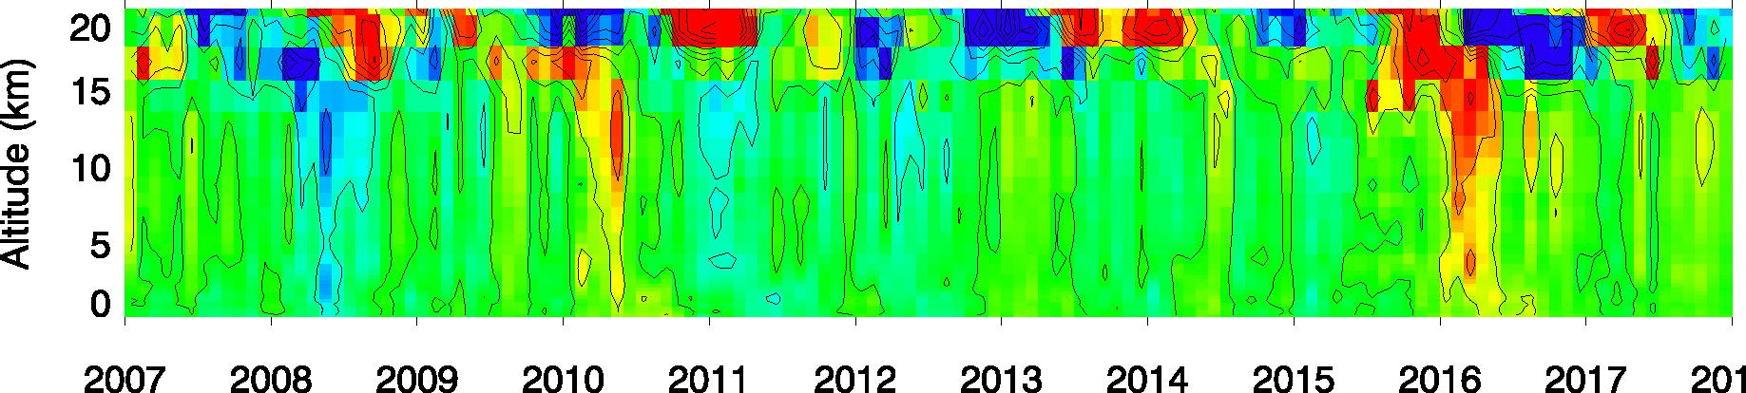
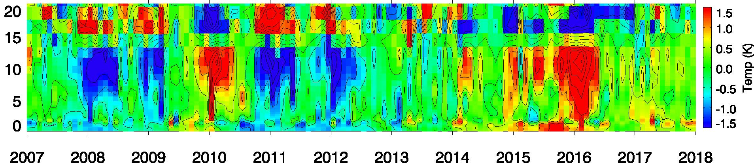
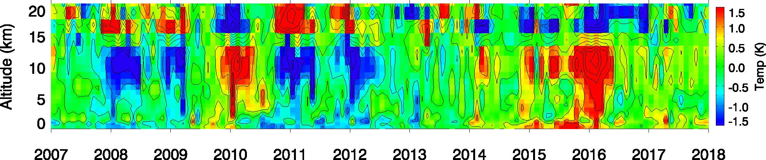
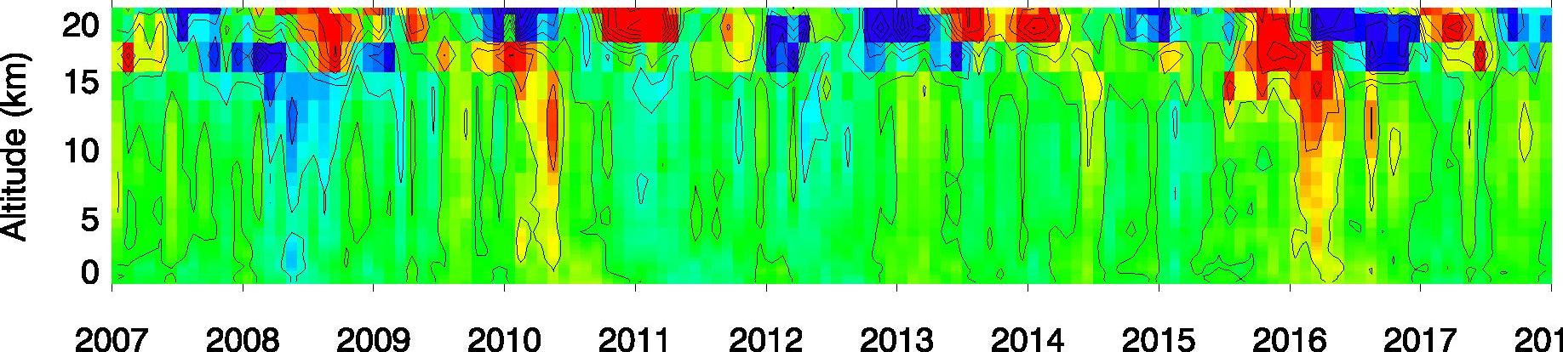
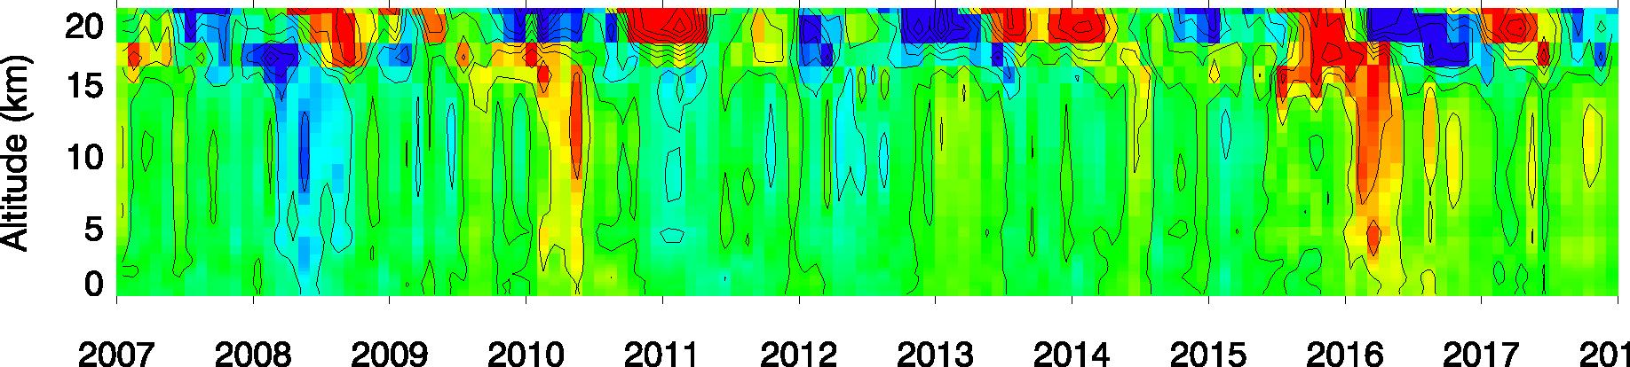
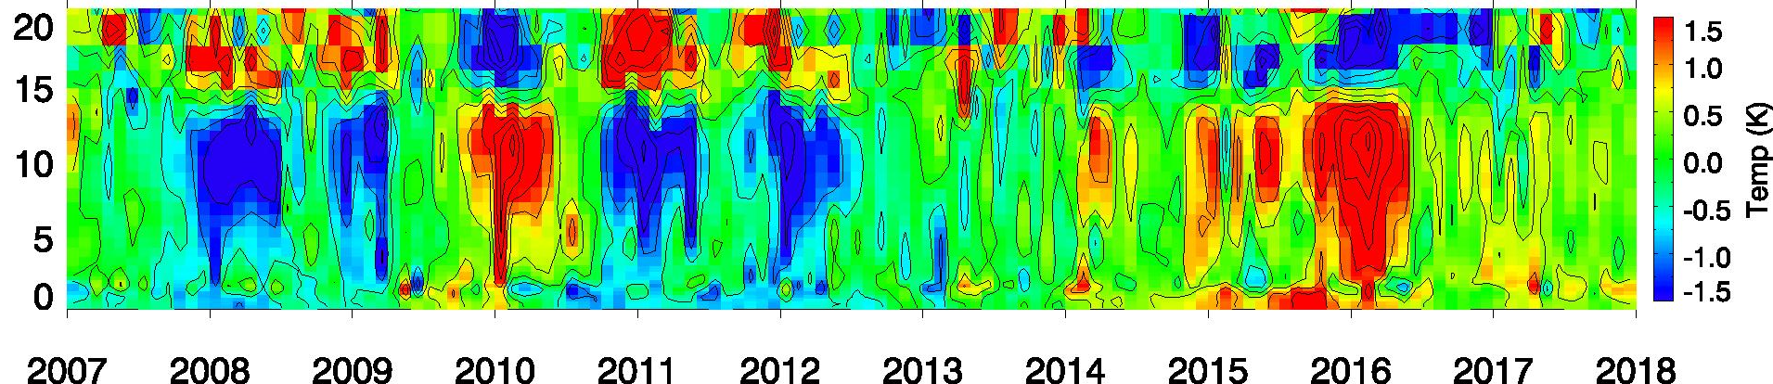
Temperature (K) anomalies in MERRA2, GEOS-5.4.1, and ERA5
Western Pacific (90°E–150°E, 15°S–15°N)
Eastern Pacific (150°W–120°W, EQ–30°N)
MERRA2
GEOS-5.4.1
ERA5

Slide 47
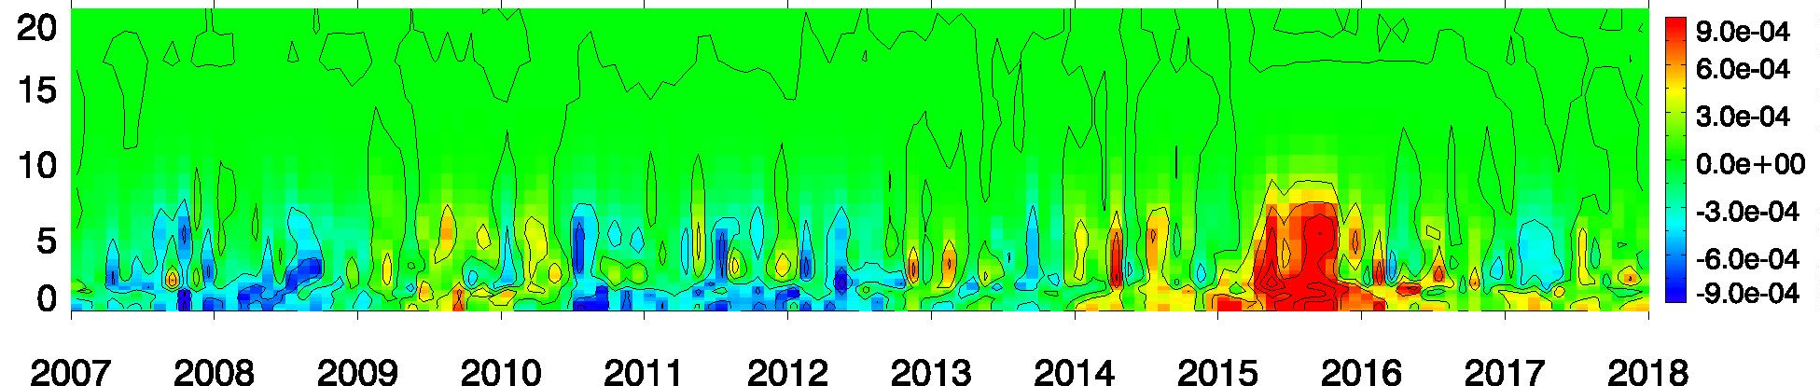
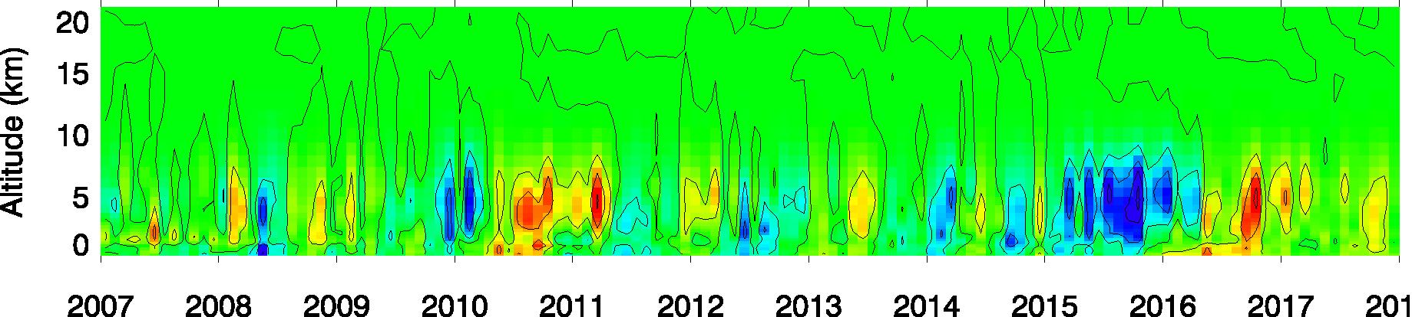
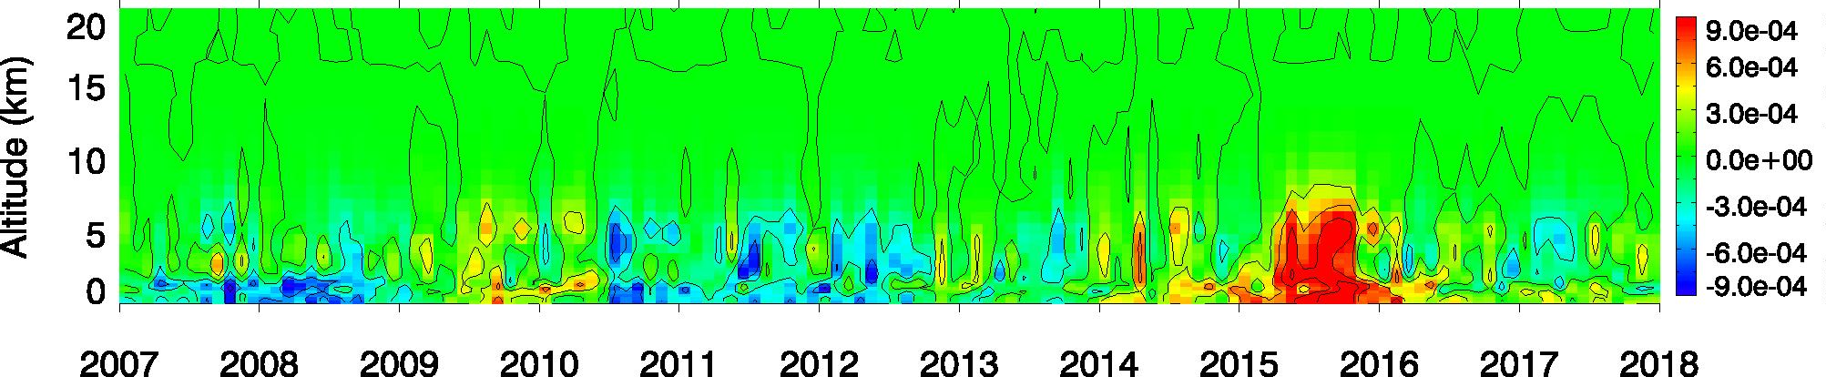
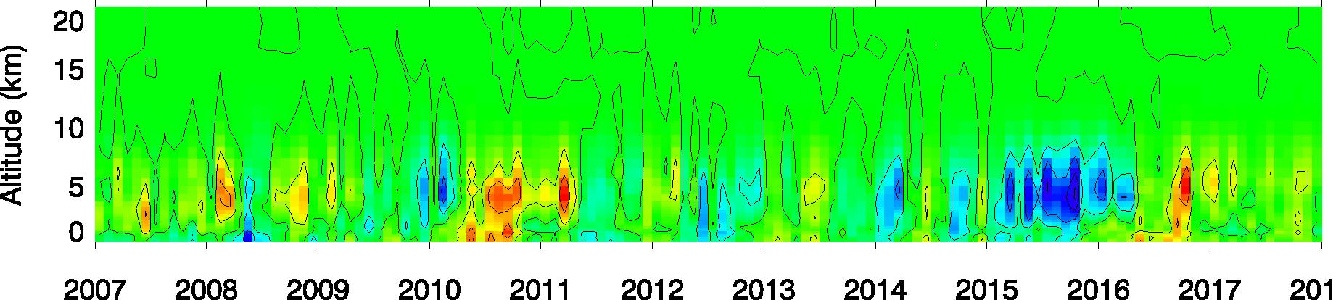
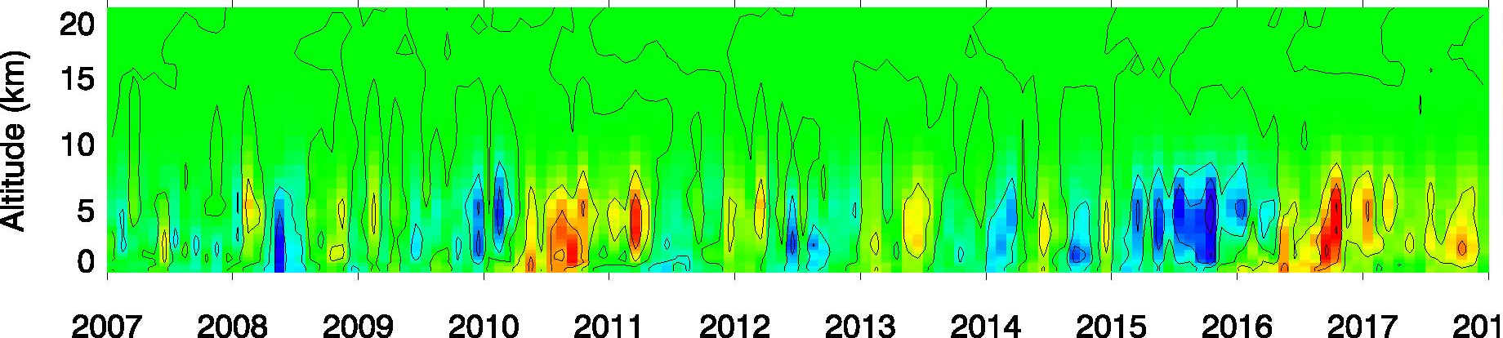
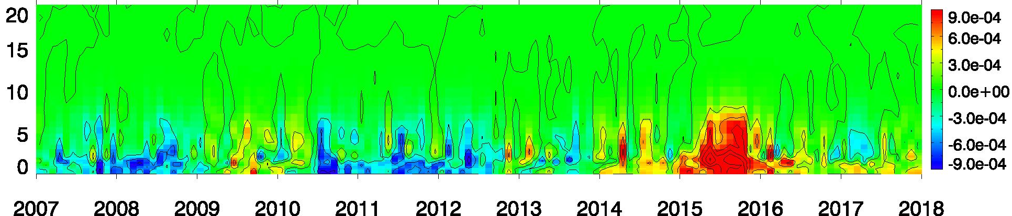
Specific humidity (g/g) anomalies in MERRA2, GEOS-5.4.1, and ERA5
Western Pacific (90°E–150°E, 15°S–15°N)
Eastern Pacific (150°W–120°W, EQ–30°N)
MERRA2
GEOS-5.4.1
ERA5

Slide 51
How the size of anomaly changes as a function of temporal and spatial averaging lengths

Slide 52
MOSAiC data

