Slide 1

Microbial Food Safety for Space Crops
Gioia Massa & Mary Hummerick
Kennedy Space Center, FL 32899 USA

Slide 2
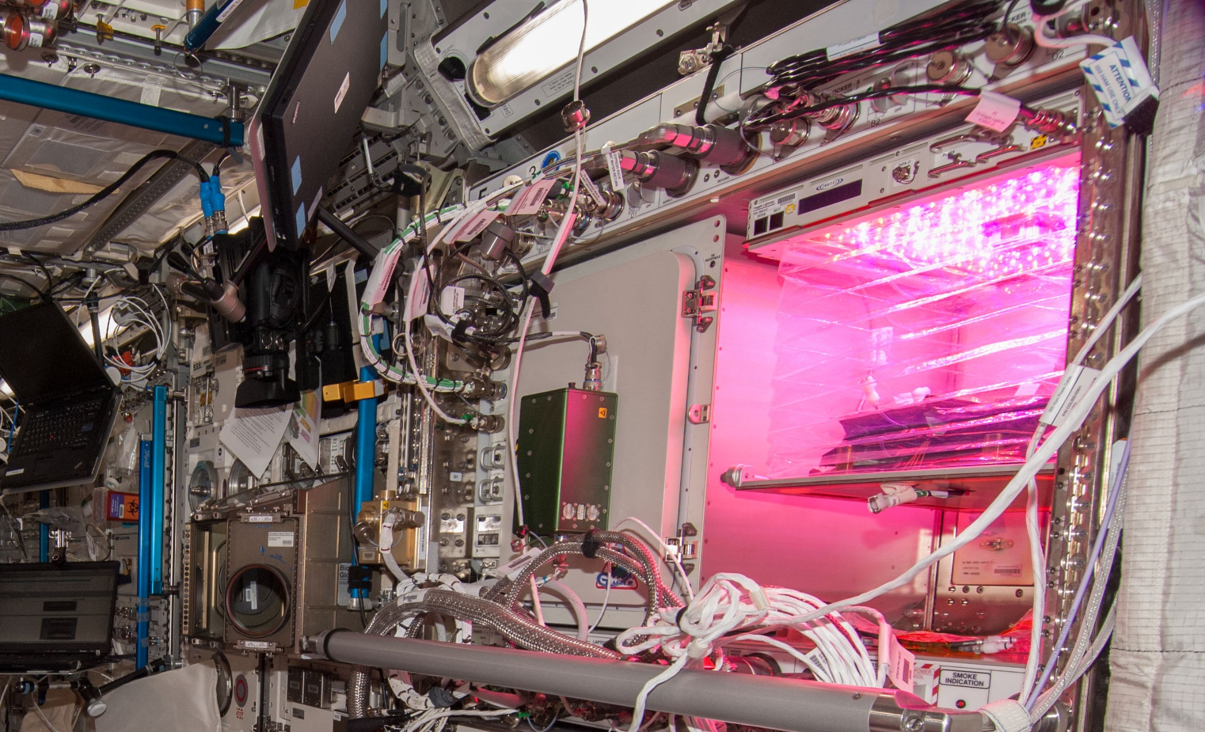
Veggie on ISS

Slide 3
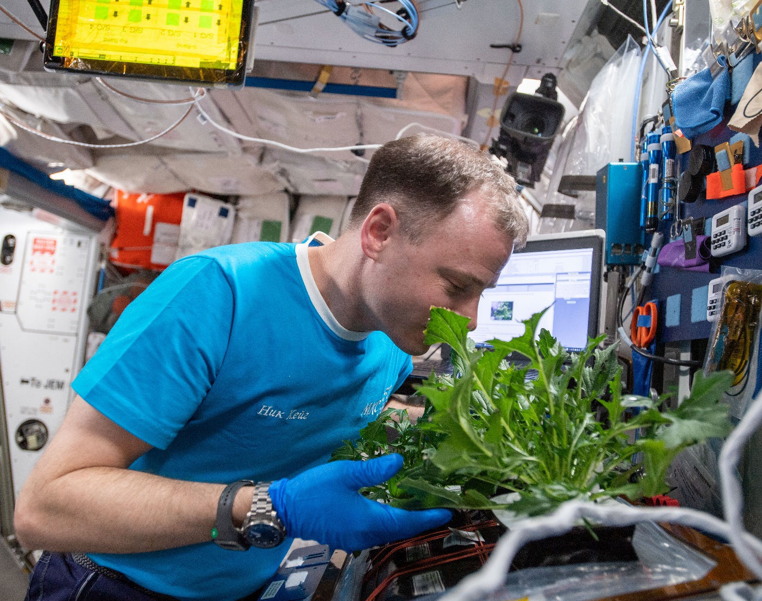
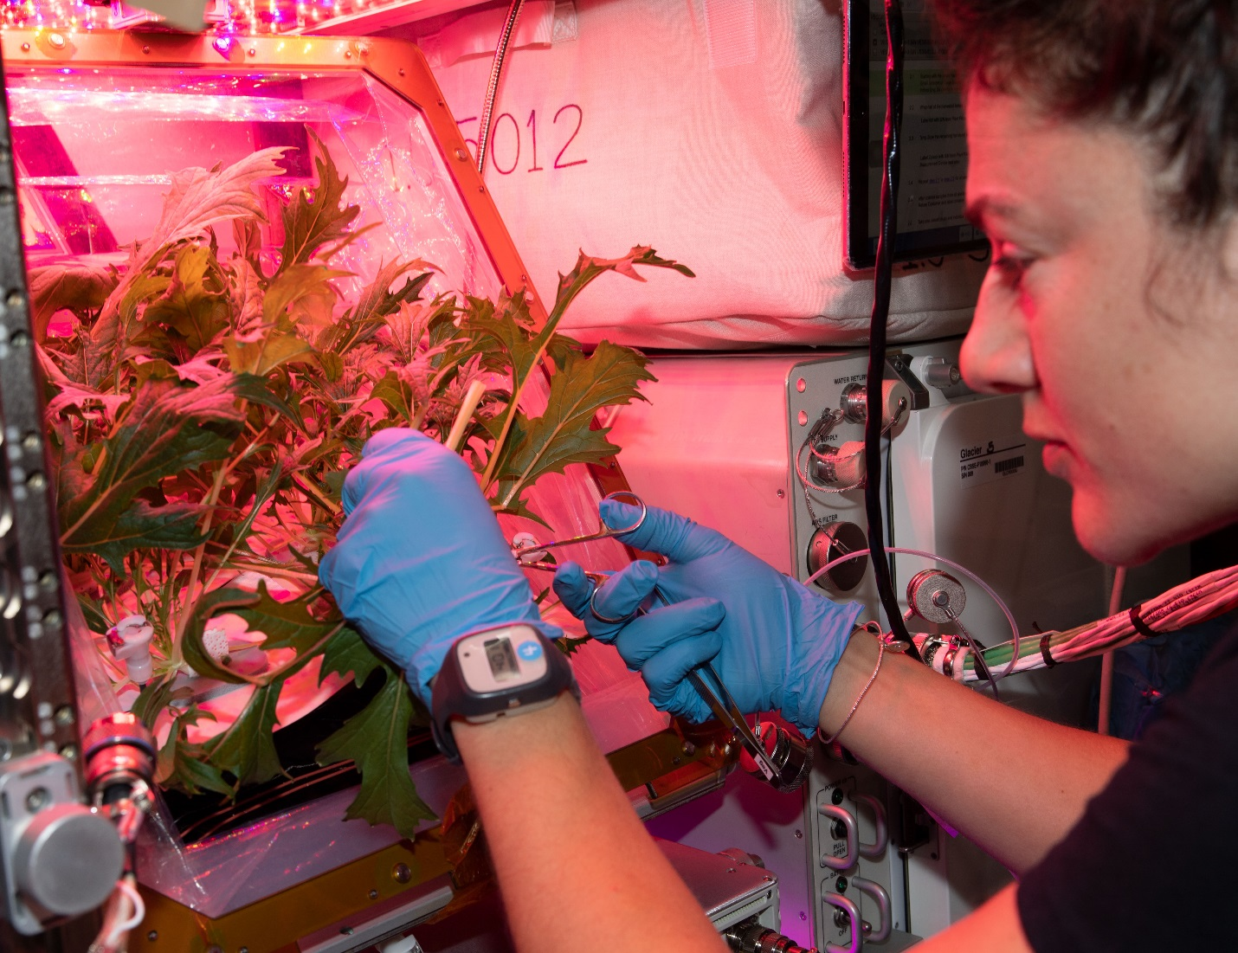
VEG-04 Harvest
VEG-04A at 35 DAI
VEG-04B at 29 DAI

Slide 4
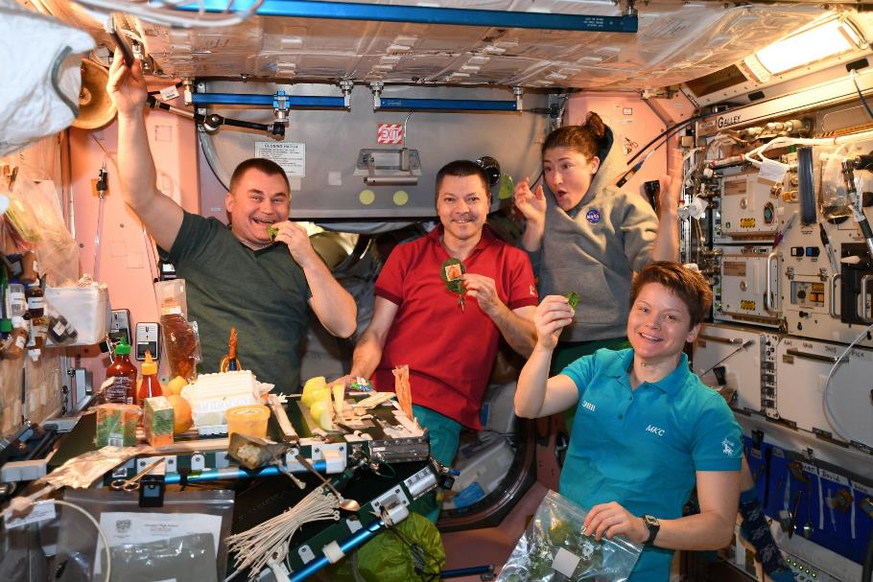
VEG-03H – (March-April 2019)

Slide 5
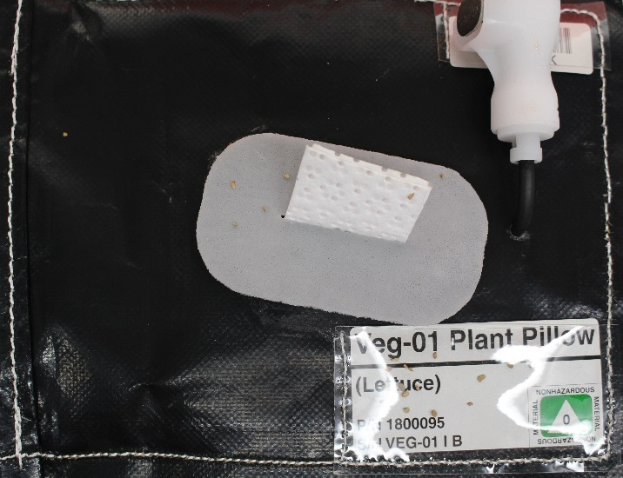
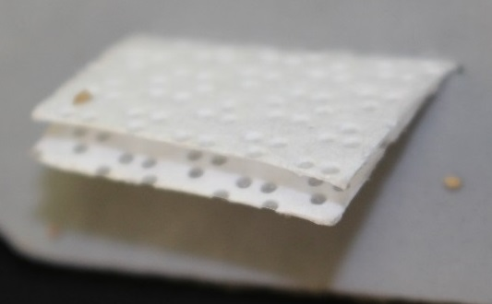
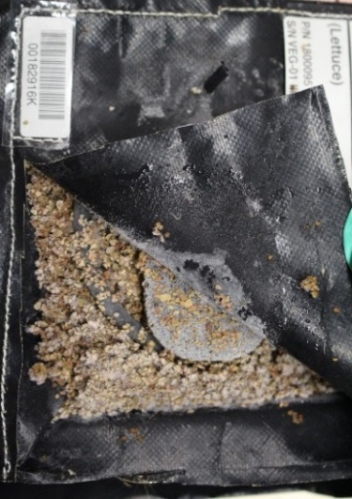
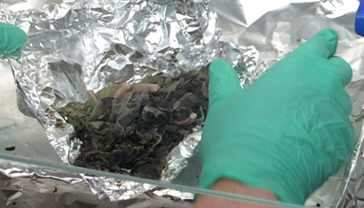
Microbiology Methods
Post harvest:
Samples taken from both ground and flight
  Plant leaves
  Root zone: Roots, Wicks, Substrate
Heterotrophic bacterial & fungal plate counts
Media specific screening
  E. coli and coliforms
  Salmonella sp.
  Staphylococcus aureus
Microbe Identification
Wick
Material
Plant Leaves
Substrate & Root Zone

Slide 6
Veggie Microbiology – VEG-01
NASA standards for non-thermostabilized food

Slide 7
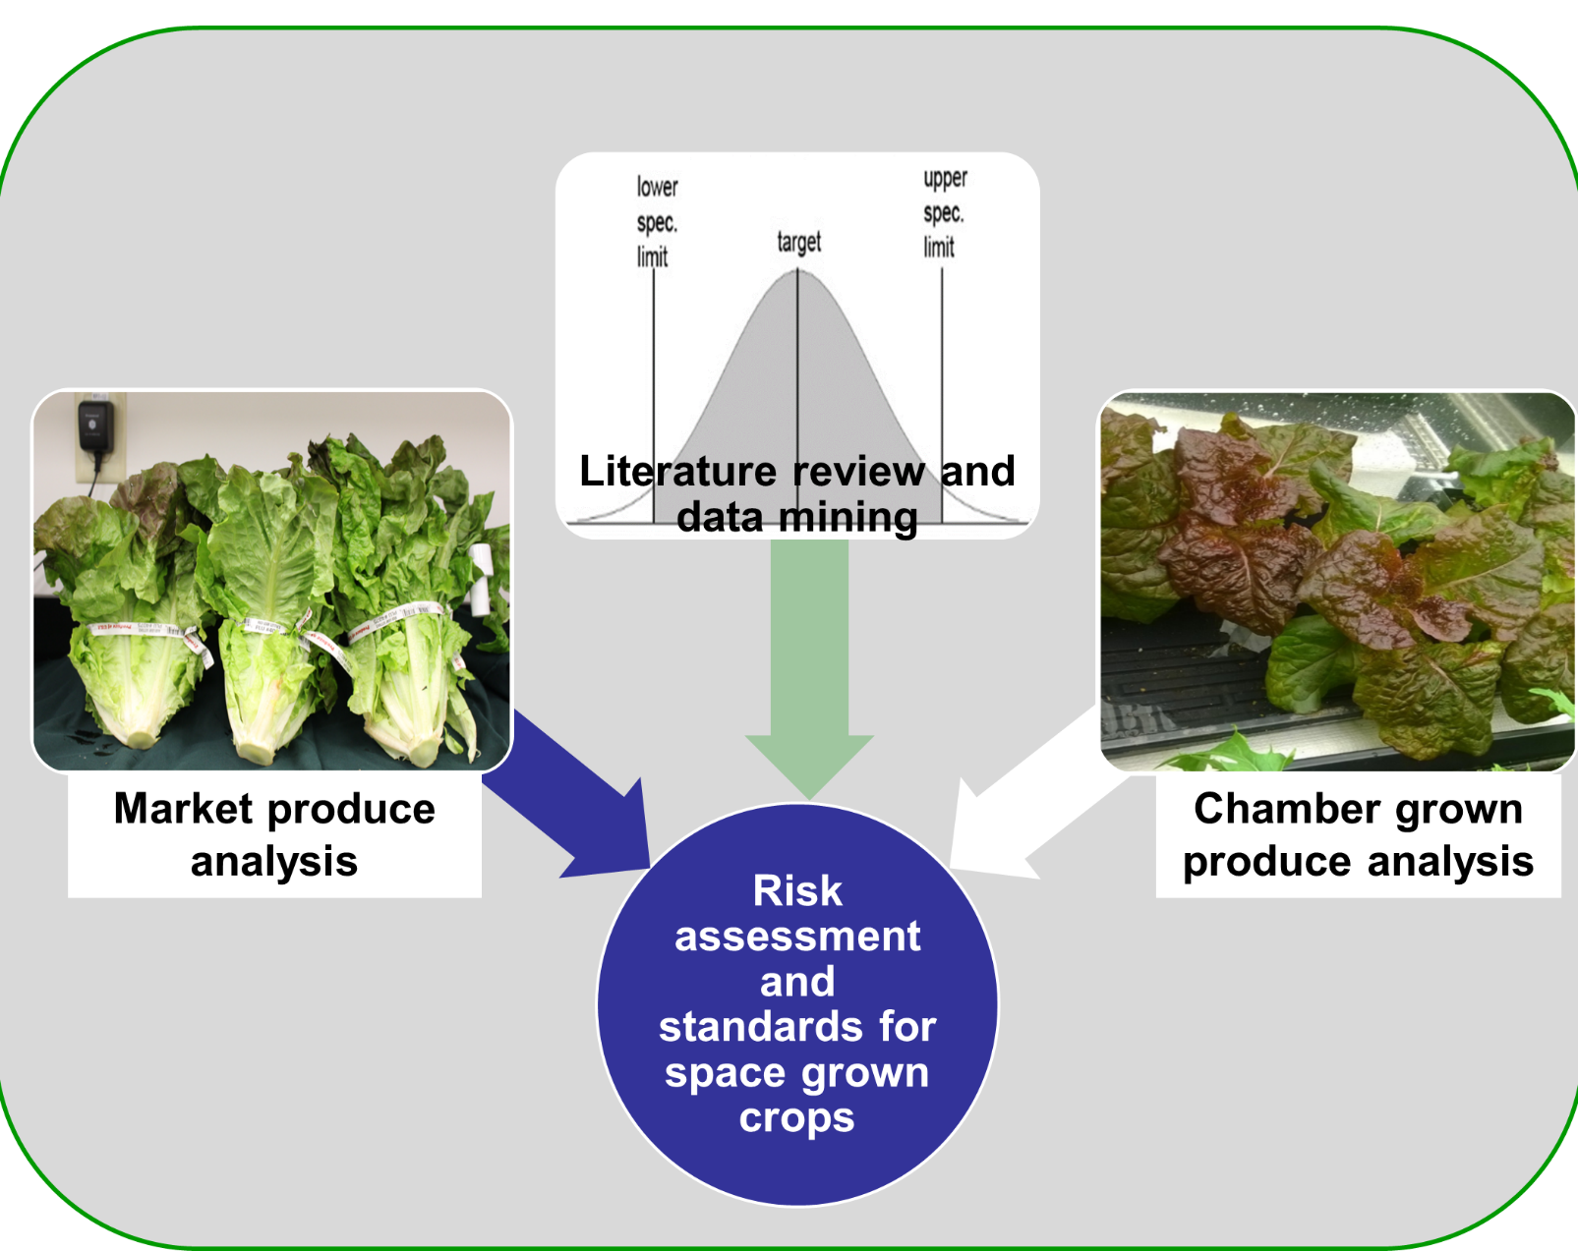
Produce Microbiology Project
Compared microbial levels of CE-grown produce, with comparable retail produce and the reported values in the literature.
Establishment of a baseline for expected microbial levels found on fresh produce will be used in a risk assessment and development of microbial safety recommendations for these types of fresh foods.
Results will help drive requirements for future food systems development beyond ISS.

Slide 8

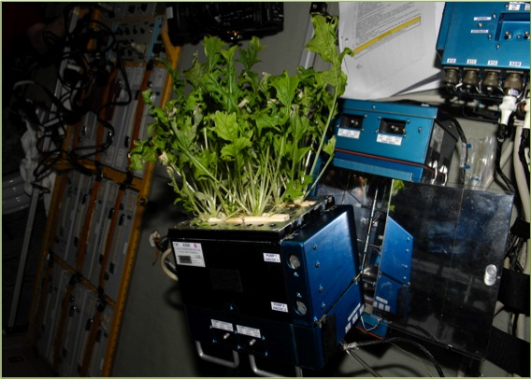
Food safety of space-grown produce
Mean bacterial and fungal counts (CFU) on Lada (L) and Veggie (V) grown crops on the ISS.
.
Crops consumed from Veggie
‘Outredgeous’ lettuce
Chinese cabbage
Mizuna mustard
Other leafy greens
Future crops
Tomatoes
Peppers
Sample | APC (GFW) | Fungi (GFW)
Mizuna (L) | 4.2E+03 | 6.0E+01
Barley (L) | 2.7E+04 | 6.0E+02
Radish (Top) (L) | 5.8E+06 | 1.0E+06
Radish (Root) (L) | 1.2E+07 | 1.0E+06
Mizuna (A19) (L) | 7.2E+05 | 6.0E+03
Mizuna (A20)(L) | 8.7E+05 | 1.2E+03
Mizuna (A21)(L) | 3.1E+03 | 9.0E+02
Mizuna (A22)(L) | 2.1E+04 | 1.2E+04
Red Romaine(V01A) | 3.6E+03 | 5.3E+02
Red Romaine(V01B) | 9.7E+04 | 6.0E+02
Astronauts Kelly, Lindgren and Yui. Photo credit NASA
ISS non-thermostabilized food requirements.
.
Factor | Limits
APC | 2E+04 CFU/g for any single sample ( two samples from a lot exceed 1E+04 CFU/g)
Enterobacteriacea | 100 CFU/g for any single sample (two samples from a lot exceed 10 CFU/g)
Salmonella | 0 CFU/g for any single sample
Yeasts and molds | 1E+03 CFU/g for any single sample (any two samples from a lot exceed 100 CFU/g or if any two samples from a lot exceed 10 CFU/g Aspergillis flavus)

Slide 9
Reported values
Produce type | APC/gram | Y & M | E. coli | Coliform
Lettuce-field / hydroponic | 4 x 10⁴ – 2 x 10⁸ | 8 x 10²-2 x 10⁶ | <DL-10² | <DL-10⁷
Lettuce retail | 1 x 10⁴ -1 x 10⁹ | 2 x 10⁴-1 x 10⁶ | <DL-10² | <DL-10⁵
Lettuce bagged | 5x10⁴-1 x 10⁸ | No Data | No Data | No Data
Outredgeous lettuce Veggie (01, 03) grown | 4 x 10⁴ -2 x 10⁷ | 1 x 10²-5x 10⁵ | <DL | <DL
Other leafy crops, i.e., spinach, cabbage, endive, arugula, Swiss chard, kale | <10⁴-10⁸ | No Data | <1-3x10⁵ | <DL-9 x10⁸
Veggie / Lada-grown mizuna | 3 x 10³-3 x 10⁷ | 6 x 10¹-3 x 10⁷ | <DL | <DL

Slide 10
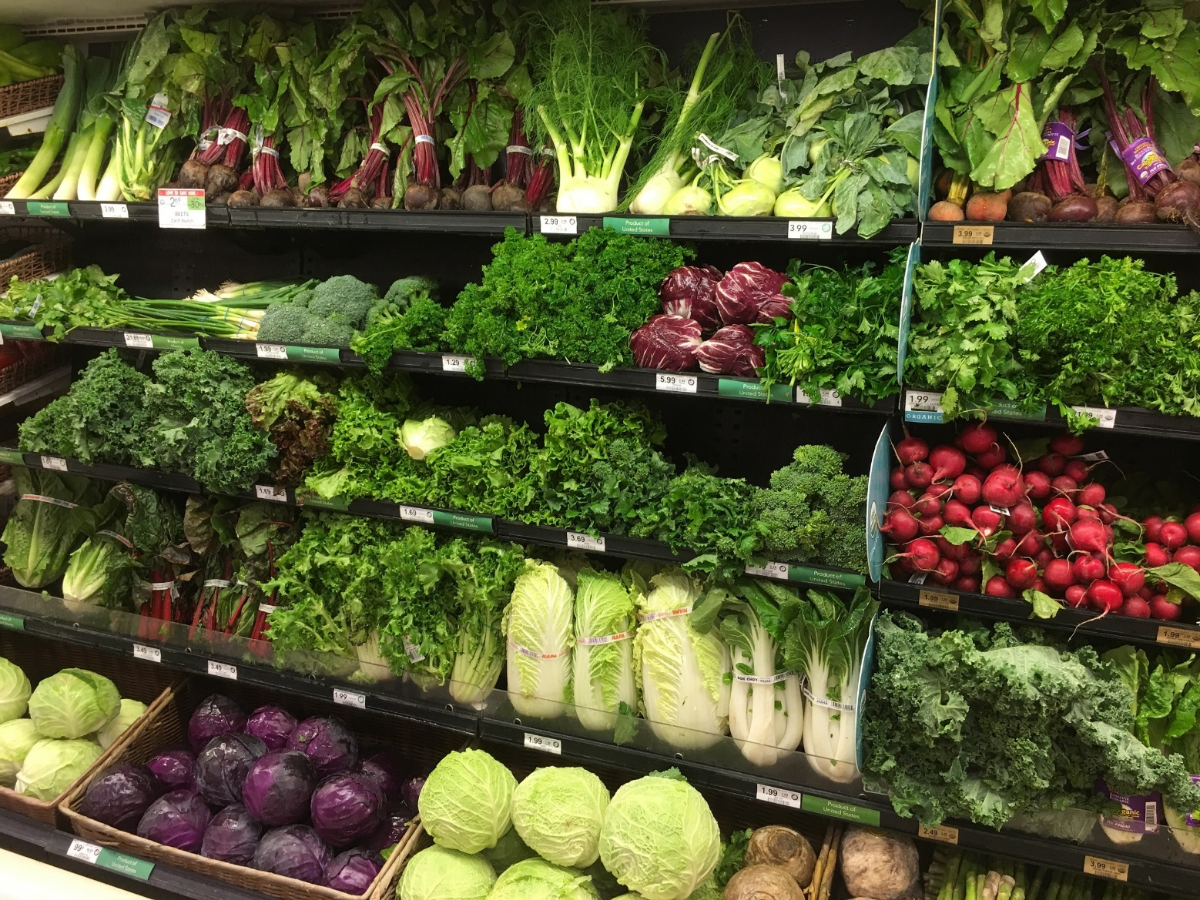
Retail Market Produce
Crops tested based on ISS potential:
Red leaf lettuce
Curly mustard
Cherry tomatoes
Radishes
Green bell peppers
Samples were collected in triplicate from 3 store brands twice at 1 month intervals.

Slide 11
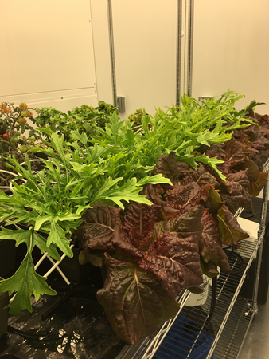
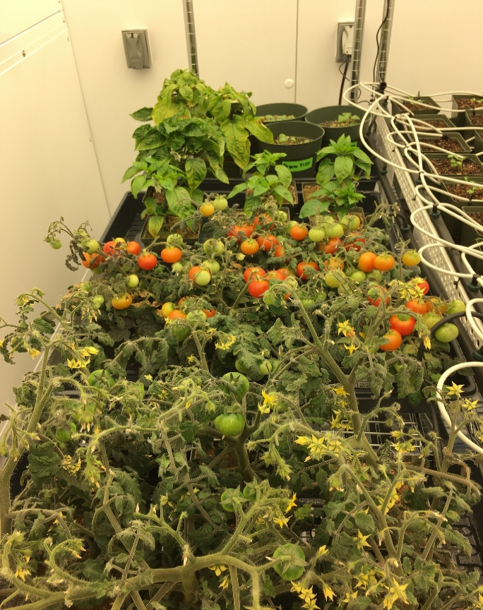
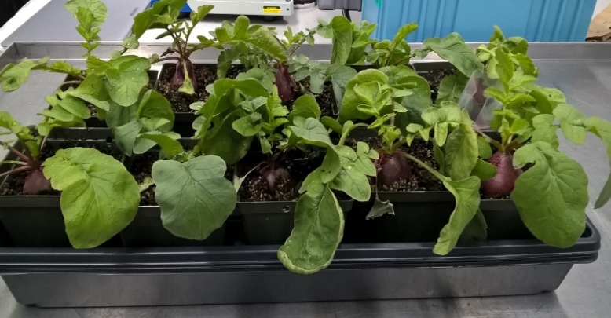
Chamber Grown Produce
ISS-relevant growth conditions:
50% RH
3000 ppm CO₂
23˚ C
Fluorescent lighting, 16 hours on 8 hours off at approximately 300 µmol·m²·s⁻¹
Growth medium similar to what is used in Veggie pillows: sterile, autoclaved “Greens Grade” arcillite with controlled release fertilizer.
Plants were sub-irrigated.

Slide 12
Microbiological Sampling and Analysis
    Total Culturable Microorganisms
                Aerobic Plate Counts (APC)/Bacteria
                Total Yeast and Mold Count
    Specific pathogens:
                Generic E. coli/Coliforms (Petrifilm)
                Salmonella sp. (enrichment/selective media)
                Staphylococcus aureus (Petrifilm)
                Aspergillus flavus (selective media)

Slide 13
Lettuce
Data distribution Box and whiskers plots for aerobic bacteria (APC) and yeast and mold counts on cleaned (water rinse) and not cleaned lettuce from various sources. CACA=cut and come again harvest. + indicates mean, whiskers are max and min values. Market lettuce n=18, Chamber, n=6, VEG-03A n=5, VEG-03D n=4.
Notes:
Significant differences in APC (P<0.05)
VEG 03 D is significantly higher than all other trials with the exception of uncleaned market lettuce. (P values ranged from 0.0035 to <0.0001)
Both harvests of VEG 03 A are significantly lower than market/not clean but not chamber grown produce.
Significant differences in Y & M (P<0.05)
Market uncleaned is higher than all except VEG 03A final harvest and VEG 03 D.
VEG 03 A 2nd Harvest is lower than the 4th and final harvest. (P=.0027)

Slide 14
Mizuna/Mustard
Data distribution Box and whiskers plots for aerobic bacteria (APC) and yeast and mold counts on cleaned and not cleaned mizuna from various sources. Cleaned produce was rinsed with water with the exception of the one labelled ProSan®. + indicates mean, whiskers are max and min values. Market mustard n=6, Chamber mizuna n=6, Ponds test n=12, Pillows test n=12, VEG- 03D n=4.
Notes:
Microbial counts on market produce were significantly higher than chamber produce with the exception of VEG-03 D (P< 0.05).

Slide 15
Conclusions
The number of bacteria and fungi on growth chamber and ISS-grown produce are no higher than market produce from field settings.
Produce sampled in this study indicated no specific microbiological risks associated with a particular type of product. In general the edible fruits, tomato and pepper had the lowest counts, while radish, a storage root had the highest, with no difference between the market and chamber grown crops.
A possible upward trend in the microbial counts was seen with VEG-03D leafy greens. Steps could be taken to minimize further microbial contamination such as increased decontamination of surfaces with sanitizing wipes and the removal of unnecessary materials
Microbial monitoring of inputs into the plant growth systems and the plants is important and should enable detection of any trends indicating increased microbial presence.
Defining risks and the development of standards and best practices for space-grown crops should allow routine safe consumption of these items.

Slide 16
Hazard Analysis Critical Control Points (HACCP) Plan
Process Step/Control Point | Food Safety hazard | Methods to reduce hazard | CCP
Ground processing-pillows | Introduction of microbes via handling and materials. | Sterilize components, aseptic technique used while assembling | 1
Ground Processing- Seed | Introduction of microbes via handling and indigenous microbes present on seeds | Disinfection. Certification of pathogen free seed. Use of sanitary handling practices | 2
Packing | no
Transport | no
Integrate with Veggie hardware | Introduction of microbes via handling. | Use of sanitary handling. | 3
Watering | Introduction of microbes via water supply or unsanitary handling | Water is potable quality and treated with biocide. | 4
Grow | Potential contamination from air and human presence, increase in indigenous flora due to availability of nutrients. | Use of sanitary handling. Minimize handling of plants before harvest. | 5
Harvest | Introduction of microbes due to harvest procedures/human handling. | Sanitized instruments should be used and gloves worn. | 6
Post-harvest | Microbial presence established during plant growth and introduction via handling. | Crops should be sanitized before consumption following procedures. Veggie facility should be thoroughly sanitized. | 7

Slide 17

Community Sequencing
Environmental
Sample
PCR completed using barcoded primers
  Bacterial 16S rRNA gene
  Fungal ITS region
Sequenced with MiSeq NGS
Preliminary data analysis
  GreenGenes bacterial database
  UNITE fungal database
DNA
Extraction
Gene Encoding 16S rRNA
PCR
Mixture of amplified specific 16S rDNA sequences with a same size (bp)

Slide 18
Veggie Microbiology
Microbiome analysis

Slide 19
Current and Future
Continue conducting ground-based microbial food safety and microbiome testing of candidate crops
Developing fresh produce food safety standards for space
Looking at use of on orbit resources when applicable
  Developing process flow for on-orbit sampling of fresh produce microbiome, nucleic acid isolation, library generation, sequencing, and data analysis
Investigating the relationship between microbiomes and food safety
Ultimate Goals:
  Effectively sanitize produce with few consumables and low inputs
  Control and identify biotic stresses and pathogens
  Use the microbiome to protect crops or enhance growth

Slide 20
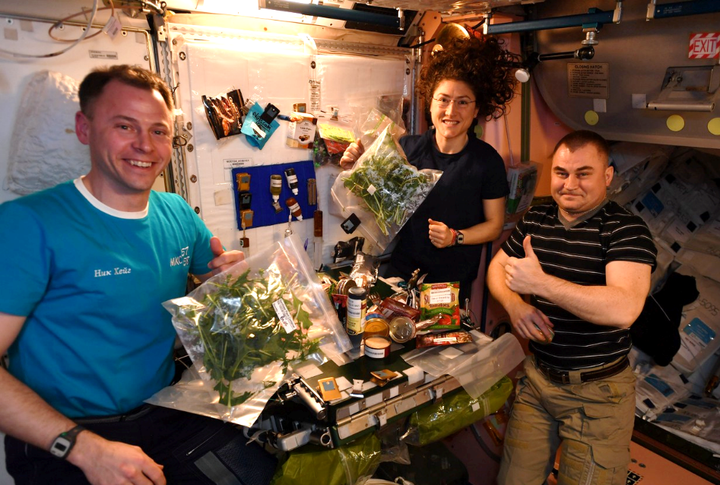
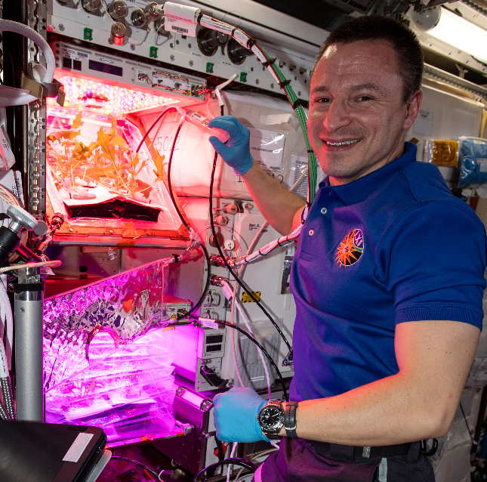
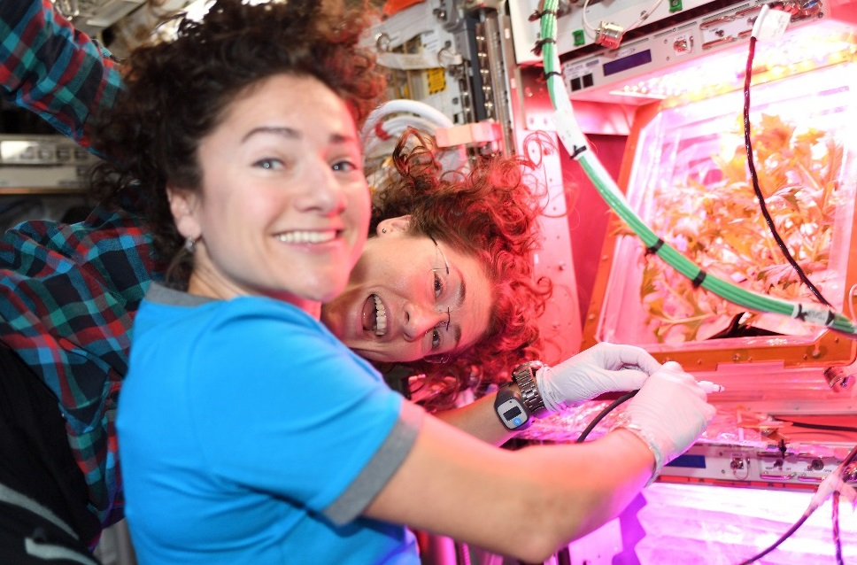
Thank you!
KSC’s Space Crop Production Team
Veggie and VEG teams at KSC, JSC, and SNC-ORBITEC
The Astronauts
Payload Operations and Integration Center
NASA’s Space Biology Program, Human Research Program and International Space Station Program

