Slide 1
Creep Testing of Vectran Yarn
Sarah L. Langston
Structural Mechanics and Concepts Branch
NASA Langley Research Center
2020 SLaMS Early Career Forum
Virtual

Slide 2
Outline
Background
Lever-Arm Test Stand
  Description
  Results
Conventional Test Stand
  Design Requirements
  Initial Design and Verification Testing
  Results
Concluding Remarks and Forward Path
Lessons Learned

Slide 3
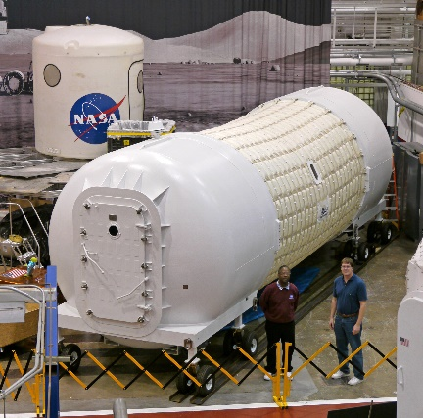
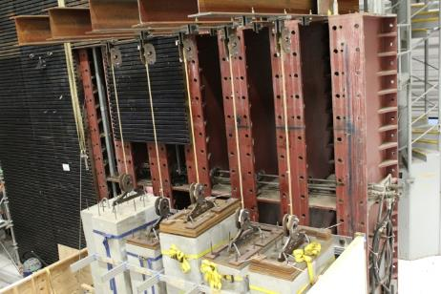
Background: Inflatable Structures
NASA and industry are developing inflatable space structures to provide deployable habitable volumes for future exploration missions in space and on the surface of the Moon and Mars
Inflatable structures provide volume savings on launch vehicles
Inflatable structures must withstand constant pressure loading over multi-year missions
Cordage and webbings provide the primary structure
  Typically constructed using high-strength synthetic fibers
  Must have high resistance to creep failure modes
Webbing
Weight
Inflatable Habitat
Creep Test

Slide 4
Background: Creep and Creep Testing
Creep is a time-based phenomenon where a structure may fail at less than ultimate load over a period of time
  Temperature can significantly affect creep behavior
Creep testing involves loading a specimen to a specified percentage of ultimate load
  Time to rupture (failure) and elongation (strain) is measured
  Creep tests data are used to produce master creep-curves of a material to be used in design
  Performing tests at elevated temperatures can be used to perform accelerated creep testing
Tertiary
Creep
Failure
x
Primary
Secondary
Strain
Creep
Rupture
Time

Slide 5
Background: Vectran Creep Testing
Vectran is often used for the webbings and cordage of inflatable structures
  Synthetic fiber – liquid crystal polymer (LCP)
  Attractive for thermal stability, high strength, and “good” creep behavior
Prior testing of Vectran webbings at Langley Research Center had poor correlation between real-time and accelerated tests
  Need more data to try alternative correlation techniques
  Webbing and cordage testing requires >1000 lbs of weight, larger test facility and higher cost
Desire to utilize testing at the yarn level to collect more data that can be used to study alternative correlation techniques
  Yarn testing requires ~ 20 lbs of weights, smaller test facility and lower cost

Slide 6
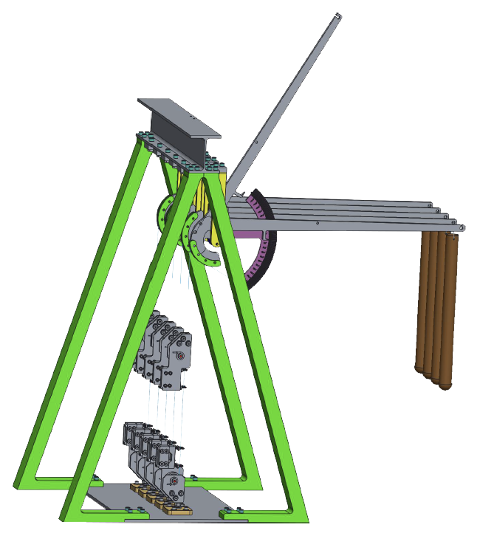
Lever-Arm Test Stand: Description
Designed and built a load-amplified test stand
  Able to load 5 yarn specimens
  10:1 loading ratio
Lever
Arm
Pros:
  Loaded 5 specimens in a very small footprint
  Load amplification allowed for the use of smaller weights
Cons:
  No integrated load cell to confirm 10:1 load ratio and monitor load throughout test
  Small separations between specimens can influence nearby specimen behavior
  Very difficult to set-up (may impart damage to yarn during set-up)
Weight
Grips
Yarn Specimen

Slide 7
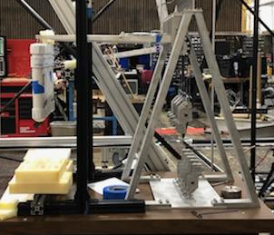
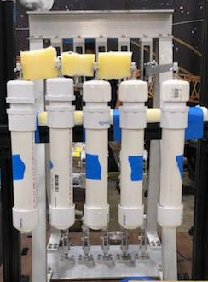
Lever-Arm Test Stand: Results
Creep rupture test (no strain data) performed at 70% of ultimate tensile strength (UTS)
Difference of 1126 hours (over 6 weeks) between first and final failure
Some spread in failure times was expected
Large spread led to the desire to create an alternative test stand and compare results

Slide 8
Conventional Test Stand: Requirements
Technical Requirements:
  Load multiple specimens using no load amplification (conventional “dead-hang” creep testing)
  Grips that would not alter specimen behavior/failures needed to occur in gage area not grips
  Set-up that could be used with loadings from 5 lbs to 50 lbs
  Simple to replicate set-up processes over many specimens
Other Requirements:
  Fit into small lab area
  Low cost
  Parts easy to acquire/fabricate

Slide 9
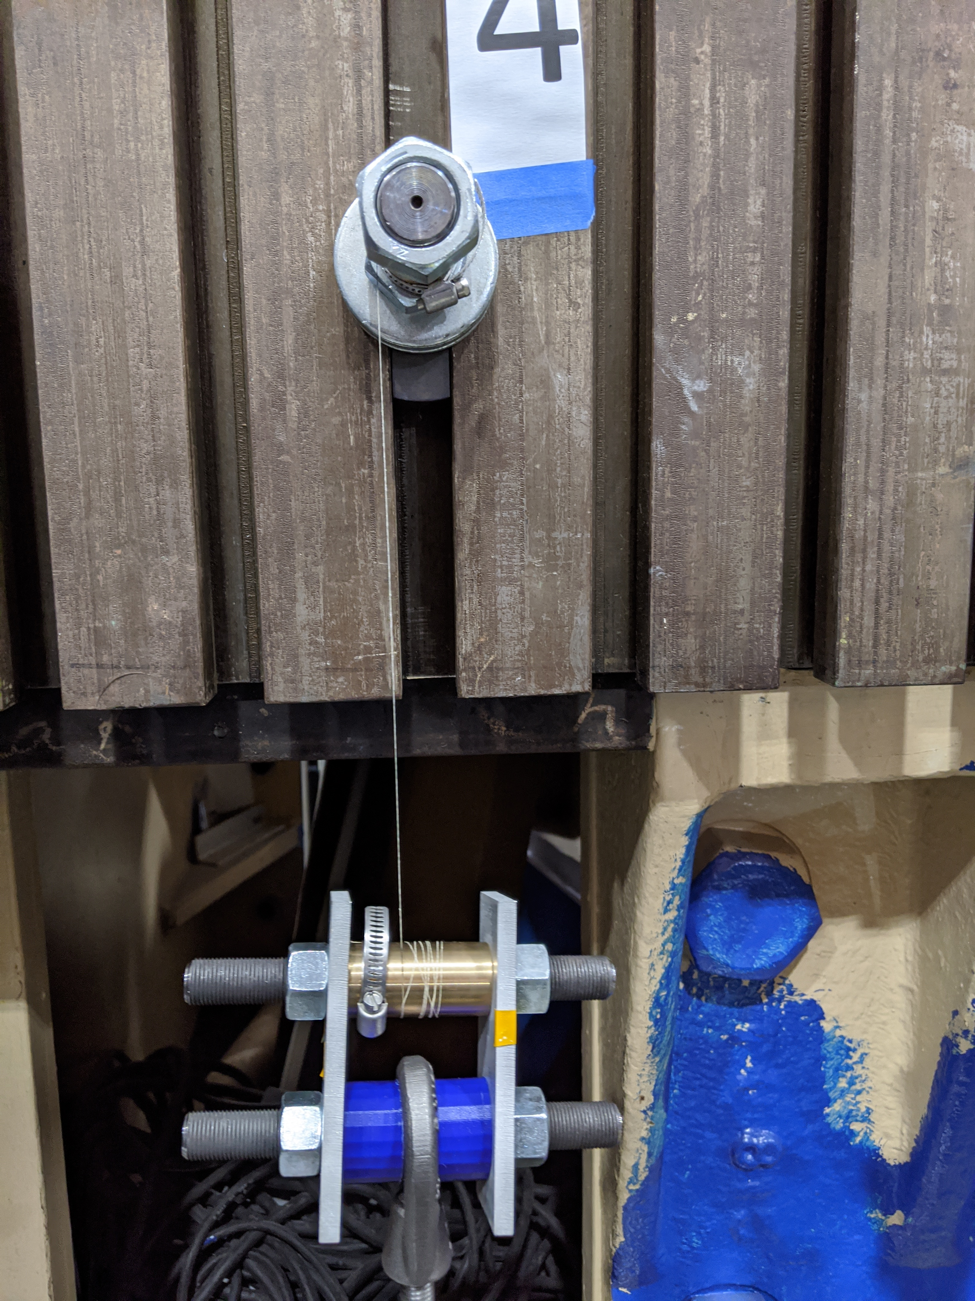
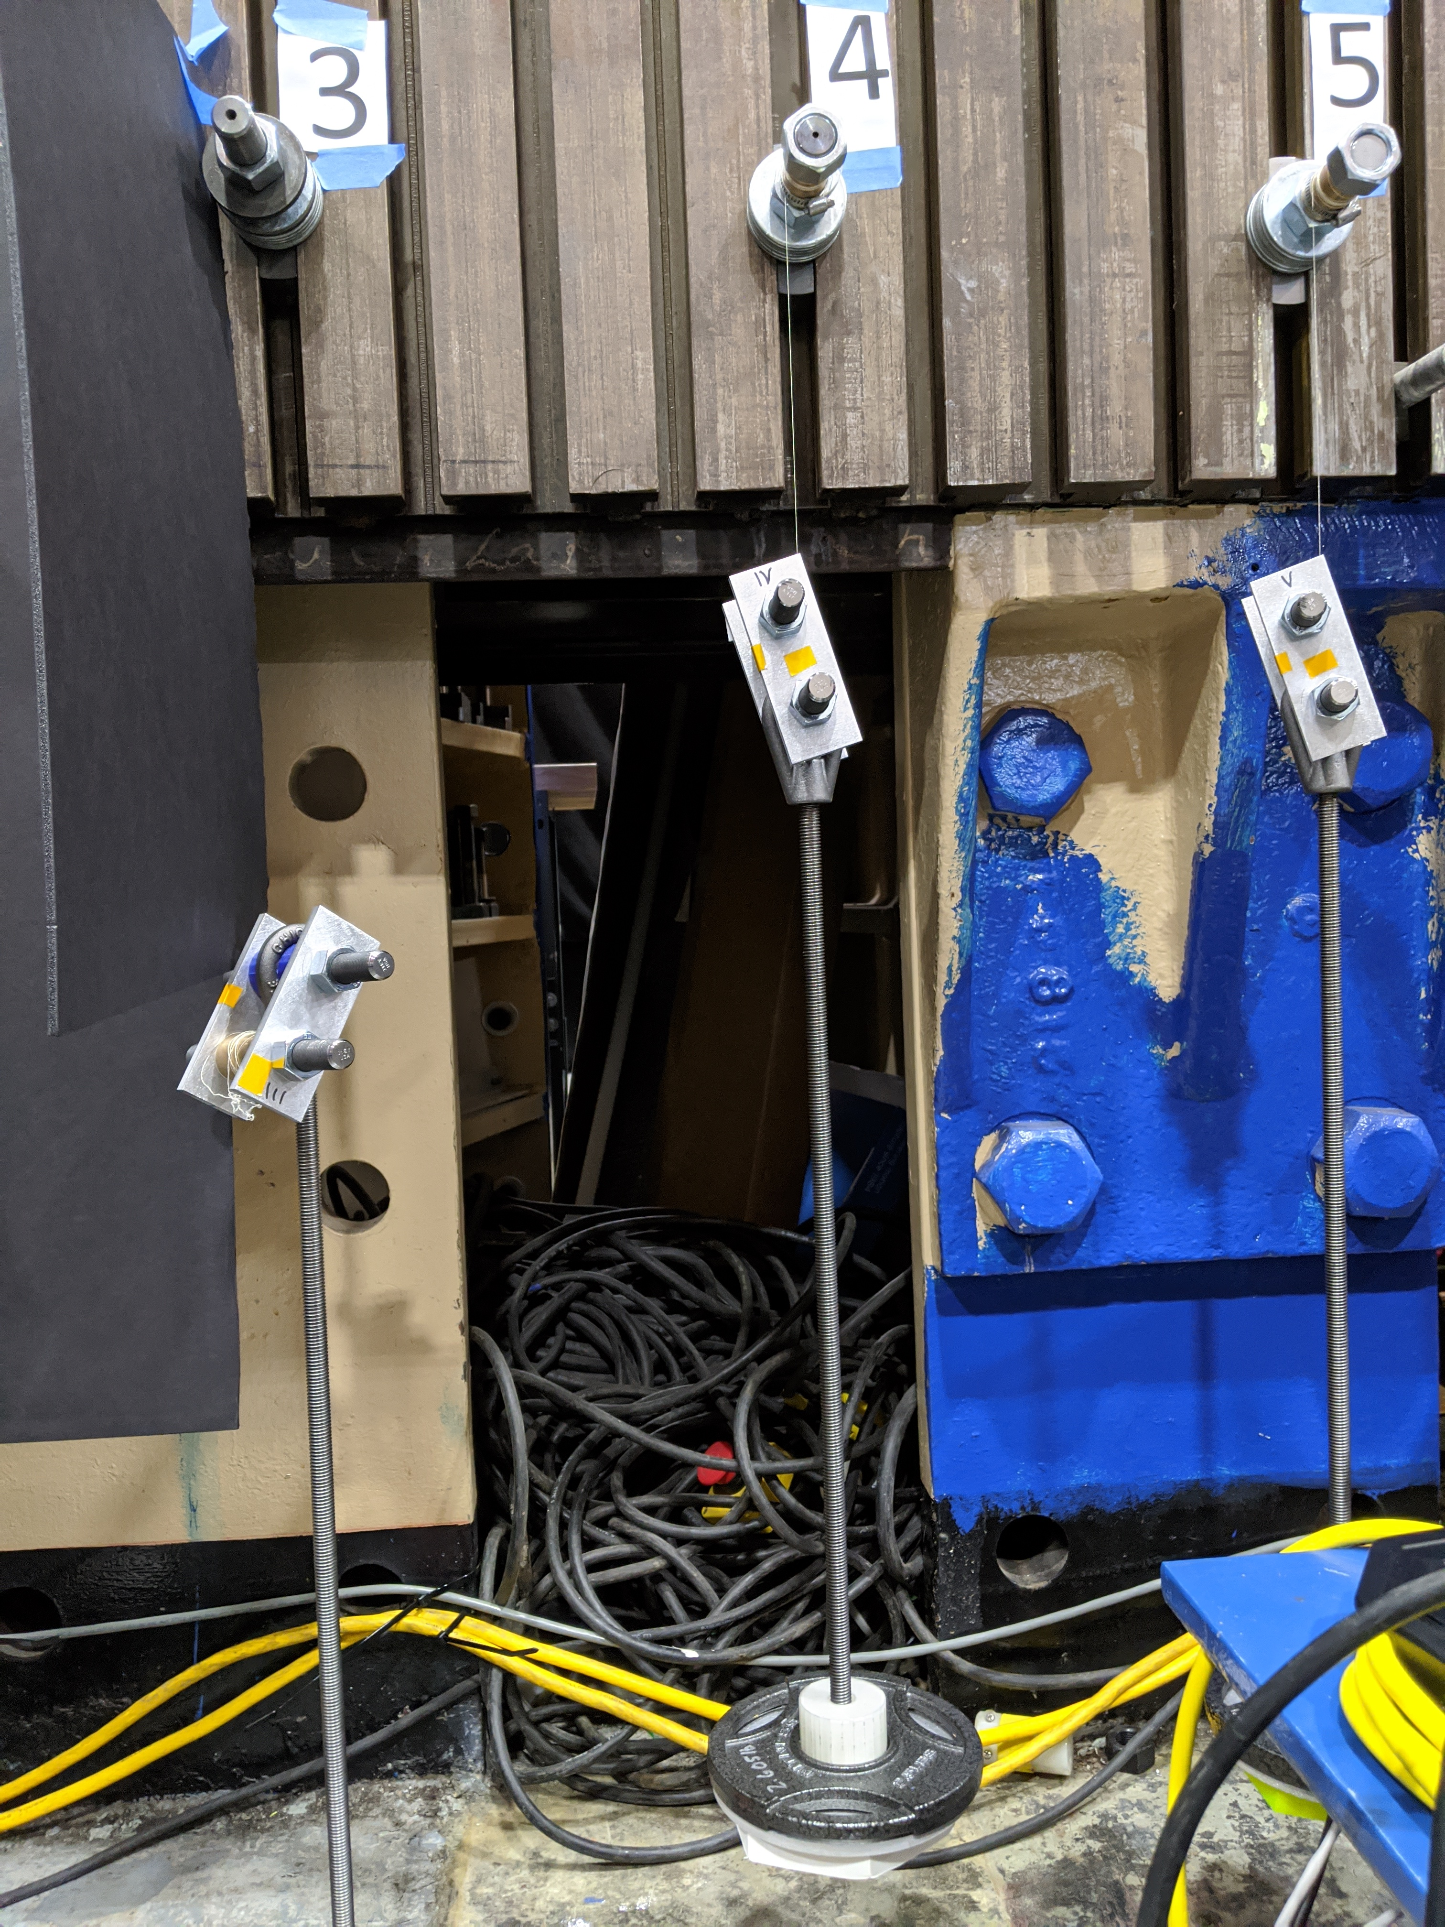
Conventional Test Stand: Design
Design primarily utilized parts quickly and cheaply available
Two side pieces for each grip and loading plate were fabricated using a waterjet from scrap aluminum
Non-structural spacers were fabricated using 3D printing
Top Grip (1 in. diameter bearing over bolt)
Top Grip
Specimen
Bottom Grip
Bottom Grip (1 in. diameter bearing over bolt)
Eye Bolt
Threaded Rod
Side Plates
Loading Plate
Bumper Ring

Slide 10
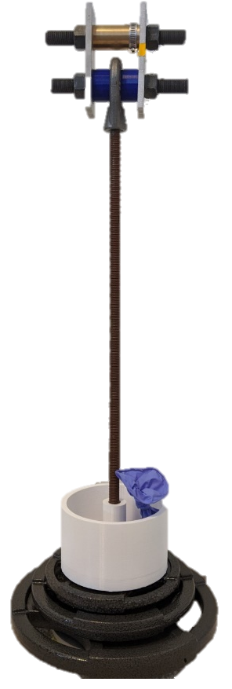
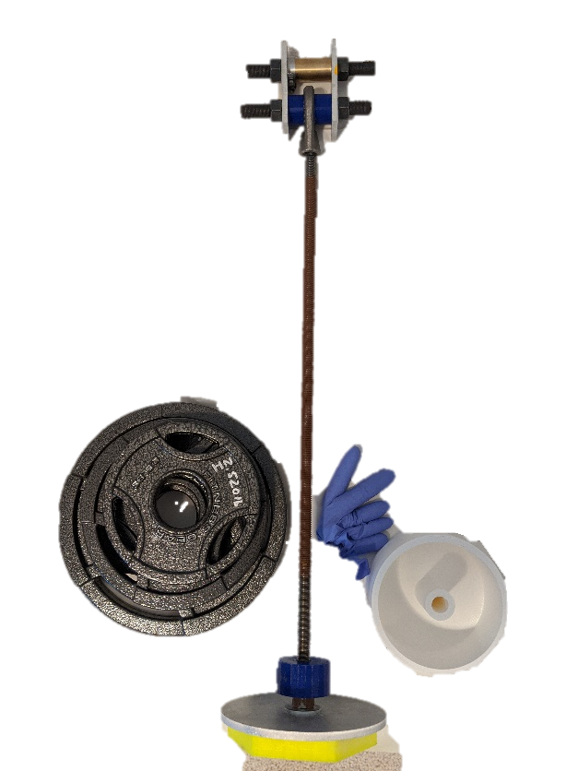
Conventional Test Stand: Loading
Utilized commercially available weights
Weighed using a calibrated scale
  Significant cost savings versus purchasing calibrated weights
Bottom Grip
Eye Bolt
Precision
Weight
Threaded Rod
Weight plates
Loading Plate
Bumper Ring
Weight Holder

Slide 11
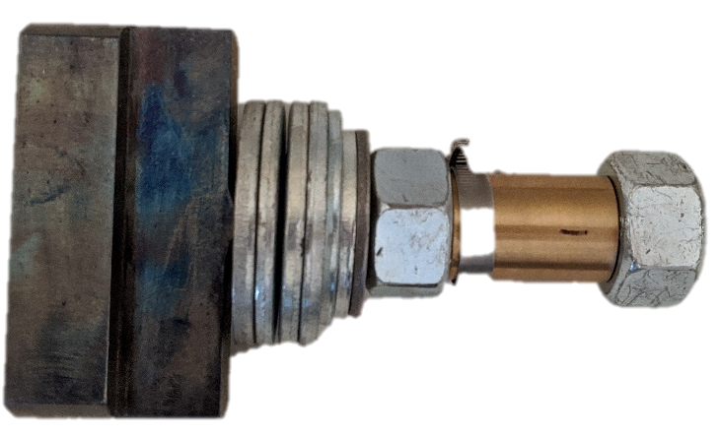
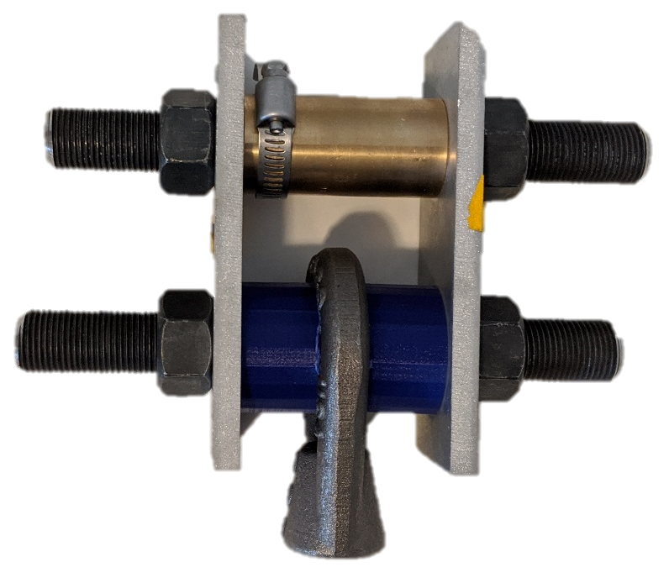
Conventional Test Stand: Grips
Pathfinder testing was used to determine that a specimen length of 61 in. wrapped 10 times around each grip would result in a 10 in. gage length with failure occurring outside of the grip
Top Grip
Bottom Grip
Clamp
1 in. Outer Diameter Bearing
T-Slot Bolt and Washers

Slide 12
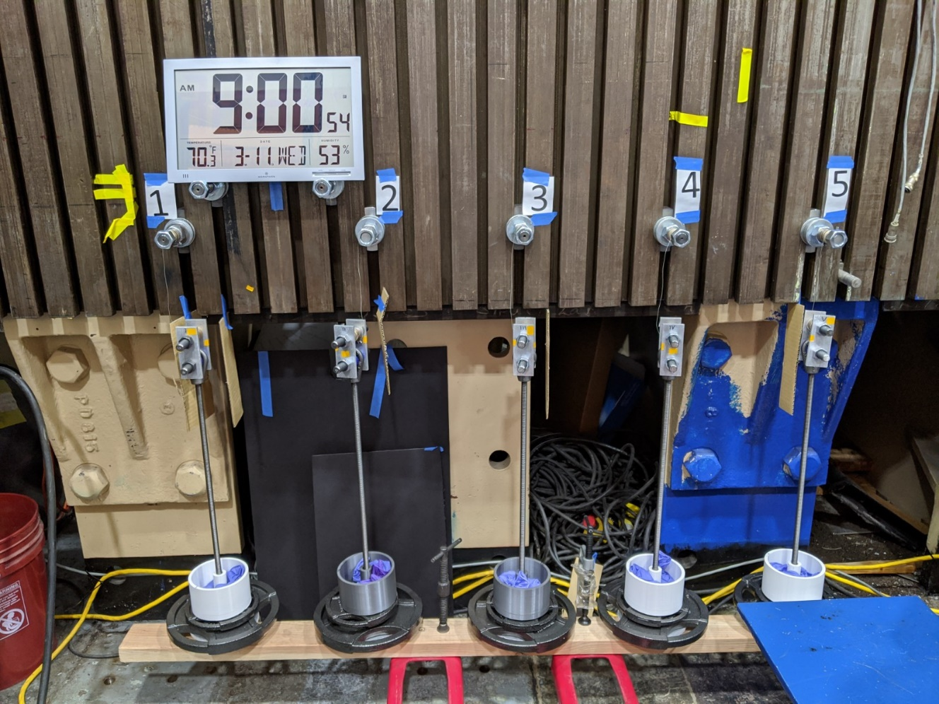
Conventional Test Stand
Final set-up allowed for testing of 5 specimens at once
  Uniformly loaded using a pallet jack

Slide 13
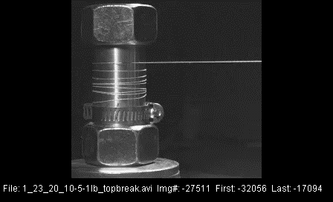
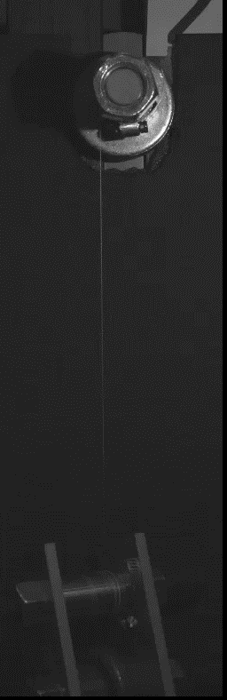
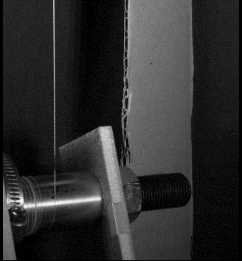
Conventional Test Stand: Verification
High-speed cameras were used to confirm yarn was not failing due to grips
  Important for the failure to occur at the tangency point of the grip or lower into the gage section
Bottom Grip
Top Grip
Notes:
From 1_23_20_10-5-1lb_top and bottom break: Start 15:09 end 15:19
From 1_9_20_10-5-1lb.avi Start: 0:46 end 0:48

Slide 14
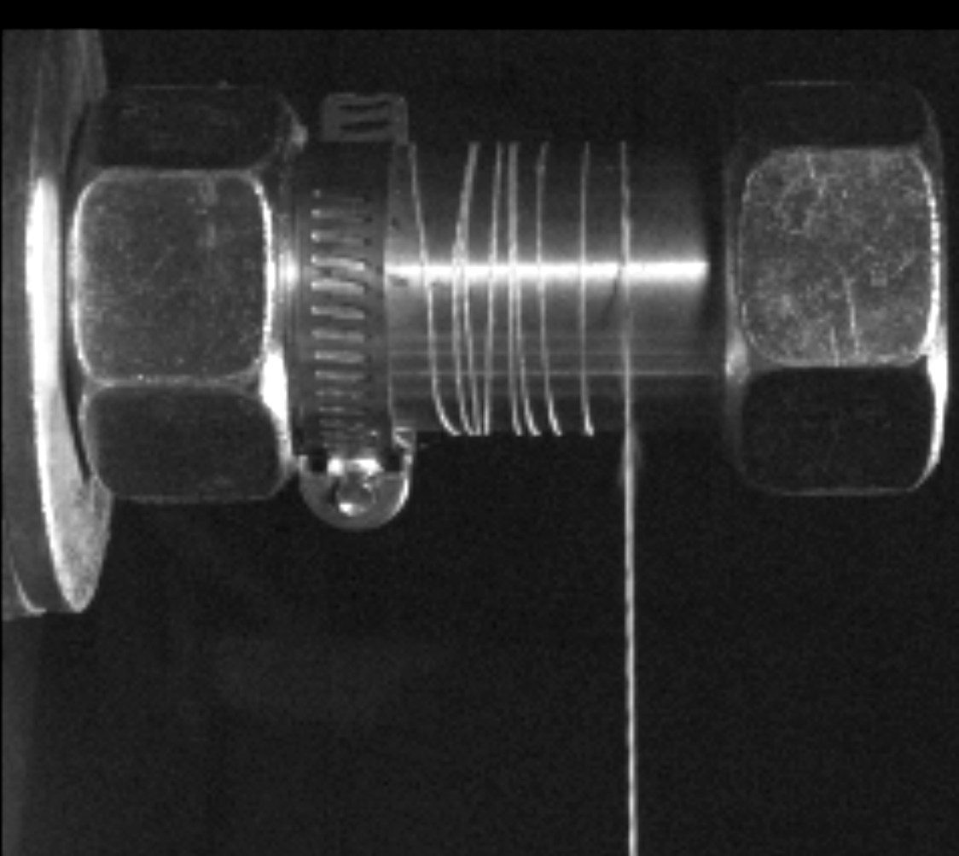
Conventional Test Stand: Verification
The failure is in the top grip, below the tangency point
  Additional testing confirmed that the failures were outside of the grips and distributed between the top and bottom grips
Failure initiation

Slide 15
Conventional Test Stand: 70% Test
5 specimens were loaded up uniformly via a pallet jack using weights at 70% of ultimate tensile strength (UTS)
  Same load level as the lever-arm test
Specimens were monitored using a Raspberry Pi^{ǂ} (RPi), which took images every second for the first 5 minutes and every 5 minutes thereafter
Large spread in failure times
Ranging from 56 minutes to 10 weeks
Specimen 1 may have lasted up to 2 weeks longer, but RPi ran out of memory
  Failure time is assumed as last image captured
*
^{ǂ} The use of trademarks or names of manufacturers is for accurate reporting and does not constitute an official endorsement, either expressed or implied, of such products or manufacturers by NASA

Slide 16
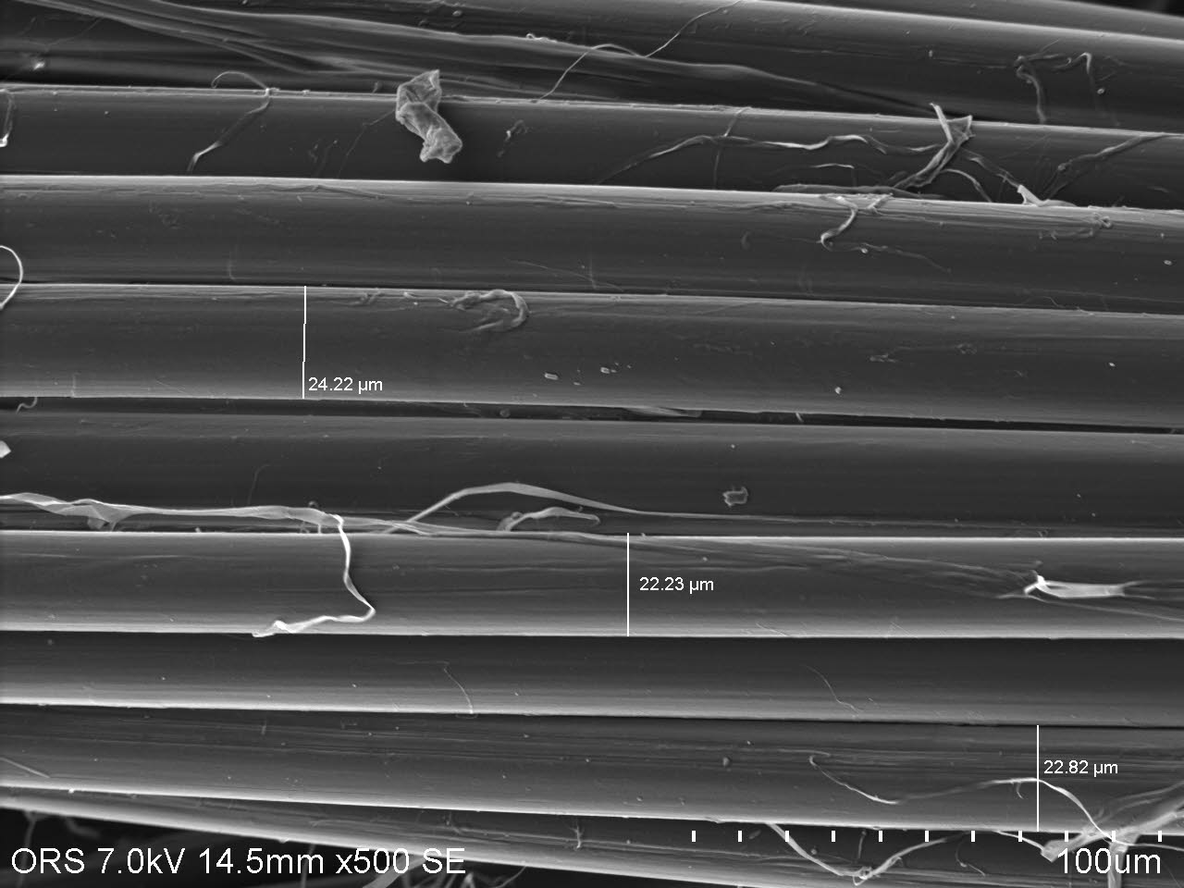
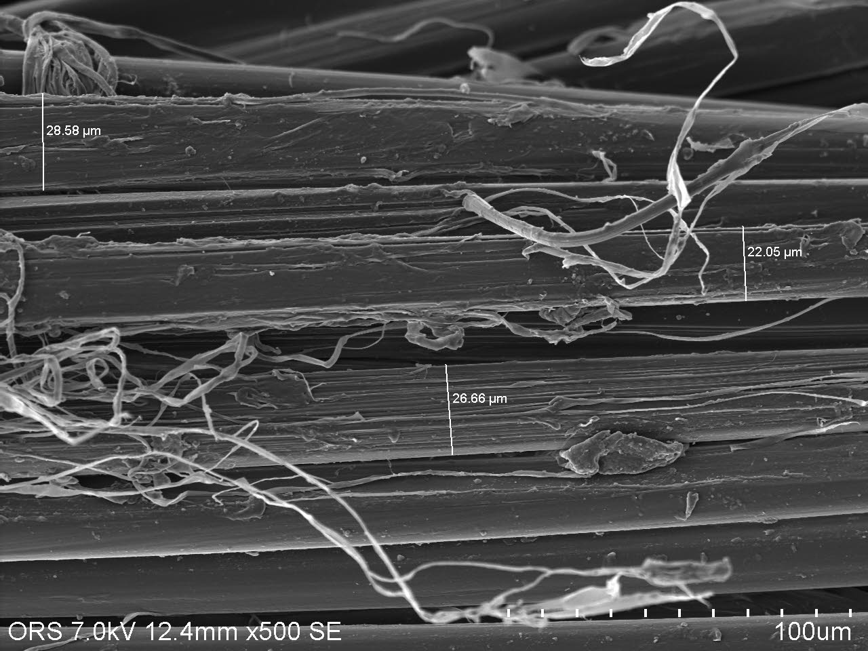
Conventional Test Stand: SEM
Scanning Electron Microscope (SEM) images were taken of the failed specimens from the 70% UTS conventional test and pristine yarn
Measurements of fiber diameter within the yarn taken to determine if there was a correlation of fiber size to failure time
Example of a pristine specimen
Example of a failed specimen

Slide 17
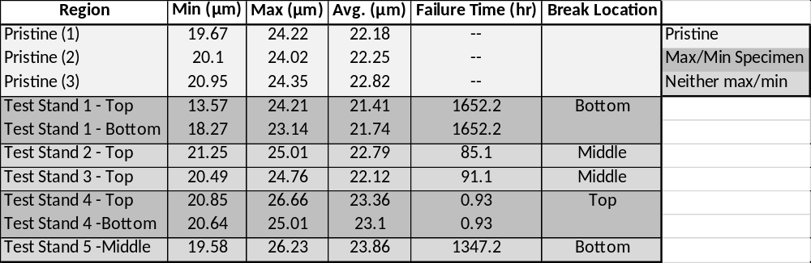
Conventional Test Stand: SEM
10 specimens were sent for SEM analysis
  3 pristine
  2 each from the specimens with the longest and shortest failure times
  1 each from all other specimens
Minimum, maximum, and average fiber diameter measurements were taken
  The average was found from 10 measurements
Legend
No correlation was found between average fiber diameter and failure time

Slide 18

Concluding Remarks
70% UTS creep rupture tests on lever-arm and conventional test stands both produced large scatter in their results
  Points towards an inherent variability in the material unrelated to test stand design
Forward Path
Integrate a load cell into the load path of the lever-arm test
  Parts have been ordered and are awaiting installation (COVID impacted)
Run additional tests for both the conventional test stand and the lever-arm test stand (COVID impacted)
Determine and integrate an accurate strain measurement technique onto both test stands (COVID impacted)
  Laser measurement system is ready to be integrated onto two specimens of the lever-arm test stand
  Additional optical measurement system in procurement process
  Integration of 3D printed circular strain gage device is in development phase

Slide 19
Lessons Learned
Check, re-check, and then confirm calibration status of any measurement item one may need to use
  Conflicting information on calibration status/requirements of load cells and scales led to delays in testing as equipment had to be re-sent out for calibration
Global pandemics last longer than one thinks
  Ran out of memory on RPi after 2.5 months
    Larger memory cards have been purchased and set-up on new RPi’s
  On multiple occasions power outages caused the python program on the RPi to stop running, had to describe over the phone how to re-start recording
    Create a simplified procedure that can be left with the set-up if someone other than oneself needs to re-start

Slide 20
Lessons Learned Continued
High-speed cameras were worth the extra effort
  Set-up/testing/tear-down only took ~one week (shorter with experience)
  Confirmed validity of test set-up and location of failures
Simplicity always wins
  Example: clock in background of pictures eliminated need to constantly re-set RPi timestamp
Do as much as one can in-house
  Learning the basics of 3D printing can save oneself a lot of time
Tight spaces means getting creative
  Example: pallet jack and 2x4 to create loading table

Slide 21
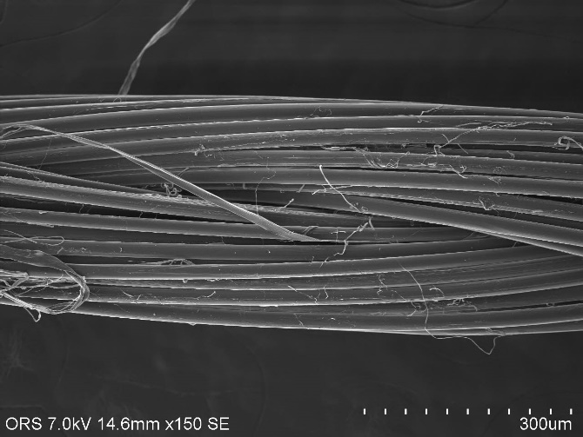
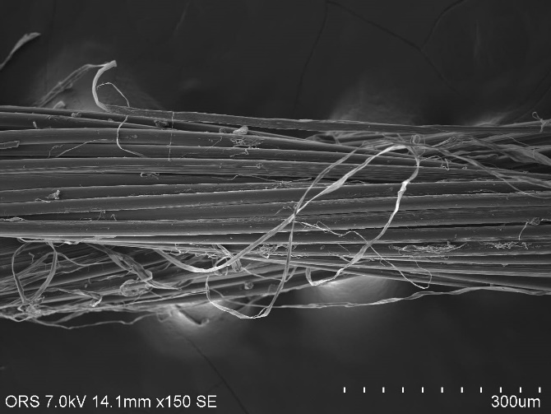
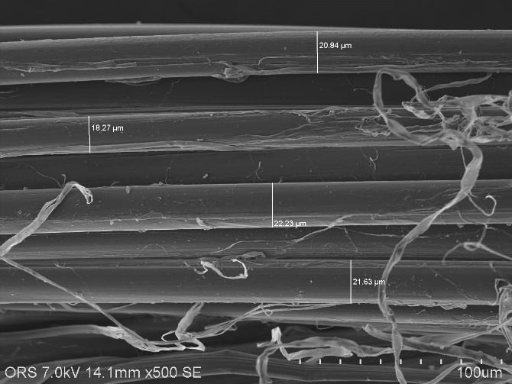
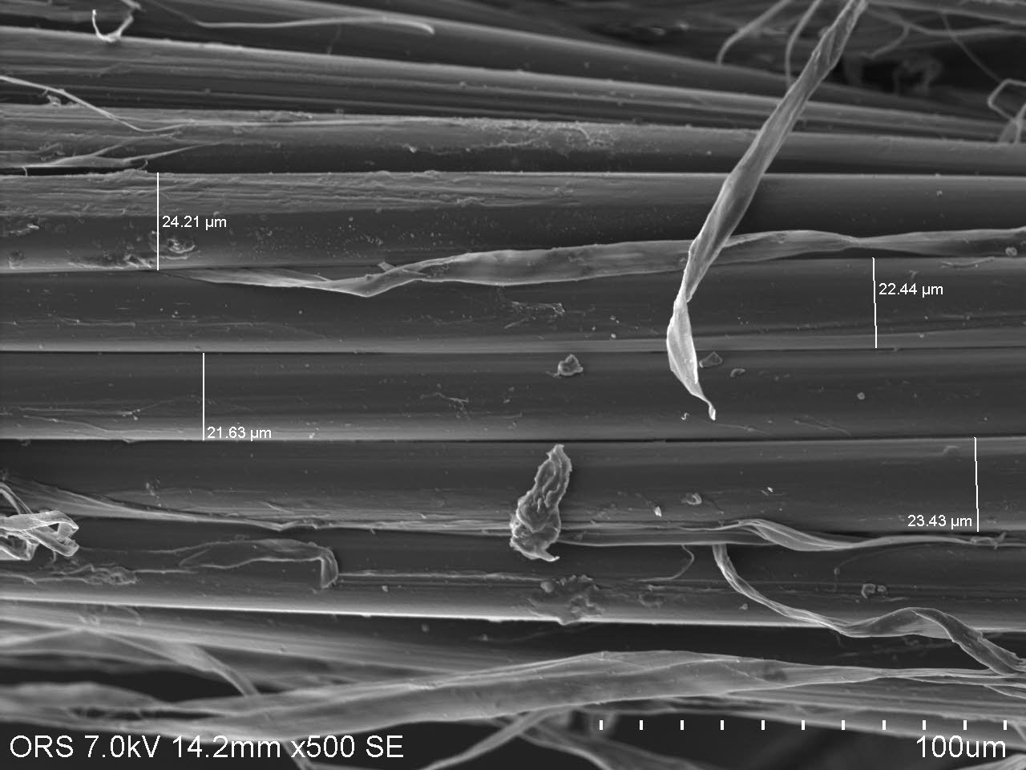
Questions?
Comments?
Suggestions?
Thank you for your attention

