Slide 1
Spacecraft Propulsion System Servicing:
Ground Support Hardware Development
September 2020
C.G. Burnside, M. Perry, C.E. Diaz, D.P. Cavender, J. Hunter Williams

Slide 2
Background
Overview
High Level Requirements
Current Status

Slide 3
Background
An MSFC Engineer (current Lunar Flashlight Propulsion System Project Manager), travelled to AFRL (Air Force Research Laboratory) to assess the Green Propellant Infusion Mission (GPIM) fueling cart design while under construction and to train with the GPIM loading team
  Purpose of visit was to assess the GPIM fueling cart design and operations to inform the design of the MSFC carts in development to support the Lunar Flashlight mission
The LFPS team consulted with and engaged the GSFC team using the ECAPS carts for fueling demo at Wallops in 2016.
The original LFPS propellant loading spec was build on the same tailoring fo AFSPECMAN 91-710 as the GPIM loading systems. It was also expanded to include the NASA-STD-5005 requirements as well.
  The LFPS team help an inter-agency specification review in October 2018
  NASA MSFC, KSC, JPL, and USAF Vandenberg AFB Safety & Mission Assurance (SMA) personnel reviewed the technical specification
In 2019, the specification was revised for the new LFPS system design
In 2020, the specification was again revised for multiple mission support and to support loading operations at AFRL

Slide 4
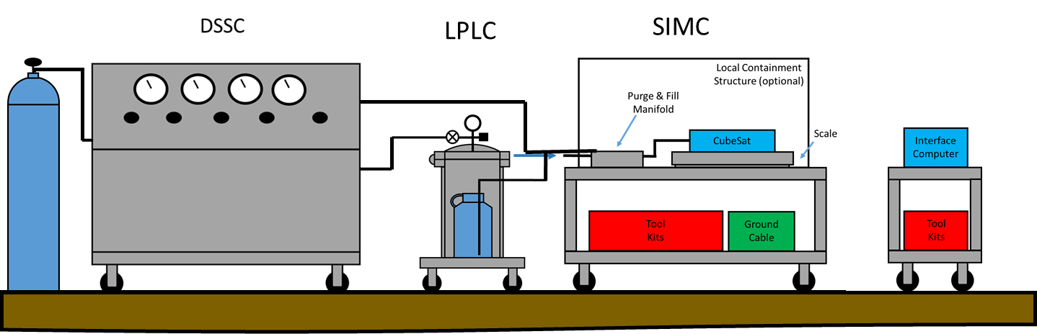
Overview
The PLS is designed for interfacing to NASA flight systems to perform fueling, pressurization, de-tanking, cleaning, and contingency operations
  Designed for AF-M315E and LMP-103S, isopropyl alcohol, helium, nitrogen, and dry missile grade air
  Nominal spacecraft sizes are cubesats (1U to 27U) and small spacecraft such as the ESPA class missions
  Can service individual modules or fully integrated spacecraft with the exception of cubesats which are stowed in deployers. No servicing is possible through the deployment containers.

Slide 5
Overview
The system is modular and transportable via commercial freight.
The nominal floor area required at the loading facility is 19 x 22 ft, but can be arranged to suit the spacecraft and facility footprint.
The PLS consists of three parts:
  Dry Side Service Cart (DSSC)
    Gas Only – regulates high pressure gas source to spacecraft pressures
    Provides vacuum system for removing residual gas from propulsion system and support vacuum loading
  Liquid Propellant Loading Cart (LPLC)
    Contains propellant and residual/waste containment
  Spacecraft Interface and Measurements Cart (SIMC)
    Supports direct spacecraft interfacing and convenient loading operation

Slide 6
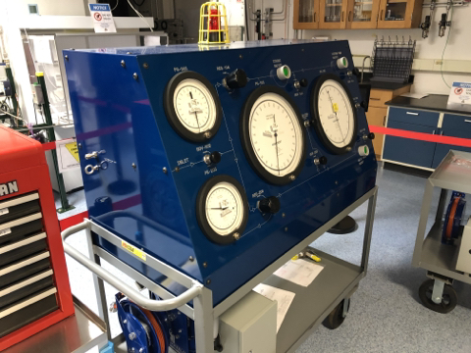
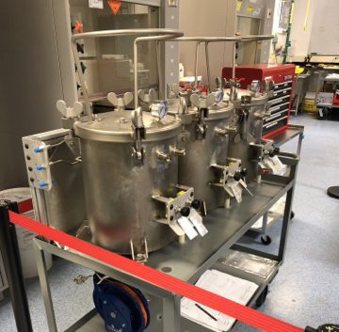
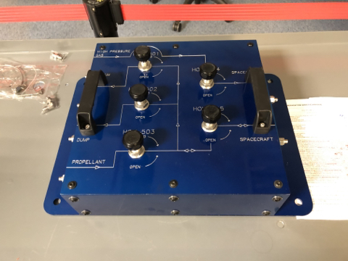
Overview – Pictures of System
DSSC
LPLC
SIMC

Slide 7
High Level Requirements
MSFC dictated high level requirements specific to the PLS system external to the AF and NASA range documents
  The PLS is designed for indoor use only, but doesn’t require a clean-room
    The PLS is not cleaned, nor ready for clean-room use.
  The PLS is designed to be mobile and shippable through standard freight
    We wanted these carts to service spacecraft at a variety of US locations
  The PLS is designed to handle spacecraft pressurization up to 500 psia
  The PLS is designed to pull vacuum (less than 20 Torr) for vacuum filling of spacecraft
  The PLS is designed for manual operations (large gauges, manual valves, etc.)
    A high pressure switch is used for indication of high pressure in the system, but is not required for safe operation
  The PLS is designed for easy servicing
    Relief valves, gauges, and other items requiring regular inspection/calibration are easily accessible/removable
  The PLS is designed for cleanliness Level 4 per MSFC-SPEC-164 rev E
    A low micro rating filter is installed immediately upstream of the spacecraft to meet particulate levels per LFPS requirements
The PLS is designed to meet AFSPCMAN 91-710 and NASA-STD-5005D for range safety requirements
Tailoring of the range documents is provided in the PLS System Requirements Document

Slide 8
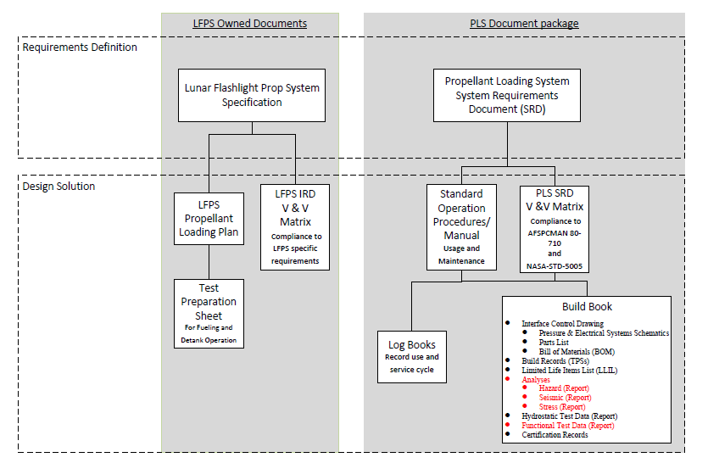
Requirements Documentation
The MSFC propellant loading went through a few iterations
  Settled on a split approach
    One document Tree for the spacecraft
    One document Tree for the PLS
Hardware is built to meet the tailored AF and NASA range documents
MSFC does a lot of flight hardware designs
  Class A missions mostly
  Class D small spacecraft are ‘new’ to many at MSFC
AFRL, KSC, GSFC, and other groups/individuals provided invaluable feedback in the development of this system

Slide 9
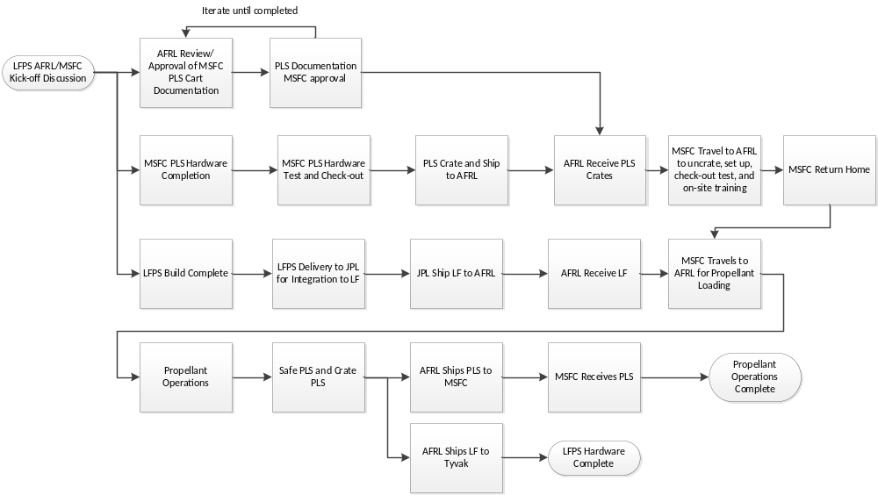
Work Flow
Initial use of carts for spacecraft loading
  Specific to NASA, AFRL, and JPL

Slide 10
Current Status
Propellant Cart Hardware Complete
  Modifications supporting LFPS specific operations in-work
    Relief valve resets, calibrations, and final procurements
Documentation in-work
  System Requirements Document Signed
  Verification and Validation of requirements in-work
  Procedures, Build book, and Log books are in-work
AFRL – MSFC kick-off
  AFRL is hosting the NASA team for loading of the LFPS at their site
  Simplifies operations for NASA and helps maintain Artemis I Launch Date

