Slide 1

International Directory Network (IDN) Report
CEOS WGISS-50
Remote Meeting, September 22 to 24, 2020
Michael Morahan
IDN Coordinator
Michael.P.Morahan@nasa.gov

Slide 2
Outline
CEOS/IDN Collaborations
IDN Metric
  IDN Homepage Usage
  IDN Search Portal
  Draft Metadata Management Tool (MMT)
IDN Development
  Keyword Viewer
IDN Useful Links

Slide 3
I. CEOS/IDN Collaborations

Slide 4
ESA Missions/Platform Validation
CMR Validator API is being updated to remove errors for Missions/Platform series names used in the collection metadata.
  Example:
  Update CMR Validation to change the error to a warning for Missions/Platform series values within Platform Name.
  Planned for the end of 2020
IDN worked with ESA (FedEO) to reduce errors by adding missing Mission/Platform LongName valids which will be added to the GCMD Keyword entries.
Mission/Parent (Series) | Children
SENTINEL-1
 | SENTINEL-1A
 | SENTINEL-1B

Slide 5
FedEO request for KMS API SKOS Update
Request:
  Define keyword relationships within the RDF (SKOS) format to be easy to identify for machine-to-machine readability.
  Work to improve the readability has been approved for the end of 2020.
  Example of the future Keyword Management Service (KMS) SKOS syntax for Platform with Instrument relationships:
<skos:related type="has_instrument" rdf:resource="d3415c4b-e95a-45c4-b3a2-1d9f622ddd81"/>
<skos:related type="has_instrument" rdf:resource="9873d448-7c5c-4d0b-b699-8683aa37dd4c"/>
<skos:related type="has_instrument" rdf:resource="a37282d4-322c-4dd0-8edc-36099b9b586c"/>
<skos:related type="has_instrument" rdf:resource="ff159b0a-e63b-4a88-a0de-d90f861a0f07”/>

Slide 6
FedEO Instrument-Science Keyword Relationships
FedEO and ESIP Semantic Technologies Cluster have asked the IDN about building SKOS relationships between GCMD Science Keywords and Satellite Instruments.
  The IDN plans start building these relationships at the end of 2020.
  What’s needed:
    A Mapping of ESA instruments to GCMD Science Keywords (ESA FedEO).
    Entering the mappings into the IDN KMS (IDN)
  KMS already has the capability to add these relationships.

Slide 7
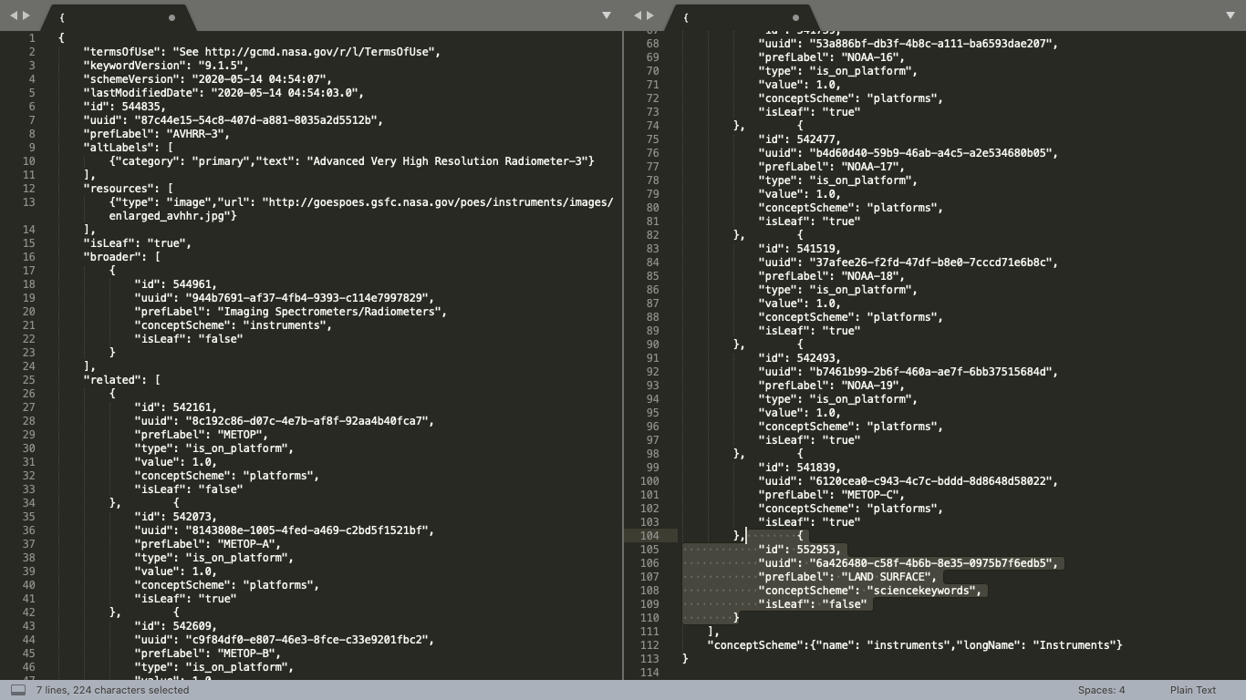
Instrument-Science Keyword Relationship Example
Instrument
ShortName
GCMD
Science Keyword
Notes:
In the right column, in highlight area, is the GCMD Science Keyword related to the Instrument.

Slide 8
ISRO Datasets requested by WGClimate
ISRO will register the Oceansat-2 SCAT metadata records:
  Level 2B (Wind Vector)
  Level 3W (Global Wind vector)
  Level 3SH (Global Sigma-0)
  Level 3SV (Global Sigma-0)
ISRO was given access to the Draft MMT
ISRO contact started work in Draft MMT on metadata records.

Slide 9
Current NOAA-IDN Activities
Reconciling NOAA Technology, Planning and Integration for Observation division (TPIO) Keywords with the GCMD keywords.
Registration of NOAA Group for High Resolution Sea Surface Temperature (GHRSST) datasets into the CEOS IDN for CWIC.
Identifying NOAA Comprehensive Large Array-data Stewardship System (CLASS) datasets need by CEOS WGClimate.
Working to ingest NOAA Southern Ocean Observing System (SOOS) dataset metadata records into the IDN (+22000 dataset records).

Slide 10
Reconciling NOAA TPIO and GCMD keywords.
GCMD/IDN Science Coordinators have been working with the NOAA TPIO team on reconciling science keywords being used in their collection metadata records with the GCMD keywords.
GCMD/IDN Science Coordinators have been providing feedback and suggestions on the keywords being suggested.
The NOAA TPIO Team is expected to deliver a set of Atmosphere keyword changes to the GCMD/IDN Science Coordinators. These keywords will go through an ESDIS Standards Office (ESO) review during the fall of 2020.
The next set of keywords expected for review are the Ocean Keywords.

Slide 11
WGClimate requested NOAA Records
Requested NOAA CLASS dataset records missing from the IDN:
Instrument Name | Dataset ID
Global Ozone Monitoring Experiment (GOME and GOME2)
 | gov.noaa.class.GOME_DAILY
 | gov.noaa.class.GOME_L2
OSTM/Jason
 | gov.noaa.class.J2-TEL
 | gov.noaa.class.J2-ORBINFO
 | gov.noaa.class.J2-AUX
 | gov.noaa.class.J2-ANC
Microwave Humidity Sounder (MHS) NOAA-19
 | gov.noaa.class.MIRS_MAP
 | gov.noaa.class.MSPPS_FXAR
MHS instruments on the MetOp
 | gov.noaa.class.IASI_CCR
Advanced Technology Microwave Sounder (ATMS) on NPOESS
 | Advanced Technology Microwave Sounder (ATMS) on NPOESS

Slide 12
NOAA Southern Ocean Observing System (SOOS) Collections
NOAA requested CEOS IDN to ingest SOOS dataset metadata records.
  SOOS Web Accessible Folder of dataset metadata records: (https://data.nodc.noaa.gov/ncei/archive/metadata/approved/iso/)
  Most of the records failed to ingest because of missing dataset <gmd:edition> values.
    Within the CMR the UMM-C Collection Version field is required and is mapped to the ISO edition field.
  Proposed solutions:
    NOAA adds:
      <gmd:edition>
      <gco:CharacterString>Not provided</gco:CharacterString>
      </gmd:edition>
    NOAA adds “gco:nilReason="inapplicable”“ and CMR maps it to “Not provided” value:
      <gmd:edition gco:nilReason="inapplicable"/>

Slide 13
II. IDN Metrics

Slide 14
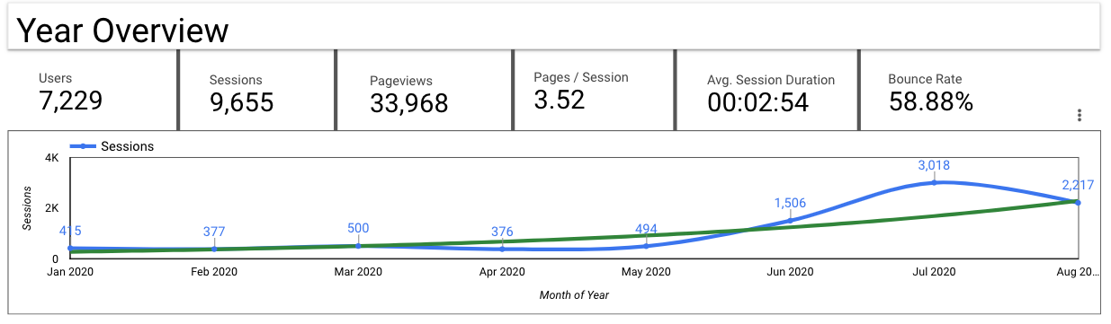
IDN Homepage Usage
(https://idn.ceos.org/)
GMCD decommission links
redirected to IDN
User: An individual person browsing the website.
Sessions: A single visit to the website, consisting of one or more pageviews.
Pageviews: A pageview is reported when a page has been viewed by a user on the website.
Pages/Session: the average number of pageviews in each session.
Avg. Session Duration: how long users are spending on your website.
Bounce Rate: is the percentage of sessions with only one interaction

Slide 15
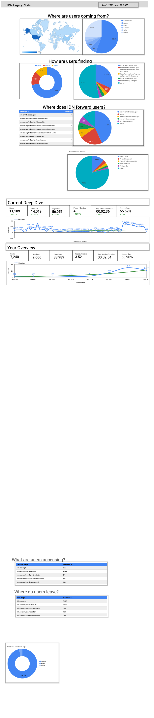
IDN Homepage Usage (continue)
(https://idn.ceos.org/)
Direct Traffic: includes people who typed your website’s URL into their browser or clicked a link in an email application.
Referral Traffic: A referral is reported when a user clicks through to your website from another third-party website.
Organic Traffic: refers to people clicking on a free link from a search results page. For example, people clicking through to your website from a free result on a Google search results page.
How are users finding the IDN?
?
Direct
Referral
Organic

Slide 16
Where does IDN forward users?
(https://idn.ceos.org/)
https://search.earthdata.nasa.gov/portal/idn/
IDN Header
https://draftmmt.earthdata.nasa.gov/
https://wiki.earthdata.nasa.gov/
https://earthdata.nasa.gov/
other

Slide 17
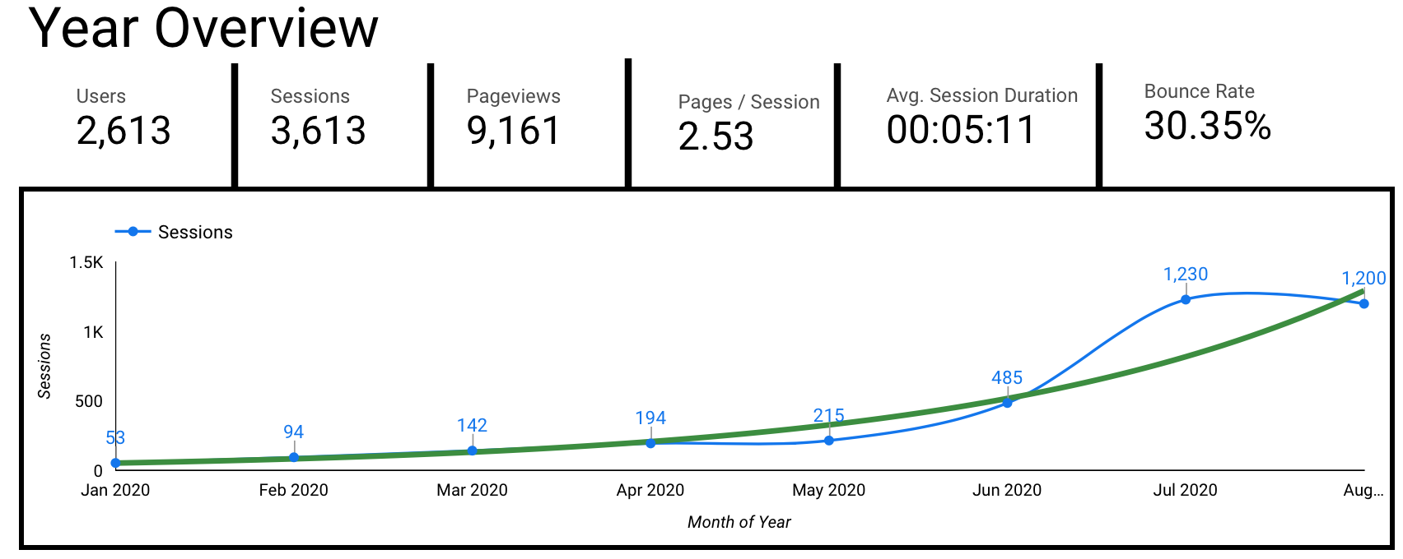
IDN Search Portal Usage
(https://search.earthdata.nasa.gov/portal/idn/search)
GMCD decommission links
redirected to IDN

Slide 18
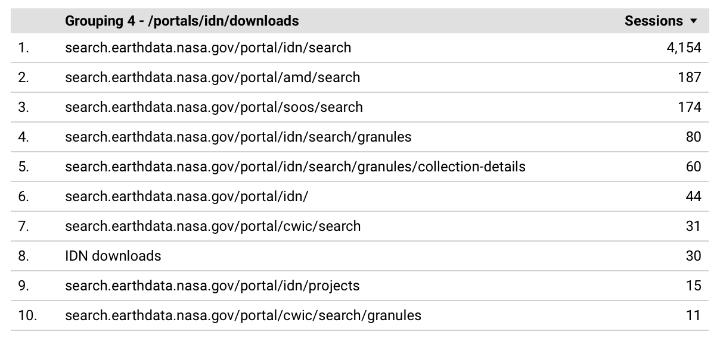
IDN Search Portal Usage
(https://search.earthdata.nasa.gov/portal/idn/search)

Slide 19
Draft MMT Usage https://draftmmt.earthdata.nasa.gov
DraftMMT Usage made public April 27, 2020.
User | Unique Login | Total Logins
Non-EOSDIS user | 22 | 130
IDN Approver | 3 | 80
Break down of Drafts created, submitted, and approved.
 | Created | Submitted | Approved
New Draft Proposals | 30 | 24 | 23
Update Collections | 6 | 6 | 6
Draft MMT will only save unsubmitted collection metadata for 30 days.

Slide 20
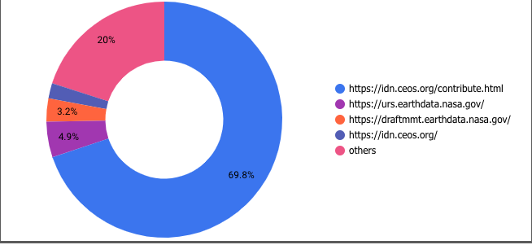
How are users finding Draft MMT?
(https://draftmmt.earthdata.nasa.gov)

Slide 21
III. IDN Development

Slide 22
Revamp GCMD Keyword Viewer Features
Web browser application accessing and visually displaying GCMD Keyword concepts
Hierarchical view and navigation concept tree display
Free text search
Displays the keyword’s
  Preferred Label
  Universally Unique Identifier (UUID)
  Definition
  Relationships
    Boarder group of the keyword
    Relationships between other concepts (Platform – Instrument relation)

Slide 23
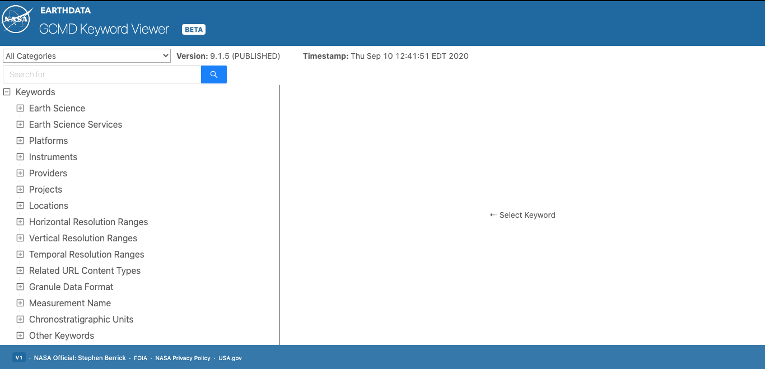
Keyword Viewer: Main Display

Slide 24
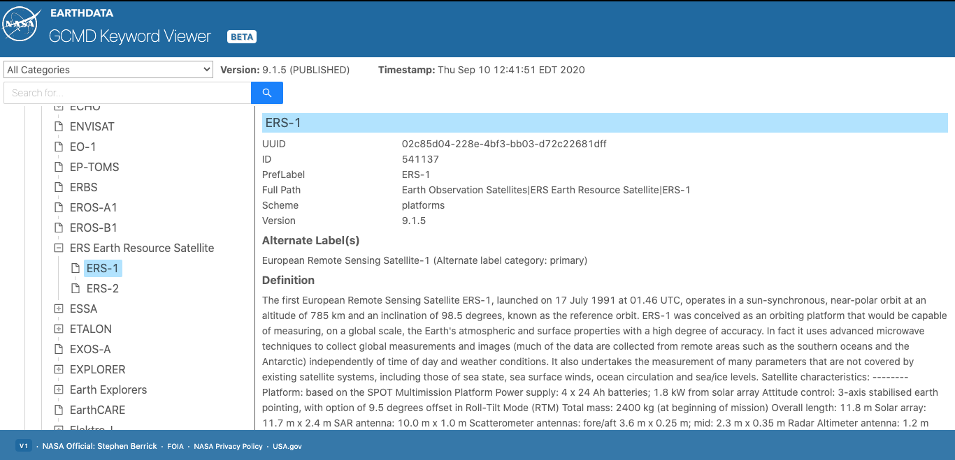
Keyword Viewer: Platform Selection

Slide 25
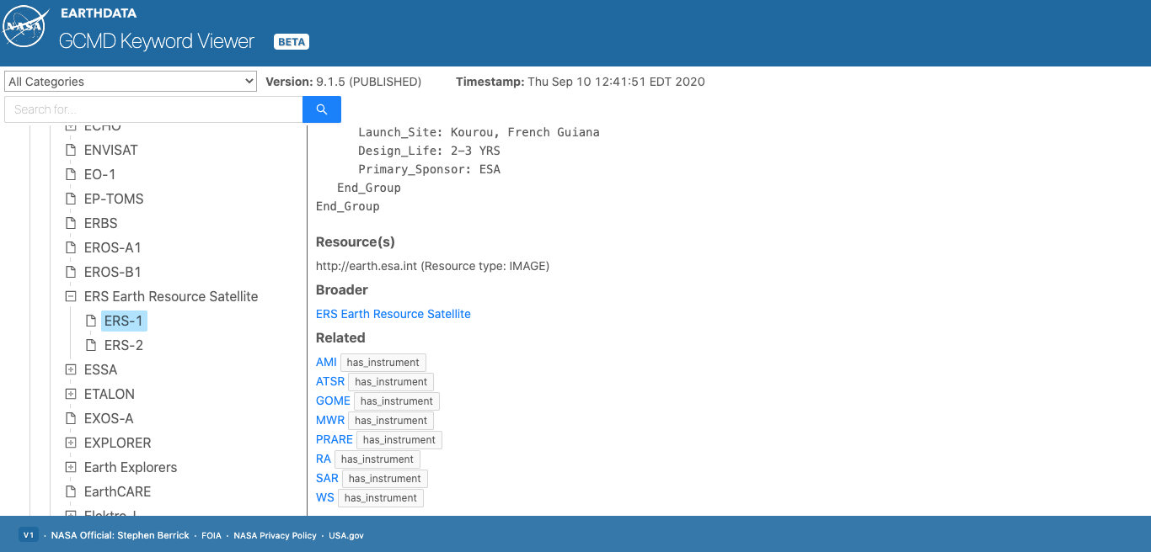
Keyword Viewer: Keyword Relationships

Slide 26
IV. IDN Useful Links

Slide 27
Useful Links
International Directory Network (IDN)
  https://idn.ceos.org/
EarthData Login
  https://urs.earthdata.nasa.gov/home
Draft MMT
  https://draftmmt.earthdata.nasa.gov/
  Draft Metadata Management Tool (dMMT) User's Guide
    https://wiki.earthdata.nasa.gov/display/CMR/Draft+Metadata+Management+Tool+%28dMMT%29+User%27s+Guide
GCMD Keywords
  https://earthdata.nasa.gov/earth-observation-data/find-data/gcmd/gcmd-keywords

Slide 28
Useful Links (continue)
New KMS URLs
  GET Capabilities
    https://gcmd.earthdata.nasa.gov/kms/
  All Science Keyword in CSV format
    https://gcmd.earthdata.nasa.gov/kms/concepts/concept_scheme/sciencekeywords?case=native&format=csv
UMM-C model
  https://wiki.earthdata.nasa.gov/display/CMR/CMR+Documents

Slide 29
Questions
  Please provide questions/comments to:
  michael.p.morahan@nasa.gov (KBR)
  valerie.dixon@nasa.gov (NASA)
  christopher.s.lynnes@nasa.gov (NASA)

Slide 30












This work was supported by NASA/GSFC under Raytheon Co.
in partnership with

