Slide 1
Learning from All Operations
29 September 2020
Jon Holbrook, Ph.D.
Human Factors Discipline Deputy, NASA Engineering & Safety Center
Crew Systems & Aviation Operations Branch
NASA Langley Research Center
jon.holbrook@nasa.gov

Slide 2
Learning From (Almost) All Operations
Learning is a consequence of interactions between people and their environment
People are learning (almost) all the time
Learning can be structured and deliberate, but also unstructured and implicit
Organizations don’t learn, but they influence people’s learning
Creating
Knowledge
Retaining
Knowledge
Transferring
Knowledge

Slide 3
Challenges to Getting Organizational Buy-In
“What we’re already doing works, so why should we change?”
“We’re already doing that.”
“We don’t see how you’re going to do that.”
“What will we learn that we’re not already learning from what we’re doing now?”
What data could be used to answer these questions?

Slide 4
“We’re already doing that”
Does NASA use Safety-I or Safety-II Thinking?
“Safety Policy” posted at a NASA field center
Safety-II Approach to Safety
Systems are complex and will degrade; there will always be flaws and glitches
Variability is normal—manage it
Procedures are always under-specified and must be interpreted and adapted
Focus on learning
People are an asset—learn, adapt
Focus on what we want: how safety is created
Photo Credit: Jon Holbrook, NASA

Slide 5
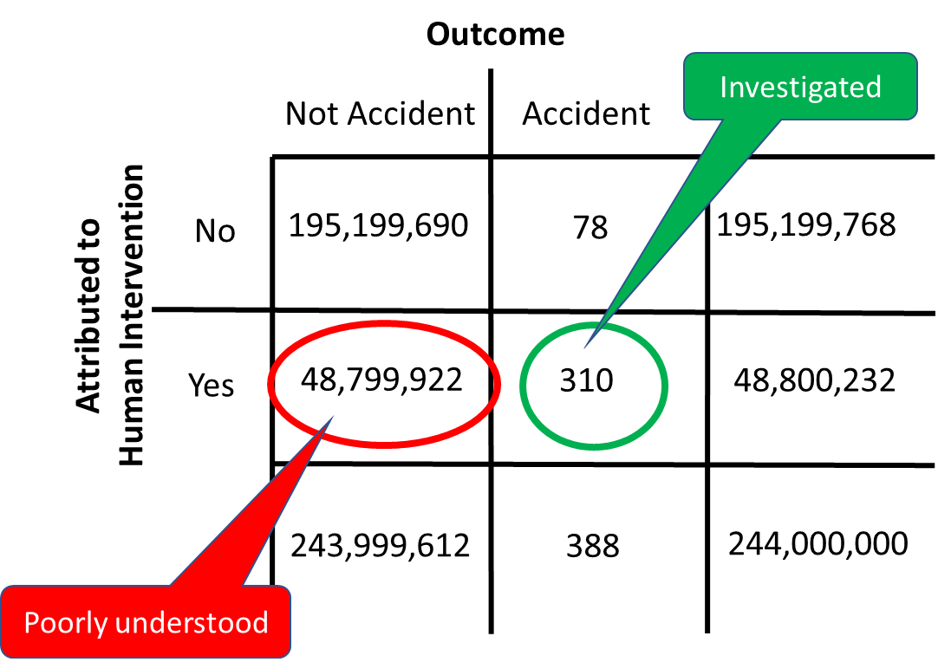
What will we learn that we aren’t already learning?
Safety-producing behaviors vastly outnumber human errors in aviation
Human error has been implicated in 70% to 80% of accidents in civil and military aviation (Weigmann & Shappell, 2001).
Pilots intervene to manage aircraft malfunctions on 20% of normal flights (PARC/CAST, 2013).
World-wide jet data from 2007-2016 (Boeing, 2016)
  244 million departures
  388 accidents

Slide 6
Being Data-Informed
Decision makers in aviation organizations want to make data-informed decisions about safety management and system design.
The data that are available to us affect how we think about problems and solutions (and vice versa).
Data
Information
Knowledge
Framework

Slide 7
Identifying Useful Sources of Data
What data are currently available?
  Operator-, observer-, and system-generated
How and why are those data collected?
What data could be collected, but aren’t?
How and why are data analyzed?
How do we turn data into information; information into knowledge?

Slide 8
Operator-Generated Data
Interviews
  E.g., critical decision method (Klein, 1989)
  NASA example: Conducted structured interviews with pilots and controllers about specific unplanned or unexpected events experienced during routine operations (Holbrook et al., 2019)
Questionnaires
  NASA example: (In-work) Developing an easy-to-implement, repeatable survey for capturing data on safety-producing behaviors, along with a guide for use and data analysis
Event Self-Reports
  NASA example: Conducted analysis of Aviation Safety Reporting System (ASRS) reports describing RNAV arrivals into Charlotte-Douglas International Airport (Holbrook et al., 2020)

Slide 9
Observer-Generated Data
Operational observations
  NASA example: (In-work) What different insights about operators’ safety-related behaviors are learned from the application of different knowledge frameworks to the collection and analysis of observer-based data?
Training/simulator observations
  NASA example: (In-work) Developing a testbed for studying resilient performance in a controlled environment, focused on how pilots manage routine contingencies during RNAV arrivals.
Psychophysiological monitoring
  NASA example: Training for self-awareness of crew state (e.g., workload, attentional state, startle/surprise) using psychophysiological sensors (Harrivel et al., 2017; Stephens et al., 2017)

Slide 10
System-Generated Data
Flight data records; flight tracks; weather data; etc.
  NASA example: Re-purposed an adverse-event precursor-detection algorithm to explore preventive crew behaviors in FOQA data for “non-event” flights (Holbrook et al., 2019)
Rules (policies, procedures, regulations)
  14 CFR § 91.3 - Responsibility and authority of the pilot in command.
    (b) In an in-flight emergency requiring immediate action, the pilot in command may deviate from any rule of this part to the extent required to meet that emergency.
Bulletins, newsletters, position papers
  “To fast-forward to the safest possible operational state for vertical takeoff and landing vehicles, network operators will be interested in the path that realizes full autonomy as quickly as possible.” (Uber, 2016)
  “Accidents, being rare events, need to be considered in the light of a meaningful number of flights, reasonably at least a million flights per year.” (Airbus, 2014)

Slide 11
Learning from Data Collection
Data collections can also be mechanisms for learning
  Operators learn from generating responses, and making inferences from the questions that are asked
  Observers learn from the act of observing
Challenges remain in integrating information across data sources to inform policies, procedures, and practice

Slide 12
Key Take-Aways
Individuals are (almost) always learning
Organizations can affect the creation, retention, and transfer of knowledge
The data we collect inform how we think about safety, and how we think about safety informs the data we collect
When policy decisions are based only on failure data, they are based on a very small sample of non-representative data
Many opportunities exist to collect and analyze largely unexploited operator-, observer-, and system-generated data on desired behaviors
Challenges remain in integrating information across data sources, which would benefit from a more structured human performance framework

Slide 13
Thank you!
Available Publications and Presentations
Holbrook et al. (2019). Human performance contributions to safety in commercial aviation [NESC Report/NASA Tech. Memo.]
  https://ntrs.nasa.gov/archive/nasa/casi.ntrs.nasa.gov/20190033462.pdf
Holbrook et al. (2020). How do pilots and controllers manage routine contingencies during RNAV arrivals? [AHFE Proceedings]
  Available upon request or from Proceedings of the AHFE 2020 Virtual Conferences on Safety Management, Human Factors, Human Error, Reliability, Resilience, & Performance
Holbrook (2019). Exploring human performance contributions to safety in commercial aviation [NESC Academy Webcast]
  https://nescacademy.nasa.gov/video/c200d7657117467c8de080b35a7fd3be1d
NASA research featured in Forbes.com article: In focusing on what pilots do wrong, we may be missing valuable lessons from what they quietly do right
  https://www.forbes.com/sites/kristykiernan/2019/11/14/new-nasa-research-explores-contribution-of-pilots-to-aviation-safety/#449bb8952ac3

