Slide 1


Roberto Aguilar Ayala, Ph.D.
NASA/UCF Postdoctoral Researcher
Exploration Research and Technology Programs
NASA Kennedy Space Center

Slide 2
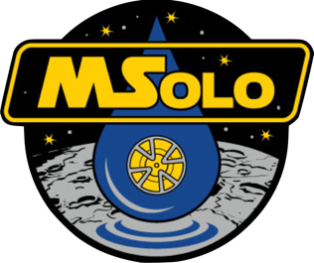
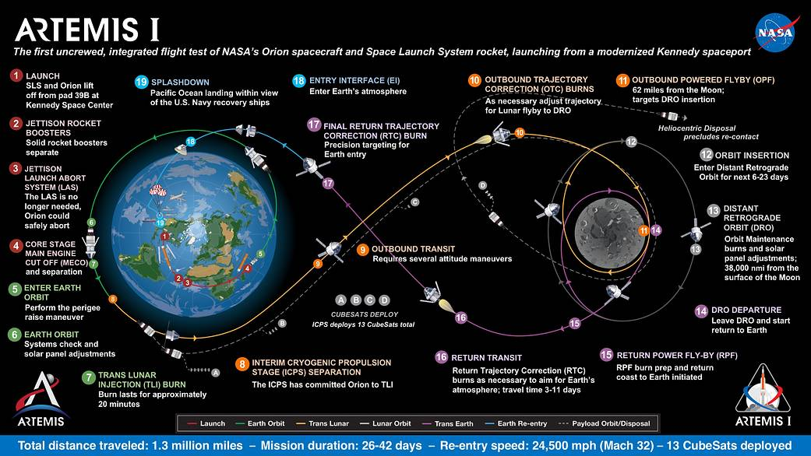
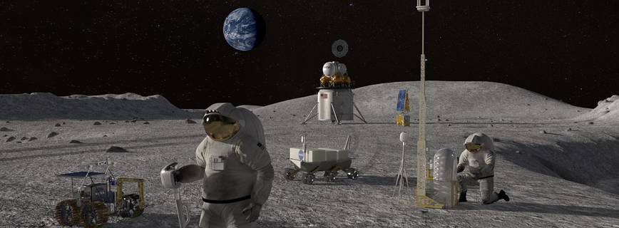
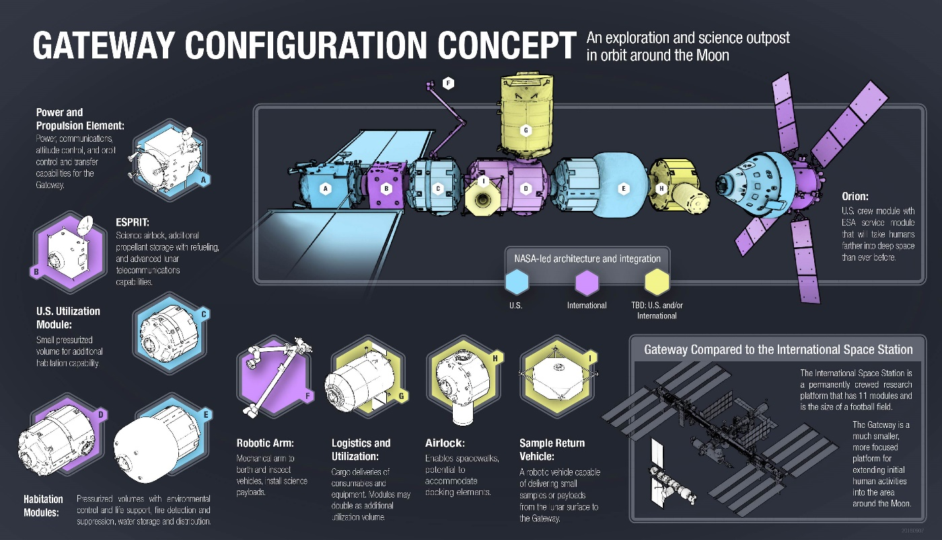

On March 26, 2019, President Trump directed NASA to land the first American woman and next American man on the lunar South Pole by 2024.

Slide 3
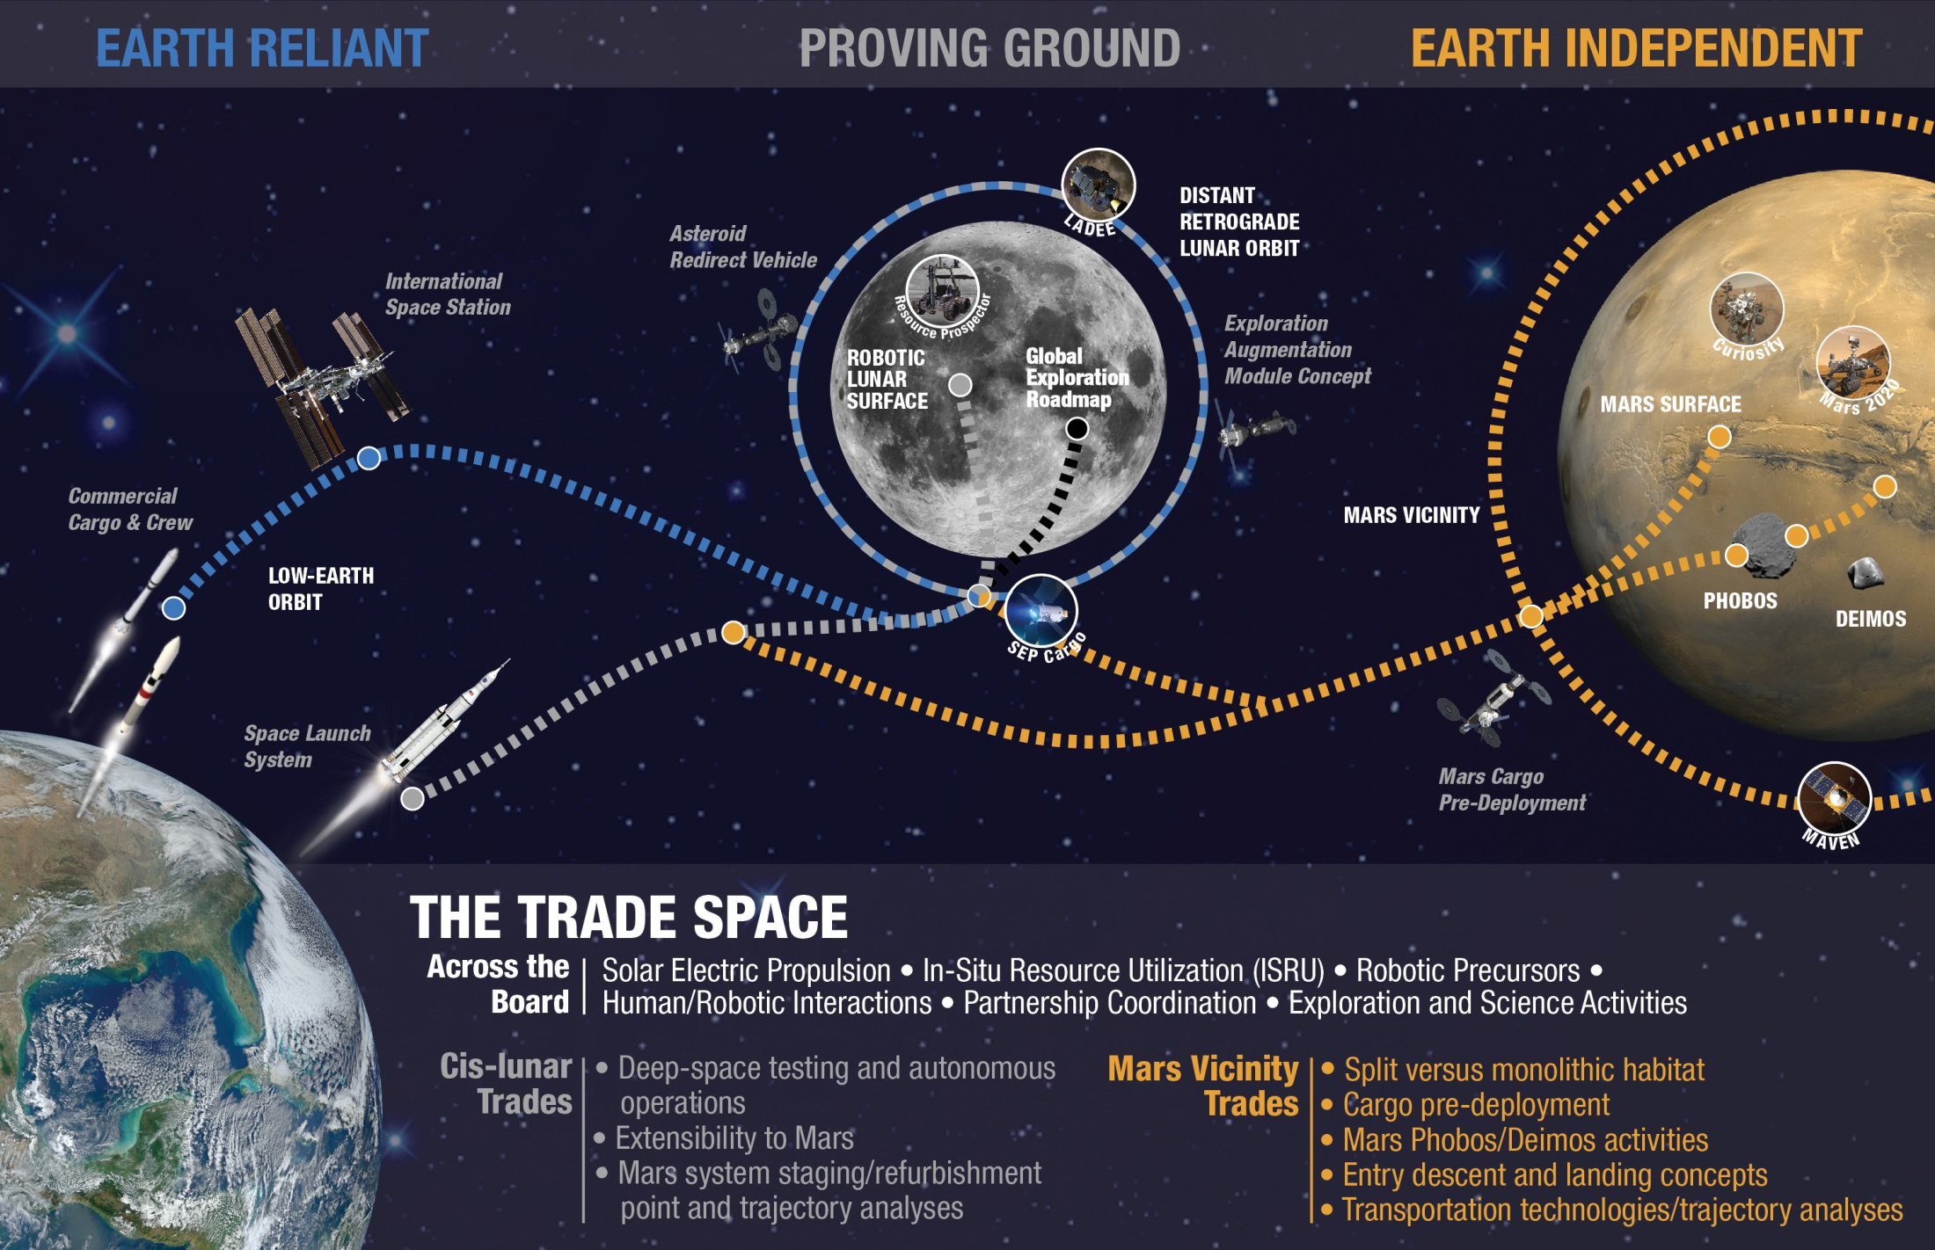

Slide 4
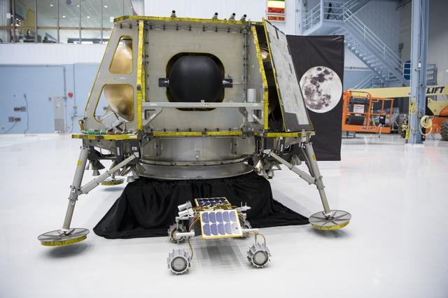
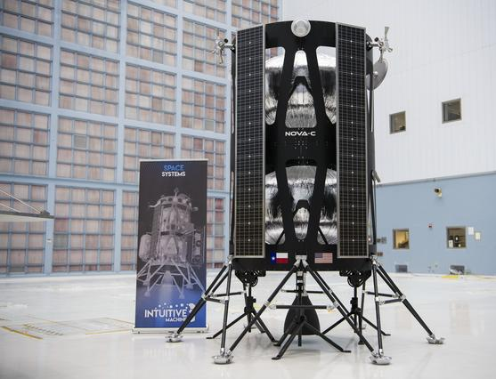
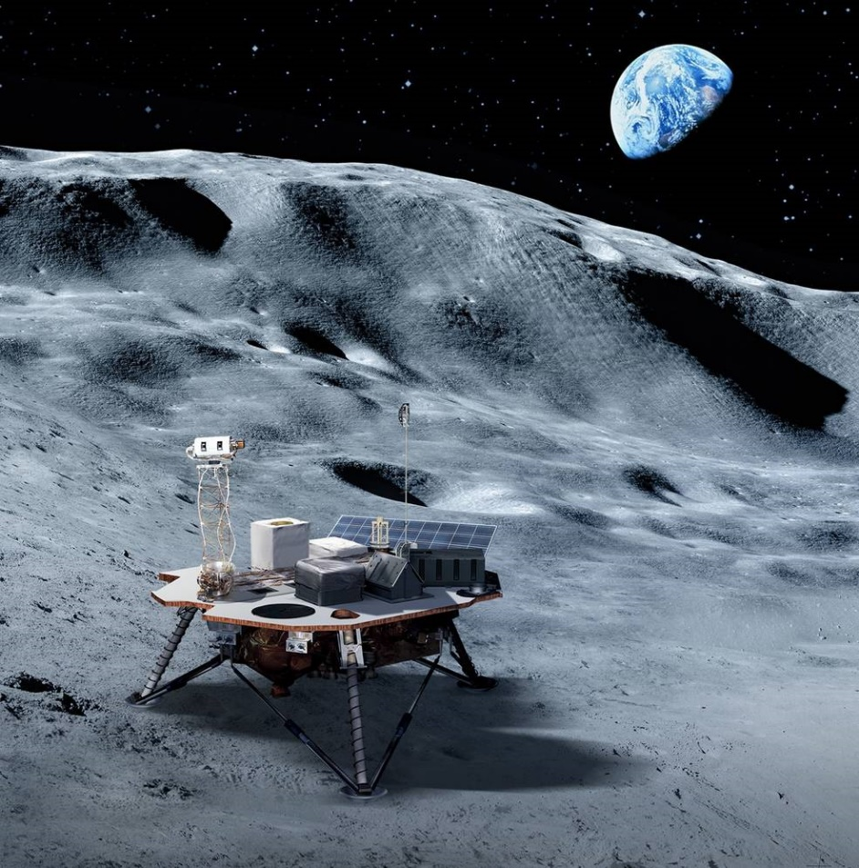
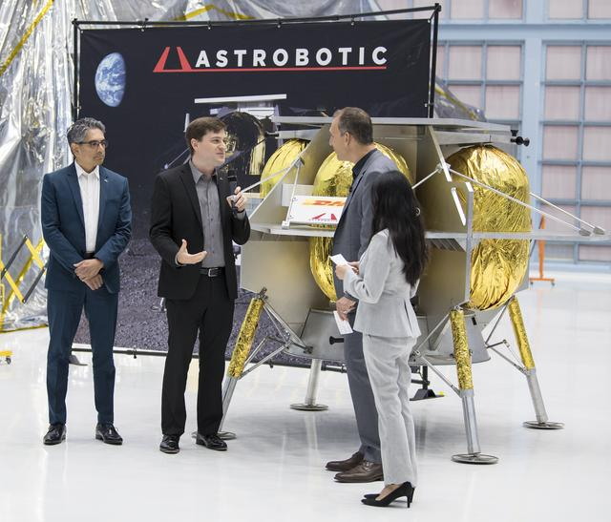
A New Approach
Beginning with a series of small commercial delivery missions, we will use new tools and technology demonstrations to conduct more science across the surface of the Moon, and exploit the resources of our nearest neighbor ahead of a human return.

Slide 5
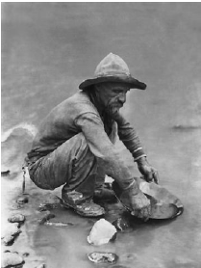
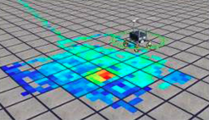
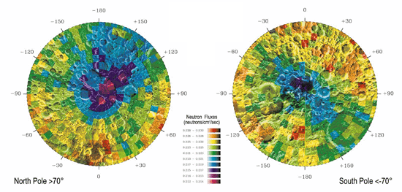
Prospecting with a New, Modern Goal
First step in mining is exploration or “prospecting”
  Need to provide strategic knowledge input to the resource potential / economics (i.e. In what environment is the ISRU potential at its maximum?)
Prospecting characterizes the location and the extent of the ore that is being sought
  Provides data for studies on the feasibility and economics to access the ore (ore = any material with potential economic or other value).
  Provides the ground truth and linkage between on-site conditions to regional remote sensing data sets.
  Test theories of emplacement and retention that will improve models, referred to industry as a “mineral model” to predict ore location and grade (concentration.)
Feldman et al., Science, 281, 1496, 1998

Slide 6
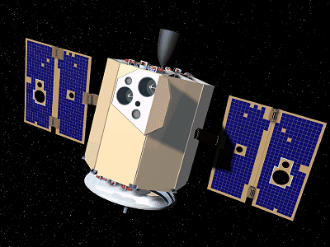
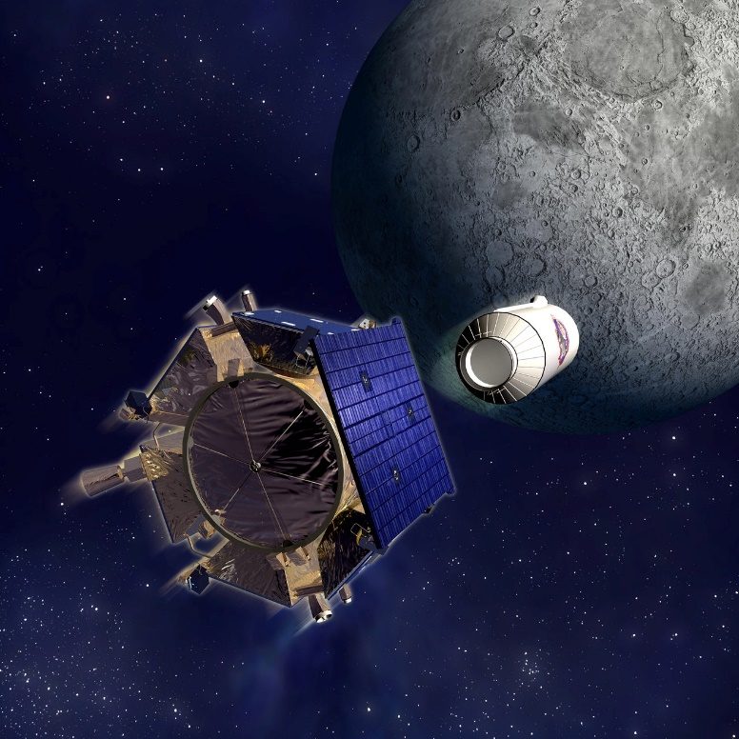
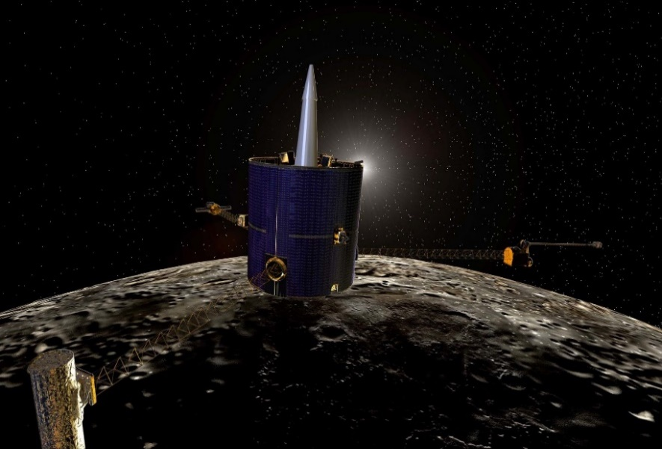
The Hunt for Lunar Volatiles
Clementine (1994):
Bi-static radar tests with Arecibo could indicate water-ice in permanently shadowed craters
Lunar Prospector (1998): Permanently-shadowed polar craters contain elevated Hydrogen levels
LCROSS/LRO (2009): There is water-ice and other volatiles in the permanently-shadowed regions
*LCROSS not only confirmed presence of water-ice in a permanently-shadowed region, but showed there may be enough to be economically viable.*

Slide 7
To be part of these new and early prospecting missions we need a tool that can:

Slide 8
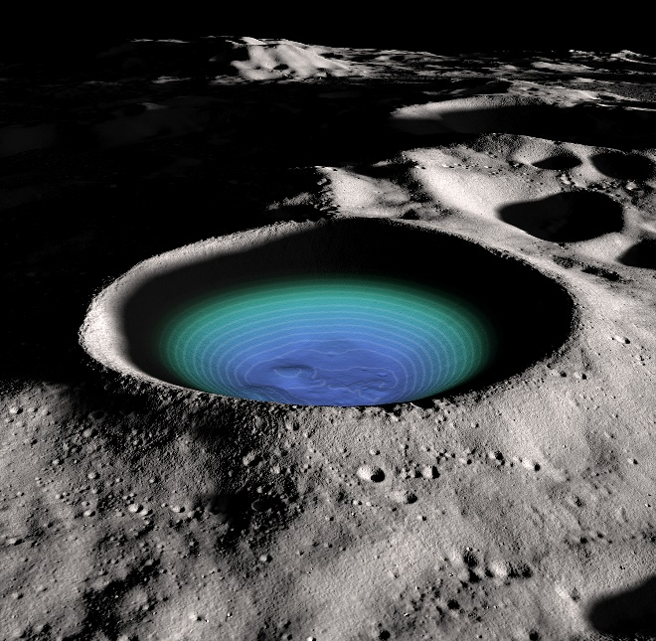
To be part of these new and early prospecting missions we need a tool that can:
Detect volatiles in the lunar surface

Slide 9
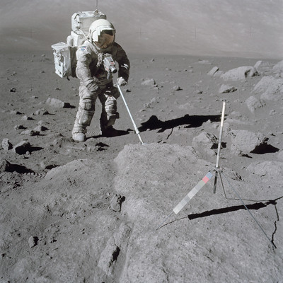
To be part of these new and early prospecting missions we need a tool that can:
Detect volatiles in the lunar surface
Work well in a vacuum environment

Slide 10
To be part of these new and early prospecting missions we need a tool that can:
Detect volatiles in the lunar surface
Work well in a vacuum environment
Have a long history of both proven analysis and reliability

Slide 11
To be part of these new and early prospecting missions we need a tool that can:
Detect volatiles in the lunar surface
Work well in a vacuum environment
Have a long history of both proven analysis and reliability
The answer?

Slide 12
To be part of these new and early prospecting missions we need a tool that can:
Detect volatiles in the lunar surface
Work well in a vacuum environment
Have a long history of both proven analysis and reliability
The answer?
Mass Spectrometry

Slide 13
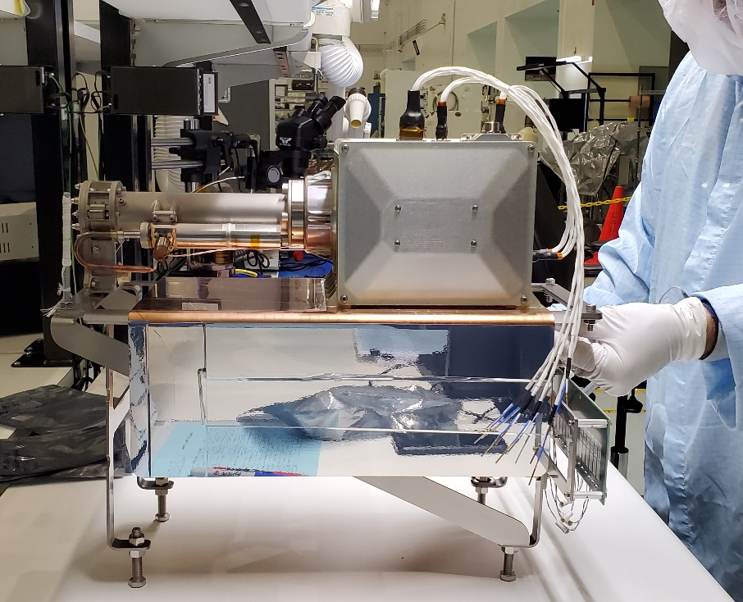
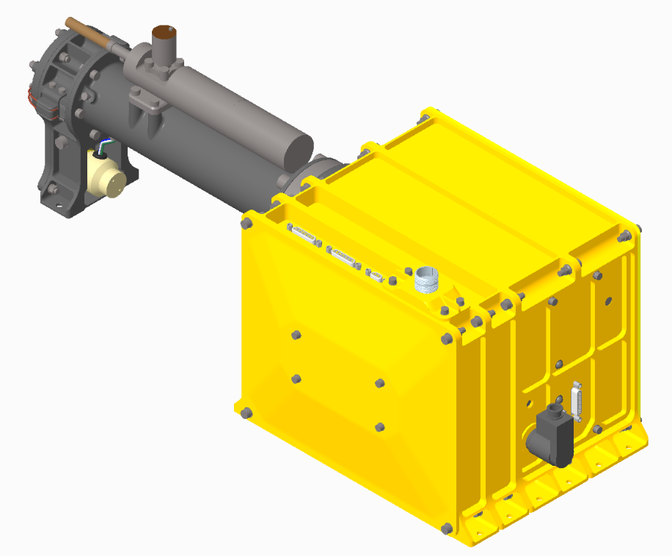
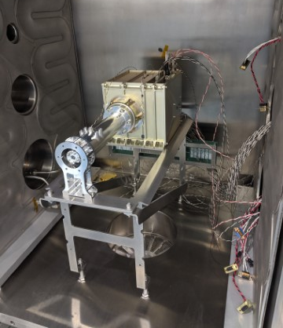


Slide 14
The objectives are simple, but the implications will be ground breaking
Objective 1: MSolo will measure within its field of view the composition of gases around the lunar lander, including those emanating from the lander itself, and any present in the lunar exosphere. This provides a baseline, lander-induced background measurement for future, more complex science missions.
Objective 2: MSolo will monitor how the local environment’s composition changes during the transition from lunar day to lunar night, allowing for a study of the lifetime and transport properties of identified compounds.

Slide 15
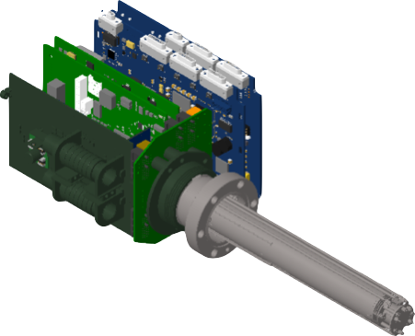
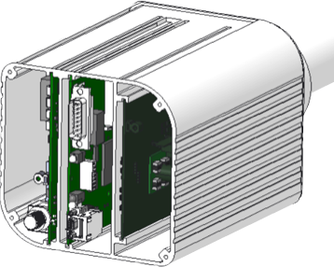
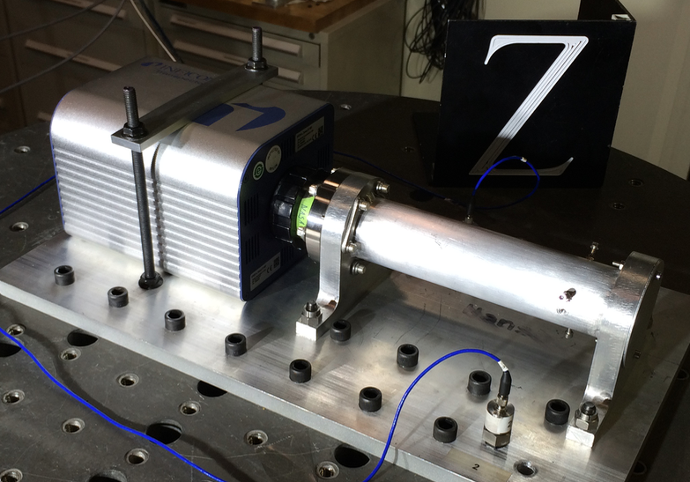
MSolo – modified COTS approach
MSolo is a modified-COTS mass spectrometer and instrument interface
Ruggedized for vibration
Improved avionics for increased de-rating and thermal margins, and increased radiation tolerance
Custom command and control software replacement for commercial interface
Commercial partnerships with KSC:
  INFICON (Syracuse, New York) – Commercially-Available Mass Spectrometer
  National Science Foundation (NSF) – SHREC (Space, High-performance, and Resilient Computing) Space Processor
  Blue Sun – Virtual Machine Language

Slide 16
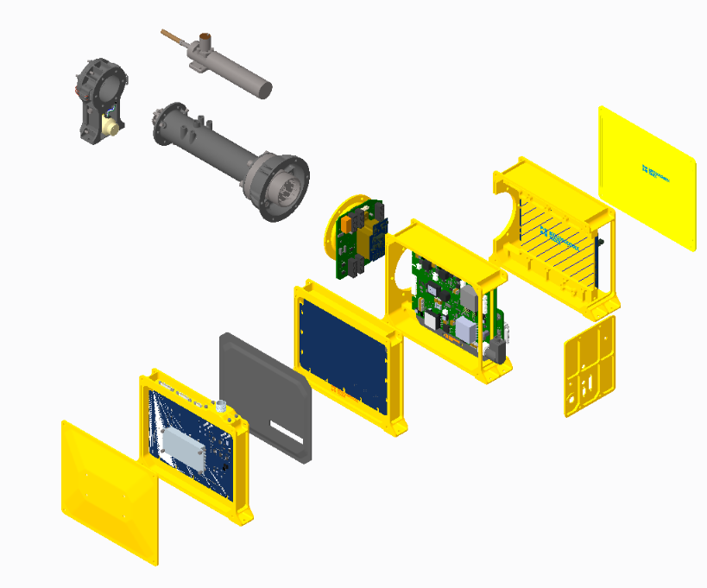
MSolo… the specs
Quadrupole mass spectrometer
Open Ion Source
Electron beam ionization - Dual Y₂O₃/Ir filaments
Faraday Cup and Electron Multiplier Detectors
Calibration Gas System
Dust cover
Chassis designed to build on instrument avionics and include spaceflight control computer (SHREC) and power board
Calibration Gas System
RF Board
Inficon MS Sensor
Motherboard
w/Electrometer
Dust Cover w/non-pyro pin puller
EMI Covers
EMI Covers
MS Power Supply (MSPS) (shown) and MS Controller card (MSC) (other side)
Space Hybrid Computer (SHC)
IIU MSolo Adapter Card (IMAC)

Slide 17
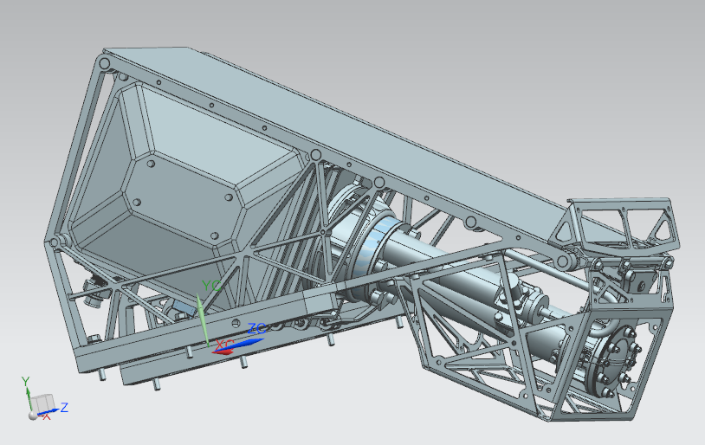
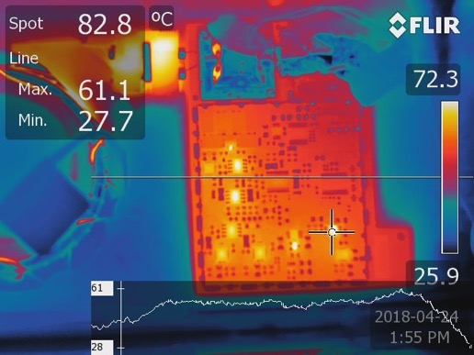
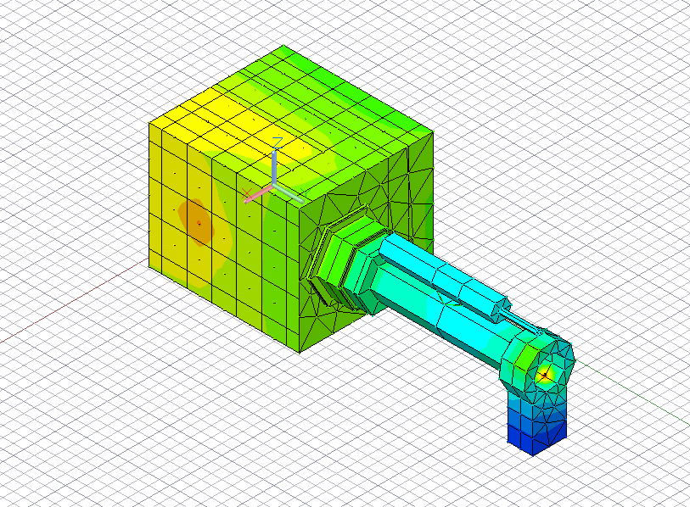
MSolo Thermal Design
MSolo is designed to implement passive methods to regulate its thermal environment
  Radiators are used to extract excess heat and radiate it to space
  MSolo must implement a thermally isolating connection to the spacecraft
    G10 Isolators are mounted to the base of each bracket and used to reduce the heat conduction to the lander mounting surface
  Multi-Layer Insulation or MLI, completely encloses the brackets (except for a small opening near the aperture) and is used to protect MSolo from undesired external thermal effects

Slide 18
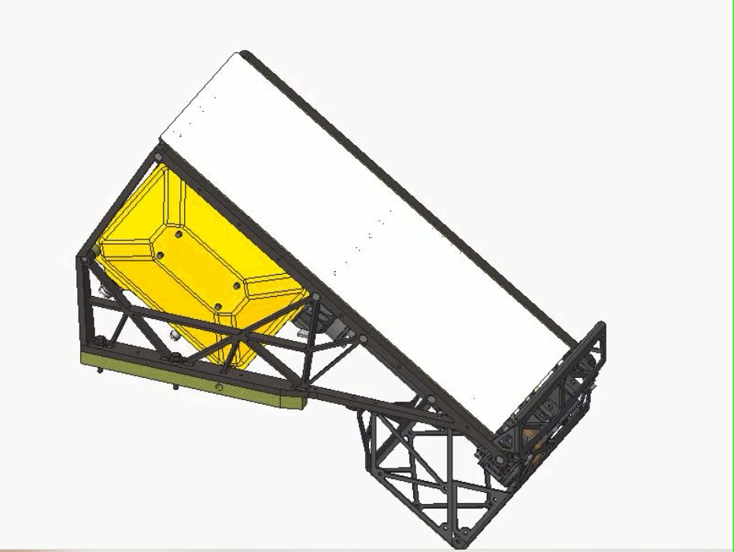
MSolo

Slide 19
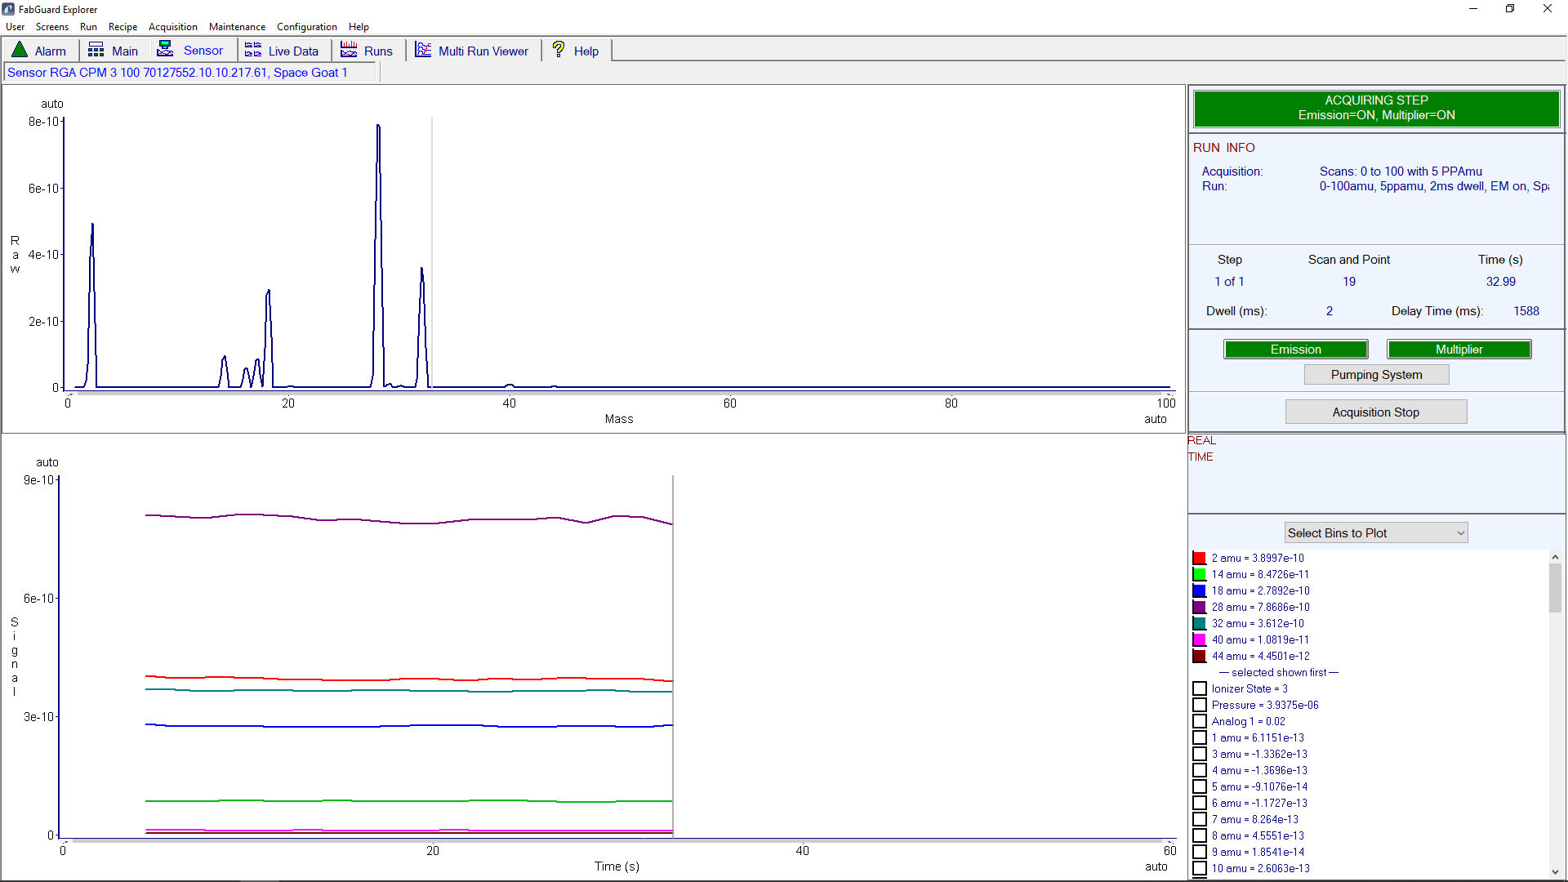
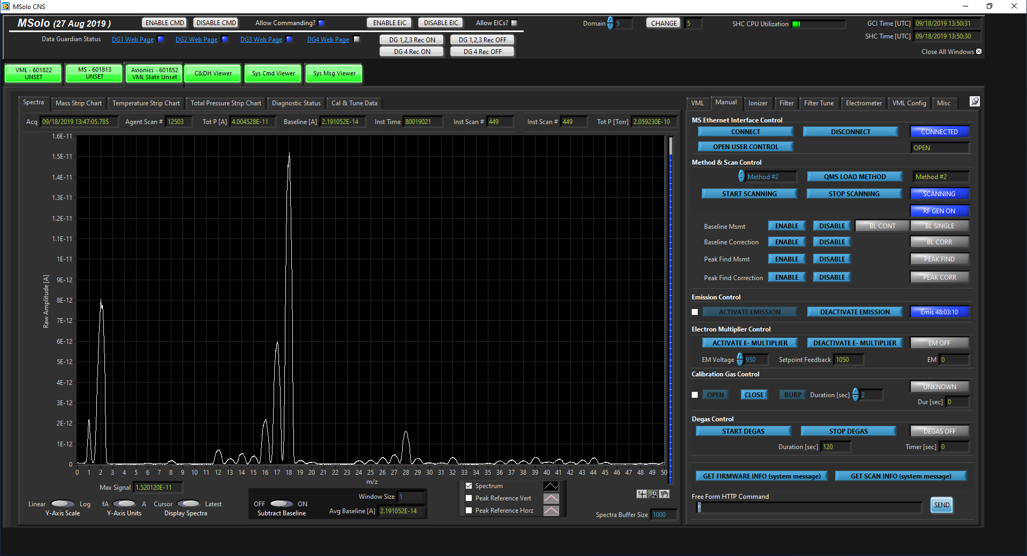
MSolo Software Design
We can’t take a windows based computer to space, so the commercial software will not be useful to us.
Software is replaced by a KSC-developed software designed for remote operations with distributed data, use of Deep Space Network, and data archiving.

Slide 20
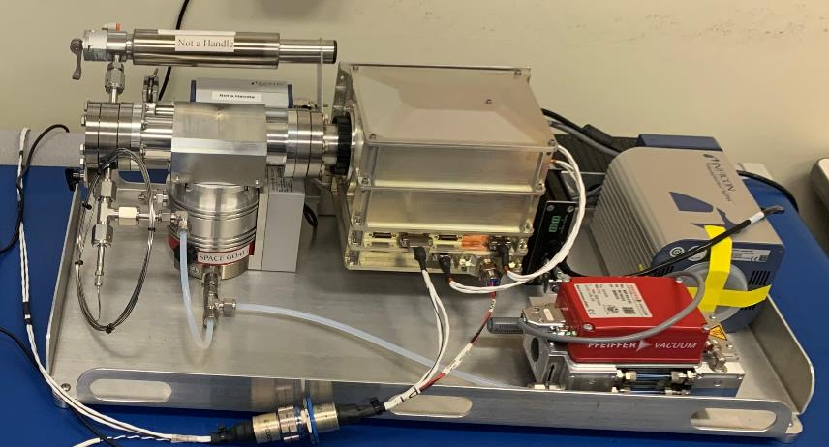
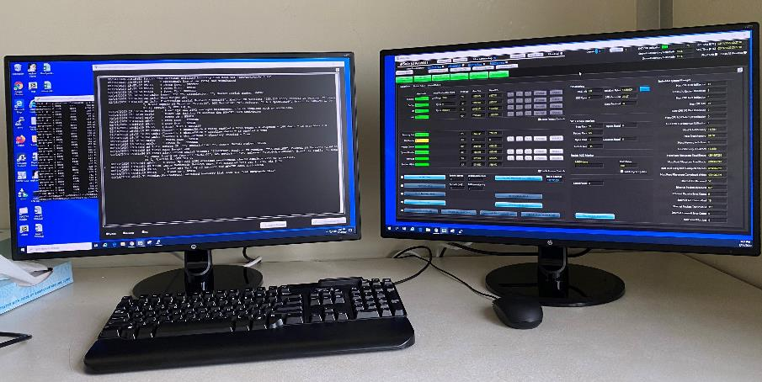
Flat Sat Test Configuration

Slide 21

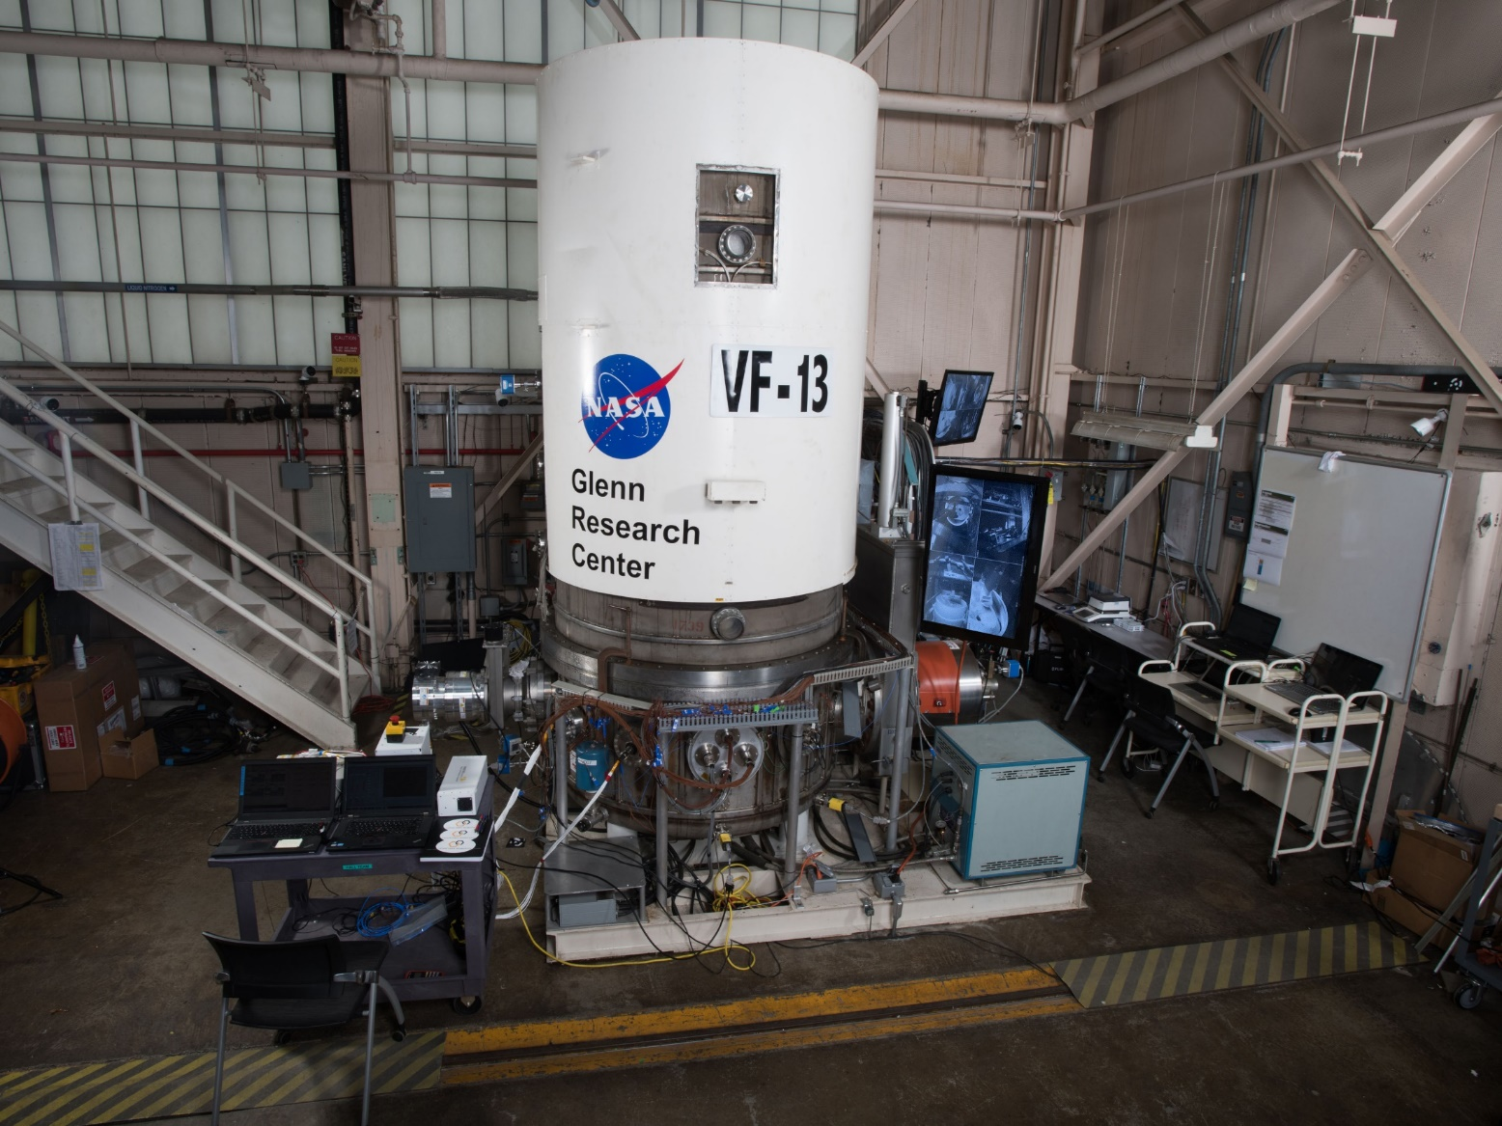
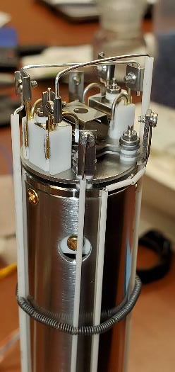
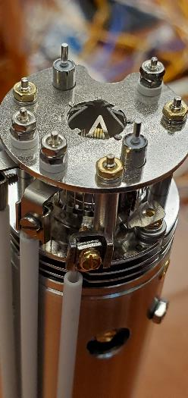
Lunar Regolith Simulant Testing
Cross Beam
Ion Source
Open Ion Source

Slide 22
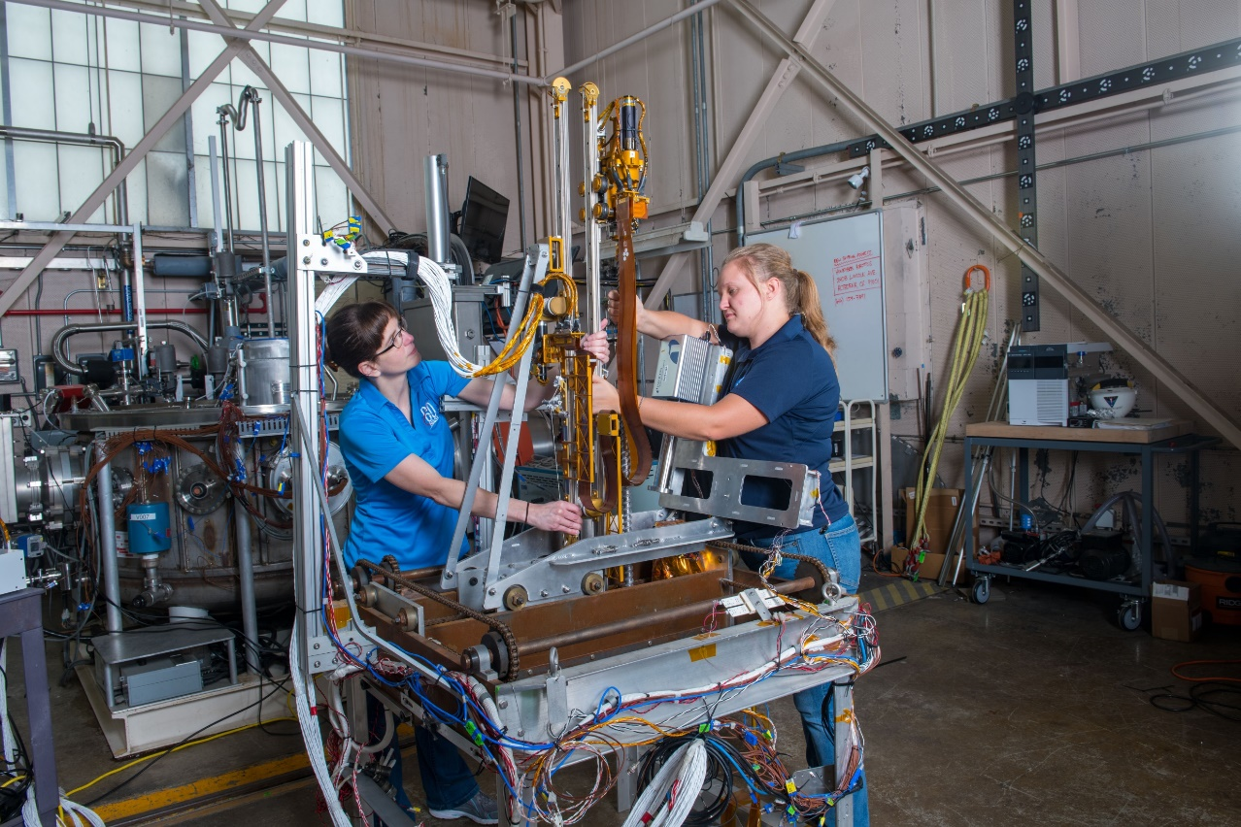
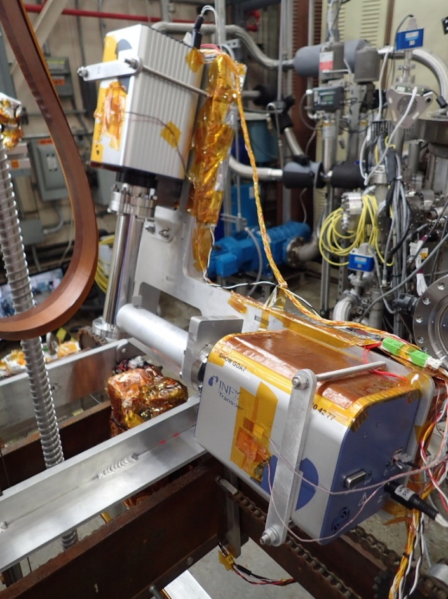
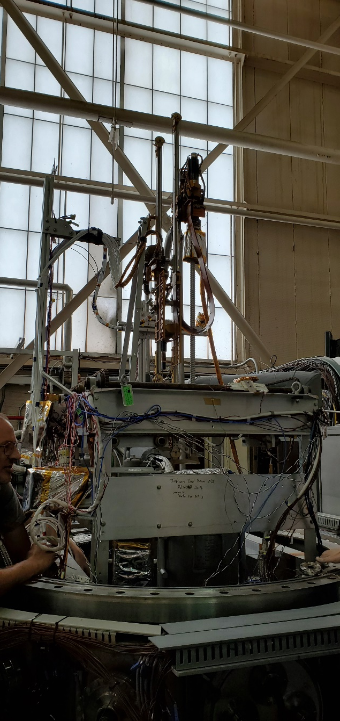
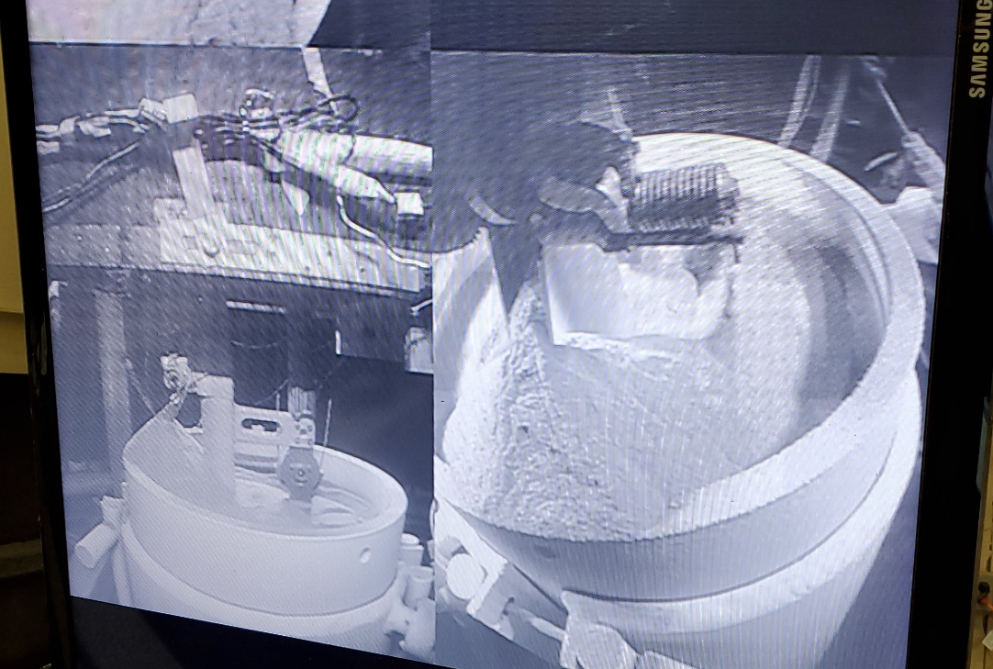

Slide 23
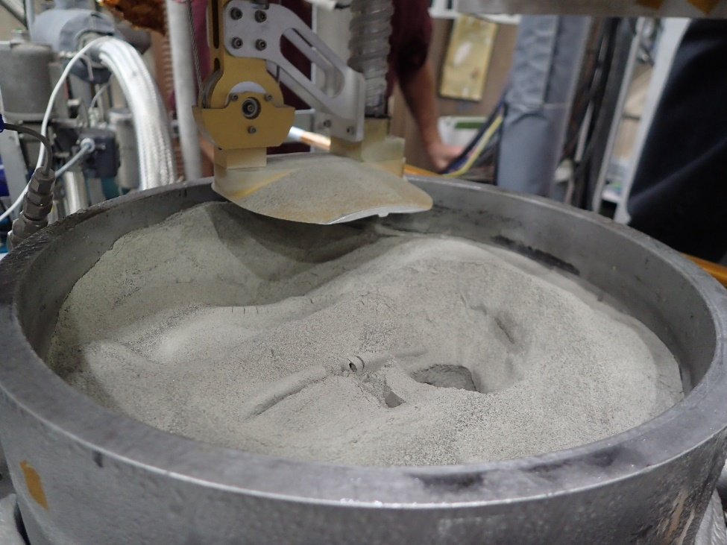
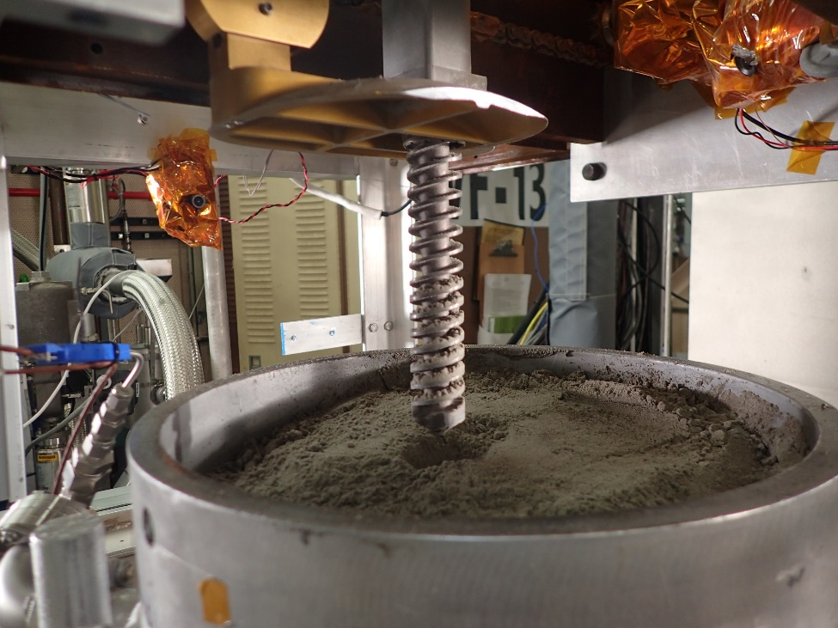
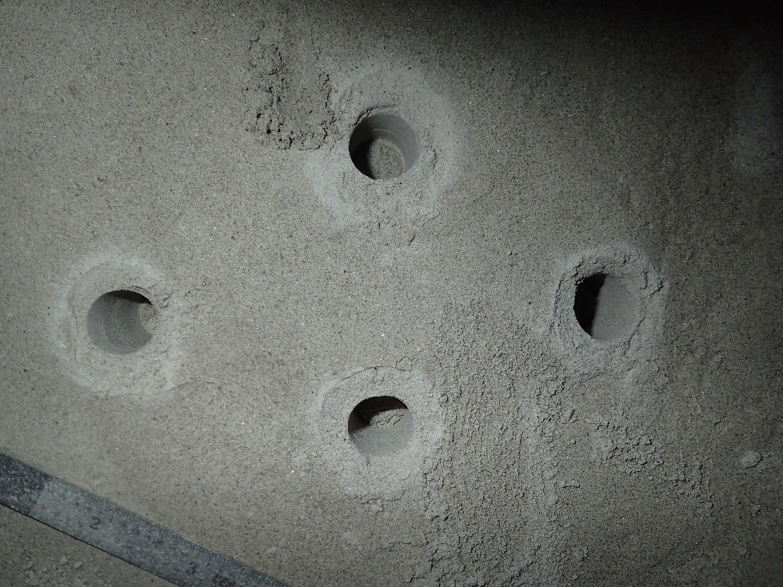
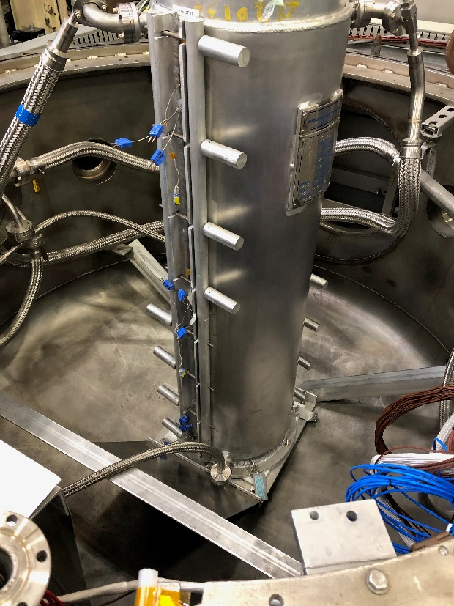
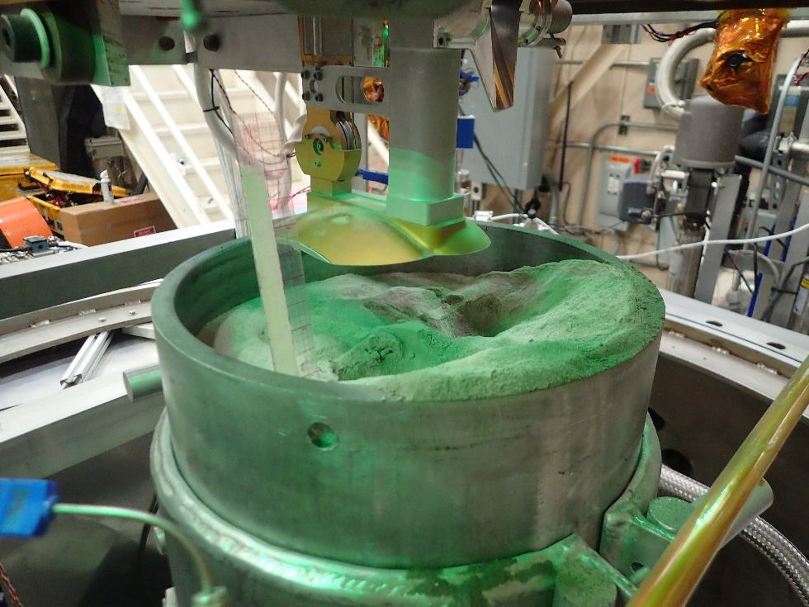

Slide 26
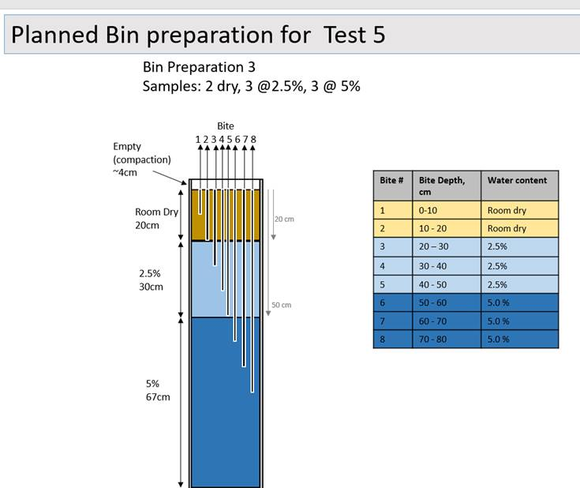

Slide 27
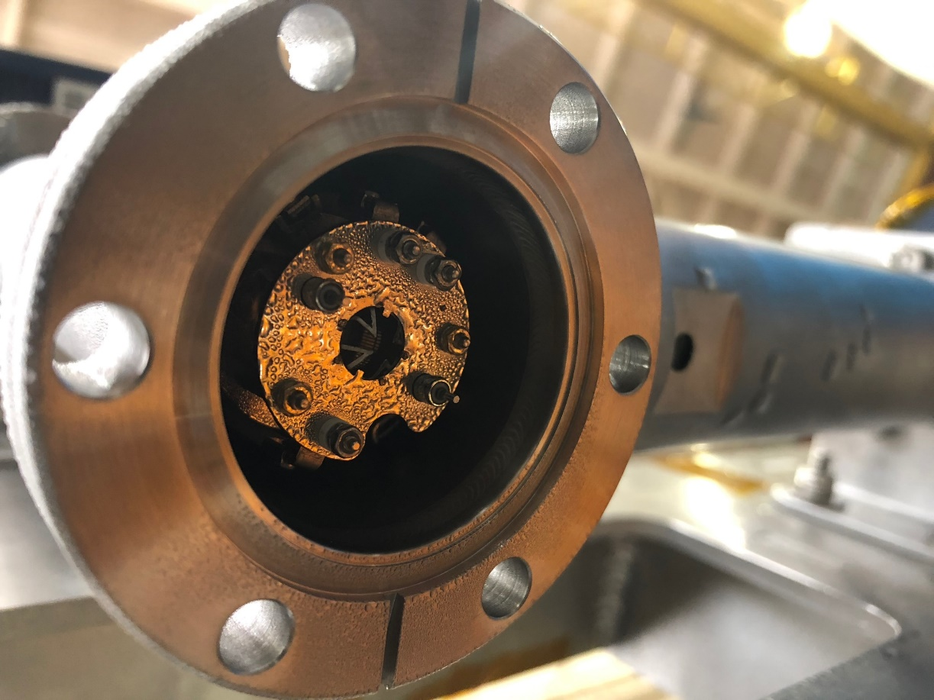
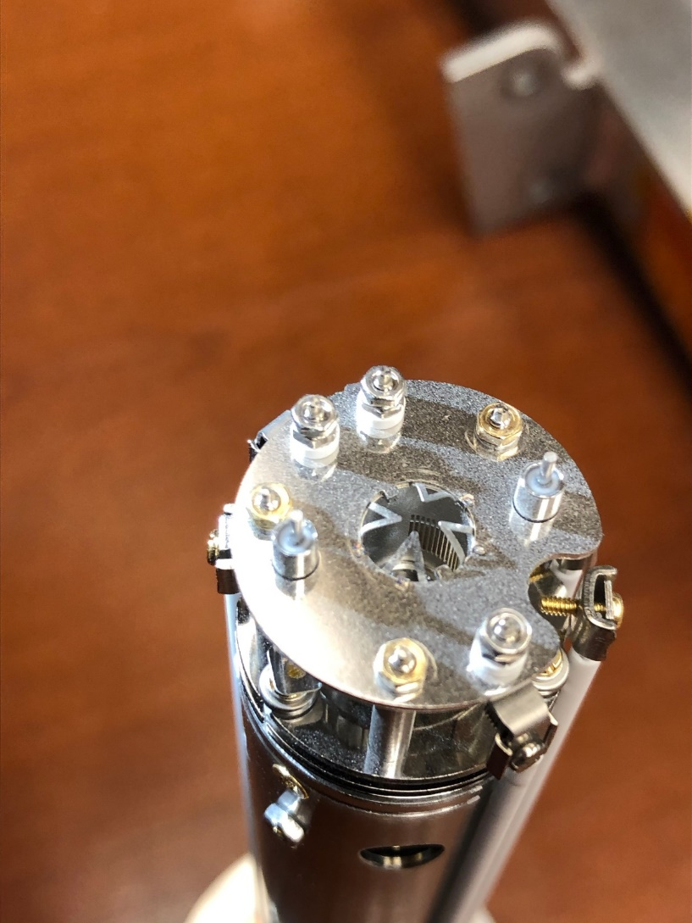
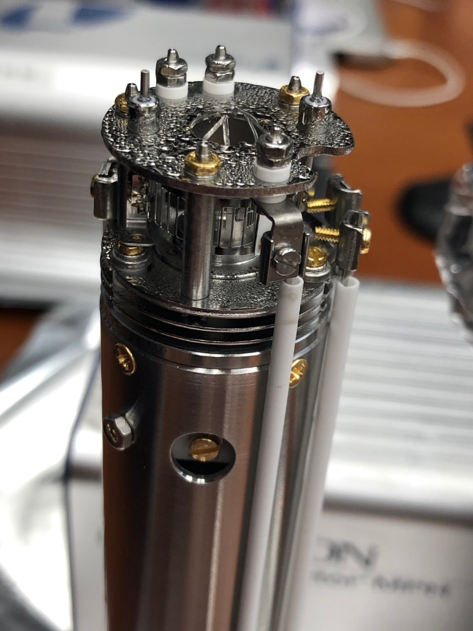
With Every Test
Comes a New Lesson

Slide 28
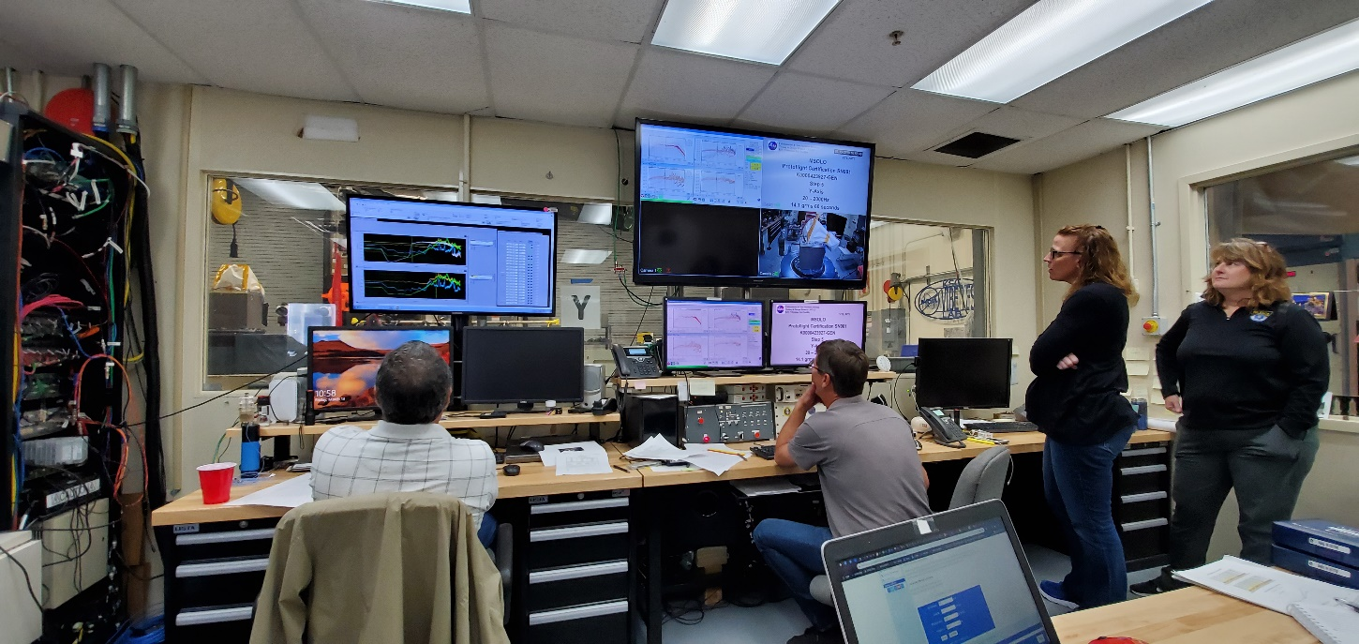
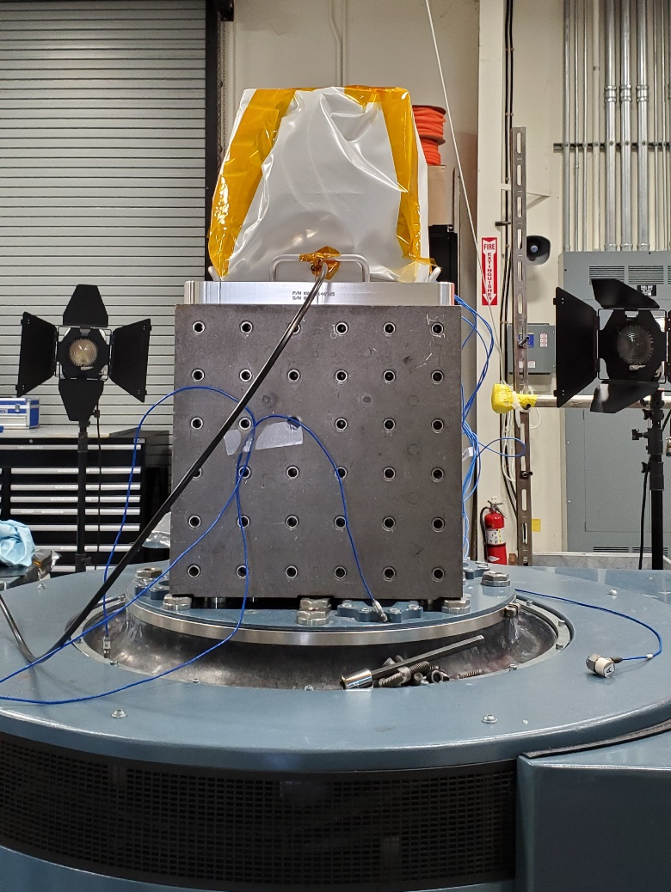


Vibration Testing

Slide 29



TVAC Testing

Slide 30



Slide 32





VIPER

Slide 33
Future Work
Currently, the AB lander is scheduled to launch in 2021 on the new ULA Vulcan Rocket
Data processing, what is there?
Improvements of avionics components on MSolo for future missions.
Software improvements (telemetry, firmware, user interfaces).
Test models for quantification of water and other volatiles on lunar surface.
Get ready for other CLPS missions, PRIME, and VIPER
Before that, the last mass spec on the surface of the moon happened during the Apollo 17 mission!

Slide 34







Life After Grad School

Slide 35




NASA Called

Slide 36





Ad Astra Per Aspera

