Slide 1

Ensuring that airspace system is ready when aircraft are ready
Ensuring that the airspace system is ready when aircraft are ready.

Slide 2


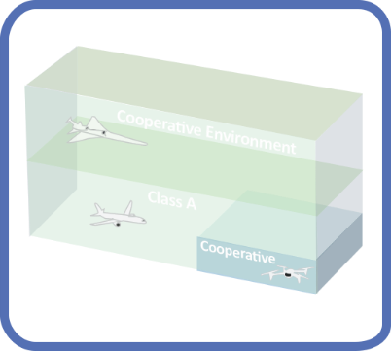
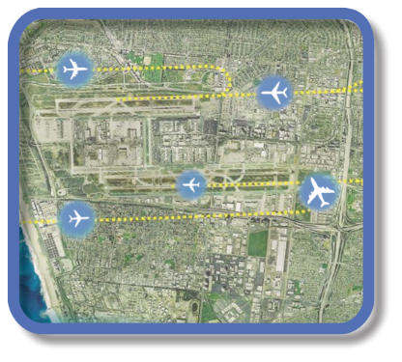

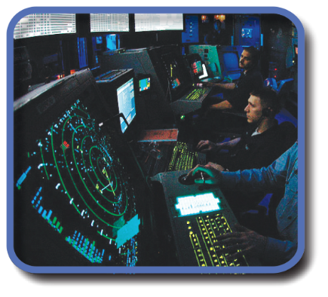
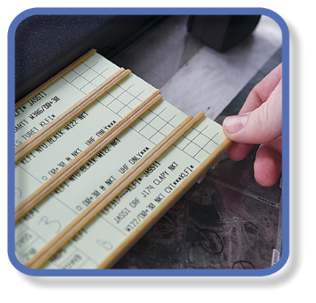




Evolution of Airspace Operations and Safety
+ Complexity, scalability,
and dynamic adaptation
+ Service oriented
architecture for
tailored mission
oriented services
+ Efficiency and
proactive planning
+Density
Safety
S-curves
Highly-Automated
ML/AI – based dynamic, robust
performance and safety
Trajectory
Know & exchange
current and planned a/c positions
Collaborative
Connected,
performance-based,
collaborative ATM
Radar
Know the current and estimate planned a/c positions
Machine-to-machine
interactions and humans collaborate
Procedural
Estimate the current and planned a/c positions
Introduces 3rd-party
service providers
Digital Transformation of ATM
Human-centered safety monitoring, assessment and mitigation
Automated in-time safety
monitoring and alerting services
Integrated predictive risk
mitigation across domains
Automatically-assured adaptive
in-time safety threat management
Human-centered safety monitoring, assessment and mitigation
Epoch 1
Epoch 2
Epoch 3
Epoch 4
(~2035)
Epoch 5
(~2045)

