Slide 1



Challenges and
Opportunities for Aero Supply Chain
(Initial focus: AAM)
Aerospace Supply Chain
Parimal Kopardekar, PhD (PK)
Director, NASA Aeronautics Research Institute (NARI)
Parimal.H.Kopardekar@nasa.gov

Slide 2
Basic Statistics on Manufacturing
Boeing and Airbus: 1600+/year
General Aviation: ~2000
(piston, turboprop, business jets)
Rotocraft: ~1020
Cars: 70M (OICA, 2018)
Cars in US: 2.8M

Slide 3

Supply chain impacts the entire life cycle—from early conceptual design to high volume manufacturing
All types of aircraft in all phases – design to final production
Maintenance, repair, and overhaul
Ability to prototype quickly and scale up at maturity
Initial Focus on VTOL and small UAS

Slide 4
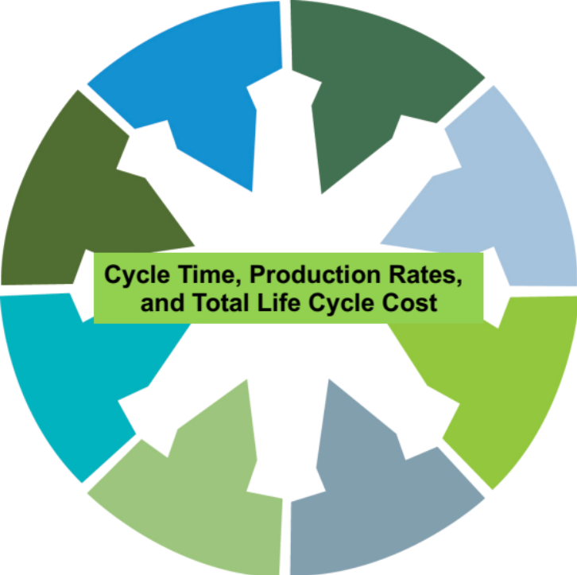
Needs
Many calls, texts, and interactions about looking for suppliers and manufacturers
- Over-molding
- Actuators
- Electric motors
- Propellers
- Casting
- Auxiliary power units
- Printed circuit boards
- Composites
- Many other components
Need suppliers for entire life cycle: Design to high volume manufacturing

Slide 5
Known Aero Supply Chain Related Issues
(California Manufacturing Network, 2018)
> Sourcing of raw materials – aluminum, steel, copper, etc., and
> Very few suppliers for many components
> Mitigating supply disruption risks (e.g., geopolitical considerations)
> Coping with modernization and emerging technologies (e.g., wiring problems, software issues, late deliveries of lavatories)
> Shortage of skilled workers (Tim Cook’s view on outsourcing)

Slide 6



NARI and Agility Prime Collaboration
Build Supply Chain:
- Drones and
- Vertical Take-off and Landing (VTOL)
Build an electronic exchange platform to connect OEMs, suppliers, and others
- Mapping of entire ecosystem
Train workforce: curriculum, skills, and entrepreneurs
Build modeling and simulation capability to assess supply chain preparedness: gaps, resiliency, scale, and cycle time
Build a tier system of supply chain all the way to the raw material

Slide 7

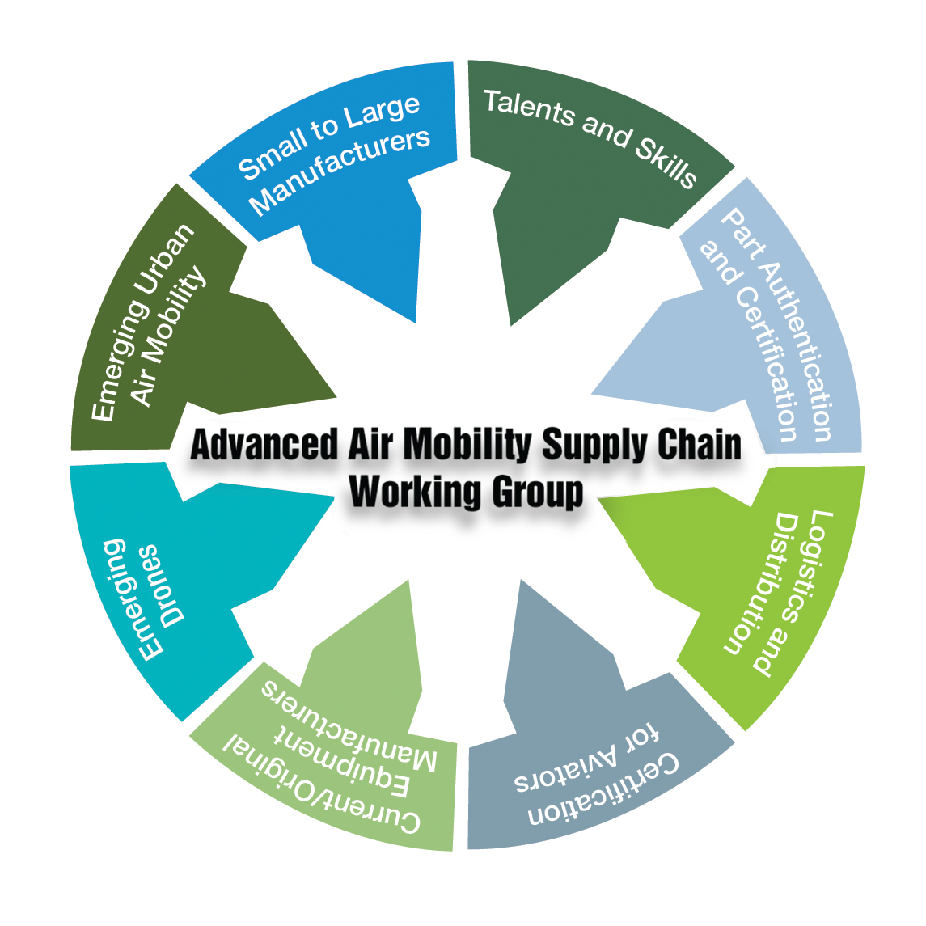
Join NASA’s AAM Supply Chain Working Group!
Workgroup meets every month
To register and learn more, visit our webpage:
https://nari.arc.nasa.gov/aamsupplychain
Feedback: arc-cal-nari@mail.nasa.gov
Parimal.H.Kopardekar@nasa.gov

Slide 8
Questions

Slide 9
Supply Chain Basics
Supply chain consists of all parties involved, directly or indirectly, in fulfilling a customer need
Aerospace supply chain is an ecosystem of different supplier tiers
Includes manufacturers, suppliers, transporters, warehouses, etc.
Supply chain management refers to coordination of all activities

Slide 10
Challenges
Castings and forging
Composites
Auxiliary Power Units
Printed Circuit Boards
Actuators
Software
High volume manufacturing and assembly methods
Many others
Cycle Time, Production Rates,
and Total Life Cycle Cost

