Slide 1


Challenges of Returning Geological Samples from Mars
Angie Jackman, MAV Project Manager
Isabeta Rountree, MAV MBSE
NASA/MSFC

Slide 2
Agenda
What is the Sample Return Mission
Vehicle Design Process
Mission Concept of Operations
Why is Mars hard?
MAV Mission and Vehicle Concepts
MAV trade studies
MAV Model Based Systems Engineering

Slide 3

Sample Return Mission Overview

Slide 4
Landing Site – Jezero Crater
Jezero Crater: Wet and Dry and Wet Again

Slide 5
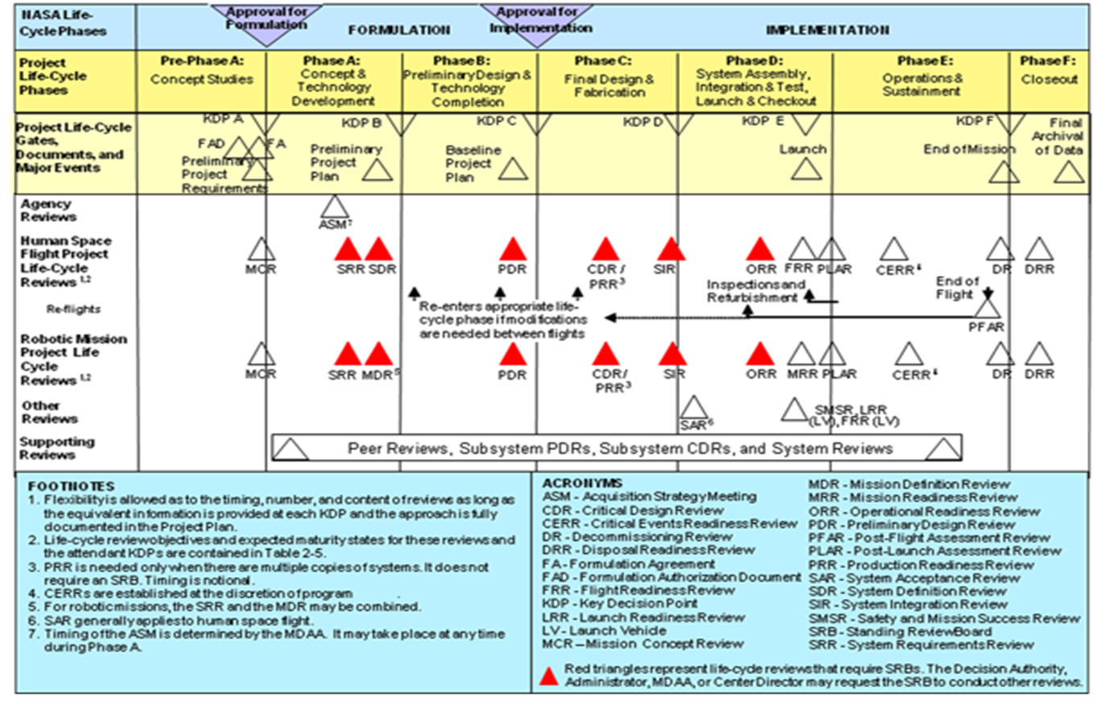
NASA Design/Review Process
Space Flight Project Life Cycle, NPR7120.5

Slide 6
Collaborative Design Process
Mission
Definition
Vehicle
Definition
Systems Engineering
Preliminary Mission Analysis
Mission
Analysis
Con-Ops Definition
Mission Trade Space Definition
Initial Con-Ops
(Mission Profiles)
Requirements Definition
Vehicle Trade Space Definition
GR&A
Definition
Interface
Definition
Preliminary GR&A Definition
Subsystem Trades
Risk Management
Mission Concept Definition
Vehicle Concept Definition
System Concept Definition

Slide 7
Formulation Design Process
GR&A
Mission Analysis
Physical constraints
Configuration
Performance/Trajectory
Requirements
Animation
Margin Strategy
Maneuver
Prop
Propulsion
Eclipse Periods
Beta Angle
Launch Loads
Comm Coverage
MPS & RCS Mass
Avionics
Valve & Control Power
Avionics Mass
Slew Rates
Avionics Power
Tank Geometry & Propellant Conditioning
Tank Insulation Mass
Mass Properties
Vehicle Power
Power
MPS Tank Mass
Power Sys Mass
Heat Rejection
TCS Power
Thermal
TCS Mass
Material Properties
Structures
Factors of Safety
Structure Mass

Slide 8


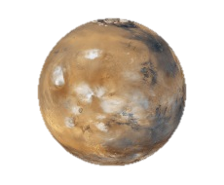
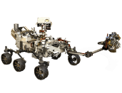
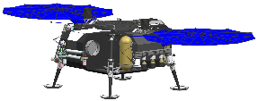

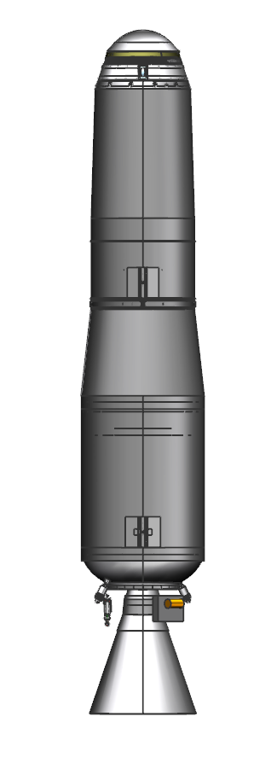




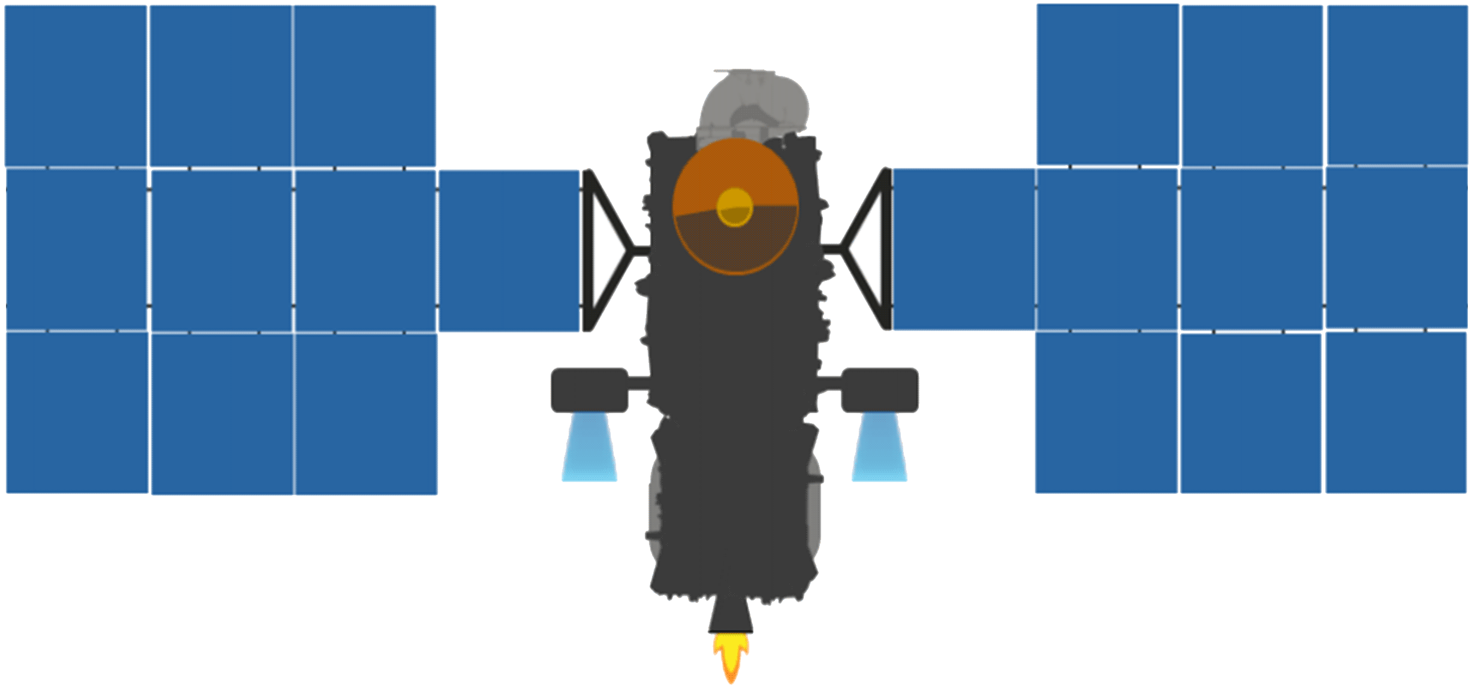





MSR Architectural Overview
Smoke and Fire
Mars
Mars 2020
Tube Delivery
SRL
Mars Ascent
Vehicle
Tube Retrieval
Sample Fetch Rover
Tube Collection & Depot
Orbiting Sample
ERO with Capture, Containment and Return System payload
Retrieve OS
Break-the-Chain
Avoid Earth
Earth Entry Vehicle
Earth
Earth Return Orbiter (ERO)
Sample Retrieval Lander (SRL)

Slide 9
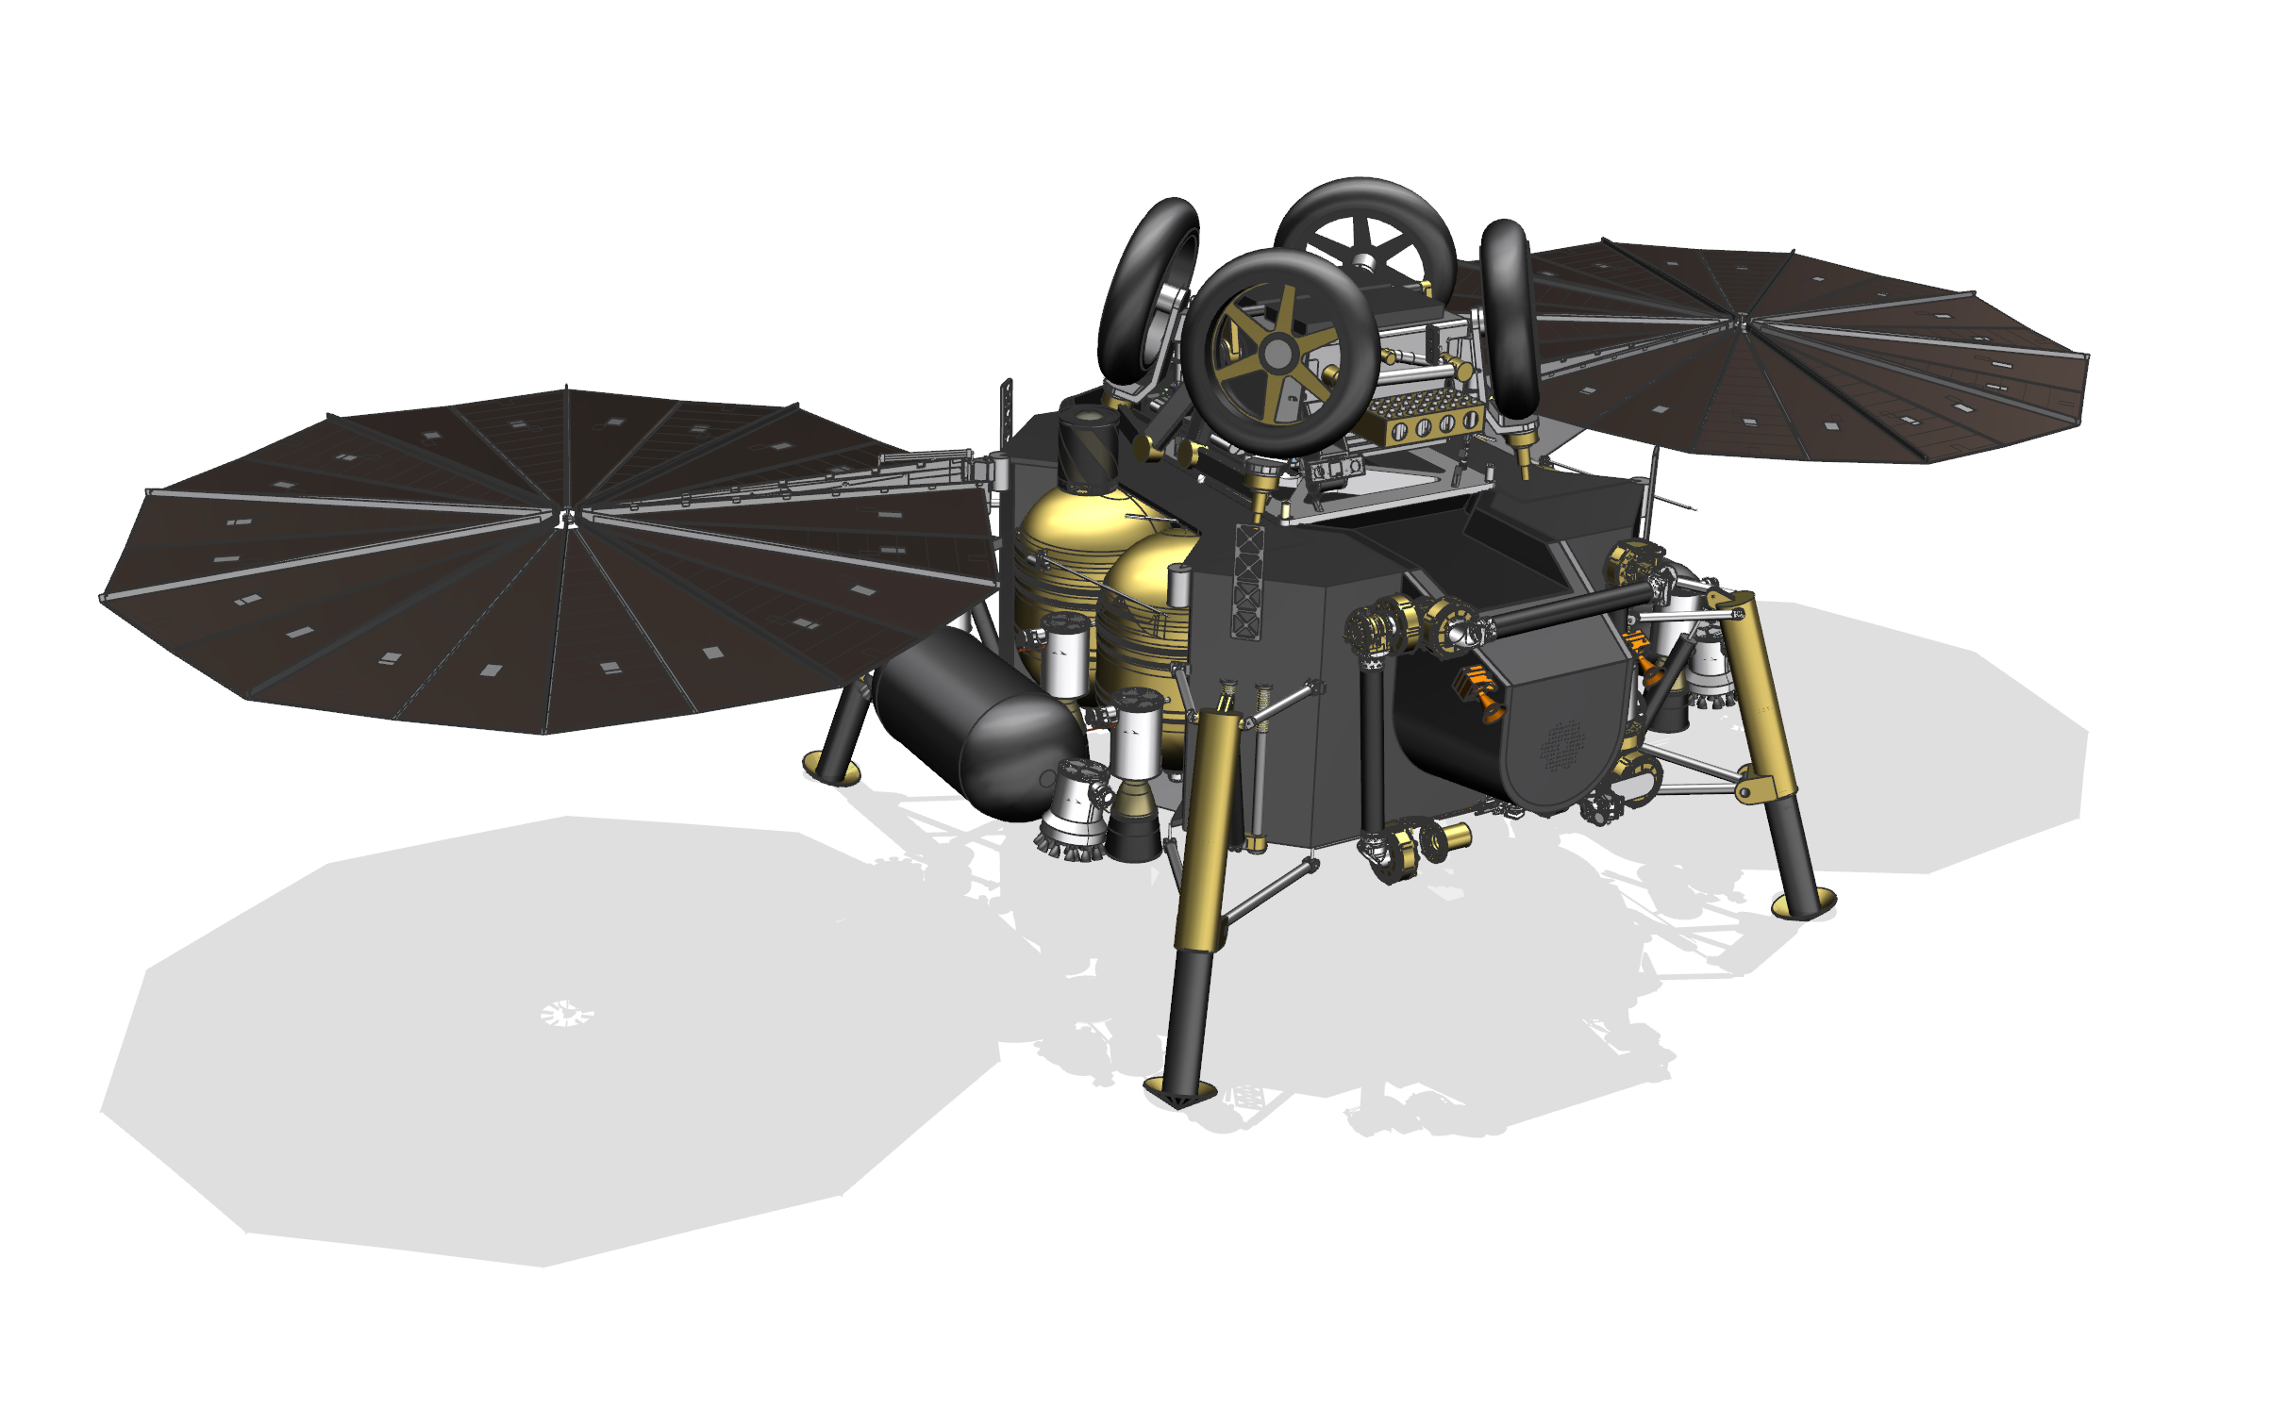
What is MAV?
MAV Mission Objectives:
  Payload inside the Sample Retrieval Lander (SRL)
  Insert the Orbiting Sample (OS) to Mars Orbit
  Command OS ejection into orbit for rendezvous with Earth Return Orbiter (ERO)
MAV mission timeline:
  SRL delivery expected April 2025
  MAV Flight Model delivery expected April 2026
  Launch from Earth in 2026
  Arrive on Mars surface in 2028
  Launch from Mars in 2029
  Return of Martian samples to Earth in 2031
ERO
Rover
STA
MAV
Notes:
MAV Payload Assembly – MPA – contains the OS

Slide 10
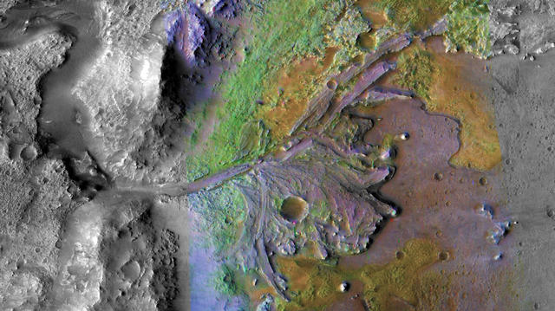
Why is Mars hard?
Remote
Temperature
Atmosphere
Radiation
Dust
Remote
Temperature
Atmosphere
Radiation
Dust
Jezero Crater: Wet and Dry and Wet Again

Slide 11
MAV Functions
Reside on Lander
  Transit time to Mars ~ 9 months
  Storage time on Mars ~ 9 months
Do not contaminate the planet
Receive sample tubes from Rover into Orbiting Sample (OS)
Launch OS with sample tubes from lander platform to Mars orbit
Release OS with sample tubes
Dispose vehicle
Reside on Lander
  Transit time to Mars ~ 9 months
  Storage time on Mars ~ 9 months
Do not contaminate the planet
Receive sample tubes from Rover into Orbiting Sample (OS)
Launch OS with sample tubes from lander platform to Mars orbit
Release OS with sample tubes
Dispose vehicle
Columbia Hills, Gusev Crater: Home to Mars Rover Spirit
Notes:
17

Slide 12
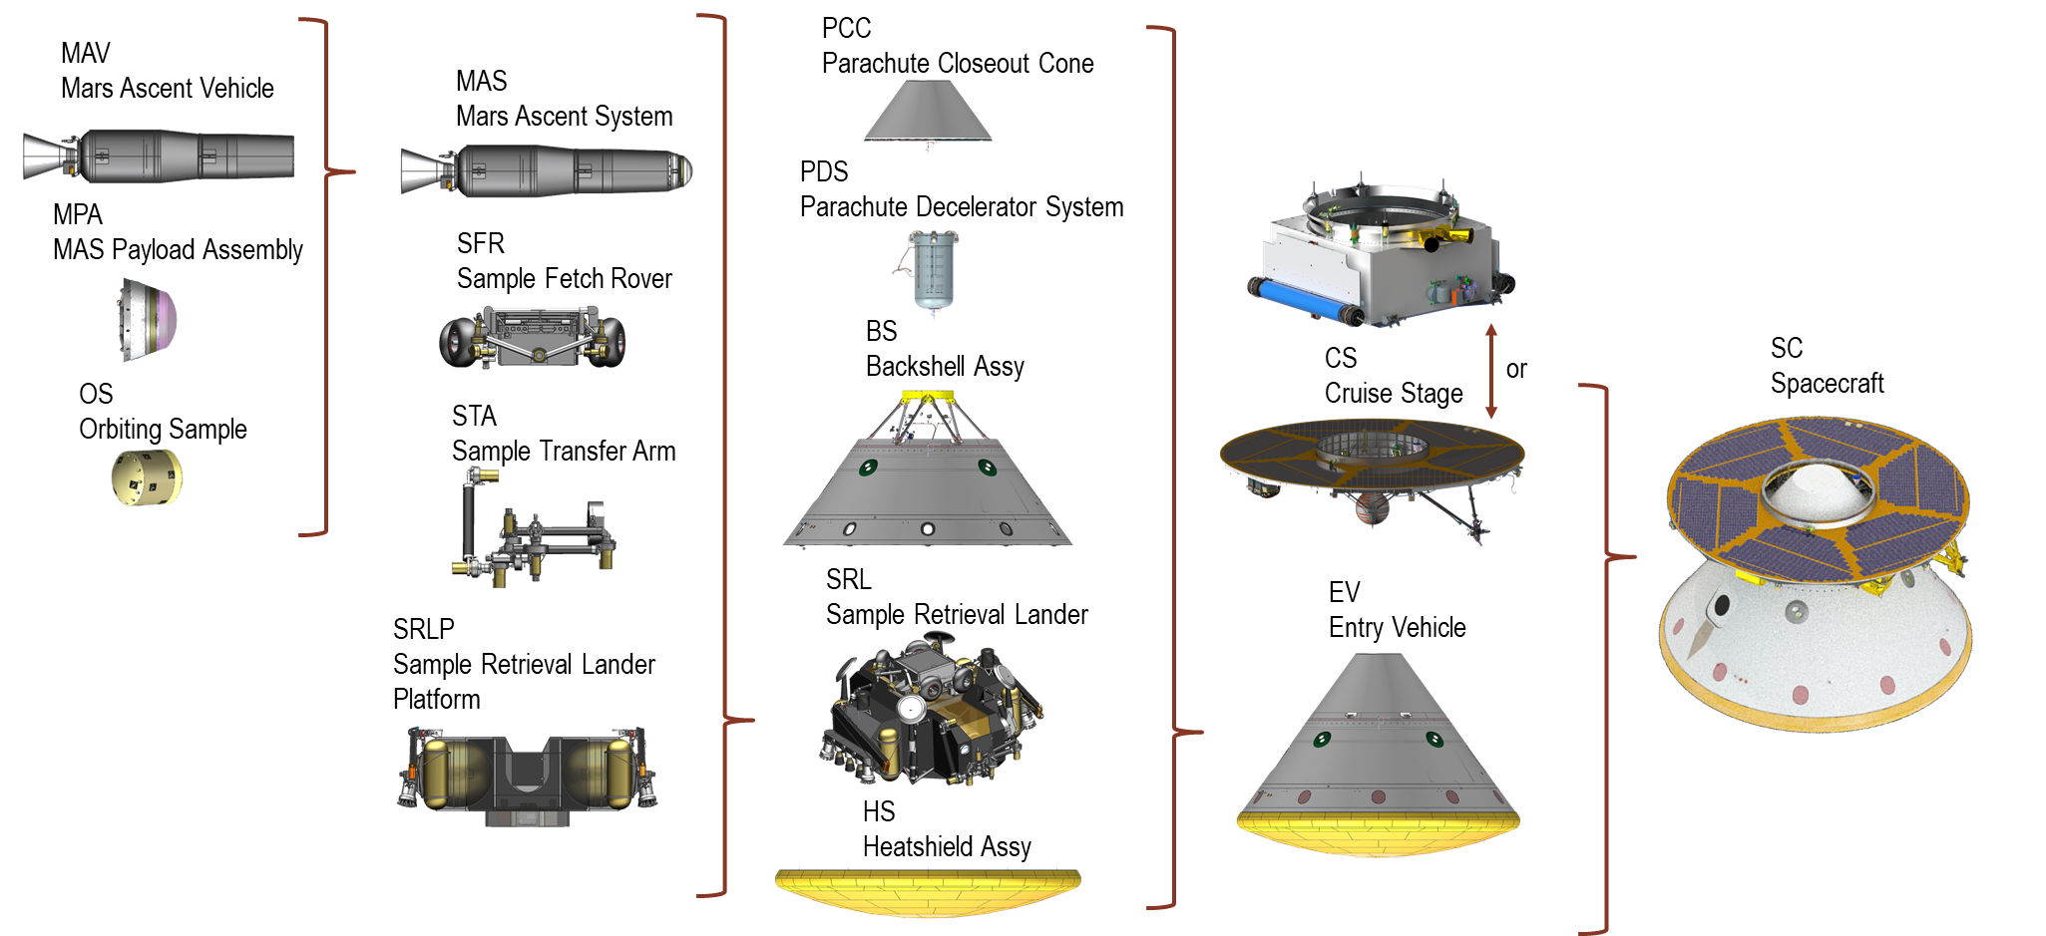
Sample Retrieval Lander Components
SRL Comparison to Mars 2020/Perseverance
No science payloads
Precision landing (from M2020) simplifies landing site requirements
Stationary (SFR is contributed)
Simpler operations activities (more similar to InSight)

Slide 13
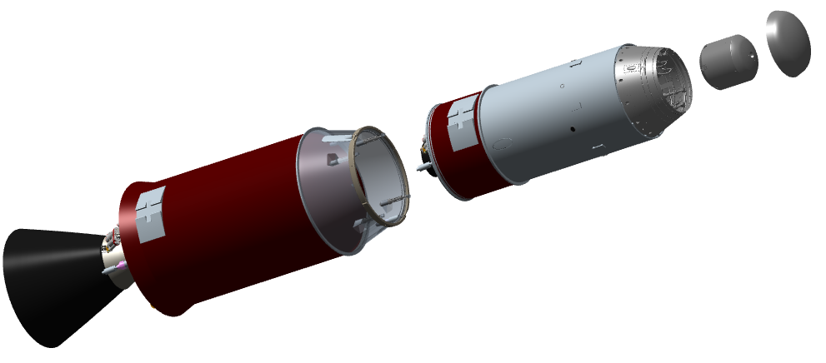
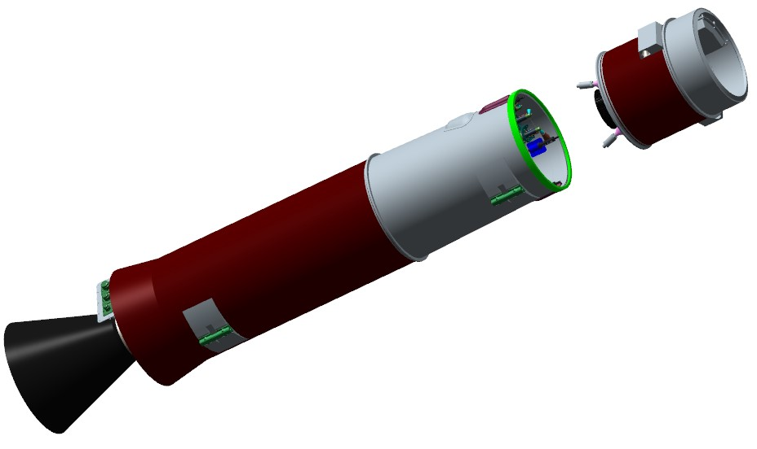
MAV SSGG/SSGU Physical Architecture
SSGG Architecture:
  Two-stage (guided, unguided) solid motor vehicle
  Pyrotechnic stage separation
  Electrical-mechanical Thrust Vector Control (TVC) on 1st stage & 2nd stage
  Monopropellant Reaction Control System (RCS) with orbital trim capability
MAV Payload Assembly (MPA) - JPL
  Ejectable fairing
  Orbital Sample (OS)
SSGU Architecture:
  Two-stage (guided, guided) solid motor vehicle
  Pyrotechnic stage separation
  Electrical-mechanical Thrust Vector Control (TVC) on 1st stage
  2x Spin Motors and 2x De-spin motors on 2nd stage, enabling spin stabilization
RCS/Avionics
OS
MPA
Fairing
SSGG
RCS/Avionics
MPA
2nd Stage
SSGU
1st Stage
Notes:
Talk about moved Avionics to 1st stage to reduce up mass

Slide 14


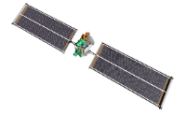


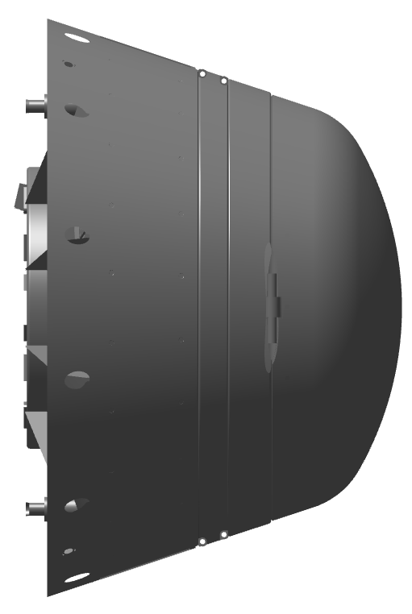







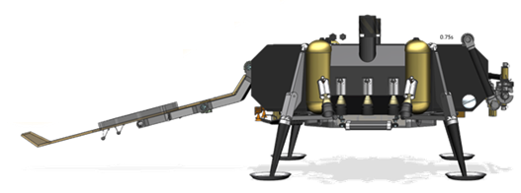
MAV Concept of Operations
Ascent Mission Operations Overview
3
4
5
6
2
SSGU
SSGG
Phase | SSGG | SSGU
1 | Launch and 1st Burn to MECO
2 | Coast, MPA Fairing Sep, Staging | Coast, MPA Fairing Sep
3 | 2nd Burn to SECO | Staging, Spin-up, 2nd burn to SECO
4 | Orbit Trim Burn | Spin-down
5 | OS Payload Delivery to Orbit
6 | OS/ERO Capture
1
Notes:
1:
VECTOR launch*
1st stage SRM 1 burn
Max Q at ~T+20-50s
SRM 1 burnout
OLG until ~T+50, then CLG until aero null
2:
Depart sensible atmosphere
RCS attitude hold until staging.
Load second burn targets.
Orient vehicle for 1st stage and MPA fairing separation
Timing based separation of 1st stage and MPA fairing
Reorient vehicle prior to burn 2
Activate TVC 2
3:
2nd stage SRM 2 burn
Ignition time driven by energy management
Periapsis raise
CLG employed
SRM 2 burnout
4:
Post-2nd burnout transients wait
Attitude hold
Load OTT burn targets
2nd stage OTT burn
CLG employed to correct OTT errors
OTT cut-off, based upon SMA error
5:
Orient vehicle for OS release
MAV transmit final IMU state
MAV enable telemetry beacon

Slide 15
MAV Model Based Systems Engineering
Notes:
17

Slide 16
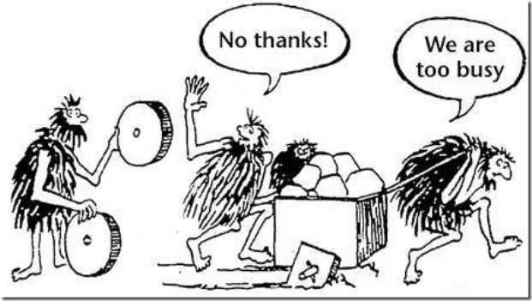
Industrial & Systems Engineering
What is an ISE?
“Industrial and systems engineers design and improve processes to make work safer, faster, easier and more rewarding… industrial and systems engineers face the challenge and common goal of saving money and increasing efficiency. By using the right combinations of human and natural resources, fabricated structures, information technologies and manufactured equipment, industrial and systems engineers look at the big picture of what makes organizations work best.” Adapted from the AU ISE Fact Sheet
The how & why of what needs to be done.
http://job-mentor.com/wp-content/uploads/2016/06/hard-work-5.jpg

Slide 17
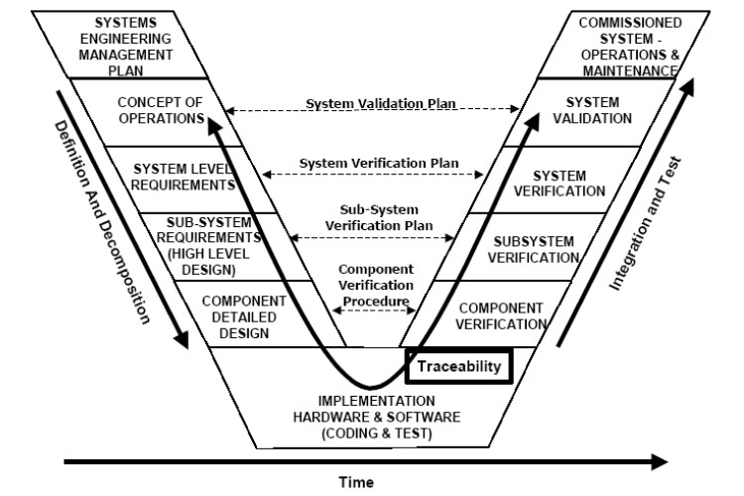
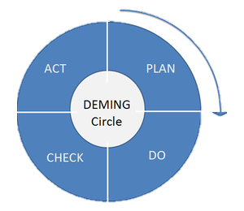
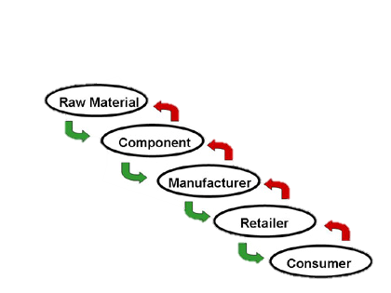

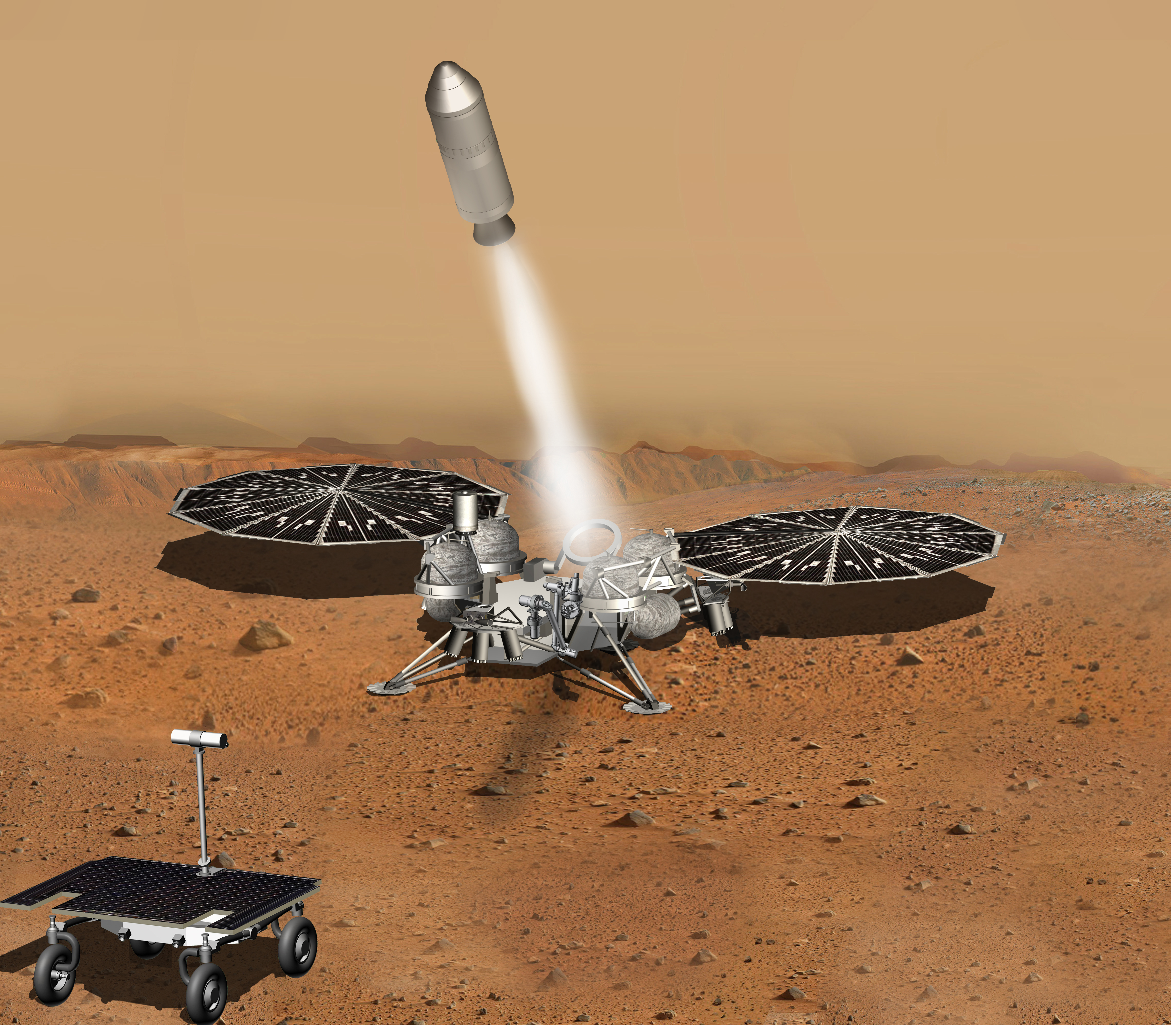

Industrial & Systems Engineering Tools
Process planning, analysis, adjustment, and design:
  Six sigma
  Quality control
  Deming Cycle (PDCA)
  Systems engineering V
  Engineering Economics Analysis
  Decision Analysis
Systems thinking
  Wholistic or ‘Big Picture’ thinking
  Emergent Properties
  Includes analysis of human interaction w/system
System analysis and simulation
  Monte Carlo
  Discrete Event
Optimization
  Operations research
$$?$$

Slide 18
A Look at Systems Engineering Today
Systems are facing growing demands: “…today’s systems are expected to perform at levels undreamed of a generation ago. Competitive pressures demand that the systems leverage technical advances to provide continuously increasing capability at reduced cost and within shorter delivery cycles.” [1]
“The interconnectivity among systems also places increased demands on systems. Systems can no longer be treated as stand-alone, but behave as part of a larger whole that includes other systems as well as humans. Systems are expected to support many different uses as part of an interconnected system of systems (SoS).” [1]
Along with these technical advances and growing demands on systems, has also come growing demands and technical advances in systems engineering.
[1] A Practical Guide to SysML Friedenthal, S., Moore, A., Steiner, R.

Slide 19
Model-Based Systems Engineering
“Model-based systems engineering is a current effort by the systems engineering community to move document-based system development to model-based system development.” [2]
System models “provide the capability to cohesively and consistently define and trace requirements to the system design. This traceability can extend from a functional level to the integration of math and simulation software for integration analysis. [2]
The advantages of MBSE could potentially include “Increased productivity; Faster impact analysis of requirements and design changes, more effective exploration of trade-space, reuse of existing models to support design evolution, reduced errors and time during integration and testing, and automated document generation.” [1]
[2] Rountree, Isabeta; L. Dale Thomas. ‘Expanding MBSE to Incorporate Human Systems Integration Modelling.’ AIAA SciTech Pending.

Slide 20
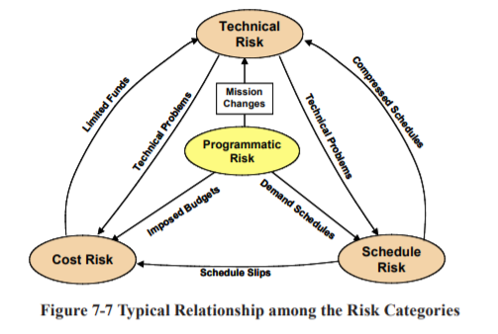
Designing for the Unknown
High risk projects, non-immediate & unknown returns.
Once the system is shipped off, we can’t change it again.
There’s no guarantee of another mission like this again.
The balance of technical, cost, schedule, and programmatic risks.
Figure 7-7 Typical relationship among the risk categories. Source: INCOSE-TP-2003-002-03, 2006, Systems Engineering Handbook, v. 3, Figure 7-7, page 7.14 of 20.

Slide 21
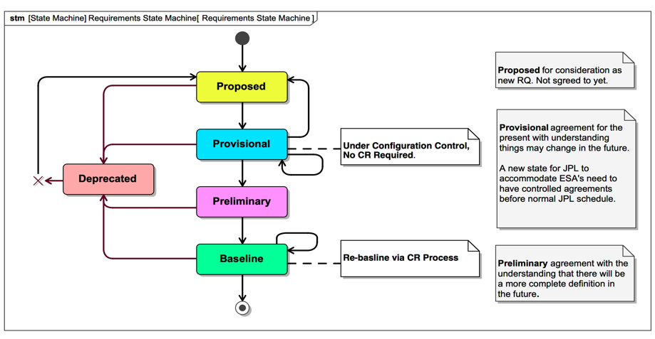
Requirements State Workflow

Slide 22
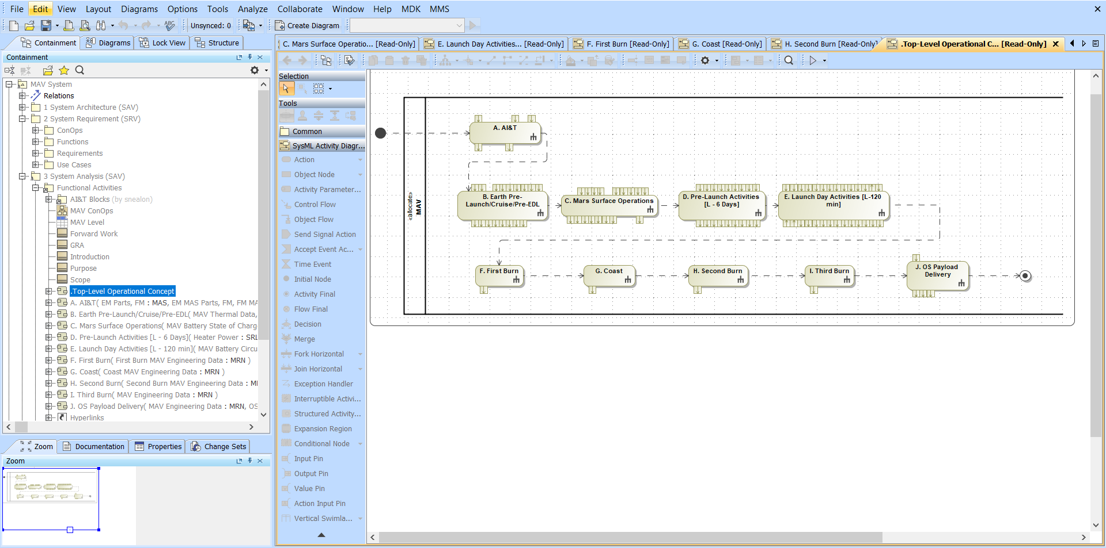
What MBSE Looks Like
A modelling tool (this one is MagicDraw)
A modelling language (SysML is what we use)

Slide 23
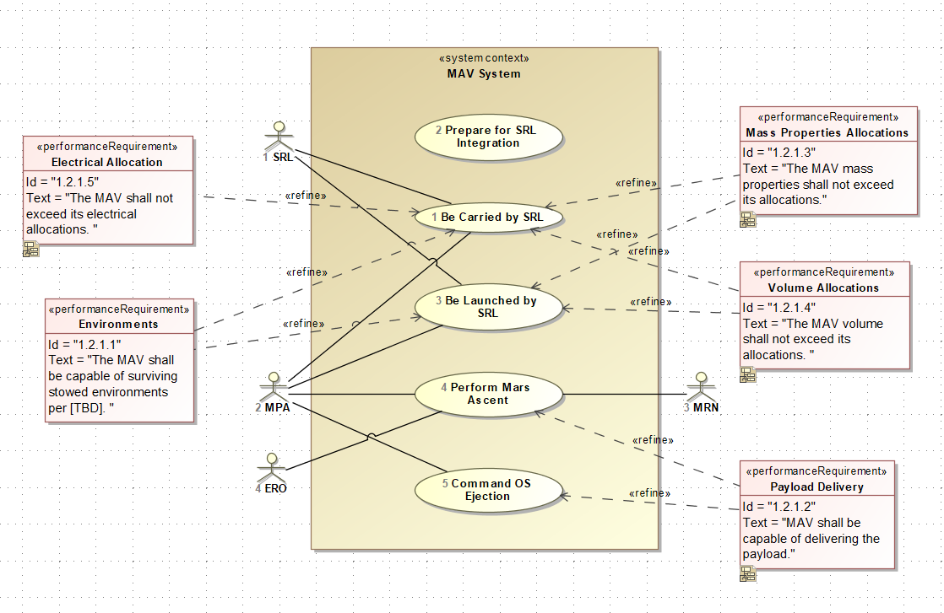
The MAV MBSE Effort
Stakeholder needs, goals, and objectives tracing

Slide 24
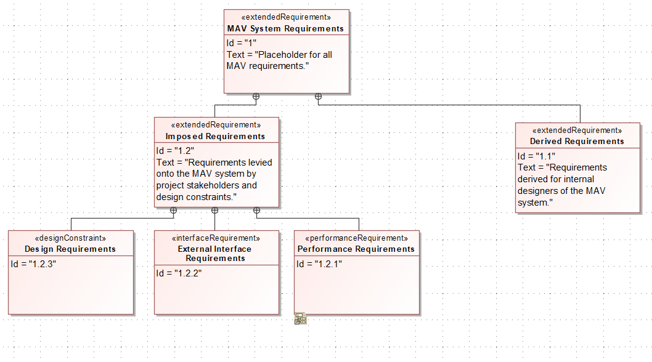
The MAV MBSE Effort
Requirements hierarchy development

Slide 25
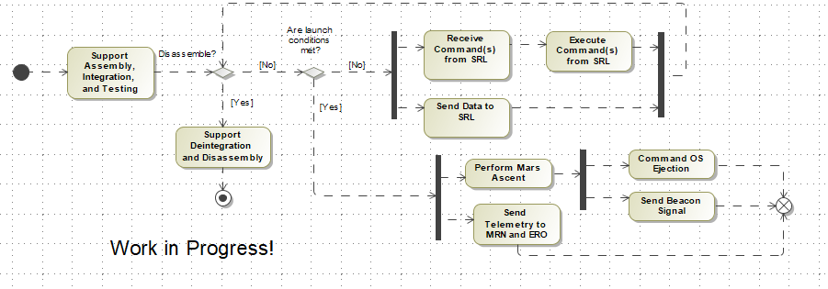
The MAV MBSE Effort
Concept of Operations

Slide 26
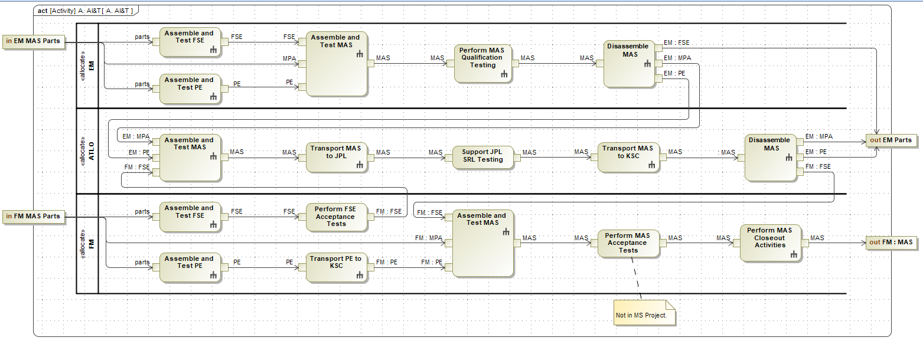
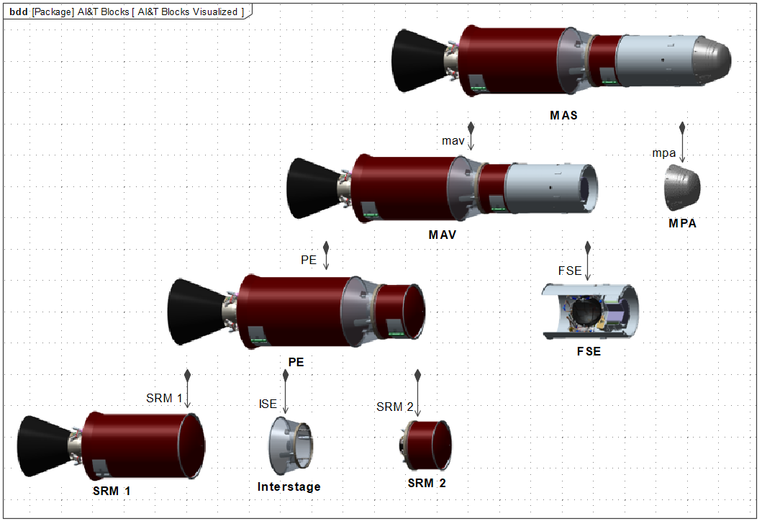
The MAV MBSE Effort
AI&T Planning
26

Slide 27
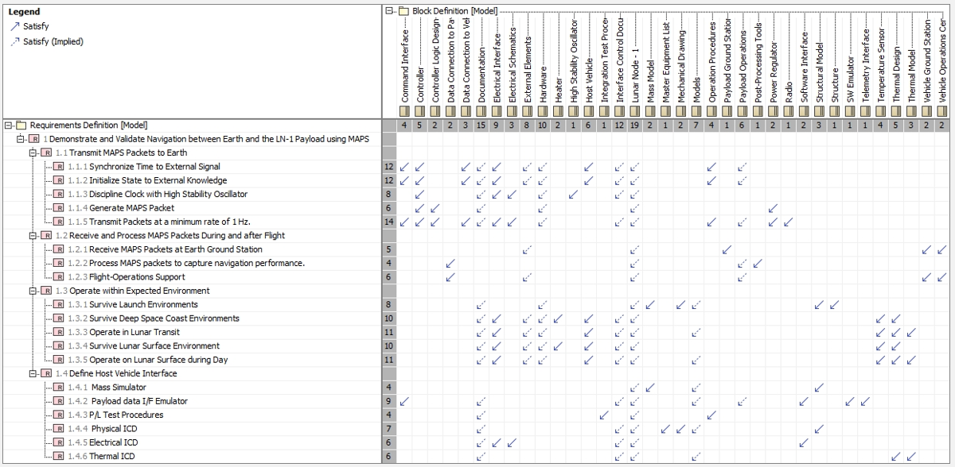
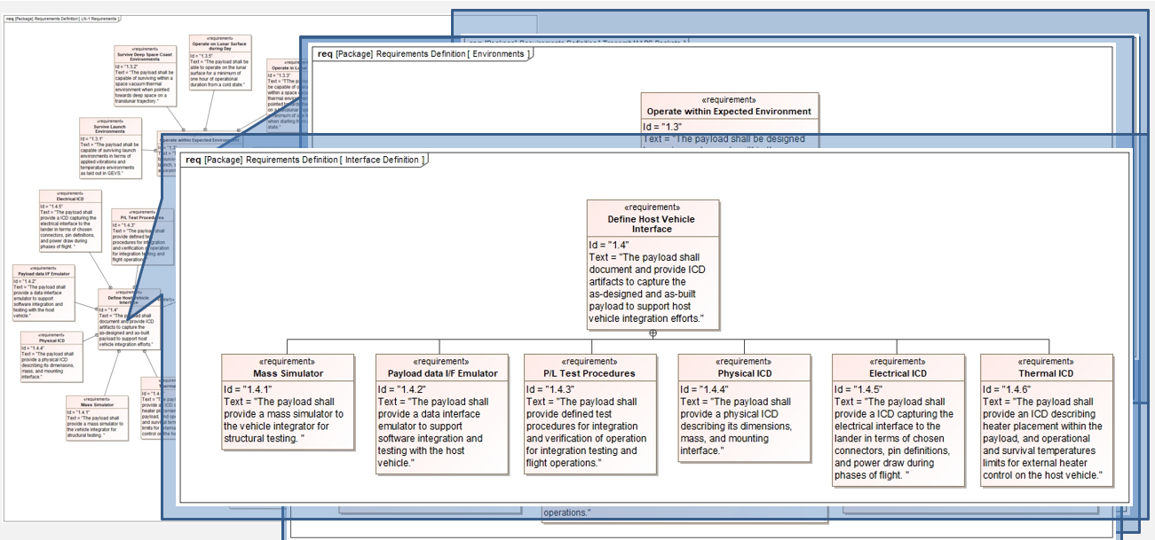
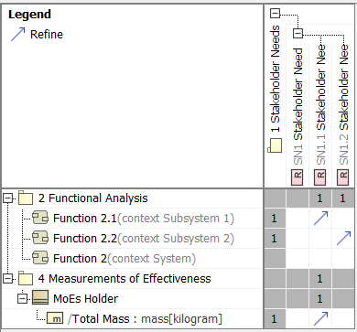
The MAV MBSE Effort
Requirements tracing
Impact Analysis
27

Slide 28
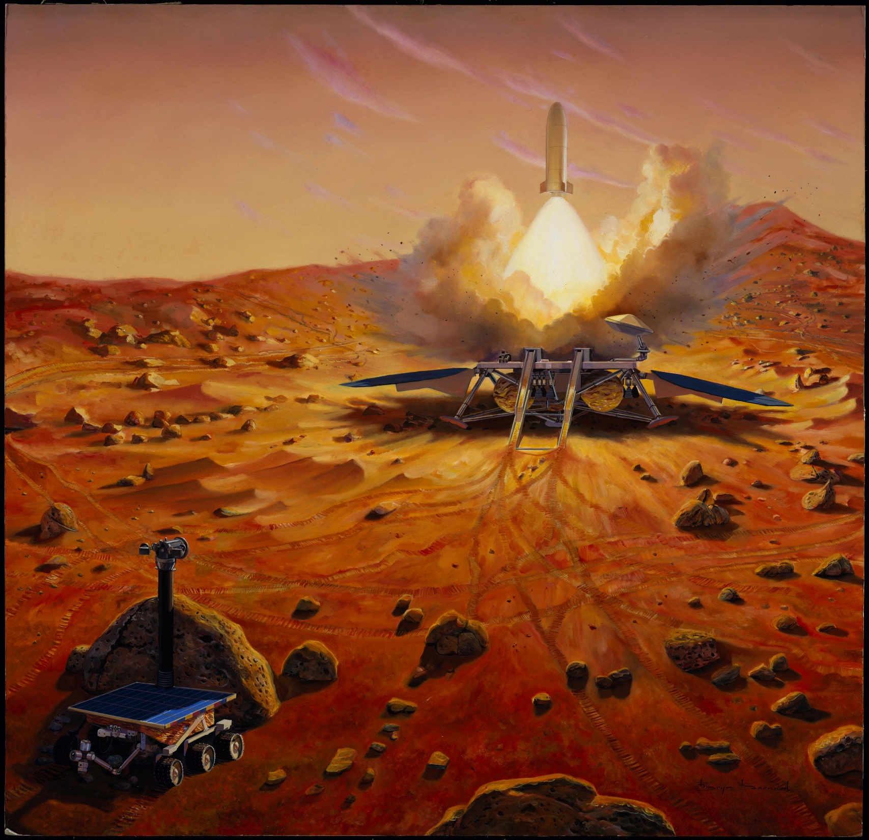
Questions?
Artist's Concept of a MAV

Slide 29
ISEs at MSFC
Center Director, Deputy Center Director, Associate Center Director
Program Managers
Project Managers
  Subsystem Managers
  Project Engineers
Business Managers
  Resource Analyst
Chief Engineers
Chief Safety Officers
  Reliability Engineers
  Quality Engineers
  Safety Engineers
Systems Engineer and Integration
  Lead Systems Engineers
  Requirements Development
  Interfaces
  MBSE
  Mass Properties
Operations
  Mission Managers
  Payload Operations Directors
  Planners
  Controllers
  Ergonomics
Testing
Facilities

Slide 30


with us

