Slide 1
Human Exploration and Lunar Outpost Considerations
Matt Simon and Michelle Rodio
NASA Langley Research Center
Sept. 25, 2020

Slide 2
WHY?
Notes:
Ref. Troutman Colloquium

Slide 3
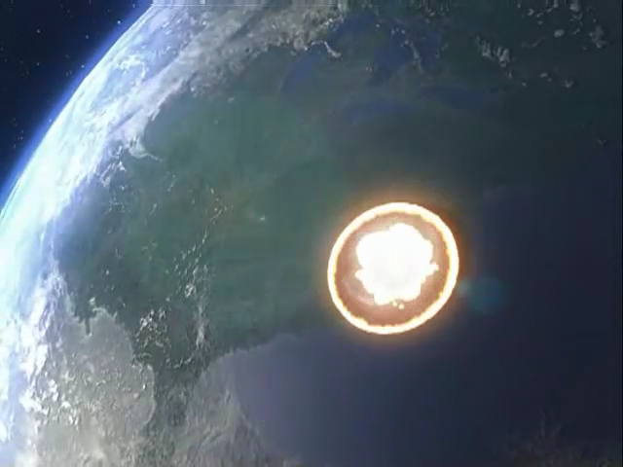
The past tells us something……
Animation Credit: NASA/AMA, Inc.
Notes:
Ref. Troutman Colloquium

Slide 4
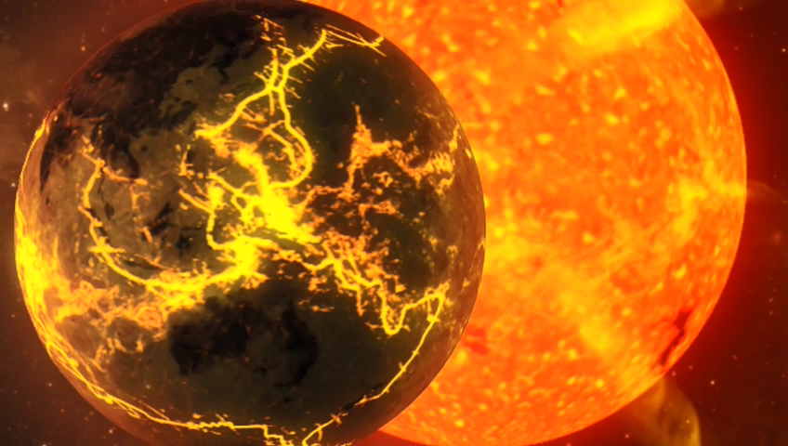
The far future may not be too good either..
Animation Credit: NASA/AMA, Inc.
Notes:
Ref. Troutman Colloquium

Slide 5
Why Should Humans Explore Space?
(A personal perspective)
To expand the human sphere of influence beyond Earth in order to further our knowledge, enhance our quality of life, and assure humanity’s survival along with stewardship of all life on Earth.
To expand the human sphere of influence beyond Earth in order to further our knowledge, enhance our quality of life, and assure humanity’s survival along with stewardship of all life on Earth.
Notes:
Ref. Troutman Colloquium

Slide 6
Why Start Now?
Because our current civilization has the capability & resources to do so!
Notes:
Ref. Troutman Colloquium

Slide 7
HOW?
The Infrastructure
Notes:
Ref. Troutman Colloquium

Slide 8
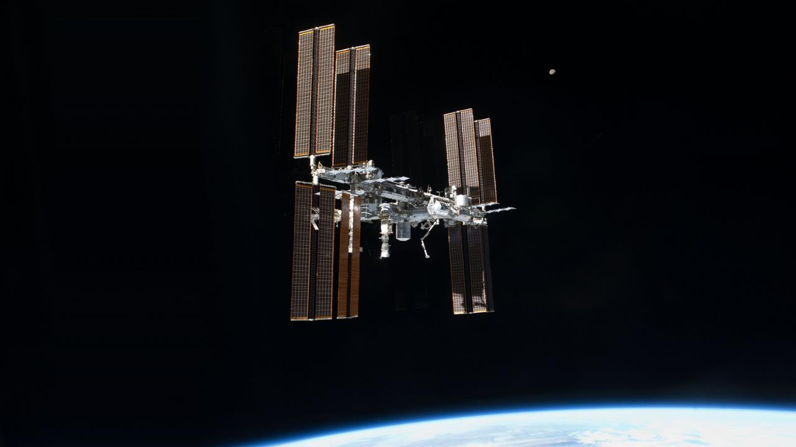
International
Space
Station
Notes:
Ref. Troutman Colloquium

Slide 9
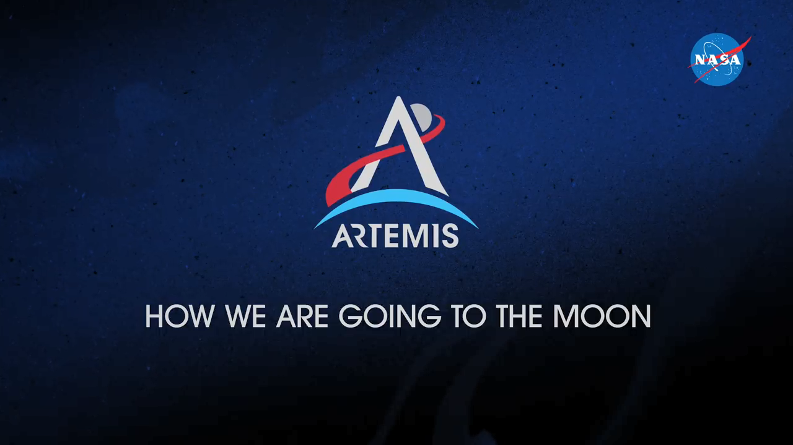
How We Get There and Currently Designed Vehicles
Video: NASA
Notes:
https://www.youtube.com/watch?v=_T8cn2J13-4

Slide 10
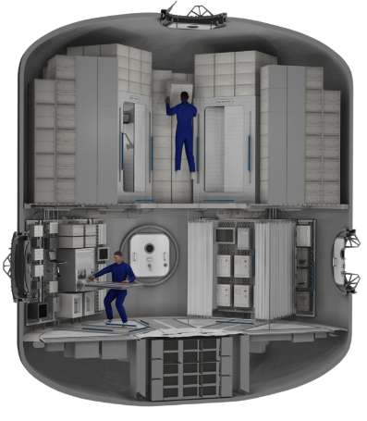
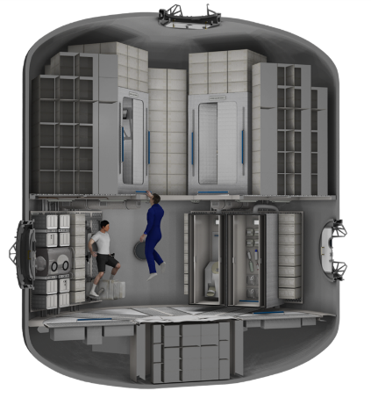
Deep Space Transit Habitat
Live in deep space on the way to Mars (capable of 1100 days)
Image credit: NASA/AMA Inc.
Notes:
20 sec
IEEE Simon 2017 – TPSAS 25771

Slide 11
Going to the Moon

Slide 12

Moon Facts
Average Distance from Earth: 238,855 miles
Orbit and Rotation Period: 27.32 Earth Days
Equatorial Radius: 1,079.6 miles
Mass: 1% of Earth’s
Gravity: 0.166 of Earth's
(If you weigh 100 pounds on Earth, you'd weight 16.6
pounds on the moon)
Temperature Range: -414 to 253 degrees Farenheit
(-248 to 123 degrees Celsius)
Notes:
Quick Facts: https://moon.nasa.gov/about/in-depth/

Slide 13
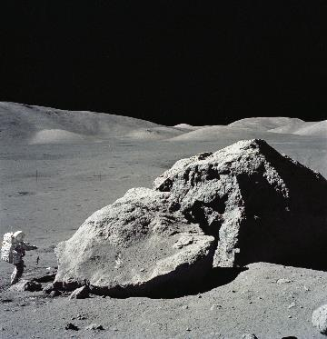
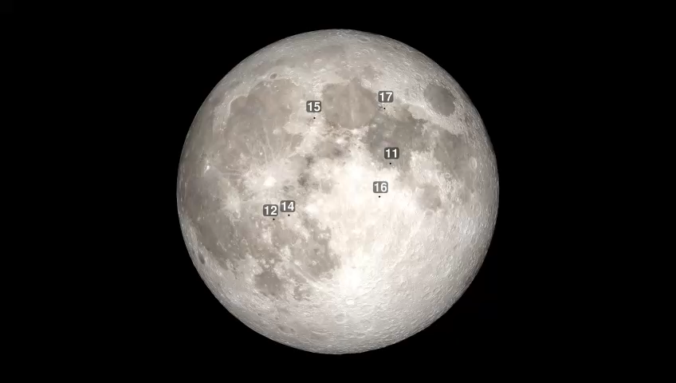
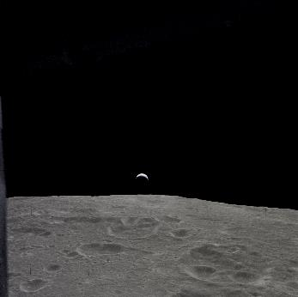
What it’s like on the moon
Craters
Boulders
Far from earth
Video: NASA
Image Credits: NASA
Notes:
https://svs.gsfc.nasa.gov/4770
https://spaceflight.nasa.gov/gallery/images/apollo/apollo17/hires/as17-140-21496.jpg
https://moon.nasa.gov/resources/111/earth-as-seen-by-apollo-12/?category=images

Slide 14
Lunar Surface Outpost

Slide 15
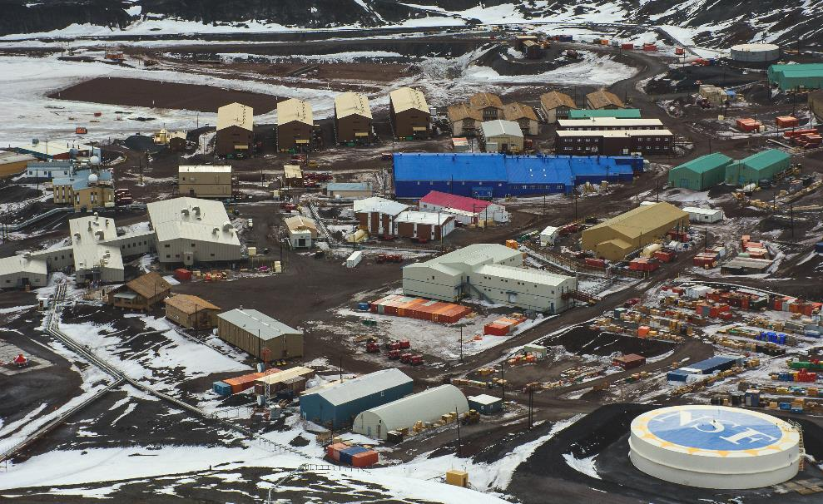
McMurdough Station, Antarctica
Image: NSF
Notes:
https://www.nsf.gov/news/mmg/mmg_disp.jsp?med_id=81216&from=

Slide 16
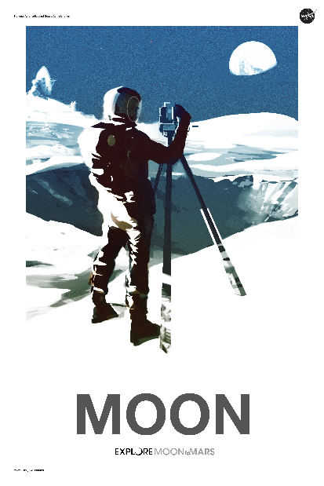
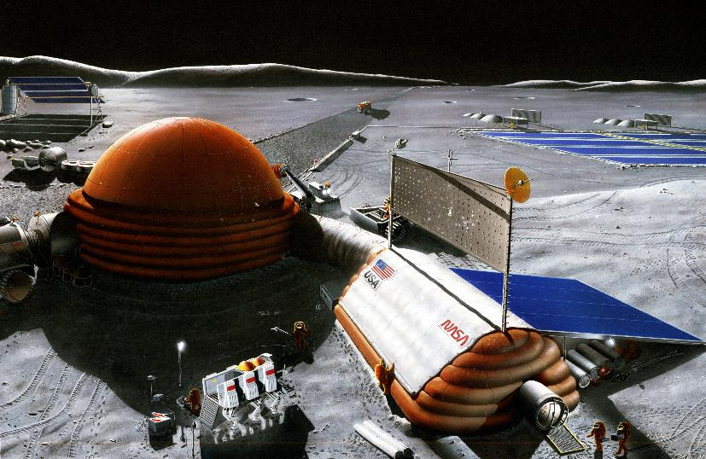
Lunar Outpost
Images: NASA
Notes:
https://moon.nasa.gov/resources/377/moon-to-mars-posters/
https://spaceflight.nasa.gov/gallery/images/exploration/lunarexploration/hires/s89_26097.jpg

Slide 17
Lunar Surface Outpost Thoughts
4 to 50 crew
Mix of skills and professions
Assume there will be some supply from Earth, but the goal is to be independent
Facilities for specific purposes (medical, group activities, private areas, utilities, etc.)
Recycling of resources (air, water, waste)
Leveraging resources from lunar surface

Slide 18
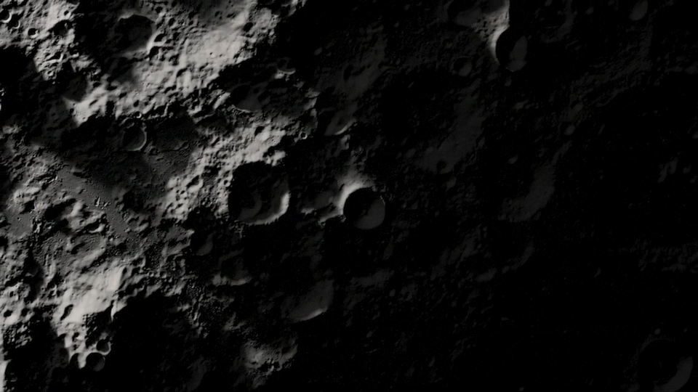
South Pole – A possible target
Video: NASA
Notes:
https://moon.nasa.gov/resources/97/the-moons-permanently-shadowed-regions/

Slide 19
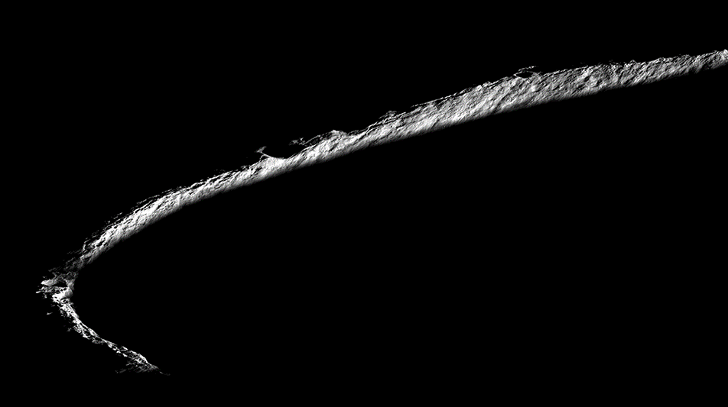
South Pole Lunar Lighting
Image Credit: NASA/GSFC/Arizona State University
Notes:
Shackelton Crater from LRO
https://moon.nasa.gov/resources/162/on-the-rim/
Image Credit: NASA/GSFC/Arizona State University

Slide 20
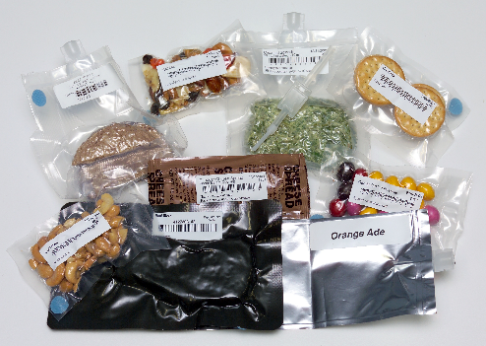
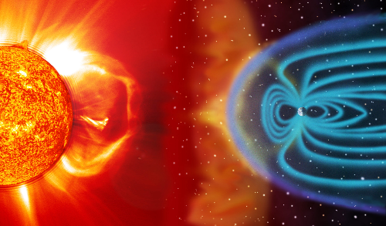
Things to Think About
Food/Medicine Stability
Active and Passive
Radiation Protection
Image Credit: NASA
Image Credit: NASA/SOHO
Notes:
Food mention food stability and
Radiation (Passive and Active) – Mention Active shielding concepts and thick shield experiments.
Exercise,
Ref. Simon SciTech 2016 – TPSAS 23401
Food Images:
https://www.nasa.gov/offices/oct/40-years-of-nasa-spinoff/food-safety-standards
Radiation Images:
https://www.nasa.gov/hrp/elements/radiation/miniseries - Credit NASA / SOHO

Slide 21
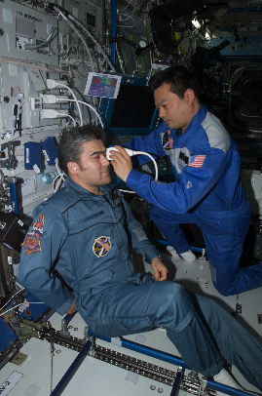
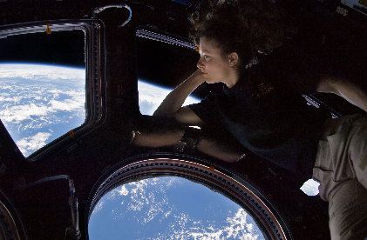
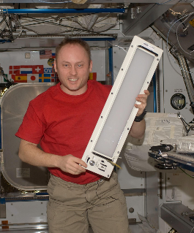
Things to Think About
Integrated Medical System and Devices
Behavioral Health Countermeasures
Images Credit: NASA
Notes:
Medical, BHP, Autonomy, IVHM,
Ref. Simon SciTech 2016 – TPSAS 23401
Medical Images
https://www.nasa.gov/mission_pages/station/research/benefits/ultrasound.html
Behavioral Health
https://spaceflight.nasa.gov/gallery/images/station/crew-24/html/iss024e014263.html
https://www.nasa.gov/press/2014/october/nasa-selects-three-proposals-to-support-behavioral-health-and-performance-on-deep/

Slide 22
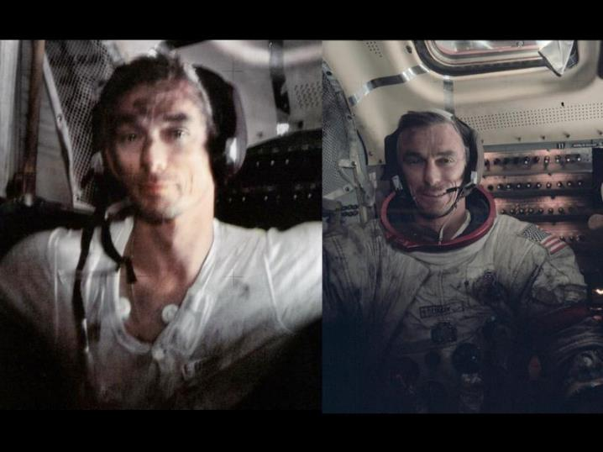
Lunar Dust
Image: NASA
Notes:
https://www.nasa.gov/images/content/390895main_Gene_Cernan_covered_in_lunar_dust_full.jpg

Slide 23
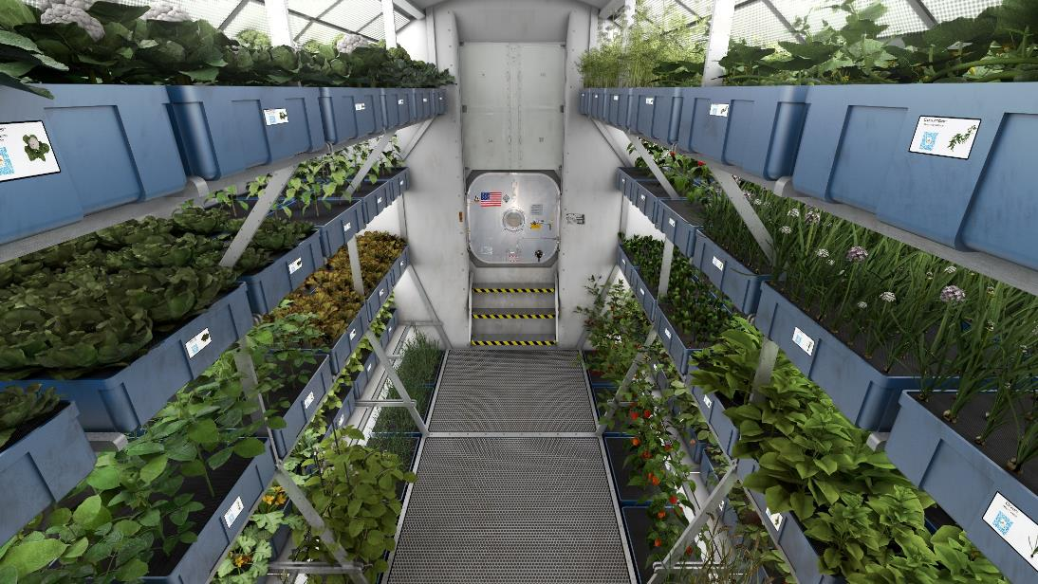
Pioneering the Moon
Image: NASA/AMA Inc.
Notes:
We also look beyond the first few missions to Mars to ensure that what we are designing will fit well into a pioneering strategy, where we learn to live independent from Earth. Major challenges like Martian dust, Radiation, Nutritional stability, maintainability of systems, and medical care without hospitals will need to be addressed.
We are trying to see how to repurpose our designs for other purposes like science labs and food growth chambers. It’s important to think now about how to design systems to serve multiple roles as each new habitat program we start is a big expense. Commonality, reusability, and modularity are big issues we try to tackle.
Ref. Simon SciTech 2016 – TPSAS 23401
Image Credit NASA

Slide 24
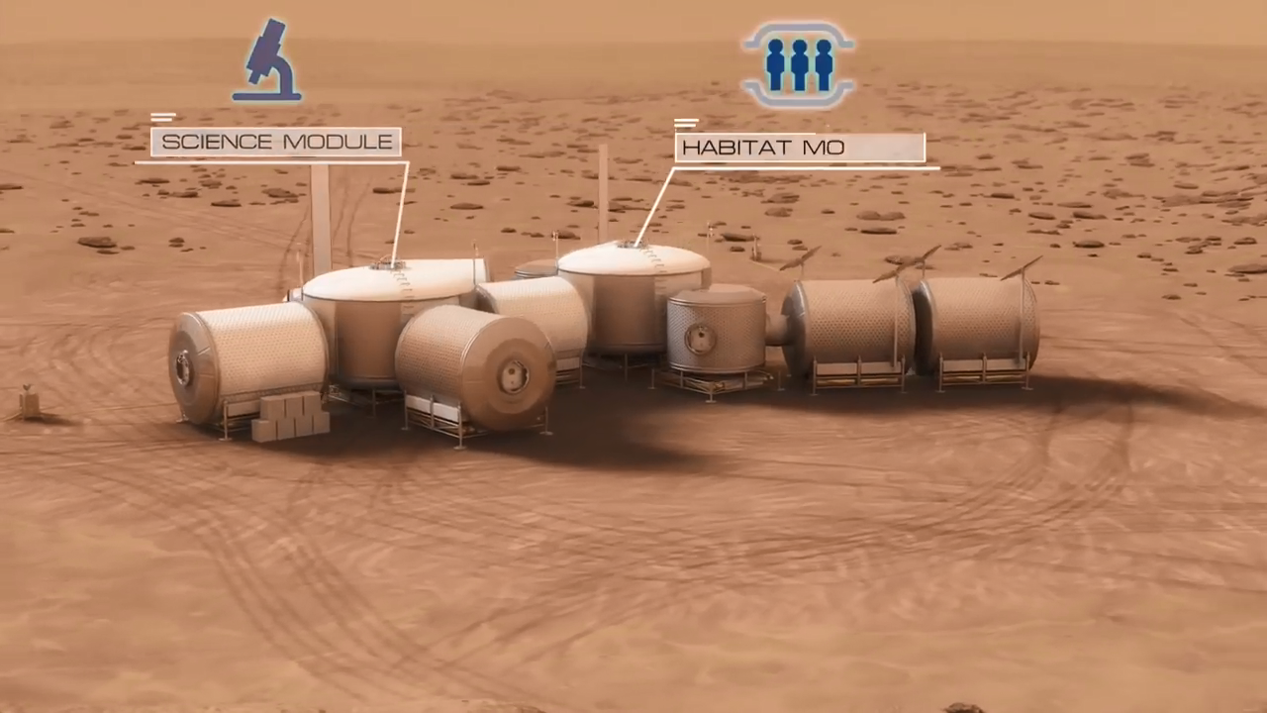
Mars Outpost Example
https://www.youtube.com/watch?v=94bIW7e1Otg
Video: NASA/AMA Inc.
Notes:
NASA Video Youtube: https://www.youtube.com/watch?v=94bIW7e1Otg

Slide 25


