Slide 1


NASA PARTNERSHIPS AND TECHNOLOGY LICENSING
Carrie Rhoades - LARC
carrie.m.rhoades@nasa.gov
757-864-8793
Kerry Leonard - GSFC
kerry.w.leonard@nasa.gov
301.286.8497
Jeramie Broadway - MSFC
jeramie.w.broadway@nasa.gov
256.961.1372

Slide 2
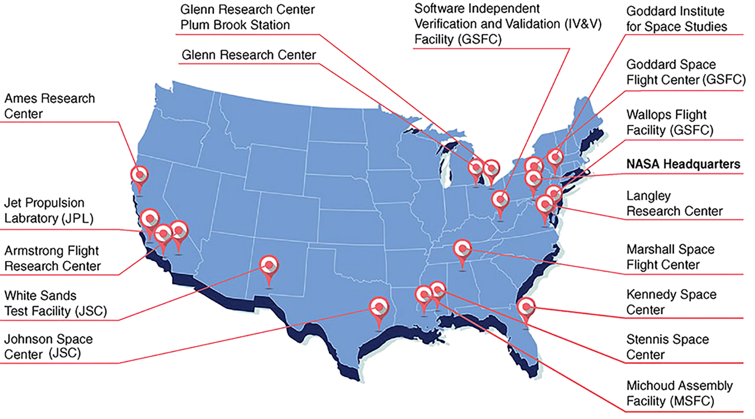
NASA Facilities

Slide 3

NASA Partnerships
HOW TO WORK WITH NASA
Carrie Rhoades - LARC
carrie.m.rhoades@nasa.gov
757-864-8793
Darryl Mitchell - GSFC
darryl.r.mitchell@nasa.gov
(301) 286-5169
Preston Schmauch - MSFC
preston.b.schmauch@nasa.gov
256.544.1218

Slide 4
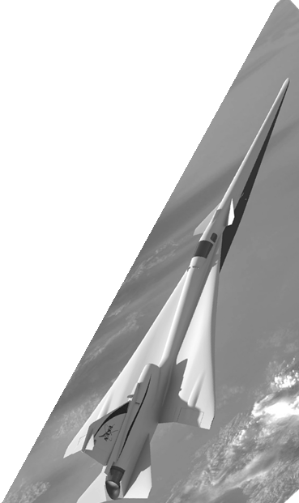

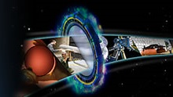
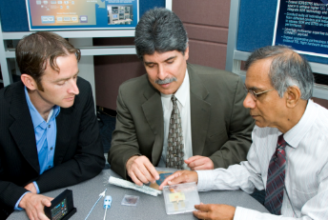
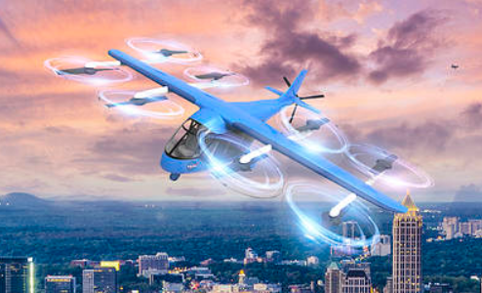
NASA’s Partnerships Opportunities
NASA.GOV/PARTNERSHIPS
Small Business Innovation Research (SBIR)
Small Business Technology Transfer (STTR)
Technology Transfer
Technology Partnerships
NASA Challenges

Slide 5
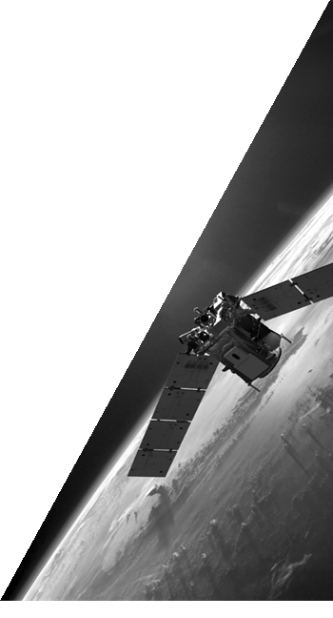
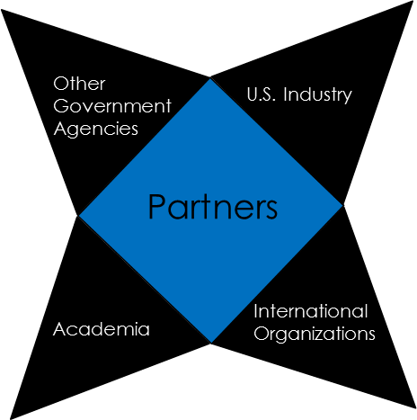
The Importance of Partnerships
NASA’s partnerships are instrumental in supporting our strategic plan and agency objectives, including:
Expanding human knowledge
Advancing U.S. competitiveness
Encouraging mutual beneficial
cooperation with other nations
Disseminating the results of NASA’s
activities to educate and inspire
Facilitating the efficient use and
management of agency infrastructure
and capabilities

Slide 6
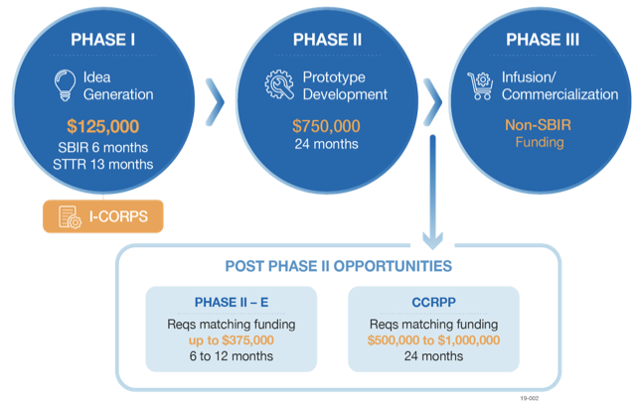
SBIR / STTR
SMALL BUSINESS INNOVATION RESEARCH (SBIR)
SMALL BUSINESS TECHNOLOGY TRANSFER (STTR)
www.sbir.nasa.gov
Programs provide an opportunity for small, high technology companies and research institutions to participate in government-sponsored research and development.
NASA’s research subtopics are organized by Focus Areas that group interests and related technologies.
NASA issues a solicitation annually highlighting its key technology needs and missions.
2021 Solicitation is expected 2 months early due to COVID - expect release in November

Slide 7
NASA SBIR
HOW TO WORK WITH NASA
Dr. Quenton Bonds - GSFC
301-286-7083
Quenton.Bonds@nasa.gov
Joe Famiglietti - GSFC
301-286-1833
Joe.Famiglietti@nasa.gov
Kim Cannon - LaRC
757-864-3814
Kimberly.A.Cannon@nasa.gov
Gwen Jasper - MSFC
256-544-1666
Gwenevere.L.Jasper@nasa.gov

Slide 8
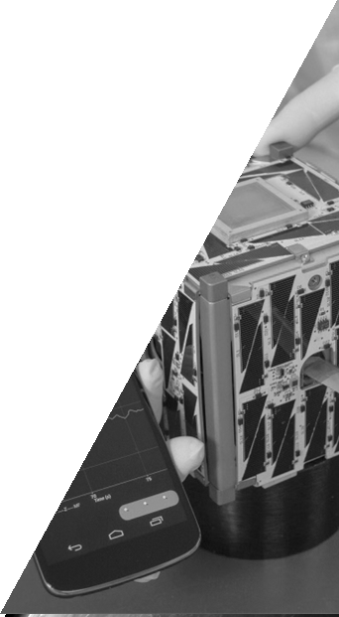
Partnering Opportunities
Procurement Opportunities
Used to acquire goods, services, or both
Competition is required in most cases
Federal Acquisitions Regulations (FAR) apply
Office of Small Business Procurement
beta.sam.gov (old fbo.gov)
Teaming With Us
Announcements of Opportunities (AOs)
Broad Agency Announcements (BAAs)
NASA Research Announcements (NRAs)
nspires.nasaprs.com/external/

Slide 9
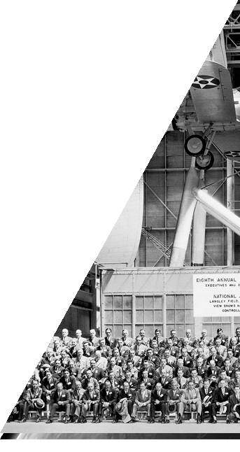
Legal Instruments
Procurement Contract​
Cooperative Agreement​
Grant​
Economy Act Agreement​
Space Act Agreement (may be called MOU, MOA)​
Commercial Space Launch Act Agreement​
Commercial Space Competitiveness Act Agreement​​
Cooperative Research and Development Agreement (CRADA)
Personal Property Loan ​
Use Permit​
Real Property Lease​
Enhanced Use Lease​
Licenses for Intellectual Property​
Employee Training And Development Agreements​
International Agreement​

Slide 10
NASA Technology Transfer
HOW TO WORK WITH NASA
Krista Jensen - LaRC
krista.y.jensen@nasa.gov
757-864-3346
Darryl Mitchell - GSFC
darryl.r.mitchell@nasa.gov
(301) 286-5169
Terry Taylor - MSFC
(256) 544-5916
terry.taylor@nasa.gov

Slide 11

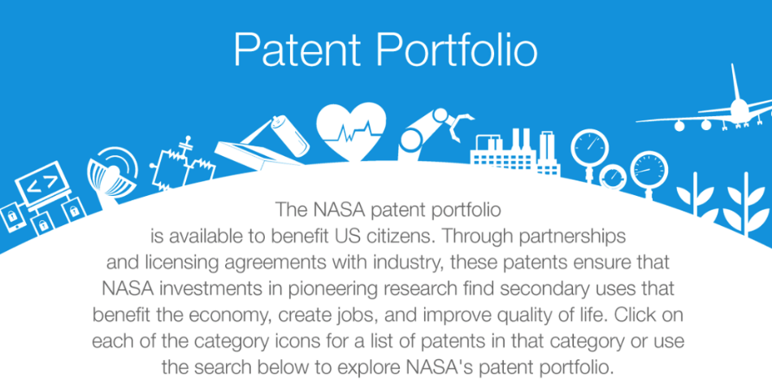
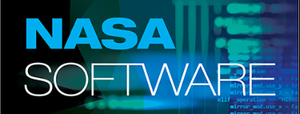
NASA Technology Transfer
technology.nasa.gov
https://technology.nasa.gov/patents
https://software.nasa.gov/

Slide 12
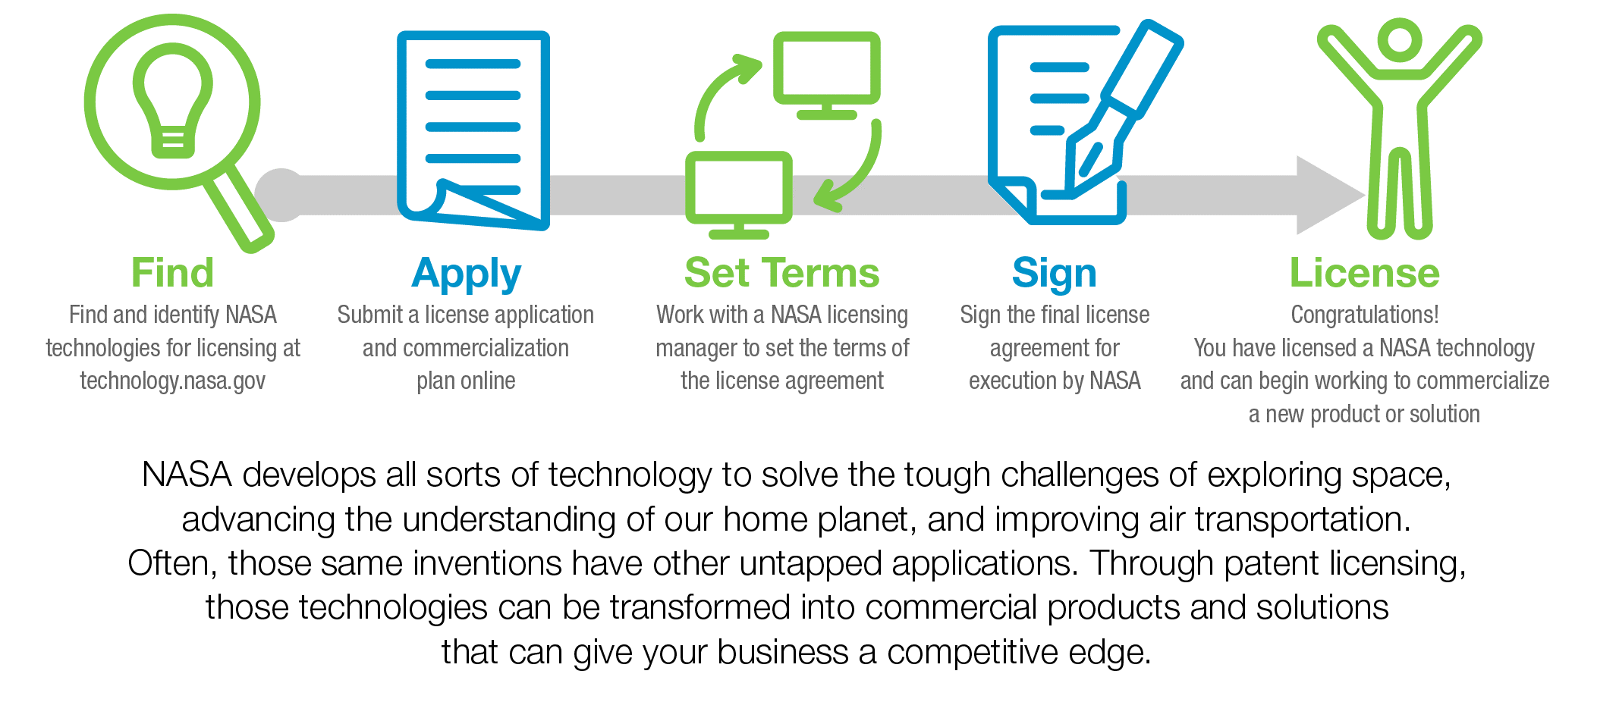
How to License NASA Technology

Slide 13
Types of Licenses
Evaluation License
Startup License
Standard Commercial License
  Non-Exclusive
  Exclusive
  Partially Exclusive for Field of Use

Slide 14
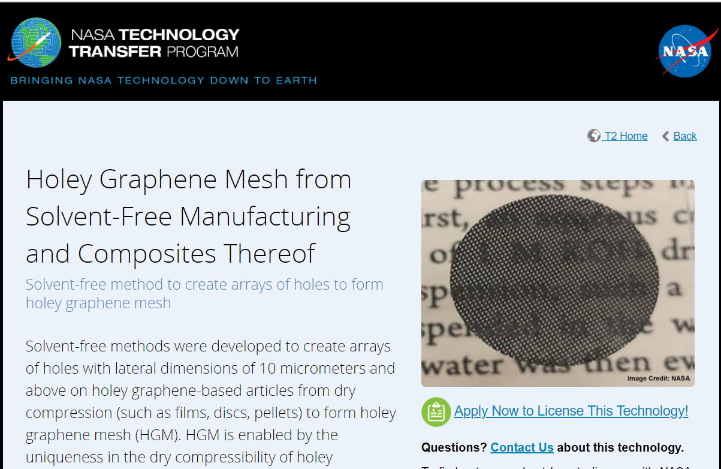
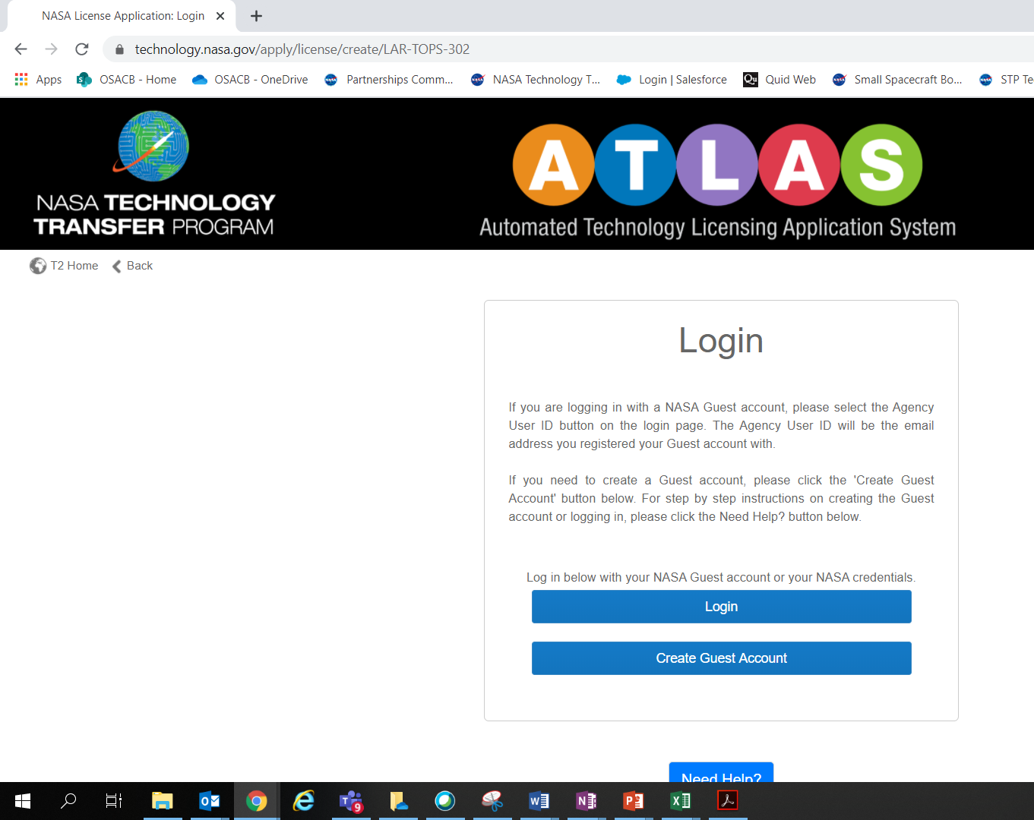
How to start a License Inquiry
Find your technology on: www.technology.nasa.gov
3. Start your ATLAS Application
2. Click “Apply Now” on any technology sheet

Slide 15
Helpful Websites
How to Partner with NASA
nasa.gov/partnerships
How to Do Business with NASA
NASA SBIR/STTR Programs
sbir.nasa.gov
NASA Technology Transfer Program
technology.nasa.gov
software.nasa.gov
NASA Procurement Office
www.hq.nasa.gov/office/procurement
NASA Office of Small Business Procurement
osbp.nasa.gov/business.html

Slide 16
New Opportunities in Tech Transfer

Slide 17

Questions?

Slide 18
Helpful Websites
How to Partner with NASA
nasa.gov/partnerships
How to Do Business with NASA
NASA SBIR/STTR Programs
sbir.nasa.gov
NASA Technology Transfer Program
technology.nasa.gov
software.nasa.gov
NASA Procurement Office
www.hq.nasa.gov/office/procurement
NASA Office of Small Business Procurement
osbp.nasa.gov/business.html

Slide 19
BACKUPS

Slide 20
Langley Research Center Patents Available for Licensing

Slide 21
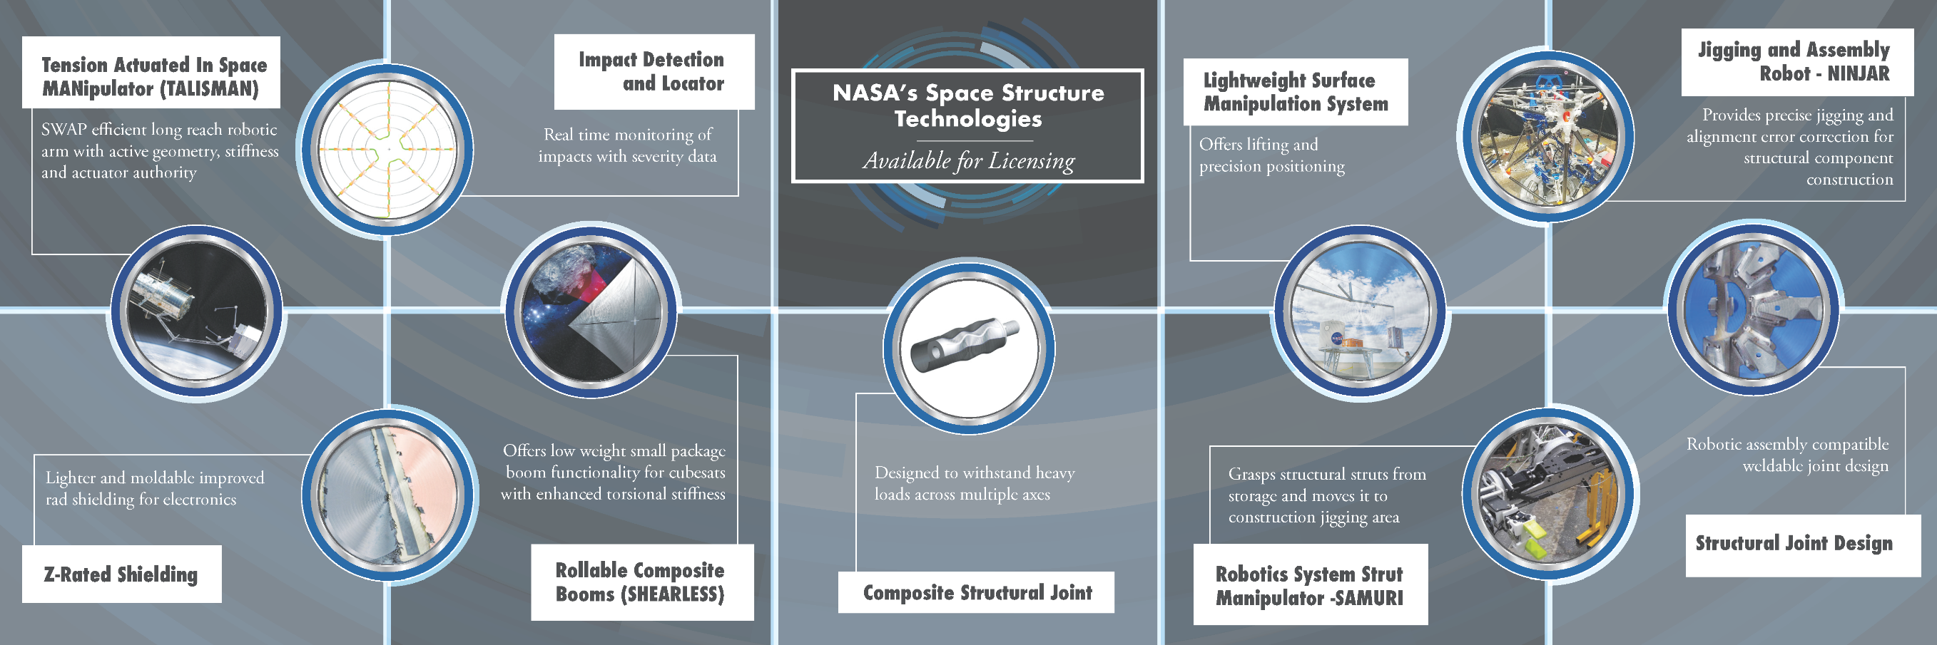
Langley’s Space Structures Technology
AVAILABLE FOR LICENSING

Slide 22
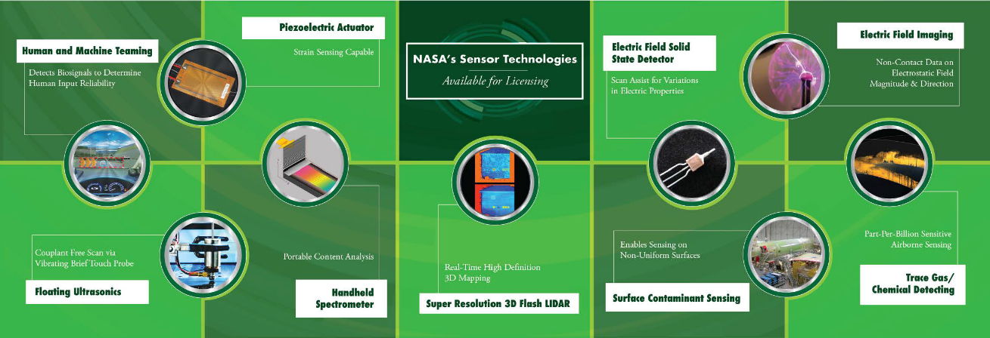
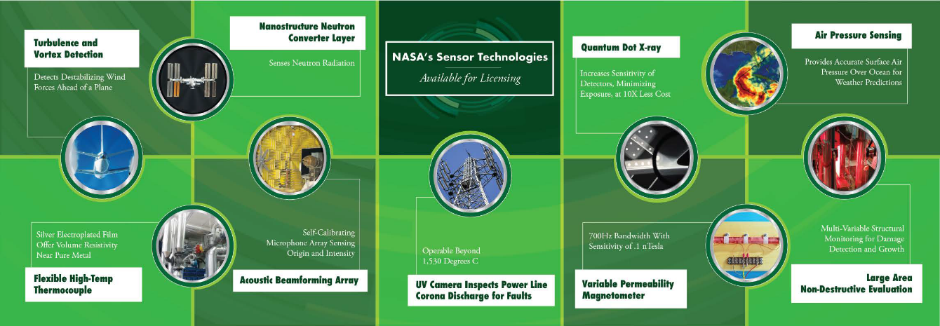
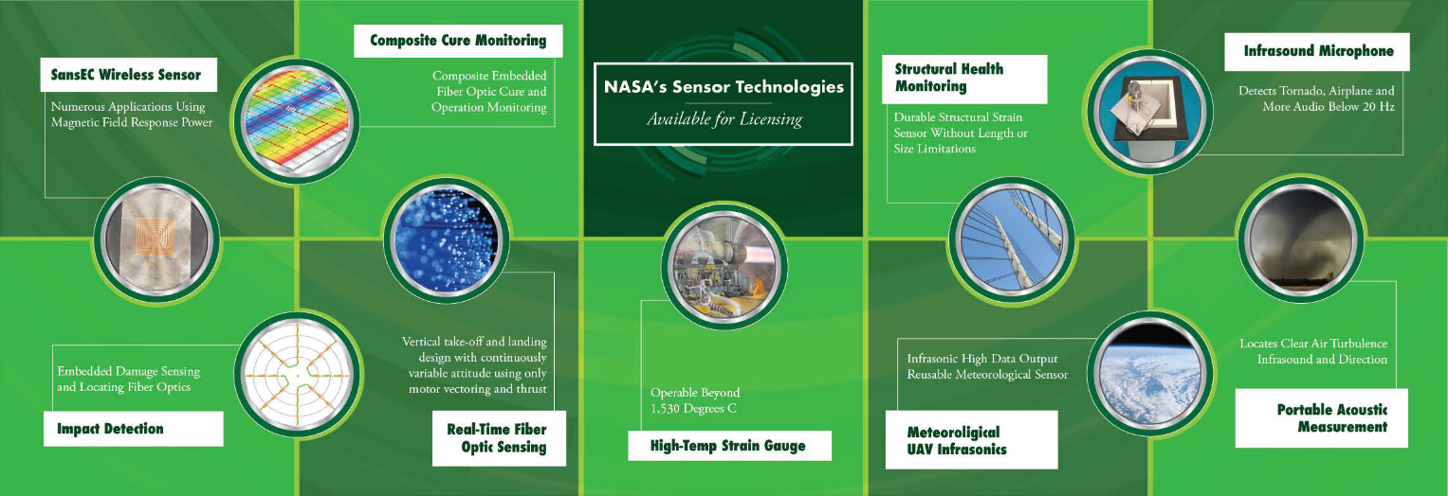
Langley’s Sensor Technology
AVAILABLE FOR LICENSING

