Slide 1
NDE Methods and Capabilities Handbook – Resources for the Composites NDE Community
Patricia A Howell
NASA Langley Research Center
Hampton, VA 23681
NDT in Aerospace 2020
October 6-8, 2020
Williamsburg, VA

Slide 2
NDE for Composites
Most NDE techniques developed for metallic materials
Complexity of Composite materials often complicates inspection
Manufacturing variability
Complex failures

Slide 3
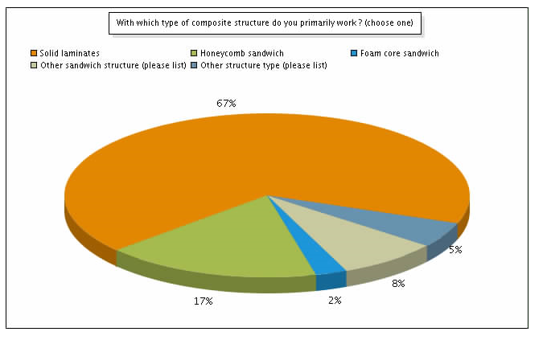
What Does industry need to transition for inspection growing uses of composite materials
Industry Survey
153 Respondents
Primary composite structure type of interest: carbon fiber reinforced polymer (CFRP)
Most commonly used NDT methods:
  Visual
  Tap Testing
  Through-Transmission Ultrasound (UT)
  Pulse Echo UT
  X-ray methods (Digital, Computed Tomography, and Film – in that order)
  Infrared Thermography
  Low Frequency Ultrasound/Bond Testing.
Automation:
  Automated Fiber Placement (AFP)
  Visual
  UT
  Thermography
Better reference standards & most common defects
  Delaminations/disbonds
  Ply waviness/wrinkles
  Bond strength
  Microcracks

Slide 4
NDE Methods and Capabilities Handbook Objectives
Capture knowledge gained from measurements on almost 100 specimens with a variety of geometries and induced flaw types
Provide guidance document that facilitates the selection of appropriate Nondestructive Evaluation (NDE) techniques and provides recommended protocols for detecting and characterizing common flaw types in complex composite structures.
Reduce the time required to develop qualified inspection processes for composite aircraft structures during the development, certification, and manufacturing phases by providing a reference that helps minimize trial and error and provides guidance on best practices, techniques, and settings, for specific flaw types and geometries.
Give an unbiased assessment of the technologies for different inspection needs - not to recommend any particular technology for a particular inspection requirement. No judgement on what was ‘better’ – left to user.
Provide a set of well-characterized NDE Standards and data on which to develop inspection and data analysis techniques

Slide 5
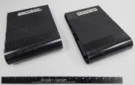
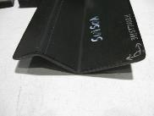
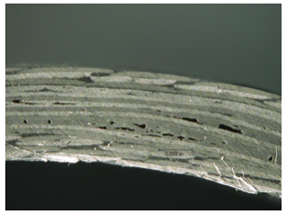
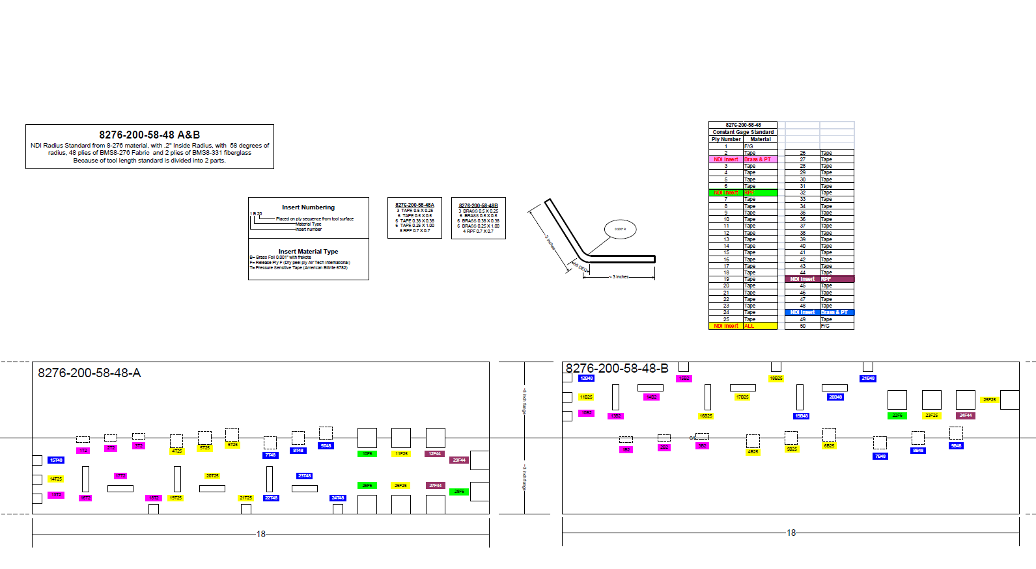
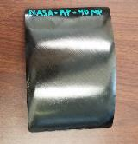

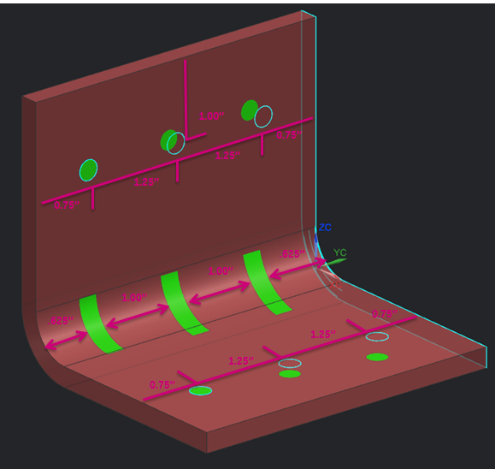
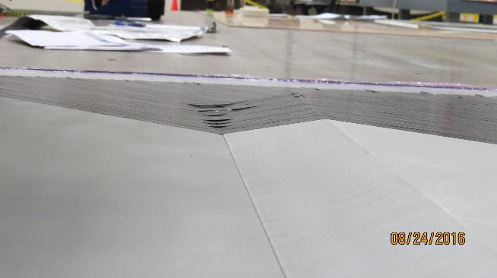
NDE Standards Fabricated by Original Equipment Manufacturers for Round Robin Testing
Materials:
  66 are made of IM7/8552 or IM7/8552-1
  10 are made of BMS 8-276
  12 are T-800SC triaxial braid fabric
Geometries:
  44 Flat panels
  10 S curve ( __/‾ ) panels
  9 Wedge panels
  8 Radius corner panels
  8 Rotorcraft blade spar tubes
  4 Step panels
  5 Flange panels
Defects:
  28 Delamination and/or FOD
  21 Porosity
  9 Fiber orientation
  11 errors in tow placement during
  Automated Fiber Placement (AFP)
  1 Bond Integrity
  18 Impact Damage (BVID)
88 Standard Specimens

Slide 6
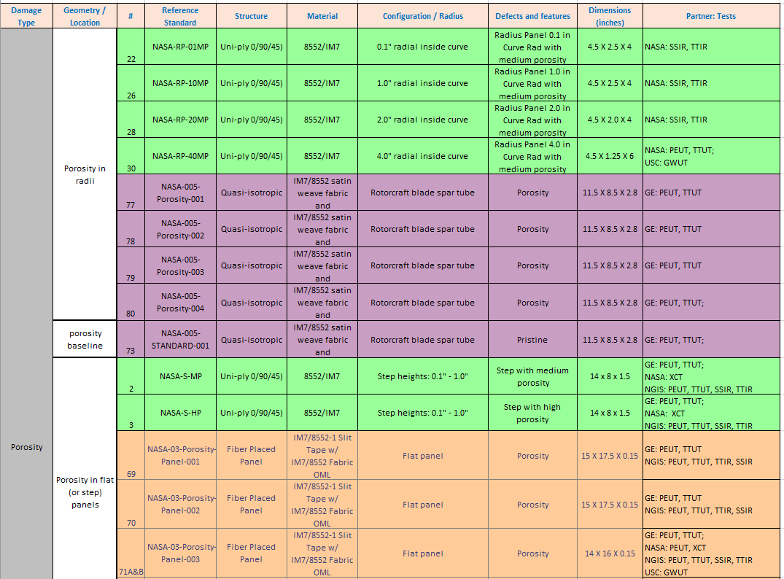




Round-robin Testing
14 specimens with 10 techniques.
13 specimens with 1 technique.
8 specimens with 4 techniques.
25 specimens with 1 technique.
44 specimens with 7 techniques.
11 specimens requested by 3 or more partners.
No specimen inspected with all techniques by all partners.
Both good overlap and coverage of specimens and technologies

Slide 7



Advanced Composites Consortium Partners and Inspection Equipment Manufactures Contributed to Database
12 Core Team Members from 6 organizations
42 Additional contributors
8 additional organizations
Summer interns to national experts
Exceptionally positive NDE community response

Slide 8
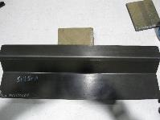
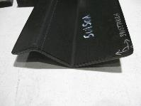
Delamination Standards
QTY | Reference Standard Part Number | Material | Radius | Angle | Ply Count | Length | Sides
2 | 8276-200-58-8 A&B | 8276 Tape | 0.2 | 58 deg. | 8 | 24" | 3x3
2 | 8276-200-58-26 A&B | 8276 Tape | 0.2 | 58 deg. | 26 | 24" | 3x3
2 | 8276-200-58-48 A&B | 8276 Tape | 0.2 | 58 deg. | 48 | 24" | 3x3
2 | 8276-200-56-48 A&B | 8276 Tape | 0.2 | 56 deg. | 48 | 24" | 3x3
2 | 8276-200-59-48 A&B | 8276 Tape | 0.2 | 59 deg. | 48 | 24" | 3x3
1 MHz Ultrasonic Through Transmission Inspection .04” x .04” resolution

Slide 9
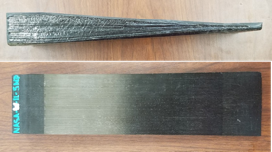
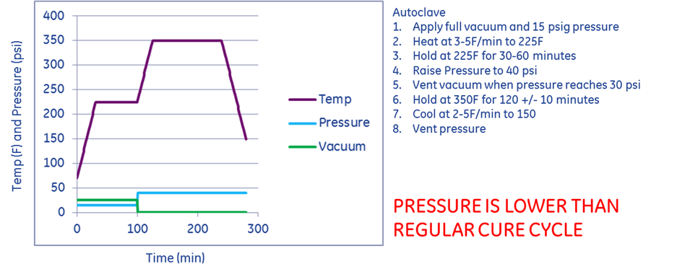
Porosity Standards
Combination of wedges and step specimens
  Ranging from 5° to 35°
IM7/8552 composite material
[0/90/45/-45]ns, where n varied depending on the thickness
Modified cure cycle used to produce porosity
  Normal vacuum cycle
  ½ recommended pressure (medium porosity)
  0 pressure (high porosity)

Slide 10
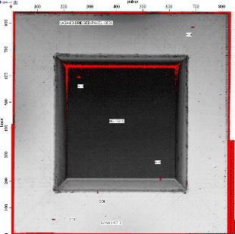
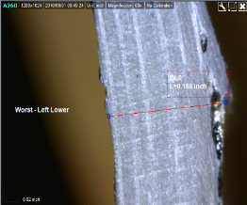
Other Standards – Bridging Defects
Photograph of Bridging Defect
Bridging Defects can occur during changes in substrate elevation and with improper tow tension
C-Scan of Cured Panel
Before Cure
After Cure
Good
Defect

Slide 11
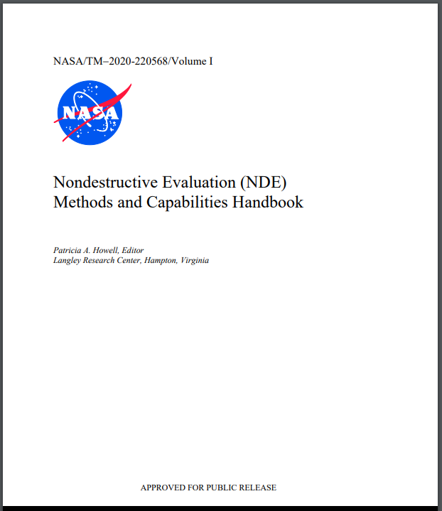
Results Compiled in NASA/TM-2020-220568/Volume I
NDE Methods and Capabilities Handbook
Statement of Intent
1.0 Contributing Authors
2.0 Introduction/scope
3.0 NDE Guidance Matrix (method vs flaw type)
4.0 Inspection Guidance by flaw type
4.1 Descriptions and Characteristics of defect types
4.2 Porosity Inspection Guidance
4.3 Delamination Inspection Guidance
4.4 FOD and Inclusions Inspection Guidance
  4.5 Fiber Defects Inspection Guidance
  4.6 Impact Damage Inspection Guidance
5.0 Inspection technology summaries and capabilities
5.1 Ultrasound
5.2 Thermography
5.3 Radiography
5.4 Shearography
5.5 Visual Inspection, Tap Testing, and Liquid Penetrant
5.6 Other NDE Techniques and Tools
5.7 Techniques not suitable for Inspection of CFRP Composites
6.0 Further Reading
7.0 Appendices
  A. State of Practice Survey Report
  B. Photos and Descriptions
  C. Round Robin Testing
  D. Manufacturing documents
  E. Individual test reports by specimen
Notes:
Volume 1: 216 pages Volume 2: 862 pages = 1078 pages
Contributing authors: 12 core team, 42 additional contributors

Slide 12
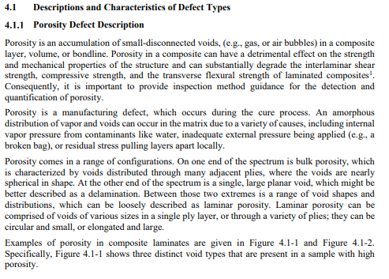
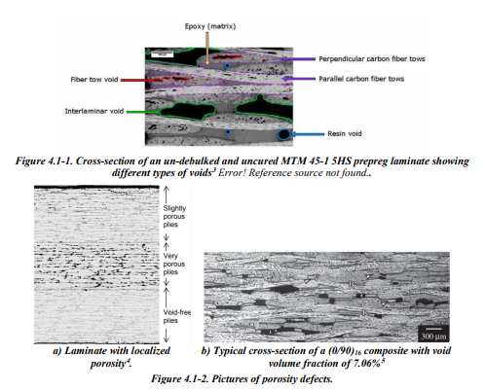
Subject Matter Expert Definitions of Flaw Types

Slide 13
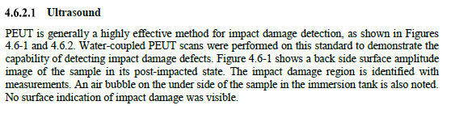
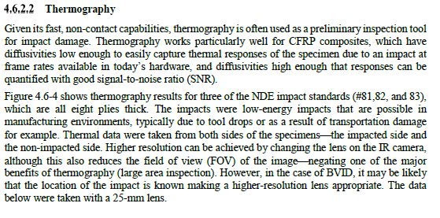
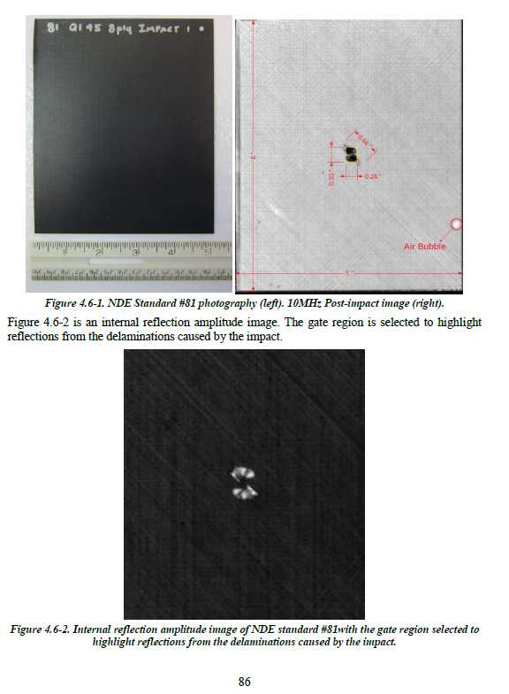
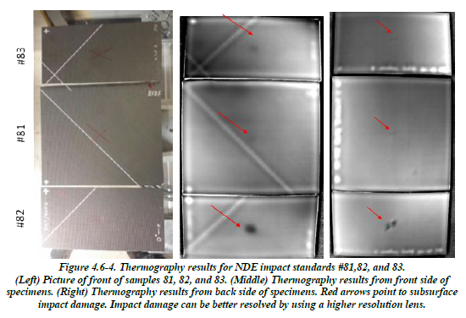
Comparison of Different Inspection
Techniques on Same Set of Flaws

Slide 14
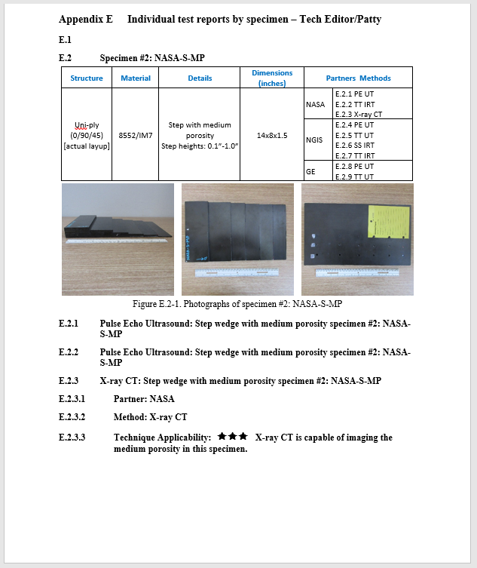
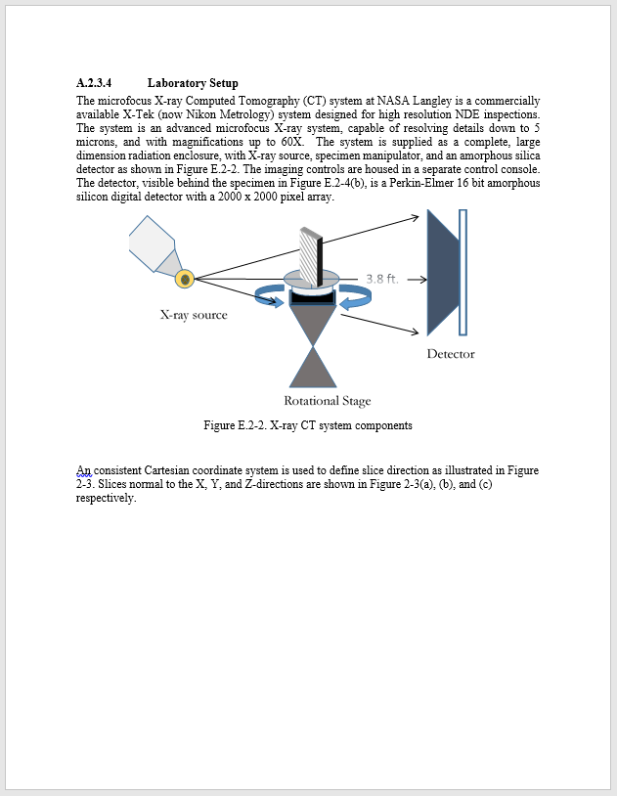
Extensive Documentation of
Inspection Procedures
General laboratory setup
All tests performed
Stand-alone reports for each specimen by each technique by each partner
Photos
3rd test
Method
Partner
3 Star ‘Bottom Line’ specific to this method for this specimen

Slide 15
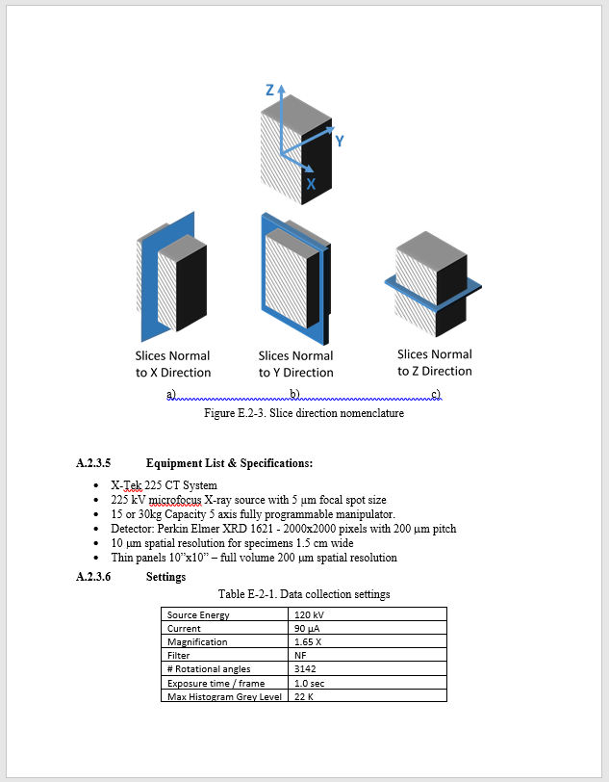
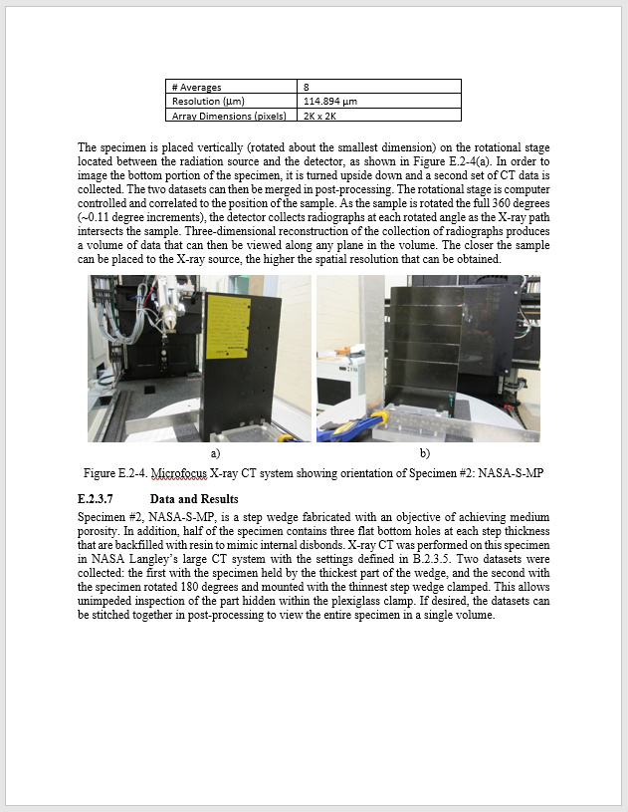
Extensive Documentation of
Inspection Procedures (cont)
Nomenclature explanation
Photos for orientation documentation
Specific laboratory setup
Data and Results
Equipment settings

Slide 16
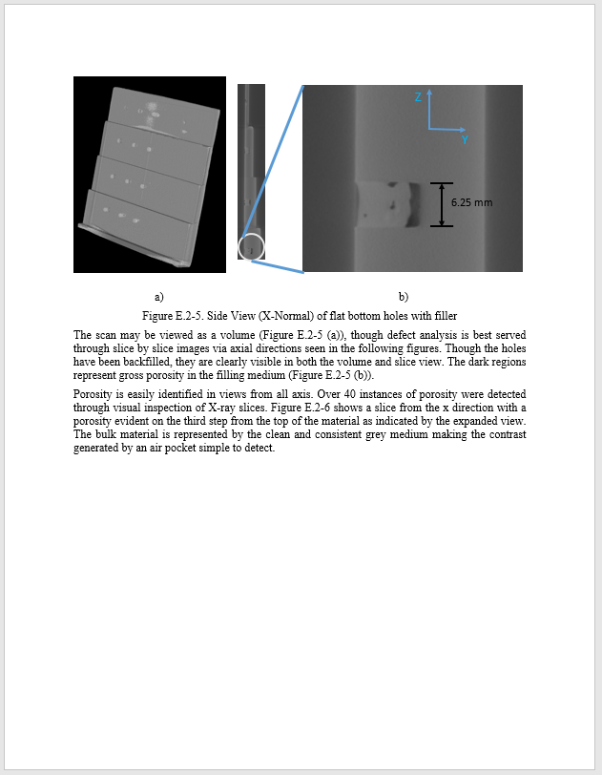
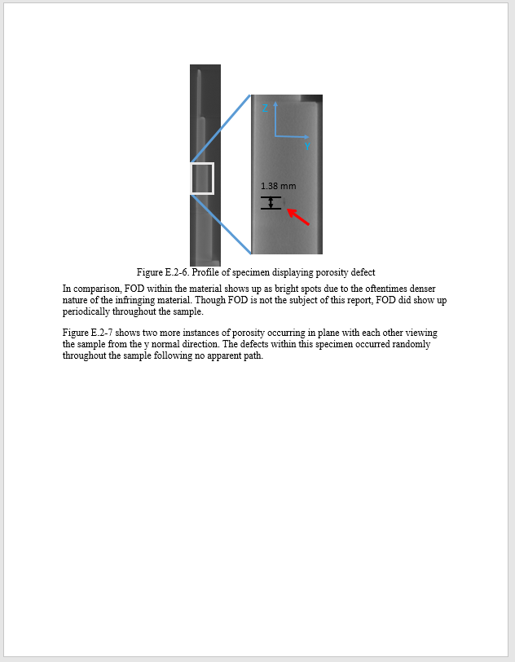
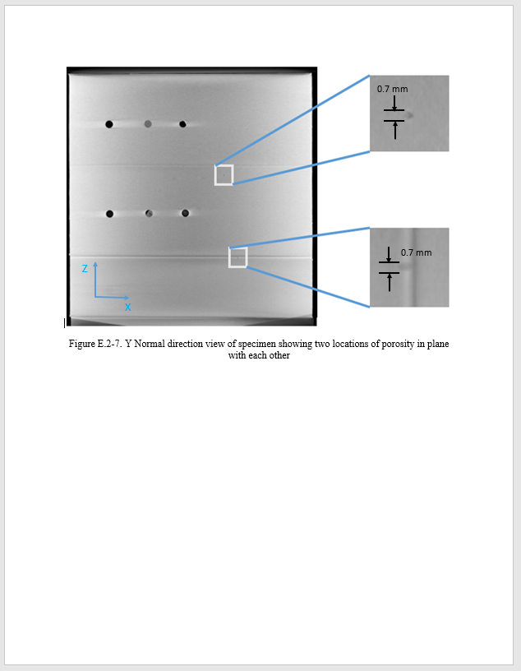
Extensive Documentation of
Inspection Procedures (cont)

Slide 17
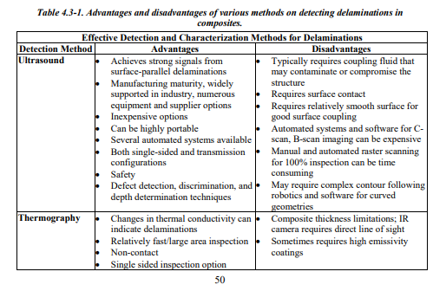
Inspection Procedures and Subject Matter Expertise Used to Compare Different Techniques for Detection of Given Flaw
Advantages and Disadvantages:
Effective Methods
Marginally Effective Methods
Ineffective Methods

Slide 18
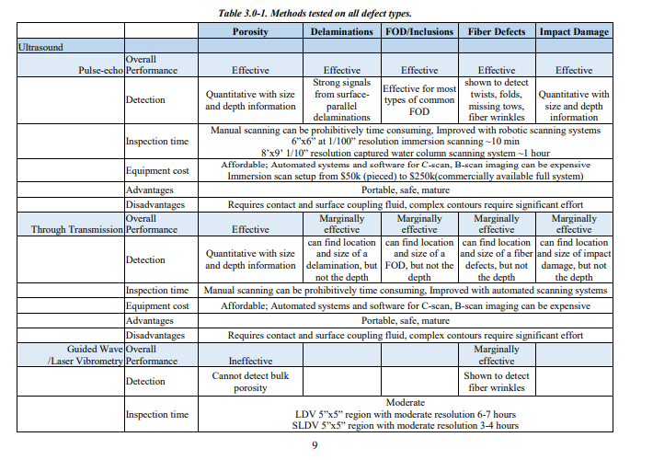
From Data, NDE Guidance Matrix Generated
Bottom line up front
Each technology for each defect type
Summary of metrics

Slide 19
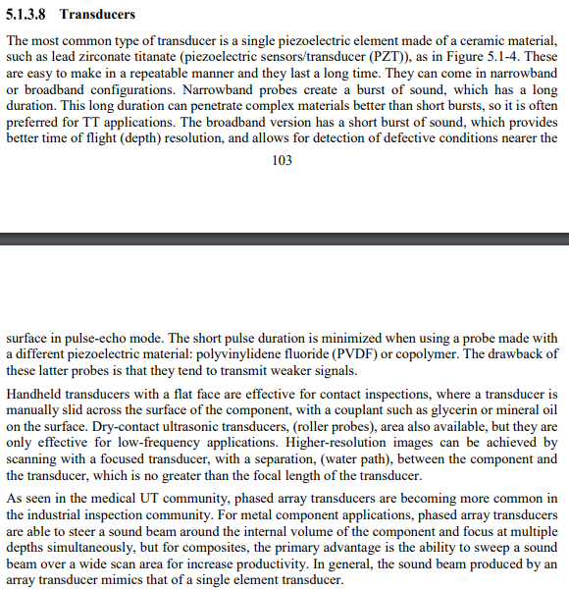
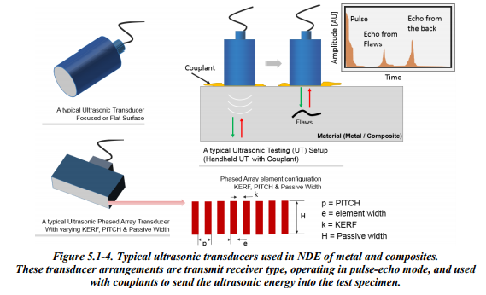
Physics Principles of Techniques Included in Handbook
Brief technical explanation of the physics of the technique.
Specifics important to the inspection of composites.
Types of defects that have successfully been analyzed with the techniques.
Important parameters, technique limits, differences in application of the technique for composites versus metals.
Data analysis techniques that have been used to quantify damage.

Slide 20
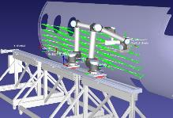
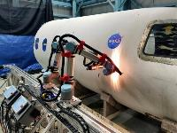
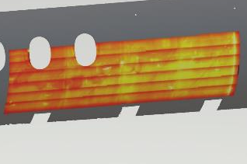
Results from Emerging Technologies
Present Problem: Manual Inspection Techniques
Larger skilled labor requirements
Manual positioning is imprecise
Unmeasured areas may go unnoticed
Human operators introduce variability
Reachable areas limited to operator flexibility
Solution: Automated Inspection Techniques
Fewer skilled labor requirements
Faster inspection speed with complete inspection coverage assurance
Offline programming allows offsite path and reach verification as well as interference detection.
Feature-based scan location registration enables precise repeatability(Digital Twin)

Slide 21


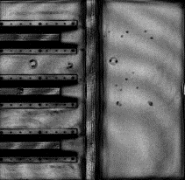
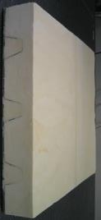
Inclusion of Techniques Not Viable for CFRP Composites
Carbon Fiber Composites
Ceramic composites
Glass fiber composites
Kevlar and Nomex fabrics
Moisture
Non-conducting honeycomb layups
Some types of chemicals and foreign materials
0.2 THz
Terahertz Data
Spray-on foam insulation

Slide 22
NASA/TM-2020-220568/Volume II
NDE Methods and Capabilities Handbook Appendices
7.0 Appendices
  A. State of Practice Survey Report
  B. Photos and Descriptions – Listed by Defect Type
  C. Round Robin Testing
  D. Manufacturing documents and Validation reports
  E. Individual test reports by specimen
  ~ 650 pages of NDE results on round robin specimens
Notes:
Volume II split into 5 parts, totals 862 pages
Full handbook 1078 pages

Slide 23
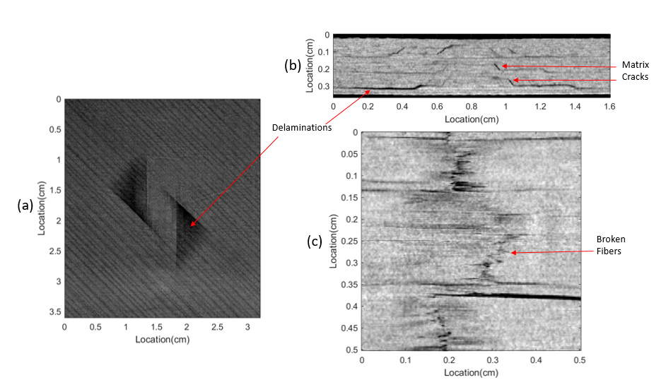
NDE Methods and Capabilities Handbook Products
NDE Methods and Capabilities Handbook NASA/TM-2020-220568
  A publically available guidance document that facilitates the selection of appropriate NDE Techniques and provides recommended protocols for detecting and characterizing common flaw types in complex composite structures.
A Unique Resources for NDE Community
  NDE Standards Library: 88 Well-characterized NDE Composite Standards
  Digital records of preprocessed inspection data acquired on select specimens: verification, algorithm development, and machine learning
Acceptance by Industry
  Referenced by The Composite Materials Handbook-17 (CMH-17). CMH-17 provides information and guidance necessary to design and fabricate end items from composite materials. Its primary purpose is the standardization of engineering data development methodologies related to testing, data reduction, and data reporting of property data for current and emerging composite materials.
#1
Thermography of ply wrinkles
X-ray CT of Impact Damage
#2
#3
Ultrasound of imbedded flaws in S-curve Panels
#4

Slide 24
How to Obtain Resources
Handbook: NASA Technical Reports Server
  http://ntrs.nasa.gov
Specimens and Data: Space Act Agreement with National Institute for Aviation Research (NIAR)
On hold due to COVID-19
  http://nde.larc.nasa.gov and click on “NDE Standards Library” for up-to-date info

