Slide 1

World Data Systems Forum
Earth Science Data and Information System (ESDIS) Project Update
Jeanne Behnke & Chris Lynnes
Jeanne.Behnke@nasa.gov/Christopher.S.Lynnes@nasa.gov https://earthdata.nasa.gov
ESDIS Project, NASA GSFC
September 2020

Slide 2
EOSDIS Distributed Active Archive Centers
LPDAAC
Land Processes
SEDAC
Human Interactions in Global Change
PO.DAAC
Physical Oceanography
LAADS
Atmosphere
CDDIS
Crustal Dynamics
ASF DAAC
Synthetic Aperture Radar
GES DISC
Atmosphere
Modeling
Hydrology
OB.DAAC
Ocean Biosphere
ASF: Alaska Satellite Facility
LP: Land Processes
PO: Physical Oceanography
OB: Ocean Biology
ORNL: Oak Ridge National Laboratory
NSIDC: National Snow and Ice Data Center
GHRC: Global Hydrology Research Center
ASDC: Atmospheric Science Data Center
CDDIS: Crustal Dynamics Data and Information System
SEDAC: Socio-Economic Data and Applications Center
LAADS: Level 1 and Atmosphere Archive and DIstribution System
GES DISC: Goddard Earth Sciences Data and Informations Services Center
NSIDC DAAC
Cryosphere
ORNL
Biogeochemical Dynamics
ASDC
Radiation Budget
Troposphere
GHRC
Severe Weather
2
Notes:
The actual data in EOSDIS are stored and managed by 12 Distributed Active Archive Centers, colloquially known as DAACs, and they literally span the nation from coast to coast. To Coast. They have been storing and distributing data since the early 1990s, quite successfully. But things are changing, both in the amount of data and the technology available to us for managing and working with them.

Slide 3

One more thing...
Notes:
In the current on-premise world, if a user wants to use datasets from multiple DAACs together, they pretty much have to download them to their own space.

Slide 4
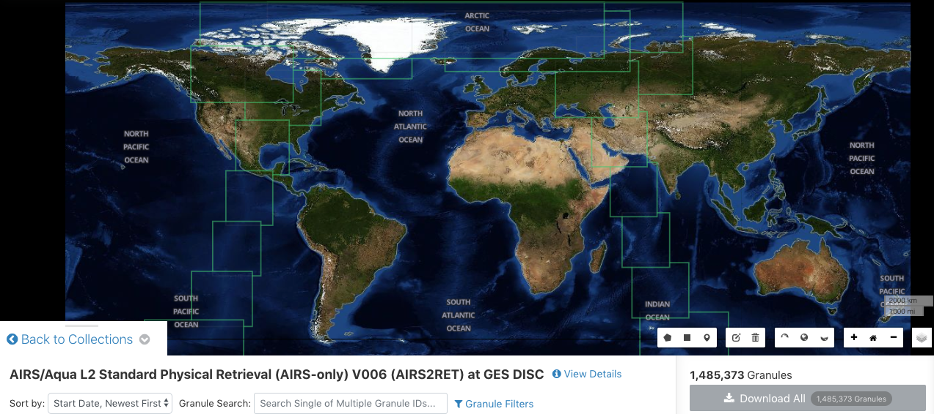

The Data Deluge - Pieces
Trying to look at surface temperature trends from AIRS Swaths over the globe...
Notes:
YIKES! Never a good sign when your results count needs two commas.

Slide 5

Hey, we’re going to have an EOSDIS “Data Lake”!
Notes:
But by putting the data in the cloud, we have created a data lake, where it should be easier for the users to use the data together, again without having to move or manage all these bits of data.

