Slide 1

Characterization of Composite Damage using Passive Thermography
Joseph N. Zalameda
NASA Langley Research Center
Hampton, VA 23681
NDT in Aerospace Conference Oct. 8, 2020

Slide 2
Outline
Introduction
Passive Thermography
  Single Stringer Panel Quasi-static Loading
    Imaging for Damage Growth with Ultrasonic and X-ray CT Comparisons
Reduction of Thermal Data for Damage Depth
  Model Fit to the Thermal Data (Fatigue and Quasi-static Loading)
Single Stringer Panel Fatigue (Cyclic) Loading
    Imaging for Damage Growth
Conclusions

Slide 3
Passive Thermography vs. Active Thermography
In a general sense both require energy: application or removal to produce temperature differences.
Active thermography implies control of the energy for the inspection (flash, quartz lamp, ultrasonic, microwave, hot air, etc.).
Passive thermography implies no control of the energy, simply observing (environmental heating, moisture detection, structural loading, etc.).

Slide 4
Introduction: Passive Thermography for Structural Testing
Objectives
Real time inspection for early detection of onset damage and controlled growth of damage up to failure.
In-situ wide area real time inspections on composite structures during load testing using passive thermography.
Implementation of a detailed inspection (ultrasonics or X-ray CT) for through thickness detail.
Payoffs
Early detection and quantitative measurement of damage onset and growth validates test articles and feeds damage prediction models which decreases certification times.
Notes:
While testing composite structures – CG with real time NDE, passive thermography lets you know the damage state of the entire structure while loading,. Stop load testing when we see damage growth and do UT or X-ray CT. also PT documents the failure of the structure
This work was done under NASA’s advanced composite project.

Slide 5
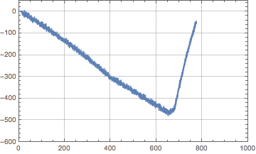
Quasi-Static Load Configuration
Applied Load
Load (Pounds)
Time (Seconds)
Testing is composed of multiple load runs and each last approximately 15 to 25 minutes, acquired thermal data is approximately 60 Gigabytes of data.

Slide 6
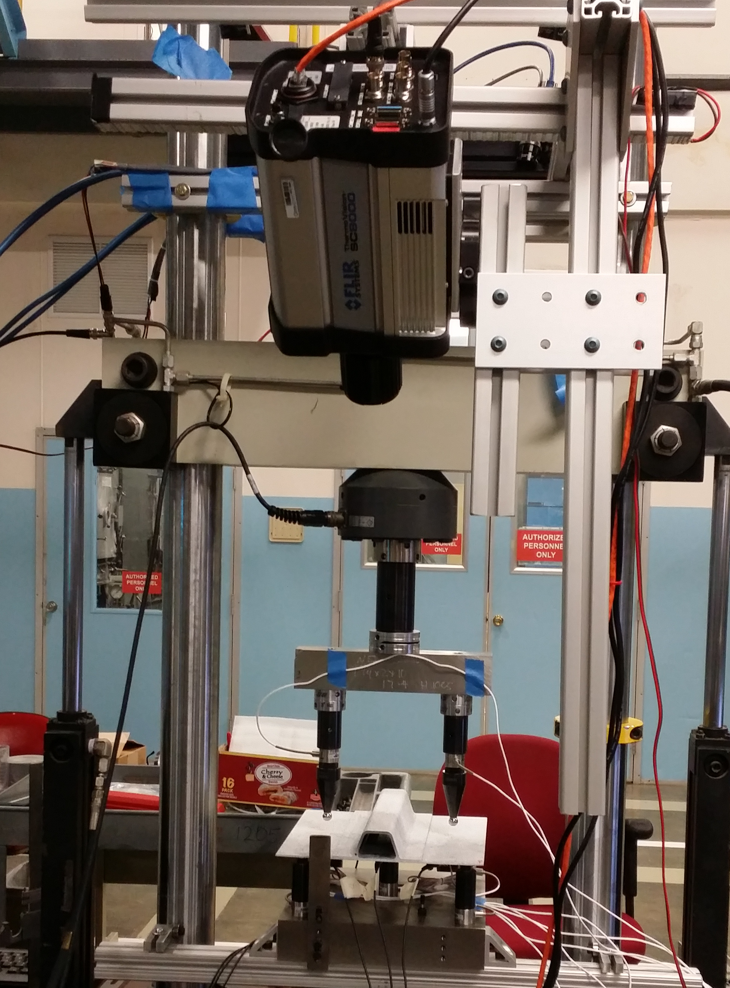
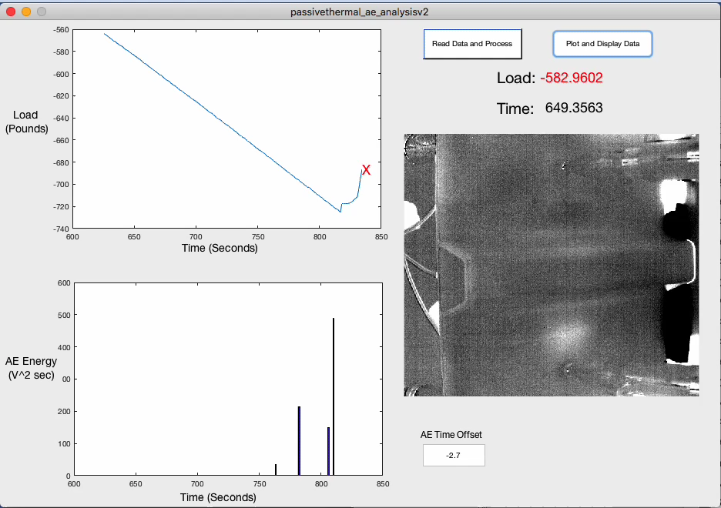
Single Stringer Panel Quasi-static Loading
IR Camera
Single Stringer Panel
Skin is 12 plies (0.22 cm thick), stiffener flange is woven composite 12 plies (0.24 cm thick), camera is synchronized to loading, 640 x 512 cooled InSb sensor, 25 mm Ge optics, and load is acquired for each frame, frame rate of camera is 80 -180Hz, applied load to over 1,000 pounds typically over 15 – 25 minutes.

Slide 7
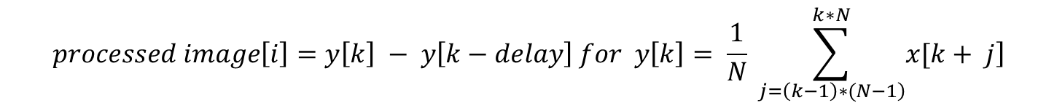
Processing of Thermal Data using a Delayed Subtraction
$$processed image\left[i\right]=y\left[k\right] − y\left[k−delay\right] for y\left[k\right]= \frac{1}{N} \sum_{\left.j=\left(k−1\right)∗(N−1\right)}^{k∗N}{\left.x[k+ j\right]}$$
Y[k] is the averaged thermal image, x[k + j] is the raw acquired thermal image (rate = 80 Hz), j is the acquired image number, k is the averaged image number, N is the number of boxcar averages (typically 10), delay is the offset subtracted averaged image (typically 100), and i is the processed image number.

Slide 8
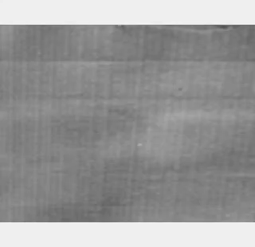
Thermal Imaging of Damage Formation

Slide 9

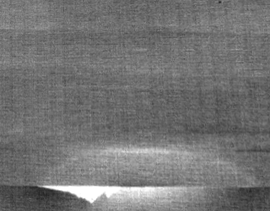
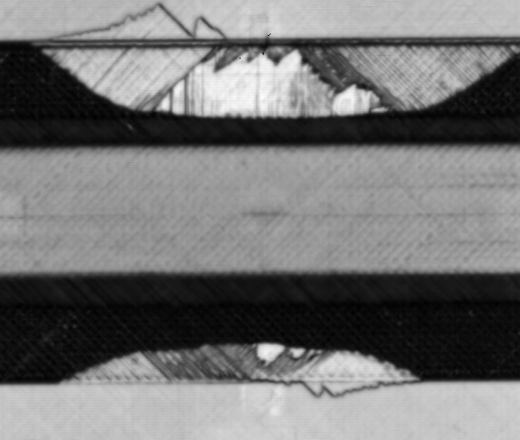
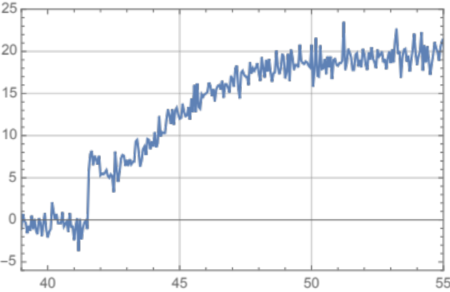
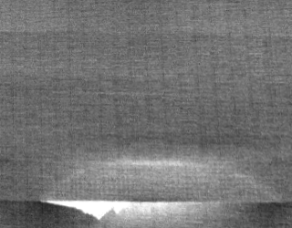
Single Stringer Panel Quasi-static Loading Thermal Responses
Next Image:
Elapsed Time = 0.056 seconds
Before Failure
Ultrasonic Inspection
7.6 cm
Instantaneous Heating
Single Pixel Plot
Instantaneous Heating Image
7.6 cm
Temperature (Counts)
Time (Seconds)

Slide 10
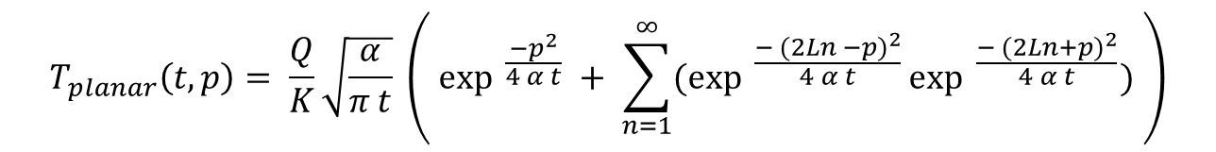
1-Dimensional Series Solution for a Planar Heat Source and Thermoelastic Heat Source
Infrared Camera
Winfree, W. P., Zalameda, J. N., and Michael R. Horne, “Simulations of Thermal Signatures of Damage Measured during Quasi-Static Loading of a Single Stringer Panel”, AIP Conference Proceedings 2102, 120007 (2019); https://doi.org/10.1063/1.5099849, Published Online: 08 May 2019.
Stiffener Flange
Thickness = L
T (t)
Heat Flux
depth = p
Heat Source
from Damage
at depth = l
Skin
$$T_{planar}\left(t, p\right)= \frac{Q}{K}\sqrt{\frac{α}{π t}} \left( {\exp{ }}^{\frac{−p^{2}}{4 α t}} + \sum_{n=1}^{∞}{({\exp{ }}^{\frac{− {(2Ln −p)}^{2}}{4 α t}}{\exp{ }}^{\frac{− {(2Ln+p)}^{2}}{4 α t}})} \right)$$
$${Instantaneous Respone : T}_{thermoelastic}\left(t\right)= \int_{0}^{l}{E_{0}\left(1 −\frac{2p}{l}\right)T_{planar}\left(t, p\right) dp}$$
$$Instantaneous Respone +Transient: T\left(t\right)=\int_{0}^{l}{E_{0}\left(1 −\frac{2p}{l}\right)T_{planar}\left(t, p\right) dp}+T_{planar}\left(t, L,l\right)$$
Notes:
The transient heating can be modeled with a simple 1-d thermal model

Slide 11
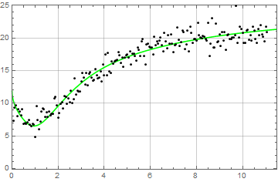
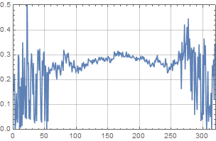
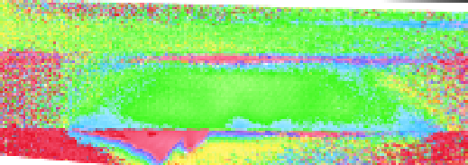
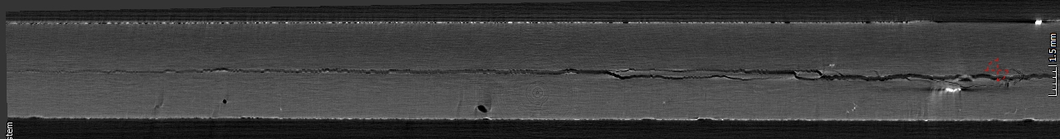

Model Fit to Data and Imaging of Damage Depth
Single Pixel Plot with Model Fit
Line Plot
0.4 cm
Thermal Thickness Image
Temperature (Counts)
Thickness (cm)
Data:
2.5 cm
Model:
0.0 cm
Position (pixels)
Time (Seconds)
Center of Crack
Position (pixels)
0.24 cm Depth
0.29 cm Depth
X-ray CT Cross Section Slice
Stiffener Flange Side
Skin Side
Crack at Multiple Interfaces
Notes:
The transient heating can be modeled with a simple 1-d thermal model

Slide 12
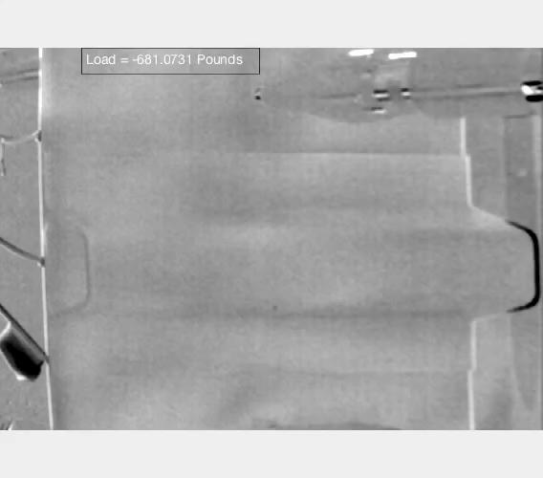
Thermal Imaging of Damage Formation:
Small Delamination

Slide 13
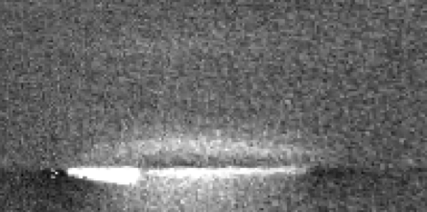
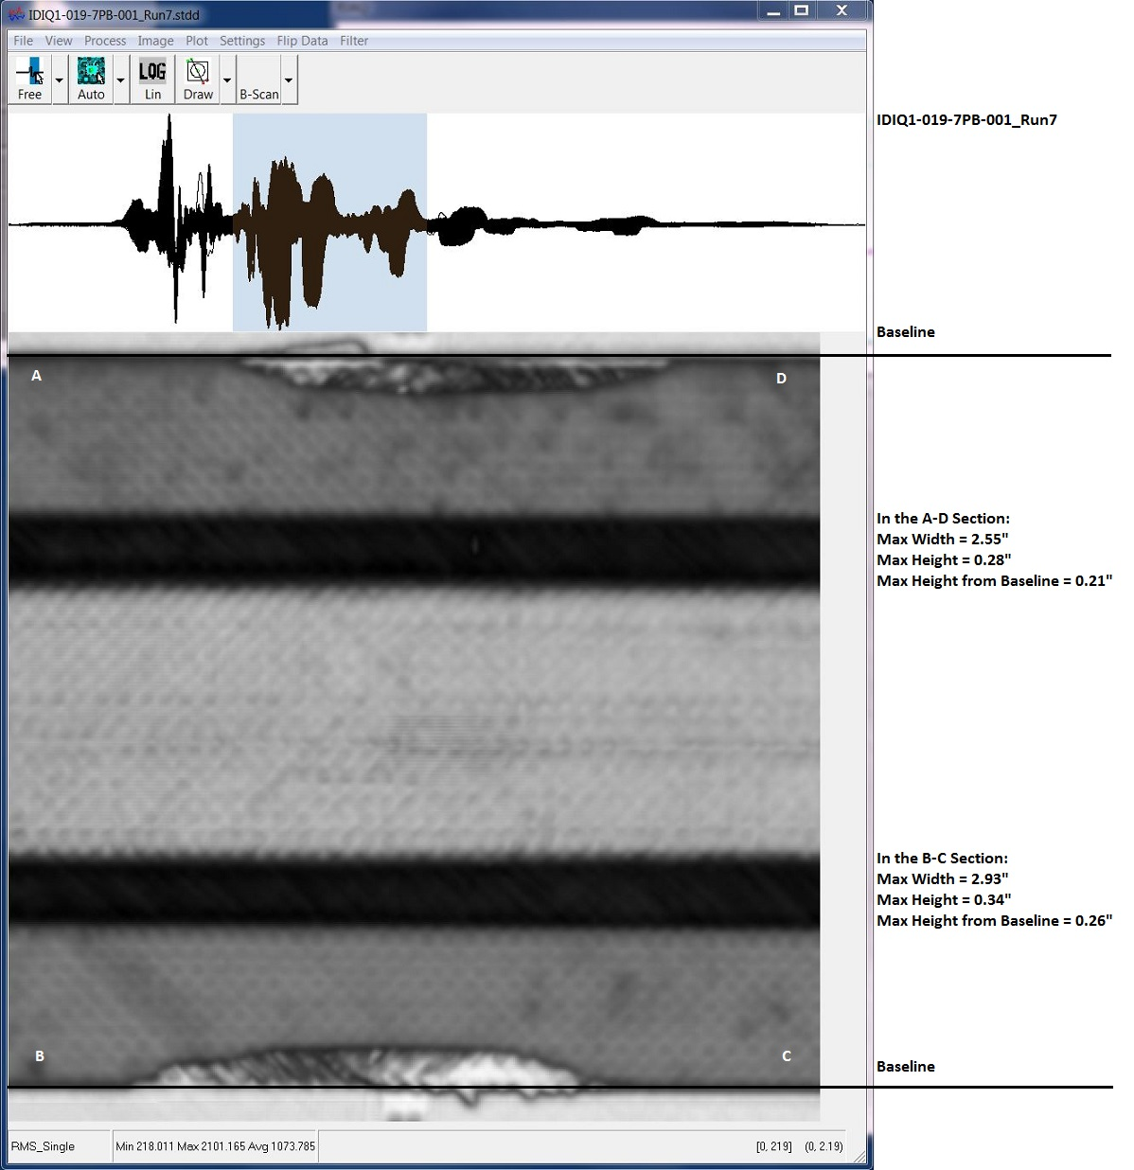
Thermal Inspection Results: Small Delamination
Next Image:
Elapsed Time = 0.125 seconds
Before Failure
Ultrasonic Inspection
2.5 cm
Instantaneous Heating
Instantaneous Heating Image
Single Pixel Plot
2.5 cm
Temperature (Counts)
Time (Seconds)

Slide 14
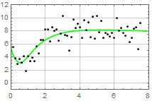
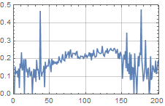

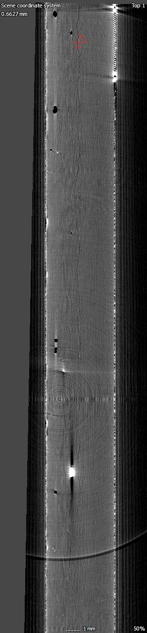
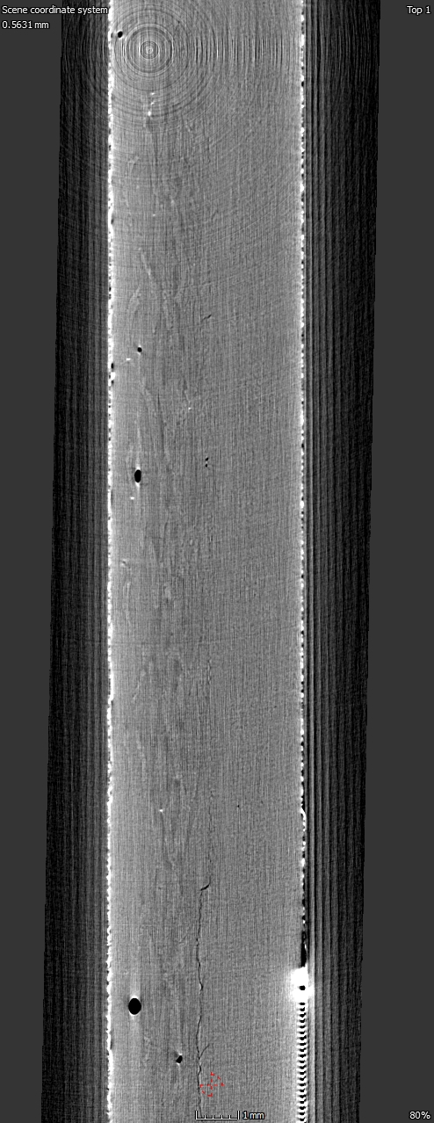
Thermal Imaging of Damage Depth with Comparison to X-ray CT: Small Delamination
Pixel Plot with Model Fit
0.4 cm
Line Plot
Thermal Damage Depth Image
Temperature (Counts)
2.5 cm
Thickness (cm)
Data:
Model:
0.0 cm
Position (pixels)
Time (Seconds)
Center of Crack
Stiffener Flange Side
0.2 cm Depth
X-ray CT Cross Section Slice
Skin Side
Skin Side Strain Gauge

Slide 15
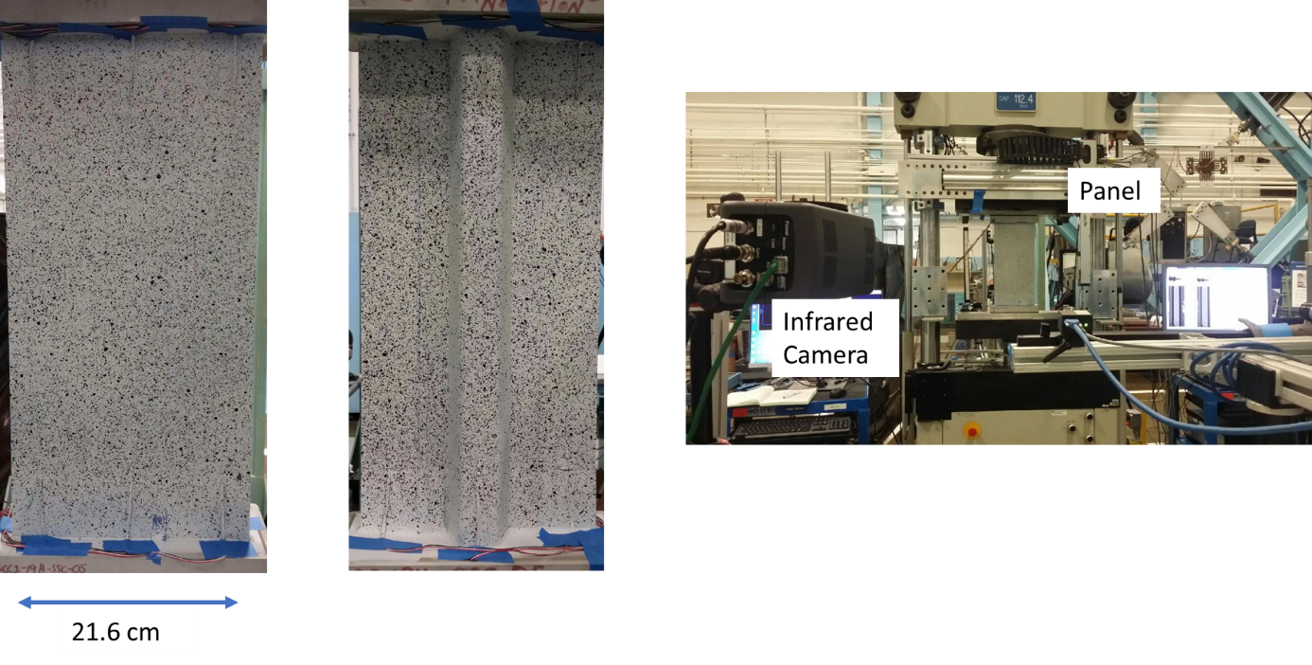
Single Stringer Panel with Fatigue Loading
Skin is 12 plies (0.22 cm thick), stiffener flange is woven composite 12 plies (0.24 cm thick), frequency of loading = 2 Hz, and maximum compressive load is -25,000 pounds, camera is synchronized to loading, 640 x 512 cooled InSb sensor, 25 mm Ge optics, and load is acquired for each frame.

Slide 16
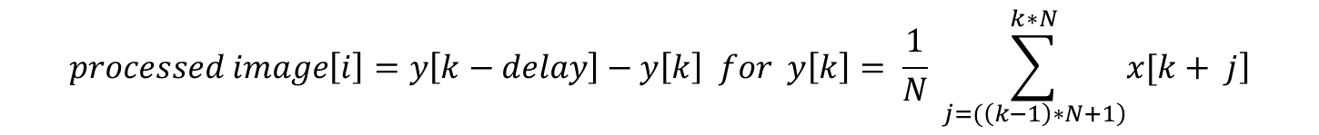
Data Processing for Rapid Growth Damage Response (Single Stringer)
$$processed image\left[i\right]=y\left[k−delay\right]−y\left[k\right] for y\left[k\right]= \frac{1}{N} \sum_{\left.j=(\left(k−1\right)∗N+1\right)}^{k∗N}{\left.x[k+ j\right]}$$
Frequency of loading = 2 Hz. Y[k] is the averaged thermal image, x[k + j] is the raw acquired thermal images (80 Hz), j is the acquired image number, k is the averaged image number, i is the processed image number, N = 40 is the number of boxcar averages, j is the acquired image number, delay = 25 is the offset subtracted averaged image.
Parameter for processing behaves as a simple notch filter.
Delay is sufficient to capture transient thermal response 12.5 seconds or less.
Notes:
Non periodic processing, is same but use 40 averaged images to filter out the periodic response (behaves as a simple notch filter), any signal at 2 Hz and its harmonics are removed, use longer delay subtraction of 25 averaged images.

Slide 17
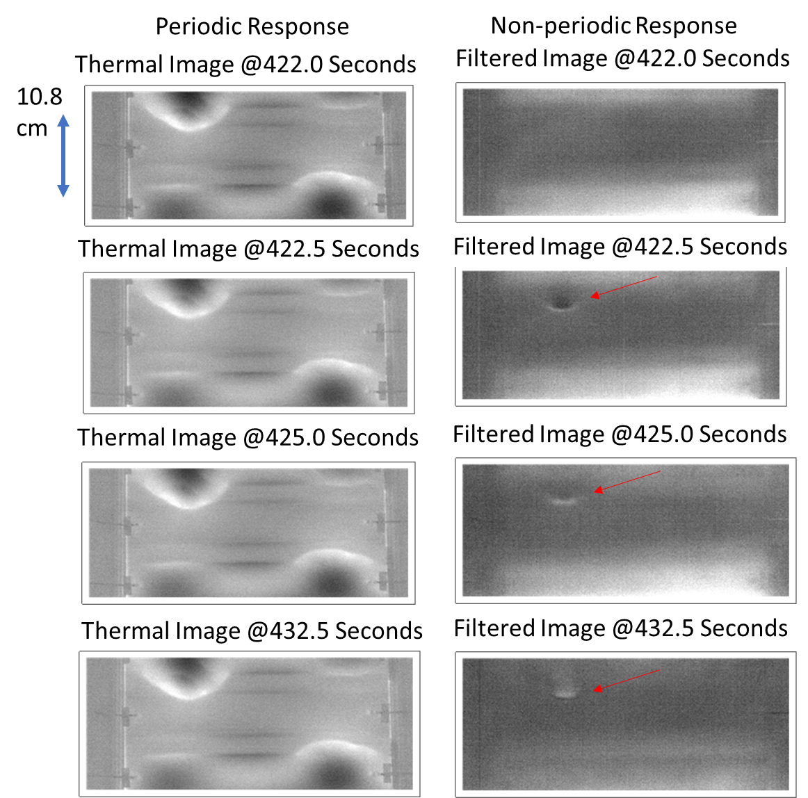
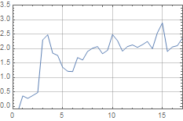
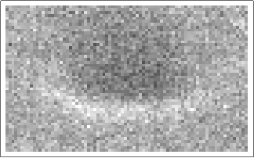
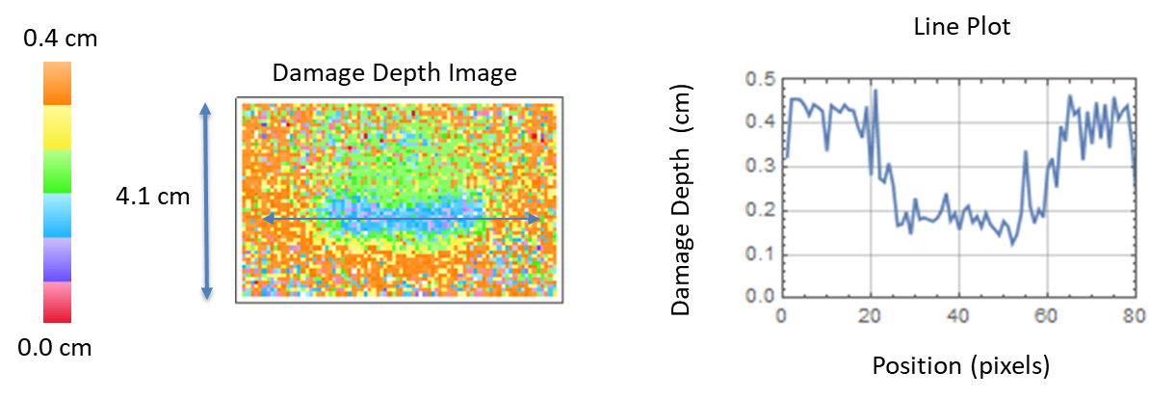
Comparison of Periodic to Rapid Growth Thermal Responses with Model Fit Results
Transient
Heating
Instantaneous Heating
Averaged Pixels Plot
Temperature (Counts)
4.1 cm
Time (Seconds)
Notes:
Single stringer panel, left is periodic response dominated by the TE heating, right is the non-periodic response with the 2 hz TE heating filtered out., see this rapid growth heating at 422.5 seconds and it stays for over 10 seconds.

Slide 18
Conclusions
Passive thermography has been shown to be an effective real time NDE technique for composite panels during quasi-static and fatigue loading.
A recently developed model was used to process the passive thermal data to obtain damage depth of rapid growth damage using the both the instantaneous and the transient thermal responses. This was demonstrated for quasi-static loading.
Using notch filtering, the periodic response was removed and the non-periodic (rapid growth) thermal response was captured and thus allowing the damage depth imaging.
Notes:
With passive thermography we can detect the location, size and depth of the rapid growth damage

