Slide 1
New Capabilities in MAPL
T. Clune
Atanas Trayanov, Arlindo da Silva,
Ben Auer, William Jamieson, Matt Thompson
Hamid Oloso, and Weiyuan Jiang
Notes:
Abstract:
MAPL is an ESMF-based coupling layer within the GEOS data assimilation system and continues to evolve in response to novel
coupling requirements. New features include (1) a generic NUOPC wrapper which allows MAPL components to be used within a NUOPC-based
application, (2) expansion of couplers to include connecting component-provided services, (3) exploiting recent ESMF advances to
provide threading for column physics without direct OpenMP instrumentation, and (4) asynchronous input for demanding CTM configurations.

Slide 2
Outline
What is MAPL
What’s new
  mepo – holistic approach to multi-repo git
  ESMF-enabled shortcut for hybrid MPI + OpenMP
  MAPL-NUOPC interoperability layer
  Subscriber-Provider services
What’s next

Slide 3
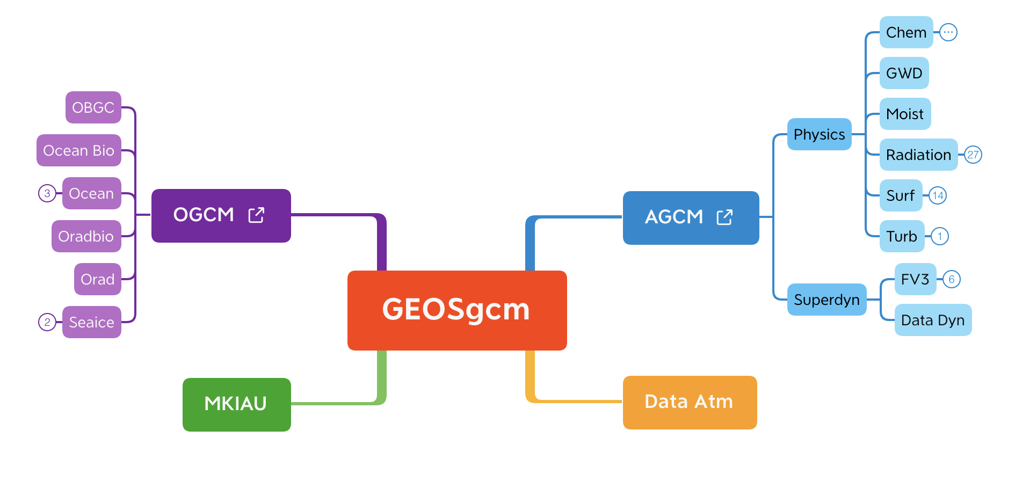
What is MAPL
MAPL: a framework on top of ESMF to simplify the creation and use of ESMF gridded components in a hierarchical architecture
  Easy specification of import, export, and internal states
  Easy addition of child components
  Default implementation for checkpoint/restart.
  Framework standard gridded components:
    History – run time configurable output
    ExtData - configurable input – imports of last resort
    Cap – drives hierarchy; manages History+ExtData
  Wrap user-specified ESMF entry points to
    Instantiation of fields, est. field connections,
    Profile (time and memory)
    Insert couplers (when needed)
  Enforce conventions
Similar motivations have led to NUOPC but unfortunately the details diverged.

Slide 4
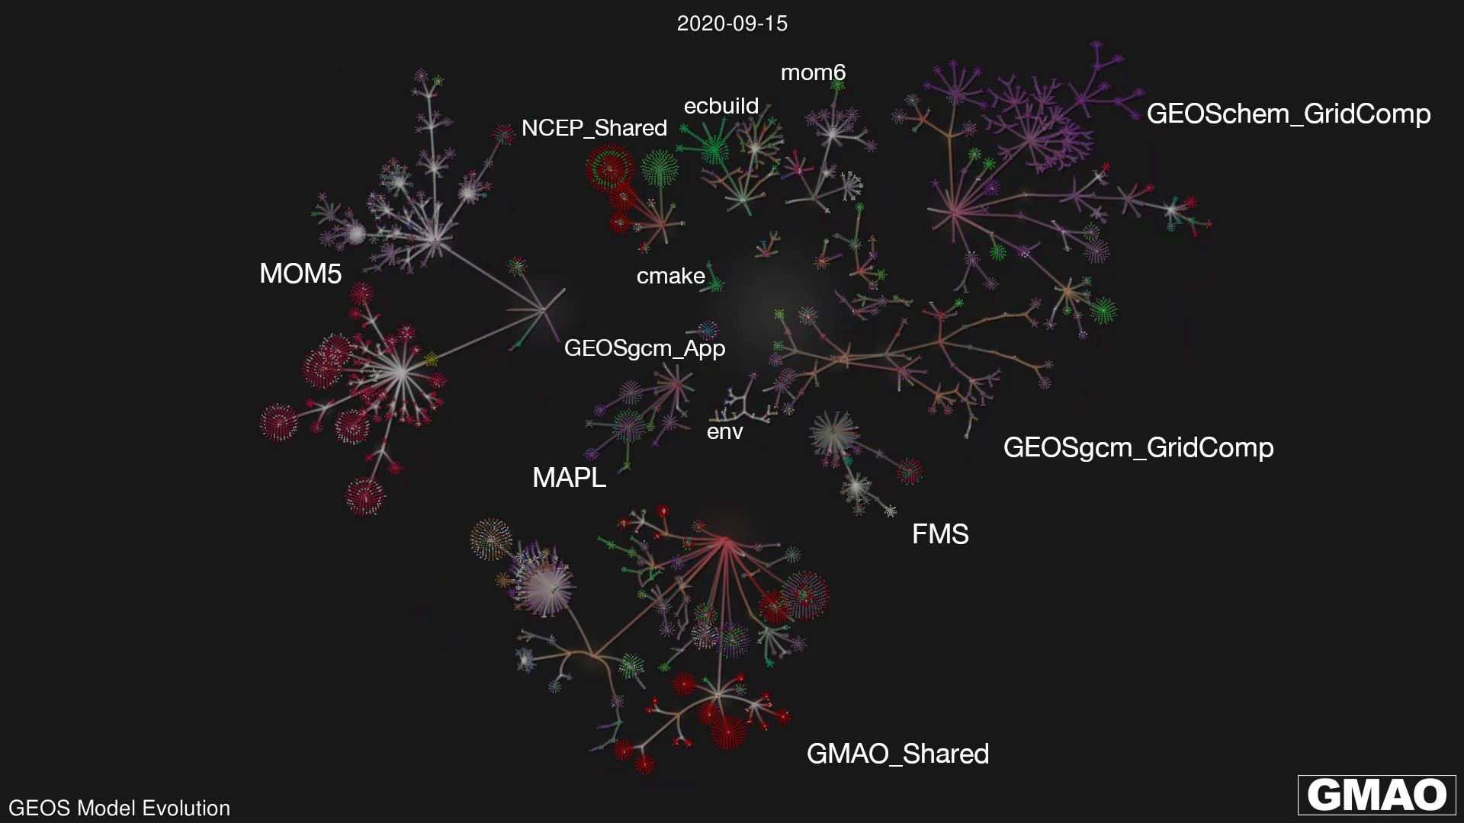
Notes:
Multi-organizational management of shared components. Cmake, fine grained Git repositories.

Slide 5
mepo
Driver: Simplify routine development with nested Git repositories
Available technologies:
  Git submodules
  Git subtree
  Manage Externals
Solution: Extensible Python package mepo (https://github.com/GEOS-ESM/mepo)
  Typical syntax: $ mepo <git-command> <git-options> <repo-list>
Currently supported commands
  clone
  status
  diff
  fetch
  checkout
  branch
  commit
  push
  init
  stage
  tag
  stash
  list
  checkout-if-exists
  develop
  compare
  whereis
  stage
  unstage
  save
  restore-state
  fetch-all
  pull-all
M. Thompson, T. Clune,
P. Chakraborty, & A. da Silva

Slide 6
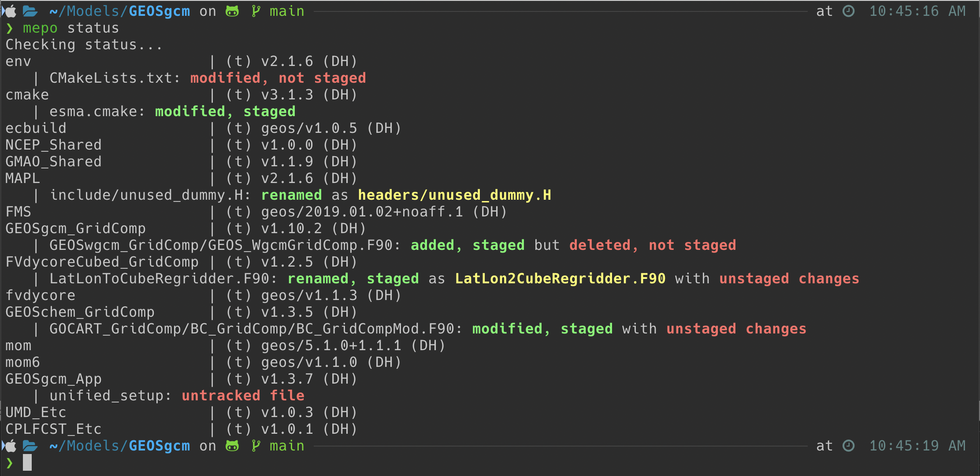

Slide 7
mepo (cont’d)
Top level YAML config file
  Mount point in src tree
  URL of repo to clone
  Tag/branch
  Optional path to sparse checkout
  Name of “develop” branch (for GitFlow)
Caveats
  Single config – not nested (design tradeoff)
  Just Git; no SVN (or CVS)
GMAO_Shared:
local: ./src/Shared/@GMAO_Shared
remote: ../GMAO_Shared.git
tag: v1.1.8
sparse: ./config/GMAO_Shared.sparse
develop: main
MAPL:
local: ./src/Shared/@MAPL
remote: ../MAPL.git
tag: v2.1.6
develop: develop
FMS:
local: ./src/Shared/@FMS
remote: ../FMS.git
tag: geos/2019.01.02+noaff.1
develop: geos/release/2019.01

Slide 8
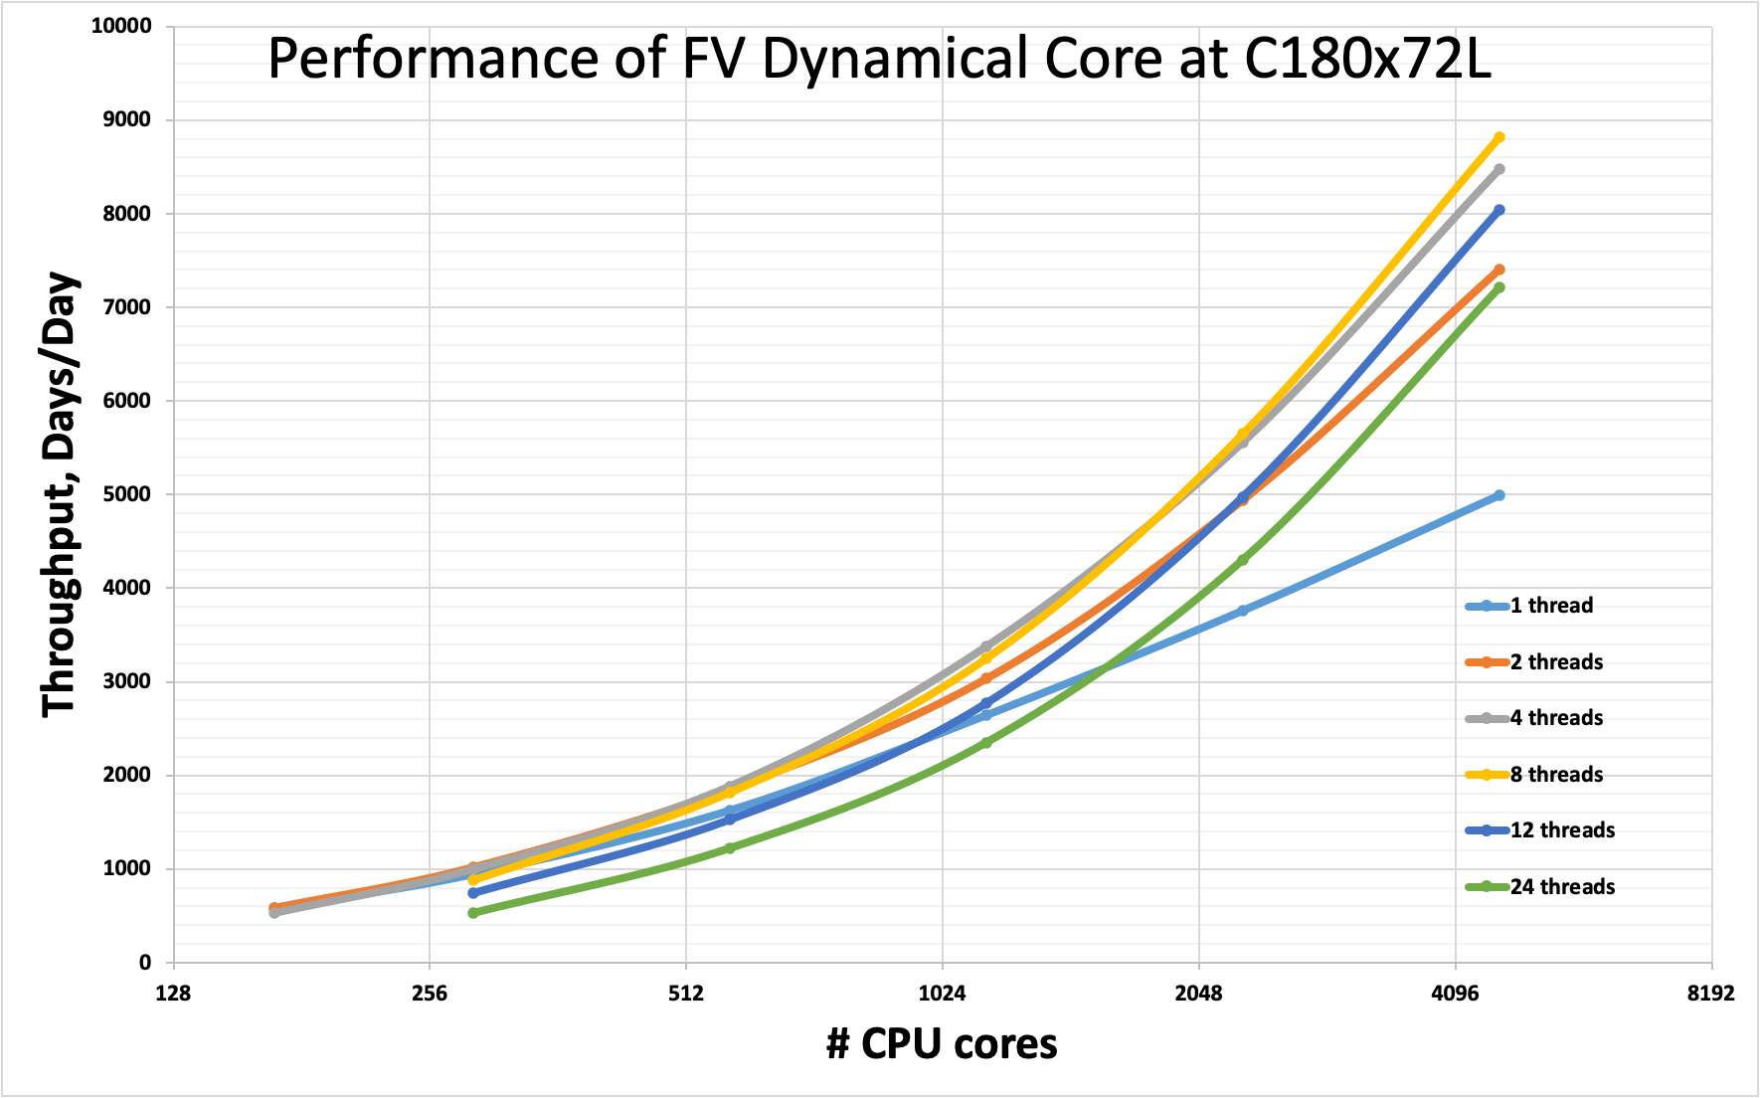
ESMF-enabled MPI+OpenMP
Driver:
  Hybrid MPI+OpenMPI improves perf of FV core by up to 50% at extreme scales.
  Legacy parameterizations not (properly) instrumented with OpenMP.
Solution: Use ESMF to couple pure-MPI physics with hybrid FV.
  ESMF idles subset of PETs; FV launches OMP threads during
  Data transferred using ESMF shared-image Field data storage
    Low overhead – copy required due to halos anyway
Results encouraging on synthetic example
Investigating why pinning seems to go wonky with full use case.
A. Oloso, T.Clune, & G. Theurich

Slide 9
MAPL NUOPC Compatibility Layer
Drivers:
  Concurrent execution of MAPL components – e.g. CTM driven by GCM
  Run MAPL components within a NUOPC architecture – e.g. GOCART aerosols inside NOAA UFS
Major issues:
  Conflicts between initialization phasing
  Grid sharing
  Data pointer sharing (performance)
Near term solution – Develop a generic NUOPC-MAPL Cap
  New top-level config options:
    Specify which fields are to imported/exported (using “standard” names).
    Specifier for whether pointer is shared and/or which side allocates
  Extend MAPL VarSpec to include new config options
  Extend MAPL internal logic to
    handle variant allocation cases
    receive externally specified grid
W. Jamieson, T. Clune, & A. da Silva

Slide 10
Any MAPL component can go here.
MAPL Cap
ExtData
Root Component
History
Child 1
Child 2
…
MAPL Generic Services

Slide 11
NUOPC Model
NUOPC-MAPL cap
This is a NUOPC cap, but generic for any MAPL component.
Config
File
MAPL Cap
Minor modifications for new config options.
ExtData
Root Component
History
Child 1
Child 2
…
MAPL Generic Services
Minor modifications to internals to enable new use cases

Slide 12

NUOPC
NUOPC-MAPL Cap
Export pointers
and grid
Import pointers
and grid
Import pointers; export grid
Export pointers; import grid
Set Services
Set Services
Set Services
Set Services
Phase 0
Advertise
Transfer
Initialize
Initialize 1
Receive
Accept
Realize
Initialize
Initialize 2
CTM Use Case
GOCART
UFS

Slide 13
Provider – Subscriber Services
(generalization of data-services)
Drivers:
  Simplify inter-component coordination of services such as advection, convective transport, etc.
  Allow for dynamic selection of variant services
Example: Selectively advect some tracers with DynCore and others with AdvecCore with a longer timestep.
Concept:
“provider” component advertises service
call advertise_service(self, ‘advection’, bundle_name)
“subscriber” component requests service with label and list of field names
call subscribe_to_service(self, ‘advection’, my_fields)
common ancestor component specifies connection: {service, provider, subscriber}
call add_connection(‘advection’, provider=child_a, subscriber=child_b)
Under-the-hood: MAPL combines subscriber bundles into single import bundle for provider
A. Trayanov, T. Clune, & A. da Silva

Slide 14
What’s Next?
Major refactoring of MAPL core layers underway
  Clean OO design and comprehensive unit tests
  Generalize some increasingly inconvenient assumptions
  Switch from static libraries to dynamic loads
    Enable run-time configurability
    Eliminate dependencies between components (loose coupling)
  Replaces ESMF “classic” config files with YAML
Improved interoperability with NUOPC
  Either MAPL component ⬄ NUOPC cap
  Or MAPL components have factory method that produces a NUOPC cap
Share ExtData and History gridded components with community
  Refactor code and create comprehensive unit tests
  Enable server-side ESMF regridding
  Produce thorough tutorials/documentation

Slide 15
Questions?

