Slide 1
Realistic Thermographic Simulation of Impact Damage with Quadrupole Method
William P. Winfree, Joseph N. Zalameda and Patricia A. Howell
NASA Langley Research Center Hampton, VA 23681
2020 NDT in Aerospace Virtual Conference: October 6 – 8, 2020

Slide 2
Overview
Simulations assist in developing an understanding of the limitations of the technique and enable quantitative characterization of subsurface flaws
Quadrupole Method is used for rapid simulation of thermographic inspection of composites
This presentation:
  Examines the sensitivity of simulation to in-plane diffusivity and delamination contact resistance
  Based on the computed tomography characterization of impact damage in a composite, simulates the thermal response
  Compares the simulation results to experimental measurements
  Iterates on contact resistance to improve agreement between simulation and experiment

Slide 3
Quadrupole Method
Solves Laplace transform of heat equation, then inverts to temporal solution
Used extensively for 1-D layered systems
Extended to 3-D in particular for composites
  Previous methodology developed for single delamination at an interface between two layers
    Batsale, J., Maillet, D., and Degiovanni, A., International Journal of Heat and Mass Transfer 37 (1), 111, (1994).
    Bendada, A., Modelling and Simulation in Materials Science and. Engineering 10 (6), 673 (2002).
    Bendada, A., Erchiqui, F., and Lamontagne, M Inverse Problems 21 (3), 85 (2005)
    Winfree,W., Zalameda, J., Howell,P., and Cramer, E., Proc. SPIE 9861, Thermosense: Thermal Infrared Applications XXXVIII, 98610N (11 May 2016);
  Methodology developed for multiple delaminations at multiple interfaces between layers and plates that are not aligned
    Winfree, W., Zalameda, J. and Howell, P., Proc. SPIE 11004, Thermosense: Thermal Infrared Applications XLI, 110040F (2 May 2019)
    Winfree, W., Zalameda, J. and Howell, P., Thermosense: Thermal Infrared Applications XLII; 114090K (2020)

Slide 4
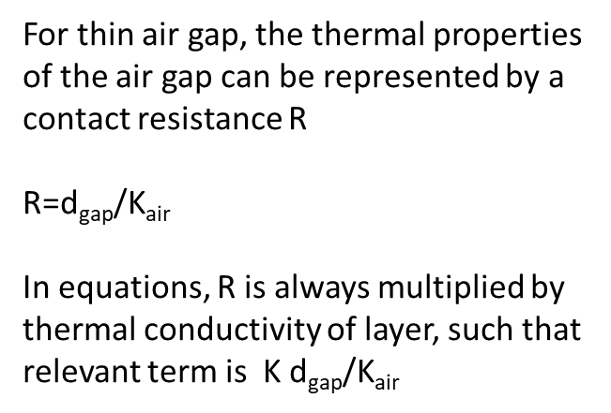
One-Dimensional Model of Two Layer System with Air Gap
Layer Thermal Conductivity(K), Thermal Diffusivity(κ), Thickness(d₁)
Thin Air Gap
d_{gap} Thickness
K_{air} Thermal Conductivity of Air
Layer Thermal Conductivity(K), Thermal Diffusivity(κ), Thickness(d₂)
For thin air gap, the thermal properties of the air gap can be represented by a contact resistance R
R=$\text{d}\text{gap}$/K_{air}
In equations, R is always multiplied by thermal conductivity of layer, such that relevant term is K d_{gap}/K_{air}

Slide 5
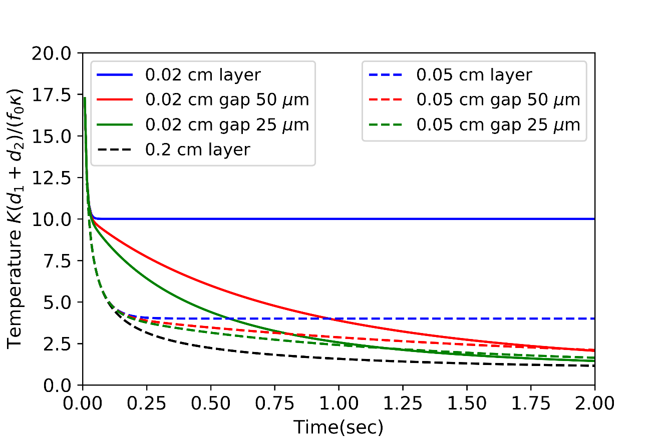
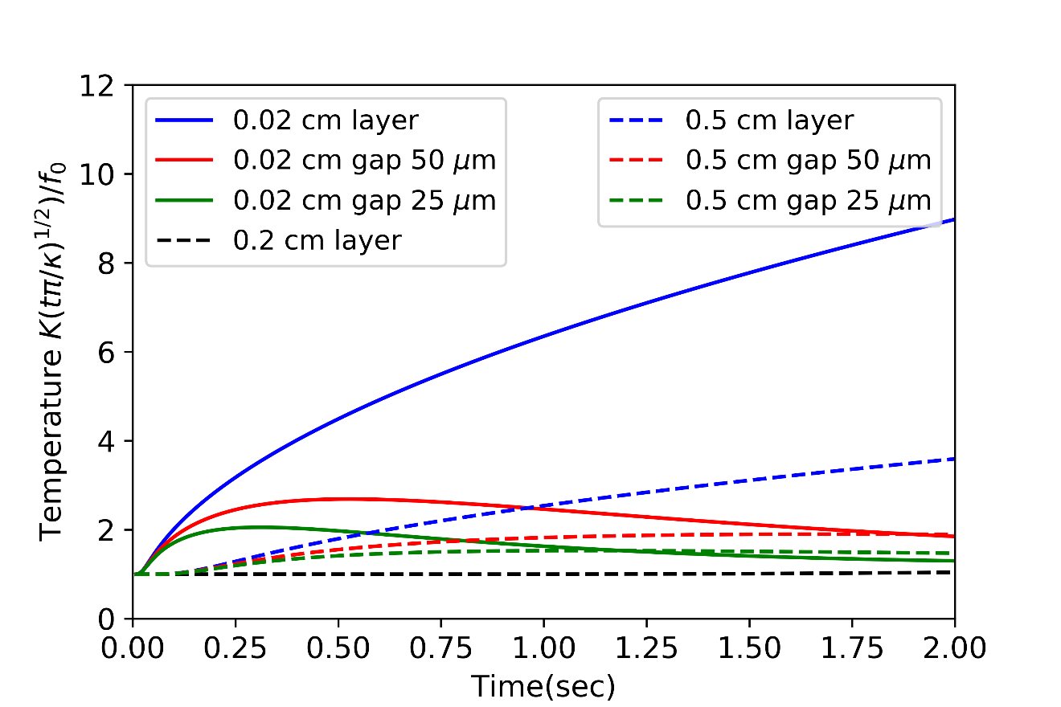
Gap Thickness Influence on
One-Dimensional Thermal Response
First layers are 0.02 cm and 0.05 cm thick
Second layers are 0.18 cm and 0.15 cm thick
Two different representation of the same data
Normalized by dividing by the combined heat capacities of the two layer and the input flux. For long times approaches 1 if contact resistance is less than infinity
Normalized by dividing by the response of a semi-infinite layer with the same thermal properties and the input flux. Thermal response is 1 for early times.

Slide 6
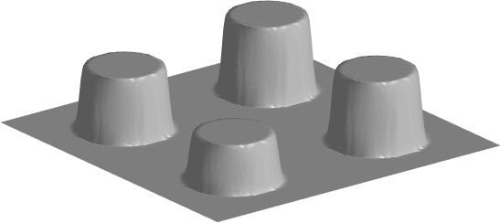
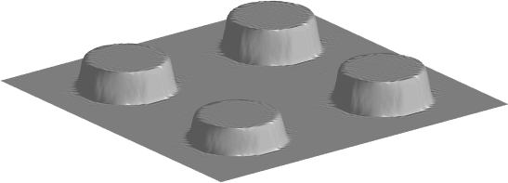
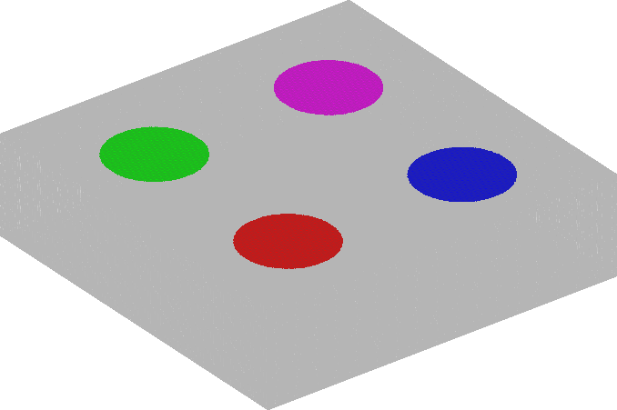
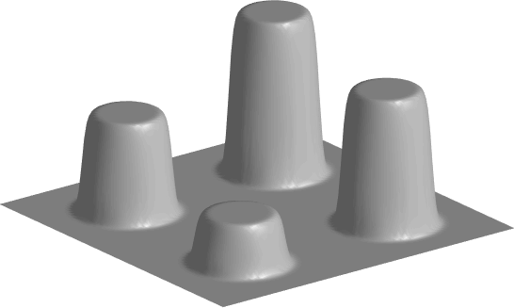
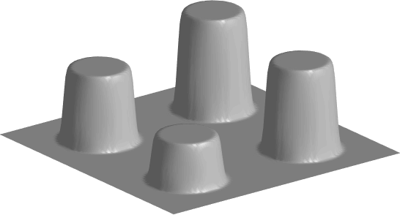
Gap Width Influence on
Three-Dimensional Thermal Response
First layer is 0.02 cm and thick Second layer is 0.18 cm thick
Normalized by dividing by the response of a semi-infinite layer with the same thermal properties and the input flux.
In-plane and surface normal diffusivities are both 0.005 cm²/sec
Air Gaps Widths
40 μm
0.05 sec
0.10 sec
20 μm
30 μm
10 μm
Diameter of circular air gaps 1 cm
Block 4 x 4 x 0.2 cm
Aspect ratio (1,1,5)
0.20 sec
0.40 sec
Same scaling for all surface plots

Slide 7
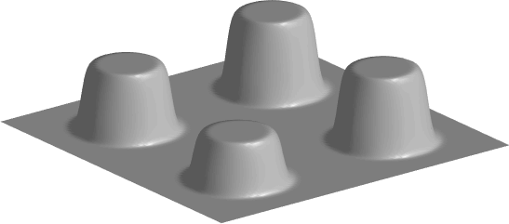
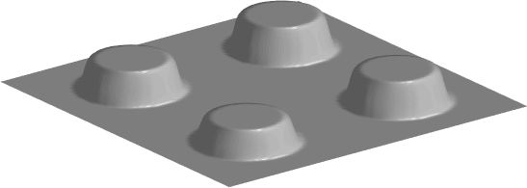
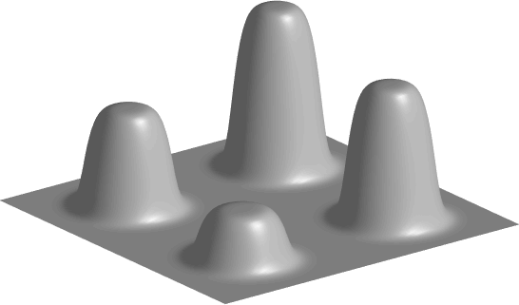

Gap Width Influence on
Three-Dimensional Thermal Response
First layer is 0.02 cm and thick Second layer is 0.18 cm thick
Normalized by dividing by the response of a semi-infinite layer with the same thermal properties and the input flux.
In-plane diffusivity is 0.025 cm²/sec and surface normal diffusivity is 0.005 cm²/sec
Air Gaps Widths
40 μm
0.05 sec
0.10 sec
20 μm
30 μm
10 μm
Diameter of circular air gaps 1 cm
Block 4 x 4 x 0.2 cm
Aspect ratio (1,1,5)
0.20 sec
0.40 sec
Same scaling for all surface plots

Slide 8

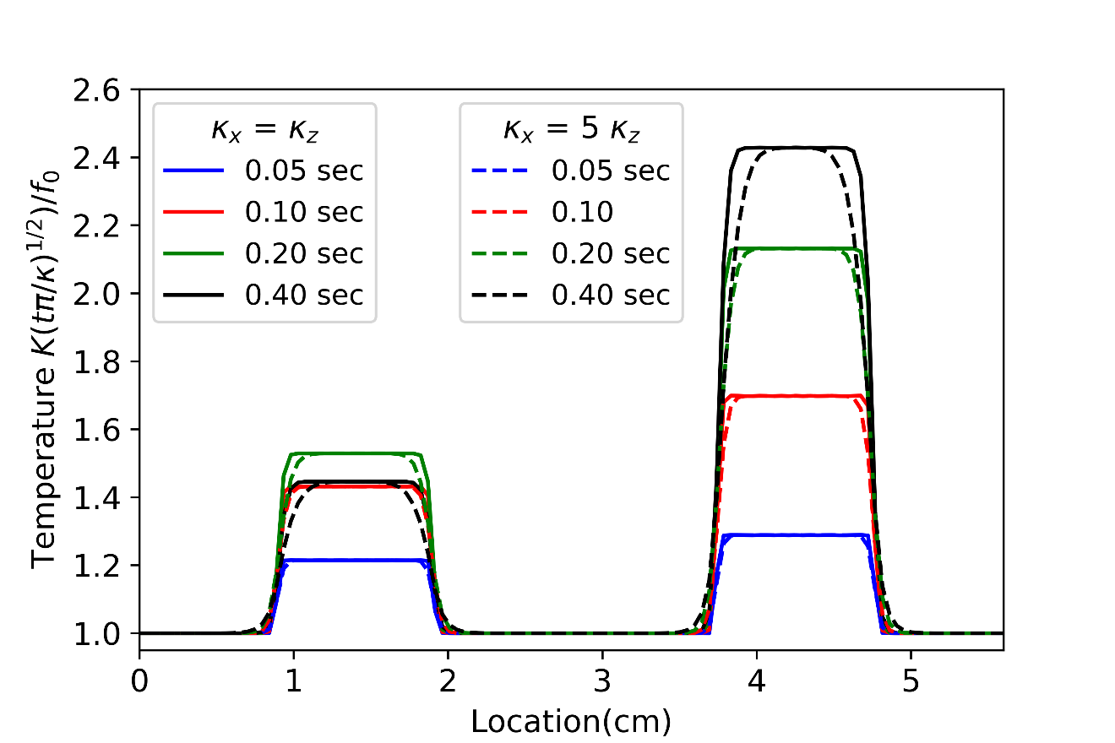
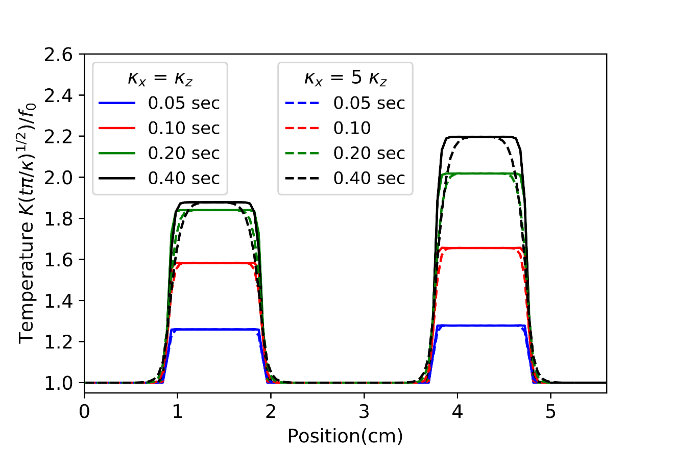
Temperature Profiles Along Diagonals of
Three-Dimensional Thermal Responses
10 μm
40 μm
20 μm
30 μm
Over the 10 μm air gap the thermal contrast decreases between 0.2 sec and 0.4 sec
Over the 20 μm air gap the thermal contrast does not significantly increase between 0.2 sec and 0.4 sec

Slide 9
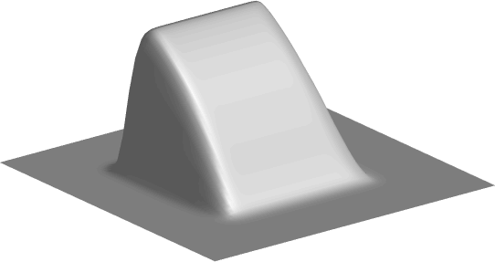
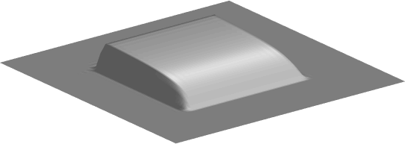
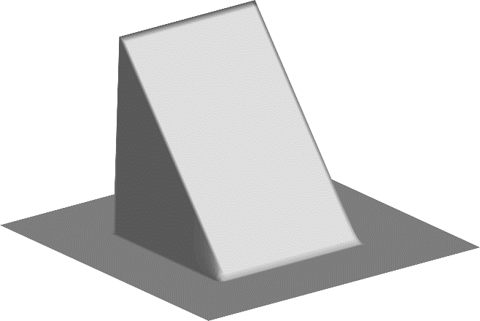
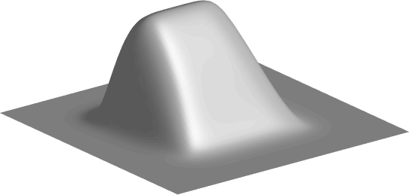
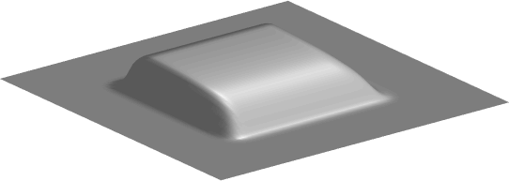
Three-Dimensional Thermal Response for Wedge Gap
First layer is 0.02 cm thick. Second layer is 0.18 cm thick
Surface normal diffusivity is 0.005 cm²/sec
In-plane diffusivity 0.005 cm²/sec
0.05 sec
0.40 sec
In-plane diffusivity 0.025 cm²/sec
Wedge air gap between first and second layers varies from 0 to 40 μm
Layer 2 cm x 2 cm
Wedge 1 cm x 1 cm
0.05 sec
0.40 sec
Same scaling for all surface plots

Slide 10
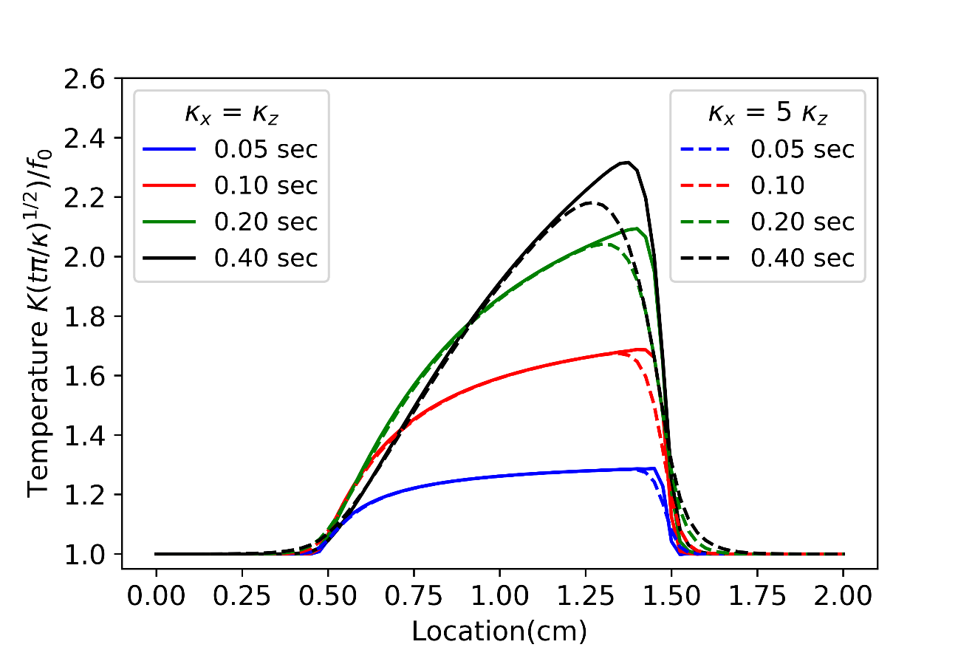
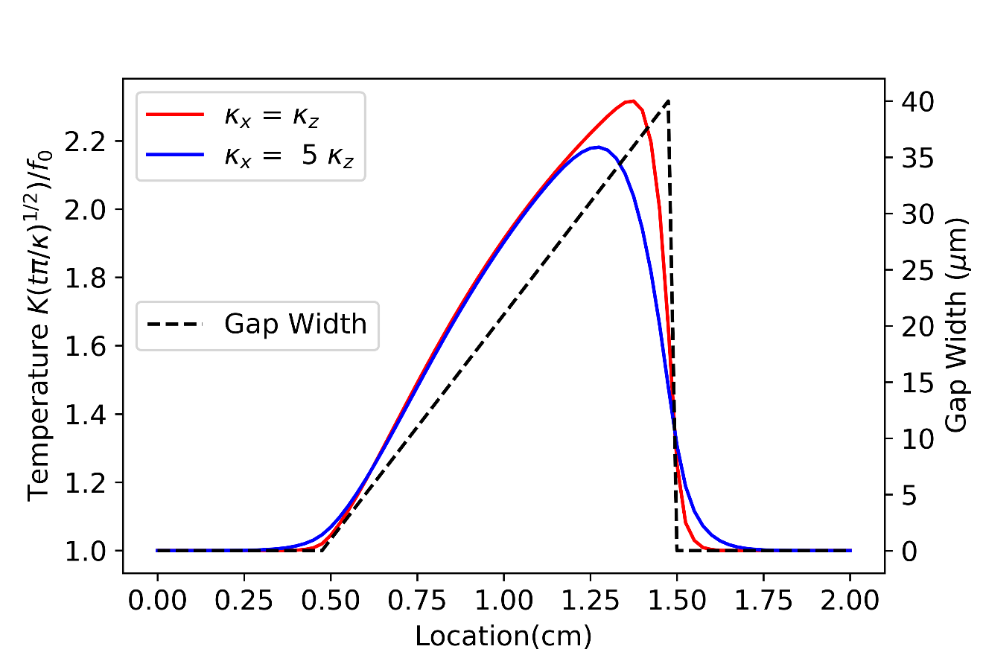
Temperature Profiles Along Wedge Center
Initial time response does not reflect the shape of the wedge
Later time responses reflect the shape of the wedge
Increasing in-plane diffusivity by a factor of 5 does not dramatically change response

Slide 11
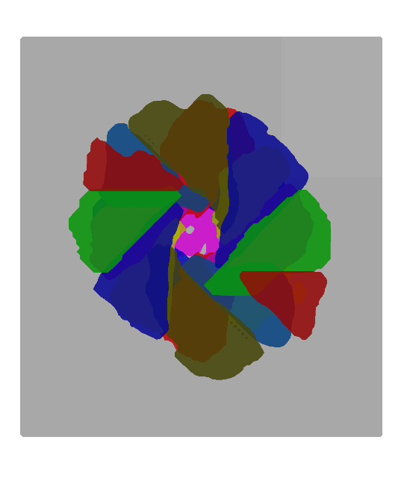
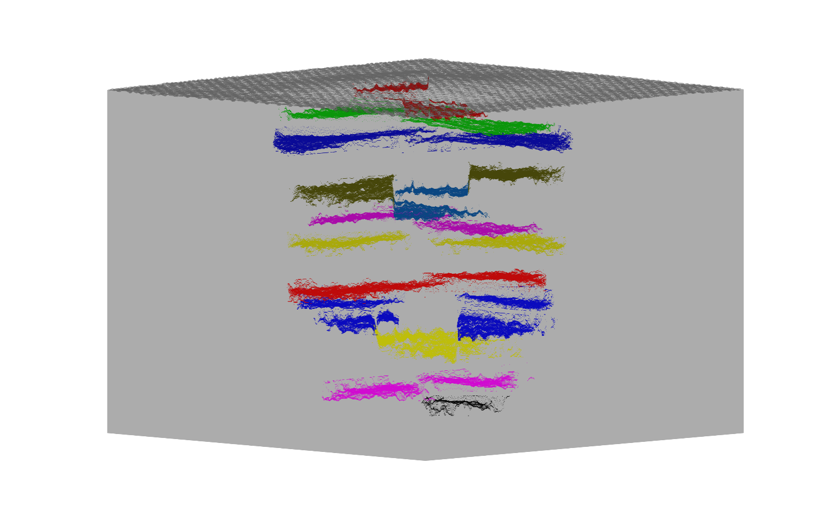
CT Estimation of Impact Damage Composite
Composite has 18 plies
From CT data, delaminations were present at 13 different depths
Most Depths have two significant delaminations
Impact Damage has the typical “petal” appearance
Different Color for each depth
First three depths
Red 0.0178 cm
Green 0.0347 cm
Blue 0.0532 cm
Volume 3.2 cm by 3.2 cm by 0.332 cm
Aspect ration 1:1:8
View from top
Area 3.2 cm by 3.2 cm

Slide 12

CT Data Through an Impacted Region of the of the Composite
Gap width not the same for all delaminations
Delaminations are not flat
0.33 cm
Contrast between delamination and composite indication of gap width
This contrast is used to estimate the gap width of the delamination

Slide 13
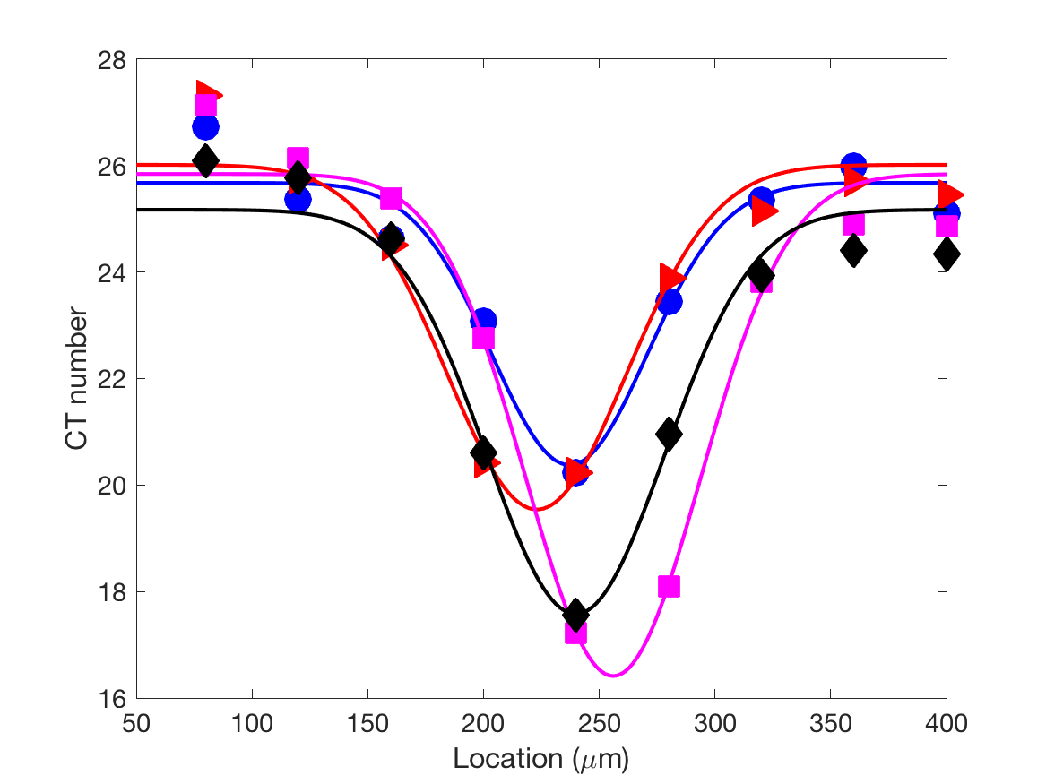
Gaussian Fit for Calculation of Gap Width
Fit with a constant minus a Gaussian
Amplitude of the Gaussian proportional to the gap width
Point spread of CT system estimated from CT response at edge of composite

Slide 14
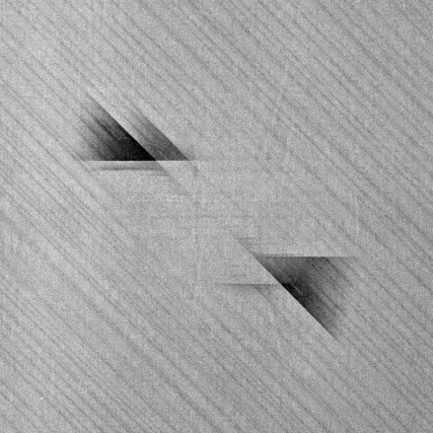
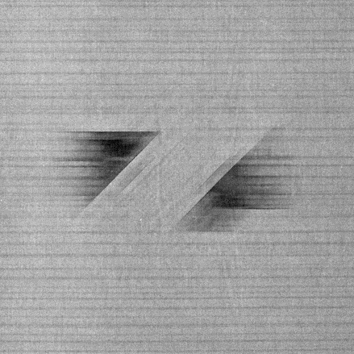
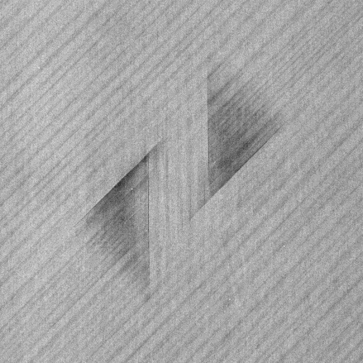
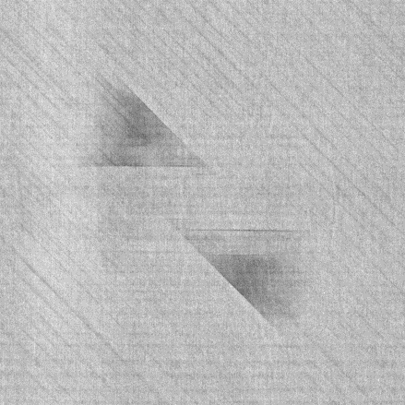
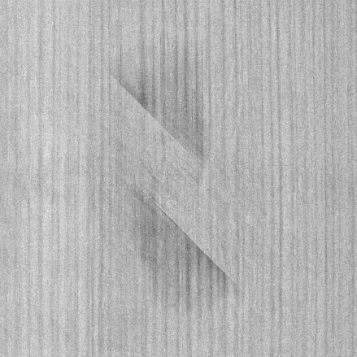
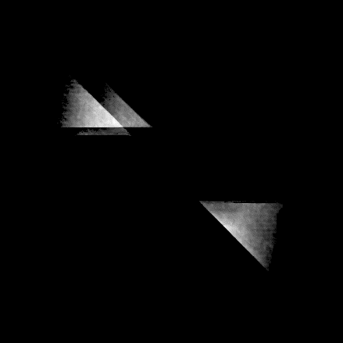
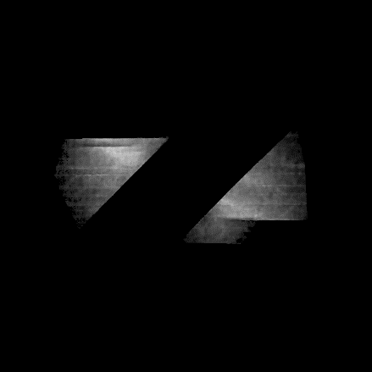
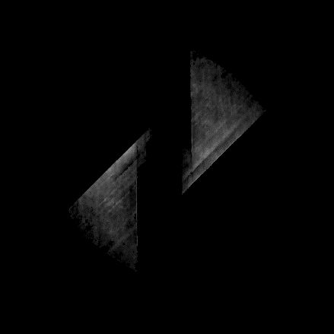

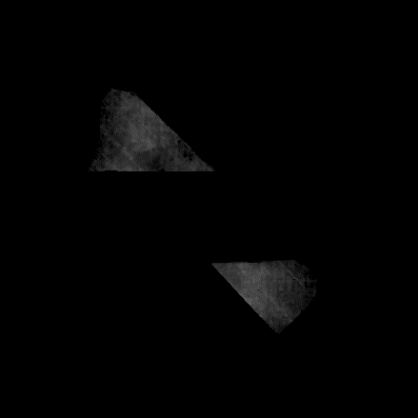
CT Images and Estimated Gap Spacing
CT image
Gap thickness image
Interface 1
Interface 2
Interface 3
Interface 5
Interface 6
All CT images scaled the same
All of the gap spacing scaled from 0 to 0.050 mm

Slide 15
Quadrupole Simulation of Impacted Composite
Gap spacings map is multiplied by the thermal conductivity of air to provide a contact resistance map at interfaces identified by CT as having a delamination
Largest gap thickness ~ 50 μm
Thermal conductivity composite: 97000 Erg/(cm K sec)
Diffusivity: 0.0044 cm²/sec
Thermal conductivity of air: 2624 Erg/(cm K sec)
Largest K_{composite} R is ~0.18 cm

Slide 16
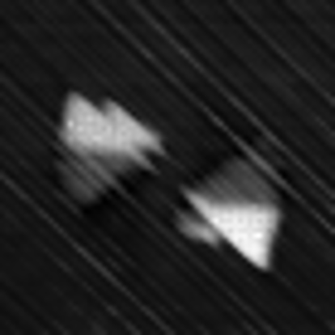
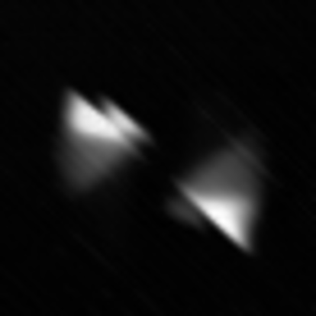






Comparison of Flash Thermography Simulation of Impacted Composite and Measured Response
images 3.2 by 3.2 cm
Measured Response
Areas with thinner gap widths tend to fade faster in measurement than simulation
Simulation Results
0.1 sec
0.2 sec
0.4 sec
0.8 sec

Slide 17
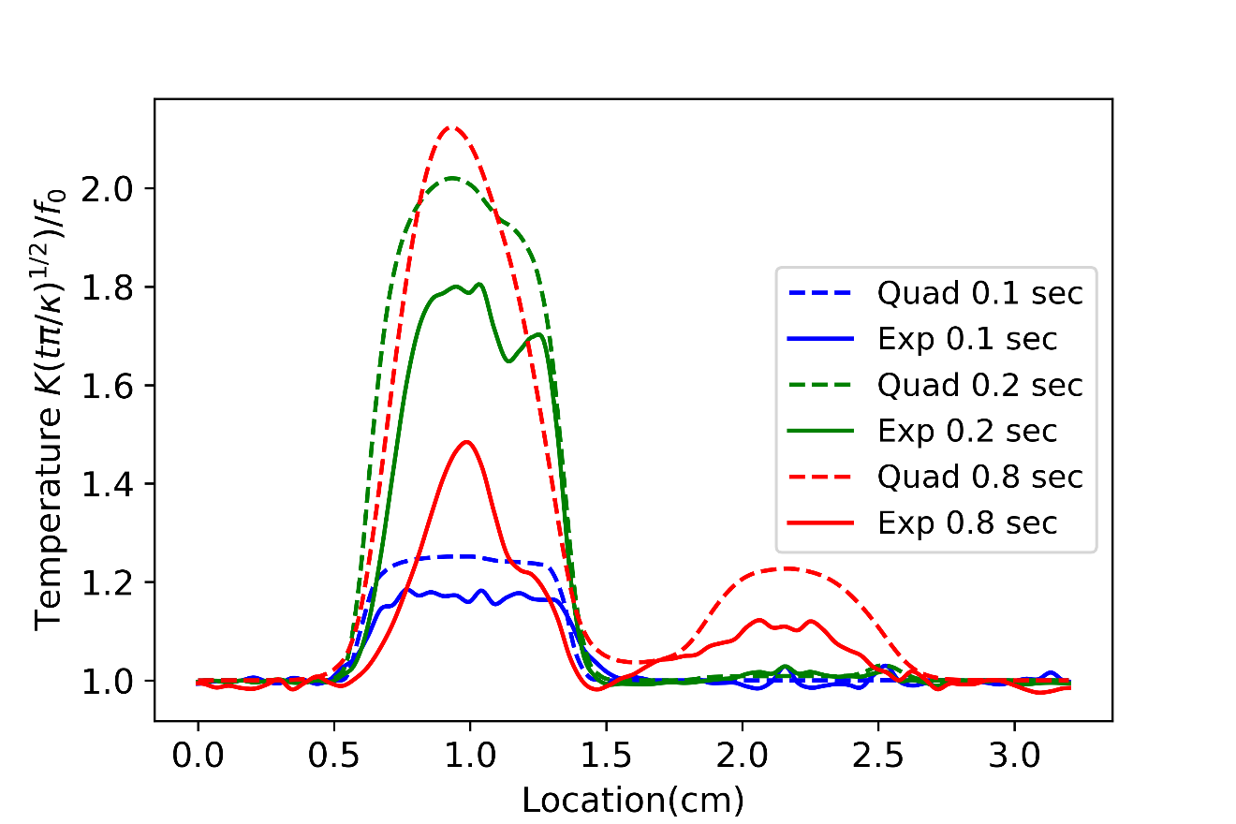
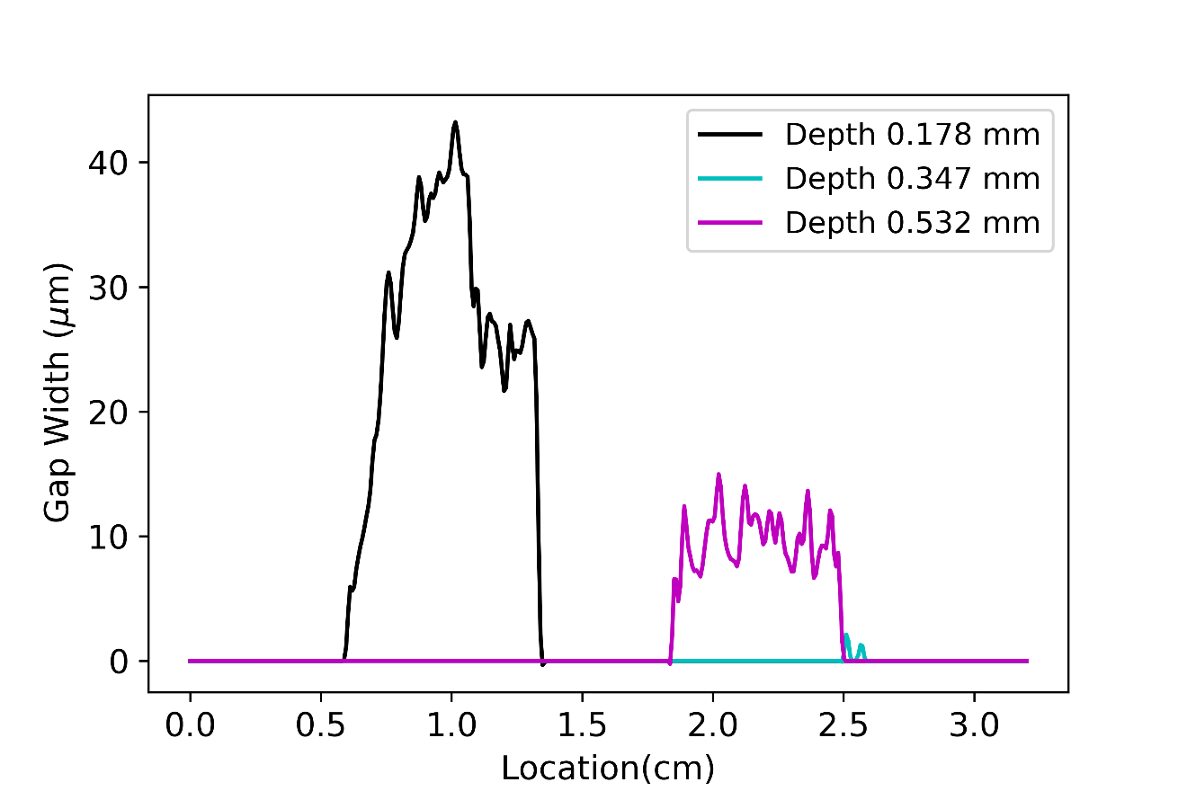
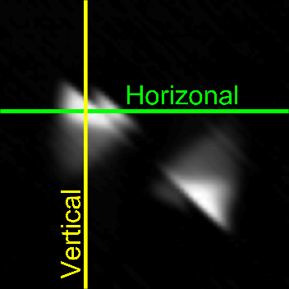
Horizontal Profiles of Experimental Data and Simulation Data
Delamination
0.178 cm
from
surface
Delamination
0.532 mm
from
surface
Reasonable agreement early times
Poor agreement at later times
Quad- Simulation data
Exp – Experimental data

Slide 18
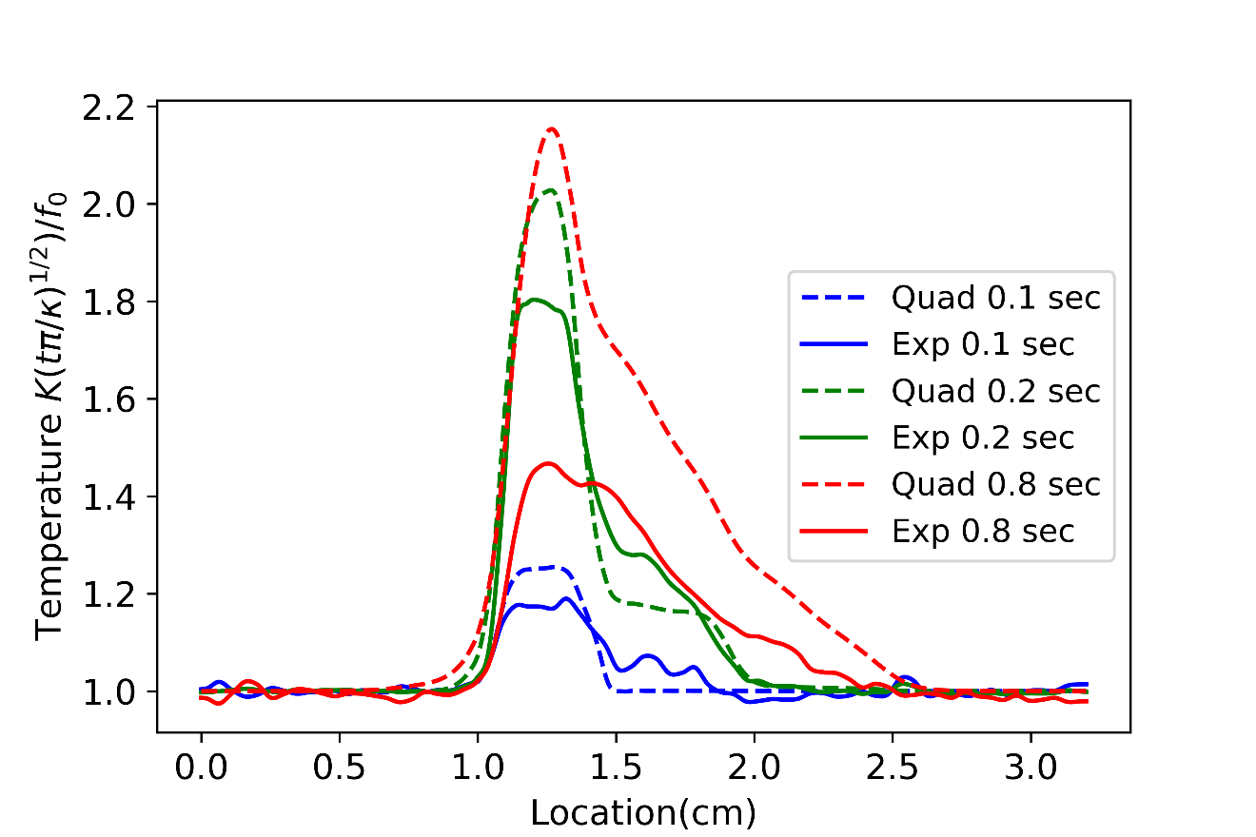
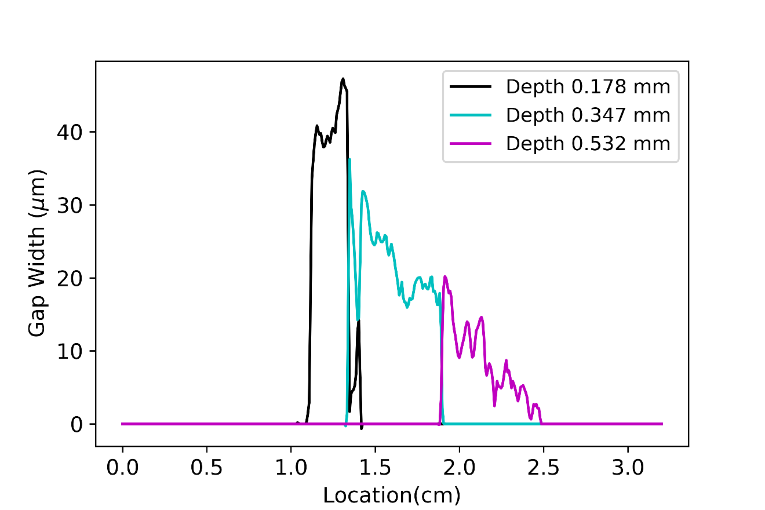
Vertical Profiles of Experimental Data and Simulation Data
Delamination
0.178 cm
from
surface
Delamination
0.178 cm
from
surface
Delamination
0.532 mm from surface
Reasonable agreement early times
Poor agreement at later times
Quad- Simulation data
Exp – Experimental data

Slide 19
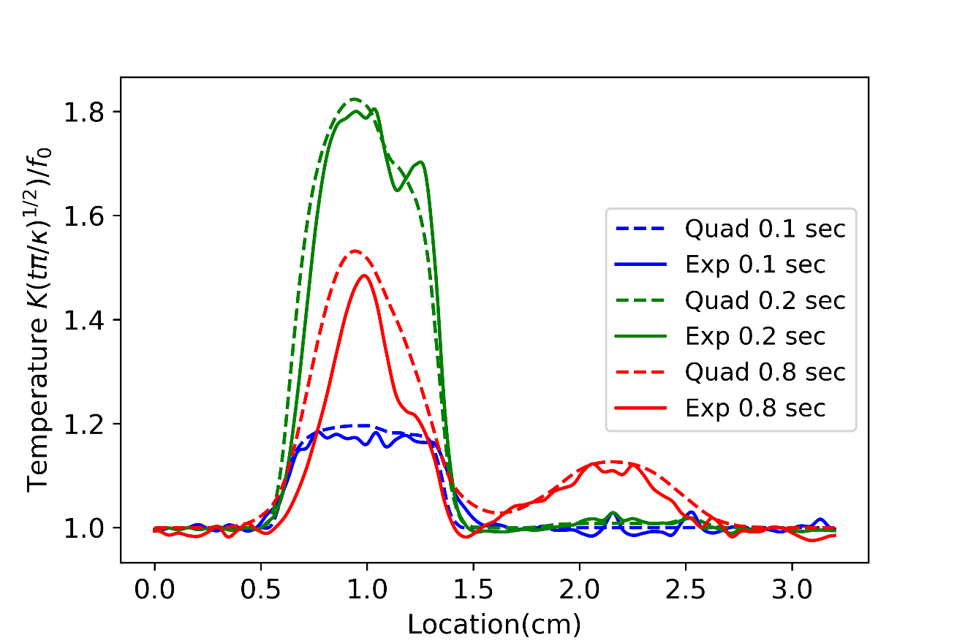
Horizontal Profiles of Experimental Response and Simulation Results for ½ K R Value Estimated from CT
Delamination
0.178 cm
from
surface
Delamination
0.532 mm
from
surface
Much better agreement when KR is ½ the value estimate based on CT measurement and literature values for thermal conductivities
Quad- Simulation data
Exp – Experimental data

Slide 20
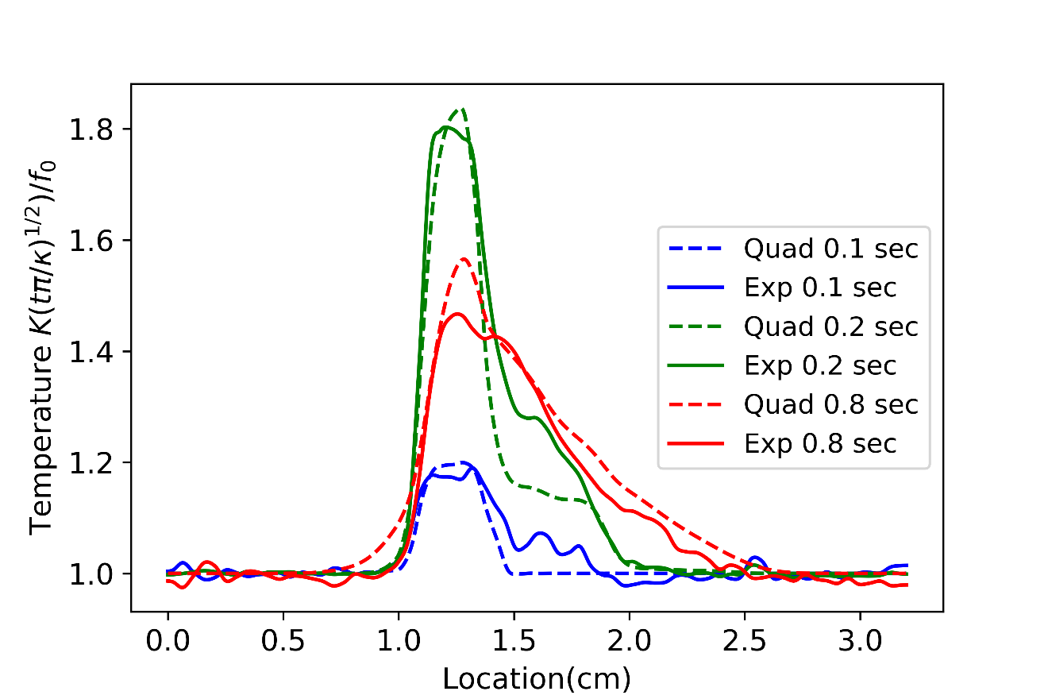
Vertical Profiles of Experimental Response and Simulation Results for ½ K R Value Estimated from CT
Delamination
0.178 cm
from
surface
Delamination
0.178 cm
from
surface
Delamination
0.532 mm
from surface
Much better agreement assuming K R is ½ value estimated from CT
Quad- Simulation data
Exp – Experimental data

Slide 21
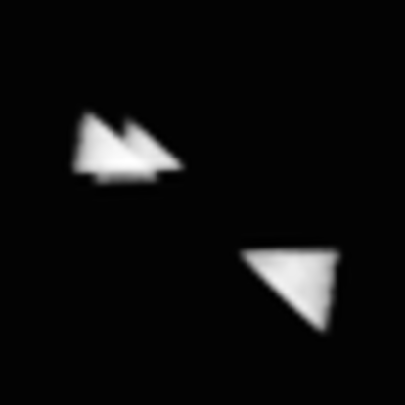



Comparison of Flash Thermography Simulation When KR Reduced by Factor of Two
Measured Response
Absolute values are considerably better, however, contrast images are not dramatically different
Simulation Results
0.1 sec
0.2 sec
0.4 sec
0.8 sec

Slide 22
Summary
Small changes in contact resistance result in most significant changes in the contrast
For the thermal properties of interest within the time frame of interest, large changes in in-plane diffusivity don’t significantly change the contrast
When using the K R estimated from CT and literature values for thermal conductivities, comparison of the absolute values of contrast between measurements and simulation is poor, particularly at times greater than 0.2 sec
Using ½ the K R estimated from CT and literature values for thermal conductivities, comparison of the absolute values of contrast between measurements and simulation is reasonable

