Slide 1
SCALPSS Project Overview
LRO Planetary Science Working Group Meeting
29 September 2020
Michelle Munk (Principal Investigator, NASA LaRC)
Robert Maddock (Project Manager, NASA LaRC)
Chi Nguyen (Technical Lead, NASA LaRC)
Notes:
STILL

Slide 2
Motivation and Project Overview
As landers grow to human scale, understanding how these landers interact with the environment (including other landed assets), particularly during the landing event, becomes increasingly critical.
SCALPSS is the first payload specifically designed to collect Plume Surface Interaction (PSI) flight data for verification of computational models. Complements NASA modeling/ground testing project.
Stereo CAmera for Lunar Plume-Surface Studies (SCALPSS) was selected in February 2019 by the Science Mission Directorate (SMD) NASA Provided Lunar Payload (NPLP) Development Program
SCALPSS is scheduled to fly on the Intuitive Machines NOVA-C lander to Vallis Schröteri in October 2021, as part of the initial Commercial Lunar Payload Services (CLPS) mission selections
The SCALPSS payload is currently undergoing environmental testing in support of a payload delivery in October 2020
SCALPSS 1.1, planned for CLPS flight 19D to Mare Crisium in early 2023, will be a “re-fly” of SCALPSS incorporating lessons learned/minor design changes to reduce risk and enhance science
Project partners include:
NASA Langley Research Center (Lead)
NASA Marshall Space Flight Center
Jet Propulsion Laboratory / California Institute of Technology

Slide 3
SCALPSS Science Objectives
Primary Science Objectives
Detect onset altitude of ejecta and erosion effects (turn on @ 30 m altitude)
Record transient 3D crater morphology as the vehicle is descending to estimate transient crater formation volume rates (15 fps through landing)
Capture post-landing 3D site-alteration morphology
Measure crater depth, diameter and eroded volumes
Estimate erosion rates
Quantify uncertainty in photogrammetry measurements (post-landing images)
Secondary Science Objectives
Measure ejecta structure during onset and descent (may be able distinguish ejection angles, ejecta sheath morphology, etc.)
Measure dust settling density as a function of time (10 s post-landing @ 15 fps)
Conduct comparisons between predictions and flight reconstructed data
Uncertainties will remain, due to regolith unknowns:
Bulk density (compaction, porosity)
Particle size distribution
Particle shape and cohesion
At depth, down to [20 cm] (?)

Slide 4
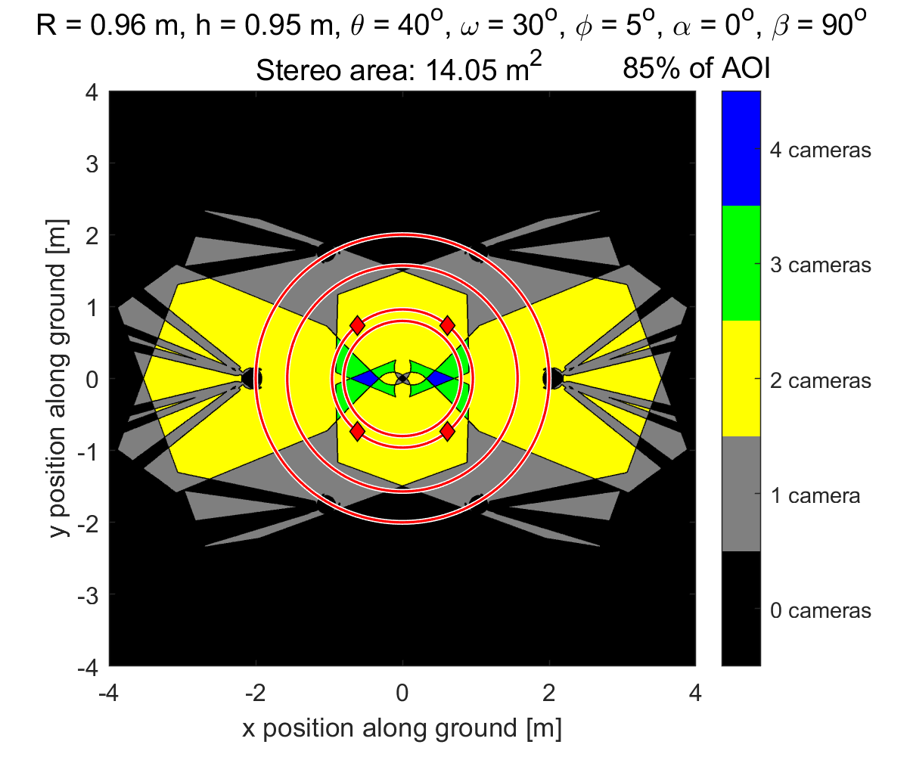
Stereo Photogrammetry
Mars InSight Topography Analysis
Stereo Coverage of SCALPSS Cameras
Context Camera Images
7.6 cm
17.8 cm
18.5 cm
15.0 cm
Estimated Accuracy of Pseudo-Stereo Method: +/- 0.25 cm
(Mehta & Liever, 2019)

Slide 5
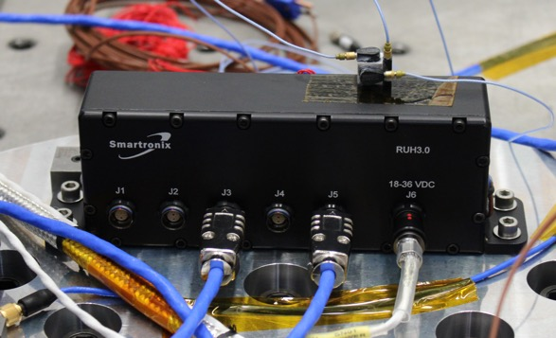
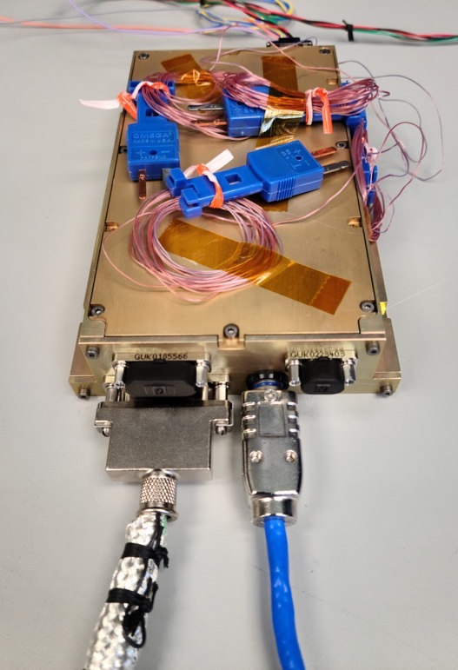
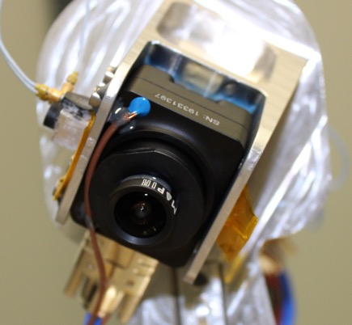
SCALPSS Payload Architecture
SCALPSS is a distributed payload with 6 separate components
Data Storage Unit (DSU)
build-to-print of M2020 EDLCam electronics
USB Hub
hardened; same COTS part as used for M2020 EDLCam
2 pairs (4 ea.) short focal-length high resolution down-look cameras
COTS camera; same make as M2020 EDLCam cameras, but monochrome model
COTS lenses; short focal-length lenses used for SLS
optimized locations and pointing to maximize stereo coverage
USB Hub
Camera
DSU

Slide 6
Questions?

