Slide 1
Dust and MMOD Impact on Mars Sample Return Missions
Ethiraj Venkatapathy
Michael Barnhardt
Presentation to ONR FY20 MURI Topic #9 Kick-off Meeting
October 7, 2020

Slide 2
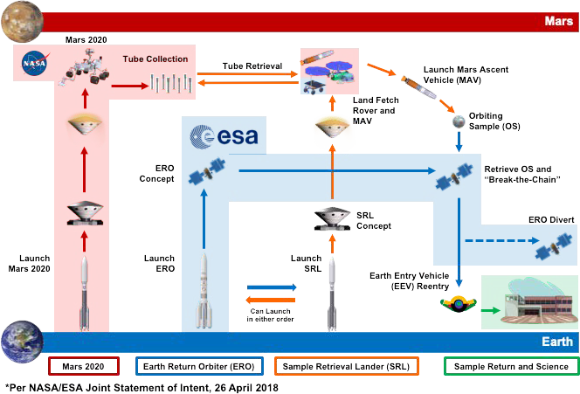
Dust and MMOD Impact on MSR Missions
MSR Mission Overview
Dust Storm at Mars for SRL, and micro-meteor and orbital debris (MMOD) prior to earth entry for the EEV carrying the sample are of concern.
Design needs to be robust against these two risks.
Mike Barnhardt will address the former and I will address the latter

Slide 3
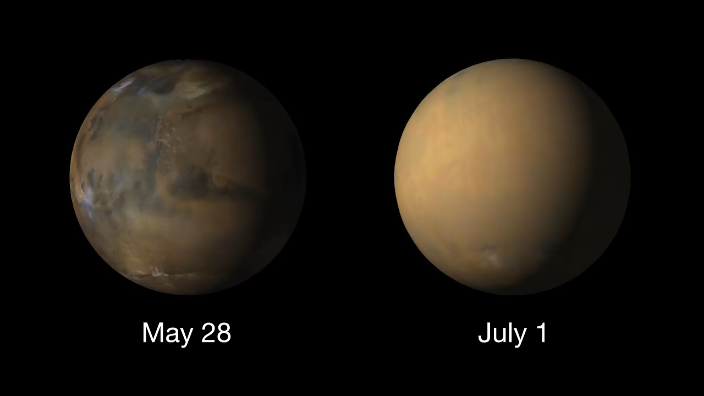
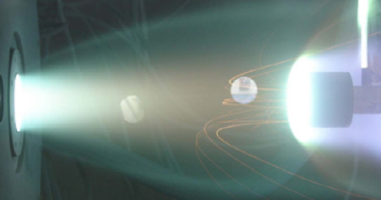
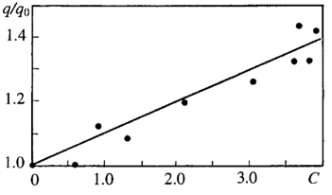

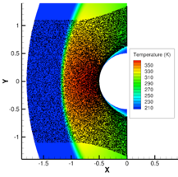
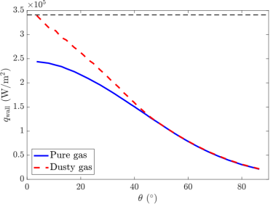
Aerothermal-mechanical Erosion of TPS Due to Dust
Martian dust storms can augment TPS recession through mechanical erosion and greater heating. Global dust storms have been observed to occur every few years without warning.
State of the art traces back to mid-90s studies for Mars Pathfinder
    Phenomenological models of erosion based on scant experimental data
Risks carried for Mars InSight and ExoMars Schiaparelli; same expected for Mars Sample Return Lander
Entry Systems Modeling project leads broad NASA collaboration
    German Aerospace Center (DLR) providing critical and unique experiments to guide modeling
    Stanford University (Ihme grant)
    University of Minnesota (Kroells fellowship)
In 2018, Mars Reconnaissance Orbiter detected a sudden growth of dust suspended in the atmosphere. Within a month, the entire planet was shrouded. InSight would land only 4 months later.
Source: Vasilevskii, 2001
Heating increases with particle concentration
Observed erosion patterns due to particle-laden flow
Source: Ali Guelhan, DLR
Stag point heat flux from experiment

Slide 4
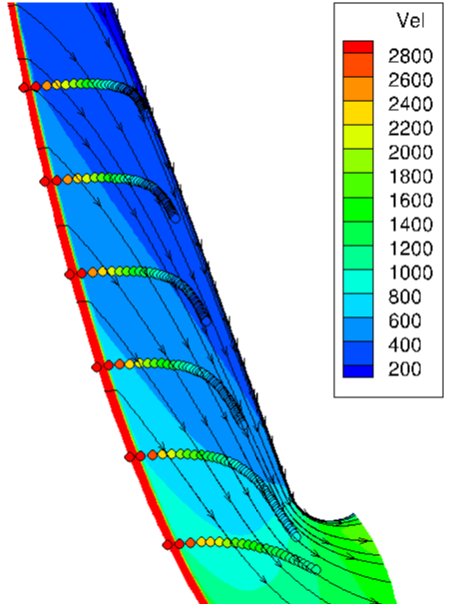
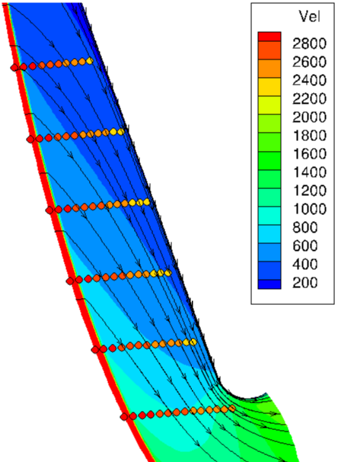
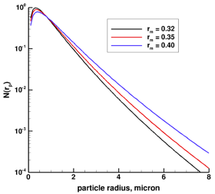
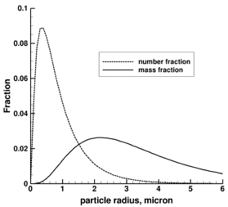
NASA Development 2018 – present
First complete analysis of heatshield erosion due to dust particle impacts published in 1993
  Dust environments.
  Dust composition.
  Particle trajectory equations.
  Surface damage models for AVCOAT and fused-silica (i.e. Shuttle tiles).
  Results for a 26-meter diameter (!) sphere cone entry vehicle.
Revived legacy model to set performance baseline and identify gaps
Leveraged MRO data to update Martian dust model
Developed procedure for updating material models
One-way coupling tool
“Heatshield Erosion in a Dusty Martian Atmosphere”, J. of Spacecraft and Rockets, Vol. 30, No. 2, March 1993, pp. 140-151
1-micron particles 5-micron particles
Atmospheric dust model
“Modeling Heatshield Erosion due to Dust Particle Impacts for Martian Entries”, AIAA Paper 2020-0254
Modified gamma distribution (MRO data)
Convert to number and mass fractions

Slide 5

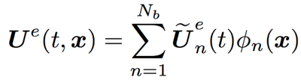
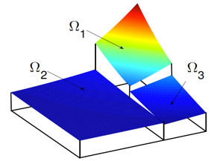
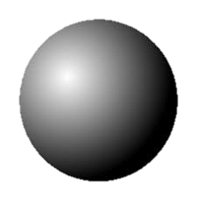





NASA Early Career Faculty Award
Matthias Ihme (Stanford): Investigation of particle-CFD modeling and high-order numerical methods for entry systems
Carrier phase (c): discontinuous Galerkin (DG) method
Compressible N-S equations with reverse-coupling source term
Approximate local solution with polynomials of arbitrary order p
    p+1 order of accuracy
    Compact stencil
    Inter-element discontinuities permitted
Disperse phase (d): Lagrangian point-particle tracking
Position:
Momentum:
Energy:
Drag:
[1] Reed and Hill, TR-LA-UR-73-479 1973;
[2and Warburton, Springer 2008;
[3] Cockburn et al., Springer 2000.
Heating Rate:

Slide 6
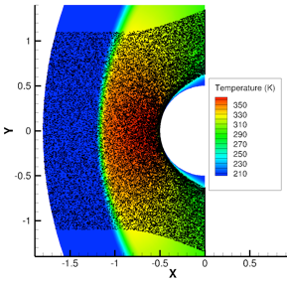
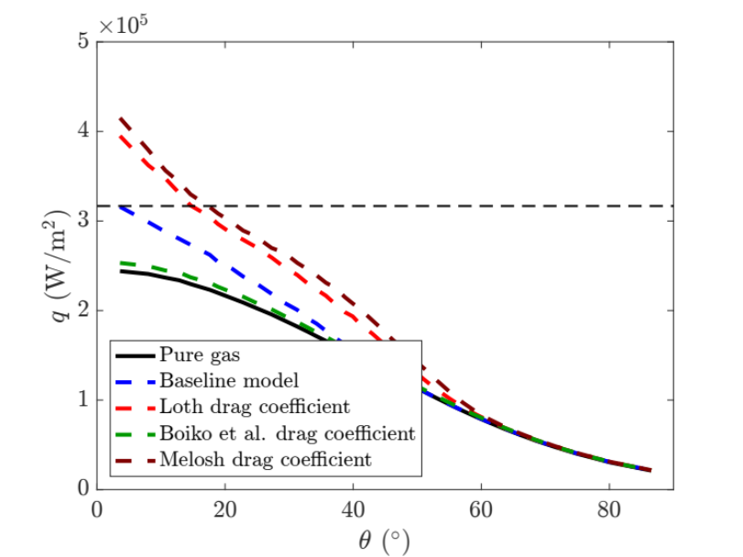
NASA Early Career Faculty Award
Matthias Ihme (Stanford): Investigation of particle-CFD modeling and high-order numerical methods for entry systems
Drag coefficient:
Henderson (AIAA J, 1976)
Loth (AIAA J, 2008)
Boiko et al. (Shock Waves, 1997)
Melosh and Goldin (Lunar and Planetary Science, 2008)
Nusselt number:
Fox et al. (11th International Shock Tubes and Waves Symposium, 1978)
Carlson and Hoglund (AIAA J, 1964)
Oppenheim (J Aero Sciences, 1953)
Other phenomena:
Thermophoretic force
Pressure drag
Undisturbed-unsteady energy contribution
Modified quasi-steady heating
Drag coefficient

Slide 7
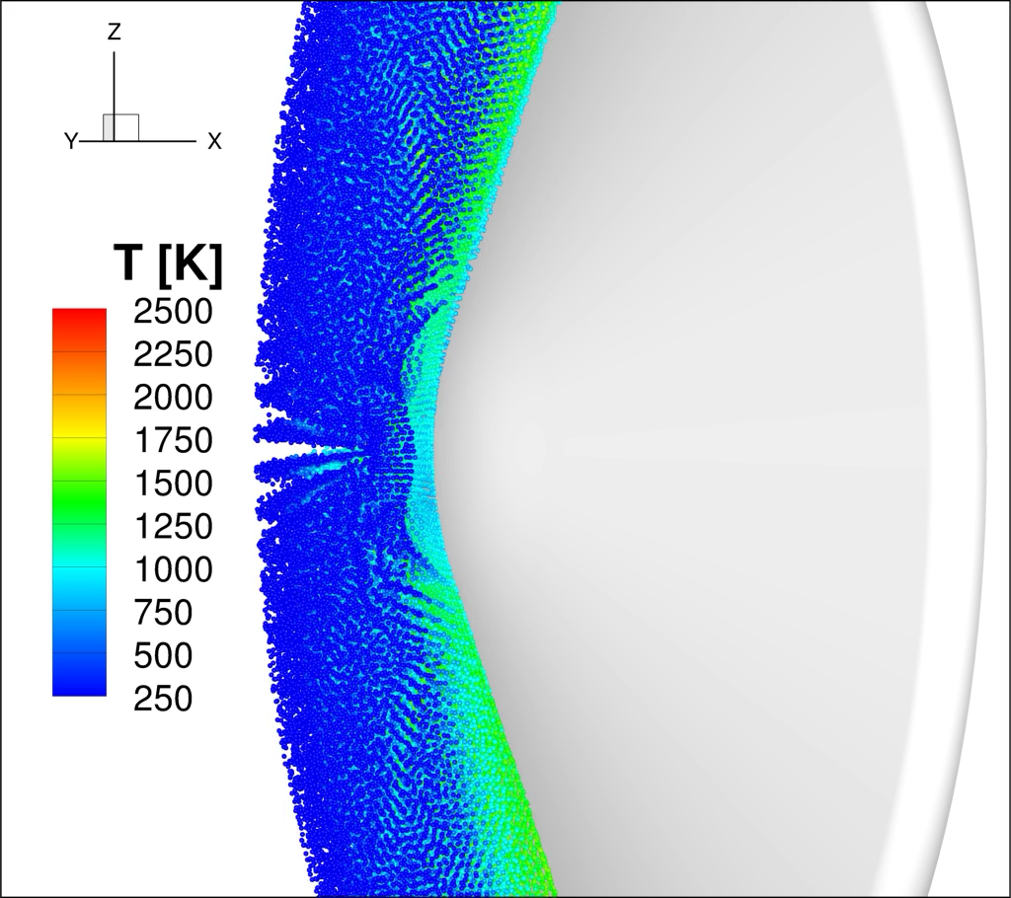
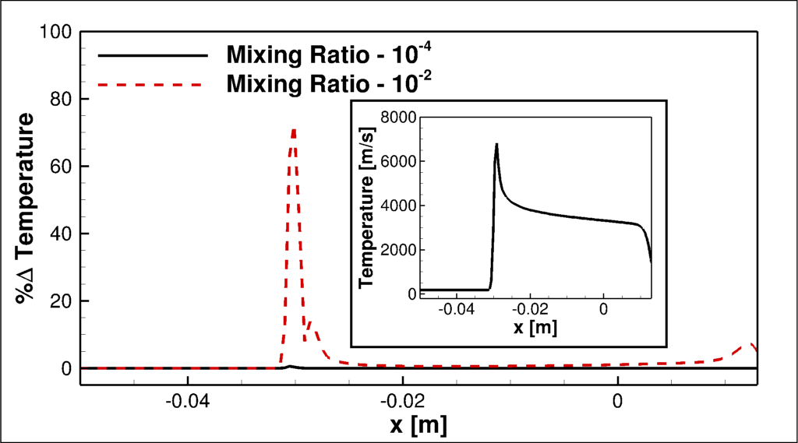
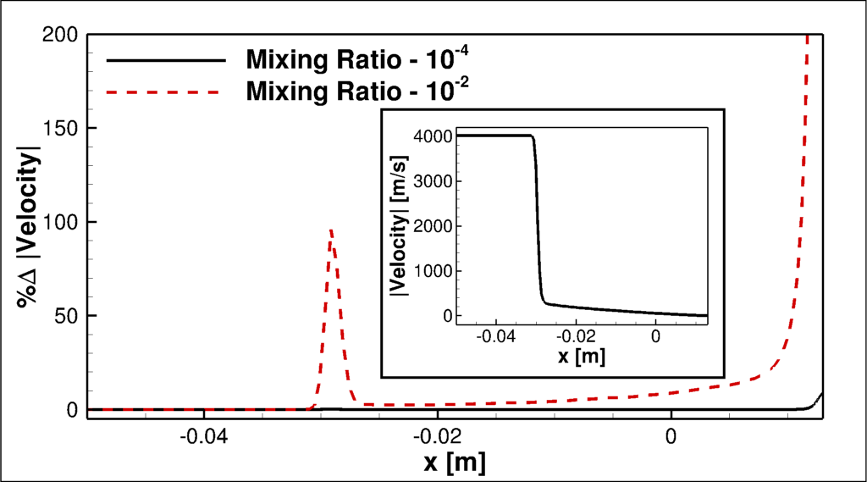
Particle Coupling in US3D
CFD
(US3D)
Particle
Ablation
Radiation
Assumptions
Lagrangian point-particle method
Particles are smooth non-rotating spheres, uniform properties
Two-way momentum & energy coupling – no particle-particle interaction (yet)
Governing Equations
Same formulation as Stanford work
Particle sublimates after reaching vaporization temperature (size change)
Mathematical treatment of source term coupling differs between DG and finite volume
Augmented heating due to particle laden flow Schiaparelli 3D coupled flow test case.

Slide 8
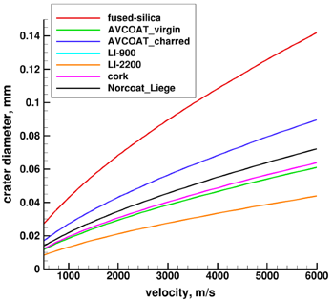
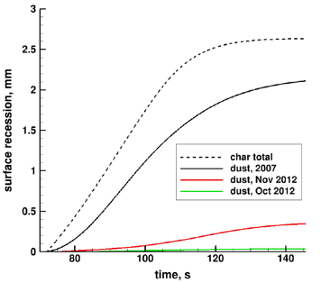
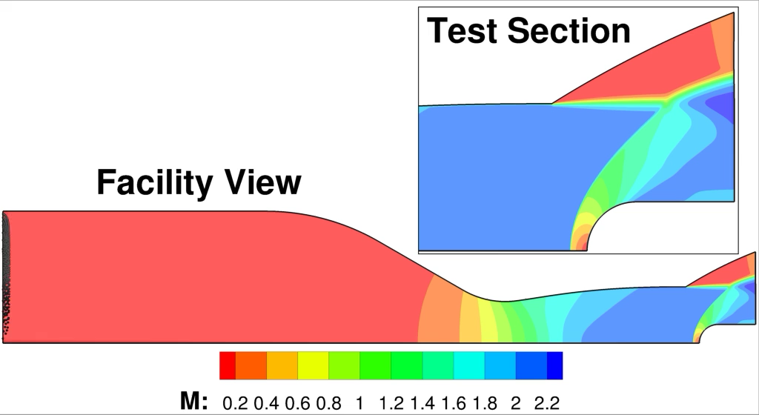
DLR Collaboration 2018 – present
NASA and DLR signed “implementing arrangement” in 2018 to collaborate on studies of aeromechanical erosion due to Martian dust
DLR develops test diagnostics and performs experiments in developmental wind tunnel (GBK) and arc jets (L2K and L3K)
NASA develops simulation models and provides test analyses
Joint publication of data
Data from DLR tests are used to generate material-specific erosion models…
Above: Heat flux probe in GBK facility
Below: Simulation of particle flow through nozzle and test section
…which can then estimate contribution to total recession under flight conditions, e.g. Schiaparelli lander

Slide 9
MMOD

Slide 10
MMOD Impact –
It Can Happen and It Did on OSIRIS – REx

Slide 11
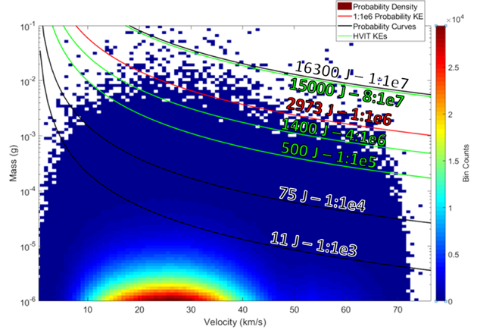
The MM Threat for MSR EEV
MSR EEV has to be robust against MMOD impact damage. Damage flaws, if it happens, do not lead to failure.
Over 6 days of free-flight, the MSR EEV is exposed to a range of MM particles
  A 2,973 Joule impact is ~ P(1:1e6)

Slide 12
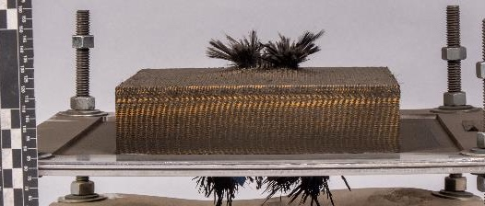
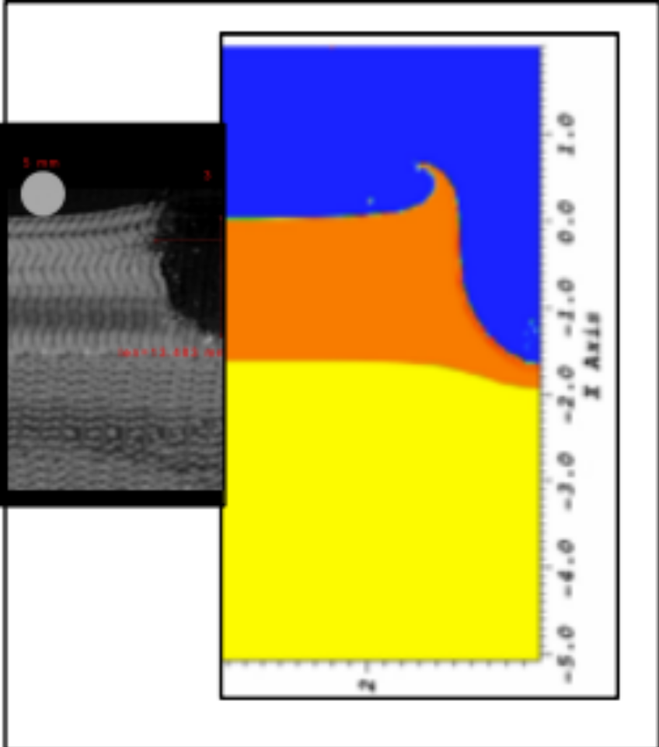
Characterizing the MMOD Impact Cavity:
Impact Testing and Analysis
Micro-meteoroid / Orbital Debris (MM/OD) Testing
MM/OD impacts during EEV free-flight can cause damage to the EEV TPS or underlying aeroshell structure
Impact behavior is characterized with Hyper-velocity Impact Testing at White Sands and hydrocode analysis by NASA Ames
Response of damaged TPS materials and aeroshell structure characterized through arc jet testing and thermal analysis
Hypervelocity Impact Testing of HEEET Thermal Protection System - tests run between 400 and 14,000 J at 7 km/s
Simulation by Hydrocodes
CT Scan of Impact Crater

Slide 13
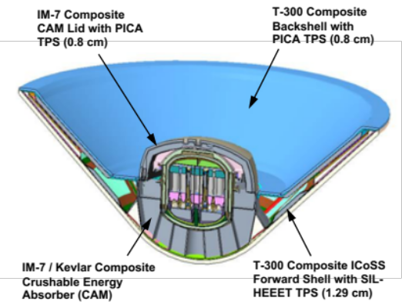
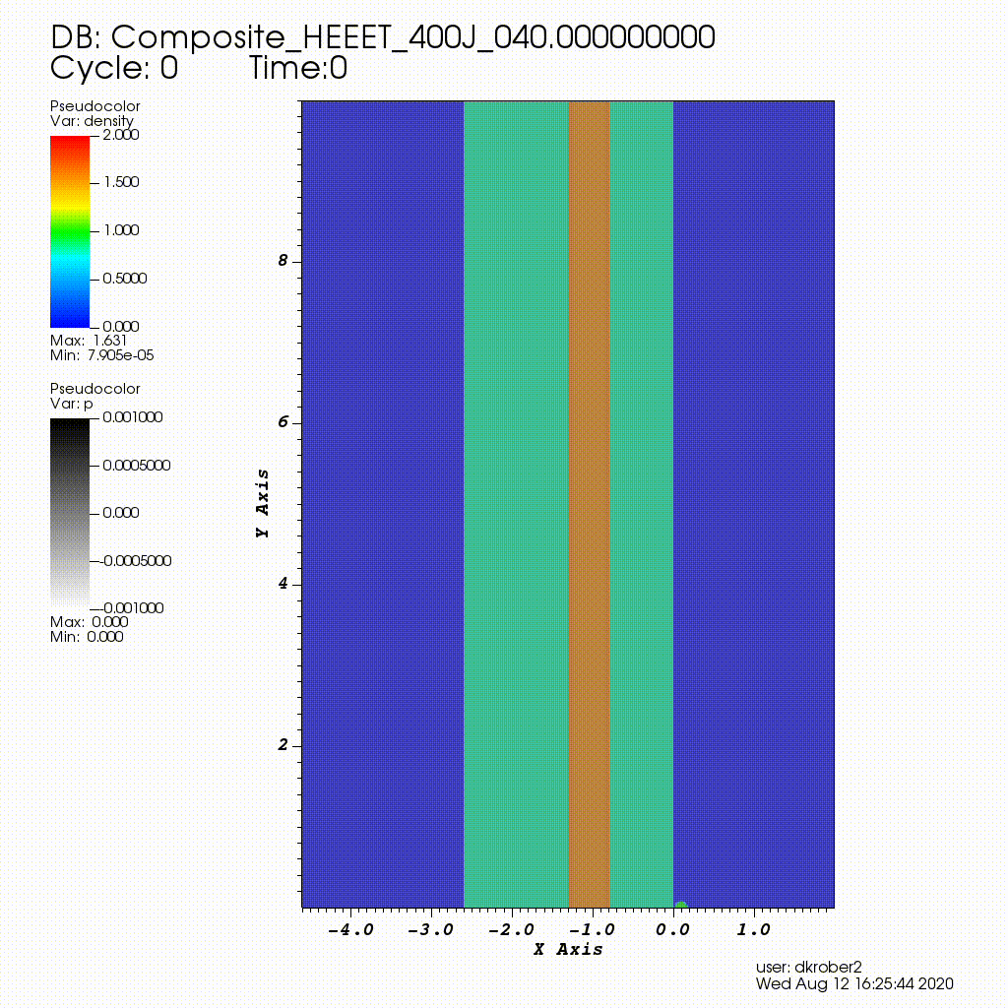
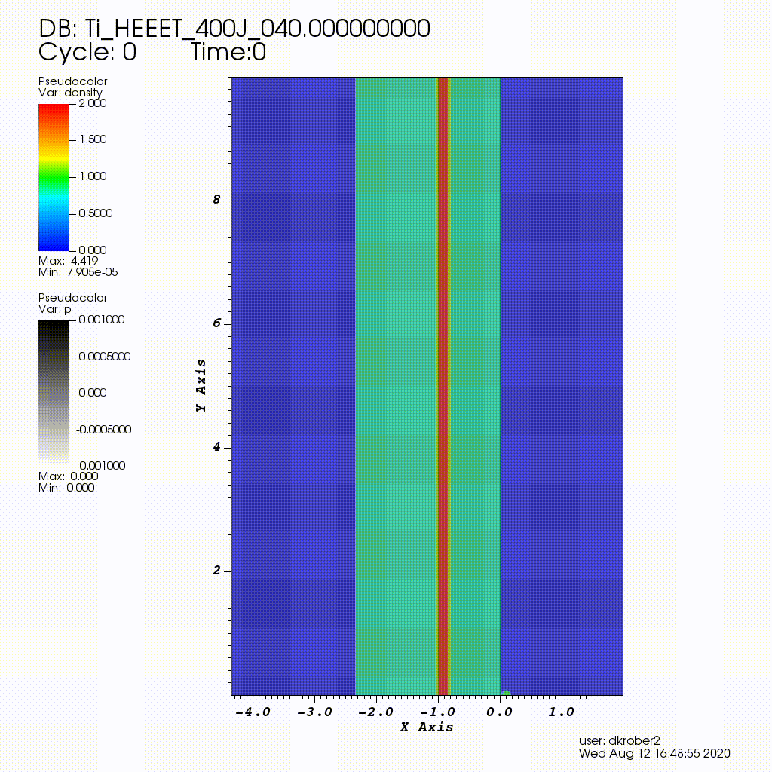
Can MMOD Impact Create Structural Flaws? Hydrocodes Simulation and Design Analysis
ALE3D and CTH hydrocodes can re-create not only the crater geometries well, it has been useful to understand the disjoint that can develop between the TPS and structure as well as stack-up
Work is on-going to simulate full TPS-structural stacks
Analysis is helping to differentiate between composite vs titanium structure

Slide 14
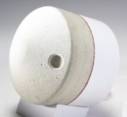
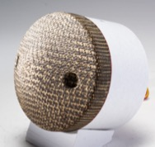
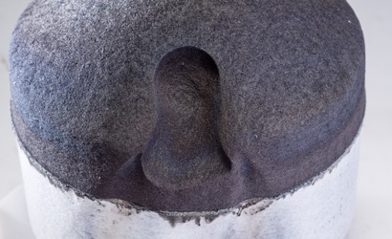
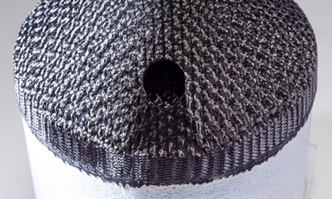
Evolution of MMOD Cavity During Entry
Arc Jet Testing
Arc Jet Testing in the NASA ARC Interaction Heating Facility
Data to validate TPS response models and characterize MM/OD damage progression through EEV entry heat pulse
PICA and HEEET exhibited graceful hole growth with no catastrophic failure under the conditions tested (1,700 W/cm², 135 kPa at the test model nose)
Damaged PICA
Damaged HEEET
Pre-Test
Post-Test

Slide 15
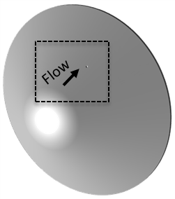
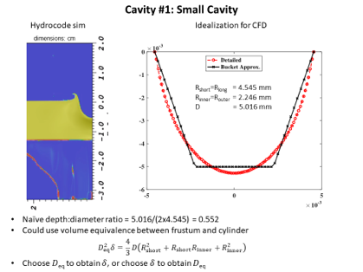
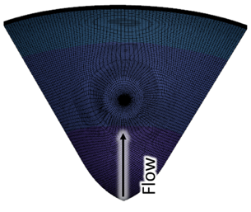
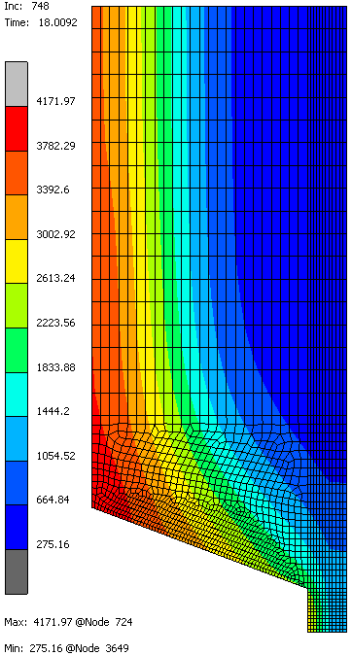
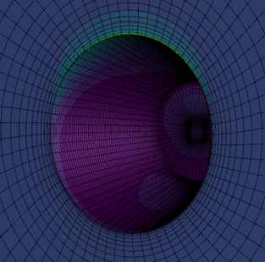
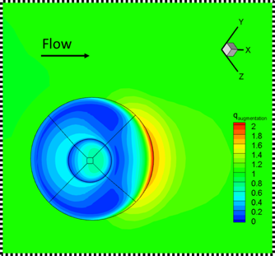
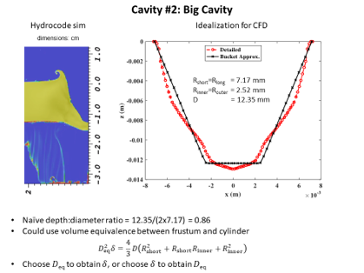
Thermal Penetration due to MMOD Cavity
MMOD cavity on the flank of the heat shield is modeled and CFD simulations along with in-depth thermal simulation provide the time evolution of thermal profile
Only the upstream and downstream heating along the vertical axis is analyzed.
Cavity Depths: Cav#1 = 5.016 mm, Cav#2 = 12.35 mm, Cav#3 = 8.683mm
Cavity Location and Flow Direction
Cavity Geometries
Internal Thermal Gradients
Flow

Slide 16
Concluding Remarks
Efforts are underway in developing validated tools for modeling the effect of dust during entry at Mars and these tools will be used in evaluating the heat-shield design
  Collaboration between NASA, DLR, Stanford, and UMN
Combination of testing and analysis tools are currently being used in design trades to ensure the EEV aeroshell is robust against MMOD
  Combination of Hydrocodes, NASA’s CFD codes and in-depth thermal response modeling anchored with hypervelocity impact testing and arc jet testing.

Slide 17
Acknowledgements
German Aerospace Center (DLR)
  Ali Guelhan
  Dirk Allofs
Mars Sample Return Team
  Jeremy Vander Kam

