Slide 1
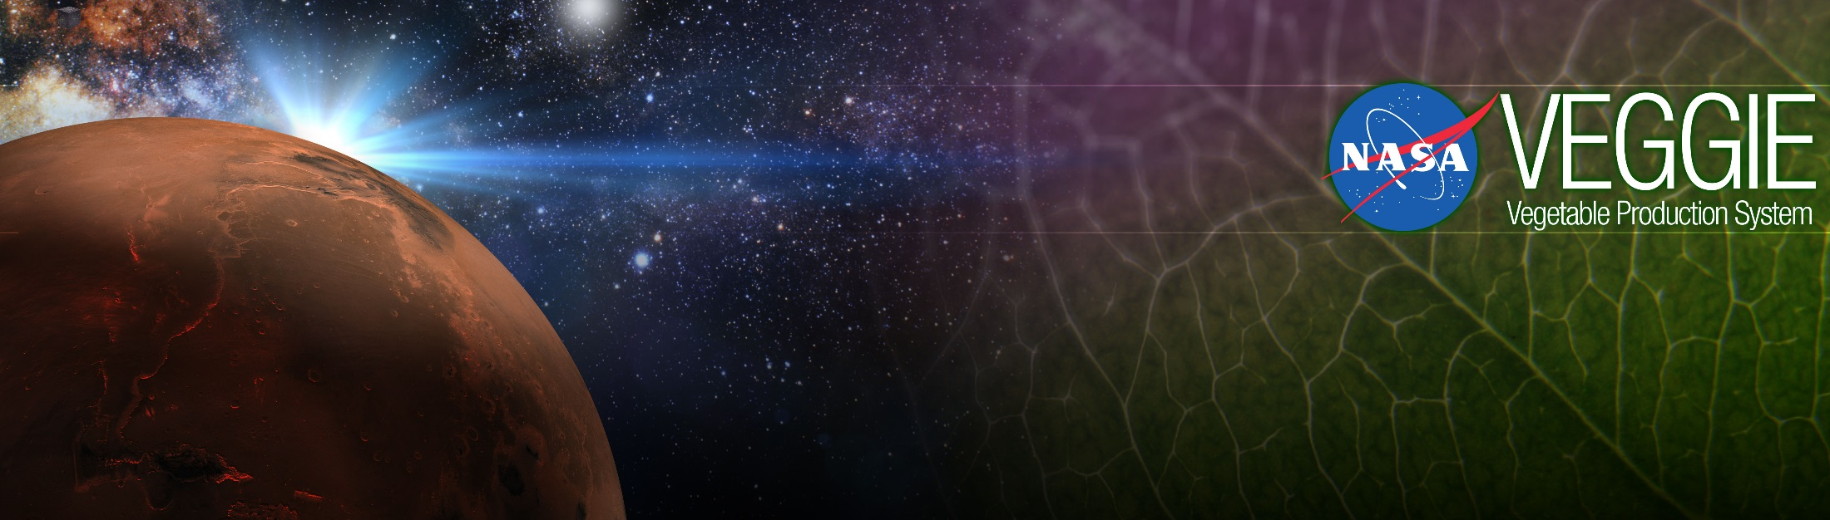
Space Crop Production
Gioia Massa
NASA, Kennedy Space Center, FL, USA
WSSU NIGMS-RISE Seminar 9/29/2020

Slide 2
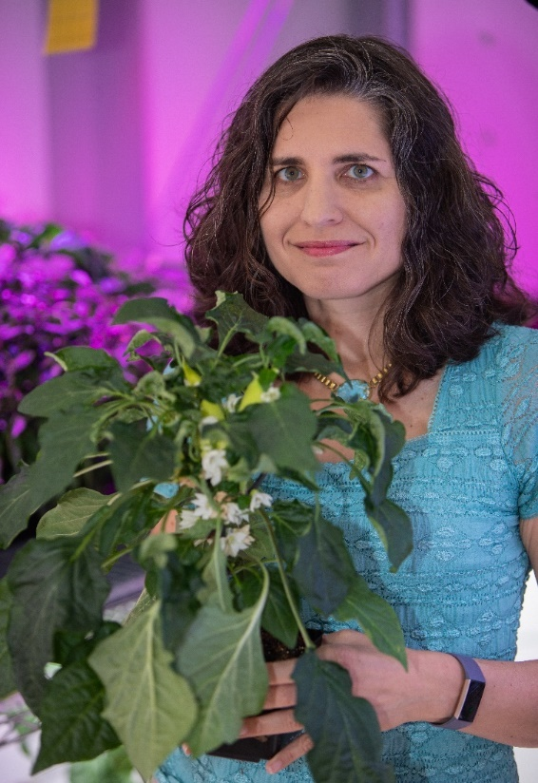



Education
BS – Cornell University – Plant Science
PhD – Penn State – Plant Biology with Geosciences minor
Gioia Massa, PhD
Kennedy Space Center
Life Sciences Project Scientist

Slide 3
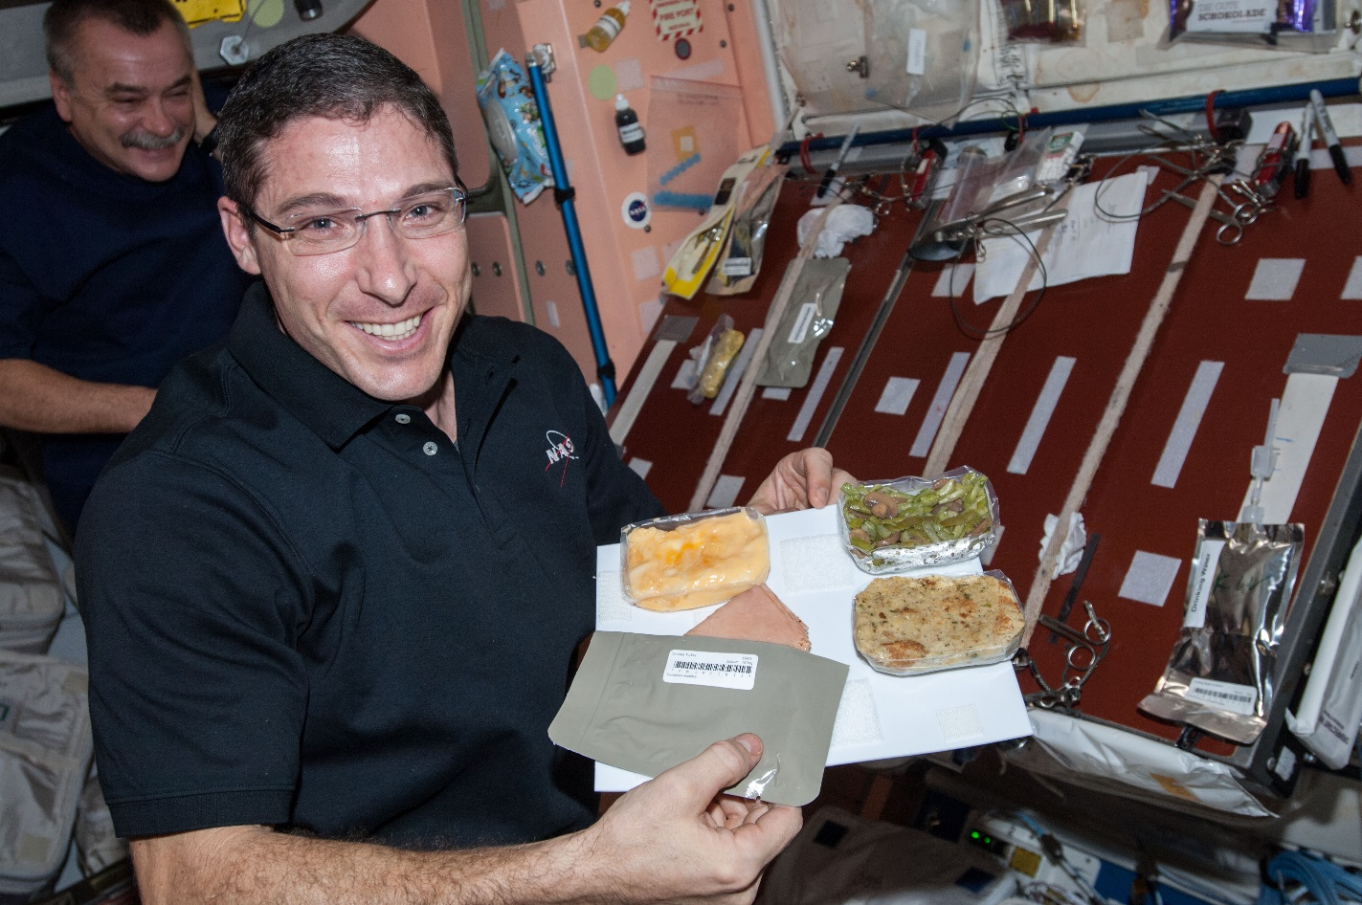
Why grow plants in space?
Food
Psychological well being
Atmosphere
Water

Slide 4
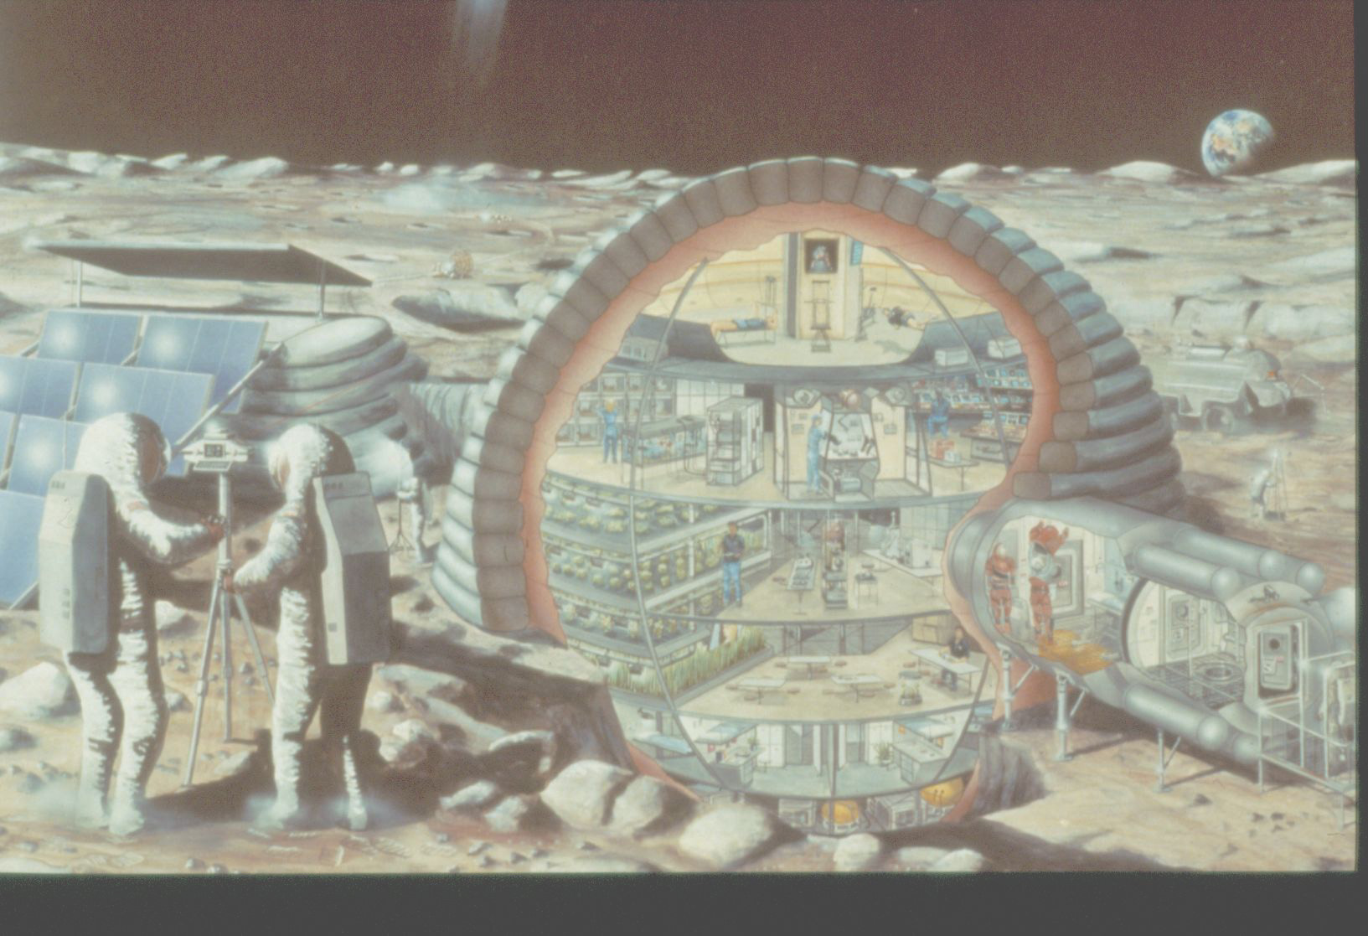

Slide 5
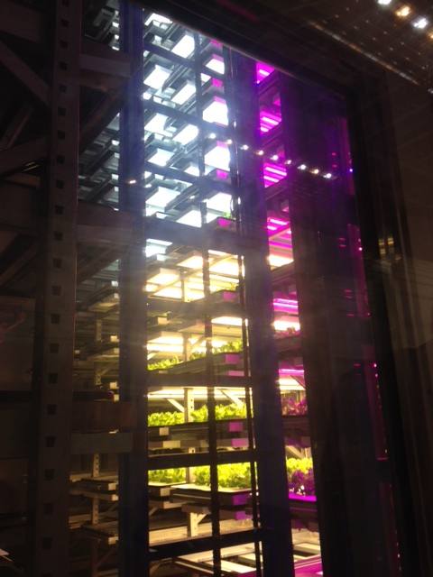
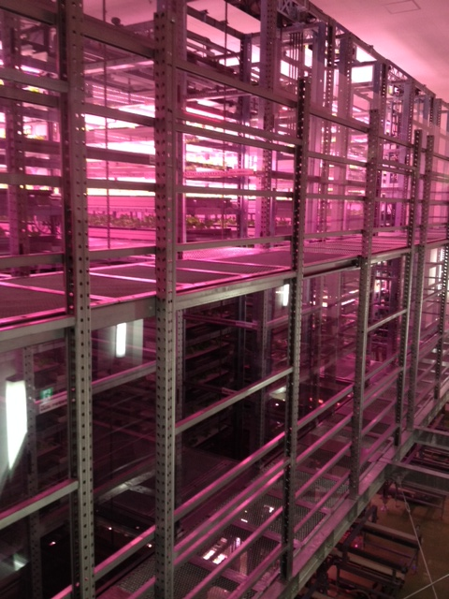
Plant Factories
Photos of Osaka Prefecture University training facility courtesy of Ray Wheeler

Slide 6
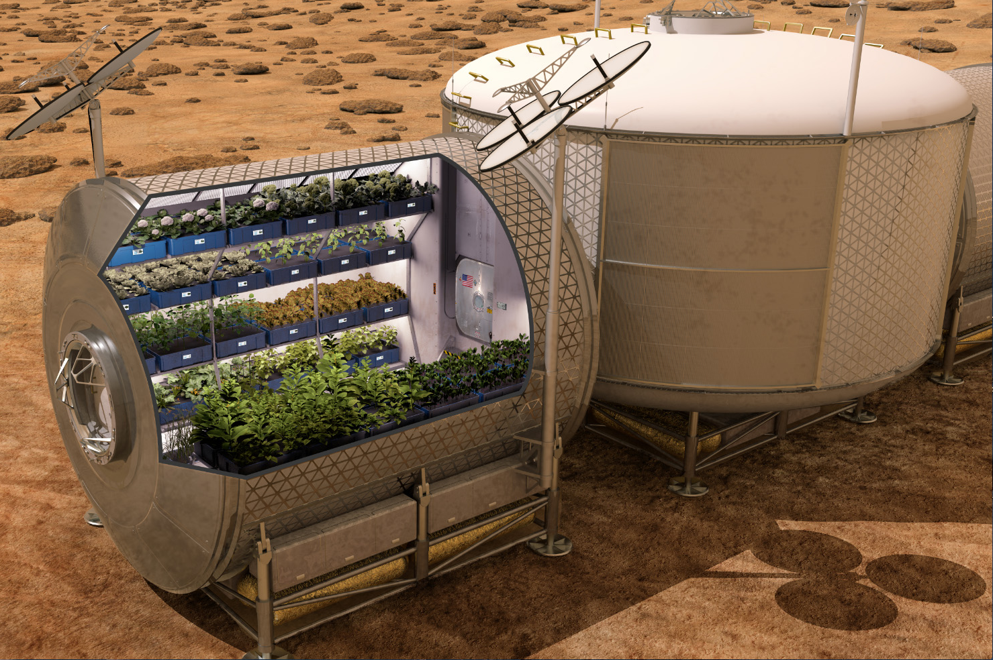

Slide 7
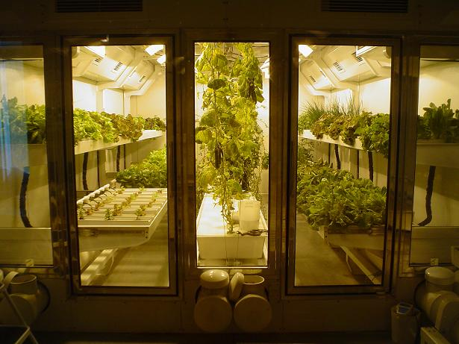
South Pole Greenhouse
Photo from “On the Ice” Blog of Russ Durkee

Slide 8


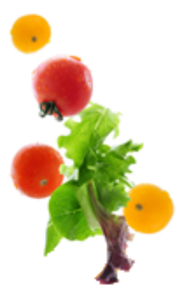
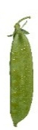


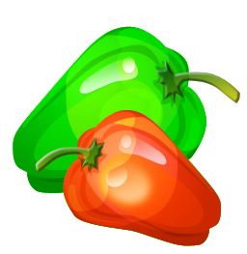


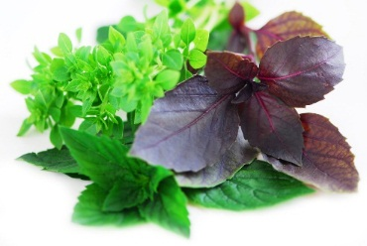


Space Crop Production Candidates
Lettuce, Chinese cabbage, Swiss chard, Mizuna, Spinach
Salad
Leafy Greens
Tomato
Pepper
Radish
Strawberry
Green Onion
Pea
Carrot
Staple Crops
White Potato
Sweet Potato
Rice
Wheat
Dried Bean
Soybean
Peanut
MINIMAL PREPARATION / COOKING
SIGNIFICANT PREPARATION / COOKING
Herbs
Basil
Mint
Chives
Dill
CONSUMED FRESH WITHOUT PROCESSING

Slide 9




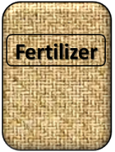

Plant Growth and the Environment
5 Cardinal Factors of Plant Growth…..
O₂

Slide 10

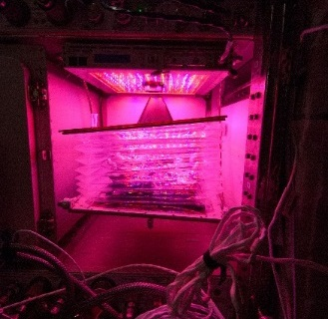
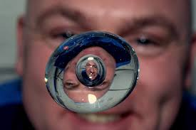


The Space Environment
….and how these work with and without Gravity!
Humans like white light, but plants are fine with red and blue
No convection in space so need to mix the air
O₂
Water forms a ball, and water and air don’t mix well, a problem for roots which need both!
Fertilizer is heavy to launch so we need to learn how to recycle plant waste

Slide 11
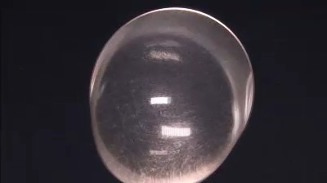
The Space Environment
….and how these work with and without Gravity!

Slide 12
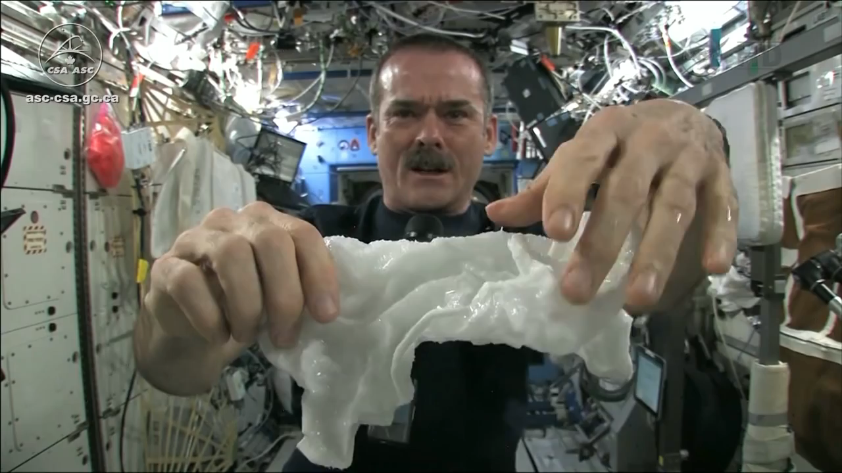
The Space Environment
….and how these work with and without Gravity!
Please Play Video 2

Slide 13
Space Crop Production Challenges
Deep Space
Water
Recycling
Radiation
Pressure
Micrometeorites
Surface
Microgravity
Fluid movement
No convection
Dust
Partial gravity
Plant Size
High CO₂
Food Safety
Nutrient output
Sustainability
Abiotic stresses
Vehicle resources
Crew time
Waste
Productivity
Stress tolerance
Environmental optimization
Crop scheduling
Crop

Slide 14
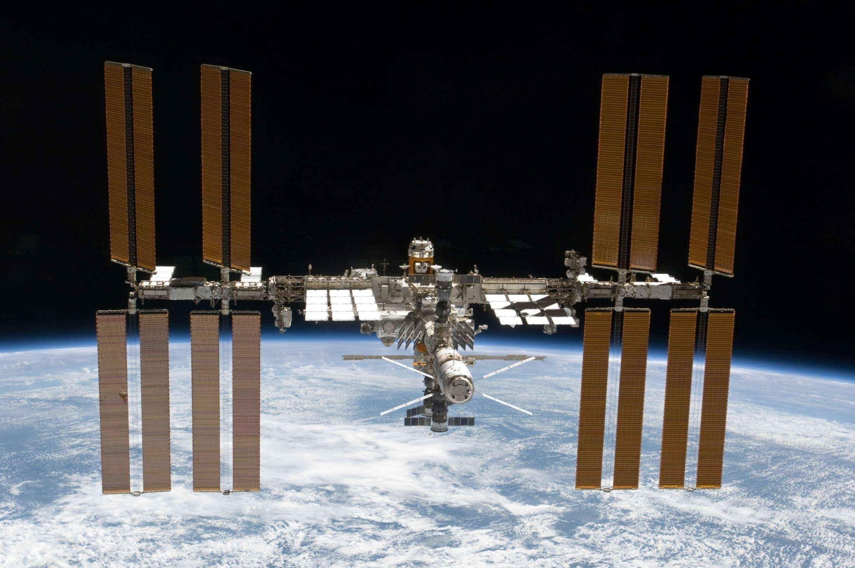
The International Space Station

Slide 15
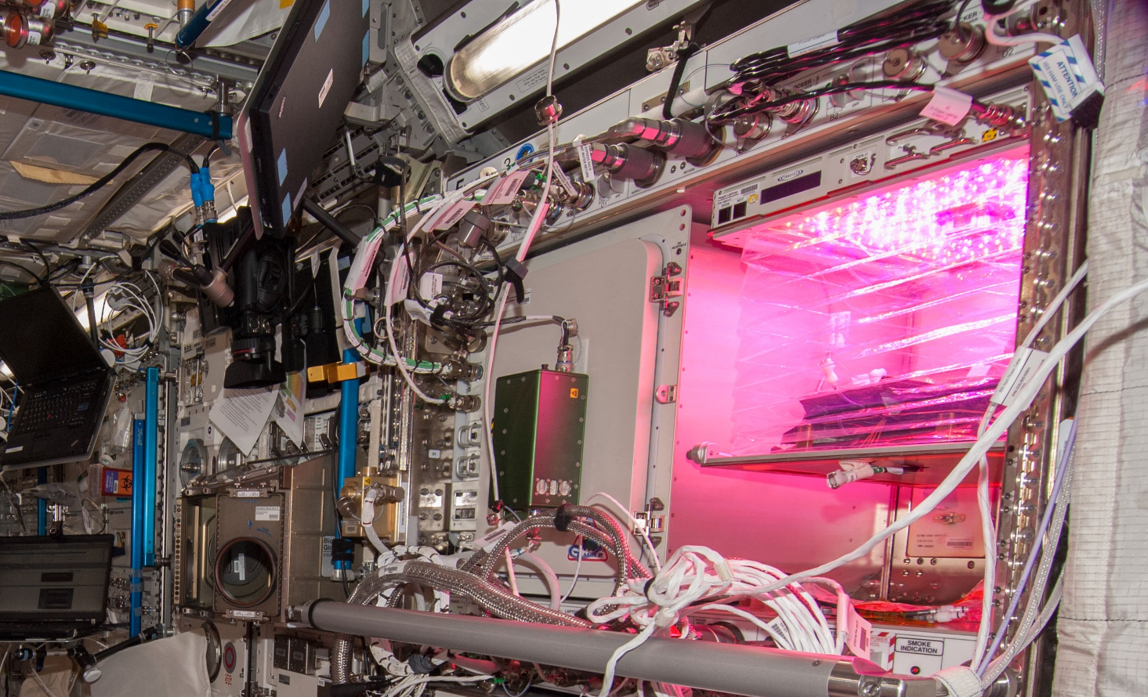
Veggie on ISS

Slide 16

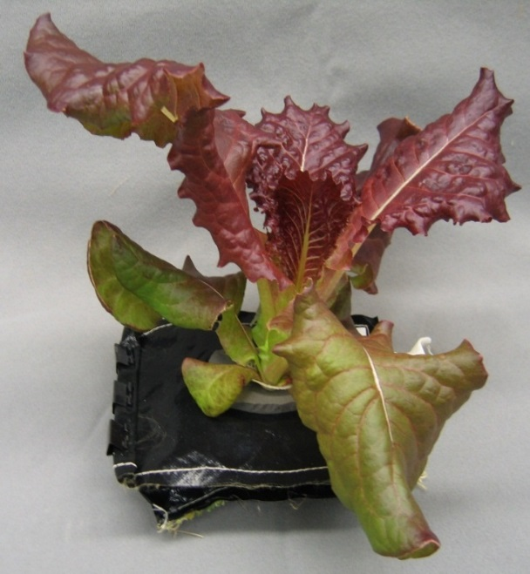
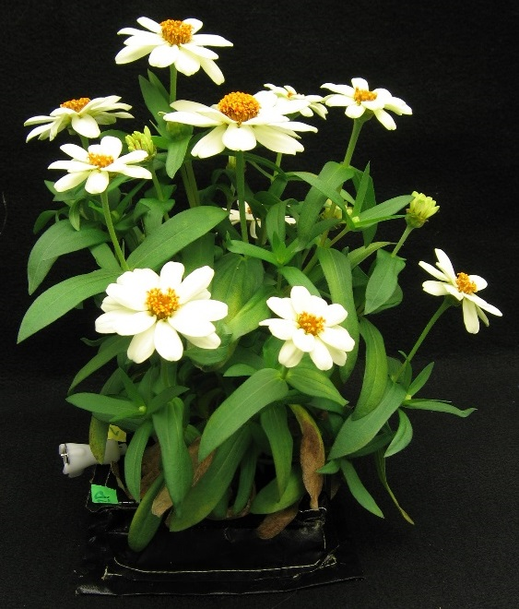
Crop Selection for VEG-01
Reliable germination
Rapid growth
Attractiveness
Low native microbial levels
Palatability / acceptability
Antioxidants
‘Outredgeous’
red romaine lettuce
‘Profusion’ Zinnia
VEG-01 consisted of two sets of ‘Outredgeous’ lettuce and one set of ‘Profusion’ zinnia pillows

Slide 17
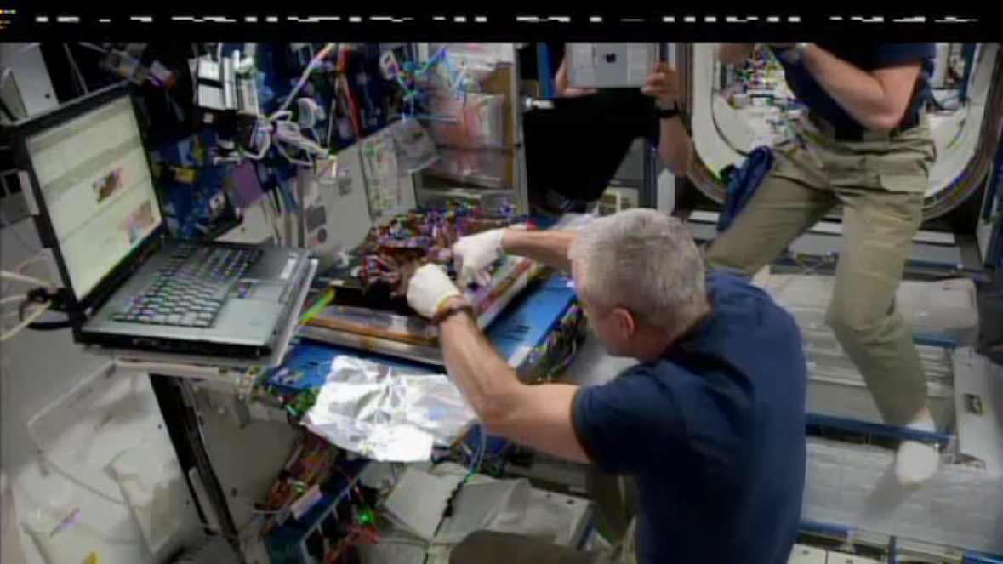
VEG-01A Harvest (June 2014)
Notes:
Note that while Swanny harvests the plants, his crew mates surround him taking photos and enjoying the activity. Wiseman (with iPad), Gerst (taking photos), and Oleg Artemyev off camera to the left.

Slide 18
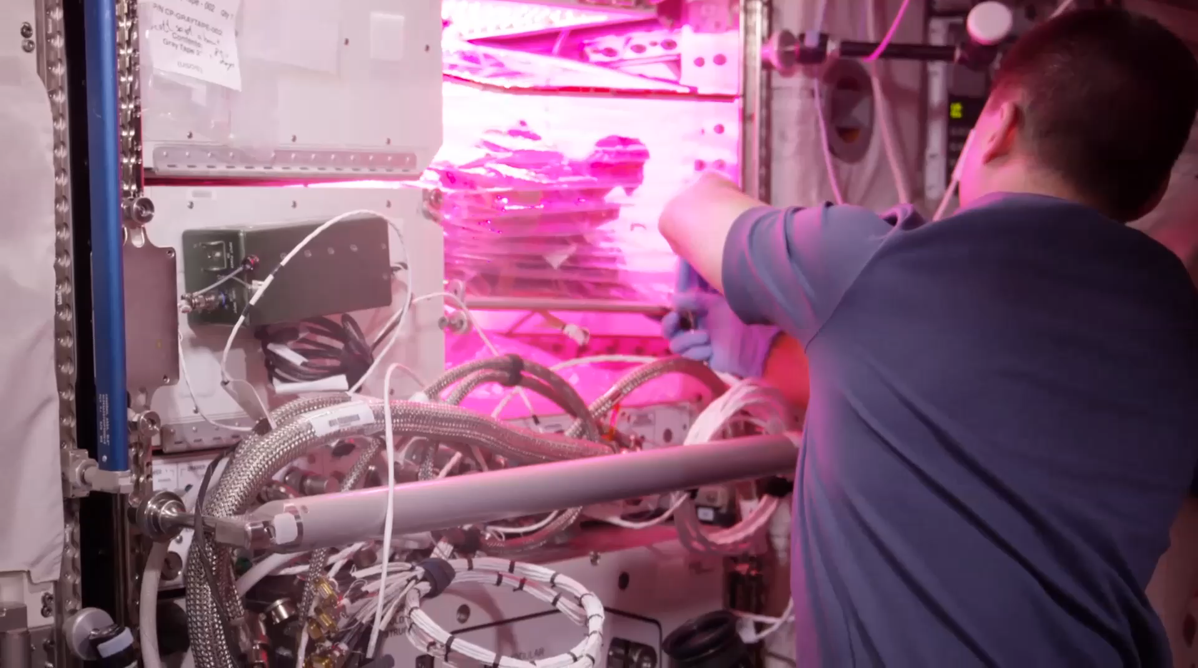
VEG-01B Harvest (August 2015)
Notes:
Veg-01 second crop, first consumption

Slide 19
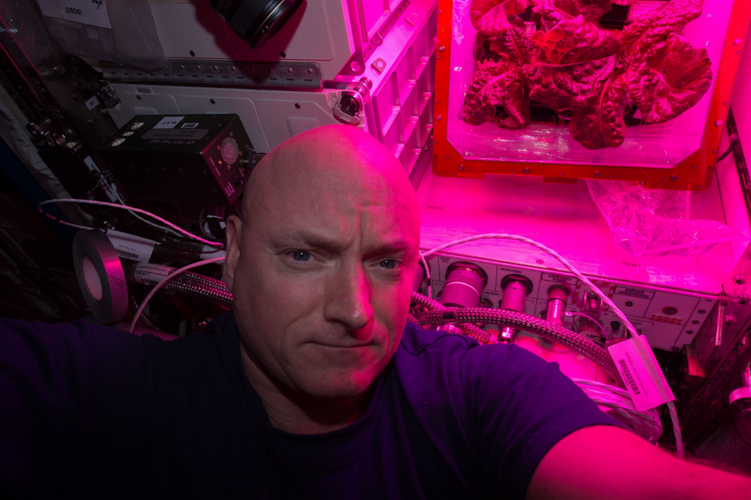
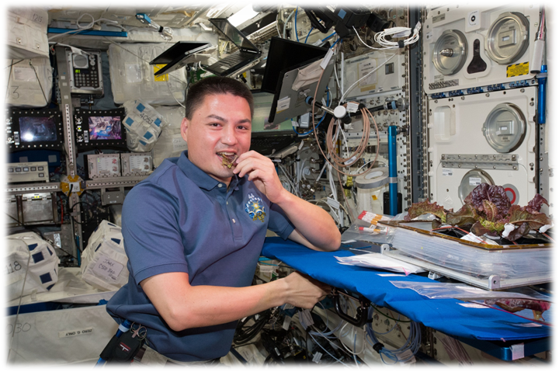
Astronaut Comments
Scott Kelly
  the logistical complexity of having people live and work in space for long periods
  the supply chain that is required
  For Mars, need a space craft that is more self-sustainable with regards to its food supply
Kjell Lindgren
  benefit of eating the fresh food
  contribution that plants have to the ISS ecosystem
  psychological benefit - it’s really fun to see green growing things in the sterile environment of the ISS

Slide 20
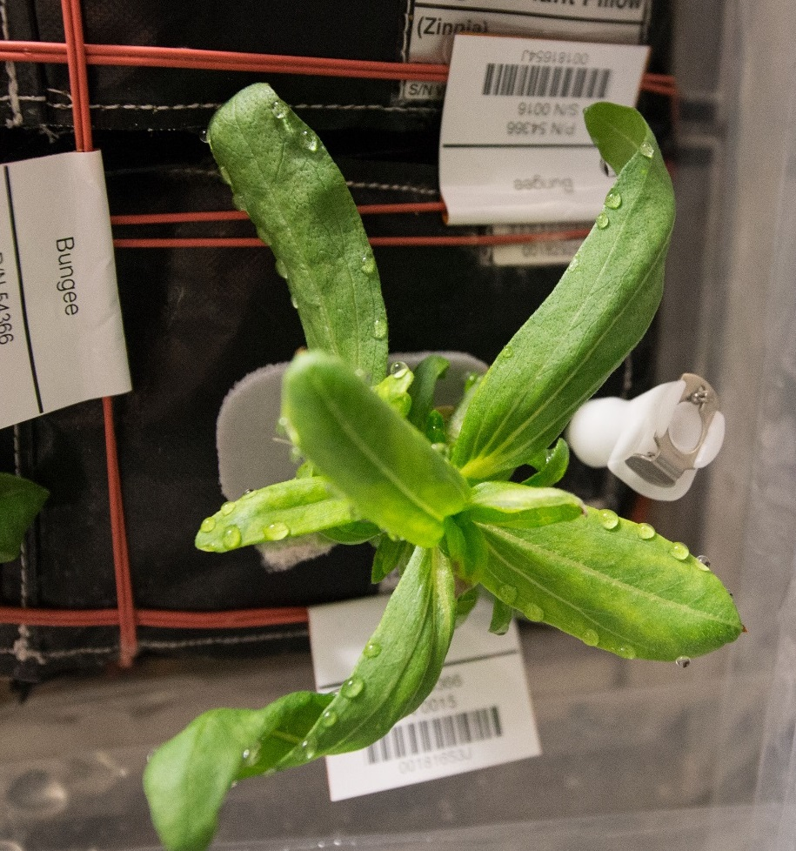
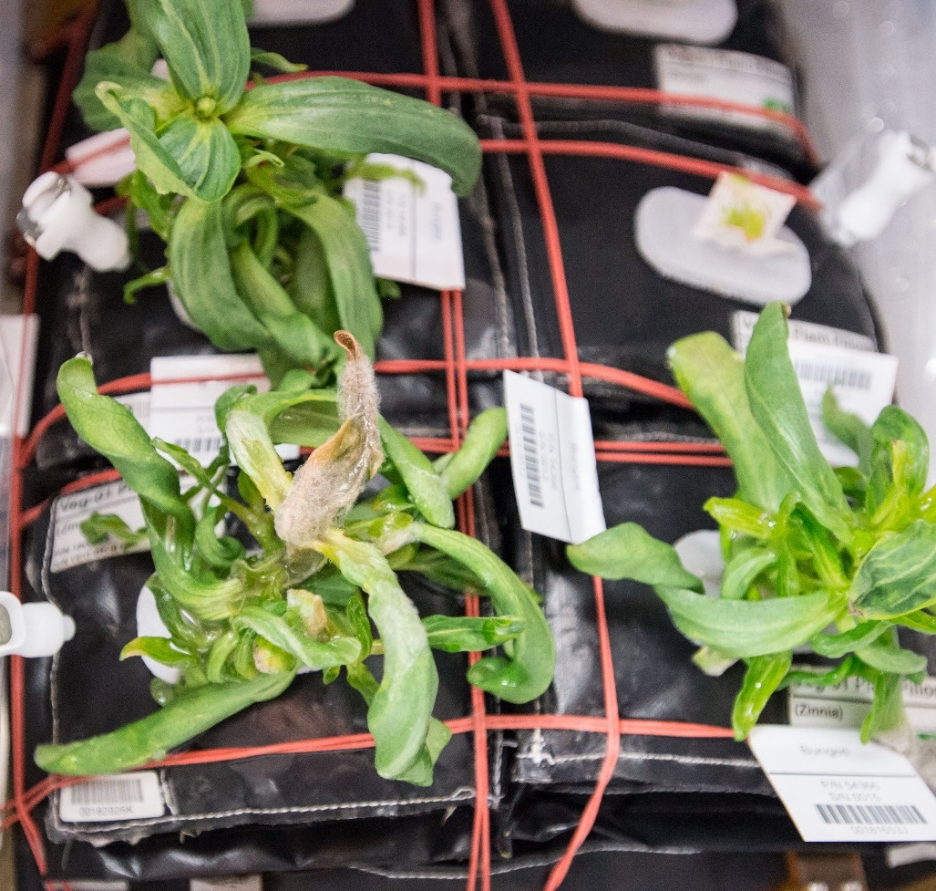
Water Issues / Consequences
Guttation and Leaf Curling
Fungal Development
& Abnormal Growth

Slide 21
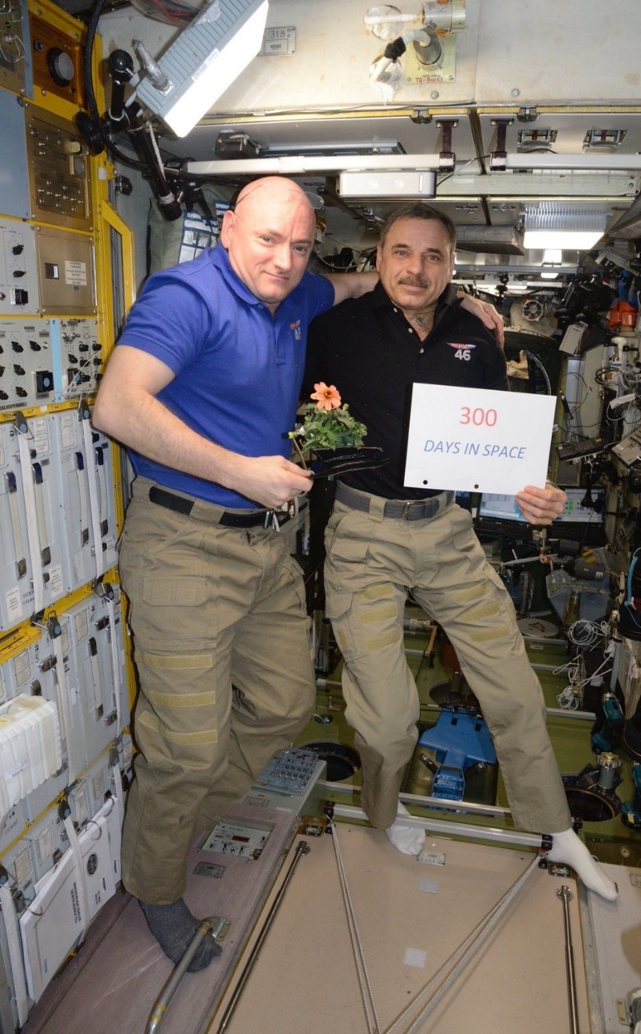
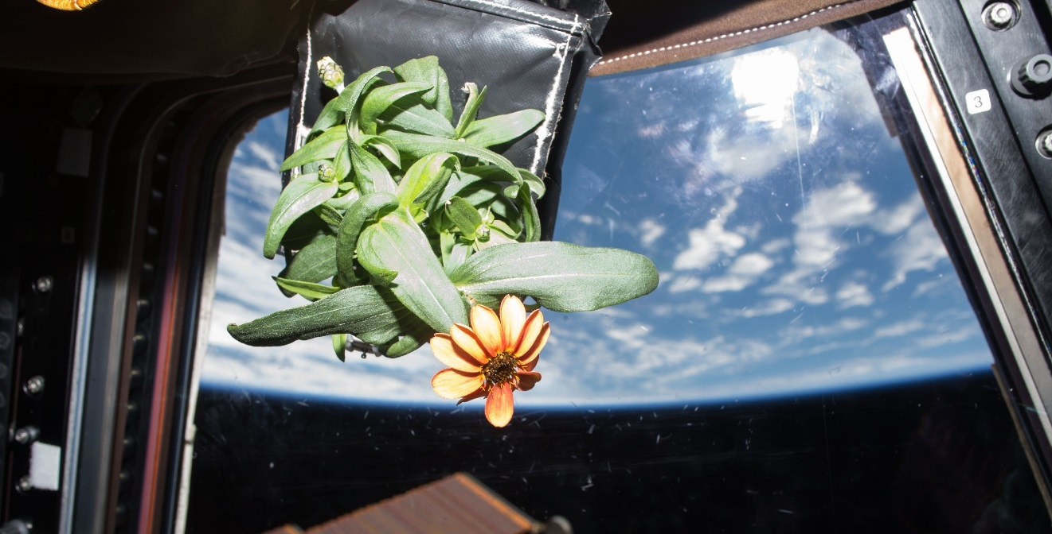
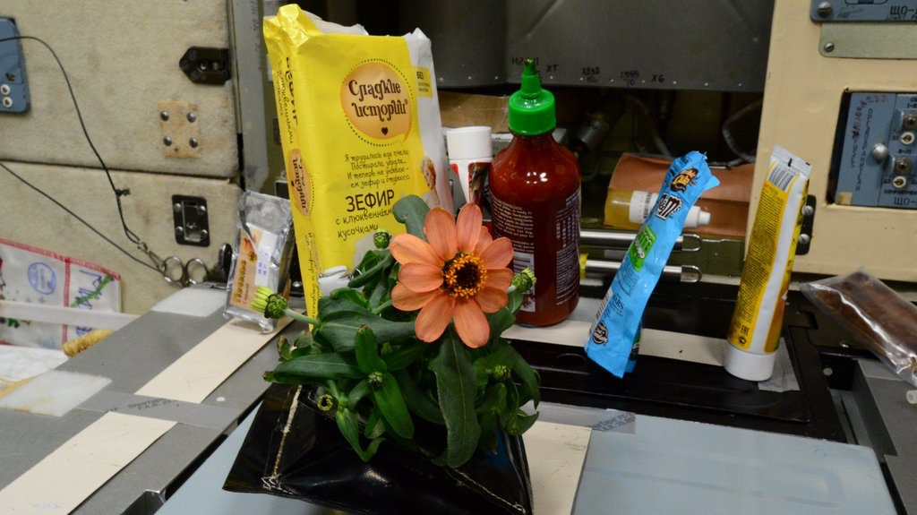
Zinnia Action Shots

Slide 22
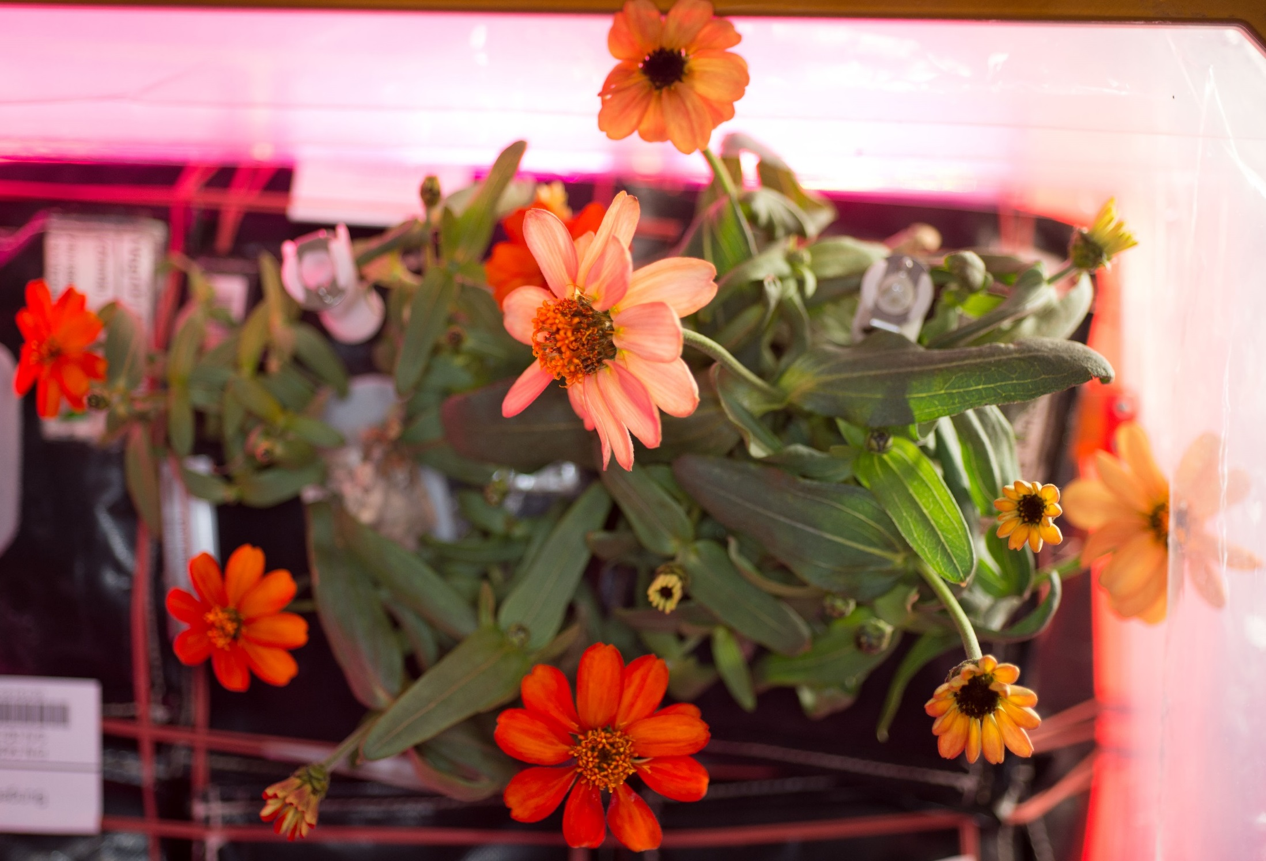
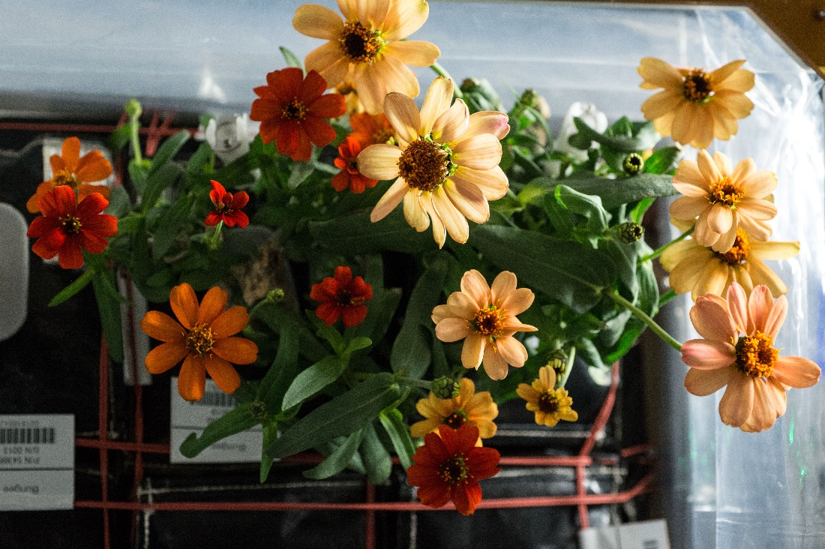
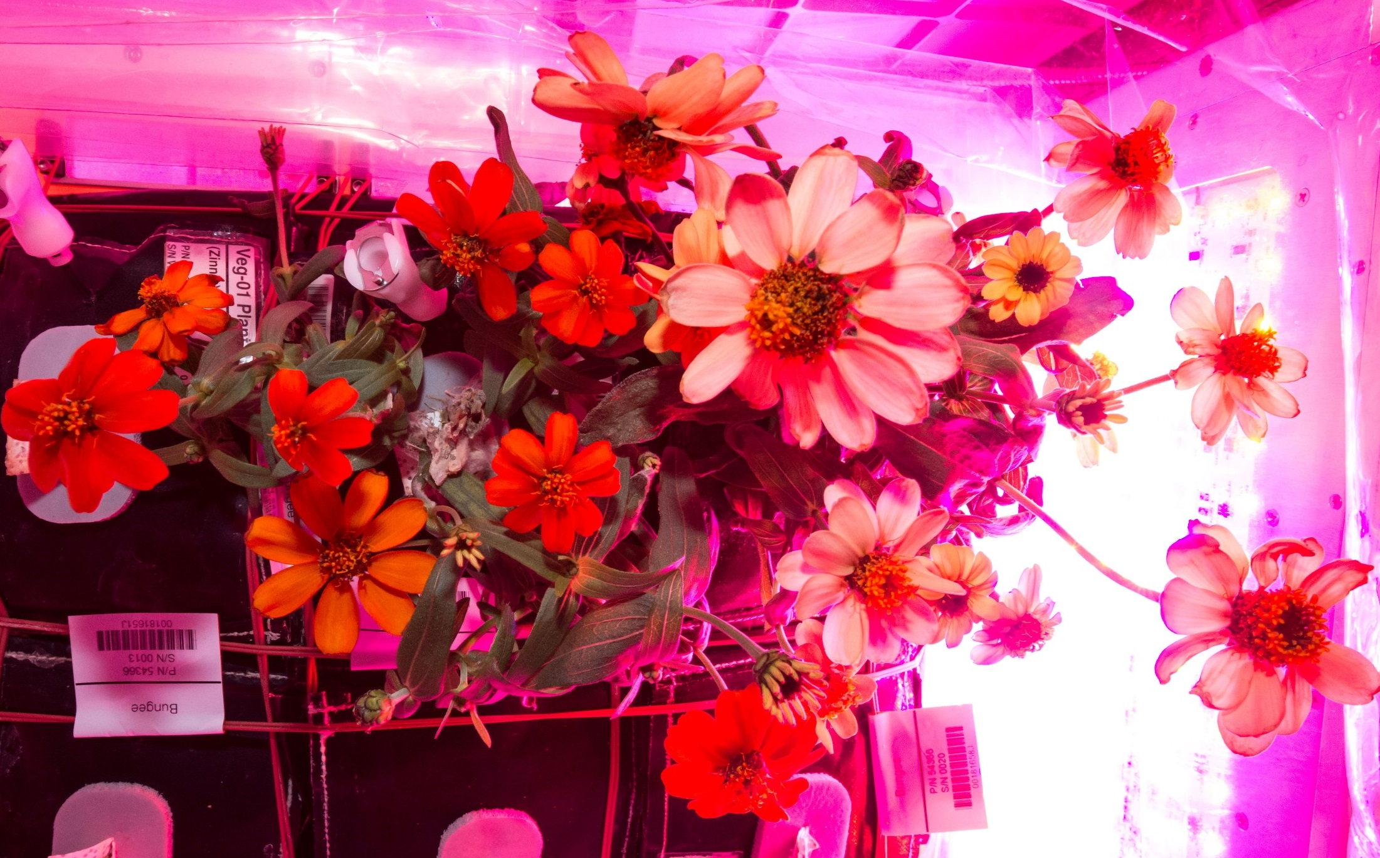
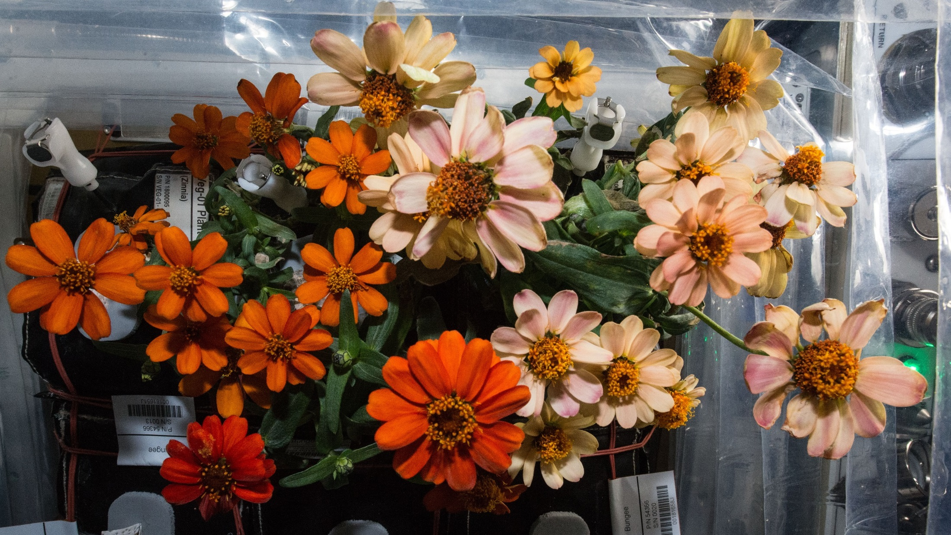
And they bloomed, and bloomed...
77 DAI
71 DAI
80 DAI
87 DAI

Slide 23
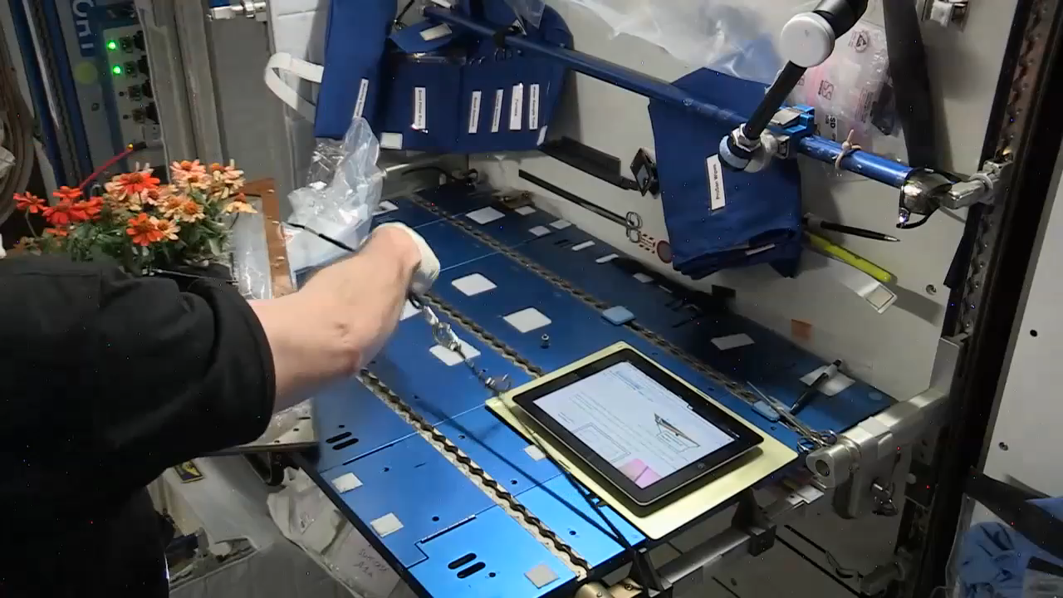
90 DAI: Harvest on February 14, 2016
Notes:
Video by Rachel Hobson

Slide 24
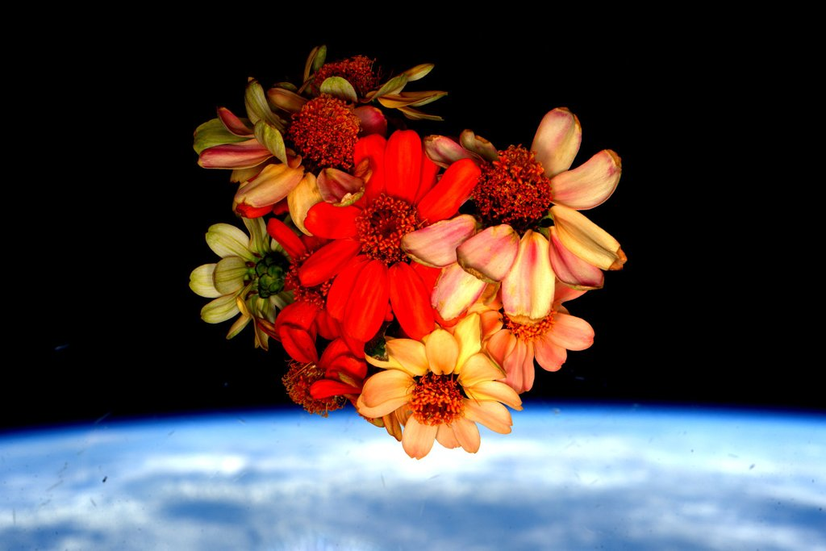
Valentine’s Day Bouquet on the ISS

Slide 25
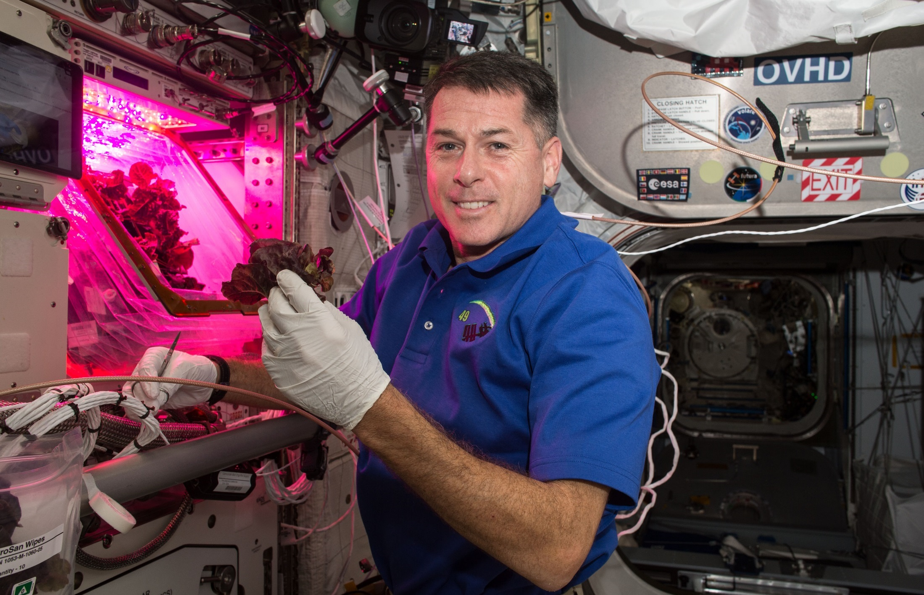
VEG-03A Cut-and-Come-Again

Slide 26
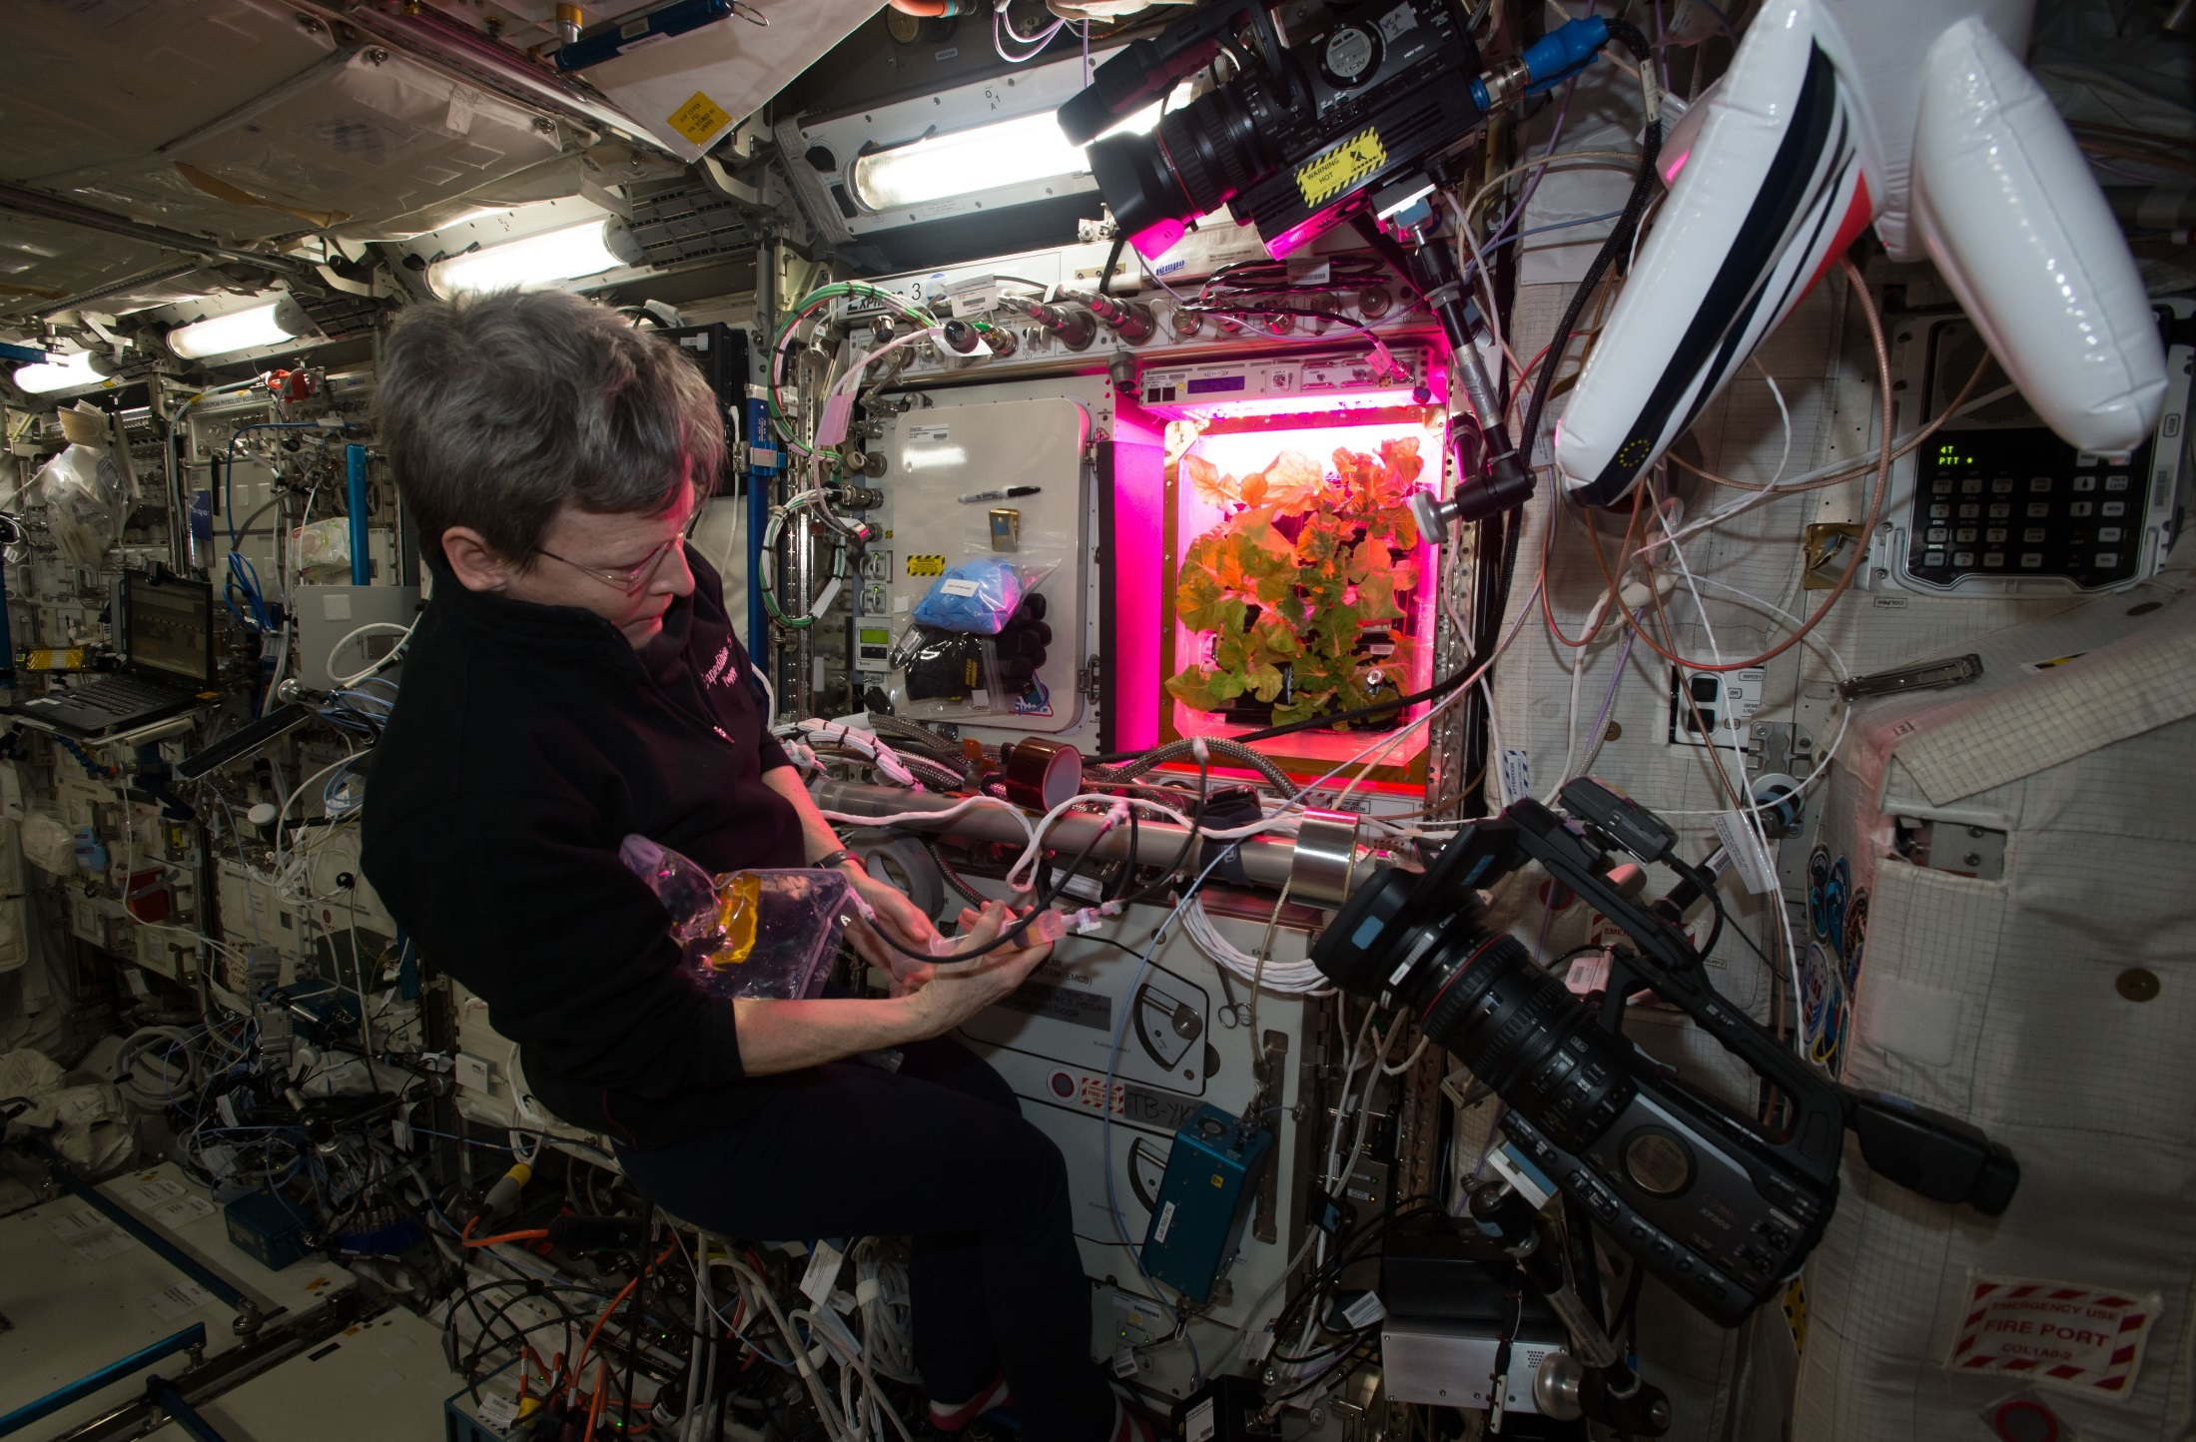
VEG-03C Cut-and-Come-Again

Slide 27
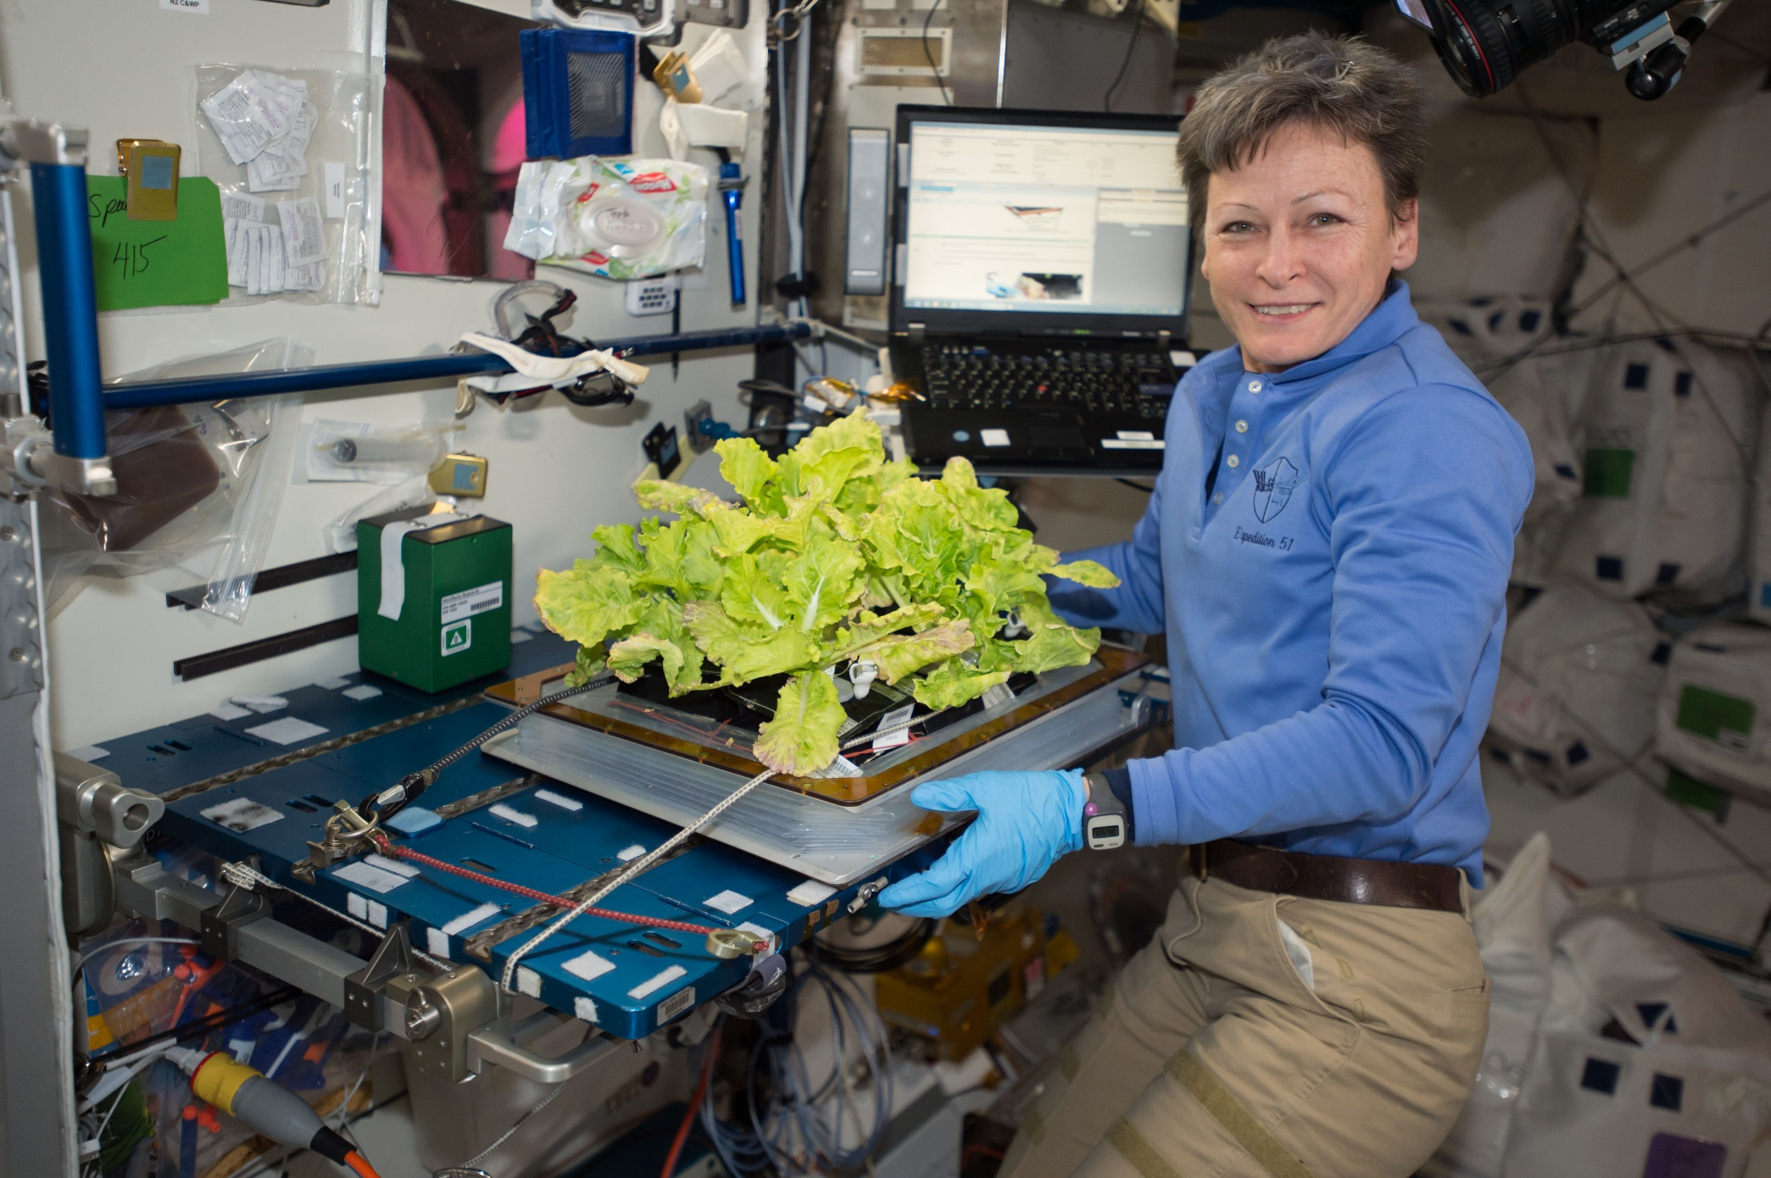
VEG-03C Cut-and-Come-Again

Slide 28
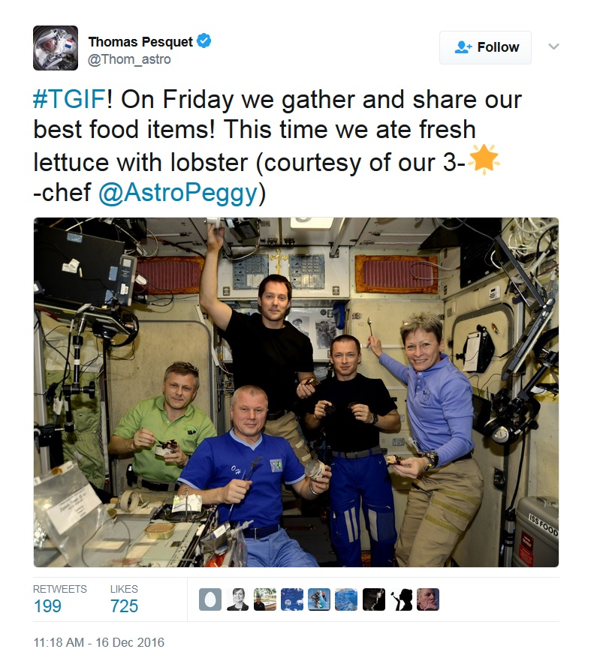
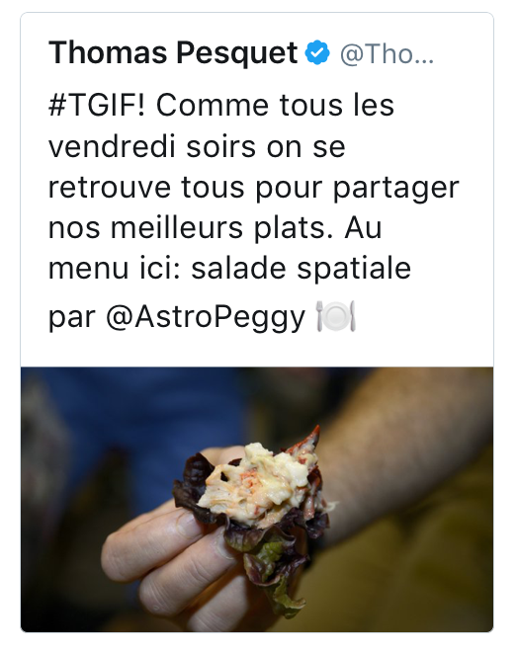
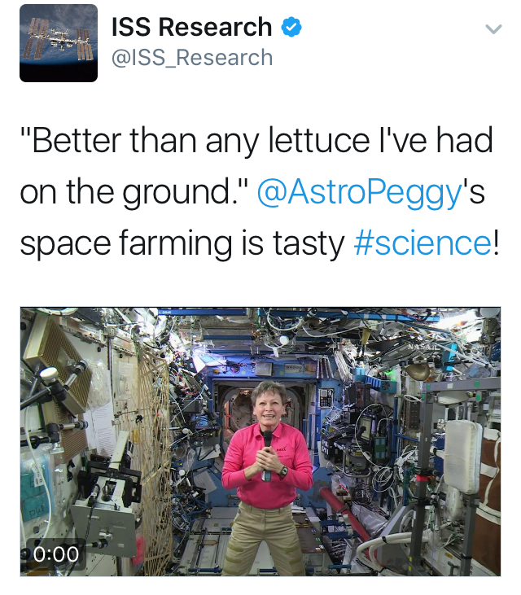
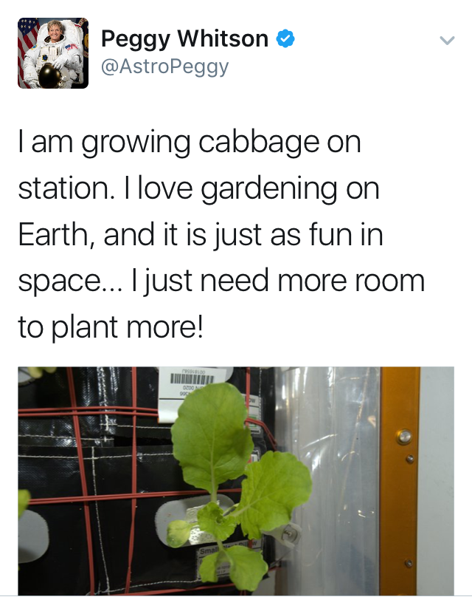
Happy Crew

Slide 29
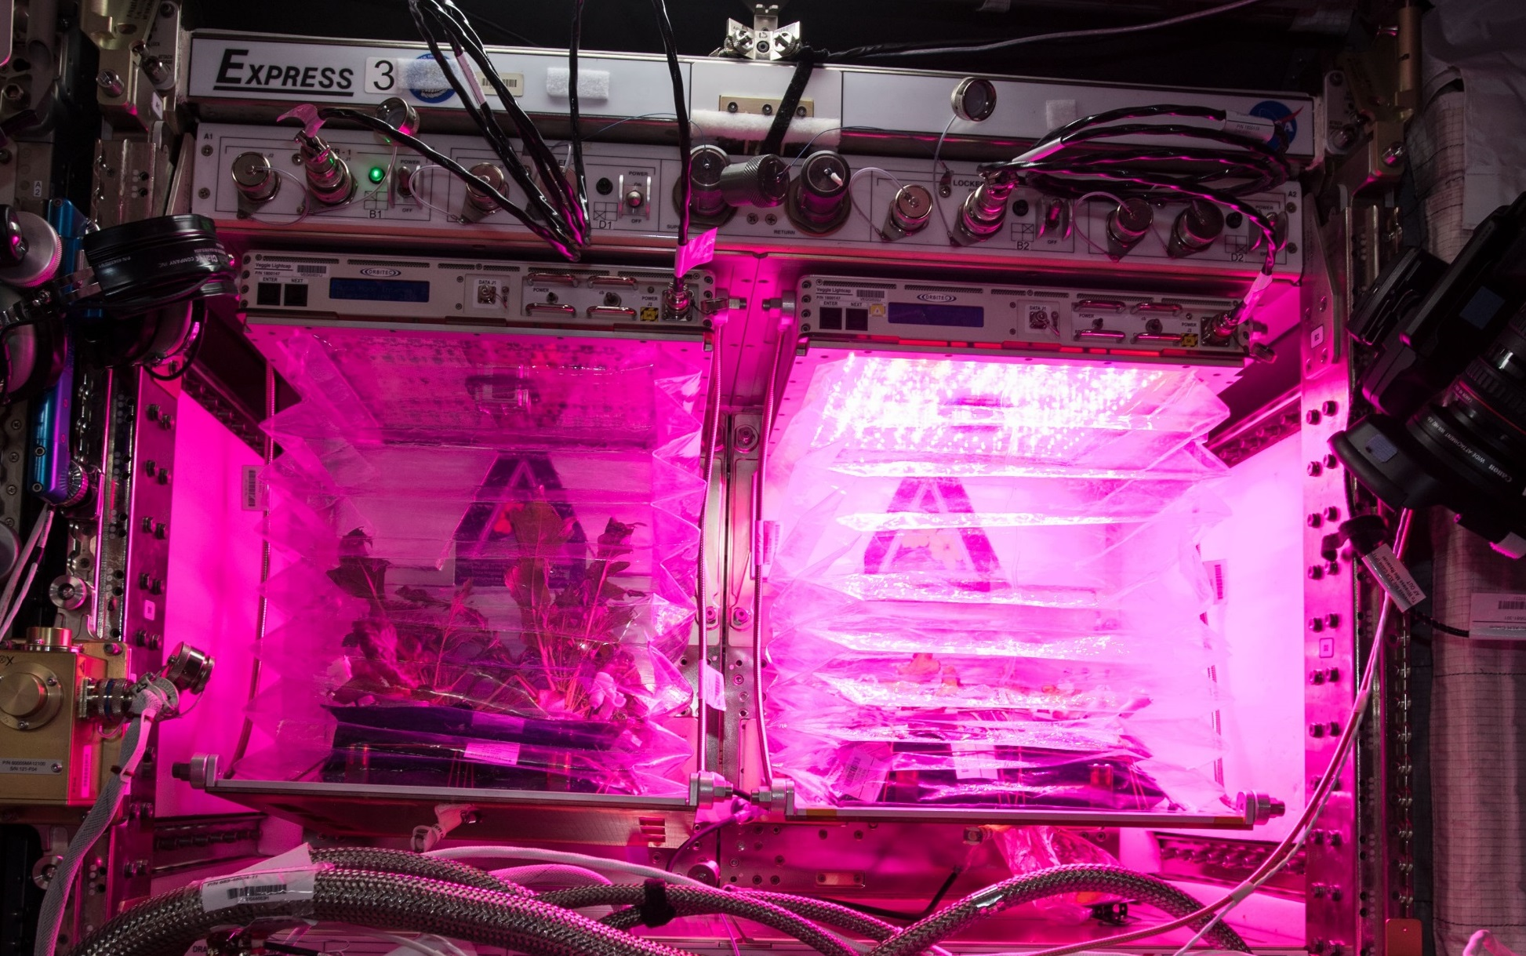
VEG-03E & F - A Tale of Two Veggies

Slide 30
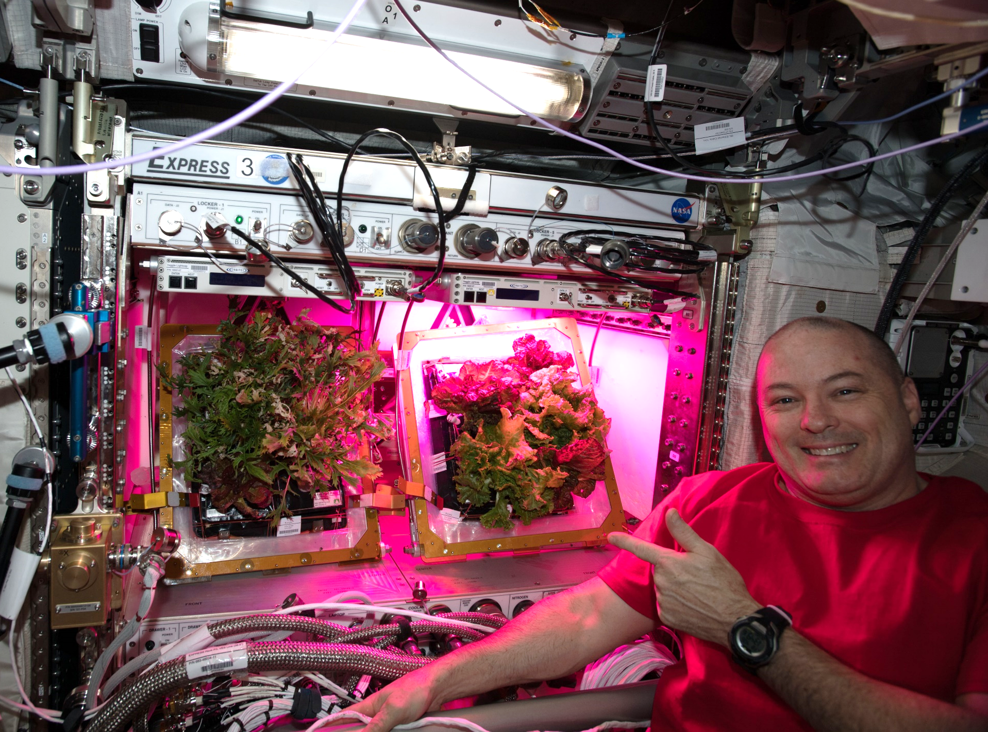
VEG-03E & F - A Tale of Two Veggies

Slide 31
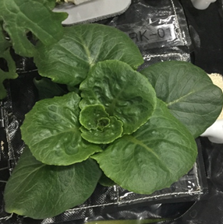
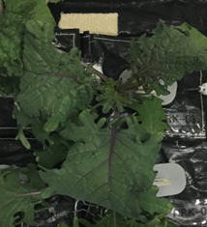
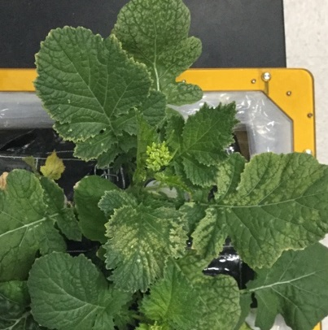
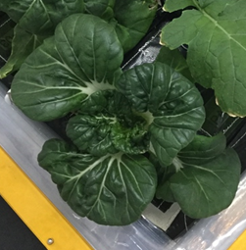
VEG-03 G, H, I - New Crops on Orbit
Red Russian Kale
*Dragoon Lettuce
Wasabi Mustard
*Extra Dwarf Pak Choy
Outredgeous lettuce
Three sets will be grown in
different combinations
*= Student Selected Crops!

Slide 32
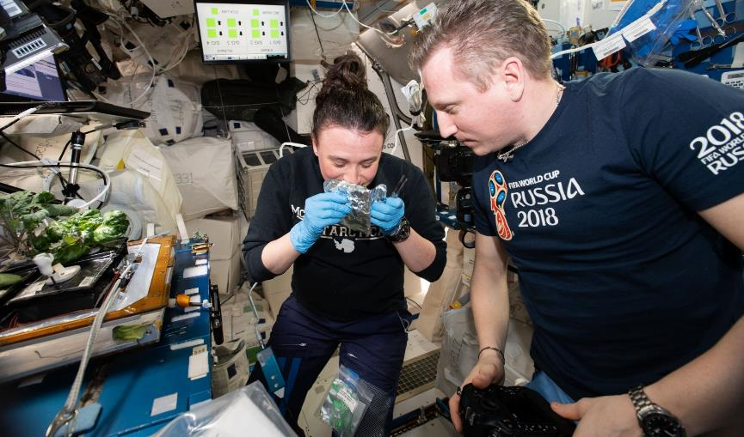
VEG-03 G (October-November 2018)

Slide 33

VEG-03H – (March-April 2019)

Slide 34


Recently completed on ISS – VEG-04
Research to study the impacts of Red: Blue: Green light ratios on Mizuna crop growth, nutrient composition, organoleptic appeal and microbial food safety with additional assessments of crew behavioral health.
Collaboration between KSC, JSC, Purdue University and SNC-ORBITEC

Slide 35


Slide 36


VEG-04 Harvest
VEG-04A at 35 DAI
VEG-04B at 29 DAI

Slide 37



VEG-04 Crew Engagement

Slide 38

Thank you!
Veggie and VEG teams at KSC and SNC-ORBITEC
Astronauts Steve Swanson, Rick Mastracchio, Scott Kelly, Kjell Lindgren, Shane Kimbrough, Peggy Whitson, Jack Fischer, Joe Acaba, Scott Tingle, Serena Auñón-Chancellor, Alex Gerst, Anne McClain, David Saint-Jacques, Christina Koch, Nick Hague, Drew Morgan, Jessica Meir
Payload Operations and Integration Center
NASA’s Space Biology Program, ISS Program, Human Research Program

Slide 39















