Slide 1

Estimating LNOx from Lightning Measurements
UAH Seminar Series
Dr. William Koshak, NASA/MSFC
October 28, 2020
Huntsville, AL
Koshak, NASA/MSFC

Slide 2
General Comments
Charges Deposited by Lightning
Lightning Nitrogen Oxides Model (LNOM)
Modeling Return Stroke LNOx
Estimating LNOx from LIS/GLM
Koshak, NASA/MSFC

Slide 3
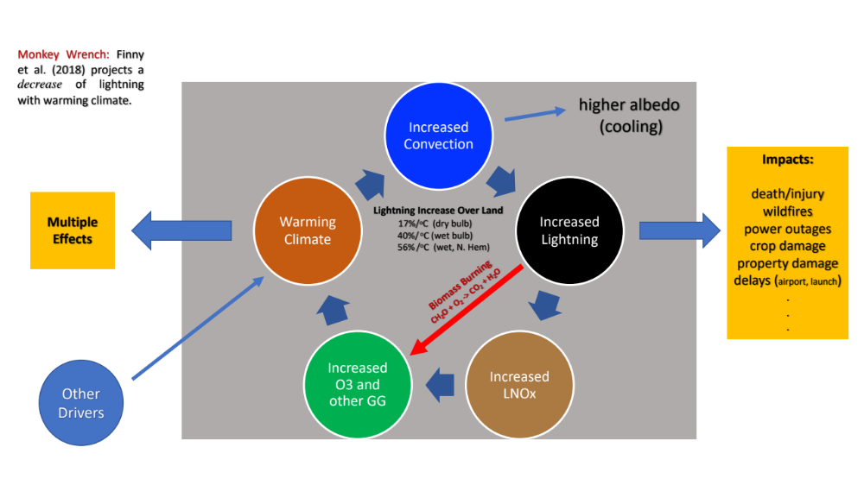
Lightning/Climate Interaction
Koshak, NASA/MSFC

Slide 4
Mathematical Inversion
Koshak, NASA/MSFC

Slide 5
Common Retrievals
Item | Measurement | Retrieval
Ground-Based
1 | Electrostatic field changes | Charges deposited by Lightning
2 | VHF time-of-arrival | Channel mapping
3 | VLF/LF radiated electric field amplitude, (also magnetic direction & time-of-arrival) | CG return stroke peak current, (CG strike location)
In-Situ
4 | Aircraft electric field mill amplitude | Thundercloud electric field
Satellite (GLM/LIS)
5 | Maximum Group Area (MGA) in optical | Flash type (CG or cloud flash)
6 | Intercepted flash optical energy | LNOx
LNOM
Koshak, NASA/MSFC

Slide 6
General Comments
Charges Deposited by Lightning
Lightning Nitrogen Oxides Model (LNOM)
Modeling Return Stroke LNOx
Estimating LNOx from LIS/GLM
Koshak, NASA/MSFC

Slide 7
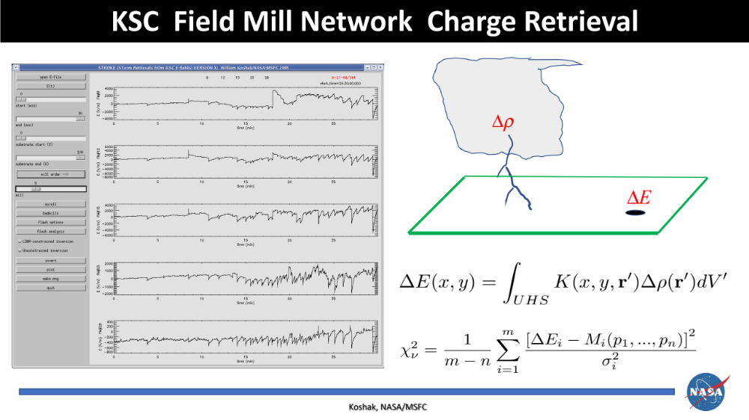

Slide 8
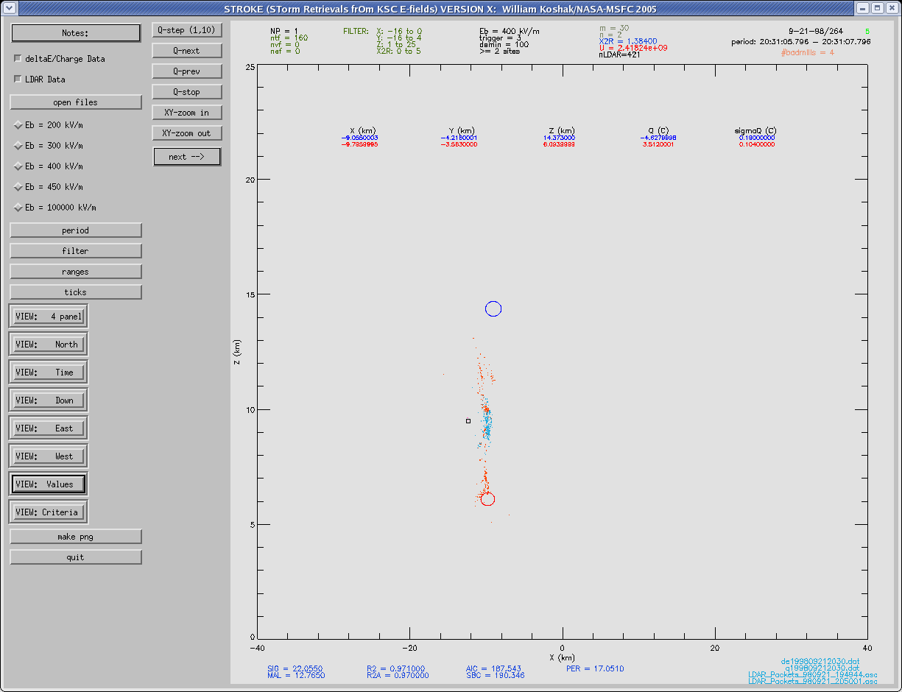
Sample Charge Retrieval
Dipole Moment
Change due to a
Cloud Flash
Koshak, NASA/MSFC

Slide 9
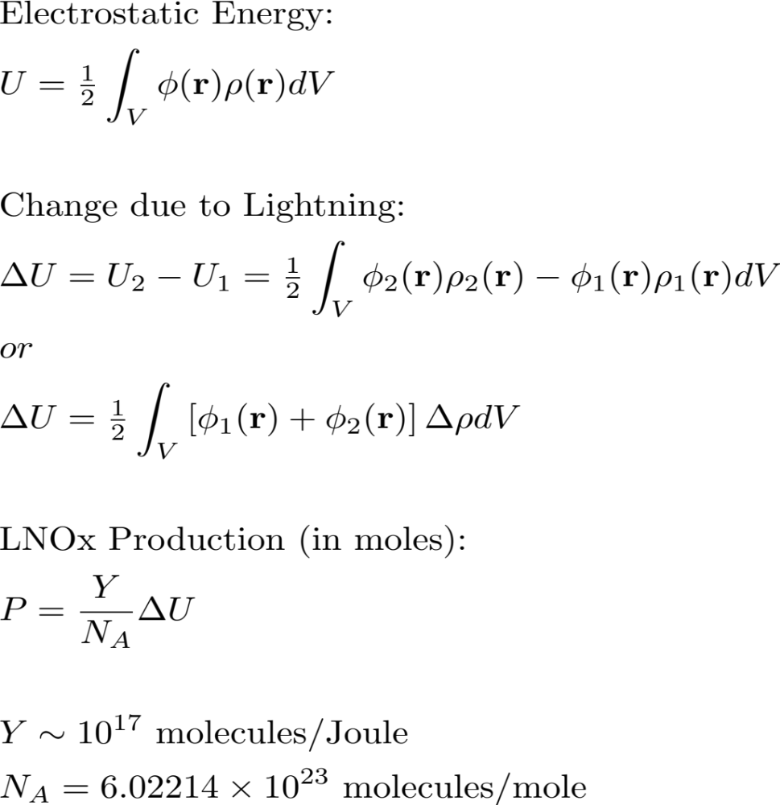
Charge … Energy … LNOx
Obtain from
Charge Retrieval
Koshak, NASA/MSFC

Slide 10
General Comments
Charges Deposited by Lightning
Lightning Nitrogen Oxides Model (LNOM)
Modeling Return Stroke LNOx
Estimating LNOx from LIS/GLM
Koshak, NASA/MSFC

Slide 11
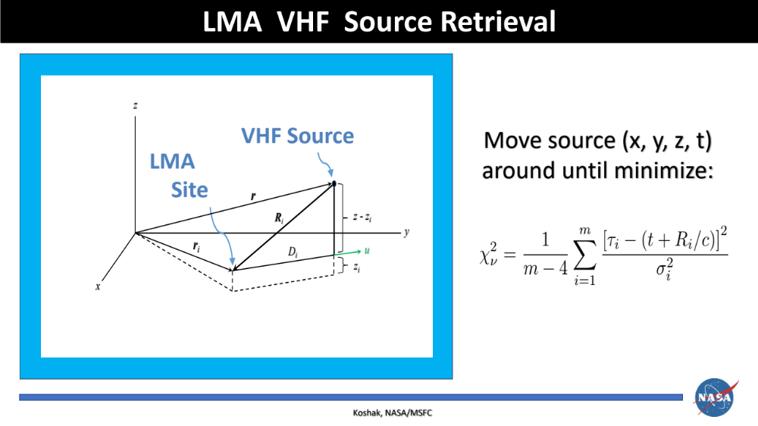

Slide 12
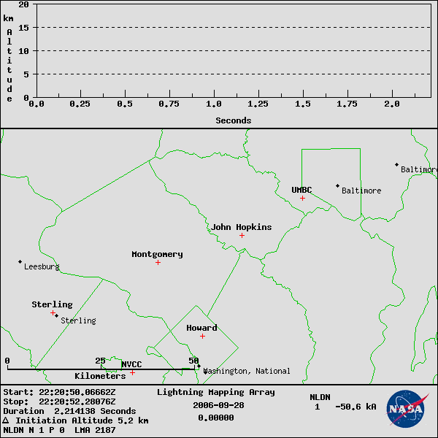
Sample LMA Flash
DC Area Lightning
Discharge
2.2 sec hybrid flash
50 km horizontal extent
Initiation at 5.2 km
VHF Sources 2187
CG strike at 2 s
Koshak, NASA/MSFC

Slide 13
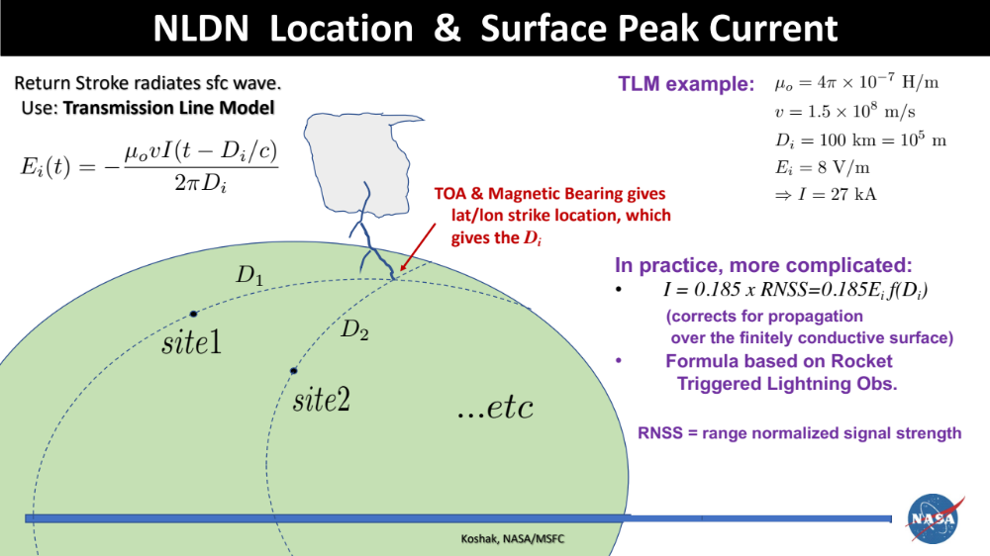

Slide 14
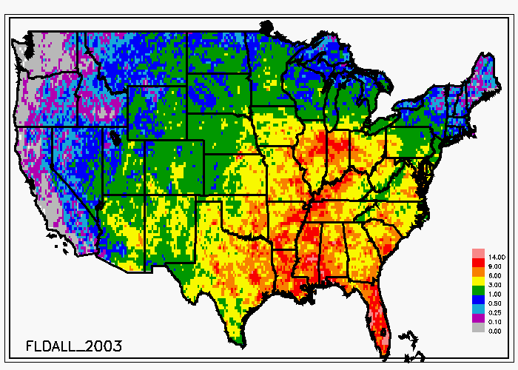
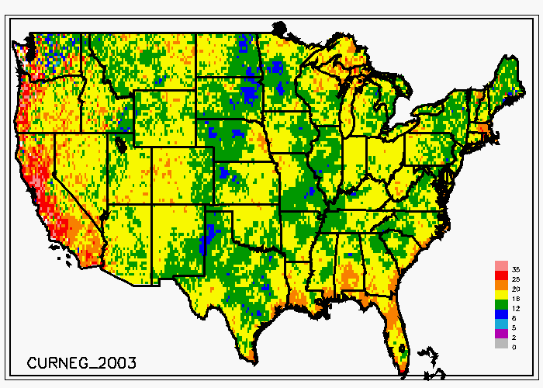
Flash Density
(#CG/km²)
- Peak Current
(kA)
Koshak, NASA/MSFC

Slide 15
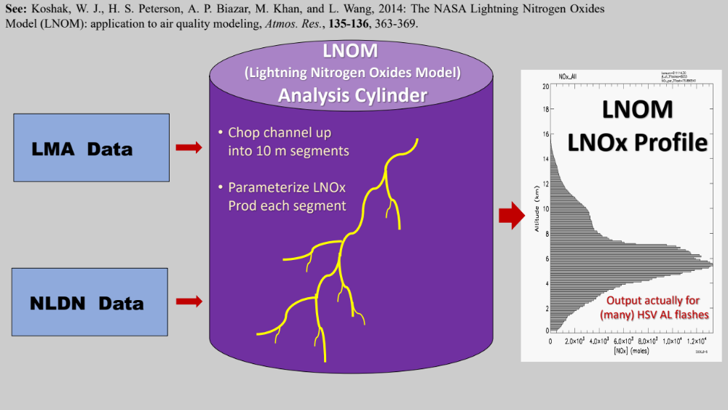
LNOM
Koshak, NASA/MSFC

Slide 16
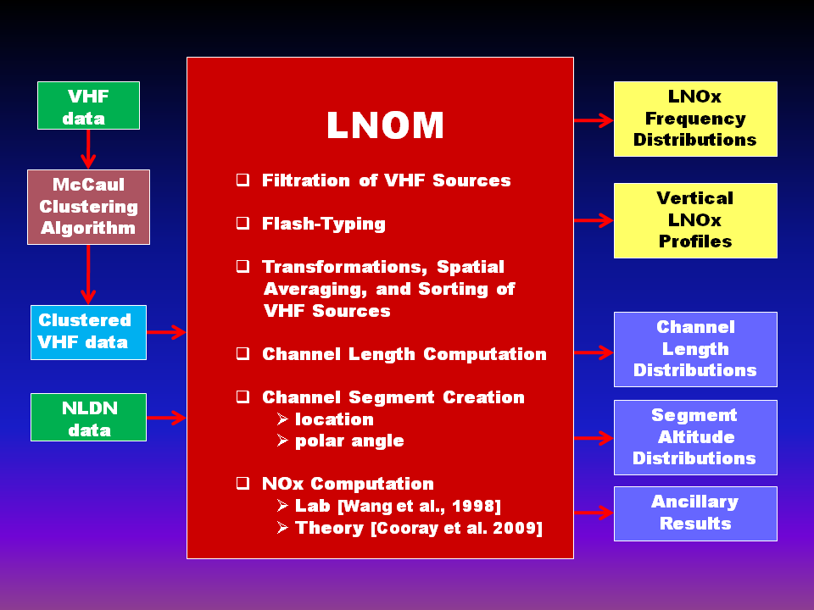
LNOM (cont.)
Koshak, NASA/MSFC

Slide 17
LNOM (cont.)
Koshak, NASA/MSFC

Slide 18
General Comments
Charges Deposited by Lightning
Lightning Nitrogen Oxides Model (LNOM)
Modeling Return Stroke LNOx
Estimating LNOx from LIS/GLM
Koshak, NASA/MSFC

Slide 19
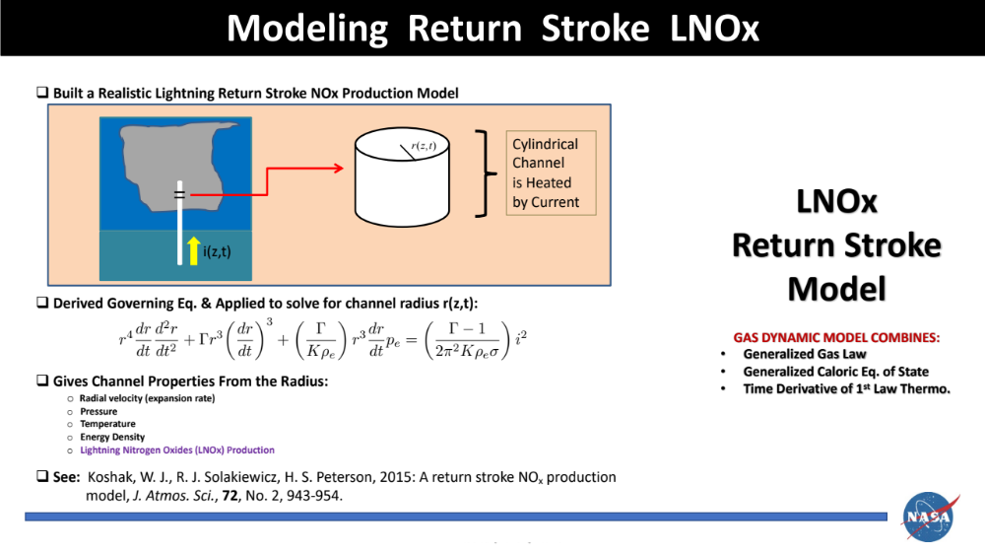

Slide 20
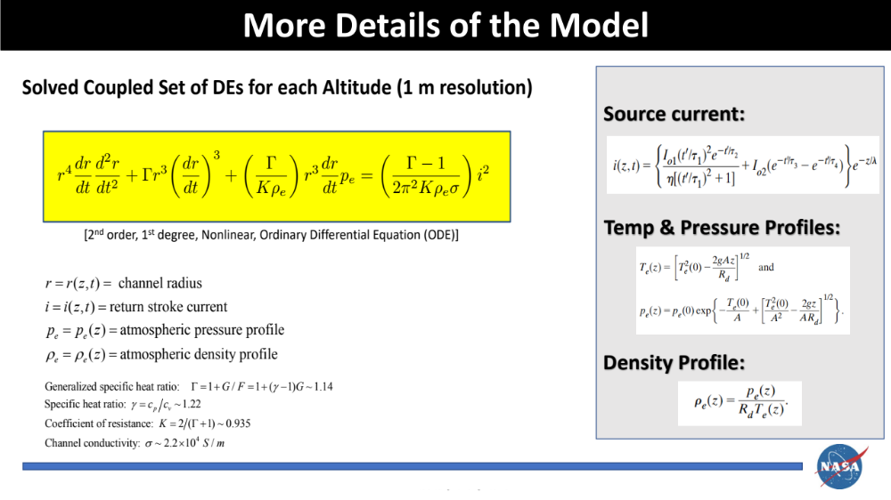

Slide 21
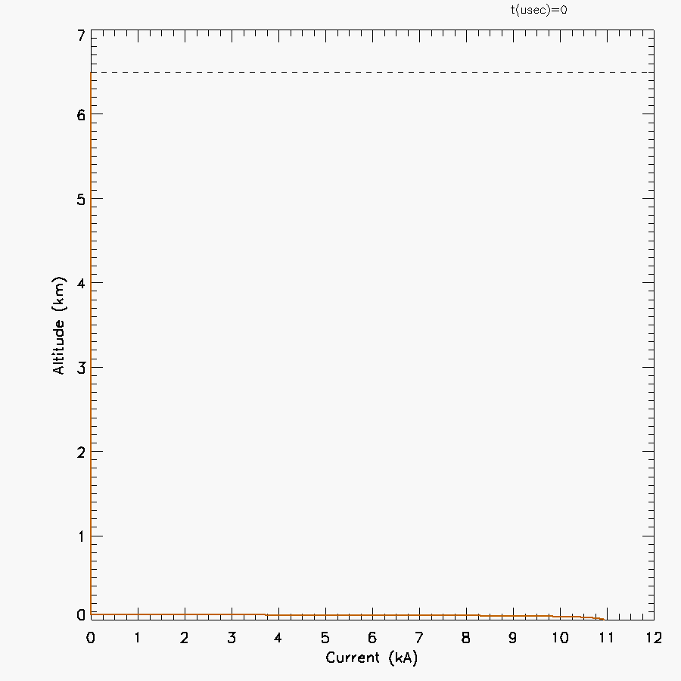
Modeled Return Stroke Current Pulse
Input
Channel
Current
Koshak, NASA/MSFC

Slide 22
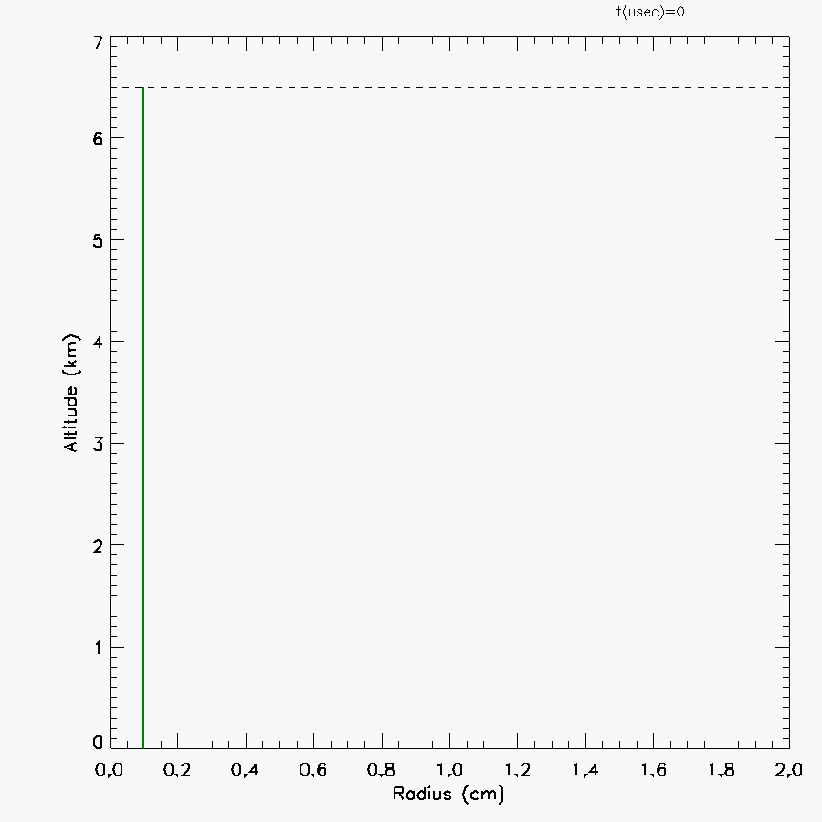
Channel Radius Solution
Output
Channel
Radius
Run 1 (Baseline): 0.045 mole/km
Run 2 (Enhanced Initial Radial Velocity): 0.265 mole/km
Run 3 (Enhanced Peak Current): 0.730 mole/km
Koshak, NASA/MSFC

Slide 23
General Comments
Charges Deposited by Lightning
Lightning Nitrogen Oxides Model (LNOM)
Modeling Return Stroke LNOx
Estimating LNOx from LIS/GLM
Koshak, NASA/MSFC

Slide 24
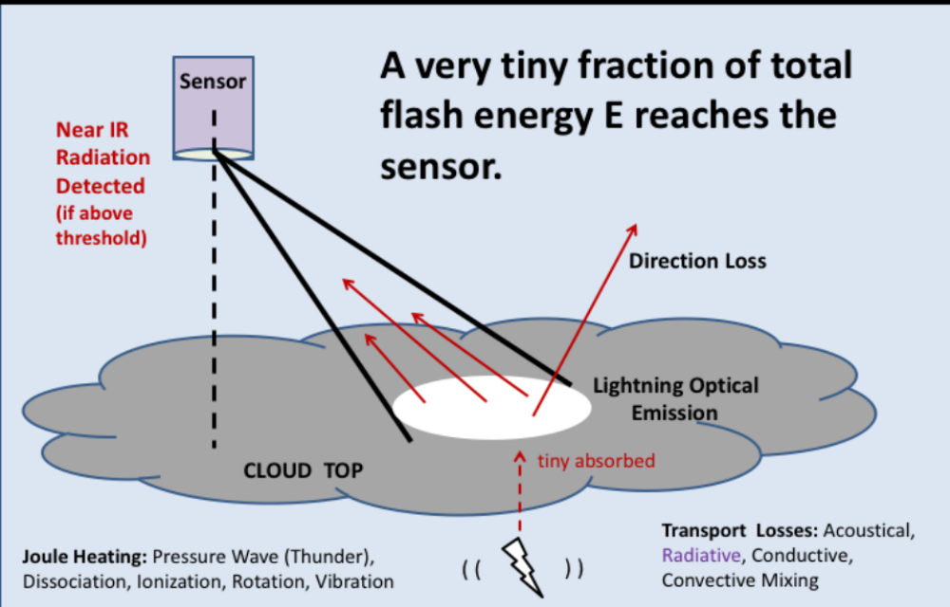

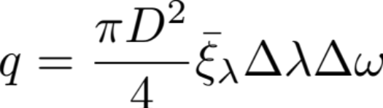
Energy Flow
Flash Energy
Typically GigaJoules
Flash Optical Energy
100s of femtoJoules
Energy Intercepted
by Pixel:
GLM pixel solid angle
small, but D large.
Koshak, NASA/MSFC

Slide 28
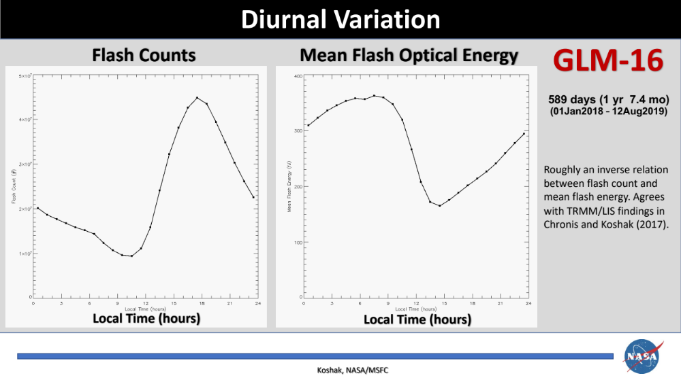

Slide 29
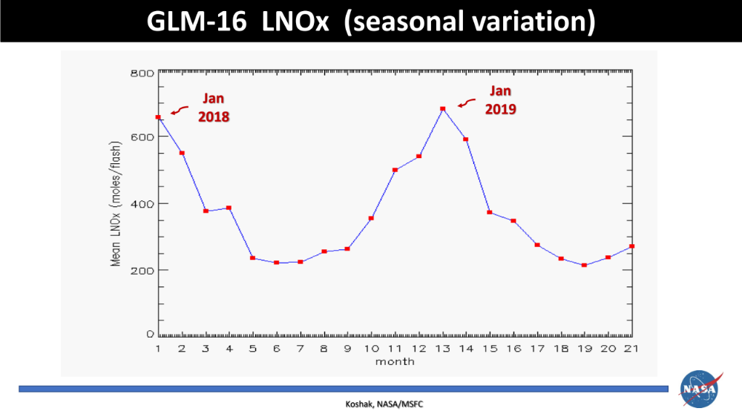

Slide 30
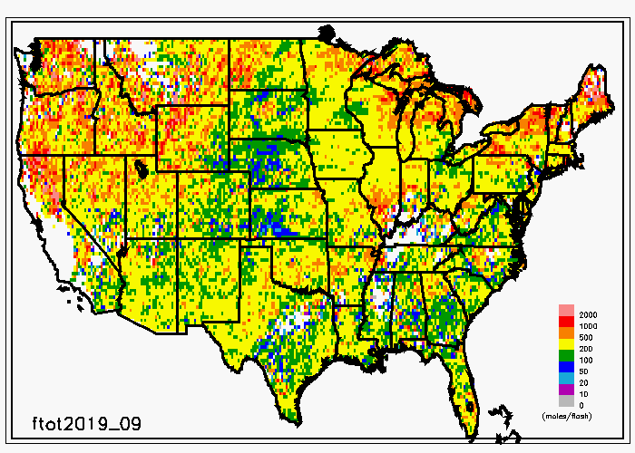
GLM-16 LNOx (geographical variation)
Sample
Month
Koshak, NASA/MSFC

Slide 31
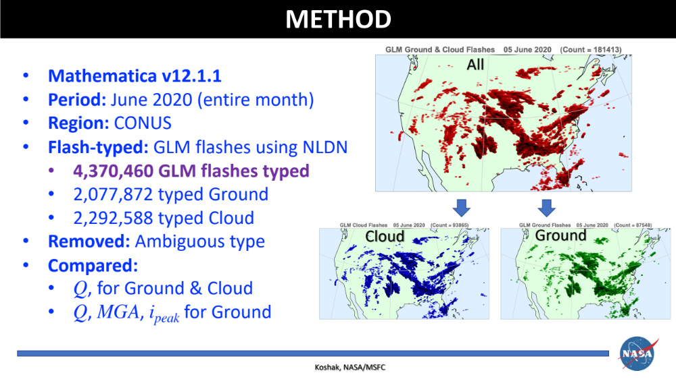

Slide 32
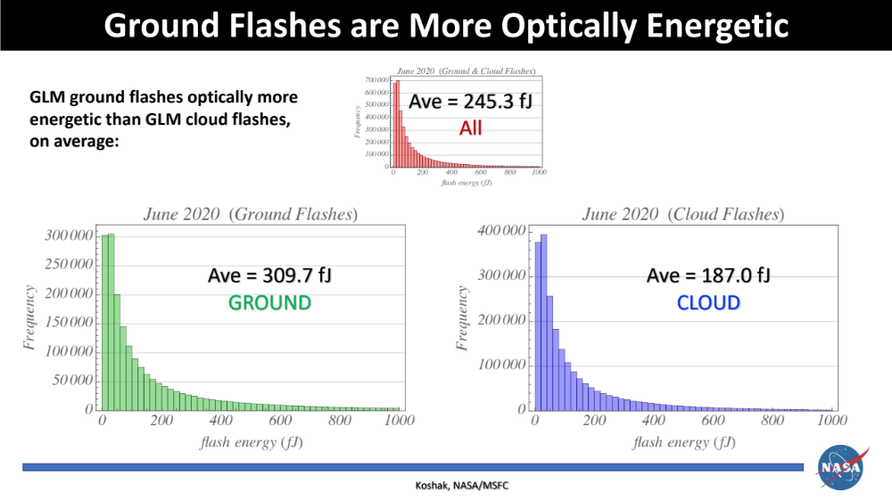

Slide 33
