Slide 1
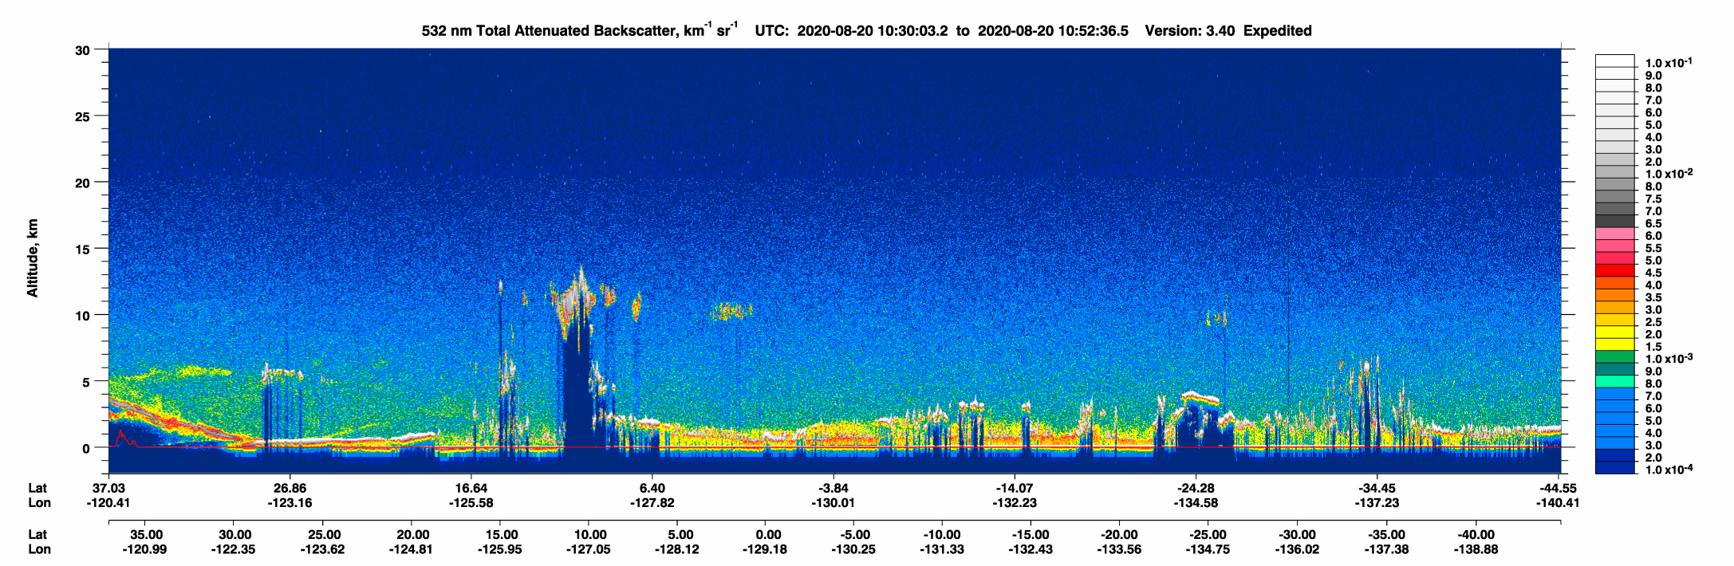
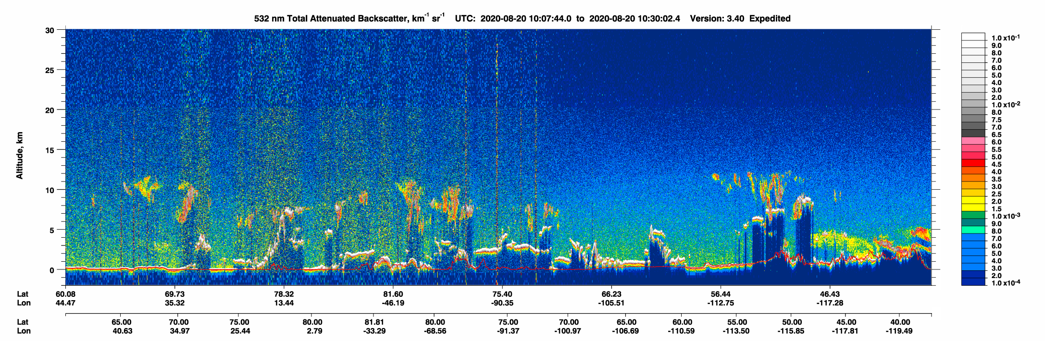
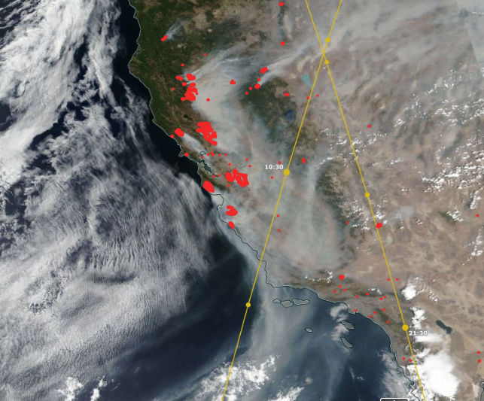
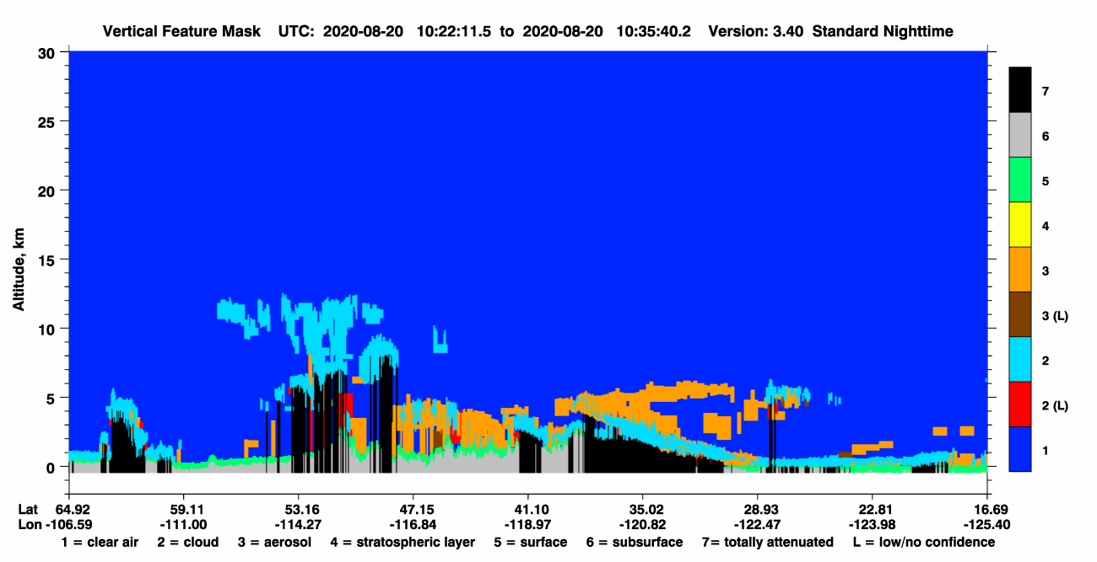
CALIOP Lidar on CALIPSO
532 nm Attenuated Backscatter
Measures vertical profiles of aerosols and clouds. Operational since 2006. Polar orbit, currently with overpass times of 3:30 a.m./2:30 p.m. (PST).
Altitude (km)
lat
lon
CALIOP ground track
Feature Classification
Aerosol
Cloud
Altitude (km)
California Fires
Aug 20th 2020
lat
VIIRS/NPP, courtesy NASA Worldview
lon

Slide 2
CALIOP Lidar on CALIPSO
532 nm Attenuated Backscatter
Primary products:
Level 1
Attenuated backscatter at 532 nm and 1064 nm
Depolarization (particle shape indicator)
Level 2
Layer top and base altitudes
Layer type: aerosol, cloud, surface
Aerosol type: smoke, dust, marine, others…
Aerosol extinction vertical profile & optical depth
Level 1.5
Cloud-cleared and coarsely averaged profiles of attenuated backscatter
Resolution:
30 m vertical
333 m horizontal
Altitude (km)
lat
lon
Feature Classification
Aerosol
Cloud
Altitude (km)
lat
lon

Slide 3
CALIOP Lidar on CALIPSO
532 nm Attenuated Backscatter
Data production streams
Altitude (km)
Expedited
12 – 24 hour latency
Near-real time applications
lat
lon
Standard
3 – 4 month latency
Science publication quality
Feature Classification
Aerosol
Cloud
Altitude (km)
lat
lon

Slide 4
CALIPSO resources
Expedited browse images
https://www-calipso.larc.nasa.gov/products/lidar/browse_images/exp_index.php
CALIPSO data access through the Atmospheric Science Data Center (HDF format)
https://asdc.larc.nasa.gov/project/CALIPSO
EPA Remote Sensing Information Gateway
https://www.epa.gov/hesc/remote-sensing-information-gateway
NASA Worldview – CALIOP ground track visualization; CALIOP level 1 data to be added soon.
https://worldview.earthdata.nasa.gov/
CALIPSO Contacts
Jason Tackett – CALIPSO Lidar Science Working Group (jason.l.tackett@nasa.gov)
Brian Getzewich – Data Manager (brian.j.getzewich@nasa.gov) for level 1.5 expedited product access
Chip Trepte – Project Scientist (charles.r.trepte@nasa.gov)

