Slide 1
Europa Lander Gas Generator Separation System Study
Walter King, MSFC—ER62, Summer 2020 Pathways Intern
08/04/2020

Slide 2
Agenda
Motivation and Request for Information (RFI)
Vendors and Responses
Gas Generator Separation System (GGSS) Integration
  Visualizations
  Implications for Vehicle Mass and Length
Performance Analysis
  Baseline System Analysis
  Isentropic Expansion Analysis
  Vendor Response Validation
Conclusions and Forward Work
Questions?

Slide 3
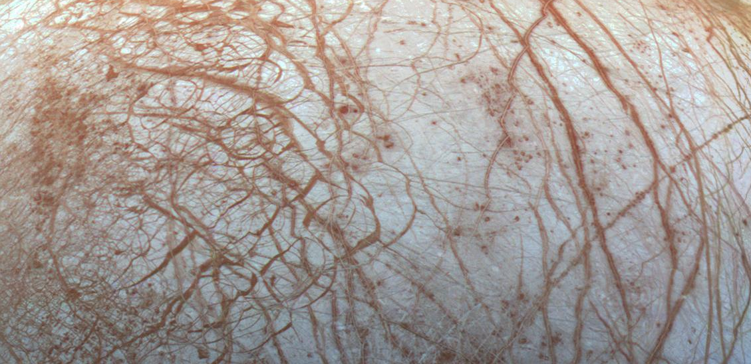
Motivation and Request for Information

Slide 4
Background
Baseline Separation System
After the Europa Lander Cruise Vehicle deposits the Deorbit Vehicle at Europa, a Star48 class solid rocket motor will commit the deorbit burn that begins the descent to the surface.
A separation event will jettison this motor before the Descent Stage (a sky-crane) carries out final descent.
The baselined separation system will use four Star 3 class solid rocket motors (SRMs) to carry the Deorbit Stage (DOS) away from the rest of the vehicle. The remaining vehicle stack is referred to as the Powered Descent Vehicle (PDV) and consists of the Descent Stage (DS) and Lander.
Gas Generator Separation System (GGSS)
A Gas Generator Separation System is being considered in lieu of the baselined SRM system.
Gas generators are devices that produce gas, typically by way of chemical reactions or the combustion of propellants.
Gas generators are used to inflate airbags in automobiles and escape slides in aircraft, to produce supplemental oxygen on airliners, and in some fire suppression systems.
A Gas Generator Separation system would use the expanding hot gas from a gas generator to drive a piston-cylinder actuator to propel the DOS away from the PDV.

Slide 5
Motivation
Why replace the current Star 3 solid rocket motor (SRM) separation system?
  A Gas Generator Separation System (GGSS) eliminates the concern of hot gas and particulate impinging on the Powered Descent Vehicle (PDV) during separation.
  A GGSS reduces the risk of recontact between the DOS (Deorbit Stage) and PDV (Powered Descent Vehicle).
  A GGSS will greatly reduce the time between separation initiation and separation completion.
Notes:
There is concern that exhaust products from the star 3 motors will impinge on the DS and Lander, potentially causing issues with those systems after the separation event.
There is less risk of recontact because there is less time for a surge in the star48 tail off to interfere and potentially lead to recontact.

Slide 6
NASA RFI
(Request for Information)
MSFC has generated RFI 80MSFC20LER1107 to gather information on the potential use of a Gas Generator Separation System (GGSS) for the Europa Lander mission.
The system must actuate to push the DOS motor away at sufficient velocity.
The system (optionally) should provide for detachment of the DOS motor.
  A non-pyrotechnic detachment mechanism would replace the frangible nuts between the DOS and the DS.
Vendors were asked to assume a PDV wet mass of 1750 Kg and a DOS dry mass of 250Kg.
Key Requirements | Value
Delta V | 13 m/s
Powered Descent Vehicle Acceleration | 10 g
Mass | 10 Kg
Actuator Stroke | <= 8 in
Notes:
RFI Generated to gather information on creation of GGSS. Is this workable? What systems might we expect from potential vendors and are meeting the performance goals realistic?
Vendors were asked to respond with a system that could push the DOS motor away with sufficient velocity and optionally describe a non-pyrotechnic detachment method for the DOS.
Vendors were asked to assume a PDV mass of 1750 Kg and a DOS mass of 250Kg at the time of separation.
Key Requirements
See table
Note that vendors seemed to interpret the mass req. differently: some chose to interpret as a limit for the weight of their actuator and others as the total mass of the system including supporting structure

Slide 7
Motivation and Request for Information
Vendors and Responses

Slide 8
Vendors and Responses
Responses were received from five vendors.
Three vendor responses were selected by the ER62 Gas Generator Team for further study.
Details of these responses may not be discussed due to limited rights and export control concerns.
Notes:
5 vendors responded to the request for information.
ER62 Gas Generation Team developed criteria to evaluate and down selected to the three most promising designs.

Slide 9
Vendors and Responses
Summary of Down-Selected Responses
  Down-selected vendor responses provided anticipated system mass, stroke length, and number of actuators.
  2 of 3 vendors proposed mechanisms to perform detachment in addition to separation.
  2 of 3 vendors provided details about support structure for their actuators.
  2 of 3 vendors included cost, schedule, and current Technology Readiness Level (TRL) estimates.
  All vendors were confident in their ability to meet the delta V Requirement.
  2 of 3 vendors expressed apprehension about meeting the mass requirement.
  1 of 3 vendors expressed apprehension about meeting the PDV acceleration requirement.
Notes:
5 vendors responded to the request for information.
ER62 Gas Generation Team developed criteria to evaluate and down selected to the three most promising designs.

Slide 10
Motivation and Request for Information
Gas Generator Separation System (GGSS) Integration
Notes:
How will the systems presented by vendors integrate with the deorbit vehicle?
Solid model assemblies were created in CREO based on the information provided in vendor responses.
This was done to visualize how they operate and visualize potential integration solutions.
The solid models also allowed for mass estimates.

Slide 11
Work Performed
Detailed solid model assemblies were created in CREO for each vendor system based on the information provided in the RFI responses.
Vendor system models were then integrated with a CAD assembly of the Europa Lander Deorbit vehicle, provided by JPL.
Renderings were created of both the isolated and integrated vendor systems in both the pre-separation and post-separation states.
These solid model assemblies and renderings helped stakeholders at MSFC and JPL:
  Visualize how the vendor systems would operate
  Visualize potential integration solutions for the vendor systems
These assemblies also allowed the impact on the length and mass of the vehicle to be assessed.
Initial and final actuator volumes were also derived from the solid models for use in a performance analysis.
Unfortunately, these models and renderings may not be displayed due to limited rights and export control concerns.

Slide 12
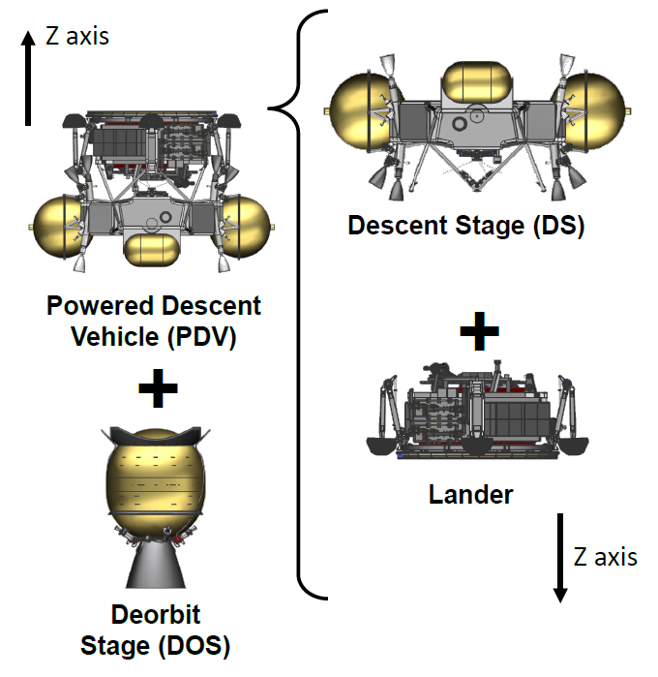
Generalized Integration and Operation Scheme
Lander
Descent Stage
GGSS
Deorbit Stage*
*The SRMs visible above the base of the nozzle will not be present if a GGSS is implemented.

Slide 13
Conclusions Reached
Based on the models created, it is expected that:
A GGSS will increase the mass of the Deorbit Vehicle by between 10Kg and 60kg. Between 0Kg and 1Kg of this mass will remain with the PDV after the jettison of the DOS.
A GGSS is expected to increase the length of the Deorbit Vehicle by between 200mm and 450mm.

Slide 14
Motivation and Request for Information
GGSS Performance Analysis
Notes:
A central aspect of this study was a performance analysis.
The purpose of the analysis was to corroborate the performance capabilities presented by vendors in their responses.

Slide 15
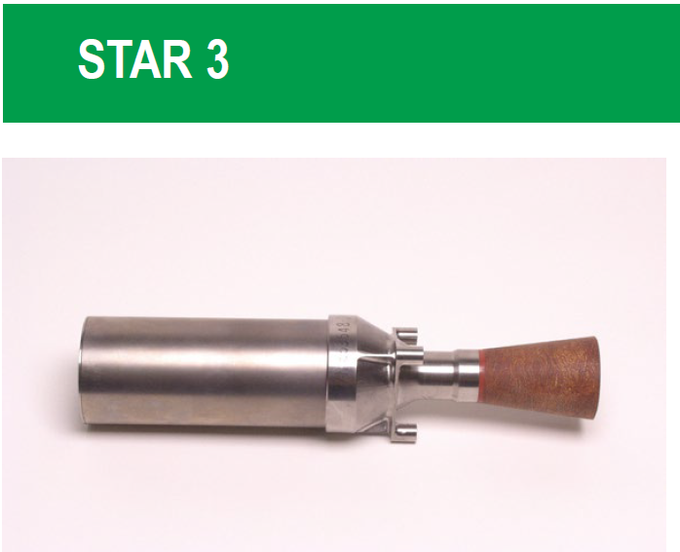
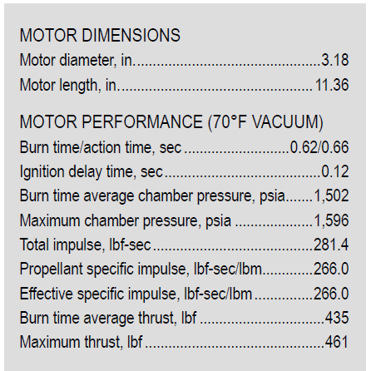



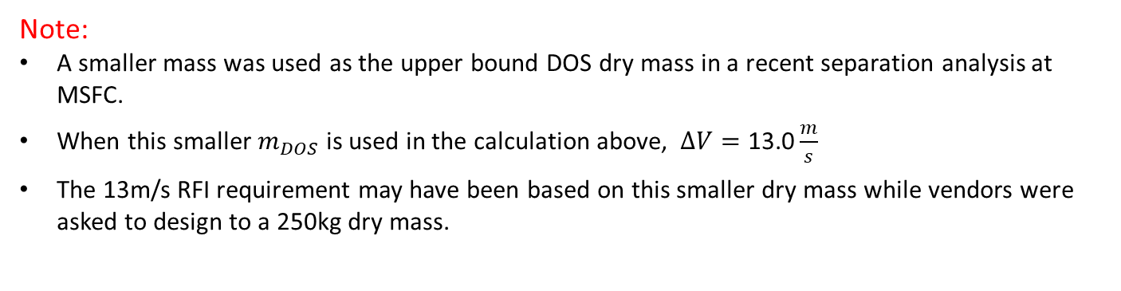



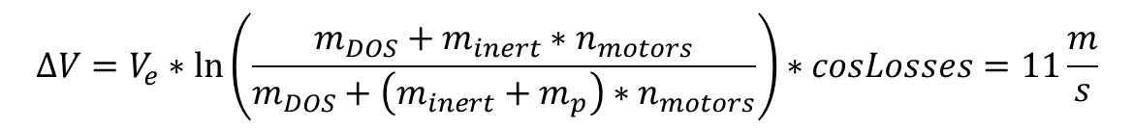


SRM Separation System Analysis
$$m_{DOS}=250 Kg$$
$$n_{motors}=4$$
$θ_{cant}$
$$θ_{roll}$$
$$m_{p}=1.06 lbm= 0.481 Kg$$
$$m_{inert}=1.49 lbm=0.676 Kg$$
$$isp=266 \frac{lbf∗s}{lbm}$$
Source: 2016 OATK Motor Catalog
$$V_{e}=−isp=−2609 \frac{m}{s}$$
$$cosLosses=\cos\left(θ_{roll}\right)∗\cos\left(θ_{cant}\right)$$
$$∆V=V_{e}∗\ln\left(\frac{m_{DOS}+m_{inert}∗n_{motors}}{m_{DOS}+\left(m_{inert}+m_{p}\right)∗n_{motors}}\right)∗cosLosses=11\frac{m}{s}$$
Note:
A smaller mass was used as the upper bound DOS dry mass in a recent separation analysis at MSFC.
When this smaller $m_{DOS}$ is used in the calculation above, $∆V=\text{13}\text{.0}\frac{m}{s}$
The 13m/s RFI requirement may have been based on this smaller dry mass while vendors were asked to design to a 250kg dry mass.
Notes:
An analysis of the baselined separation system
Delta V is predicted using the ideal rocket equation with cosine losses
Expected dV is 11 m/s when the calculation is carried through with a DOS mass of 250Kg
Notice this is not the 13 m/s RFI req.
However, if the calculation is repeated with a smaller DOS mass the result is 13.0 m/s
This smaller mass is the upper bound DOS dry mass used in a previous detailed separation analysis at MSFC.
It is possible that the 13m/s RFI requirement may have been based on a smaller dry mass while vendors were asked to design to a 250kg dry mass.
This is something to keep in mind when juxtaposing the vendor systems with the baselined system.

Slide 16
Gas Generator Separation System Analysis
How much propellant is needed?
Will vendor designs exceed the 10g PDV acceleration requirement?
Assumptions
Instantaneous propellant combustion
Gas generator produced primarily N₂
Isentropic expansion
Initial gas temperature is T₀, chosen to be 1000 K
PDV wet mass is 1750 Kg, DOS dry mass is 250 Kg
Notes:
The analysis attempts to answer two questions:
How much propellant?
Can the vendor design meet the deltaV req. while maintaining the acceleration requirement.
The stated assumptions were made.

Slide 17


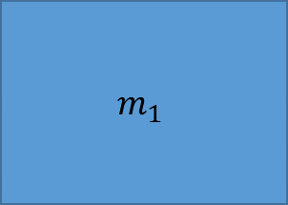




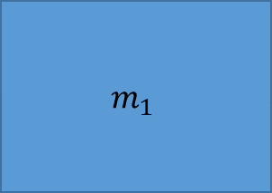


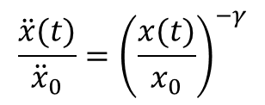
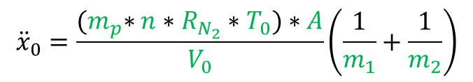


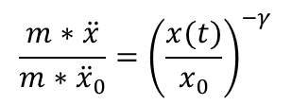


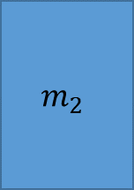

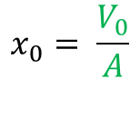
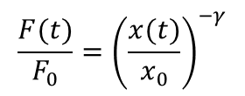

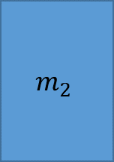


Mathematical Model
$$m_{p}$$
$$∆x=x−x_{0}$$
$$\frac{P}{P_{0}}={\left(\frac{V}{V_{0}}\right)}^{−γ}$$
$$m_{2}$$
$$V_{0}$$
$$m_{1}$$
$$\frac{P∗A}{P_{0}∗A}={\left(\frac{V/A}{V_{0}/A}\right)}^{−γ}$$
$$\frac{F(t)}{F_{0}}={\left(\frac{x(t)}{x_{0}}\right)}^{−γ}$$
$$m_{2}$$
$$m_{1}$$
$$V$$
Non-dimensionalize
$$\frac{m∗\ddot{x}}{m∗{\ddot{x}}_{0}}={\left(\frac{x(t)}{x_{0}}\right)}^{−γ}$$
$$x=0$$
$${x=x}_{0}$$
$$x$$
$$\frac{\ddot{x}(t)}{{\ddot{x}}_{0}}={\left(\frac{x(t)}{x_{0}}\right)}^{−γ}$$
$$τ=\sqrt{{x_{0}/\ddot{x}}_{0}}$$
$$t=T∗τ$$
$$x_{0}= \frac{V_{0}}{A}$$
$$\ddot{X}(T)={\left(X(T)\right)}^{−γ}$$
$${x=X∗x}_{0}$$
$\dot{x}=\dot{X}∗$ ${\dot{x}}_{0}$
$${\dot{x}}_{0}=\sqrt{{{\ddot{x}}_{0}∗x}_{0}}$$
Solve
$$\ddot{x}=\ddot{X}∗{\ddot{x}}_{0}$$
$${\ddot{x}}_{0}=\frac{{(m}_{p}∗n∗R_{N_{2}}∗T_{0})∗A}{V_{0}}\left(\frac{1}{m_{1}}+\frac{1}{m_{2}}\right)$$
Re-dimensionalize
Notes:
Math model used in the analysis is shown here.
Physical representation:
Pre-Expansion -> Post-Expansion
m1 -> PDV
m2 -> DOS
mp -> mass of hot gas present in the expanding volume
Yellow is the volume occupied by hot has
x = 0 is the bottom of the cylinder
x = x0 is the initial position of the piston
x is the position of the piston at some time t in the future
deltax is the change in position of the piston from time t = 0 to time t
Math Representation
Centers around the isentropic expansion relation at the top of the slide
This relation is non-dimensionalized and solved with an ode solver in MATLAB
The general dimensionless solution is then transformed into a specific solution according to dimensionalizing constants that depend on the specific system parameters of each vender design
Note:
Position, velocity, and acceleration that result from this model are all relative quantities.
Acceleration is the sum of the acceleration of m1 in the inertial frame + m2 in the inertial frame
What we are really interested in is the acceleration of m1, the PDV, in the inertial frame

Slide 18



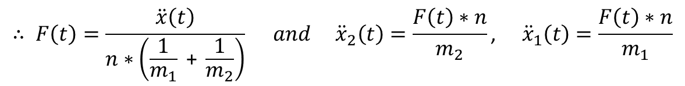
Acceleration in the Initial Frame
$$m_{p}$$
$$∆x$$
$$m_{2}$$
$$V_{0}$$
$$m_{1}$$
$$m_{2}$$
$$m_{1}$$
$$V$$
$$x=0$$
$${x=x}_{0}$$
$$x$$
$\ddot{x}\left(t\right)={\ddot{x}}_{1}\left(t\right)+{\ddot{x}}_{2}\left(t\right)=\frac{F\left(t\right)∗n}{m_{1}}$ + $\frac{F(t)∗n}{m_{2}}=F(t)∗n\left(\frac{1}{m_{1}}\text{ + }\frac{1}{m_{2}}\right)$
$$∴ F\left(t\right)=\frac{\ddot{x}\left(t\right)}{n∗\left(\frac{1}{m_{1}}\text{ + }\frac{1}{m_{2}}\right)} and {\ddot{x}}_{2}\left(t\right)=\frac{F\left(t\right)∗n}{m_{2}}\text{,} {\ddot{x}}_{1}\left(t\right)=\frac{F\left(t\right)∗n}{m_{1}}$$
Notes:
The acceleration of m1 in the inertial frame can be arrived at fairly easily
We already know the sum of the two accelerations
We can work out Force applied by the actuator as a function time
Since also we know the mass of the PDV and the number of actuators being used, we can also arrive at the acceleration felt by PDV as a function of time.

Slide 19
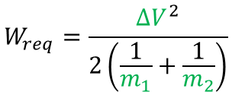
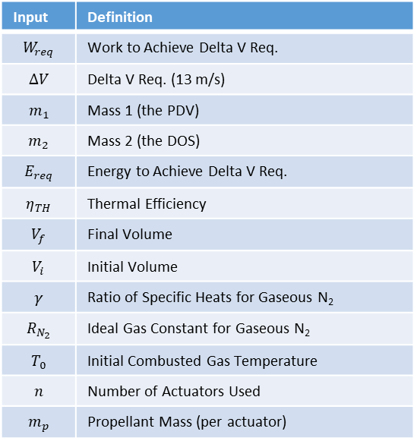



Cross Checking Propellant Mass
Input | Definition
$$W_{req}$$ | Work to Achieve Delta V Req.
$$∆V$$ | Delta V Req. (13 m/s)
$$m_{1}$$ | Mass 1 (the PDV)
$$m_{2}$$ | Mass 2 (the DOS)
$$E_{req}$$ | Energy to Achieve Delta V Req.
$$η_{TH}$$ | Thermal Efficiency
$$V_{f}$$ | Final Volume
$$V_{i}$$ | Initial Volume
$$γ$$ | Ratio of Specific Heats for Gaseous N₂
$$R_{N_{2}}$$ | Ideal Gas Constant for Gaseous N₂
$$T_{0}$$ | Initial Combusted Gas Temperature
$$n$$ | Number of Actuators Used
$$m_{p}$$ | Propellant Mass (per actuator)
$$W_{req}=\frac{{∆V}^{2}}{2\left(\frac{1}{m_{1}}+\frac{1}{m_{2}}\right)}$$
$$η_{TH}=1−{\left(\frac{1}{V_{f}/V_{i}}\right)}^{γ −1}$$
$$E_{req}=\frac{W_{req}}{η_{TH}}$$
$$m_{p}=\frac{E_{req}\left(γ −1\right)}{{R_{N_{2}}∗T}_{0}∗n}$$
Purpose:
This energy analysis is used as a cross check.
It is also used as the initial guess for the iterative isentropic expansion code to find the needed prop mass and associated quantities.
Notes:
The analysis of propellant mass was also approached from an energy standpoint
Calculating the work and thermal efficiency will yield the total energy required
The required prop mass can be found by essentially dividing the energy required by the energy the expanding hot gas can deliver
This approach is used as a crosscheck with the propellant mass found in the expansion analysis.
It has another use as well: the matlab code for the expansion analysis iteratively guesses the needed prop mass. The energy analysis serves as the first guess for the iterative code.

Slide 20
Vendor Analysis
Specific analyses performed for vendor designs will not be presented.
The following two slides show a detailed analysis of a fictitious vendor design with system parameters that would fulfill the RFI performance requirements.

Slide 21
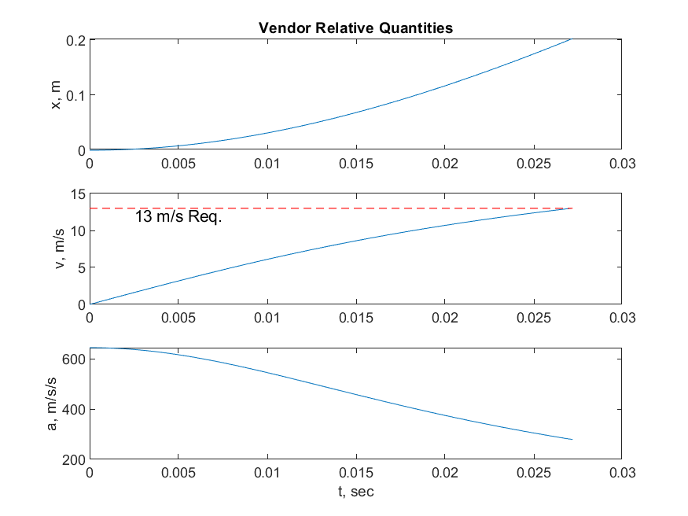
Vendor Parameters and Performance (Example)
10.2 cm
20.32 cm
m₁ = 1751 Kg
m₂ = 270 Kg
DOS + GGSS Mass
PDV + GGSS Mass
V_{i} = 2000 cm³
V_{f} = 3750 cm³
Item | Mass [Kg]
PDV Mass | 1750
GGSS Impact | 1
Item | Mass [Kg]
DOS Mass | 250
GGSS Impact | 20
V_{f} / V_{i} = 1.875

Slide 22
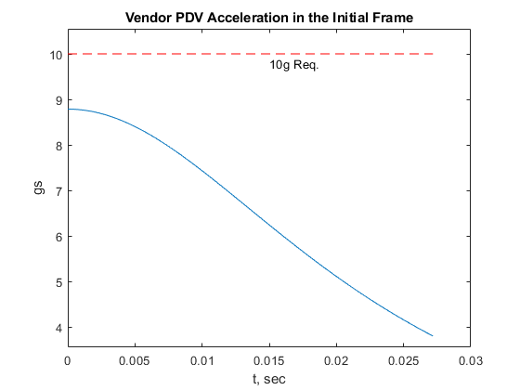
Vendor Performance (Example)
This design would not exceed the PDV acceleration requirement. It would also reach 13 m/s within the stroke of the actuator.
Max PDV Accel: 8.79 gs
Time above 10g: 0 ms
Delta V Achieved: 13.02 m/s
Actuation Time: 27.2 ms
Prop Mass Needed
-Energy Estimate: 119.77 grams
-Expansion Analysis: 125.39 grams
-Percent Change 4.69%

Slide 23
Performance Validation
Specific analysis results for the vendor designs were compared with the performance capabilities reported in the vendor responses.
Approximate ranges for performance values across the vendor systems studied are shown.
Analyses for all vendor designs showed PDV accelerations exceeding the 10g requirement by at least a small margin.
 | Max PDV Accel [g] | Time Exceeding 10g [ms] | Delta V [m/s] | Separation Time [ms] | Prop Mass (total) [g]
Reported Values | 5-15 | N/A | 13 | 10-40 | N/A
Analysis Results | 10-25 | Up to 10 | 13 | 20-30 | 60-115

Slide 24
Performance and Property Comparison
All GGSS designs require far less propellant mass than baseline.
All GGSS designs have far shorter separation times than baseline.
All GGSS designs are expected to require more mass than baseline.
Two of the respondent designs have similar performance profiles.
One vendor design requires significantly more mass and is expected to have more difficulty meeting the acceleration requirement than the others.
 | System Mass [Kg] (Estimated) | Total Prop Mass [g] (Analysis) | ∆V [m/s] (Analysis) | PDV Accel [g] (Analysis) | Sep Time [ms] (Analysis) | ∆V [m/s] (Reported) | PDV Accel [g] (Reported) | Sep Time [ms] (Reported)
Baseline | 4.627 (SRMs Only) | 1924 (from SRM Vendor) | 11 | 0 | >1000* | N/A | N/A | N/A
Vendors | 10-60 | 60-115 | 13 | 10-25 | 20-30 | 13 | 5-15 | 10-45
*Inferred from recent separation analysis at MSFC.

Slide 25
Observations
All systems offer separation times more than an order of magnitude shorter than the baselined system.
Two of the vendor systems studied have similar performance profiles.
  The discrepancies in PDV acceleration and separation time for these systems may be a result of the isentropic expansion analysis disregarding propellant burn rate.
A discrepancy in reported and predicted propellant mass for one studied system should be investigated.
The isentropic expansion analysis suggests a very high PDV acceleration for one vendor. This discrepancy should be investigated further.

Slide 26
Motivation and Request for Information
Conclusions and Forward Work

Slide 27
Conclusions
The vendor responses and subsequent analysis work in ER62 show that a gas generator separation system (GGSS) is a feasible option. Replacing the SRM separation system with a GGSS is possible and would be advantageous.
One vendor design was identified as most promising. It will likely require the least mass and appears to achieve the RFI requirements.
  The RFI responses cannot be used to make conclusions regarding the vendors’ abilities to deliver a Gas Generator Separation System. Judgments leveled before a competitive proposal request would be premature.
A complete GGSS system will add mass to the vehicle.
  How much additional mass is uncertain. Assessments based on RFI 80MSFC20LER1107 range from 10 to 60 Kg.
However, it will also:
  Reduce the opportunity for exhaust products and particulate to interfere with the Descent Stage or Lander.
  Mitigate the risk of recontact between the DOS and the PDV by reducing the temporal length of the separation event.
The team recommends that a GGSS be pursued for use on the Europa Lander mission.

Slide 28
Forward Work
Investigate detachment methods and configurations in greater detail.
Investigate the structural validity of the integration schemes presented.
  Is extending the length of the vehicle acceptable? Is creating a longer moment arm acceptable?
  Could actuators be mounted on the side of the deorbit motor to avoid a length increase?
Assess environmental effects such as temperature and radiation for propellants and materials of vendor designs.
Refine the performance analysis to account for propellant characteristics, particularly burn rate and gas temperature.
  A constant pressure analysis could also be performed to help bound the expected performance for each vendor design.
Assess the separation system ignition scheme in greater detail.
Assess changes to ancillary hardware and their effect on mass.
  Removal of pyro devices and brackets required for SRMs
  Addition of GGSS ancillary components for arming, ignition, etc.
  Removal of frangible nuts and ancillary components for designs that include an alternative detachment system

Slide 29
Questions?
Acknowledgments:
Lisa McCollum, Tim Kibbey, Yvonne Villegas-aguilera, The MSFC ER62 Gas Generation Team

Slide 30
Back Up

Slide 31
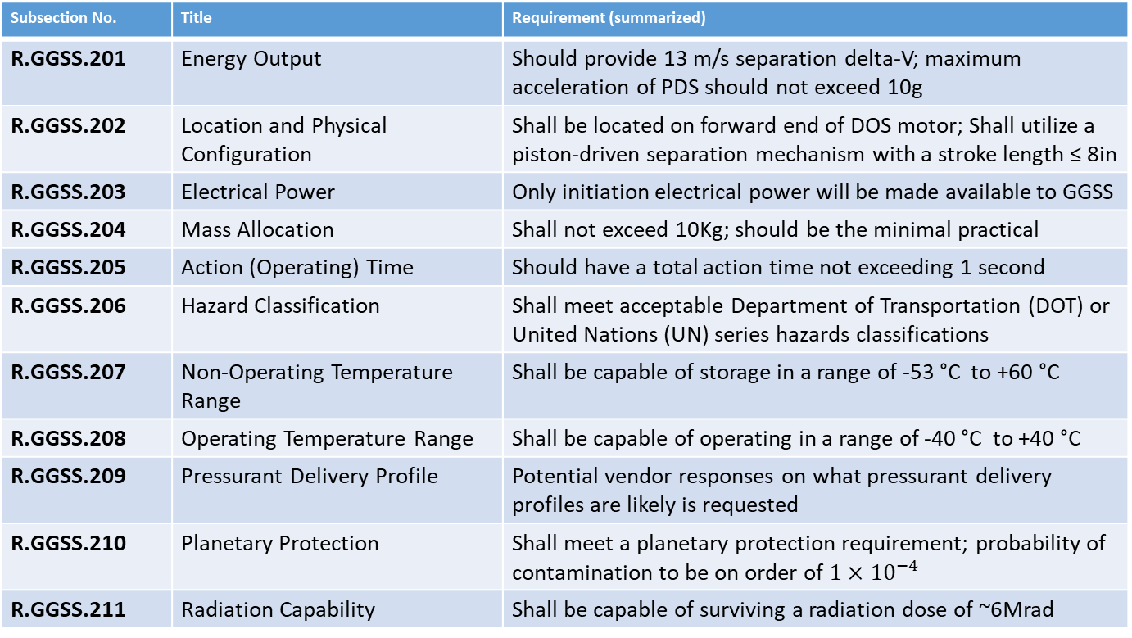
NASA RFI
Requirements List
Subsection No. | Title | Requirement (summarized)
R.GGSS.201 | Energy Output | Should provide 13 m/s separation delta-V; maximum acceleration of PDS should not exceed 10g
R.GGSS.202 | Location and Physical Configuration | Shall be located on forward end of DOS motor; Shall utilize a piston-driven separation mechanism with a stroke length ≤ 8in
R.GGSS.203 | Electrical Power | Only initiation electrical power will be made available to GGSS
R.GGSS.204 | Mass Allocation | Shall not exceed 10Kg; should be the minimal practical
R.GGSS.205 | Action (Operating) Time | Should have a total action time not exceeding 1 second
R.GGSS.206 | Hazard Classification | Shall meet acceptable Department of Transportation (DOT) or United Nations (UN) series hazards classifications
R.GGSS.207 | Non-Operating Temperature Range | Shall be capable of storage in a range of -53 °C to +60 °C
R.GGSS.208 | Operating Temperature Range | Shall be capable of operating in a range of -40 °C to +40 °C
R.GGSS.209 | Pressurant Delivery Profile | Potential vendor responses on what pressurant delivery profiles are likely is requested
R.GGSS.210 | Planetary Protection | Shall meet a planetary protection requirement; probability of contamination to be on order of $1×{10}^{−4}$
R.GGSS.211 | Radiation Capability | Shall be capable of surviving a radiation dose of ~6Mrad

Slide 32
NASA RFI
Requirements List
A GGSS should meet the requirements of NASA, MSFC, and ANSI/AIAA standards for design and construction
A GGSS should also meet environmental and interface requirements
Subsection No. | Title | Standard
R.GGSS.301 | Strength and Life Design | NASA-STD-5001B
R.GGSS.302 | Metallic Pressure Vessel Design | ANSI/AIAA S-080
R.GGSS.303 | Composite Overwrapped Pressure Vessel Design | ANSI/AIAA S-081A
R.GGSS.304 | Structural Strength requirements | MSFC-HDBK-505B
R.GGSS.305 | Mechanism Design | NASA-STD-5017A
R.GGSS.306 | Fracture Control | NASA-STD-5019A
R.GGSS.307 | Materials and Processes | NASA-STD-6016A
Subsection No. | Title | Requirement
R.GGSS.401 | Dimensions | The GGSS should be able to fit within a cylindrical volume bounded by 49 inches outside diameter (OD) by 18 inches in height.

Slide 33
NASA RFI (Request for Information)
Information Requested
  Physical Characteristics
  Interface Description
  Design, Qualification, and Acceptance
  Manufacturing
  Handling and Operations
  Safety and Risk Mitigation
  Engineering Cost Estimates and Schedule
  Relevant History

Slide 34
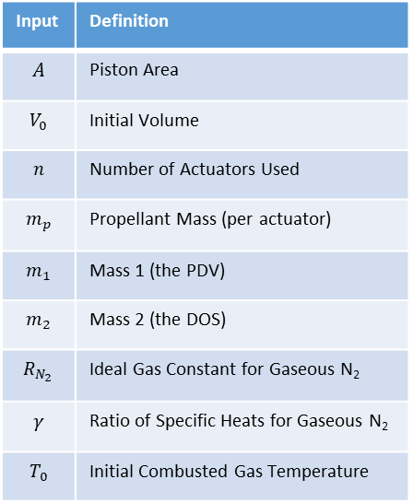
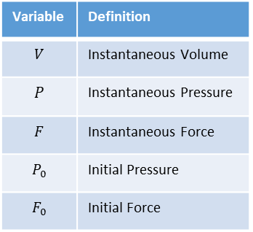
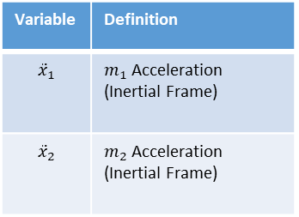
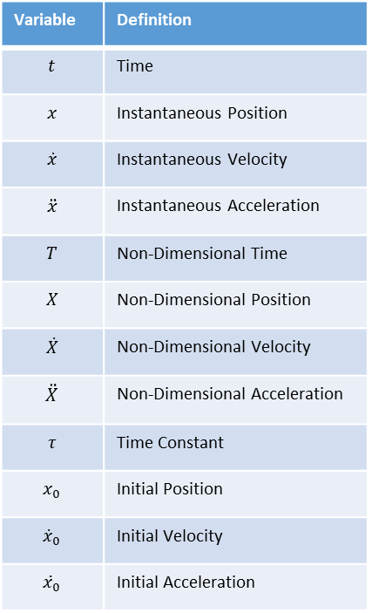
Gas Generator Separation System Analysis
Definition of Variables
Input | Definition
$$A$$ | Piston Area
$$V_{0}$$ | Initial Volume
$$n$$ | Number of Actuators Used
$$m_{p}$$ | Propellant Mass (per actuator)
$$m_{1}$$ | Mass 1 (the PDV)
$$m_{2}$$ | Mass 2 (the DOS)
$$R_{N_{2}}$$ | Ideal Gas Constant for Gaseous N₂
$$γ$$ | Ratio of Specific Heats for Gaseous N₂
$$T_{0}$$ | Initial Combusted Gas Temperature
Variable | Definition
$$t$$ | Time
$$x$$ | Instantaneous Position
$$\dot{x}$$ | Instantaneous Velocity
$$\ddot{x}$$ | Instantaneous Acceleration
$$T$$ | Non-Dimensional Time
$$X$$ | Non-Dimensional Position
$$\dot{X}$$ | Non-Dimensional Velocity
$$\ddot{X}$$ | Non-Dimensional Acceleration
$$τ$$ | Time Constant
$$x_{0}$$ | Initial Position
$${\dot{x}}_{0}$$ | Initial Velocity
$${\ddot{x}}_{0}$$ | Initial Acceleration
Variable | Definition
$$V$$ | Instantaneous Volume
$$P$$ | Instantaneous Pressure
$$F$$ | Instantaneous Force
$$P_{0}$$ | Initial Pressure
$$F_{0}$$ | Initial Force
Variable | Definition
$${\ddot{x}}_{1}$$ | $m_{1}$ Acceleration (Inertial Frame)
$${\ddot{x}}_{2}$$ | $m_{2}$ Acceleration (Inertial Frame)

Slide 35


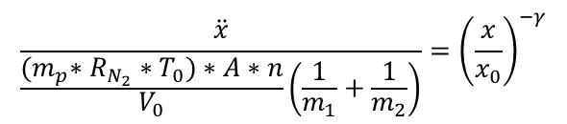







Derivation of Acceleration Constant
$\ddot{x}={\ddot{x}}_{1}+{\ddot{x}}_{2}=\frac{F∗n}{m_{1}}$ + $\frac{F∗n}{m_{2}}=F∗n\left(\frac{1}{m_{1}}\text{ + }\frac{1}{m_{2}}\right)$
$$\ddot{x}=P∗A∗n∗\left(\frac{1}{m_{1}}\text{ + }\frac{1}{m_{2}}\right)$$
$$\frac{P}{P_{0}}={\left(\frac{V}{V_{0}}\right)}^{−γ}$$
$$\ddot{x}=P_{0}∗{\left(\frac{V}{V_{0}}\right)}^{−γ}∗A∗n∗\left(\frac{1}{m_{1}}\text{ + }\frac{1}{m_{2}}\right)$$
$$\ddot{x}=P_{0}∗{\left(\frac{V}{V_{0}}\right)}^{−γ}∗A∗n∗\left(\frac{1}{m_{1}}\text{ + }\frac{1}{m_{2}}\right)$$
$$\ddot{x}=P_{0}∗{\left(\frac{x}{x_{0}}\right)}^{−γ}∗A∗n∗\left(\frac{1}{m_{1}}\text{ + }\frac{1}{m_{2}}\right)$$
$$\frac{P_{0}∗V_{0}}{V_{0}}=\frac{m_{p}∗R_{N_{2}}∗T_{0}}{V_{0}}$$
$$\ddot{x}=\frac{m_{p}∗R_{N_{2}}∗T_{0}}{V_{0}}∗{\left(\frac{x}{x_{0}}\right)}^{−γ}∗A∗n∗\left(\frac{1}{m_{1}}\text{ + }\frac{1}{m_{2}}\right)$$
$$\frac{\ddot{x}}{\frac{{(m}_{p}∗R_{N_{2}}∗T_{0})∗A∗n}{V_{0}}\left(\frac{1}{m_{1}}+\frac{1}{m_{2}}\right)}={\left(\frac{x}{x_{0}}\right)}^{−γ}$$
$${\ddot{x}}_{0}$$
Notes:
Math Model Accounts for system from time of ignition and forward. Propellant is assumed to burn instantly.

