Slide 1
AIAA ASCEND
November 16th, 2020
Conceptual Design and Analysis of a Deep Space Habitat with a Venus Flyby
Akshay Prasad, NASA Langley Research Center
Joseph Adinolfi, Brian Evans, NASA Marshall Spaceflight Center
Matthew A. Simon, PhD, NASA Langley Research Center

Slide 2
Outline
Introduction
Crewed Mars Mission Assumptions
Habitat Conceptual Design
Thermal Analysis
Conclusions

Slide 3
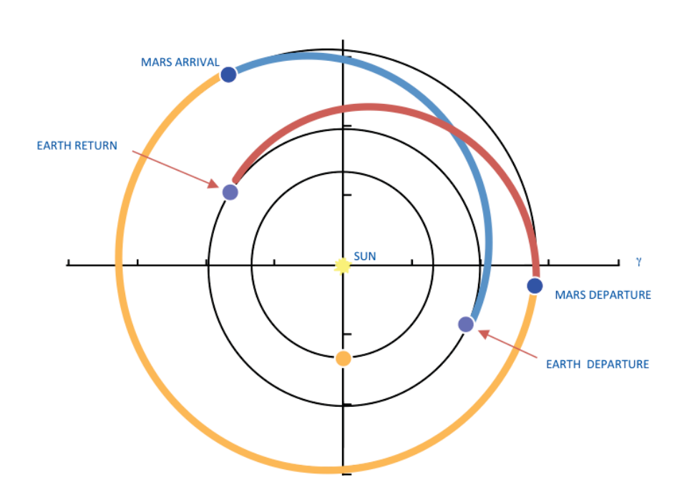
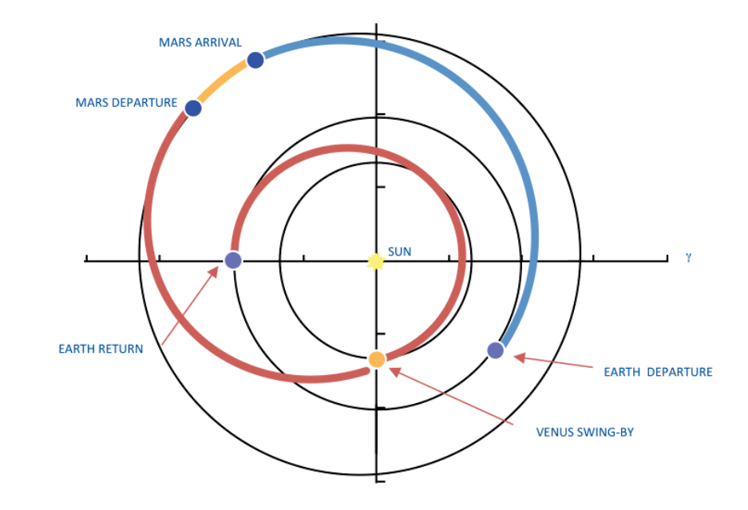
Crewed Missions to Mars
Crewed Mars mission remains the horizon goal for NASA
Two main mission types within trade space^{[1]}:
  Conjunction: Lower ΔV, Higher transit times
  Opposition: Higher Δ V, Lower transit times
  Venus flybys are considered during opposition class missions to reduce ΔV requirements
Each drive the design of deep space habitation (DSH) differently
  Venus flybys take humans close to the Sun
  Longer durations for conjunction opportunities
  Can potentially drive mass to grow significantly
  Drive new technology developments
Need to reassess previous DSH conceptual designs
  Understand operations in new environments
  Consider lower mass solutions
Notional conjunction class mission^{[1]}
Notional opposition class mission^{[1]}

Slide 4
Crewed Mars Mission Assumptions
Two main mission classes: conjunction vs opposition^{[1]}
  Opposition class missions offer fast transit options, about 2 years round-trip, at the cost of higher energy requirements
    Venus flybys are considered to reduce the ΔV requirements on transportation systems
  Conjunction class missions are usually lower in energy but require 200-300 days more in-space
Each mission class drives design of habitats differently
  Longer durations are more taxing
  Venus flyby introduces new environments that are thermally constraining
Habitat will be capable of flying either mission
  Maximum 1,100 day duration for conjunction opportunities
  Emphasis will be placed on thermal analysis for Venus flyby and solar close approach during a conjunction opportunity
15 year design lifetime was assumed to allow time for outfitting, shakedown, and analog or interim missions
Mars Stay
Mars Arrival
Mars Departure
Solar Close Approach
Venus Orbit
Earth Orbit
Mars Orbit
0.62 AU
Venus Flyby
Earth Arrival
Earth Departure
Notional depiction of an opposition class Mars mission with a Venus flyby

Slide 5
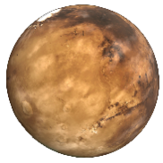

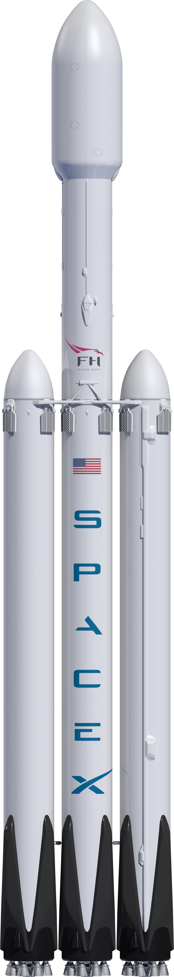
DSH Mars Mission Concept of Operations
1-2 months
Mars Orbit
DSH and transportation system arrives in Mars orbit to loiter during crewed surface mission
Venus
Venus flyby
Solar Close Approach
DSH docks to Gateway for outfitting
2 years
Gateway - NRHO
DSH undocks from Gateway and rendezvous with Mars transportation system
DSH arrives at Gateway
Boost Stage pushes DSH to NRHO
Earth Orbit
DSH on CLV
Boost Stage on CLV

Slide 6
Conceptual Design Assumptions
System Mass
  Dry mass goal of 23 t to provide a baseline for transportation analysis
  Logistics load depends on duration, but a maximum of 1,100 days was assumed
Habitation Systems
  Minimum net habitable volume of 25 m³/crew member as recommended by NASA’s Human Research Program^{[2]}
  Full set of crew support equipment and logistics similar to NASA’s Mars Transit Habitat, as recommended by NASA’s Space Flight Human Systems Standards and Human Integration Design Handbook^{[3-5]}
  Closed loop, long-duration environmental control and life support systems (ECLSS)
    Developed from existing hardware into low mass solutions
    Atmosphere of 14.7 psia and 21% O₂
Power Subsystems
  20 kWe end of life (EOL) power at 1 AU, transportation system provides power beyond 1 AU
  MegaROSA design with 2 panels^{[6]}
  28V electric power converter unit (EPCU) management and distribution system
Avionics
  DSH assumed to have free-flying capabilities
  Communications, Command and Data Handling, Guidance and Navigation hardware
Extravehicular Activity (EVA)
  Contingency EVAs only
  One 2-Person EVA every 3 months using umbilicals and lightweight suits^{[7]}
  Airlock integrated with primary structure
Propulsion
  180 m/s ΔV capability
  Covers small maneuvers such as docking and NRHO insertion
  NTO/MMH Reaction control system using Aerojet R-42s^{[8]}
  Due to reusability, refueling capability is necessary
Protection Systems
  Opposition class mission reduced time in deep space environment
  Logistics loading in the form of Cargo Transfer Bags (CTBs) will be used to line the interior of the habitat
  Multi-layer whipple shield using Nextel ceramic fabric, low-density cored polyurethane foam, and Kevlar for micrometeoroid and orbital debris (MMOD)^{[6]}

Slide 7
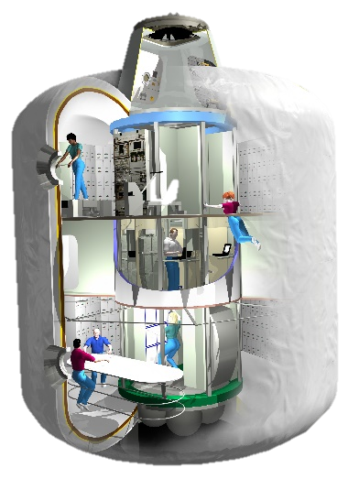
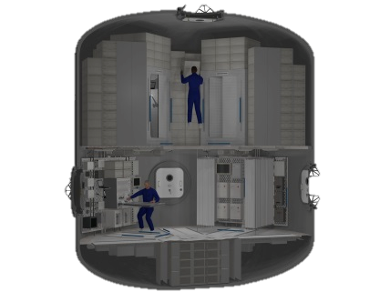
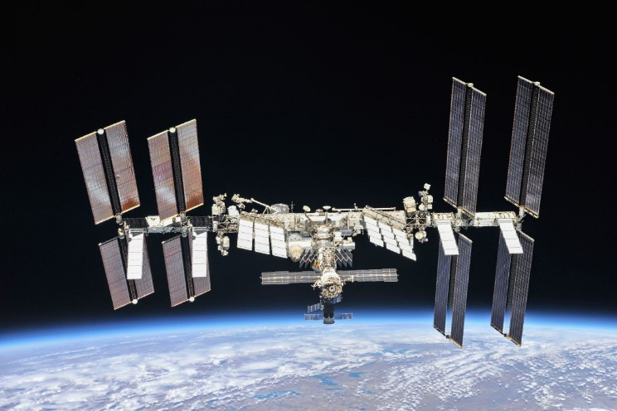
Habitat Design Trade Space – Design Strategy
Design Strategy | Modular | Monolithic
Structure | Metallic | Inflatable
Thermal Control | Radiators | Insulation | Solar Shield
Monolithic: contain all of the necessary functional requirements within on, enclosed system^{[2,7,9]}
  EX) NASA’s MTH, TransHab
  Simpler to design and develop
  Less structural inefficiencies
  Harder to design for multiple durations and crew numbers
  Higher unit mass and volume
Modular: distribute functional requirements over several, smaller units^{[2,7,9]}
  EX) International Space Station (ISS)
  Lower unit mass, can launch on smaller launch vehicles
  Simpler logistics and spares resupply operations
  Requires on-orbit assembly
  Mass penalty for integrating duplicate systems
Monolithic design was chosen for this habitat
  Reduces load on transportation system
  Less risk with fewer launches and assembly operations
NASA’s TransHab^{[2]}
NASA’s MTH^{[7]}
International Space Station^{[10]}

Slide 8
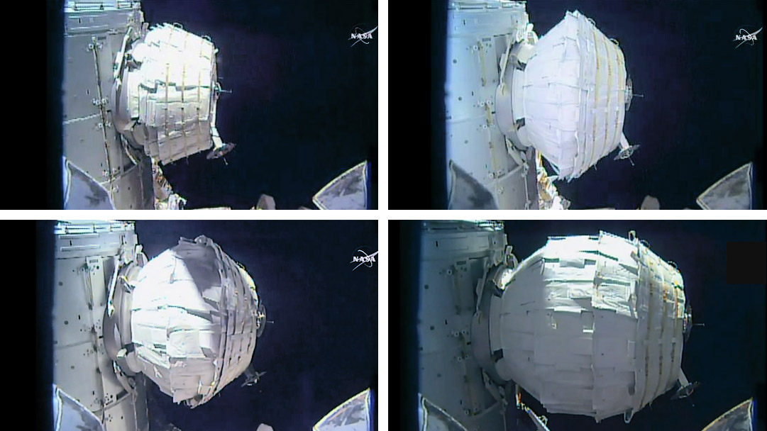
Habitat Design Trade Space – Structure
Design Strategy | Modular | Monolithic
Structure | Metallic | Inflatable
Thermal Control | Radiators | Insulation | Solar Shield
Metallic shell^{[9]}
  EX) NASA’s MTH, ISS
  Simpler to design and develop, can fit to specific launch vehicles
  Stronger structural properties
  Pre-outfit layouts without later flights
  Relatively heavier
  Requires more capable launch vehicles
Inflatable^{[9,11,12]}
  EX) Transhab, Bigelow’s Expandable Activity Module, Bigelow BA330
  Relatively higher pressurized volumes
  Can launch on smaller launch vehicles
  Structural augmentation is necessary (metallic core for thrust loads and docking ports)
Inflatable structure was chosen for this habitat
  Can launch without the need for SLS
  No significant loss of habitable volume
NASA’s TransHab^{[2]}
NASA’s MTH^{[7]}
BEAM on ISS^{[13]}

Slide 9
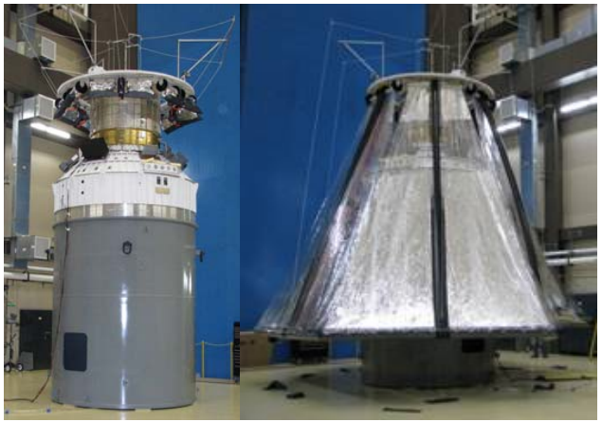
Habitat Design Trade Space – Thermal Control
Design Strategy | Modular | Monolithic
Structure | Metallic | Inflatable
Thermal Control | Radiators | Insulation | Solar Shield
Radiators
  Proven for crewed spaceflight missions
  Can potentially grow to be multi-ton mass drivers
Insulation
  Simpler to include within design of habitat
  Cannot reject internal heat loads
Solar Shields
  Lightweight
  Have been used to lower sink temperatures
  Cannot reject internal heat loads
  Potentially complex deployable
Atlas Centaur Deployable Solar Shield^{[14]}

Slide 10
Habitat Design Trade Space – Thermal Control (Cont.)
Design Strategy | Modular | Monolithic
Structure | Metallic | Inflatable
Thermal Control | Radiators | Insulation | Solar Shield
Preliminary analysis prior to the study showed a significant growth in radiator mass to reject required 14.5 kWt near Venus
  Drove the need to assess other solutions
Further analysis shows radiators are capable
  ISS-type radiators, absorptivity/emissivity (α/ε) ratio = 0.17/0.92
  Dual pumped fluid loop design
    40/60 Prop Glycol and Water for internal loop
    HFE-7200 for external loop
    Cold plates within cabin to transfer heat to external loop via heat exchanger
  Baseline sink temperature of 215K
Further detailed analyses and sensitivities are described in Thermal Analysis sections
Atlas Centaur Deployable Solar Shield^{[14]}

Slide 11
Habitat Design Point
Design point generated using the Exploration Architecture Model for In-space and Earth-to-orbit (EXAMINE)^{[15]}
197 m³ of pressurized volume, including the core
Total mass exceeds goal, but includes 30% margin
Inflatable section houses habitable living areas and crew
  Detailed layout analysis still in work
Core maintains structural rigidity and docking ports for other vehicles
  Thrust loads from transportation system, which can be docked on either end
  Radiator and solar arrays mounted on vestibule
Subsystem | Mass (kg)
Avionics | 368
ECLSS | 6,433
EVA | 811
MMOD | 2,644
Power | 1,710
Propulsion | 1,649
Structure | 5,147
Thermal Control | 846
Basic | 19,607
Growth (30%) | 5,882
System Gross Mass | 25,489
16.2m
8.5 m
7.8 m
3.0 m

Slide 12
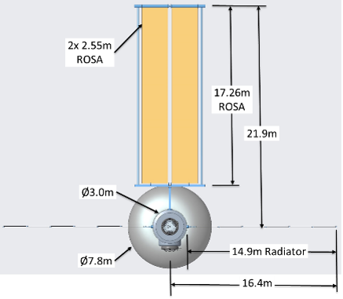
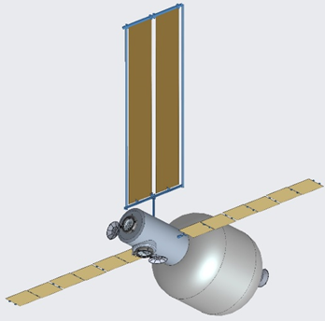
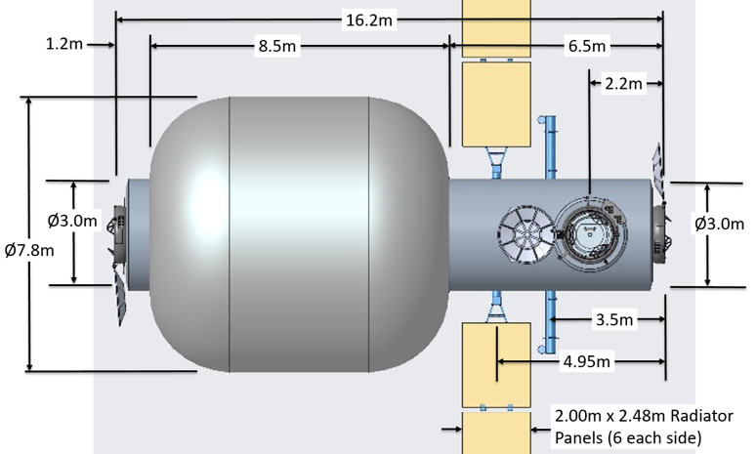
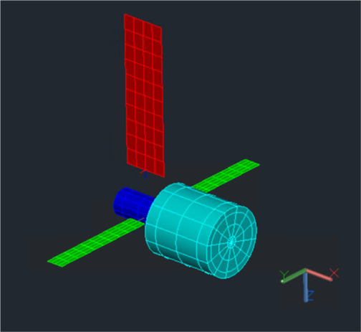
DSH Configuration
Notional 3D model of the DSH was generated to establish a basis for a thermal math model (TMM)
AutoCAD 2018 for geometric modeling
Habitat radiators (green)
  2 x 2 m x 13 m = 52 m² effective area (deployed & articulating)
  α/ε = 0.17/0.92 (single-sided)
  Deployable and single-sided
  Articulating about Y-axis
Solar Array (red)
  5.1 m x 17.26 m = 88 m²
  α/ε = 0.93/0.85
Habitat (light blue) + Vestibule (dark blue)
  Inflatable Section: 7.8 m diam. x 8.5 m = 304 m²
  Vestibule: 3 m diam. x 6.5 m = 75 m²
Solar Array
Radiators
Vestibule
Inflatable

Slide 13
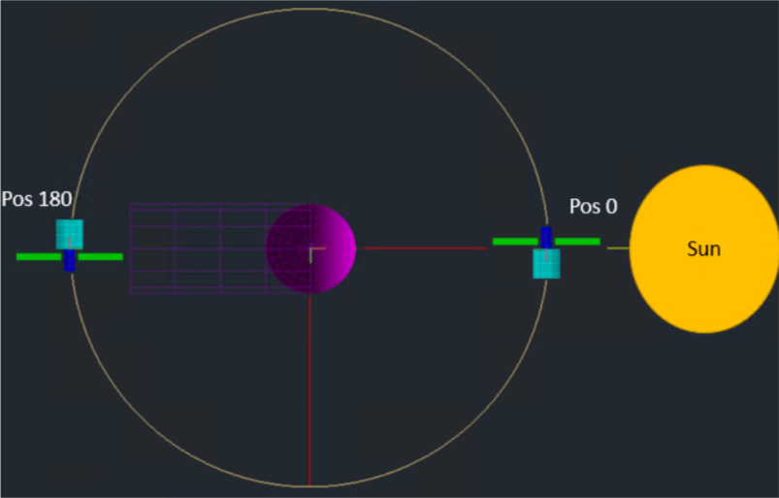
Thermal Analysis Setup
Solar close approach was considered as the thermal worse case throughout the mission
  0.62 AU assumed as baseline
  0.55 AU was assessed as a lower bound for transportation analysis
Venus flyby assumed to occur in eclipse
  Three different altitudes were considered to assess the sensitivity
For each location, solar arrays are facing ±Y, at and away from the sun
Radiators are edge-on, feathered at 0 deg and 45 deg about the Y-axis
Analysis was done using Thermal Desktop 6.1 Patch 5 and SINDA/FLUINT 6.1 Patch 3^{[15,16]}
Location | Thermal Cases | Vehicle Attitude
Pos 0 (Solar Close Approach) | 0.55 AU, 0.62 AU | Sun on DSH -Y , Velocity Vector +X
Pos 180 (near Venus eclipse) | 500 km, 832 km, 1500 km altitudes | Venus on DSH +Y, Velocity Vector +X
Y
Z
x
X
DSH Coordinate Frame at Pos 0
Y
Z
x
X
DSH Coordinate Frame at Pos 180
Depiction of the locations analyzed using the thermal model, trajectory path not to scale

Slide 14
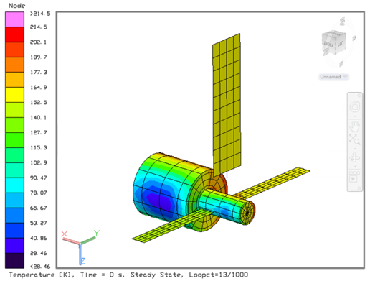
Thermal Analysis Results – Venus Flyby
Venus
Absolute sink temperatures are low enough to not warrant any radiator margin
Higher altitudes only slightly decrease the sink temperatures
Difference between each radiator assembly is minimal
Not thermally constraining

Slide 15
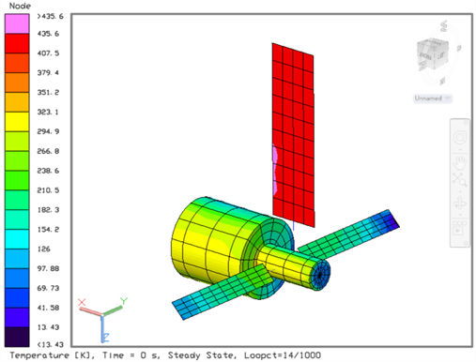
Thermal Analysis Results – Solar Close Approach
Solar close approach much more thermally constraining
Drop in approach to 0.55 AU increases worst case radiator sink temperature to 258K
Feathering 45 deg only reduces temperatures on the order of ~10K
Potential for shadowing of radiators using reorientation of entire transportation stack
Sun

Slide 16
Radiator Sensitivity Analysis
Baseline
Need to assess growth of thermal control systems to changing mission parameters
  Running TMM cases are computationally expensive
  Can assess sensitivity of radiator sizing to sink temperature
Mass and area grow significantly near 220K
Baseline 14.5 kWt of heat to reject at 215K requires 52 m² of radiators at 525 kg
Worst case 258K at 0.55 AU drives sizing to:
  940 kg and 105.6 m², for 15 kWt
  1296 kg and 145.6 m² for 20 kWt
For any given sink temperature, reducing the heat rejection load can reduce radiator mass by up to 50%
  Increase in heat load will increase mass up to 40%
Can enter a lower operating power mode during solar close approach
If mass limited, a target sink temperature can be used to drive trajectory
Worst Case
Baseline
Worst Case

Slide 17
Concluding Remarks
Conclusions
Conjunction and opposition class missions with Venus flybys drive deep space habitation design differently
  Both are in the trade space for crewed Mars missions
Venus flybys introduce new environments that affect requirements on habitation and crew systems
  Thermal environment near Venus and the Sun can be constraining
  Ensure crew safety during these mission segments
Inflatable habitat design concept is proposed that can handle up to 1,100 day conjunction missions and operate near Venus
  Can fly down to 0.62 AU without significant radiator mass and area growth
Future Work
Thermally assess more points within the mission
  Venus flyby on sun-lit side
  More vehicle attitudes
Introduce geometry of transportation system within TMM
Assess thermal environment at Gateway

Slide 18
Acknowledgements
Thank you to the rest of the team!
Joseph Adinolfi
Aerospace Engineer
Thermal Analysis and Control Branch
NASA Marshall Spaceflight Center
Brian W Evans
Senior Aerospace Engineer
Thermal Analysis and Control Branch, Jacobs Space Exploration Group/ESSCA Contract
NASA Marshall Spaceflight Center
Matthew A Simon, PhD
Aerospace Engineer
Space Mission Analysis Branch
NASA Langley Research Center

Slide 19
References
[1] Mattfeld, B., Stromgren, C., Shyface, H. R., Komar, D., Cirillo, W., and Goodliff, K., “Trades Between Opposition and Conjunction Class Trajectories for Early Human Missions to Mars,” 2014.
[2] de la Fuente, H., Raboin, J., Valle, G., and Spexarth, G., “TransHab - NASA’s large-scale inflatable spacecraft,” 41st Structures, Structural Dynamics, and Materials Conference and Exhibit, doi:10.2514/6.2000-1822, URL https://arc.aiaa.org/doi/abs/10.2514/6.2000-1822.
[3] “Human Integration Design Handbook,” Tech. rep., NASA, Washington D.C., 2010.
[4] “NASA SPACE FLIGHT HUMAN-SYSTEM STANDARD VOLUME 1, REVISION A: CREW HEALTH,” Tech. rep., NASA, Washington D.C., 2014.
[5] “NASA SPACE FLIGHT HUMAN-SYSTEM STANDARD VOLUME 2: HUMAN FACTORS, HABITABILITY, AND ENVIRONMENTAL HEALTH,” Tech. rep., NASA, Washington D.C., 2019.
[6] Hoang, B., White, S., Spence, B., and Kiefer, S., “Commercialization of Deployable Space Systems’ roll-out solar array (ROSA) technology for Space Systems Loral (SSL) solar arrays,” 2016, pp. 1–12. doi:10.1109/AERO.2016.7500723.
[7] Simon, M., Latorella, K., Martin, J., Cerro, J., Lepsch, R., Jefferies, S., Goodliff, K., Smitherman, D., McCleskey, C., and Stromgren, C., “NASA’s advanced exploration systems Mars transit habitat refinement point of departure design,” 2017 IEEE Aerospace Conference, 2017, pp. 1–34. doi:10.1109/AERO.2017.7943662, iSSN: null.
[8] Rocketdyne, A., “Bipropellant Engine Data Sheets,” URL https://www.rocket.com/sites/default/files/documents/Capabilities/PDFs/Bipropellant%20Data%20Sheets.pdf.
[9] Simon, M. A., Wald, S. I., Howe, A. S., and Toups, L., “Evolvable Mars Campaign Long Duration Habitation Strategies: Architectural Approaches to Enable Human Exploration Missions,” AIAA SPACE 2015 Conference and Exposition, AIAA SPACE Forum, American Institute of Aeronautics and Astronautics, 2015. doi:10.2514/6.2015-4514, URL https://doi.org/10.2514/6.2015-4514.
[10] “Crew Studies How Space Impacts Brain and Perception,” 2018. URL “https://blogs.nasa.gov/spacestation/2018/10/29/crew-studies-how-space-impacts-brain-and-perception/.
[11] “XBASE: a mission specific B330 with a proposed destination on the ISS,” 2019. URL http://bigelowaerospace.com/pages/b330/.
[12] Foust, J., “NASA planning to keep BEAM module on ISS for the long haul,” 2019. URL https://spacenews.com/nasa-planning-to-keep-beam-module-on-iss-for-the-long-haul/.
[13] “BEAM Expanded to Full Size,” 2016. URL “https://blogs.nasa.gov/spacestation/2016/05/28/beam-expanded-to-full-size/.
[14] Dew, Michael & Lin, John & Kutter, Bernard & Madlangbayan, Albert & Willey, Cliff & Allwein, Kirk & Pitchford, Brian & ONeil, Gary & Ware, J.. (2008). Design and Development of an In-Space Deployable Sun Shield for Atlas Centaur. 10.2514/6.2008-7764.
[15] Panczak, T., Ring, S., Welch, M., Johnson, D., Cullimore, B., and Bell, D., “Thermal Desktop User’s Manual,” , 2019.
[16] Cullimore, B., Ring, S., and Johnson, D., “SINDA/FLUINT User’s Manual,” , 2019.

Slide 20
Summary Slide
AIAA Paper Number 3413215
Conceptual Design and Analysis of a Deep Space Habitat with a Venus Flyby
Akshay Prasad
  Pathways Student Trainee, NASA Langley Research Center
  akshay.prasad@nasa.gov
Joseph Adinolfi, Brian Evans, NASA Marshall Spaceflight Center
Matthew A. Simon, PhD, NASA Langley Research Center
Conceptual design of deep space habitats is driven by mission assumptions
  Venus flybys introduce new environments for habitation and crew systems
  Previous concepts need to be reassessed to understand impacts
Inflatable habitat concept is proposed that is able to fly up to 1,100 day conjunction class missions and lower duration opposition missions with a Venus flyby
  Can handle a solar close approach down to 0.62 AU without significant mass growth
  0.55 AU approach drives radiator sizing beyond 1 t
  Venus flyby is much less thermally constraining
Further thermal analyses with the inclusion of transportation system geometry
Sun

