Slide 1
SLS Evolution: Comparing Configurations
Using System Exergy
Terry Haws
Joshua Zimmerman
Michael Fuller
Dr. Michael Watson
16-November-2020

Slide 2
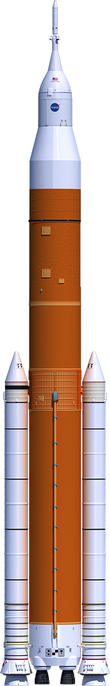
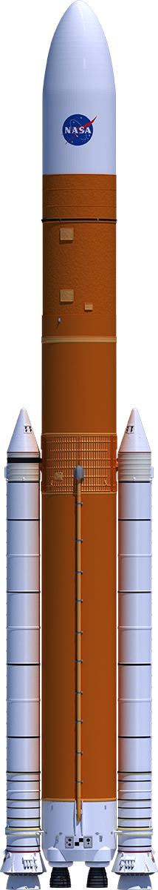
Introduction
Space Launch System (SLS) is the keystone of the NASA Moon/Mars campaign
SLS is evolving to improve performance
Compare the evolution using Exergy Analysis

Slide 3
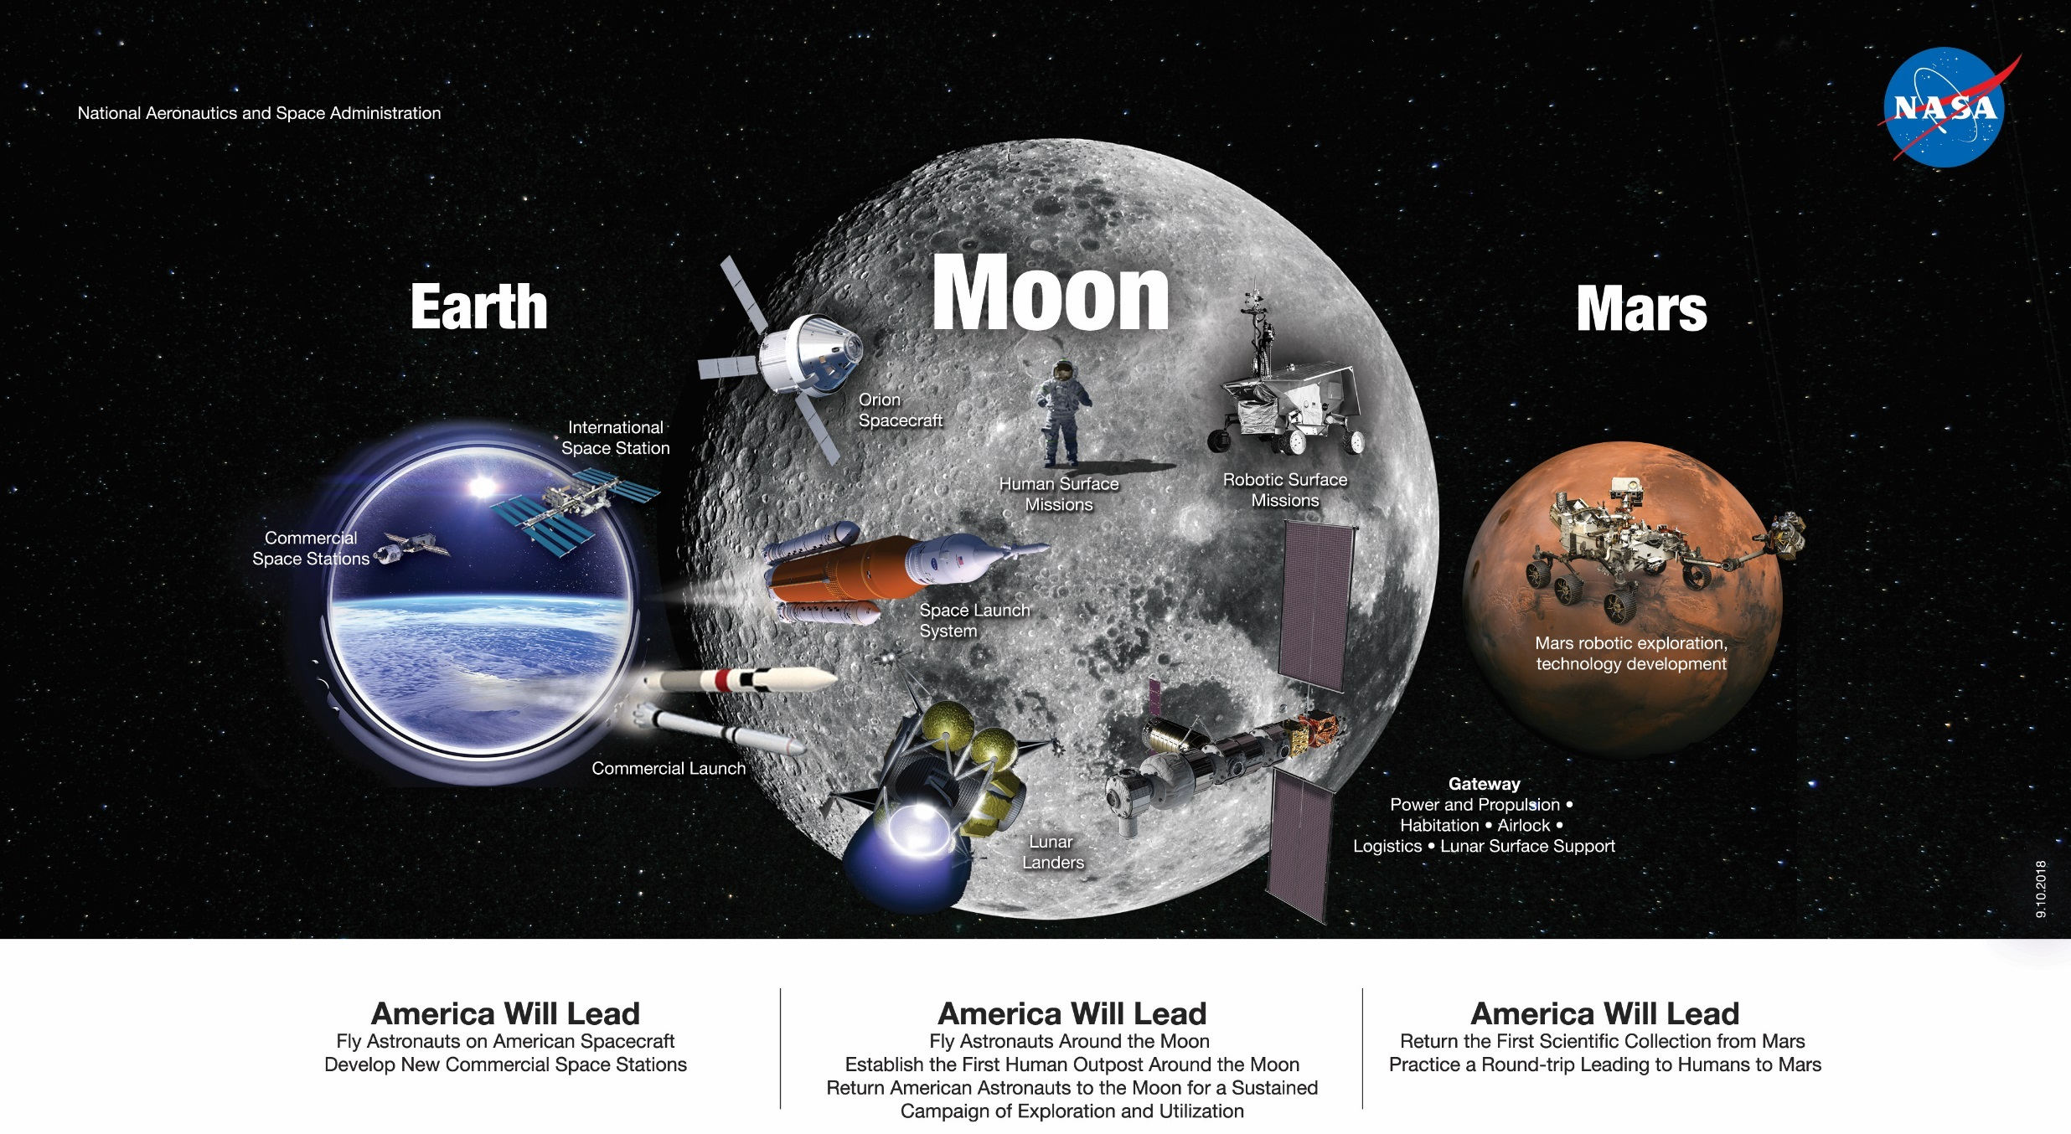
Approach to Moon and Mars Exploration
SLS is a keystone of Moon and Mars Exploration plan
Image courtesy of NASA
Notes:
SLS enables science and human exploration of lunar surface and eventually mars
SLS is the keystone in a stepwise approach to get to mars

Slide 4
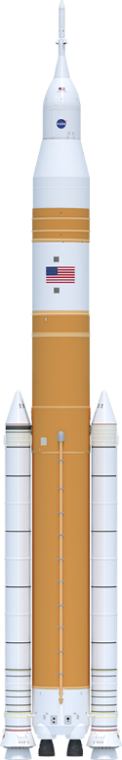
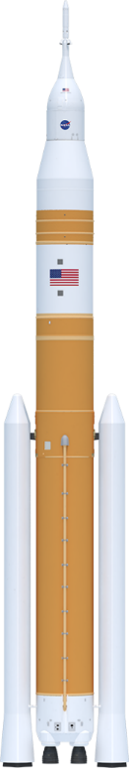
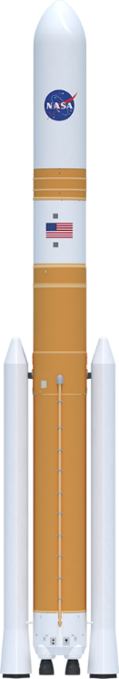
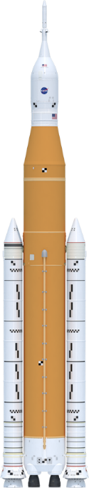
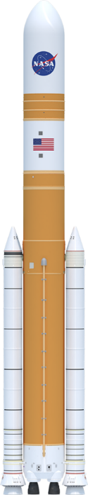
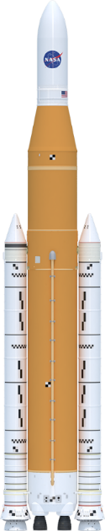
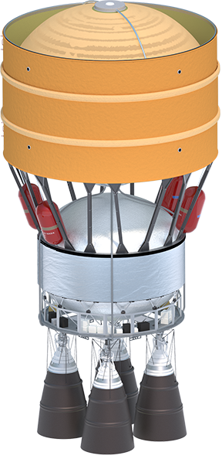
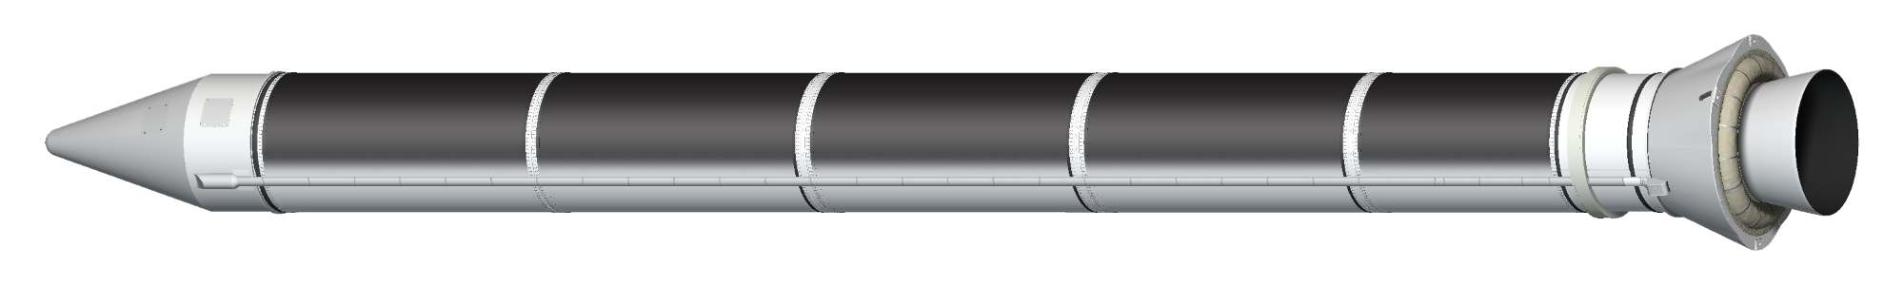
SLS Evolutionary Path
SLS Block 1
SLS Block 1 Cargo
SLS Block 1B Crew
SLS Block 1B Cargo
SLS Block 2 Crew
SLS Block 2 Cargo
Universal
Stage Adapter
Universal
Stage Adapter
8.4m Fairing
Long (Up to 90’)
Launch Abort System
5m Class Fairing
(up to 63’)
8.4m Fairing
Short (Up to 63’)
Orion
Exploration Upper Stage
Exploration Upper Stage
Interim Cryogenic
Propulsion Stage
Exploration Upper Stage
Launch Vehicle
Stage Adapter
Interstage
Interstage
Interstage
Core Stage
Core Stage
Core Stage
Solid
Rocket
Boosters
Solid
Rocket
Boosters
Evolved
Boosters
RS-25 Engines
RS-25 Engines
RS-25 Engines
EUS: Larger stage, more propellant, four engines
RS-25: 16 remaining from Shuttle program. After 4 flights, transition to new build RS-25.
Boosters: 8 flight sets of steel cases remaining from Shuttle program. After 8 flights, transition to BOLE.
New generation RS-25
Reduce costs
Certify to a higher thrust level
Simplify design
Utilize advanced manufacturing techniques – including 3-D printing
Booster Obsolescence and Life Extension (BOLE)
Composite cases
Updated insulation
Updated propellant
Optimized grain design
Optimized nozzle
Sources: graphics courtesy NASA

Slide 5
Exergy Explained
What is exergy? Let’s start with energy:
Example: Energy of a Rocket
Kinetic Energy
And that’s what orbit is – altitude and velocity
Propulsion Exergy
Potential Energy
Turn chemical energy into potential energy (altitude) and kinetic energy (velocity)
Sitting on the pad, full of fuel, the rocket has available chemical energy
If the rocket was perfectly efficient, all the chemical energy would be converted into potential or kinetic energy.
But of course it isn’t …

Slide 6

Exergy Explained
What is exergy?
  Definition: The maximum useful work which can be extracted from a system as it reversibly comes into equilibrium with its environment.
Rocket experiences losses:
gravity, atmosphere, pointing, etc.
Atmosphere
Kinetic Energy
Those losses do not turn into useful work.
This results in destroyed exergy.
The useful work turns into mass delivered to orbit
Propulsion Exergy
Potential Energy
TVC/Pointing
Gravity
Useful work (exergy)
Rocket starts with maximum available work from propellant
$Exergy Destroyed=Propulsion Exergy −(∆Kinetic Energy+ ∆Potential Energy$)
$$η_{exergy}=1− \frac{{Exergy}_{destroyed}}{{Exergy}_{propellant}}$$

Slide 7
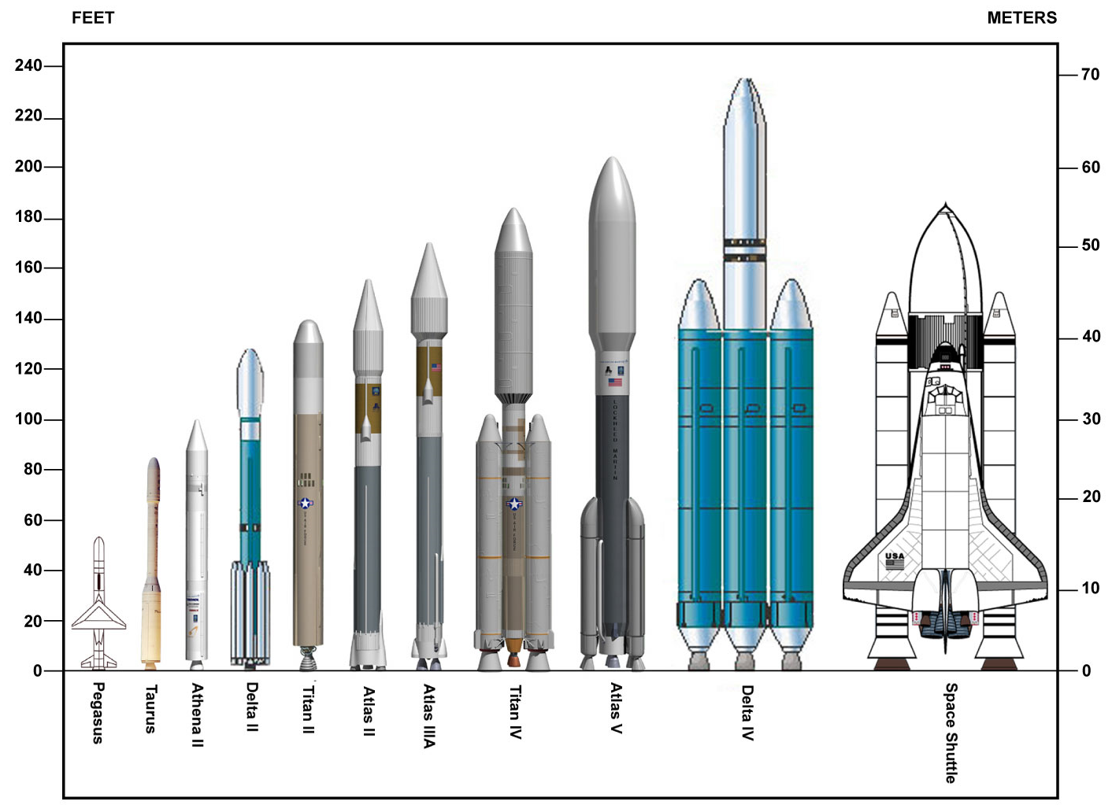
Exergy Analysis Applied
How does it apply to launch vehicle design and analysis?
  Exergy analysis provides a way to measure the system efficiency of launch vehicles
Integrates all of the system’s thermodynamic properties
Combines all aspects of vehicle efficiency into one equation
Exergy efficiency can be plotted against time across the entire trajectory
Allows comparison of multiple vehicle configurations and determine where efficiency is being lost
More instructive to plot versus ideal velocity for better comparison
Timing of different rocket configurations can be very different, hard to compare versus time
Vehicles to similar orbits should have similar ideal velocities, making comparison easier
Allows comparison of solids and liquids, different number of stages
Provides a variable to compare very different vehicles
Rocket images courtesy NASA: https://www.nasa.gov/images/content/125306main_rocket%20chart.jpg

Slide 8






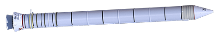

SLS Block 1B Example
Ascending:
Burning propellant, increasing kinetic and potential energy
Orbit
Departure burn
Core jettison
Booster jettison
LAS jettison
Booster jettison:
Kinetic energy of the boosters is now wasted – causes drop in efficiency
Max Q
Sitting on pad
Core jettison
Sitting on the pad:
Hasn’t burned any propellant, hasn’t done any work
η =1
LAS jettison
Booster jettison
Orbit
Departure burn
EUS jettison
Max Q
Sitting on pad

Slide 9
Comparing SLS Crew to TLI
Payload:
23.9 mT
36.0 mT
Legend
SLS Block 1
SLS Block 1B
Core providing much more velocity
Efficiency shows core burns longer than optimal
Core goes to orbit – results in much bigger loss
Blk 1 booster generating more ΔV than Blk 1B
Orbit
EUS is bigger → bigger loss
More efficient
Having an upper stage is more efficient than just an in-space stage
Less efficient

Slide 10
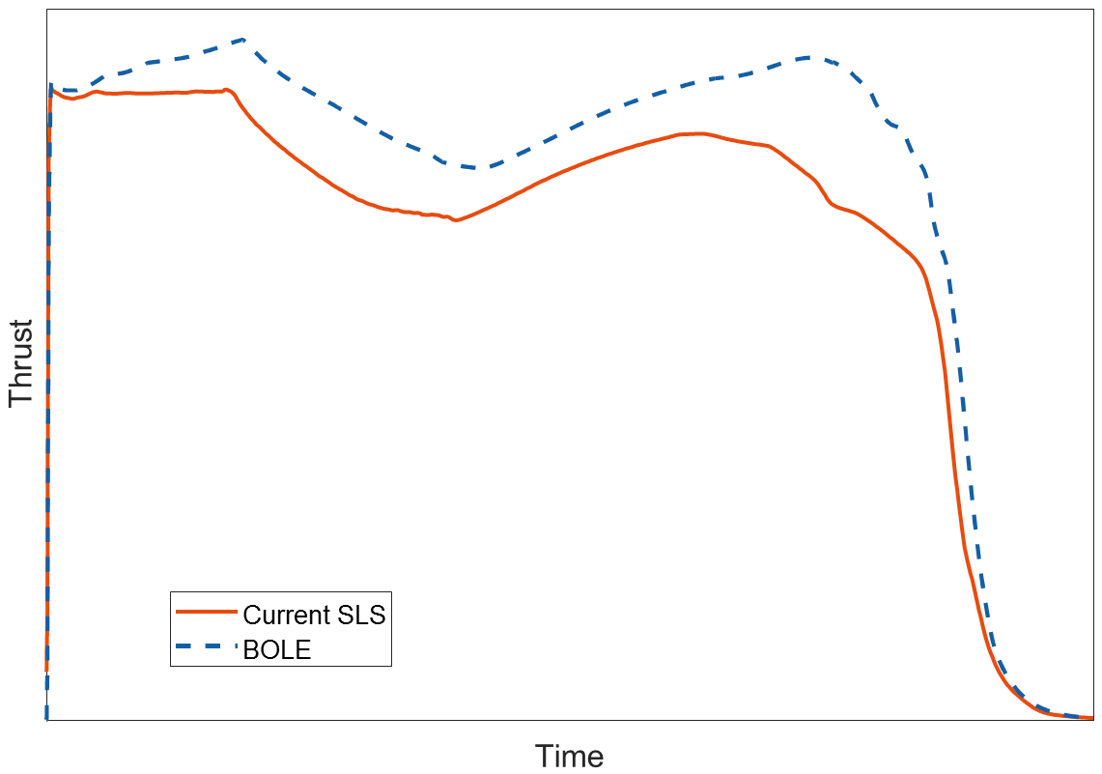
Comparing SLS Crew to TLI
Legend
SLS Block 1B
SLS Block 2
Efficiency gain can be seen throughout trajectory
Core burnout
Booster burnout
BOLE booster provides more impulse → more efficient
Overall more efficient
Adding booster impulse increases system efficiency

Slide 11
Comparing Block 1B Missions
Payload:
40.8 mT
6.8 mT
2.9 mT
Legend
Lunar Mission
Jupiter/Europa
Saturn/Titan
Lighter payloads lead to greater efficiency at core burnout
Core inert is larger proportion of mass, leads to greater loss of efficiency
Upper stage producing departure energy
Very similar through booster burn
Outer planet missions use all the propellant to deliver a small payload → lower efficiency

Slide 12
Comparing SLS Cargo to Europa
Payload:
2.8 mT
6.8 mT
8.3 mT
Legend
SLS Block 1
SLS Block 1B
SLS Block 2
Slope of in-space curve shows ICPS is more efficient
Block 2 is the most efficient of the configurations
Block 1 is least efficient
Block 2 is most efficient, delivers the most payload

Slide 13
SLS Block 1 to Europa – Add Kick Stage
Payload:
2.8 mT
3.9 mT
Legend
SLS Block 1
SLS Block 1 with STAR 48B
STAR 48B is less efficient (slope) due to lower Isp
Adding a kick stage is more efficient, delivers more payload
But staging the ICPS leads to better overall efficiency

Slide 14
Conclusions
SLS Evolution Analyzed Using Exergy Analysis
Conclusions
Having an upper stage (Block 1B) is more efficient than not (Block 1)
Having more impulse in the boosters (Block 2) is more efficient
Allows for an assessment of staging, bringing together the effects of the staged elements’ mass and Isp
Higher thrust engines are indicated for the EUS, shown by the slope in these plots
ICPS is more efficient as an in-space, having a much flatter exergy efficiency curve
Various configurations – crew and cargo; Block 1, Block 1B, Block 2; with and without a kick stage
Various destinations – TLI, Europa, Saturn
Staging, while causing a big drop in efficiency, helps overall system efficiency
Adding a kick stage is more efficient than doing the mission with the upper stage as departure stage
Indicates where the optimum cut off of a stage is, pointing to future improvements in vehicle configurations
Efficiency and payload appear to be correlated

