Slide 1
BSCW Computations Using KESTREL and AEROM
Walt Silva
Aeroelasticity Branch
NASA Langley Research Center
September 28, 2020
Presentation to Northrop-Grumman

Slide 2
Outline
Benchmark SuperCritical Wing (BSCW), Aeroelastic Prediction Workshop (AePW)
Background
AEROM
Results
  Alpha=0, 1, 3, and 5 degs (skip alpha=1 deg; similar to alpha=0 deg)
  Amplitudes = 0.04, 0.01, 0.08, and 0.001 (modal)
  Comparison of full solution GAFs vs ROM GAFs (error quantification)
  Root locus
  Comparison of full solution transients vs ROM transients (at a specified Q)

Slide 3
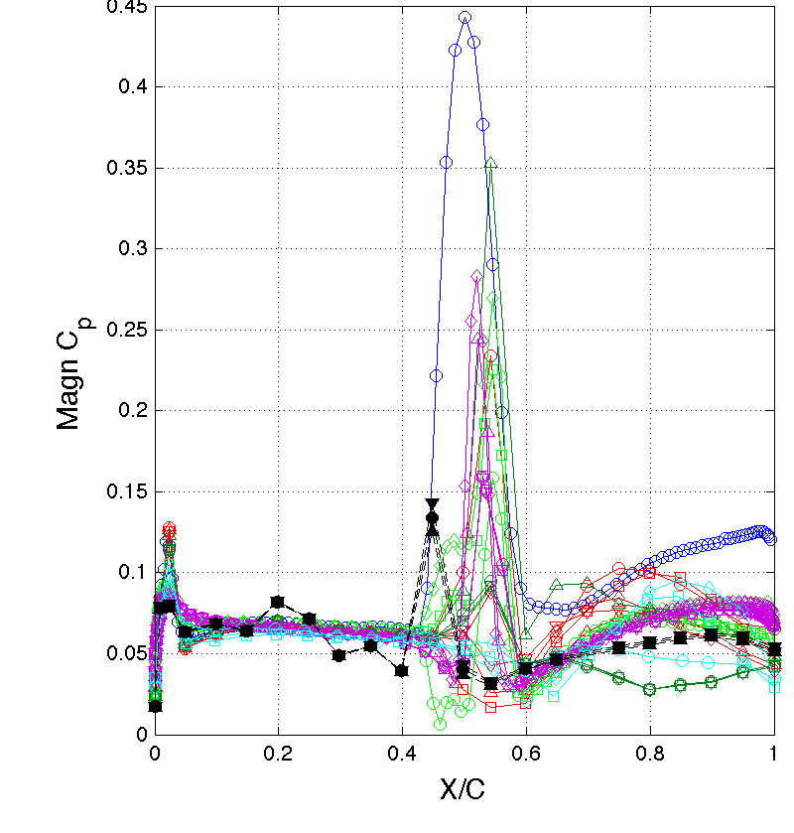
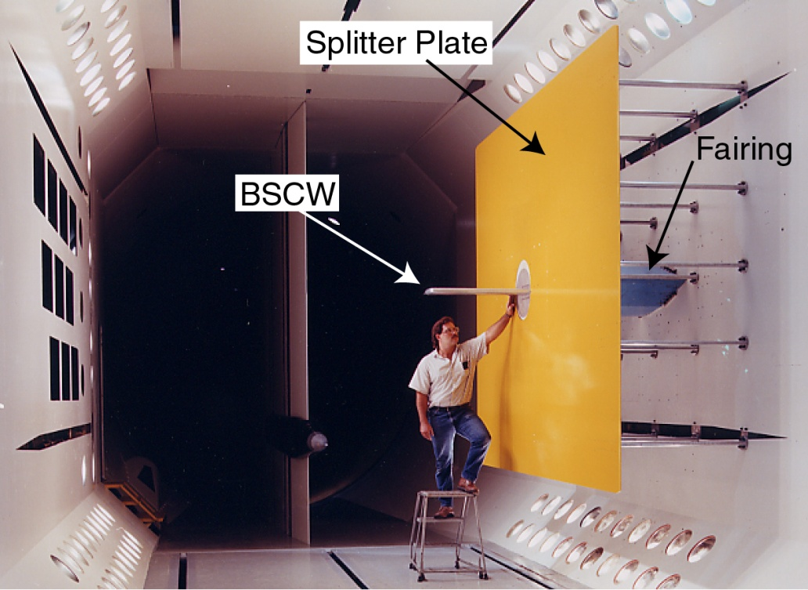
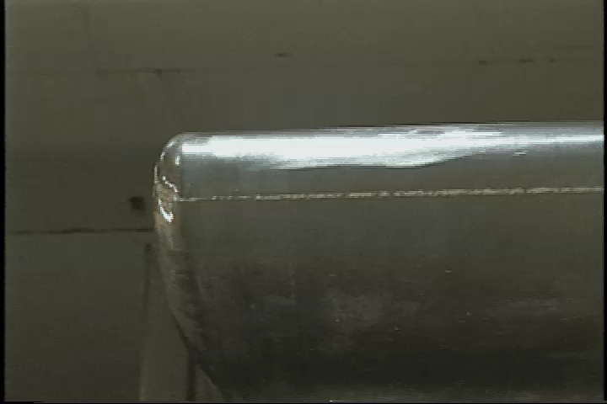
Benchmark Supercritical Wing (BSCW)
Chosen as a challenging test case, flow-wise, but simple geometry
  Strong shock with suspected shock-induced separated flow
Some preliminary assessments from AePW
  Computational methods had difficulty producing converged solutions due to flow field complexity
  Complex flow field also observed in experimental data; Largest magnitude of dynamic behavior appears to represent shock oscillations
  CFD solutions vary widely, even for static solution;
M=0.85, Re_{c}=4.49 million, test medium: R-134a, α = 5°, θ = 1°, freq 1 & 10 Hz
Likely plan of action:
Form technical working group of BSCW analysts
Extensive study of available experimental data; characterize different flow phenomena
Benchmark against more benign cases- lower Mach number, lower angle of attack
Analyze the static (unforced) problem using time-accurate evaluation methods
Study of time convergence criteria
From AePW-1 Debrief

Slide 4
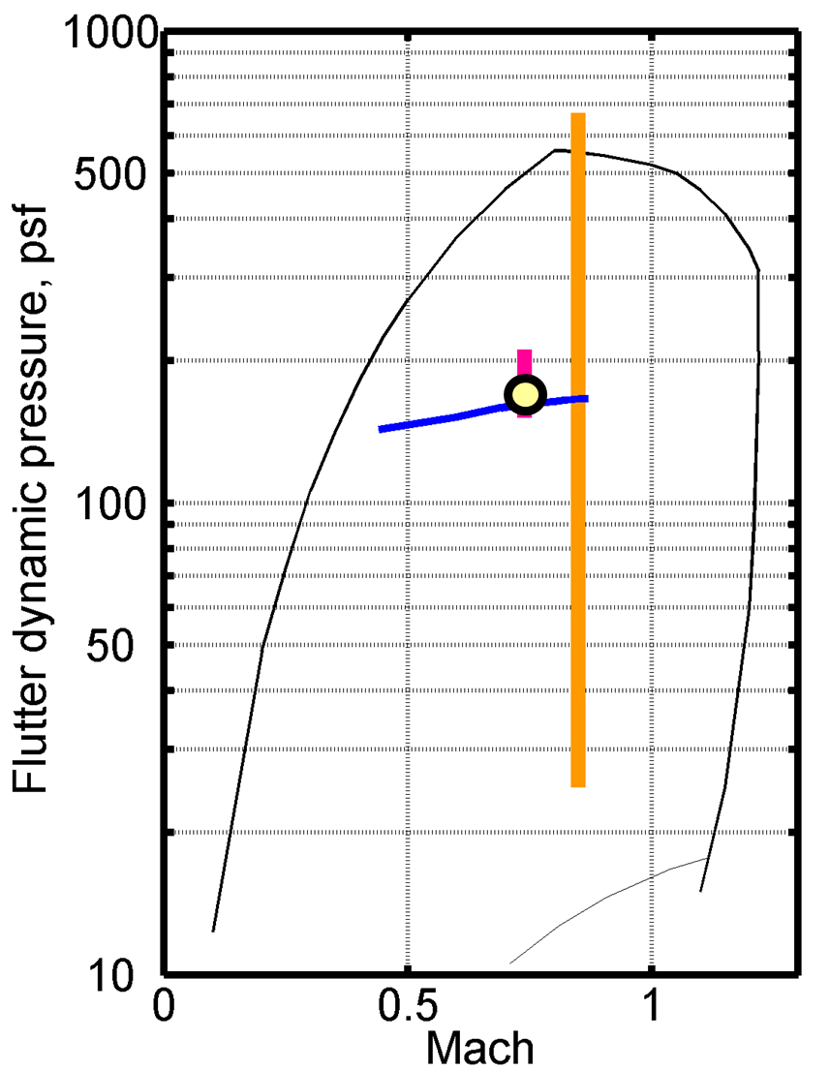
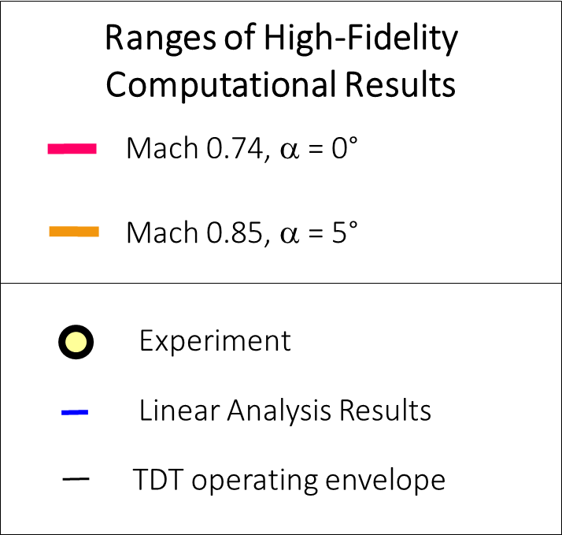
AePW-2 Summary of Results
At Mach 0.74, α = 0°
  Small variation in computational results
  Match the experimental results well
  Match the linear results well
At Mach 0.85, α = 5°
  Significant variation in predictions
  No experimental data for comparison

Slide 5
Background
Application of KESTREL and KESTREL/AEROM to BSCW wing
At M=0.74, alpha=0 deg, KESTREL, KESTREL/AEROM, FUN3D, and FUN3D/AEROM all compare nearly exactly with data
At M=0.85, alpha=5 deg, large flow separation/unsteadiness; very challenging problem
Large variance from one code to another at this condition; differences between KESTREL and FUN3D
Goal of this analysis: evaluate application of AEROM using KESTREL at M=0.80 and alpha=0, 1, 3, and 5 deg (similar unsteadiness to M=0.85) using multiple amplitude excitations (Walsh functions)
Follow-up with investigation of code-to-code comparisons
”Characterizing Aerodynamic Damping of a Supersonic Missile with CFD”, Shelton (AF), Martin (AF), Silva (NASA), SciTech 2018

Slide 6
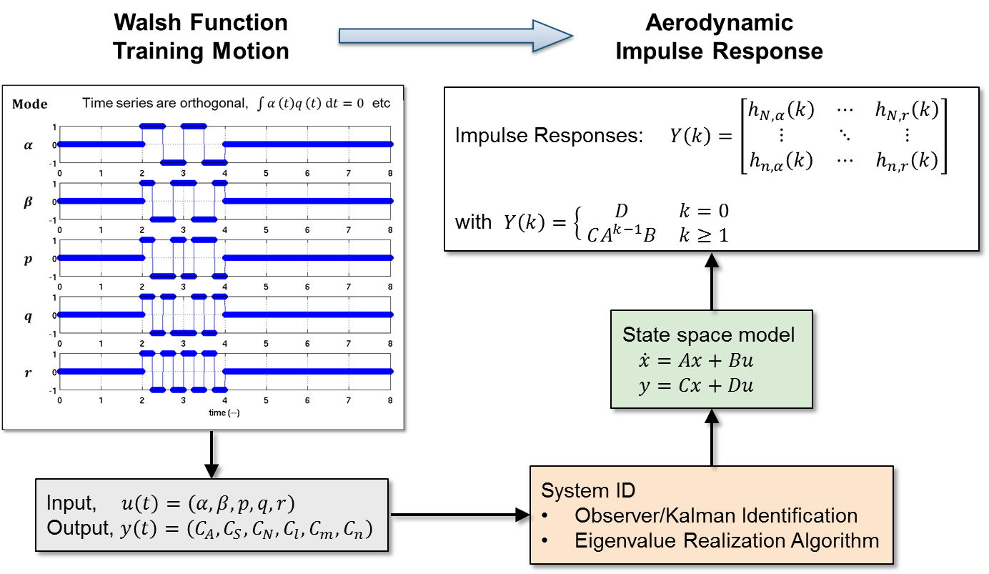
System Identification for Multiple Input-Output (cont)
Computational Fluid Dynamics
(Kestrel or FUN3D)
System/Observer/Controller Identification Toolbox
(SOCIT)

Slide 7
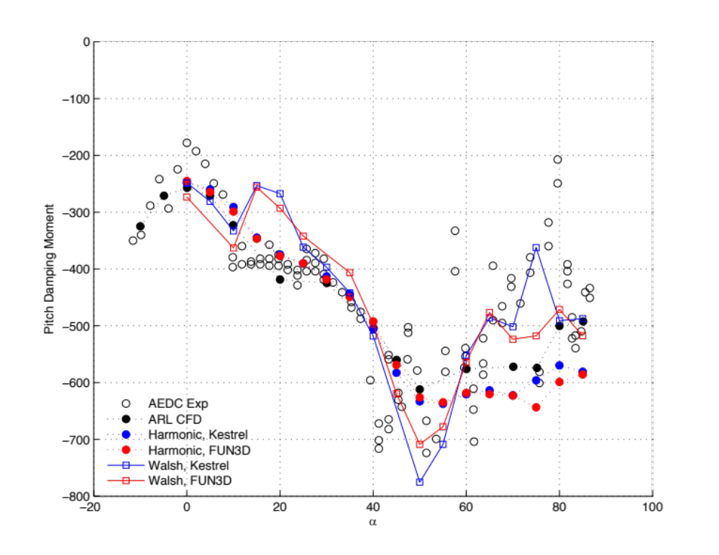
Pitch Moment Damping
Walsh Functions vs Harmonic Motion and Reference

Slide 8
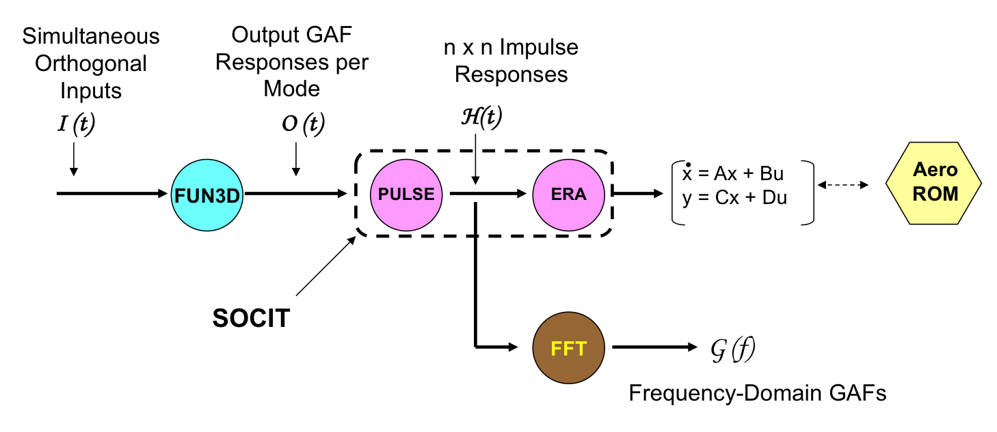
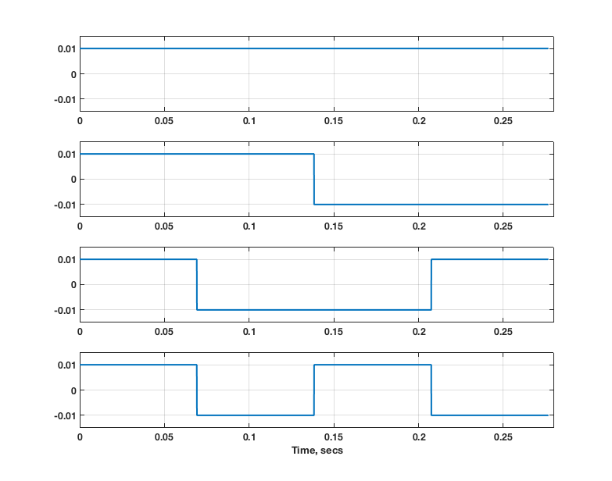
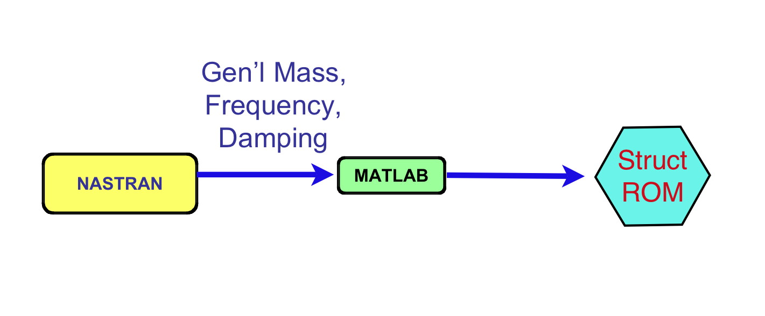
AEROM: ROM Development Process
Unsteady Aerodynamic State-Space ROM
Walsh Functions
(modal)
KESTREL
1
2
3
4
Structural state-space ROM

Slide 9
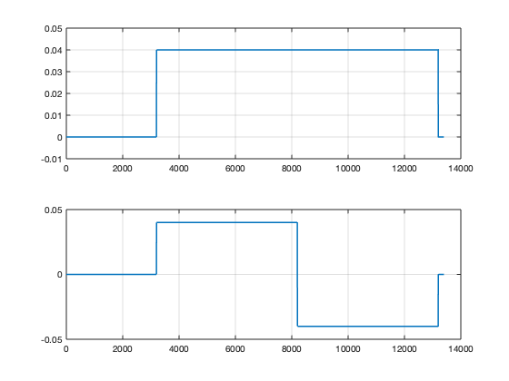
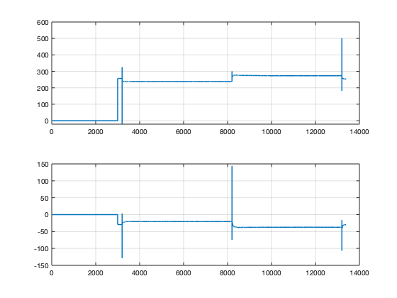
BSCW Application (KESTREL), Two modes
*.fmh file
*.modes file
KESTREL
BSCW
Two Walsh input functions
Two GAFs output functions

Slide 10
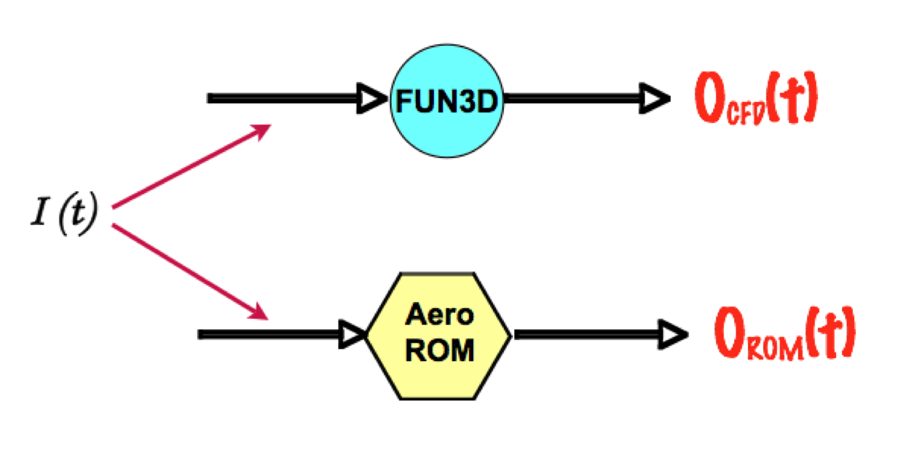
AEROM: ROM Development Process
Error Minimization (Unsteady Aerodynamics)
Low
Error
?
Yes
Continue
No
ERA
PULSE

Slide 11
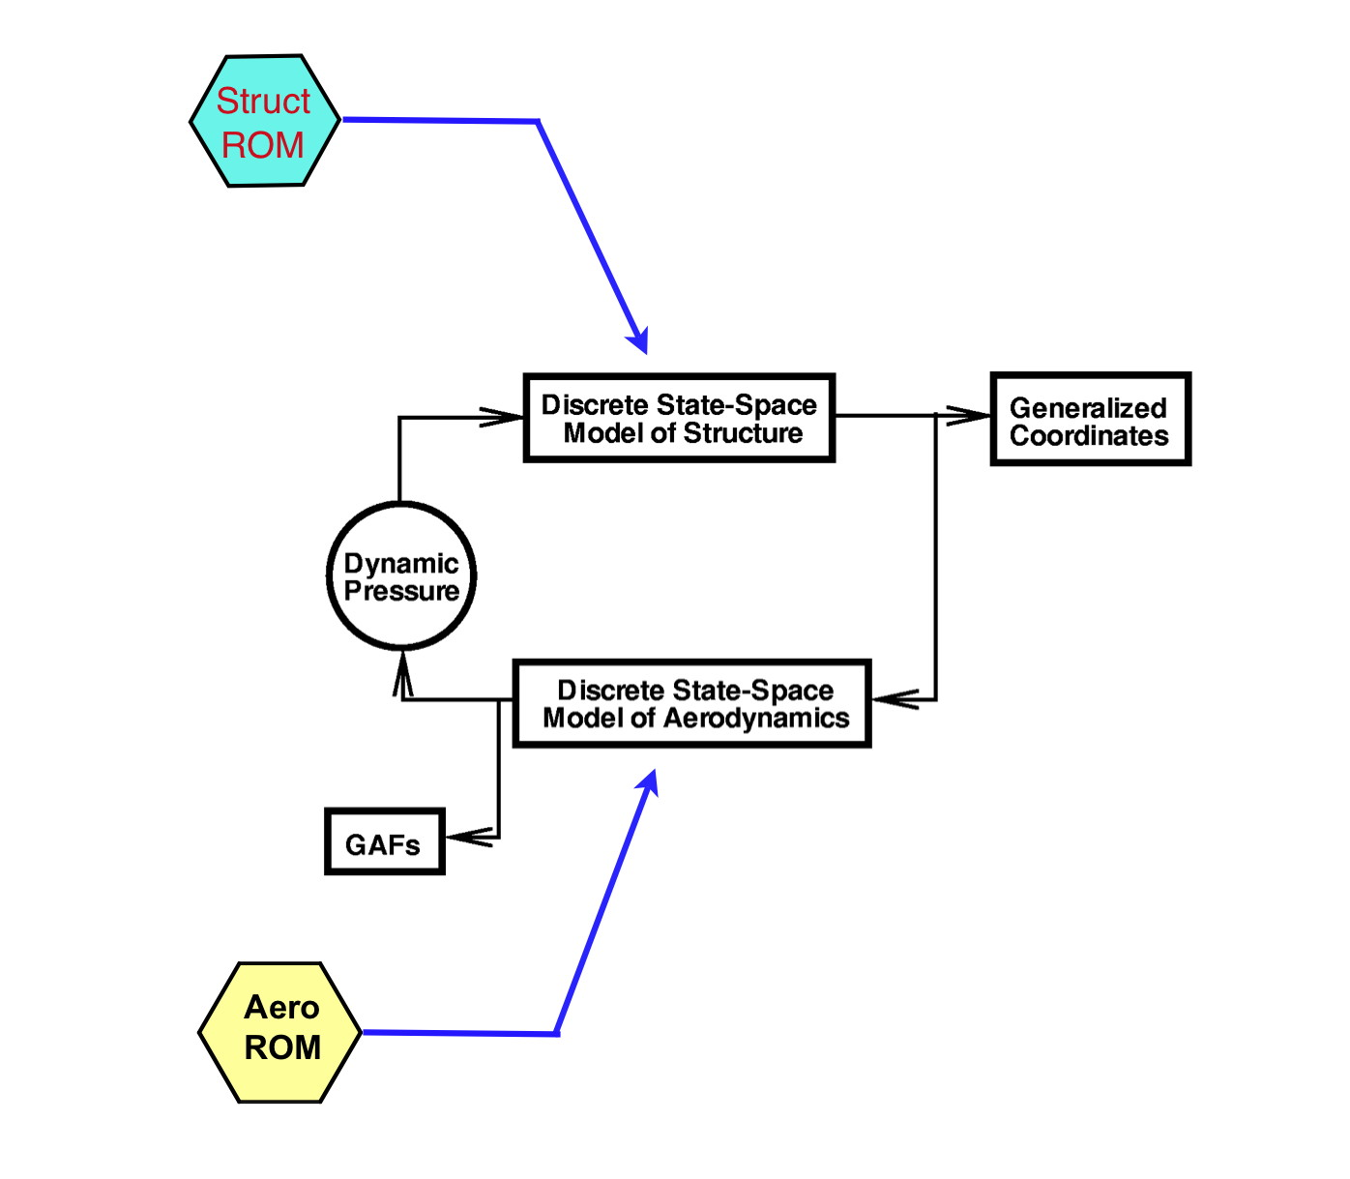
AEROM: ROM Development Process
Aeroelastic Simulation ROM (Simulink)
Simulink model that includes
Unsteady Aero ROM and
Structural Dynamic ROM used
to compare ROM responses at any
Dynamic pressure with full KESTREL
Solutions.

Slide 12
AEROM: ROM Development Process
Aeroelastic Root Locus Plot Using Aeroelastic Simulation ROM
Modeled as a closed-loop
system with gain (dynamic
pressure) in MATLAB
Eigenvalues
Z-Plane
Root Locus
Frequency vs
Damping Ratio
Root Locus
S-Plane
Root Locus

Slide 13
Walsh Function Amplitudes and Alphas
Modal Amp/Alpha (deg) | 0 (K) | 1 | 3 (K) | 5 (K)
0.04 | M8A0a | M8A1a | M8A3a | M8A5a
0.01 | M8A0b | M8A1b | M8A3b | M8A5b
0.08 | M8A0c | M8A1c | M8A3c | M8A5c
0.001 | M8A0d | M8A1d | M8A3d | M8A5d
K = comparison with full KESTREL solution available or underway; using ‘Venkat’ limiter
KESTREL Solutions: Alpha = 0 deg, Q = 100 psf, Initial Modal Velocity = 5
Alpha = 3 deg, Q = 100 psf, Initial Modal Velocity = 5
Alpha = 5 deg, Q = 50 psf, 130 psf, Initial Modal Velocity = 5
CPU Cost (NAS)
ROM solution: 10K steps, 240 cores, 9hrs 45min (set up for high alpha case; shorter duration for benign cases)
Full Solution per Q: 15K steps, 240 cores, 53 hrs 04min (~5.5 cycles)

Slide 14
Alpha = 0 deg

Slide 15
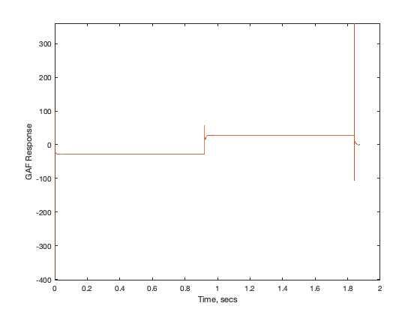
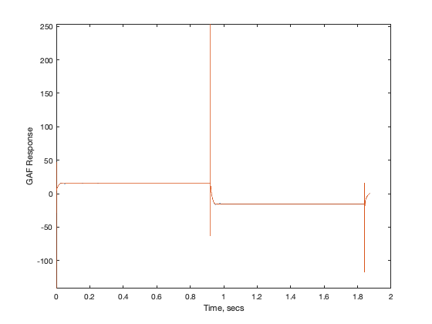
M8A0a – ROM/KESTREL GAFs
a | .04
b | .01
c | .08
d | .001

Slide 16
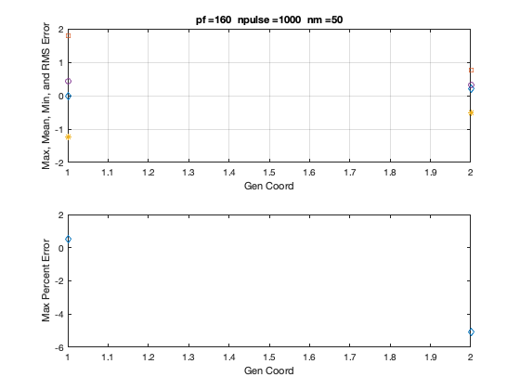
M8A0a – ROM/KESTREL GAFs Error

Slide 17
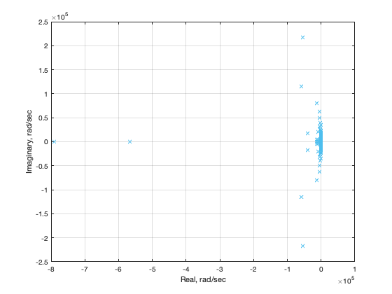
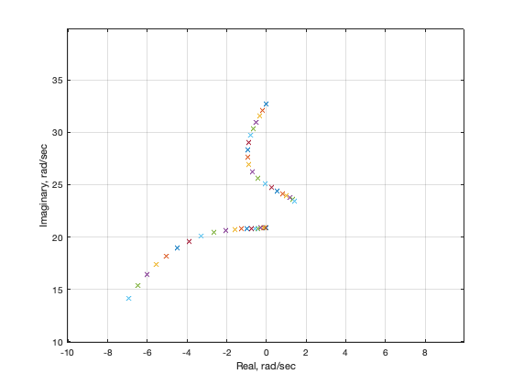
M8A0a – ROM/KESTREL Root Locus
Zoom

Slide 18
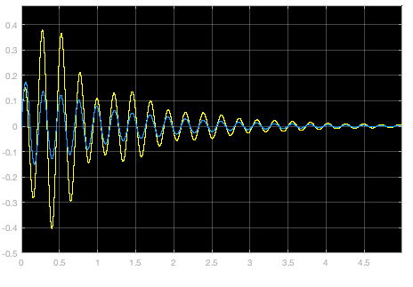
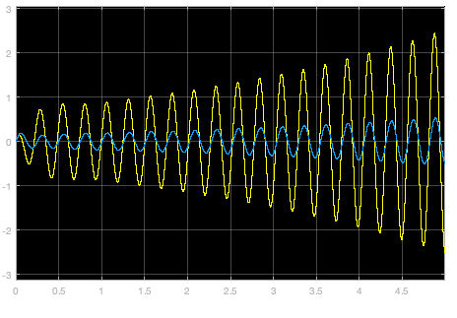
M8A0a – ROM Responses (SIMULINK)
Q = 0.9 psi
Q = 1.3 psi

Slide 19
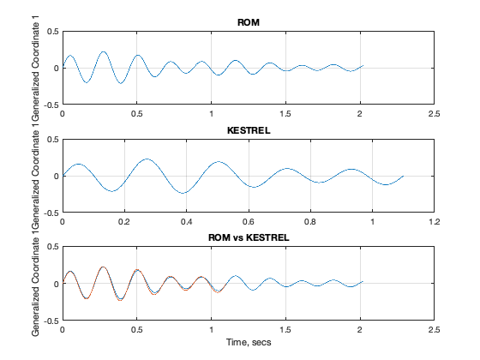
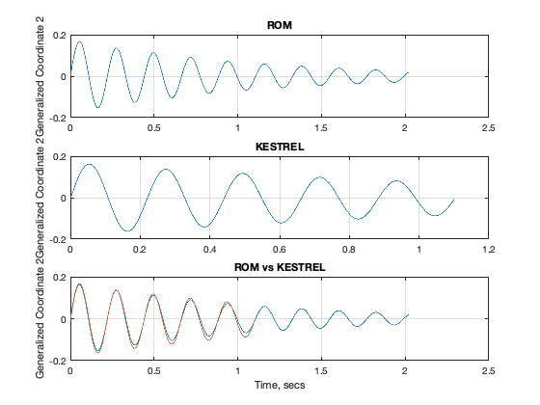
M8A0a – ROM/KESTREL Responses, Q=100 psf
Mode 1
Mode 2

Slide 20
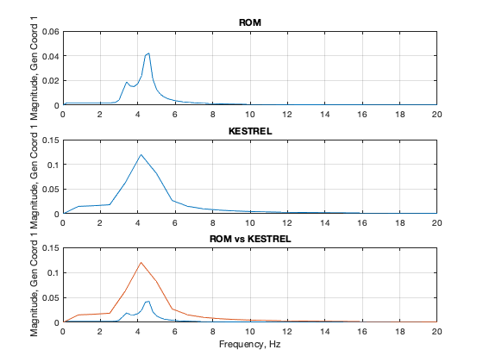
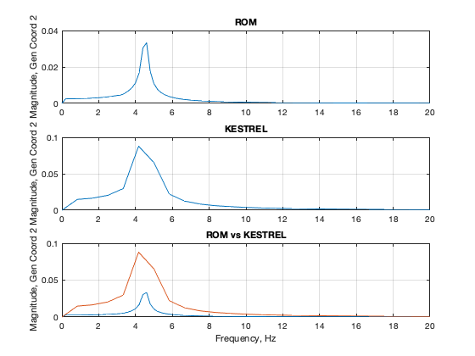
M8A0a – ROM/KESTREL Responses, Q=100 psf
Mode 1
Mode 2

Slide 21
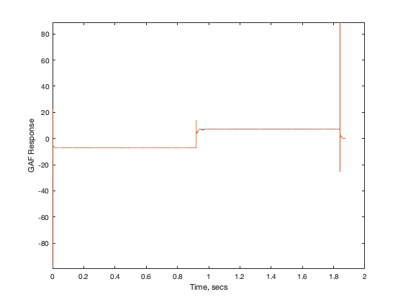
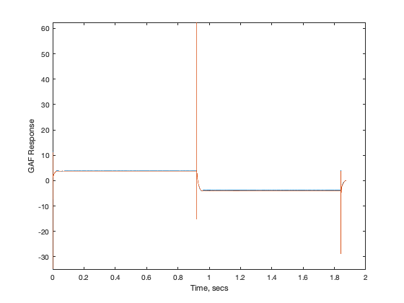
M8A0b – ROM/KESTREL GAFs
a | .04
b | .01
c | .08
d | .001

Slide 22
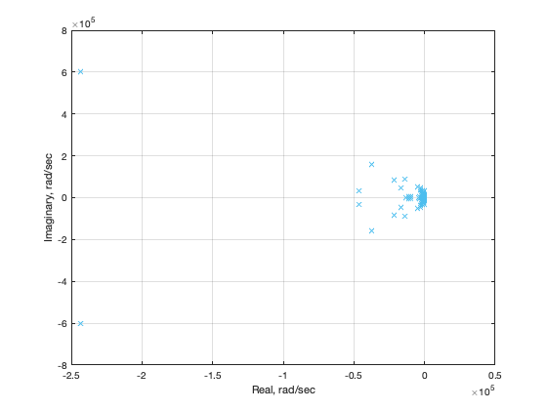
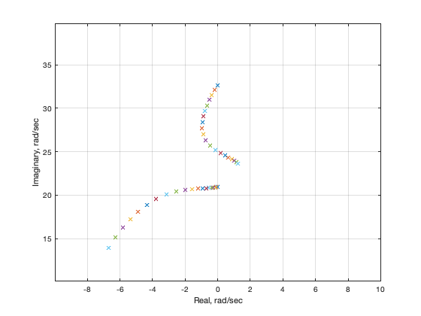
M8A0b – ROM/KESTREL Root Locus
Zoom

Slide 23
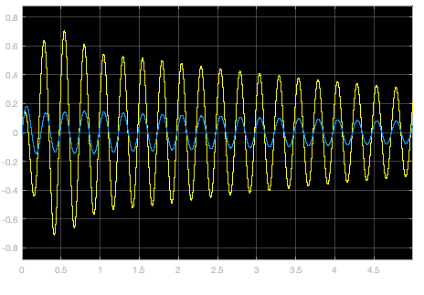
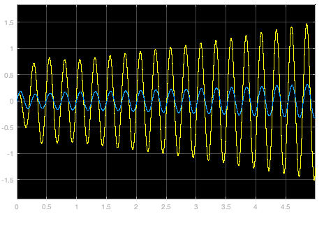
M8A0b – ROM Responses (SIMULINK)
Q = 1.2 psi
Q = 1.3 psi

Slide 24
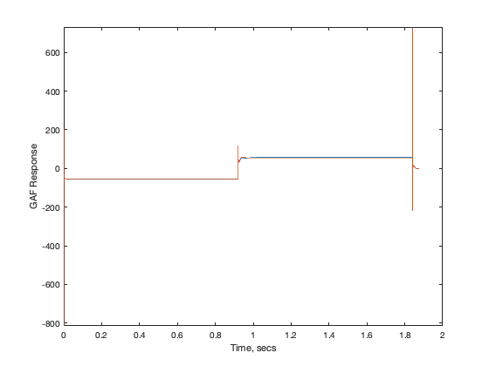
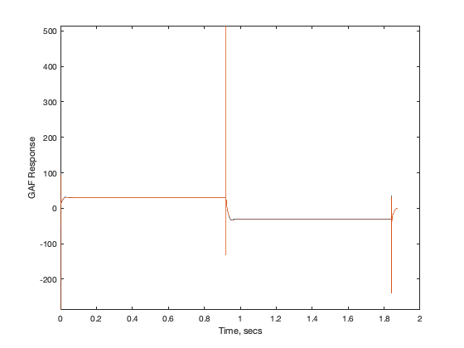
M8A0c – ROM/KESTREL GAFs
a | .04
b | .01
c | .08
d | .001

Slide 25
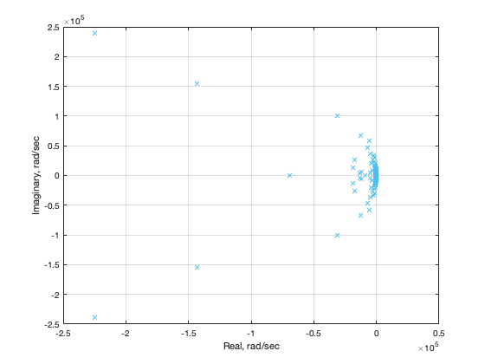
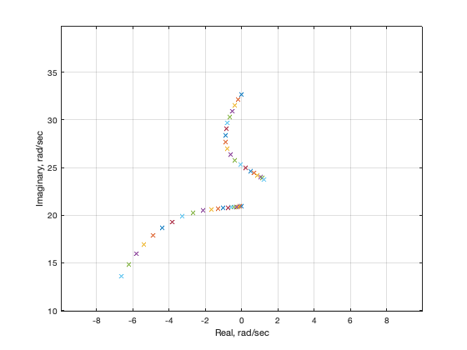
M8A0c – ROM/KESTREL GAFs Root Locus

Slide 26
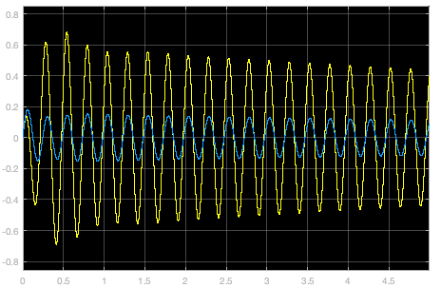
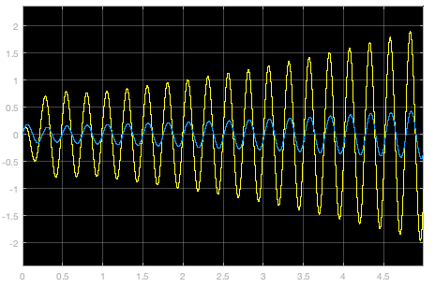
M8A0c – ROM Responses (SIMULINK)
Q = 1.2 psi
Q = 1.3 psi

Slide 27
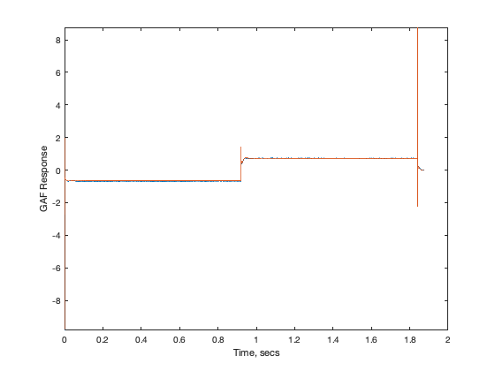
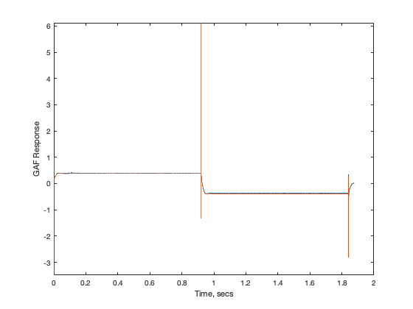
M8A0d – ROM/KESTREL GAFs
a | .04
b | .01
c | .08
d | .001

Slide 28
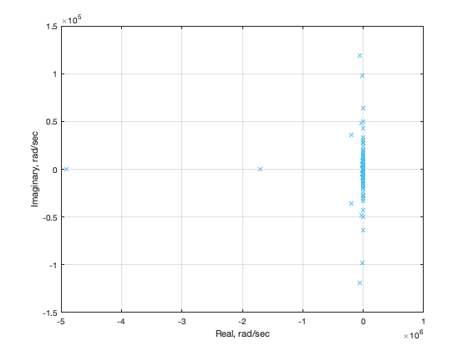
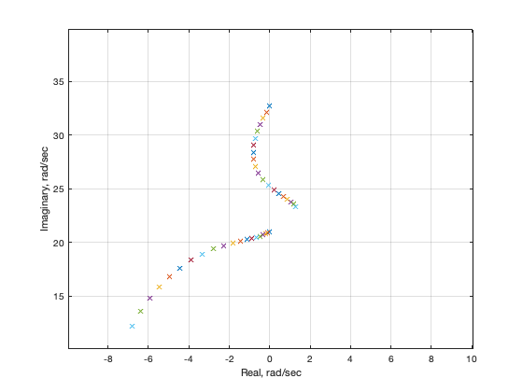
M8A0d – ROM/KESTREL Root Locus

Slide 29
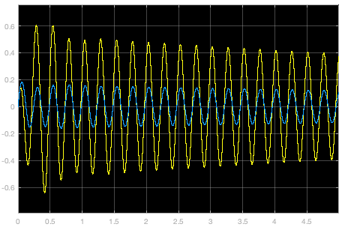
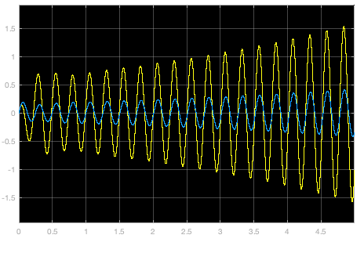
M8A0d – ROM Responses (SIMULINK)
Q = 1.2 psi
Q = 1.3 psi

Slide 30
Alpha = 1 deg

Slide 31
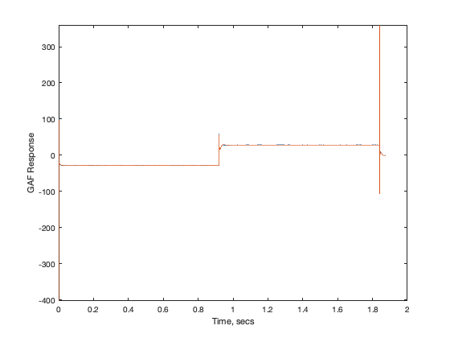
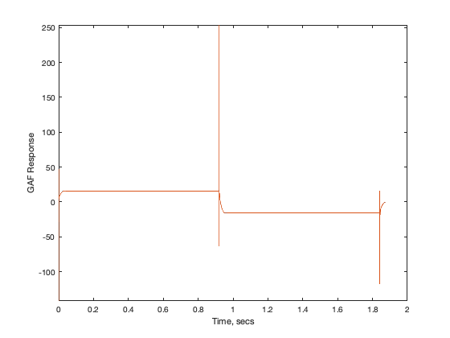
M8A1a – ROM/KESTREL GAFs

Slide 32
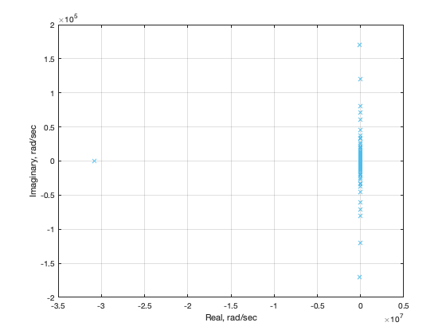
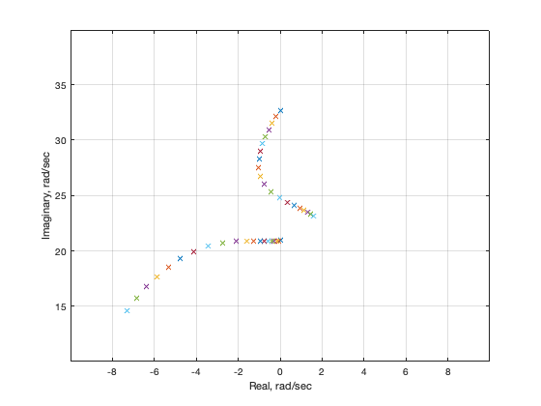
M8A1a – ROM/KESTREL Root Locus

Slide 33
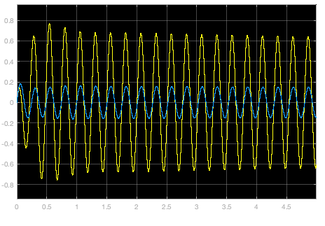
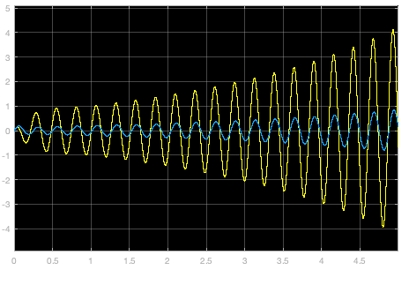
M8A1a – ROM Responses
Q = 1.2 psi
Q = 1.3 psi

Slide 34
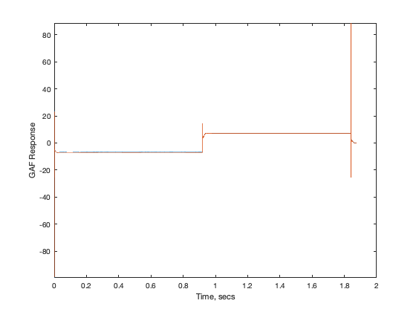

M8A1b – ROM/KESTREL GAFs

Slide 35


M8A1b – ROM/KESTREL Root Locus

Slide 36


M8A1b – ROM Responses
Q = 1.2 psi
Q = 1.3 psi

Slide 37


M8A1c – ROM/KESTREL GAFs

Slide 38


M8A1c – ROM/KESTREL Root Locus

Slide 39

M8A1c – ROM Responses
Q = 1.2 psi

Slide 40


M8A1d – ROM/KESTREL GAFs

Slide 41


M8A1d – ROM/KESTREL Root Locus

Slide 42


M8A1d – ROM Responses
Q = 1.2 psi
Q = 1.3 psi

Slide 43
Alpha = 3 deg

Slide 44


M8A3a – ROM/KESTREL GAFs

Slide 45


M8A3a – ROM/KESTREL Root Locus

Slide 46


M8A3a – ROM Responses
Q = 1.2 psi
Q = 1.3 psi

Slide 47


M8A3b – ROM/KESTREL GAFs

Slide 48


M8A3b – ROM/KESTREL Root Locus

Slide 49


M8A3b – ROM Responses
Q = 1.2 psi
Q = 1.3 psi

Slide 50

M8A3b – ROM Responses
Q = 1.5 psi

Slide 51


M8A3c – ROM/KESTREL GAFs

Slide 52


M8A3c – ROM/KESTREL Root Locus

Slide 53


M8A3c – ROM Responses
Q = 1.2 psi
Q = 1.3 psi

Slide 54


M8A3d – ROM/KESTREL GAFs

Slide 55


M8A3d – ROM/KESTREL Root Locus

Slide 56


M8A3d – ROM Responses
Q = 1.2 psi
Q = 1.3 psi

Slide 57

M8A3d – ROM Responses
Q = 1.5 psi

Slide 58
Alpha = 5 deg

Slide 59


M8A5a – ROM/KESTREL GAFs

Slide 60


M8A5a – ROM/KESTREL Root Locus

Slide 61


M8A5a – ROM Responses
Q = 1.2 psi
Q = 1.3 psi

Slide 62


M8A5a – ROM and KESTREL Responses
Q = 50 psf, Mode 1
Frequency
Time

Slide 63


M8A5a – ROM and KESTREL Responses
Q = 50 psf, Mode 2
Frequency
Time

Slide 64


M8A5a – ROM and KESTREL Responses
Q = 130 psf, Mode 1
Frequency
Time

Slide 65


M8A5a – ROM and KESTREL Responses
Q = 130 psf, Mode 2
Frequency
Time

Slide 66


M8A5b – ROM/KESTREL GAFs

Slide 67


M8A5b – ROM/KESTREL Root Locus

Slide 68

M8A5b – ROM Responses
Q = 1.2 psi

Slide 69


M8A5c – ROM/KESTREL GAFs

Slide 70


M8A5c – ROM/KESTREL Root Locus

Slide 71


M8A5c – ROM Responses
Q = 1.2 psi
Q = 1.3 psi

Slide 72

M8A5c – ROM Responses
Q = 1.5 psi

Slide 73


M8A5d – ROM/KESTREL GAFs

Slide 74

M8A5d – ROM/KESTREL GAFs

Slide 75


M8A5d – ROM/KESTREL Root Locus

Slide 76

M8A5d – ROM Responses
Q = 1.2 psi

Slide 77
ROM/KESTREL
Root Locus Plot Comparison
M=0.80, alpha=0, 5 deg

Slide 78
Alpha=0 deg Alpha=5 deg

Slide 79
Conclusions (Thus Far)
At benign conditions (alpha=0 deg), all ROMs provide same result; gratifying, as it indicates linearized flow dynamics
As alpha is increased, variations between the different ROMs (amplitudes) start to become obvious
At alpha=5 deg, there are noticeable differences between the ROMs, indicating that the higher-amplitude ROMs do a better job (at this condition) of predicting the aeroelastic responses at multiple dynamic pressures
So far, ROM Flutter Q=179 psf; KESTREL Flutter Q=168 psf (~6.5%)
Will start analyses at M=0.85, similar alpha ranges.

