Slide 1
GPU Accelerated Simulation for UT Inspection of Aerospace Materials
International Symposium on NDT in Aerospace
Tuesday, October 6, 2020
Elizabeth Gregory, Erik Frankforter
& Bill Schneck

Slide 2
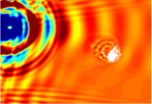
Ultrasound Testing Simulation for NDE
Ultrasonic elastic waves excited using transducer, piezoelectric wafers, pulse laser, or other methods.
Elastic waves interact with defect/damage, propagating with damage information.
Detection of these waves using a piezoelectric transducer, fiber optic sensor, non-contact laser Doppler vibrometer, etc.
Simulation can:
Provide insight into underlying interaction phenomena and energy paths.
Predict and quantify energy-damage interaction.
Extract features correlated with relevant parameters.
Optimize inspection setup.
Provide confidence in inspection results.

Slide 3
Ultrasound Simulation for Additive Manufacturing
Piezoelectric transducer
Single Simulation
Prediction of wavefield, waveforms (A-scans)
Assess microstructural effects on inspection characteristics
Capability to tune relative to experimental A-scan data
Fluid media
Parametric Studies
Sweep transducer location → Simulated C-Scan
Sweep transducer characteristics → Optimize Inspections
Sweep flaw parameters → Inspectability
Scattering from defect
Heterogeneous elastic media
Absorbing
Boundaries
Concept sketch – UT model with porosity defect
Impetus to move from one-off simulation to parametric studies
Better inform the practice of UT inspection
Moving towards more parametric studies requires
Efficient solvers for physics-based simulation
Tools for model generation & postprocessing
Standard interface and model data formats
Examples of AM UT simulation:
Effects of microstructural & porosity on stress tensor → UT propagation (Slotwinski, 2014)
Simulation of thermoelastic laser excitation with assessment of pore size/depth detectability (Cerniglia, 2015)
FEM simulation of pulse laser excitation, including modeling of temperature profile from laser source (Taheri, 2017)

Slide 4
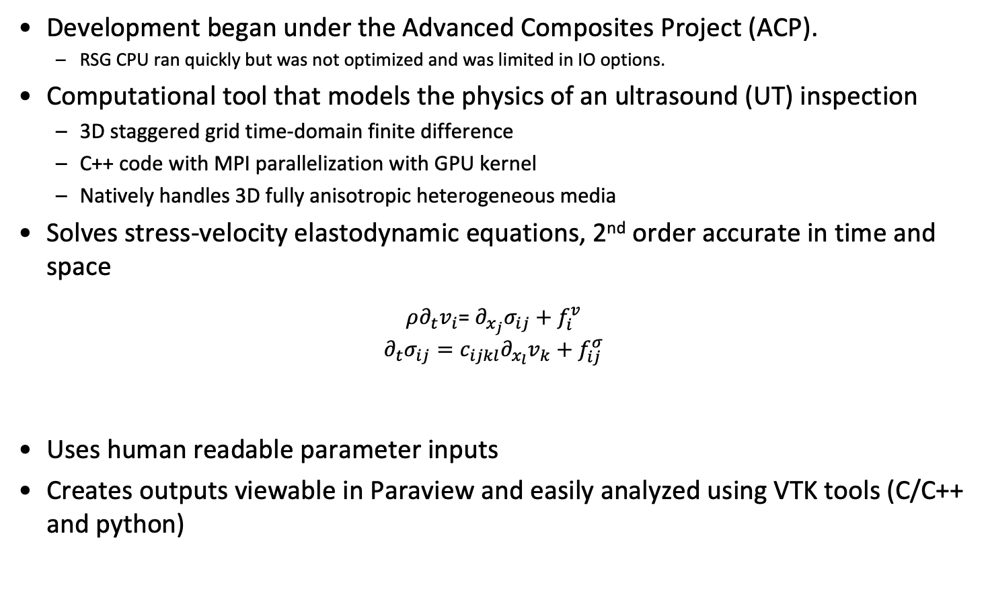
Solid Wave Simulation (swSim) Code
Development began under the Advanced Composites Project (ACP).
RSG CPU ran quickly but was not optimized and was limited in IO options.
Computational tool that models the physics of an ultrasound (UT) inspection
3D staggered grid time-domain finite difference
C++ code with MPI parallelization with GPU kernel
Natively handles 3D fully anisotropic heterogeneous media
Solves stress-velocity elastodynamic equations, 2nd order accurate in time and space
$ρ∂_{t}v_{i}$= $∂_{x_{j}}σ_{ij}+f_{i}^{v}$
$$∂_{t}σ_{ij}=c_{ijkl}∂_{x_{l}}v_{k}+f_{ij}^{σ}$$
Uses human readable parameter inputs
Creates outputs viewable in Paraview and easily analyzed using VTK tools (C/C++ and python)
$σ_{xx},σ_{yy},$ $σ_{zz}$
$$τ_{xz, }τ_{yz, }τ_{xy }$$
$$v_{x},v_{y},v_{z}$$
Repeating unit cell for ultrasound simulation algorithm – rotated staggered grid (RSG) finite difference
Trade names and trademarks are used in this report for identification only. Their usage does not constitute an official endorsement, either expressed or implied, by the National Aeronautics and Space Administration.

Slide 5
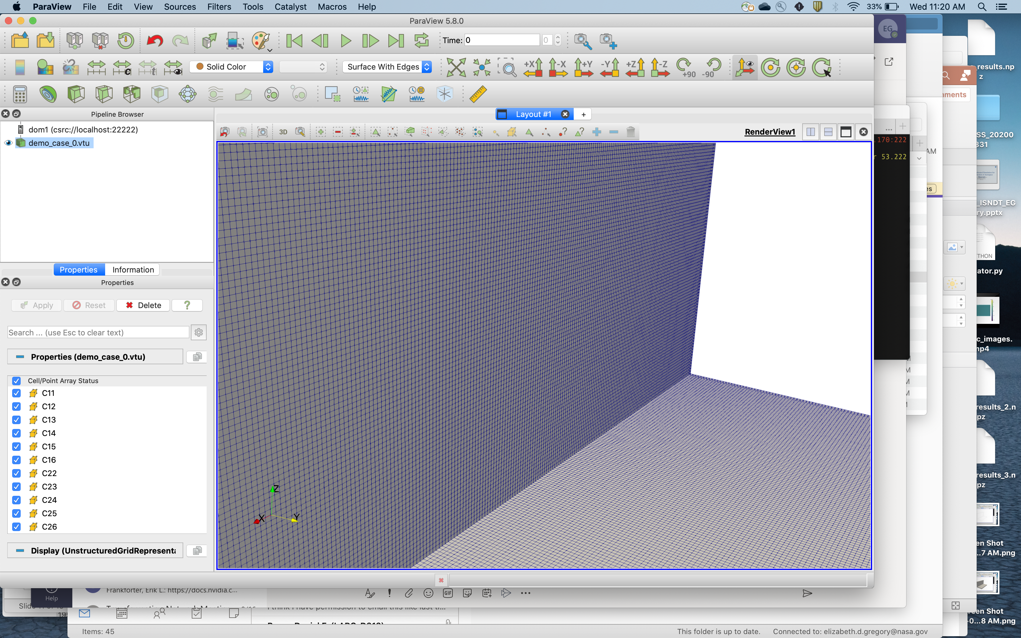
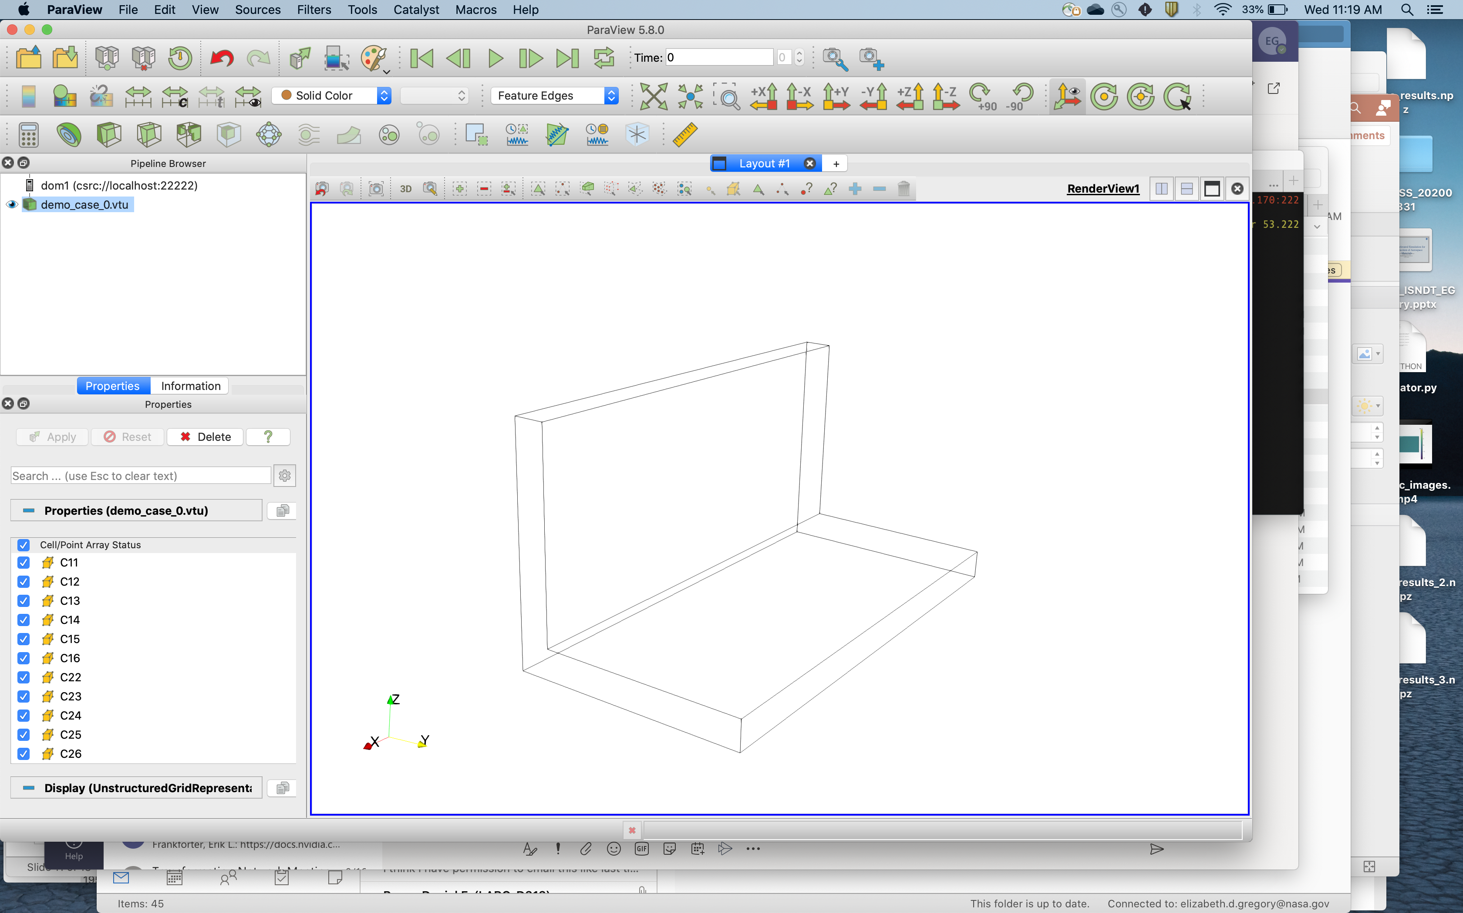
Input/Output
Inputs
Parameters Inputs in XML format
Human readable
Easily editable
<tag>value</tag> format
Parent/Child Structure
Geometry Input in binary format
Bulky
Complex Structures are not easily built or edited.
Outputs
VTK Structured Mesh
Read and processed by Paraview
Lightweight
Easily parallelizable
Mixed xml and binary format
Trade names and trademarks are used in this report for identification only. Their usage does not constitute an official endorsement, either expressed or implied, by the National Aeronautics and Space Administration.

Slide 6
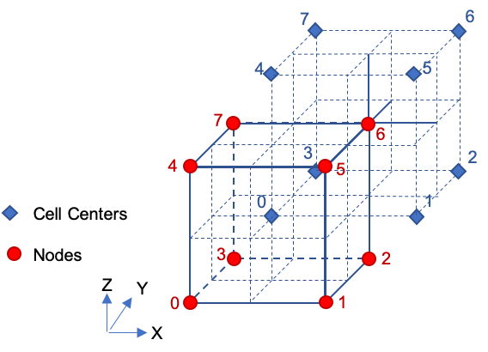
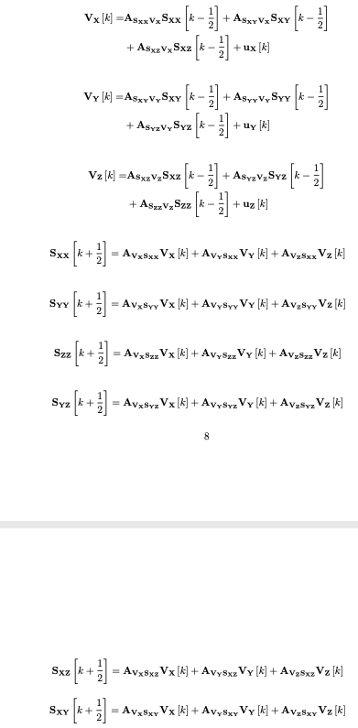
Stencil
Three cardinal velocities calculated at nodes
Six stress calculated at cell centers
Transition Matrices are defined as Eigen Sparse Matrices
Trade names and trademarks are used in this report for identification only. Their usage does not constitute an official endorsement, either expressed or implied, by the National Aeronautics and Space Administration.

Slide 7
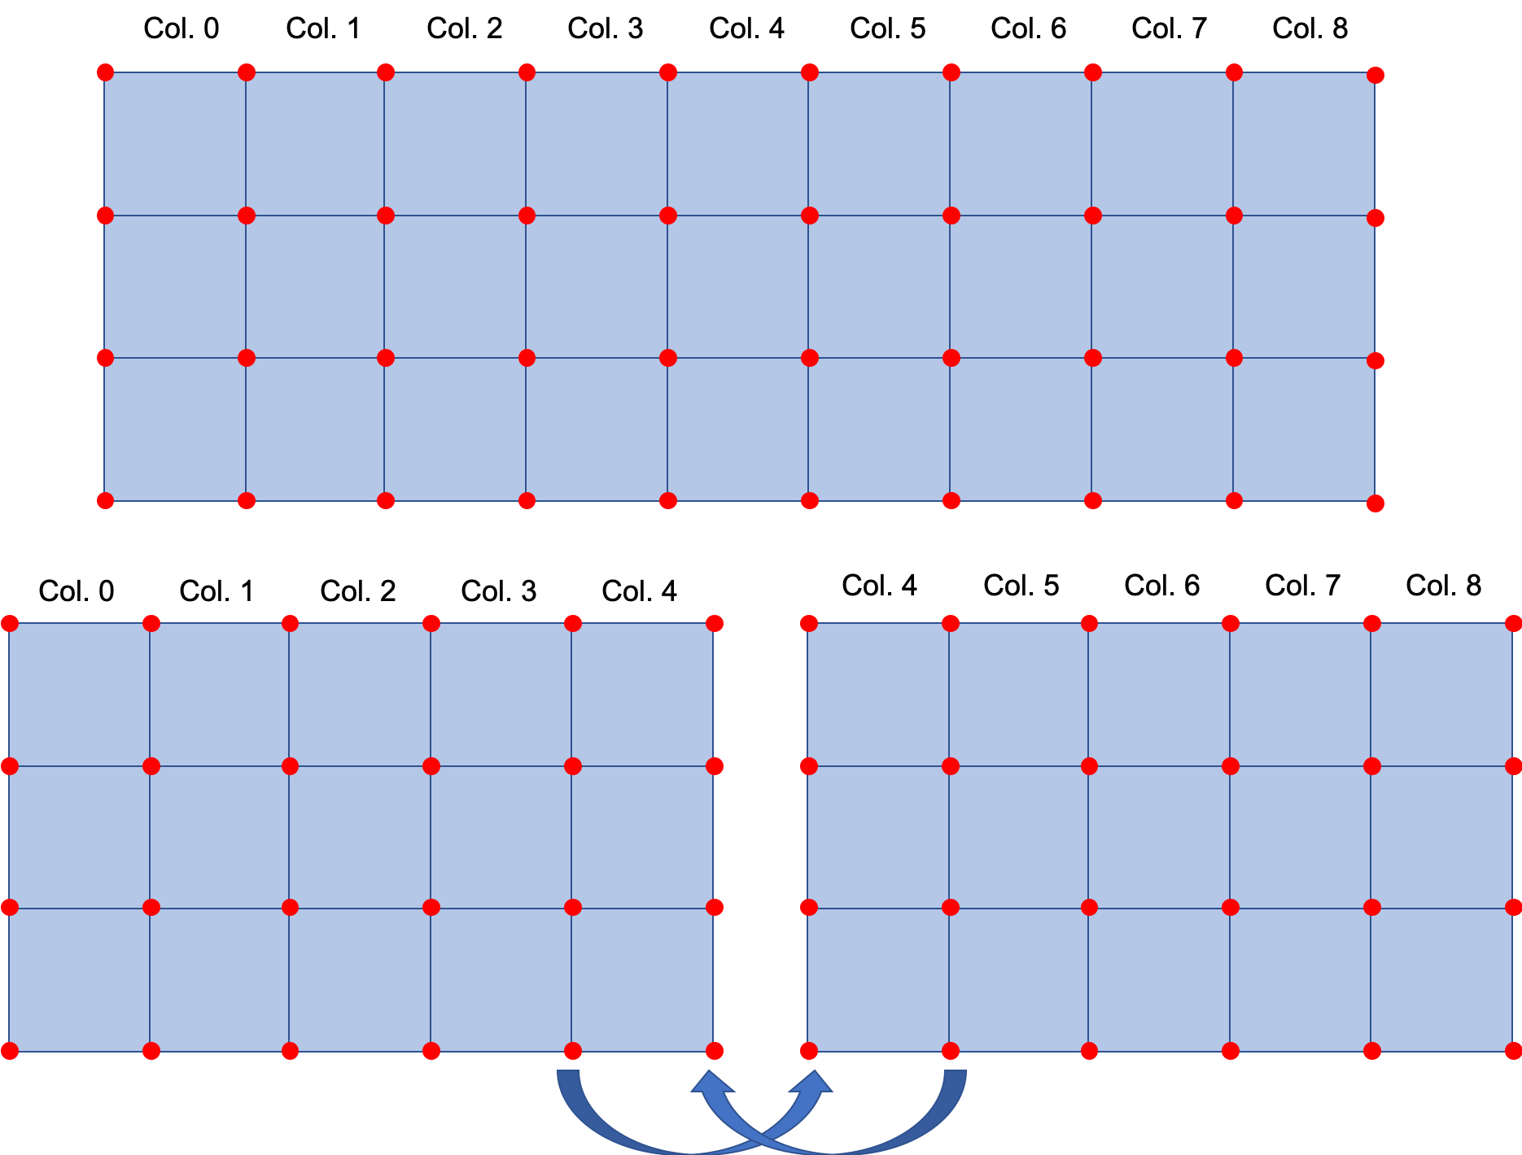
Computational Segmentation
Segmentation in One Axis.
One plane of duplicated cells
Two planes of duplicated nodes
Communication between processes only consists of one plane of nodes at each boundary
Duplicated calculation in parallel to save communication time.

Slide 8
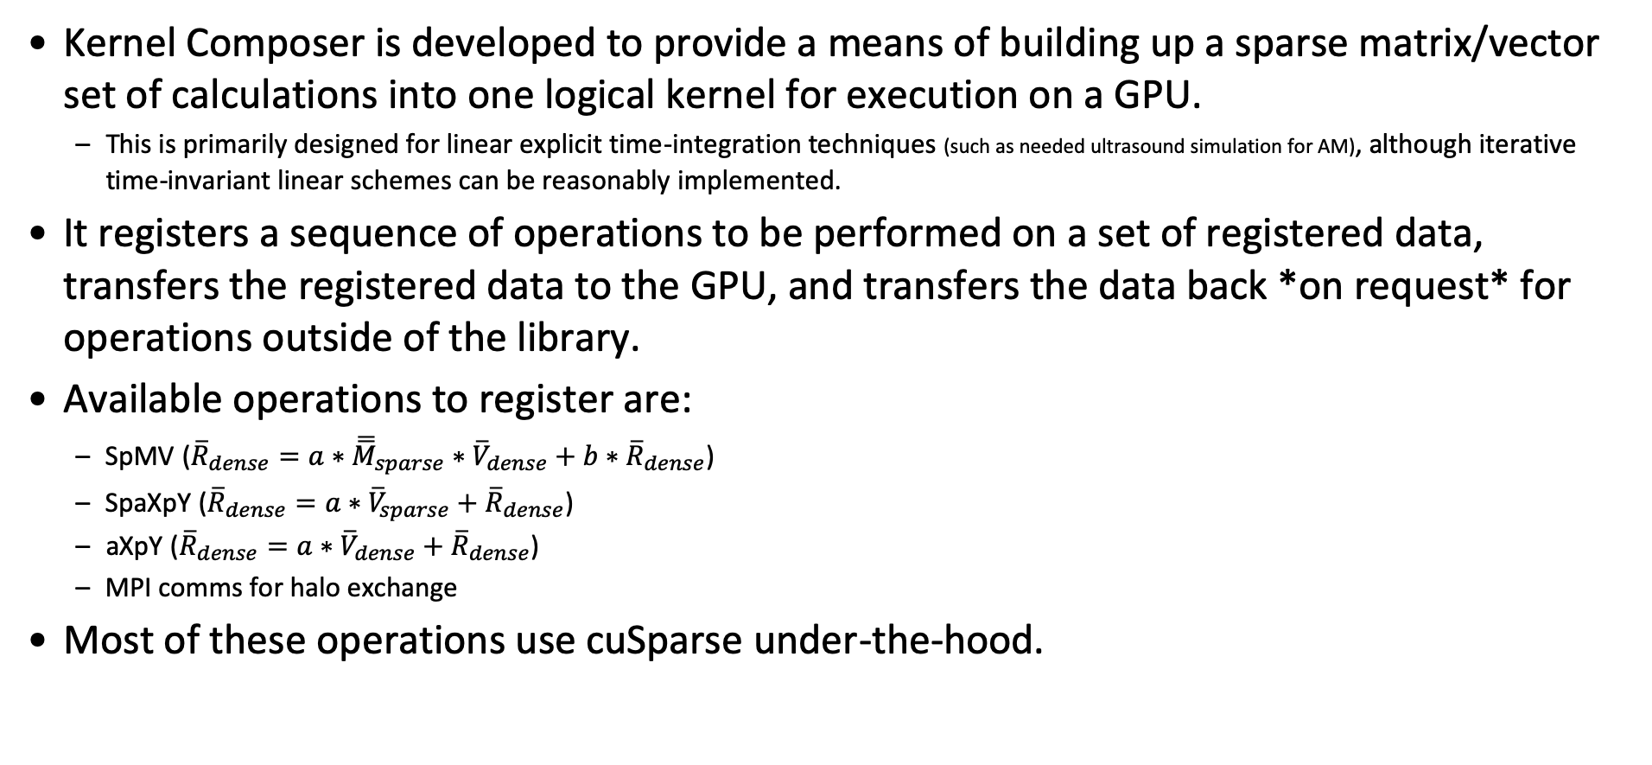
Kernel Composer
Kernel Composer is developed to provide a means of building up a sparse matrix/vector set of calculations into one logical kernel for execution on a GPU.
This is primarily designed for linear explicit time-integration techniques (such as needed ultrasound simulation for AM), although iterative time-invariant linear schemes can be reasonably implemented.
It registers a sequence of operations to be performed on a set of registered data, transfers the registered data to the GPU, and transfers the data back *on request* for operations outside of the library.
Available operations to register are:
SpMV (${\overline{R}}_{dense}=a∗{\overline{\overline{M}}}_{sparse}∗{\overline{V}}_{dense}+b∗{\overline{R}}_{dense}$)
SpaXpY (${\overline{R}}_{dense}=a∗{\overline{V}}_{sparse}+{\overline{R}}_{dense}$)
aXpY (${\overline{R}}_{dense}=a∗{\overline{V}}_{dense}+{\overline{R}}_{dense}$)
MPI comms for halo exchange
Most of these operations use cuSparse under-the-hood.
Trade names and trademarks are used in this report for identification only. Their usage does not constitute an official endorsement, either expressed or implied, by the National Aeronautics and Space Administration.

Slide 9
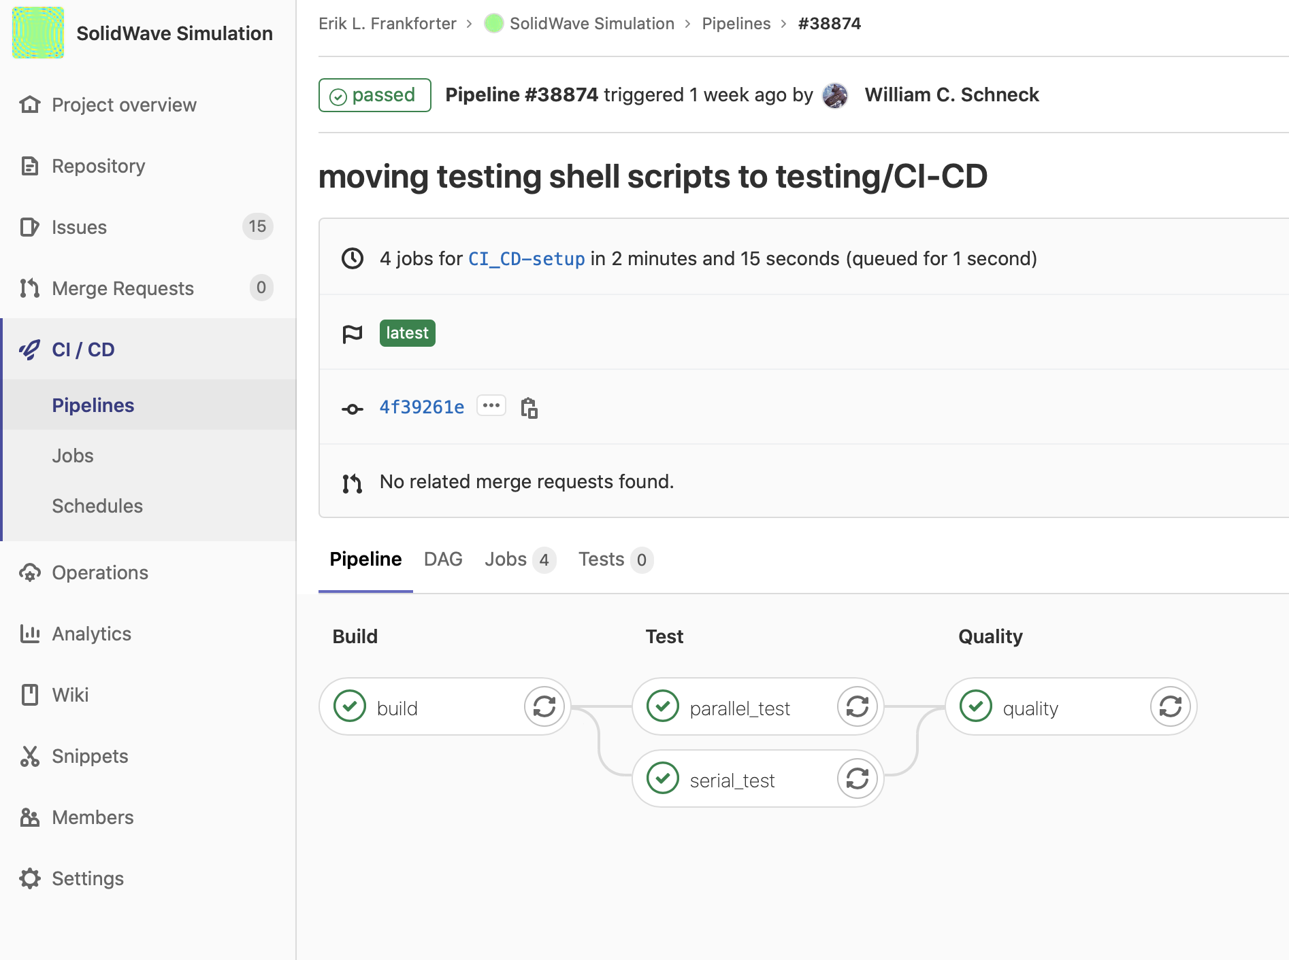
Continuous Integration and Testing
Google Test Framework
Unit Tests for all public member functions
Parallelized Tests for all MPI operations
Git Lab Functionality for Automated Testing Pipelines
Yaml files for setting up test
Automated access to HPC resources
Trade names and trademarks are used in this report for identification only. Their usage does not constitute an official endorsement, either expressed or implied, by the National Aeronautics and Space Administration.

Slide 10
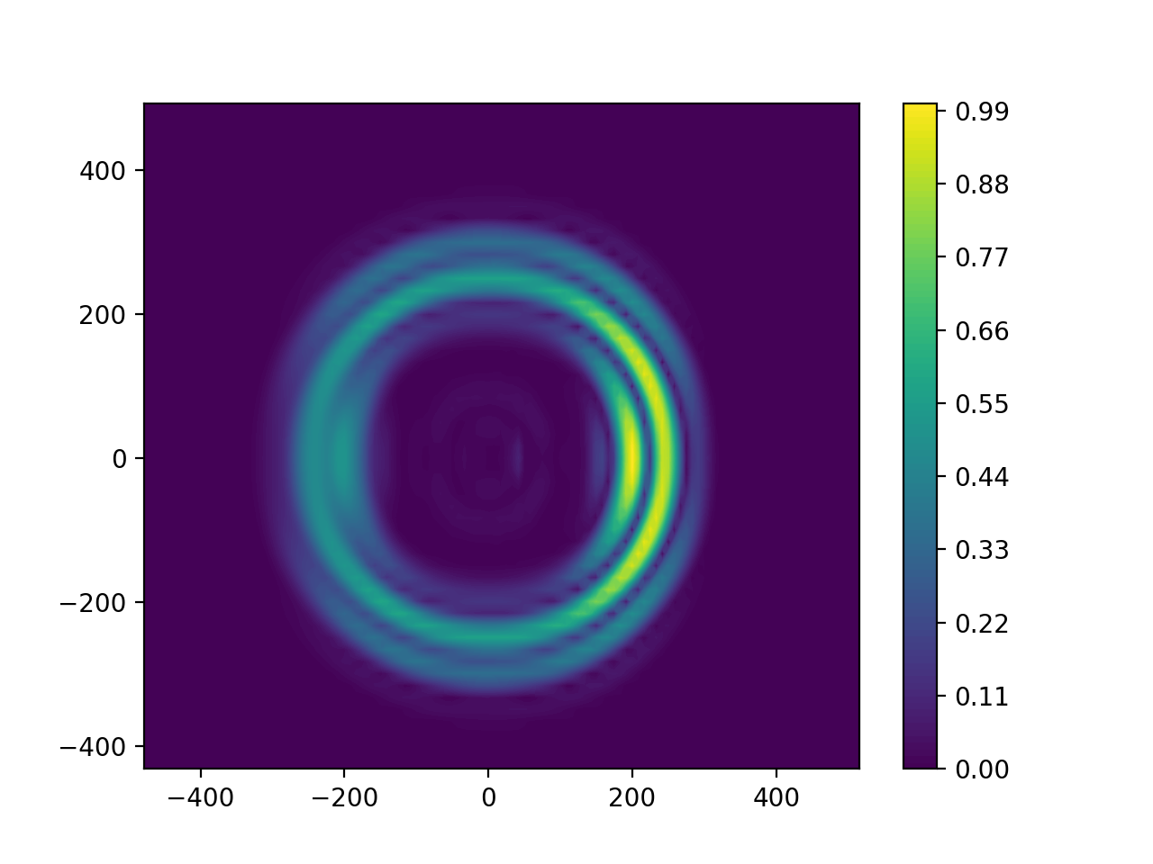
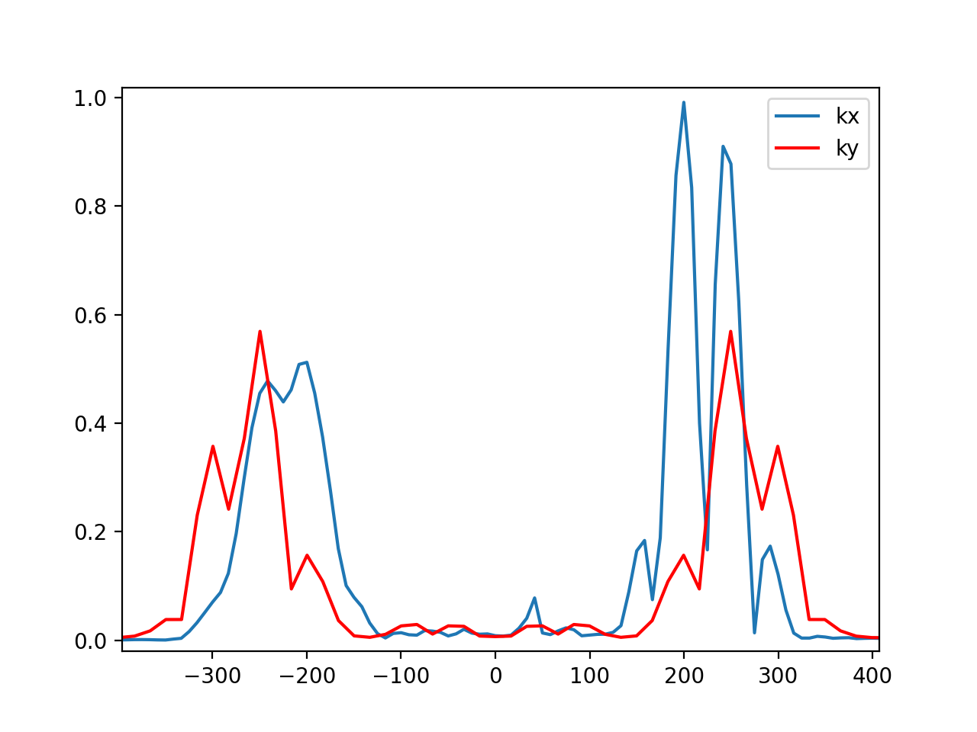
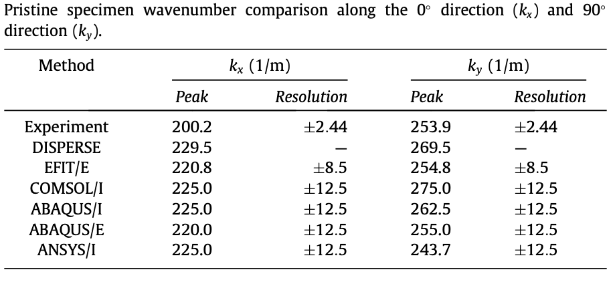
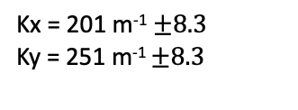
Validation and Verification
Kx = 201 m⁻¹ $±8.3$
Ky = 251 m⁻¹ $±8.3$
Leckey, Cara AC, et al. "Simulation of guided-wave ultrasound propagation in composite laminates: Benchmark comparisons of numerical codes and experiment." Ultrasonics 84 (2018): 187-200.

Slide 11
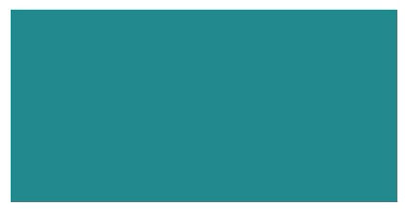
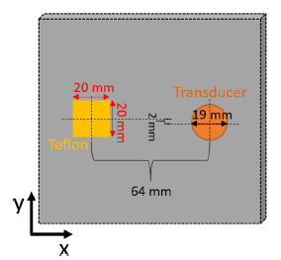
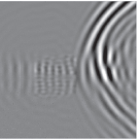
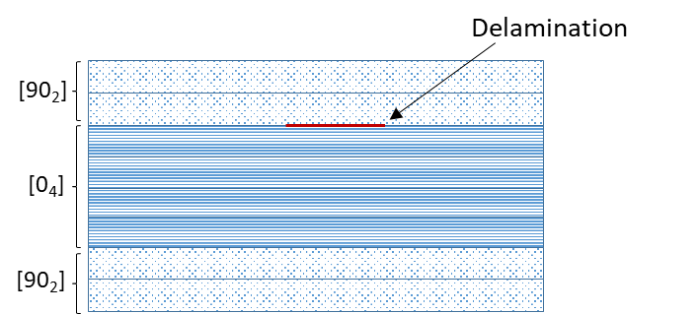
Benchmark Case – Delaminated Composite Plate
Experimental, FEM, and in-house code benchmark
Normal incidence contact transducer. Delamination via Teflon insert between 2nd and 3rd ply
Full wavefield capture via laser Doppler vibrometry (LDV)
Mode conversion and reflection off delamination edges
Velocity/wavenumber/wavelength changes above delamination observed via simulation and LDV
v_{z} surface wavefield, swSim simulation code
Experimental Wavefield data
Run time comparison with COMSOL, Abaqus, ANSYS, cpu RSG
 | T_{run} (hours) | # DoF (10⁶) | Memory (GB)
COMSOL | 19.5 | 7.77 | 266
ABAQUS Implicit | 40 | 1.7 | 28
ABAQUS Explicit | 53 | 26 | 30
ANSYS | 170 | 10 | 16
RSG cpu | 0.15 | 16.6 | 4.6
swSim | 0.2-0.62 | 17.1 | 41.9
Between ~130-1100 times faster simulation time for converged model, using comparable compute resources
Leckey, Cara AC, et al. "Simulation of guided-wave ultrasound propagation in composite laminates: Benchmark comparisons of numerical codes and experiment." Ultrasonics 84 (2018): 187-200.
Notes:
4 sockets of skylakes
4 V100

Slide 12
Future Work
Release the current code as Open Source
Modifying the input to use VTK files
Parallelizing the preprocessor to improve performance
Allow for more complex geometries
Validate with additively manufactured parts
Save state and restart
Work supported and contributed to by:
Advanced Composites Project
Transformative Technology and Tools project
High Performance Computing Incubator
Trade names and trademarks are used in this report for identification only. Their usage does not constitute an official endorsement, either expressed or implied, by the National Aeronautics and Space Administration.

Slide 13
Vision for a Unified Data Format for NDE Simulation
Existing Gap in Simulation Data Format
Open access to data
Code interoperability
Desired Traits
Self-described mesh, field, solver data
Optimized size-on-disk storage
Performant Parallel I/O
Opportunities for Community Engagement and Collaboration
Preliminary survey of existing data formats from other fields .
Agency and community NDE experts will be solicited for feedback for both data format requirements and for existing data standards which may be used as a foundation.
Potential stakeholders include experts from US government agencies, US industry, and US academics. Since the international community is highly invested in NDE simulation, this may also include research from US allies and the international academic community.
Larger adoption of uniform methods for geometry processing, parametric analysis, and post processing.
Compatible with existing data access/manipulation tools
Compatible with existing visualization tools
Extensible on-demand to new solvers and physics

