Slide 1
AEROM: Brief Summary of Recent Applications
Walter A. Silva
NASA Langley Research Center
Presentation to Northrop-Grumman
September 28, 2020

Slide 2
Applications
Supersonic Low-Boom Configuration
KTH Full-Span Generic Fighter Wind-Tunnel Model
AGARD 445.6 Aeroelastic Wing

Slide 3

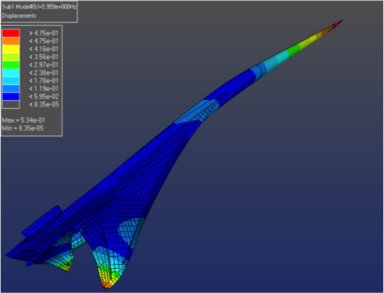
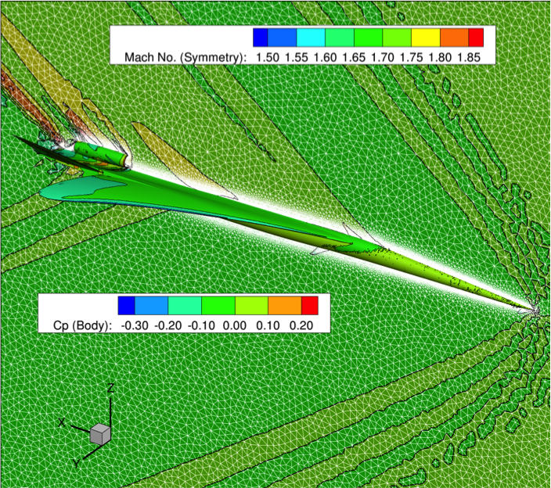
Supersonic Low-Boom Configuration
Lockheed-Martin concept
Detailed, sized FEM
Grids for aeroelastic response and sonic boom propagation

Slide 4
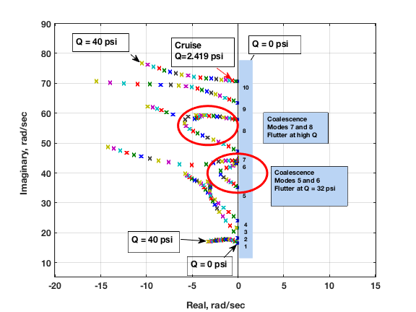
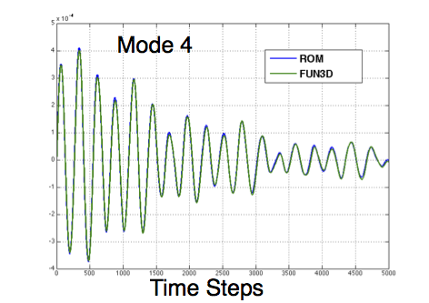
Supersonic Low-Boom Configuration
Comparison of ROM and
FUN3D Mode 4 aeroelastic
transients at M=1.7, Q=2.0 psi
Aeroelastic root locus plot with varying dynamic
pressure, indicating multiple aeroelastic flutter
mechanisms

Slide 5
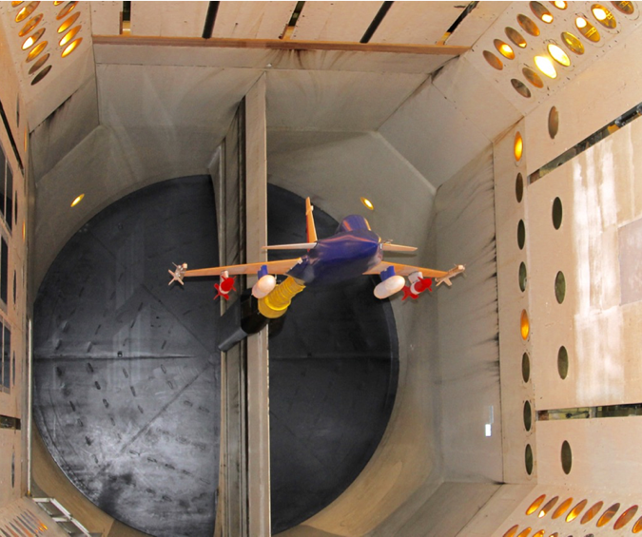
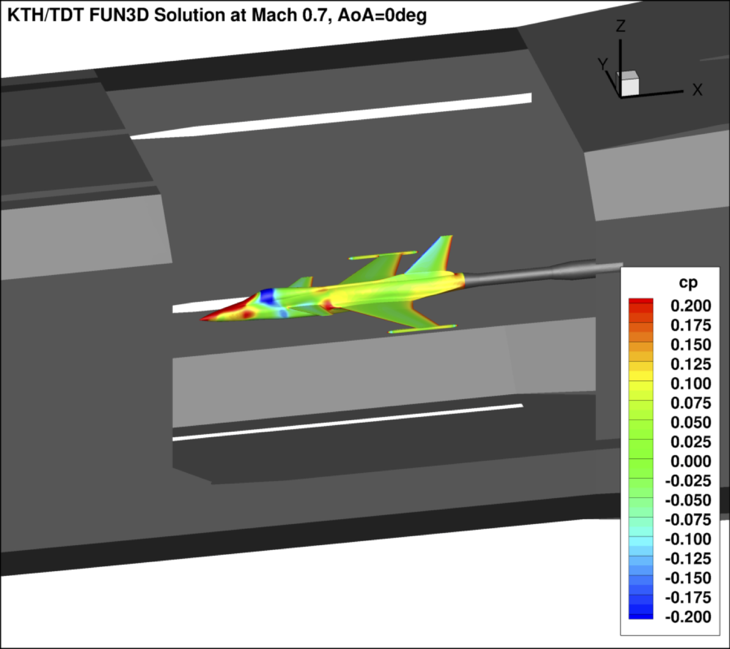
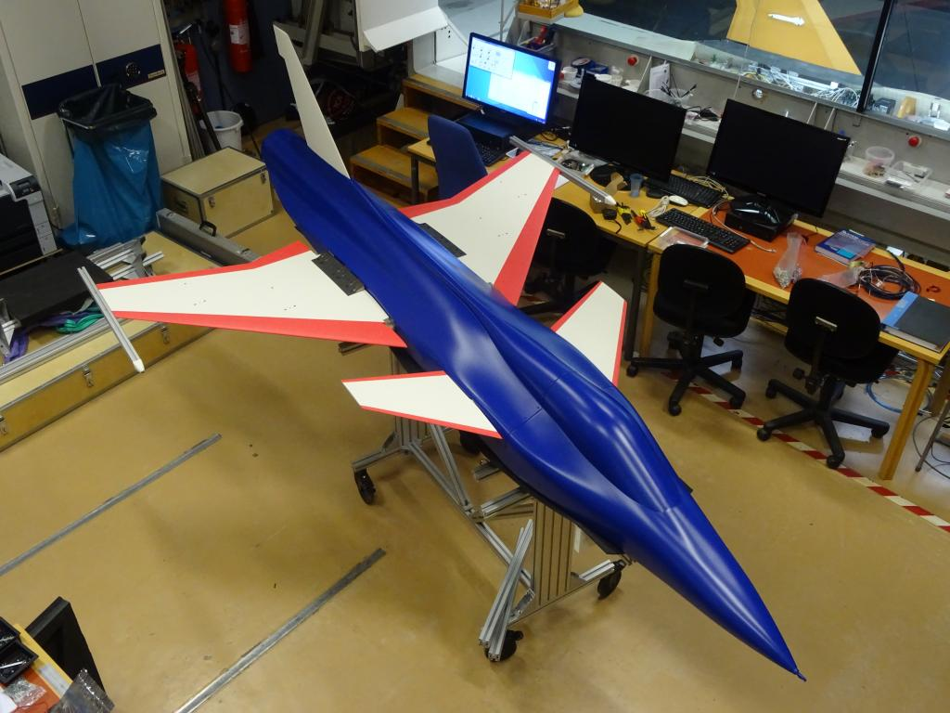
KTH Full-Span Generic Fighter Wind-Tunnel Model
Generic full-span fighter
Designed and fabricated by KTH
Tested in TDT (summer 2016)
CFD models in free air and inside
a CFD model of the TDT

Slide 6
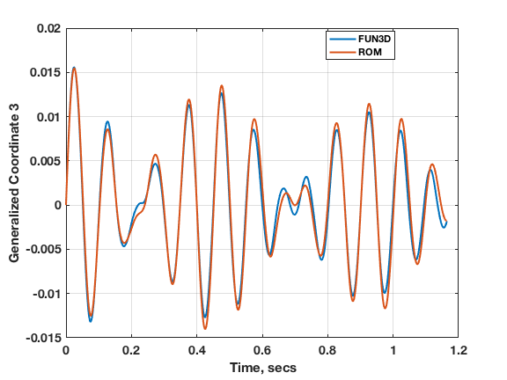
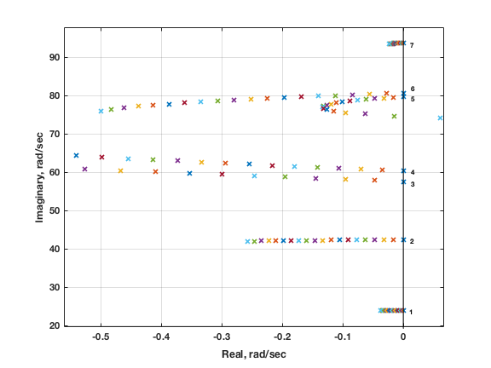
KTH Full-Span Generic Fighter Wind-Tunnel Model – TDT Model
Comparison of ROM and
FUN3D Mode 3 aeroelastic
transients at M=0.9, Q=1744 Pa
Aeroelastic root locus plot with varying dynamic pressure, indicating aeroelastic flutter mechanism between modes 5 and 6

Slide 7
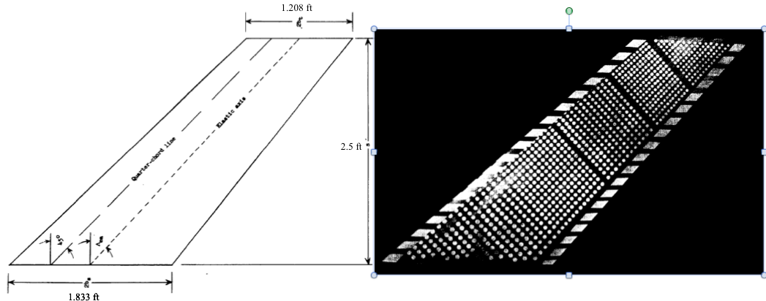
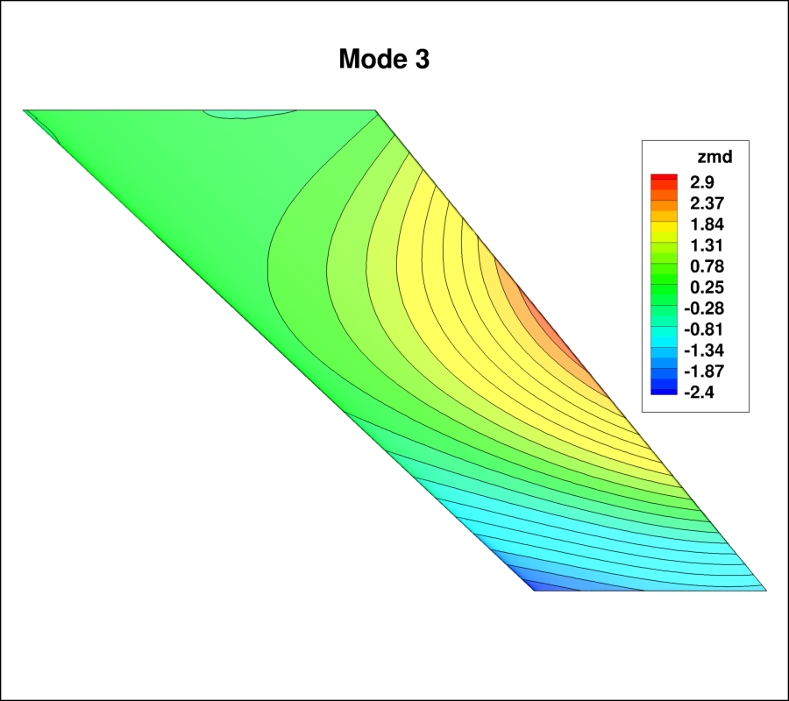
AGARD 445.6 Wing
Data acquired in the TDT in the 1960s, NASA reports by Dr. E. C. Yates, Jr.
45º sweep, 4% thick (very thin) airfoil data acquired at 0º AOA
Very thin airfoil -> narrow transonic range (starts at M=0.98)
Used significantly (overused? misused?) for CFD code comparisons
Measured flutter data often misrepresented in literature as “highly nonlinear” flutter boundary, ”transonic flutter dip”

Slide 8
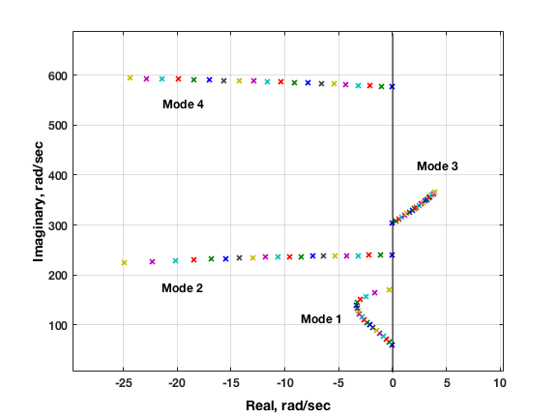
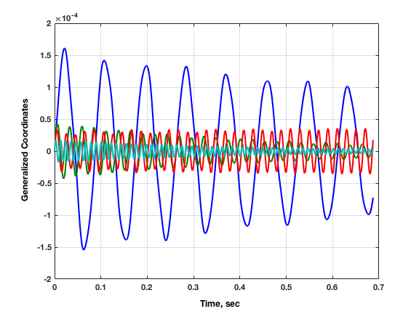
AGARD 445.6 Wing
M=1.141
M=1.141, Q=30 psf
Inviscid results indicate an unstable third mode, clearly visible in ROM root locus plot but not clearly visible in aeroelastic transients plot (red)
Because a root locus plot is the result as time approaches infinity, viewing only
transients from CFD code can be misleading
Viscous results indicate a stabilization of the third mode

Slide 9
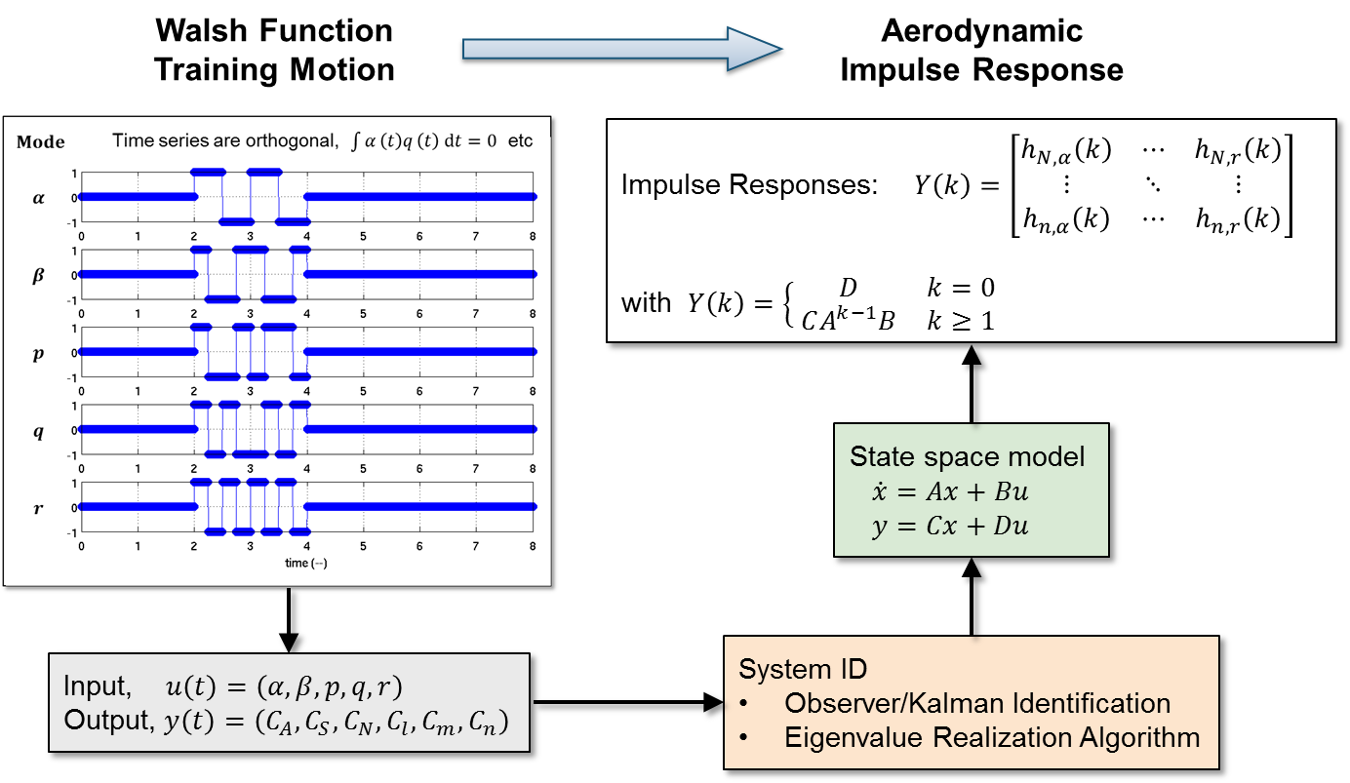
System ID for MIMO Systems for S&C
Simultaneous Inputs, Single CFD Solution
Computational Fluid Dynamics
(Kestrel or FUN3D)
System/Observer/Controller Identification Toolbox
(SOCIT)

Slide 10
Pitch Moment Damping
Walsh Functions vs. Harmonic Motion and Reference
SciTech 2018,
Aviation 2018,
Shelton, Silva
10

Slide 11
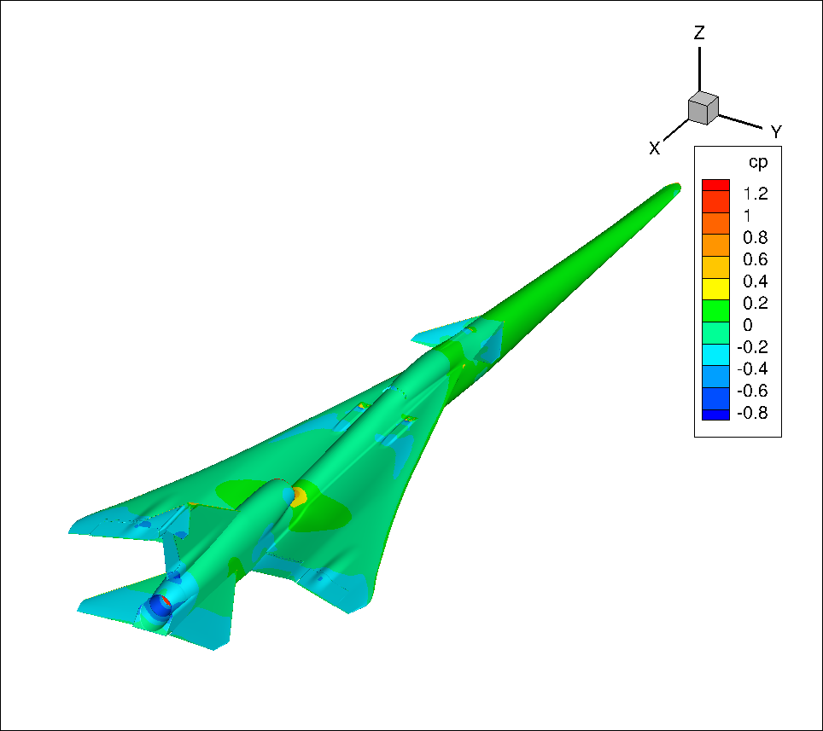
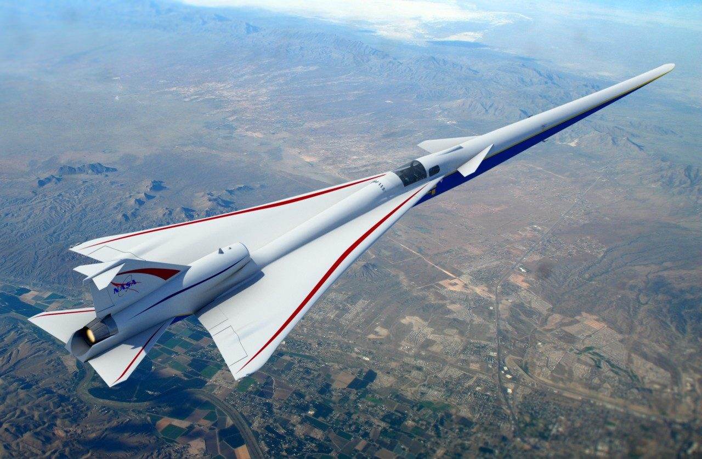
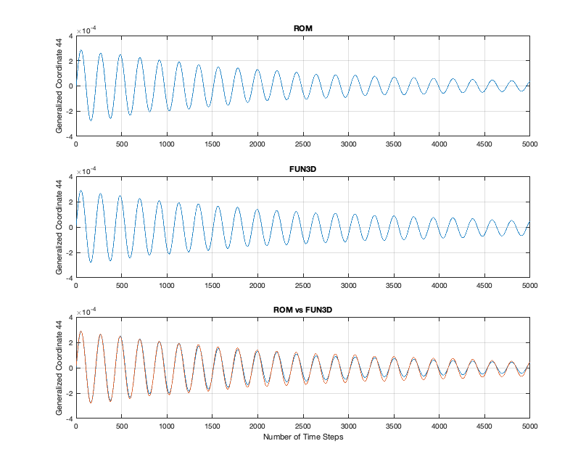
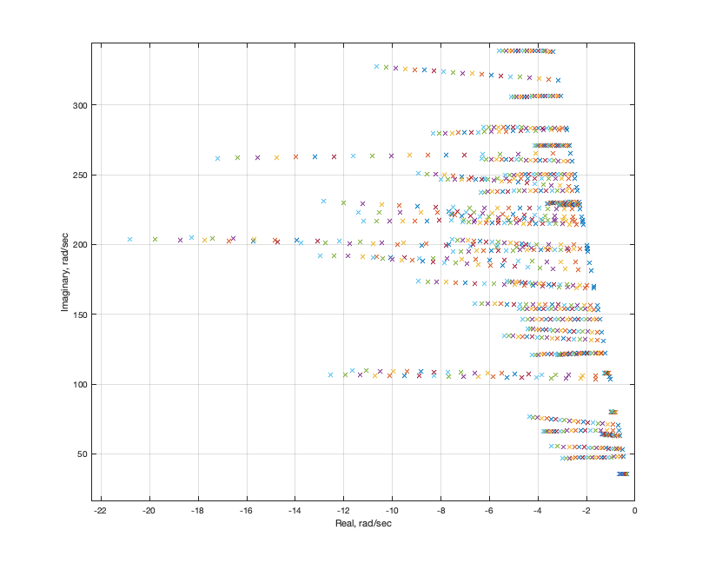
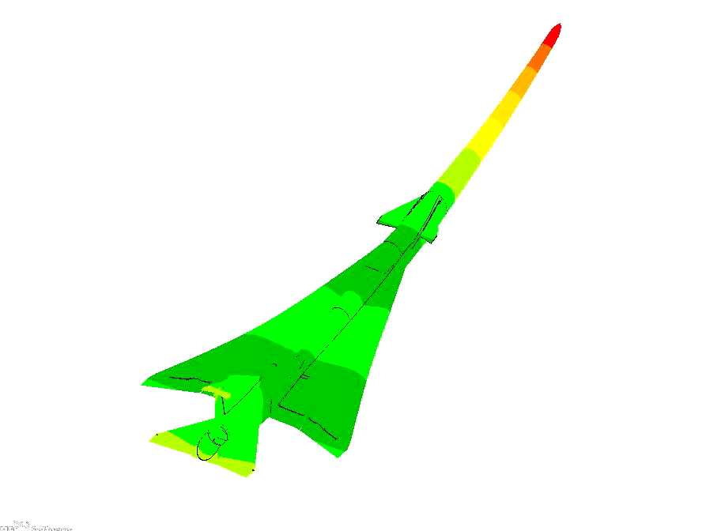
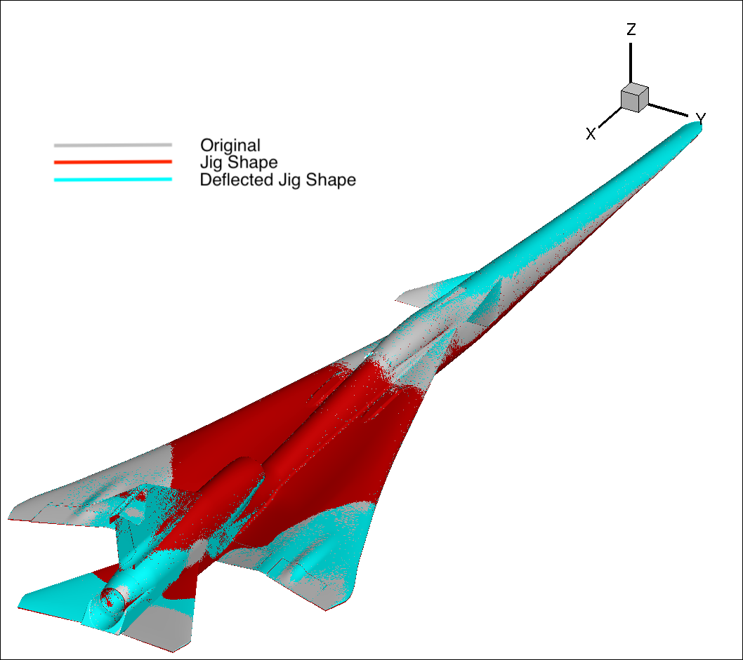
FUN3D/AEROM Transonic Applications for X-59
Mode 44 FUN3D/ROM Comparison
M=1.05
ROM
FUN3D
BOTH
Mode 7
Jig Shape Computation
Aeroelastic Root
Locus Plot
44 modes,
2% struct damping
(from single CFD
solution-AEROM)

