Slide 1
Deep Space Laboratory
Concept Study
Justin Rowe – JSEG
David Smitherman
Debra Needham
ED04 / Advanced Concepts Office
NASA Marshall Space Flight Center
Notes:
Good afternoon, I’m Justin Rowe and I’ll be presenting a project that David Smitherman and Debora Needham led last year in an effort to better quantify a trade between modular buildup of Gateway versus using a single large monolithic module to rapidly augment its capabilities. This study was done by the Advanced Concepts Office here at NASA Marshall Space Flight Center in Huntsville, Alabama, where both David and I have the privilege to work. I’ll be highlighting some of the design team’s key findings with you today:

Slide 2
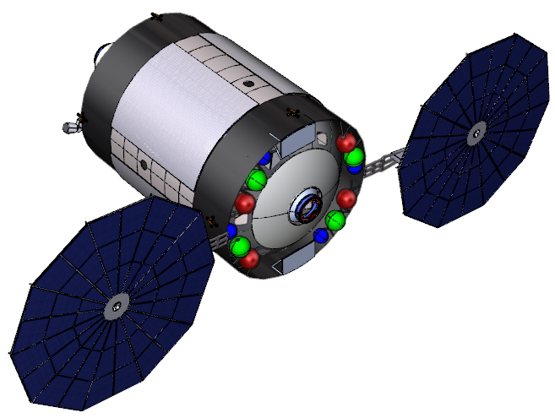
Why a Deep Space Laboratory?
The Deep Space Laboratory was designed to serve a variety of architectures:
as a monolithic addition to the Gateway to provide a significant increase in capability, research, provisioning, and habitable volume for supporting near-Earth growth.
as a servicing and refurbishment testbed for vehicles within cis-lunar space
as a geological research station for ISRU efforts or attached to an asteroid redirect mission
as a preliminary testbed for a Mars Transit Vehicle
as a way to provide a large habitable volume in deep space to augment a variety of desired mission trades
as a way of minimizing cost and schedule for module development by utilizing the existing tooling and expertise needed for Oxygen Tanks and utilizing them to create a modified short tank.
Notes:
One of the biggest benefits for a monolithic design like this is the significant increase in capability with just one launch. This module could be sent to the Gateway orbit nearly fully-loaded, and offers more than half the pressurized volume of the International Space Station. It has the potential to house a permanent revolving crew, as well as provide much-needed research equipment for exploration missions and early ISRU efforts. If the mission shifts, the lab can transition as well, providing a multi-mission platform for supporting Mars missions by acting as a base for refurbishment and reoutfitting for Mars Transit Vehicles.

Slide 3
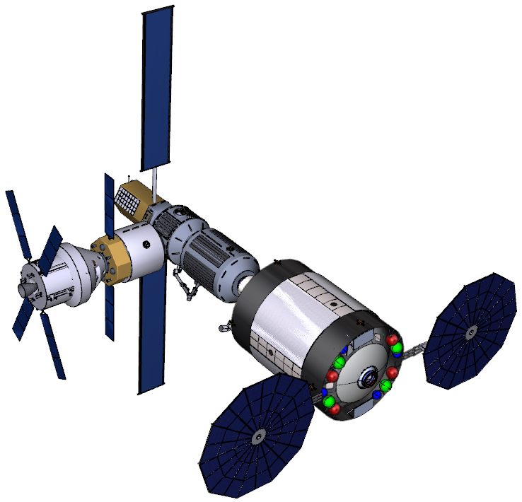
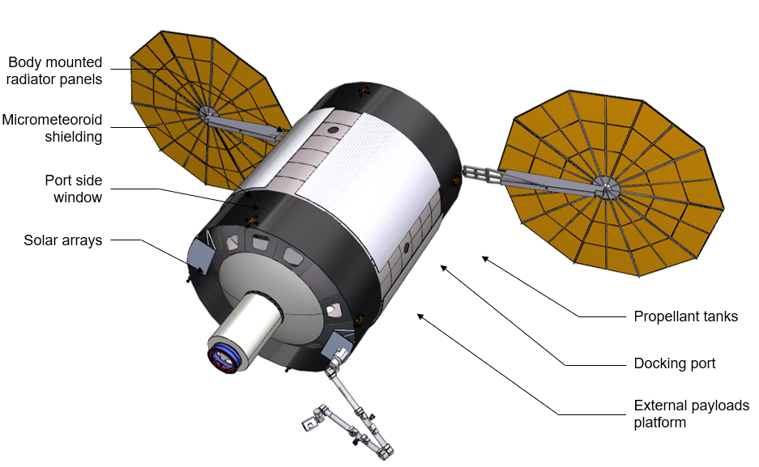
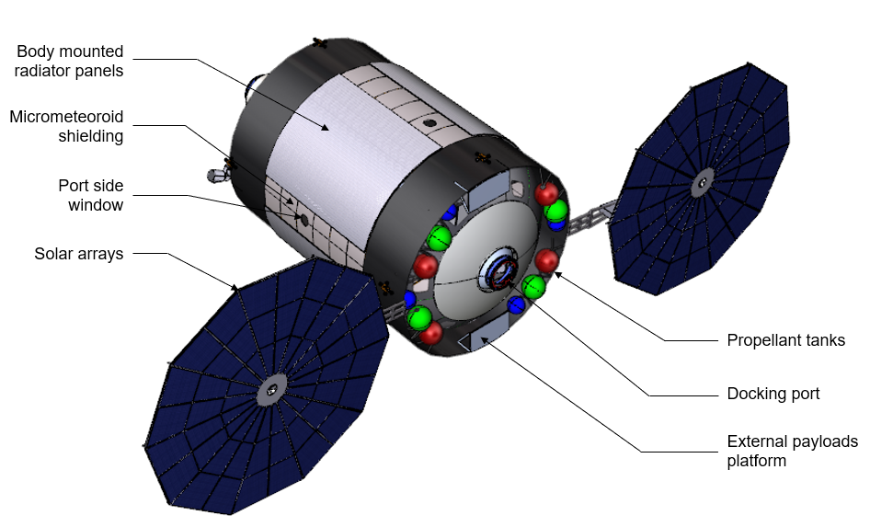
Layout
Forward View
Gateway concept by Bigelow Aerospace [4]
Aft View
Orion with a small Gateway and Deep Space Lab
Gateway concept by Sierra Nevada [4]

Slide 4
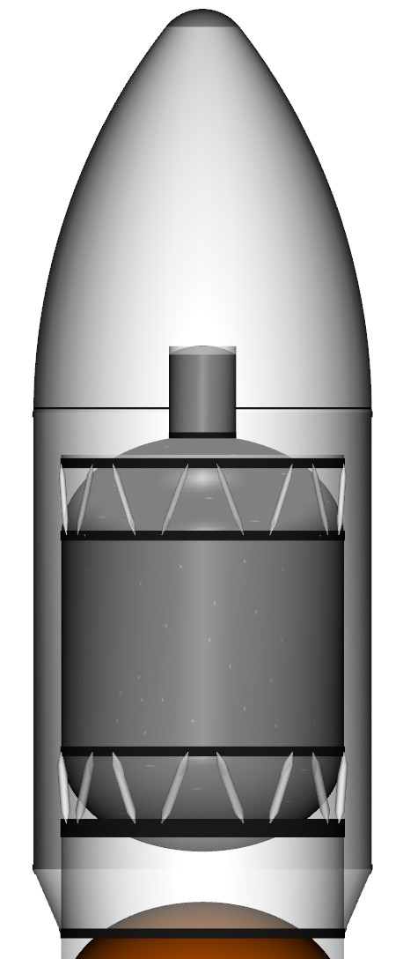
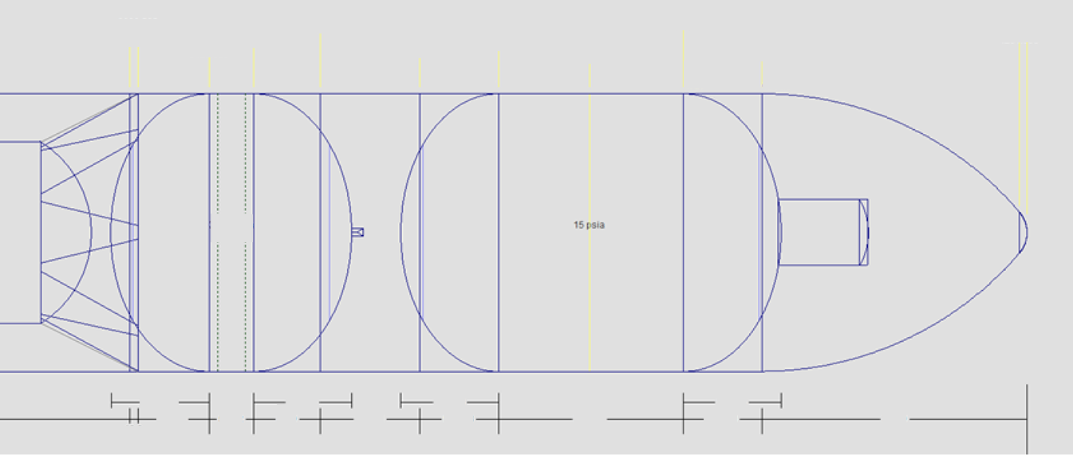
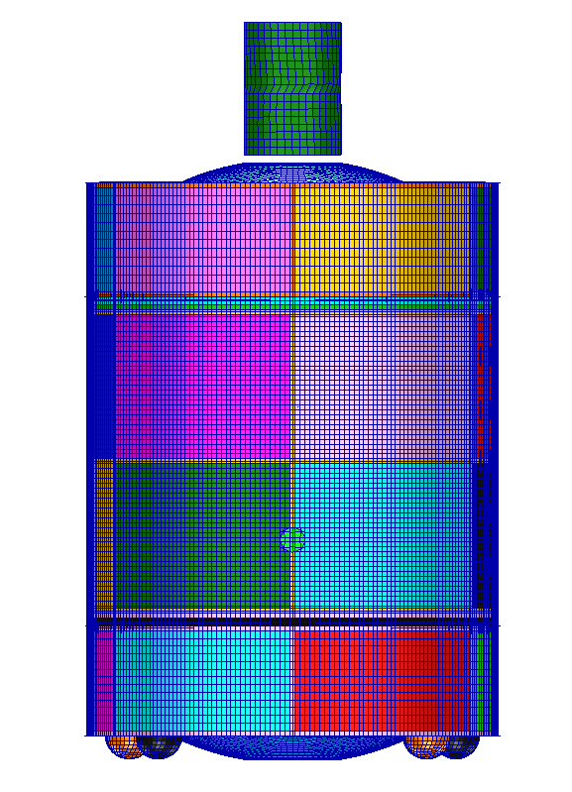
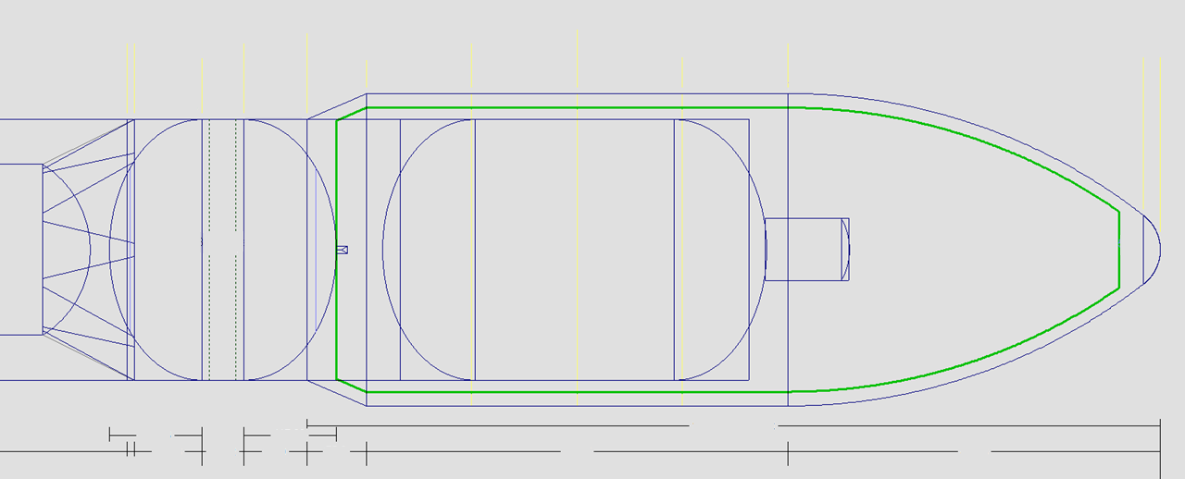
Launch Configurations
Can be packaged as either a strongback or within a 10m fairing on SLS

Slide 5
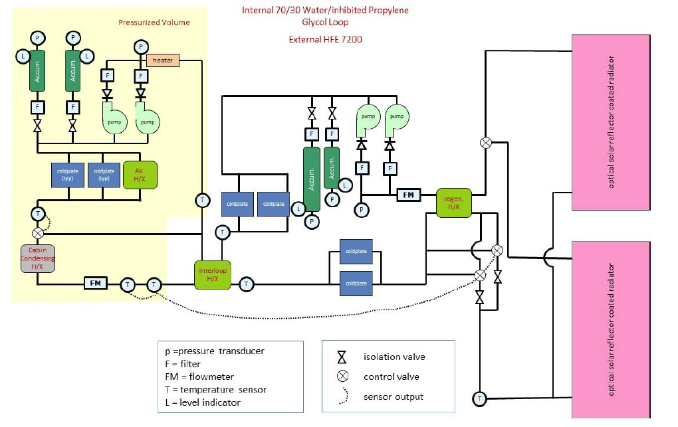
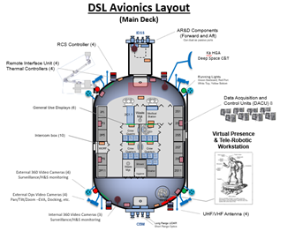
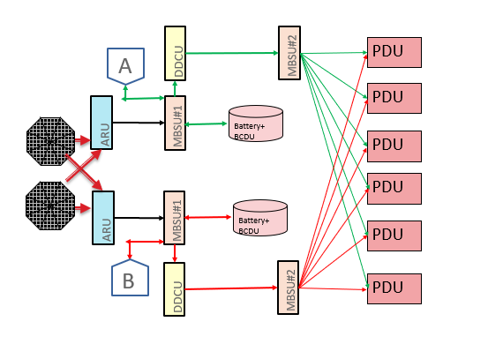
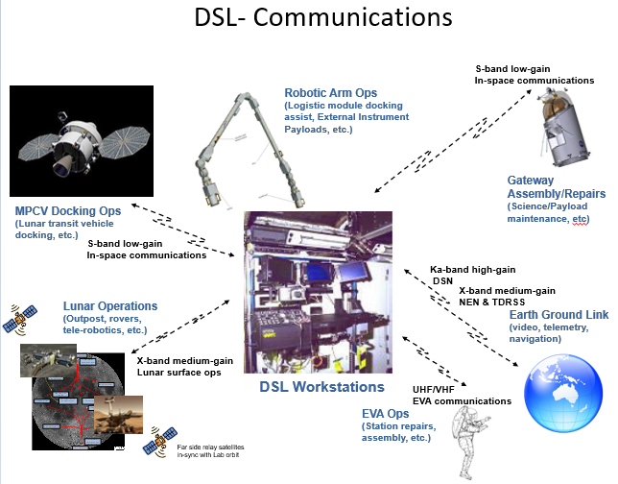
Sample Analyses – Power, Avionics, & Thermal

Slide 6
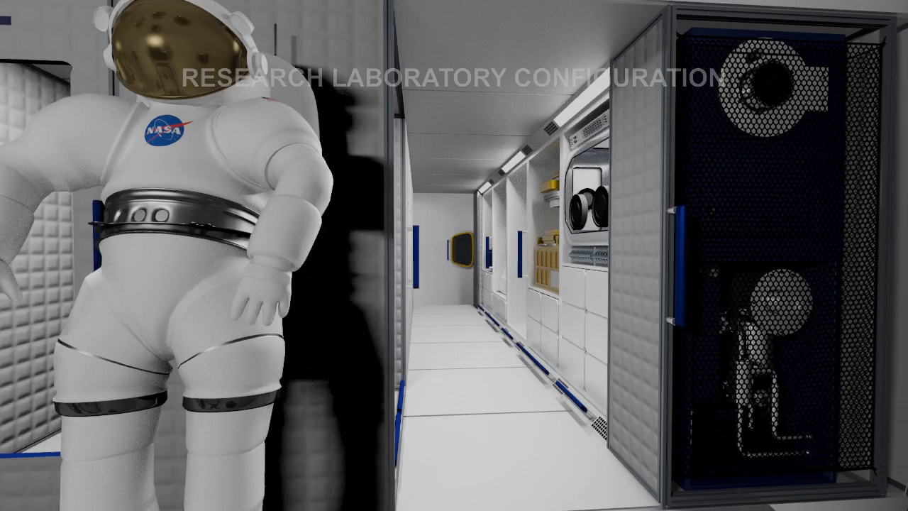
Main Deck – Geological Research Suite Animation

Slide 7
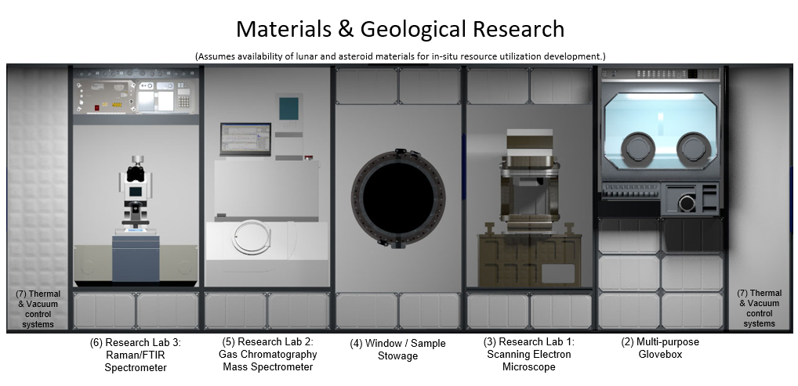
Main Deck – Geological Research Suite

Slide 8
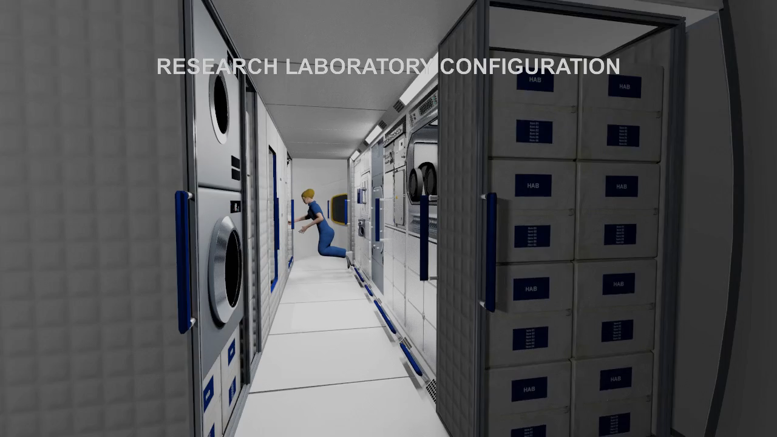
Main Deck – General Sciences Suite Animation

Slide 9
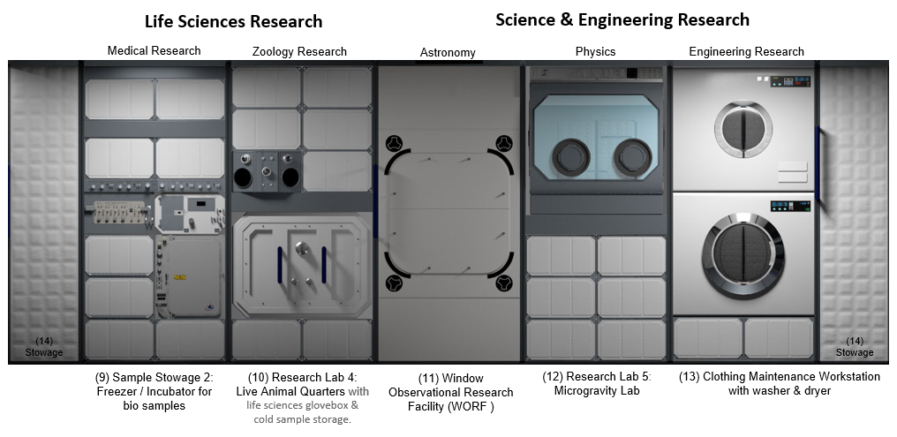
Main Deck – General Sciences Suite

Slide 10
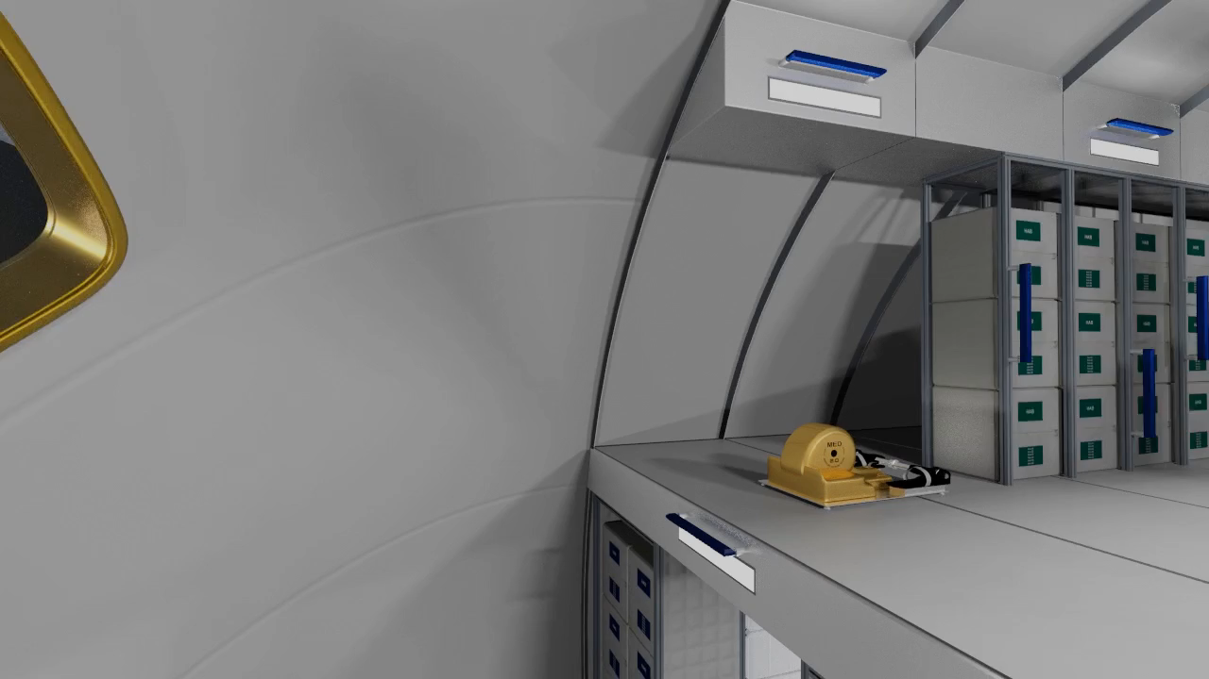
Upper Deck – Animation

Slide 11
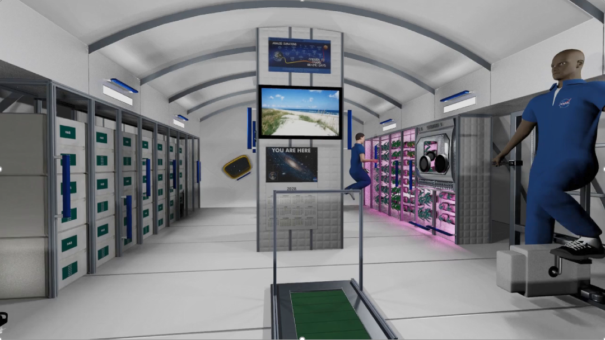
Upper Deck – Layout
Galley
  Short-term food storage
  Food warmer and prep systems
  Dining table
Plant Growth Chamber
Life Sciences Glovebox
Exercise Equipment
  Cycle Ergometer
  Advanced Resistive Exercise Device (ARED)
  Advanced Treadmill (T2/TVIS)
Additional Storage

Slide 12
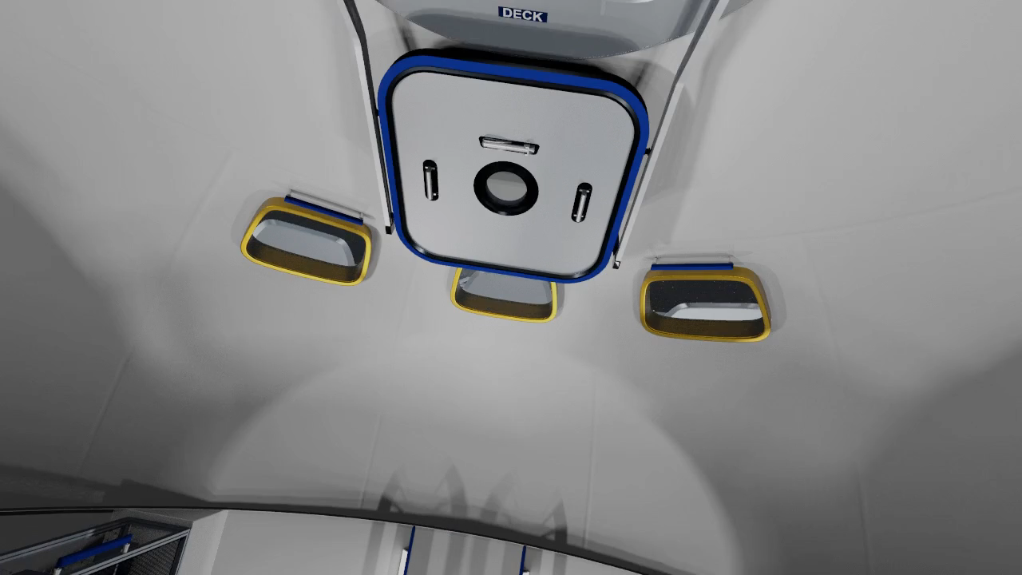
Lower Deck – Animation

Slide 13
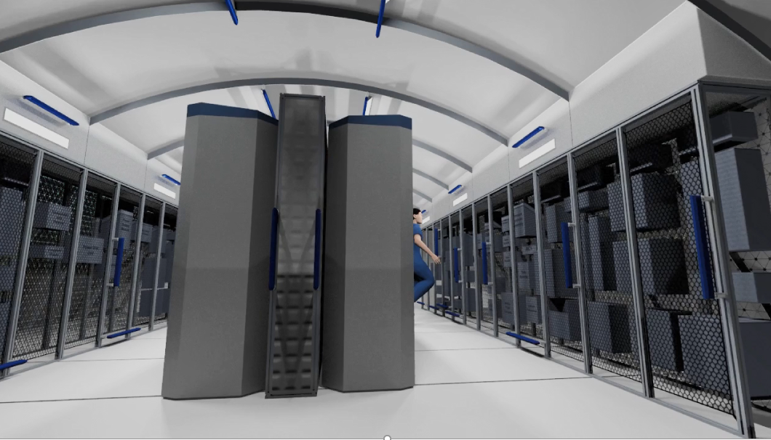
Lower Deck – Layout
Large maintenance workstation for component repairs and assembly
Additive Manufacturing suite with recycling
Advanced ECLSS
Thermal controls and plumbing
Avionics controls
Power distribution systems
Thermal controls

Slide 14
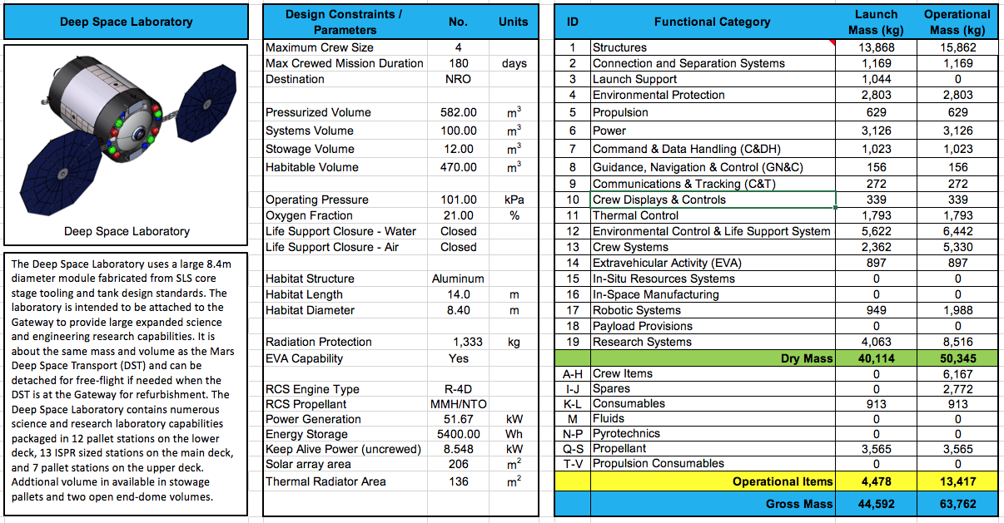
Mass Summary
Anticipated later capability improvements:
Experimental “gray water” development system for clothes washing and shower
Trash compactor (duplicate from other Gateway modules)
Improved Treadmill (TVIS 2) and Resistive Device (ARED)
Additional monitors/laptops
External robotic arm
Internal robotics
Plant Growth Chamber
Window Observational Research Facility (WORF)
Multipurpose Glovebox
Rodent Research
External Payloads
Crew & ECLSS Consumables
Spares
Launch Configuration includes a full suite of scientific equipment, systems hardware, and crew accommodations. With additional logistics flights to complete initial outfitting and replenish stowed provisions, the enhanced Gateway could offer a revolving permanent presence in deep space for at least four crew at a time.

Slide 15
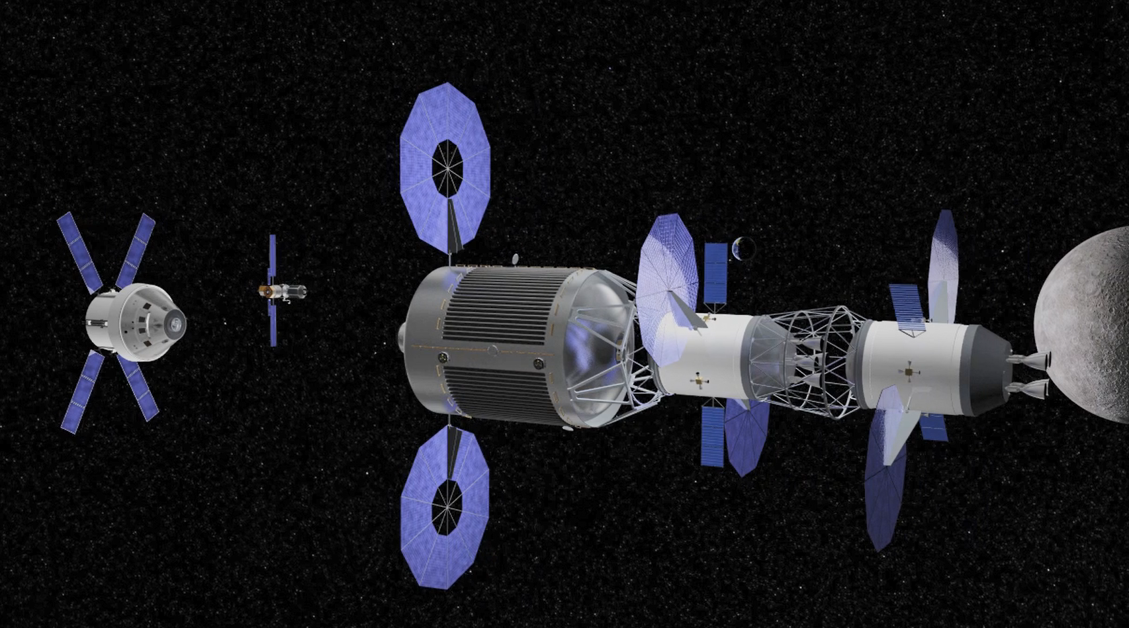
Deep Space Lab and a Mars Transfer Vehicle

