Slide 1
2020 Conference on Advanced Power Systems
for Deep Space Exploration
Electrical Power System Overview
Michael Aulisio – NASA GRC
Jeff Hojnicki – NASA GRC
Clyde Christensen – MAXAR
Bao Hoang – MAXAR
October 27, 2020

Slide 2
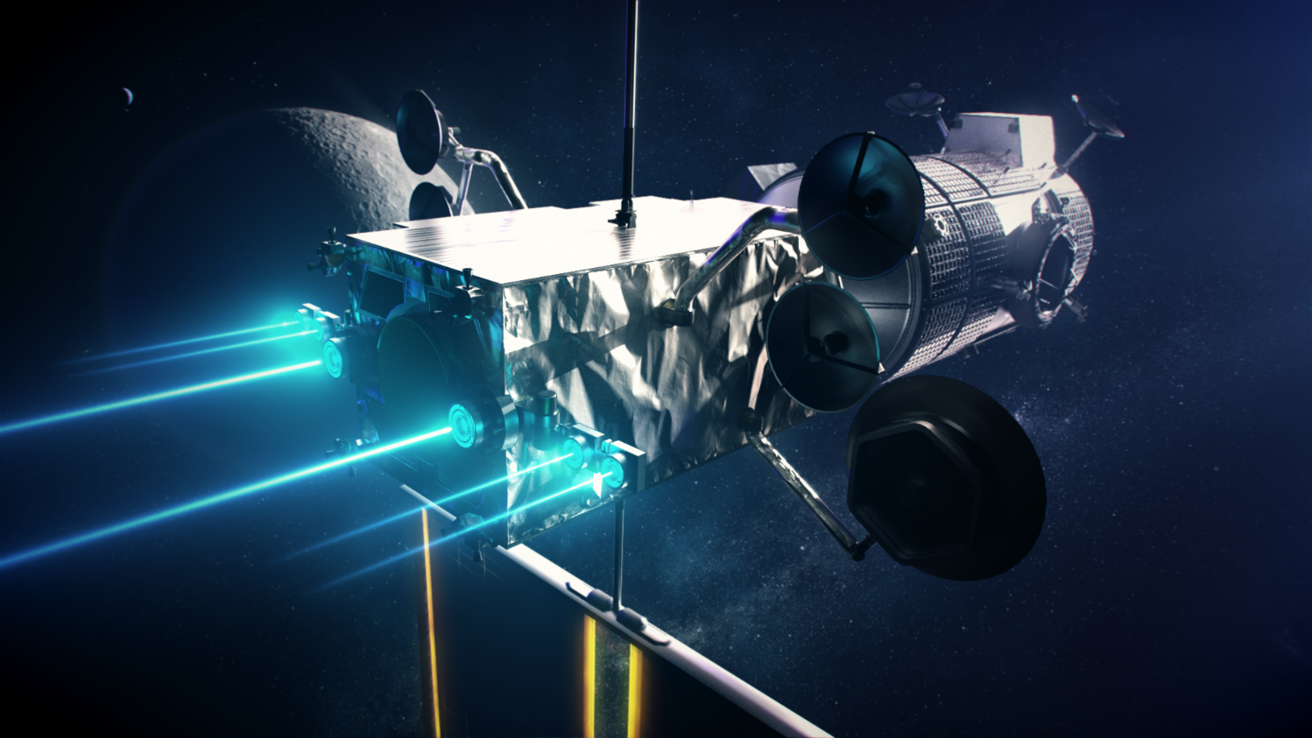
Presentation Overview
Agenda
  Background and Top-Level Mission Highlights
  Electrical Power System Overview
    Power Generation: Solar Arrays
    Energy Storage: Batteries
    Power Management and Distribution
  Current Status
  Conclusion

Slide 3



Background and Mission Highlights
The NASA Artemis Gateway functions as an orbital outpost around the moon and facilitates a sustainable, long-term human return to the lunar surface
The Power and Propulsion Element (PPE) and Habitation and Logistics Outpost (HALO) vehicles will be co-manifested and launched as the foundational elements of the Gateway
The PPE is responsible for generating all the power and propulsion required over the Gateway 15-year service life
The PPE power management and distribution (PMAD) system is sized to generate and distribute over 55 kWe EOL
The PPE will perform an electric orbit raise (EOR) to reach the NRHO utilizing solar electric propulsion at power levels >40 kW
PPE Spacecraft Prime Contractor: MAXAR
  Sub-Contractor: Deployable Space Systems (DSS) for ROSA
  Sub-Contractor: SolAero Technologies for power modules and cells

Slide 4
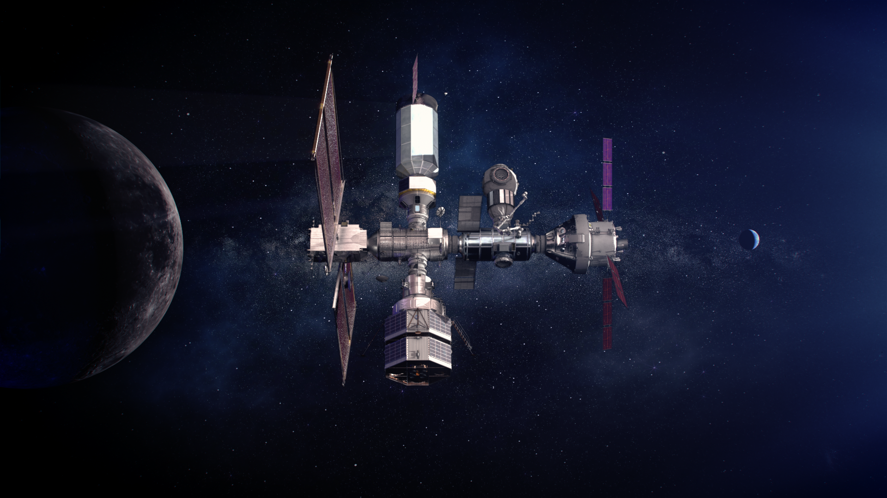
Background and Mission Highlights

Slide 5
Electrical Power System Overview
The PPE PMAD system is sized to generate and distribute over 55 kWe EOL
  Leverages Maxar Heritage 1300 Series Bus
    Internal 100 Vdc distribution for internal loads and high-power SEP
    Solar array regulation
    Battery charging and discharging electronics
  High-Power Lightweight Roll Out Solar Array (ROSA)
    Z4J Solar Cells
    SolAero Standard Solar Power Modules
  Li-Ion Batteries
  16 kW, 120V Converters
Significant operational scenarios for the EPS
  Providing >40 kW for SEP while providing power for HALO during the EOR
  Providing 24 kW to Gateway while performing SEP maneuvers at 26.6 kW levels
  Providing 32 kW to Gateway during crewed operations in NRHO

Slide 6
Electrical Power System Overview – Block Diagram
S
A
W
MAXAR
1300 Series Bus
PPE
16 kW
BCDR
Loads
S
A
W
16 kW
SORI
16 kW
16 kW
120 Vdc
SEP
SORI
BCDR
Loads
HALO

Slide 7
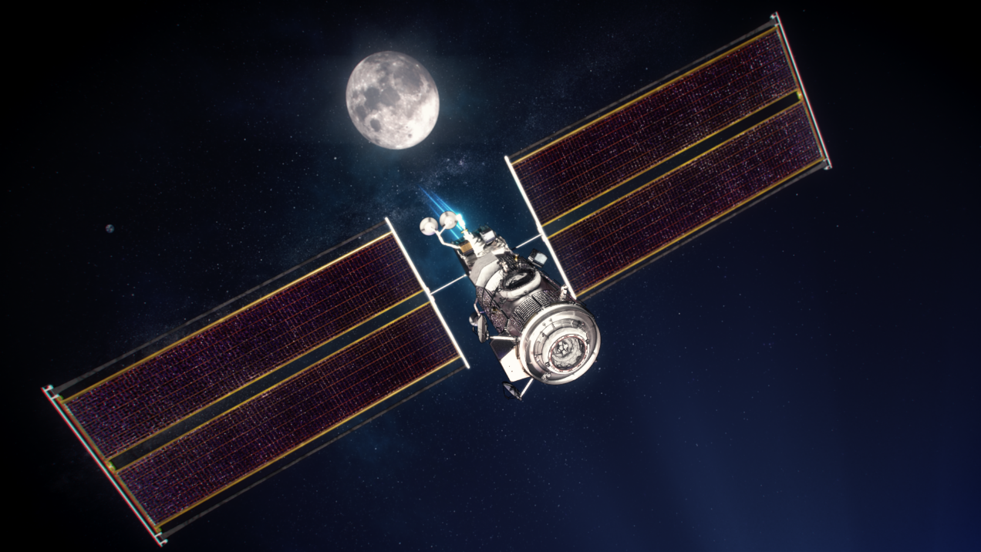
Power Generation: Solar Arrays
Requirements and Key Characteristics
  Provide >50 kW at EOL
    Support both Gateway power needs & high-powered solar electric propulsion
  Autonomous deployment
  15 year life in lunar Near Rectilinear Halo Orbit (NRHO)
  Earth-orbit raising through radiation belts
  2x 100 V, 30 kW-class wings
  Compact and lightweight

Slide 8
Power Generation: Solar Arrays
Roll-Out Solar Array (ROSA) provided by DSS (Deployable Space Systems)
  Sub-scale ROSA tested on ISS in 2017
Two 30 kW-class wings, leveraging technology developed for Maxar commercial spacecraft (GEO-ROSA)
Light weight flexible blankets
Central hinge joint with dual roll-out blankets per wing
Technology scalable to 200 kW
Modular Solar Power Modules provided by SolAero Technologies Corp
Large-area Z4J 4-junction solar cells provide high efficiency and improved radiation tolerance

Slide 9
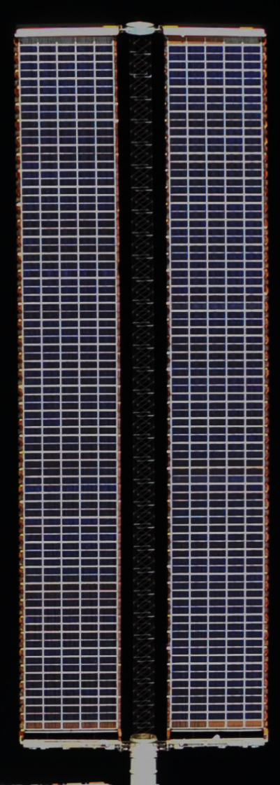
Power Generation: Solar Arrays
Heritage ISS SAW
~115 ft long x ~38 ft wide
(including mast canister)
~2400 pounds
~32 kW @ BOL
Partially autonomous deployment
Images approximately to scale
PPE ROSA SAW
~60 ft long x ~32 ft wide
(not including DOSA)
~32 kW BOL
Fully autonomous deployment

Slide 10


Slide 11
Energy Storage: Batteries
Requirements and Key Characteristics
  Quantity 4x Li-Ion batteries
  15 year life in lunar Near Rectilinear Halo Orbit (NRHO)
  Provide 12kW-hours energy to Gateway during eclipses
  Support a 12kW discharge rate to Gateway during eclipses
  Support vehicle peaking loads

Slide 12
Power Management and Distribution
Requirements and Key Characteristics
  Leverages MAXAR heritage 1300 series bus
    Solar array regulation
    Battery charge / discharge functionality
  15 year life in lunar Near Rectilinear Halo Orbit (NRHO)
  Highly channelized approach to facilitate graceful degradation of the EPS
  120V, 16kW converters provide Gateway with two power domains, 4 feeds total
  Single point ground architecture
  N+1 redundant architecture
    Supports failure of an NDS umbilical connector in downstream elements
    Supports ability to reconstitute the Gateway EPS in the event of significant failure on a given feed

Slide 13
Current Status
Design analysis cycles and integrated analysis cycles are ongoing as part of the co-manifested PPE-HALO vehicle
  Integrated Co-Manifested PEL
  EOR Environmental Impacts
  Integrated Structural and Thermal Analyses
PPE vehicle is progressing toward PDR

Slide 14
Conclusion
The PPE is responsible for generating all the power and propulsion required over the Gateway 15-year service life
The PPE EPS will feature some of the largest, high-power, lightweight solar arrays every flown
The PPE EPS will generate and distribute over 55 kWe EOL
The EPS architecture leverages the MAXAR heritage 1300 series bus and will accomplish the mission with a channelized approach
The Gateway PPE Project is developing and implementing state of the art technology such as high power, lightweight solar arrays, prominently featuring Z4J solar cells. The solar array circuits are being developed in a modular and scalable manner with extensibility to a multi-hundred kW-class mission. These efforts will not only enable sustainable exploration of the moon with greater access than every before, but could also help enable future human missions to Mars and beyond.

Slide 15
Back-up

