Slide 1
Exploration Ground Systems
NASA Kennedy Space Center
EGS Technology Infusion Strategy
ASCEND 2020
November 18, 2020
This material is a work of the
U.S. Government and is not
subject to copyright protection
in the United States.
Ashish S. Patel
Nancy P. Zeitlin

Slide 2

EGS Technology Infusion Strategy - Vision & Mission
Vision
Leading Innovation and Technology Infusion within Exploration Ground Systems (EGS) to reduce overall Production & Operations (P&O) costs
Mission
To promote Technology Implementation & Maturation that strategically aligns with the EGS Program
2

Slide 3
EGS Technology Infusion Strategy - Alignment and Approach
Strategic Alignment
  EGS Program Strategic Plan (PSP), Systems Engineering Management Plan (SEMP), KSC Engineering Processes
  PSP Goal - Optimize investments in technology to inform decisions and enable mission success
Technology Infusion Strategy
  Evaluation of mature capabilities for ground systems implementation - state-of-the-art technologies being utilized elsewhere in industry, market available (Commercial Off The Shelf or modified-COTS) or mature technologies from previous technology development activities.
Implementation Approach
  Strategic Technology Infusion Management Plan - Program level document, similar to SEMP, in-work
  Demonstrate technology advancements in parallel “shadow” mode with current processes/operations
  Validate equivalent performance and/or improved capability to augment (simplify, reduce costs/manpower) current operations and maintenance (O&M) tasks
  Implement (successfully demonstrated) mature technologies into architecture (systems and processes)
Alignment with Agency Technology and Innovation Initiatives
  HEOMD Exploration Capabilities Development Team - Define Moon-to-Mars Point of Departure (POD) Capability Gaps
  NASA Technology Taxonomy 2020 - TX13 Ground, Test, and Surface Systems
  Moon-to-Mars Surface Systems Formulation - Uncrewed Surface Concept of Operations
  STMD Strategic Technology Architecture RoundTable (STAR) - Strategic Capability Development and Technology Investment Plans
  NASA SBIR/STTR 2020 Program - Focus Area 16 Ground & Launch Processing
3
3

Slide 4
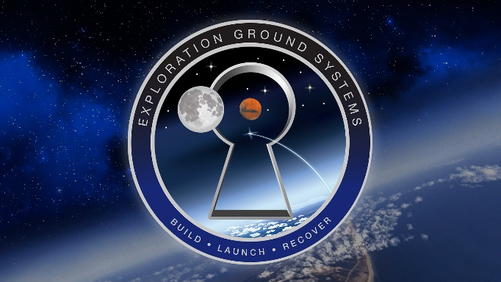

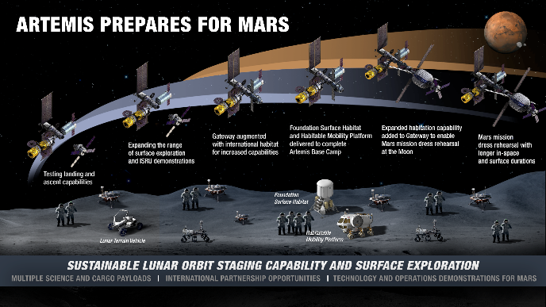
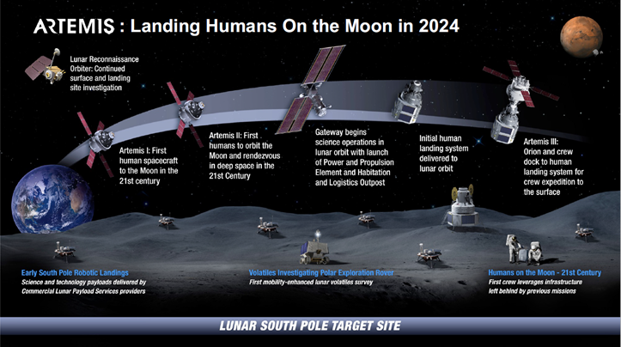

EGS Technology Infusion Strategic Initiatives
QUICK RESPONSE
TECHNOLOGY & INNOVATION CALL
CAPABILITY GAPS
Subject Matter Experts (SMEs) from multiple disciplines of relevance to EGS
  the “Brain Trust”
Quick Response Tools and Capabilities
  to address operations, element, and engineering concerns and challenges
Engineering/Performance Gaps
Annual solicitation through NASA@WORK platform
Requests Ideas to address:
  Schedule Risk
  Operation & Maintenance (O&M) costs
  Reliability & Mission Availability
  Safety & Health
  High Priority Capability Gaps for Artemis Missions
Provides Information:
  Capability Gaps based on upgrades
  Using Point of Departure (POD) baseline and Manifest Planning Sync (MPS) documents for Artemis II & Beyond
  Path forward for top technology investments
Technology/Development Gaps
TENET: DO NOT IMPACT CRITICAL PATH OPERATIONS OF THE EGS PROGRAM
4

Slide 5
EGS Technology Infusion Tools and Capabilities
GHe Flow Controller Analysis
Goal: Demonstrate through analysis that testing validated performance of Gaseous Helium (GHe) Bronkhorst flow controllers.
Value: Mitigate changing interface requirements, redesign, acquiring new sensors, new qualifications, schedule delays.
Acoustic Emission System
Goal: Optimize non-destructive evaluation system for field use to locate sound sources in large extended mechanical systems.
Value: Reduce schedule time and limit the possibility of taking equipment out of service to search for and locate noise concerns and issues.
MIR Fire Detector False Alarms
Goal: Develop capability to mitigate the multiple occurrences of false alarms experienced by the new Pad Mid-Infrared (MIR) fire detectors from reflections.
Value: Limit Mid-IR fire detector false alarms to improve reliability and performance for leak detection/ monitoring during hazardous ops.
SRB Insulation Inspection Tool
Goal: Develop new tool for inspection of the Solid Rocket Booster (SRB) segment insulation to case bond line edge for defects and debonds.
Value: Address human factors by mitigating current challenge of inspection fatigue which could lead to inspector overlooking a debond.
UV Hydrogen Flame Simulator
Goal: Optimize prototype handheld UV Hydrogen (H2) Flame Simulator for field use to address human factors, portability, size and power.
Value: Capability to validate the performance of the UV H2 flame detectors in the field will mitigate need to remove the FDs from their position for testing and calibration.
Orion Window Inspection Tool
Goal: Develop surface light optimizing tool to support the inspection of the Orion Capsule Windows at the pad prior to launch.
Value: Provide a better alternative for window inspection that complies with established O&M requirements and specifications (interest also by JSC and Orion window teams).
SRB Propellant Inspection Tool
Goal: Develop prototype remote imaging system for inspection of SRB propellant grain with the ability to display and detect defects.
Value: Mitigate the operational hazard of technicians climbing inside a “live” segment and addresses human factors issues for visual inspections.
IHM Remote Monitoring
Goal: Develop an Integrated Health Management (IHM) approach for remote monitoring of EGS subsystem components in real time.
Value: On demand Condition-Based Maintenance to predict future maintenance events (i.e. failures, breakdowns) and most cost effective time for maintenance.
Completed in FY20
In Progress
5

Slide 6
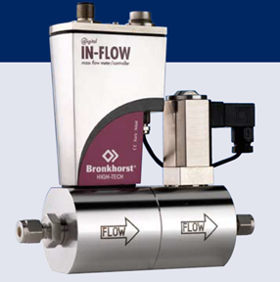
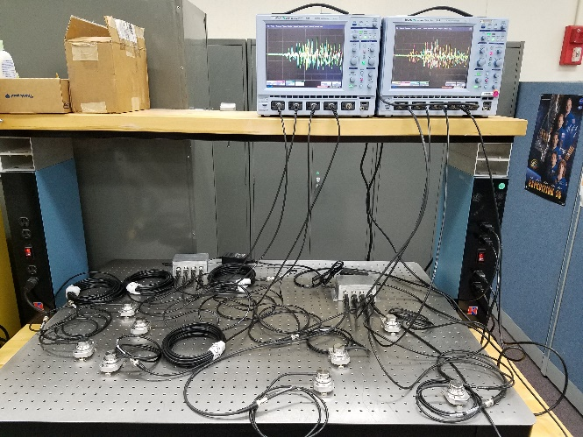
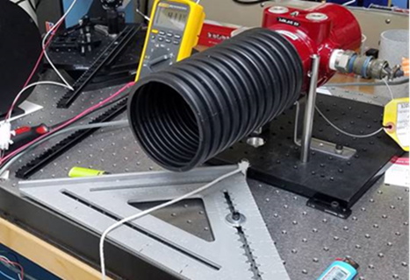
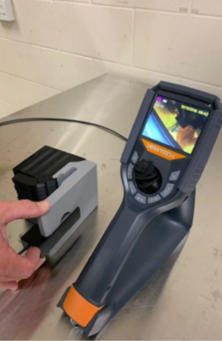
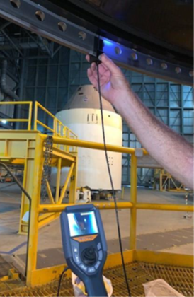
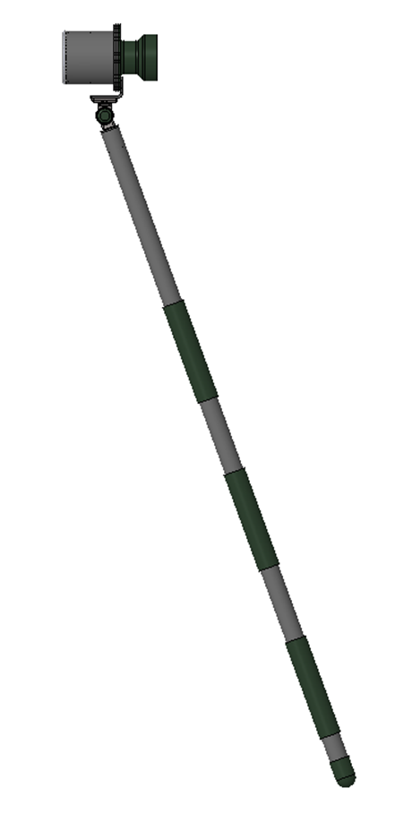
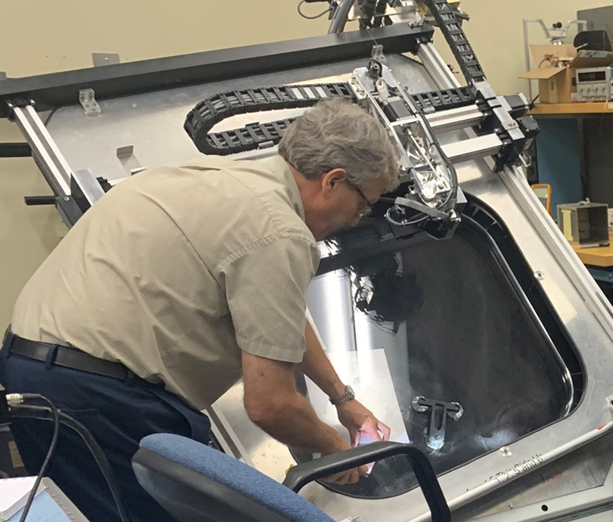
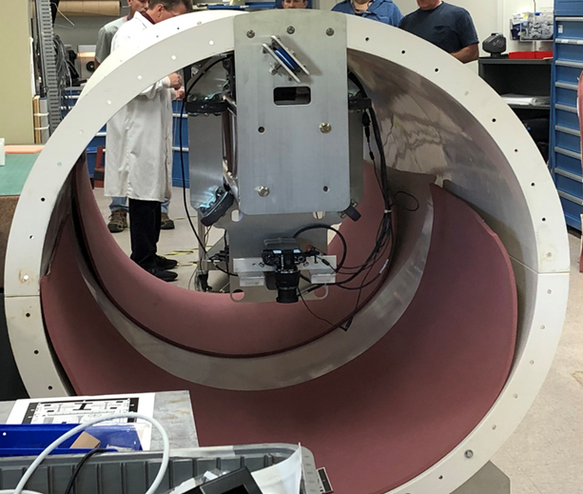
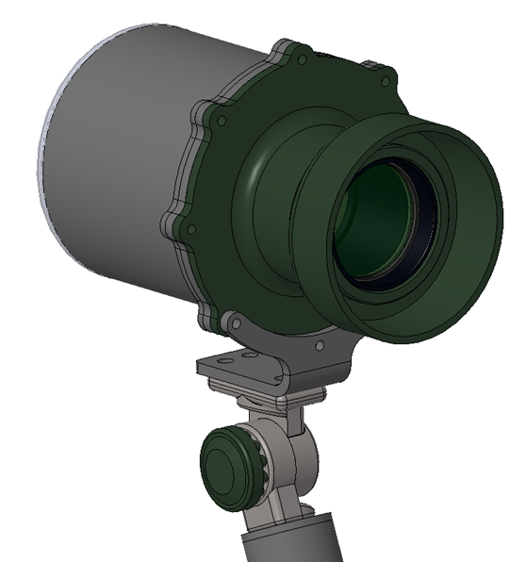
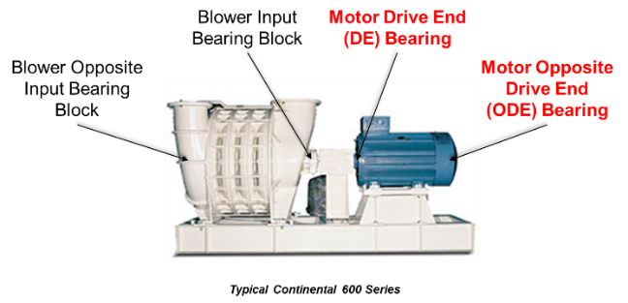
EGS Technology Infusion Tools and Capabilities
GHe Flow Controller Analysis
Acoustic Emission System
MIR Fire Detector False Alarms
SRB Insulation Inspection Tool
UV Hydrogen Flame Simulator
Orion Window Inspection Tool
SRB Propellant Inspection Tool
IHM Remote Monitoring
6

Slide 7
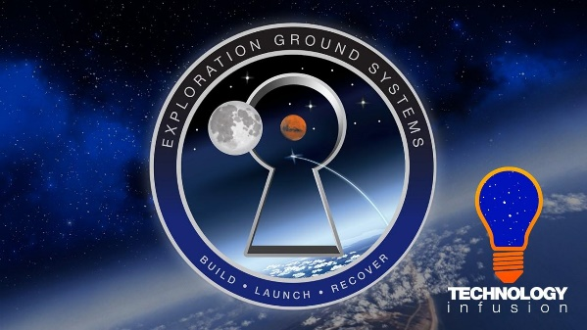
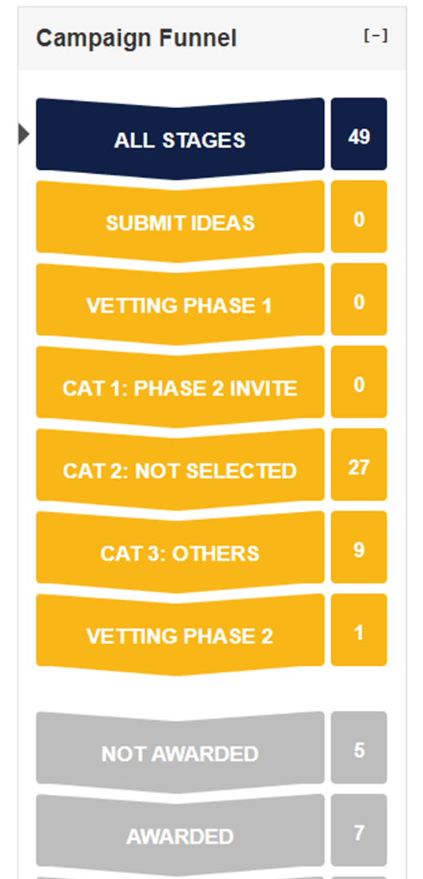
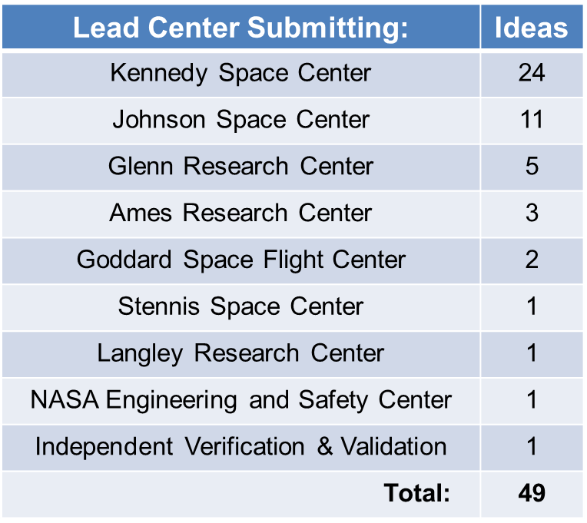

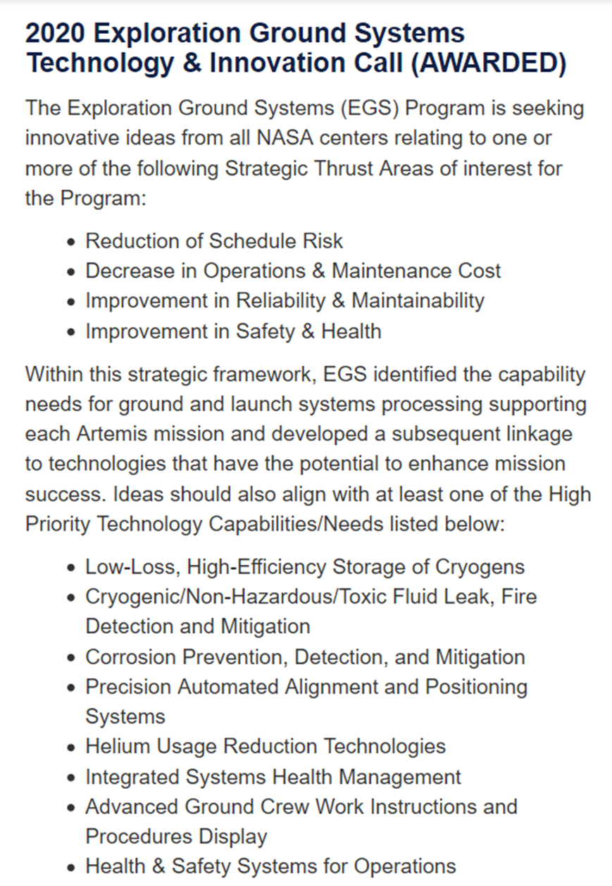
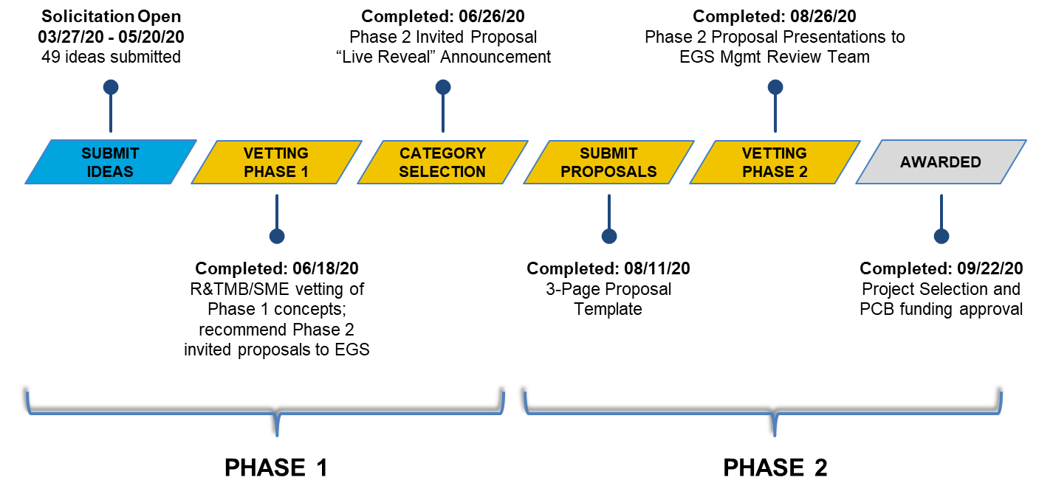
2020 EGS Technology and Innovation Call
NASA’s internal agency-wide platform provides a central hub for ideas and collaboration across the entire NASA community to solve challenges and competitions related to the agency’s mission.
www.nasa-at-work.nasa.gov
Campaign Timeline
OPEN TO ALL NASA CENTERS –
CIVIL SERVANTS & CONTRACTORS
Almost 3000 Unique Page-views during the open solicitation period!
7

Slide 8
2020 EGS Technology and Innovation Call - Summary
Phase 1 Results – 49 ideas evaluated by the KSC Research and Technology Management Board (R&TMB) technical sub team and EGS SMEs
  Rating Criteria: Benefit to EGS, Alignment with EGS Capability Gaps, Implementable into EGS Program, and Technical Feasibility
  14 ideas selected for Phase 2 Invited Proposals - 1 withdrawn; moved to not selected
  26 ideas not selected, not being considered further in this formulation cycle
  9 ideas forwarded for other consideration (further Technology Development or Engineering Assessment required, enhancement to Center institutional/lab capabilities).
Phase 2 Results – 7 proposals awarded for execution starting in Oct 2020 (FY21)
  Rating Criteria: Technical Merit, Return on Investment, Implementable into EGS
  Simplified Dewpoint Testing
  An Improved Ultrasonic Leak Detector
  Exposure and Evaluation of Corrosion-Resistant Alloys at the Kennedy Space Center
  More Efficient Methods to Remove, Prepare, and Repair Coatings for GSE Structures
  Kennedy Ground Control Subsystem (KGCS) Cryogenic Vacuum Readings
  High Efficiency Cryogenic Propellant Transfer Lines
  Foundational Steps Toward Full Control Liquid Hydrogen (LH2) Storage
8

Slide 9
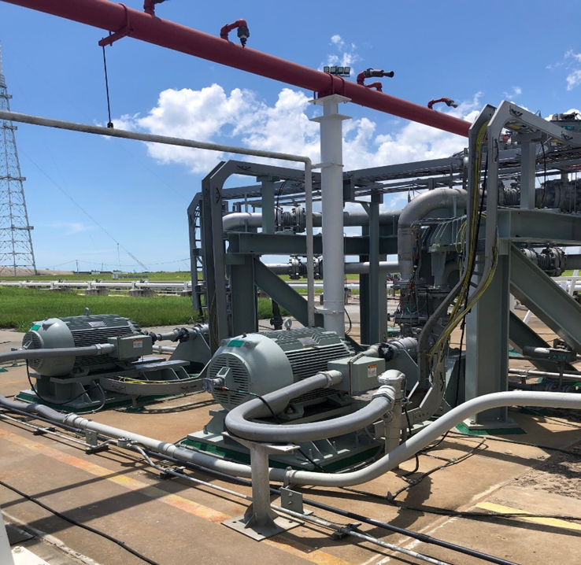
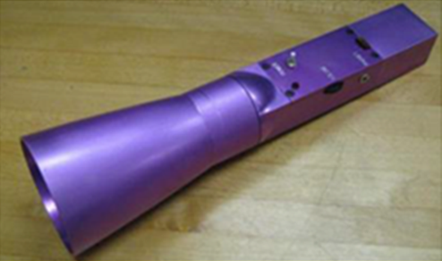
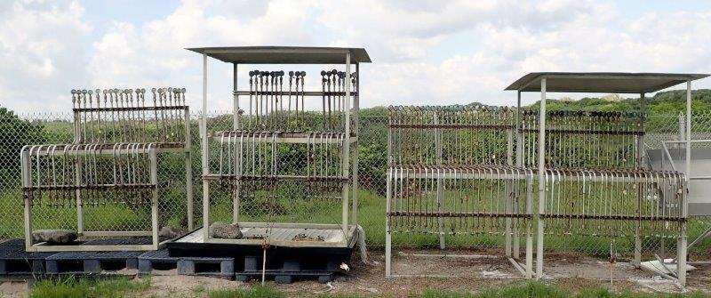
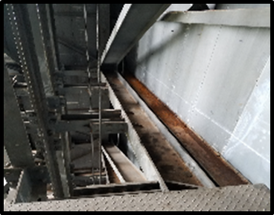
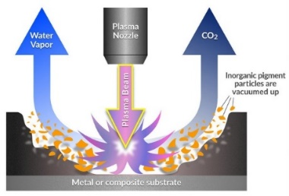
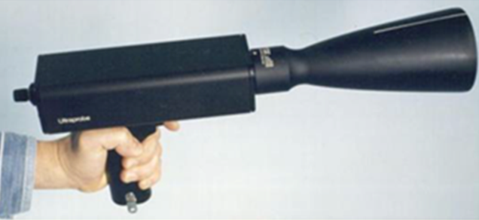
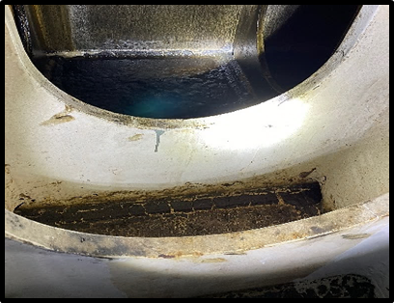
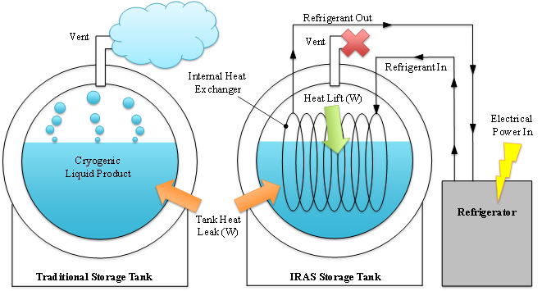
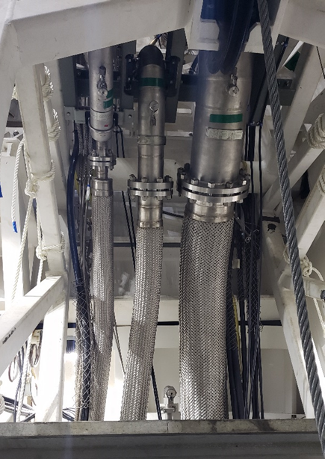
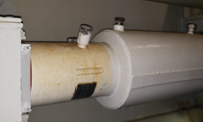
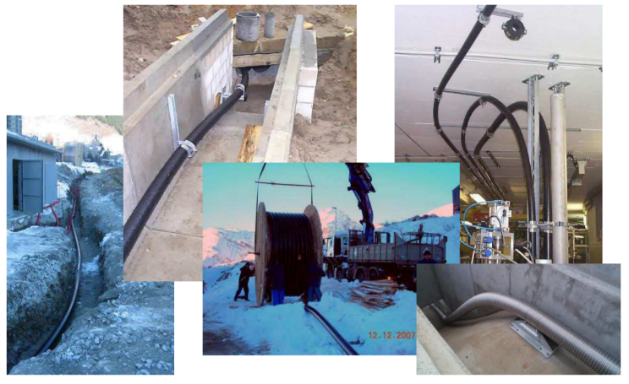
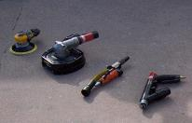
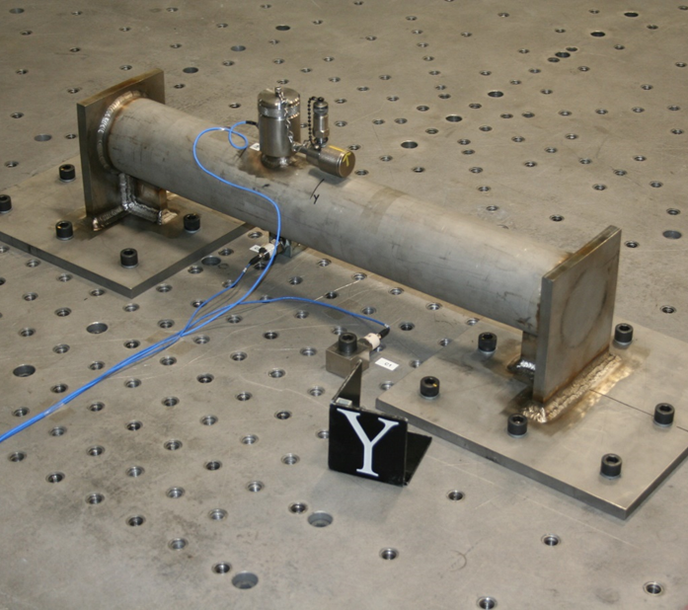
2020 EGS Technology and Innovation Call - Results
Exposure and Evaluation of Corrosion-Resistant Alloys at the Kennedy Space Center
Simplified Dewpoint Testing
in the Liquid Oxygen System
Improved Ultrasonic Leak Detector
Foundational Steps Toward Full Control
LH2 Storage
More Efficient Methods to Remove, Prepare, and Repair Coatings for GSE Structures
High Efficiency Cryogenic Propellant Transfer Lines
(https://stfc.ukri.org/files/nexanscryogenictransferlinesystems
KGCS Cryogenic Vacuum Remote Monitoring
9

Slide 10
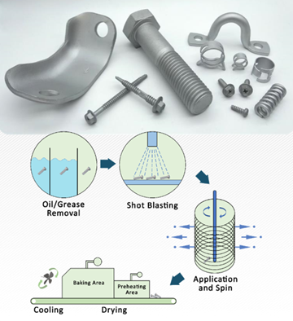
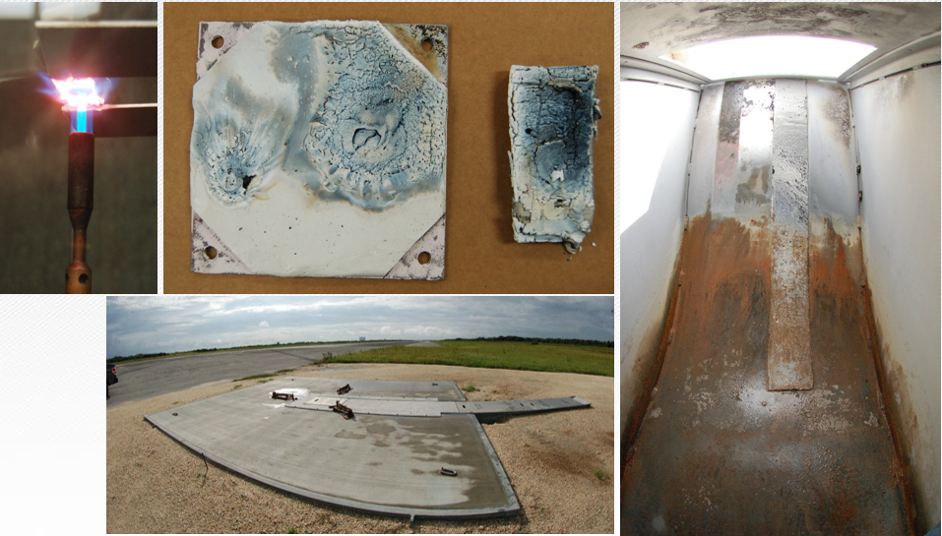
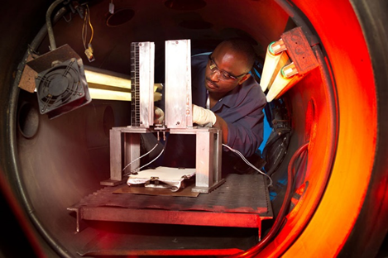
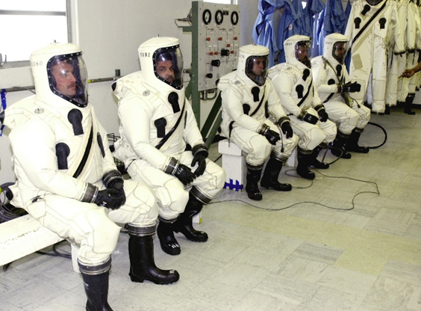
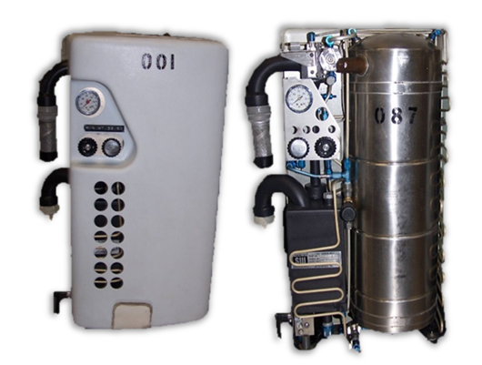
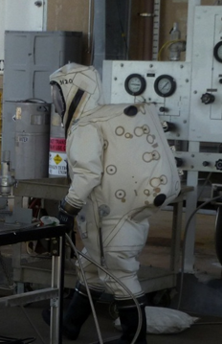
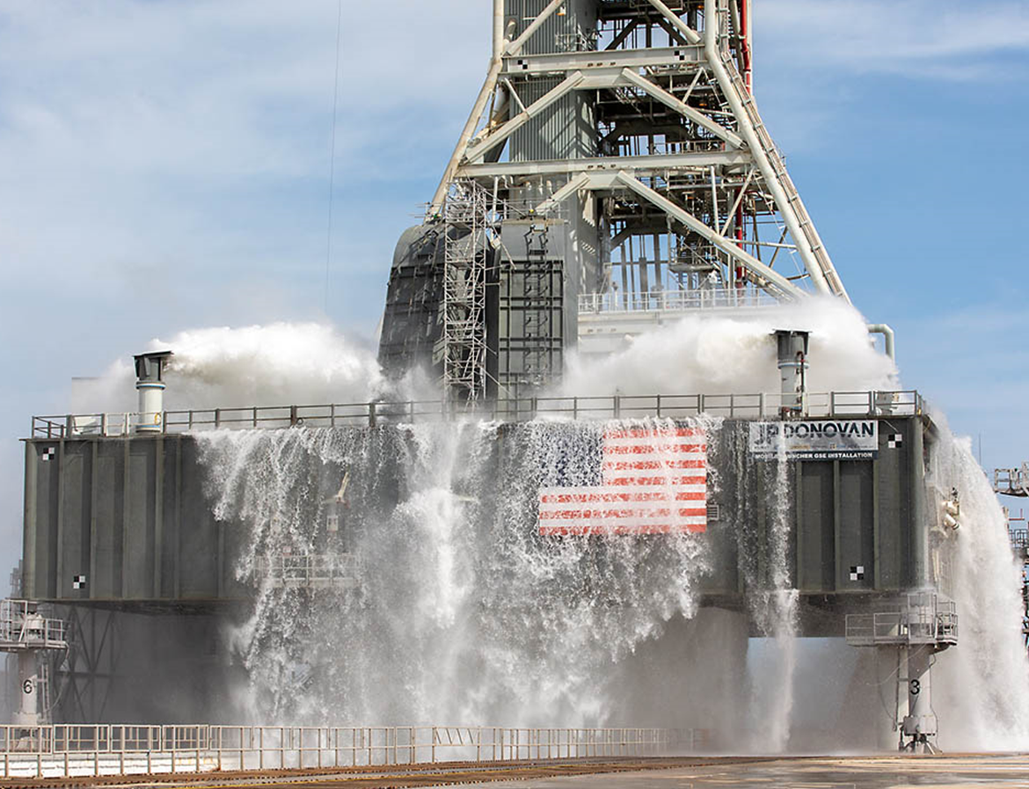
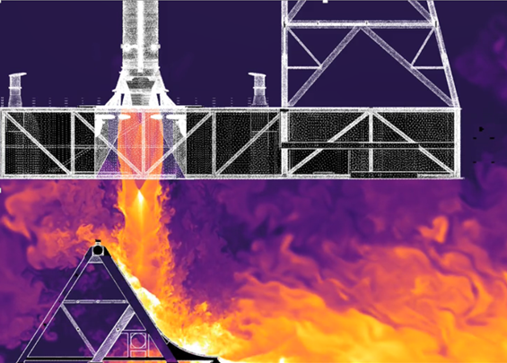
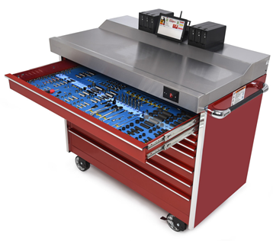
2019 EGS Technology Call - Results (5 projects in work)
Silicone Ablative Material Qualification
MSFC Rocket Engine Exhaust Testing Capability (L)
WSTF Flammability Testing per NASA-STD-6001 Test 1 (R)
Materials Options for High Strength Alloys on Ground Support Structures
Propellant Handlers Ensemble (PHE) Environmental Control Unit (ECU) Improvements
  Multiphysics Prediction Capability for Launch Environment
  Modelling the Water-Based Ignition Over-Pressure/
  Sound Suppression (IOP/SS) System
Digital Asset
Management System
10

Slide 11
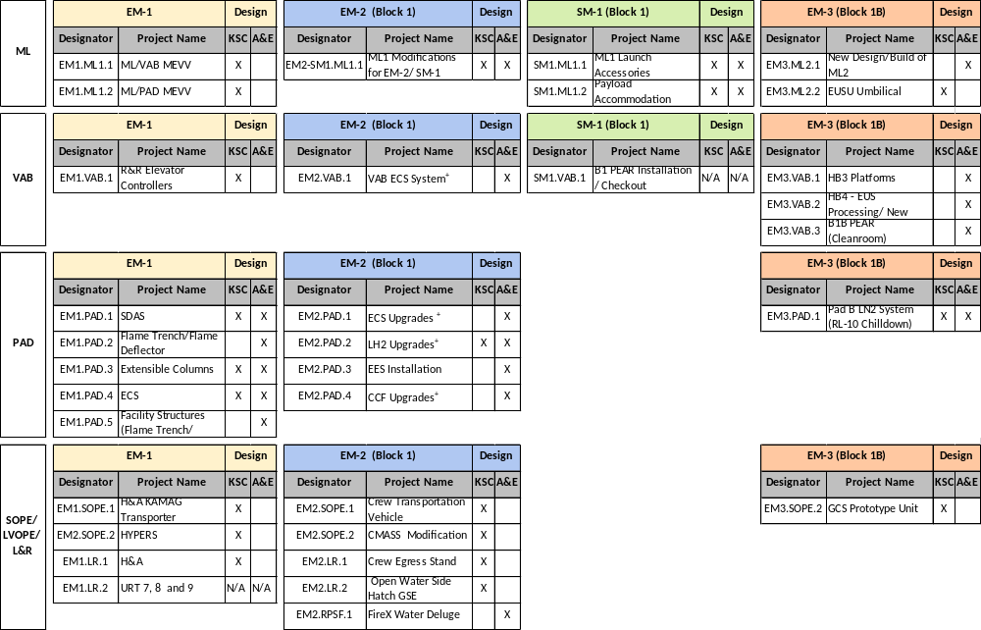
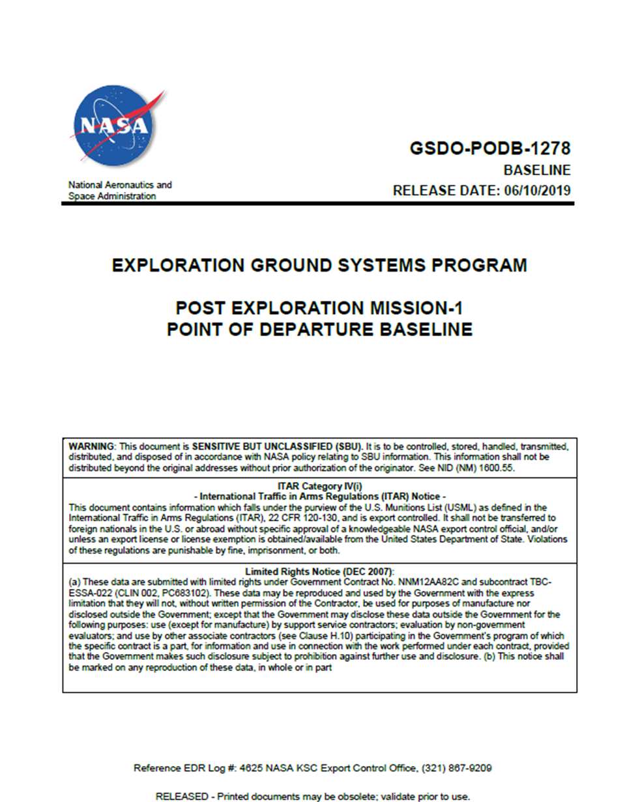
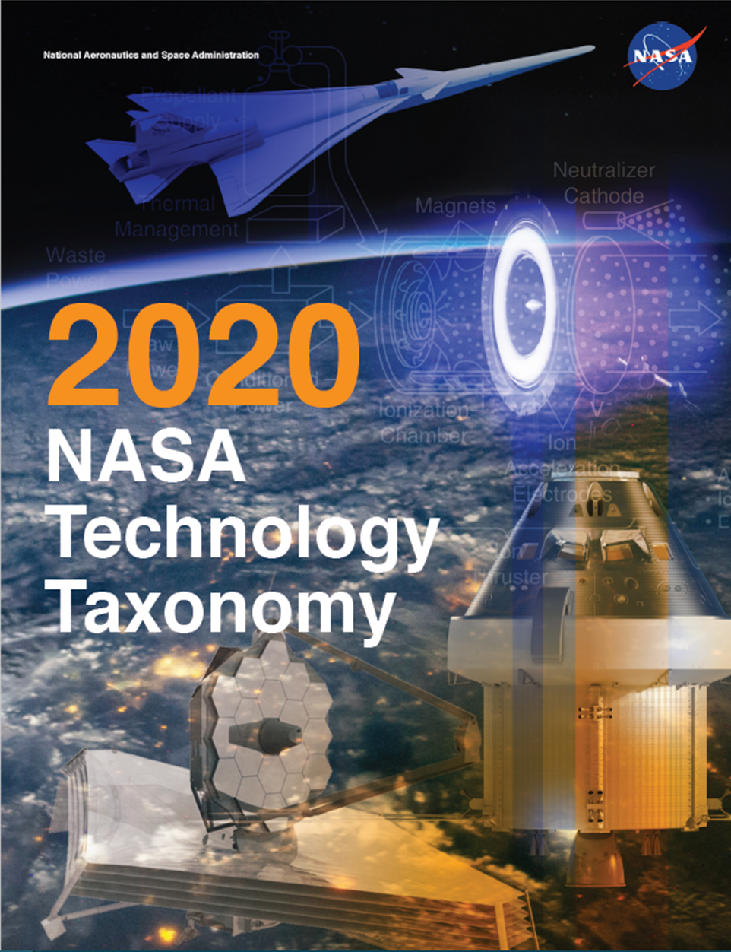
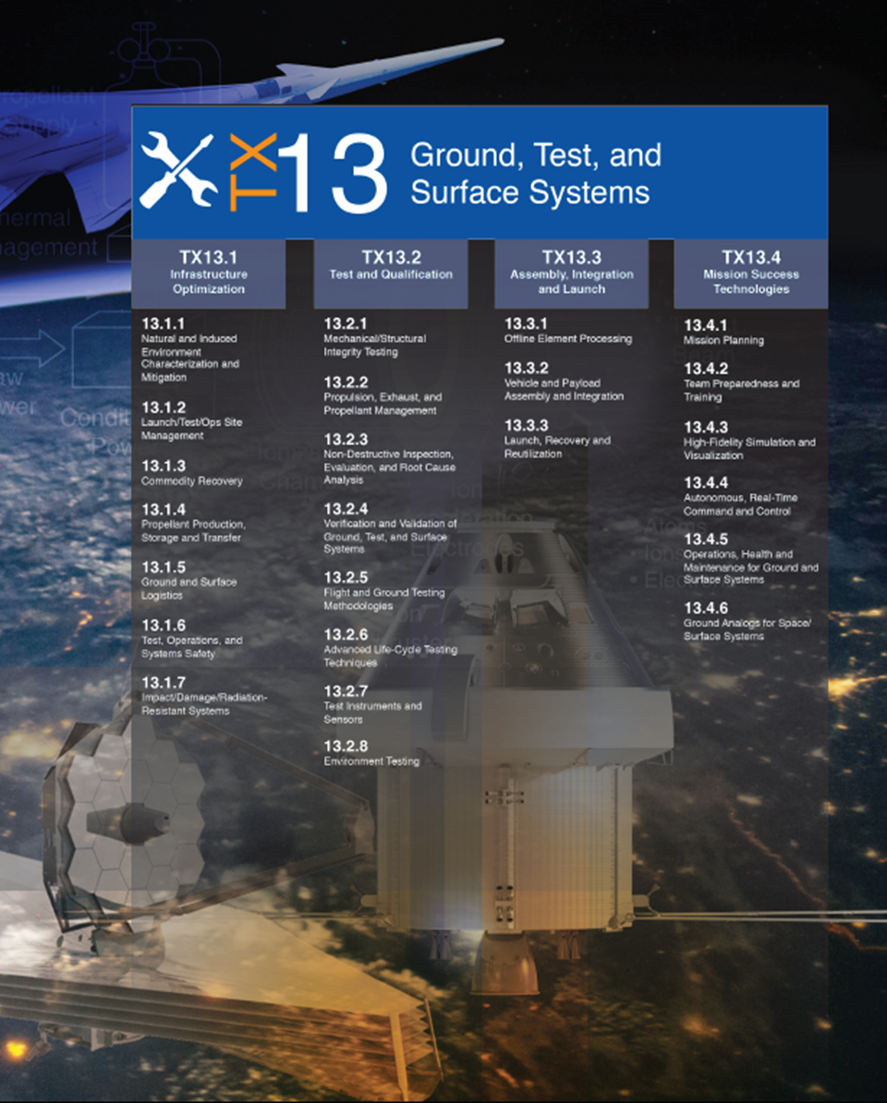
EGS Capability Gaps for Artemis Missions - Development
Synthesized information about mission capabilities and needs from:
  Previous Performance Management Team (PMT) Presentation
  Manifest Planning Sync (MPS)
  Post Artemis 1 Point of Departure (POD) Baseline
  Program Risk Review (PRR)
Linked with technologies from:
  NASA Technology Area Roadmap (TA) 2015
  NASA Technology Taxonomy (TX) 2020
Exploration Mission (EM) designation changed to Artemis
11

Slide 12
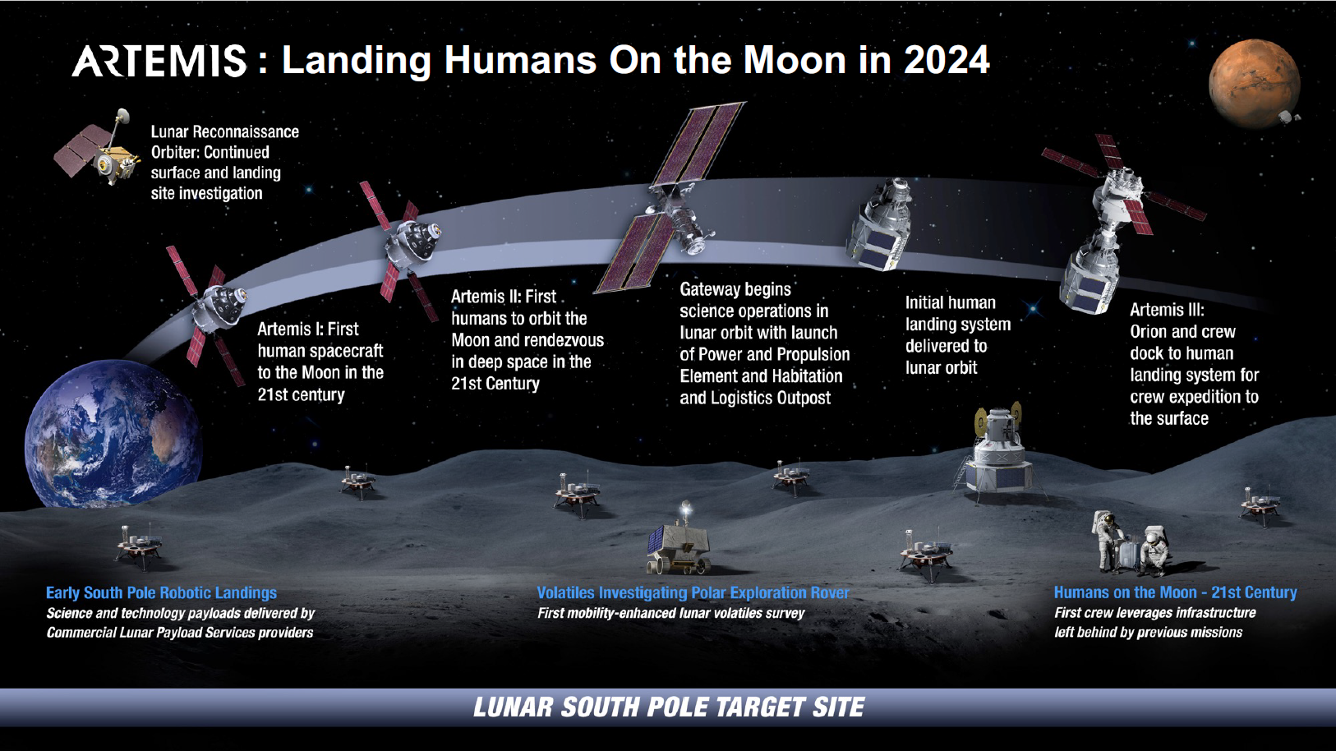
EGS Capability Gaps for Artemis Missions - Manifest
12

Slide 13
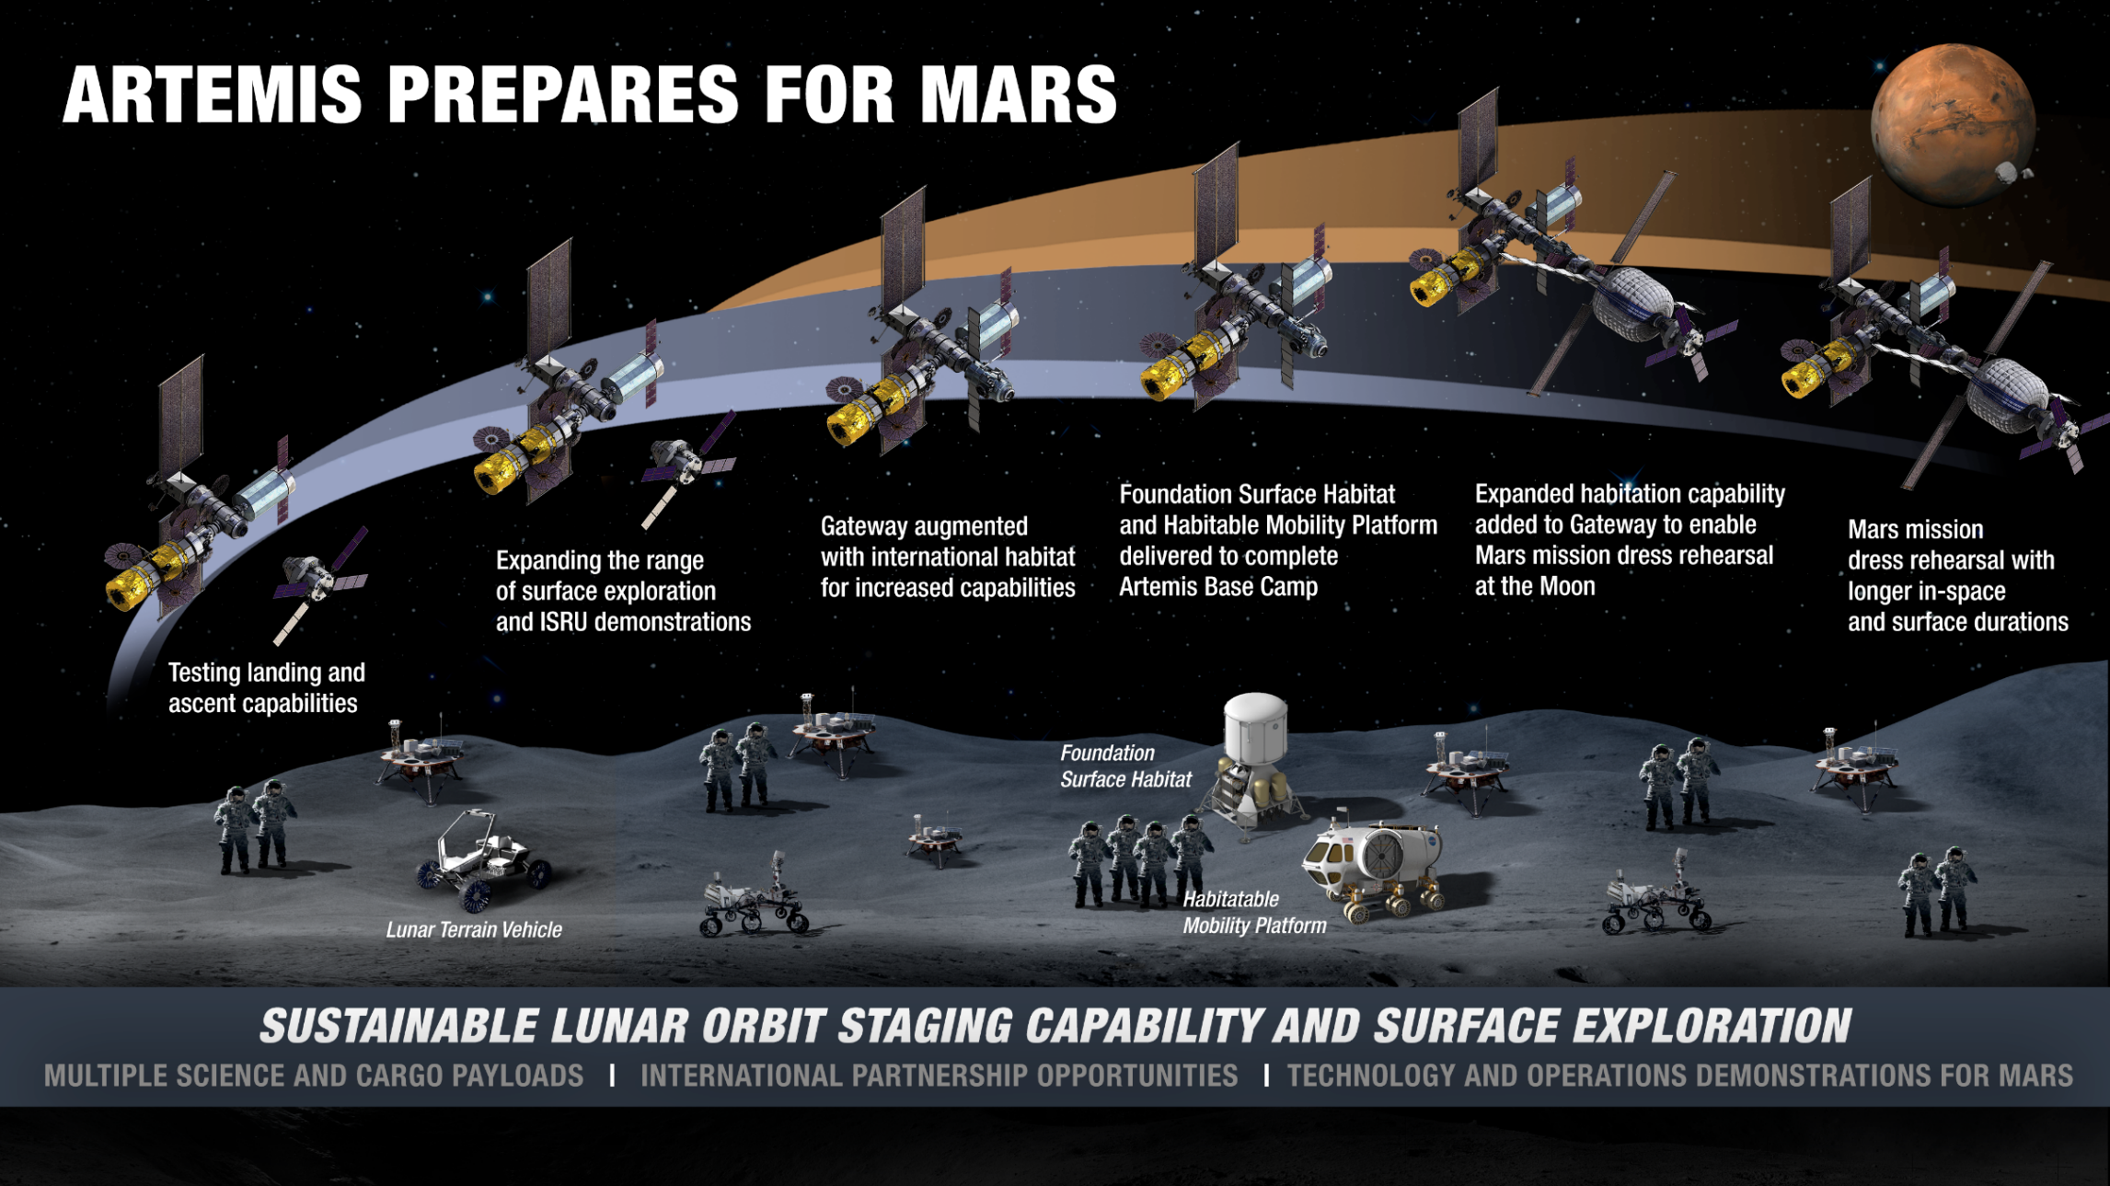
EGS Capability Gaps for Artemis Missions - Manifest
13

Slide 14
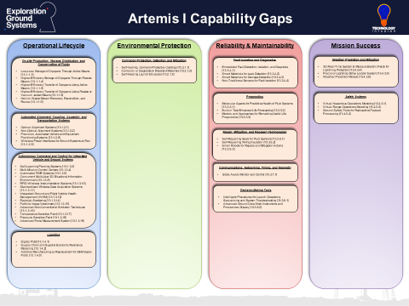
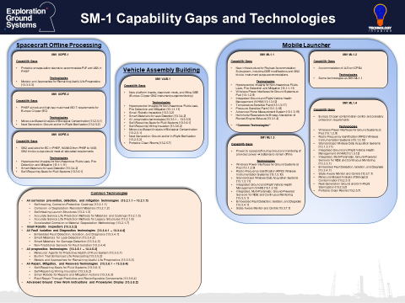
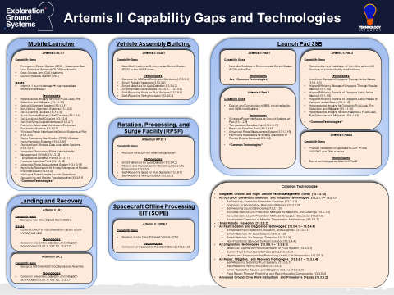
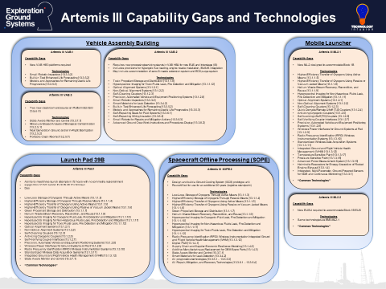
EGS Capability Gaps for Artemis Missions - Comprehensive
14

Slide 15
EGS High Priority Capability Gaps
Low-Loss, High-Efficiency Storage, Distribution, and Conservation of Cryogenic Fluids and Commodities through Passive, Active, and Vacuum Jacket Means
Cryogenic/Non-Hazardous/Toxic Fluid Leak, Fire Detection and Mitigation
Corrosion Prevention, Detection, and Mitigation
Integrated Systems Health Management (ISHM)
  Anomaly Detection
  Fault Isolation and Diagnostics
  Prognostics
  Repair, Mitigation, and Recovery
  Small Robotic Inspectors
Precision Automated Alignment and Positioning Systems
Advanced Ground Crew Work Instructions and Procedures Display
Helium Usage Reduction Technologies
Health and Safety Systems for Operations
15

Slide 16
EGS High Priority Capability Gaps - Descriptions
Low-Loss, High-Efficiency Storage, Distribution, and Conservation of Cryogenic Fluids and Commodities through Passive, Active, and Vacuum Jacket Means
  Reduce Hydrogen boil-off losses, improve/optimize fill rates while maintaining liquid properties, minimize transfer losses, reduce reliance on expert operators for routine, labor intensive activities (autonomous propellant loading), optimize storage and distribution of propellants (e.g., green, toxic, or cryogenic) for use at launch complex.
Cryogenic/Non-Hazardous/Toxic Fluids Leak, Fire Detection and Mitigation
  Area surveillance and hazard sensing systems to detect and identify, spills, leaks, increased background percent of commodities, and fires of cryogenic, green, hypergolic and toxic fluids and gases in storage areas as well as monitoring of operational areas when personnel are present.
Corrosion Prevention, Detection, and Mitigation
  Corrosion detection under coatings, corrosion inhibitors, environmentally friendly coatings (no/low VOC), corrosion preventative compounds and protective coatings, new coating options for the Qualified Products List, corrosion-resistant materials and coatings to minimize inspection, maintenance, repair, and refurbishment requirements (composites and ablatives).
Integrated Systems Health Management (ISHM)
  Reduce ground operations maintenance and processing time with on-site inspection and anomaly detection and identification, fault isolation and diagnostics, prognostics, repair, mitigation, and recovery, decision-making tools, autonomous command and control to automate complex and time critical decision making, small robotic inspectors to identify and resolve problems in difficult-to-access spaces, and measurement systems.
16

Slide 17
EGS High Priority Capability Gaps - Descriptions
Precision Automated Alignment and Positioning Systems
  Real-time, rapid, and quantifiable systems that allow for accurate, controlled, and timely placement of large hardware for element-to-element integration during vehicle processing.
Advanced Ground Crew Work Instructions and Procedures Display
  Overlay electronic procedures, directions, and engineering schematics on top of the actual system in the user’s visual field of view for the work as it is being performed to monitor user actions, provide directions, real-time guided-troubleshooting, diagnosis and repair, or certify that the process has been performed correctly.
Helium Usage Reduction Technologies
  Eliminate/reduce/substitute the use of Helium where possible, real-time in-situ measurement to allow using only the minimum amount of Helium needed to meet the engine specifications, purge systems optimization, and alternative purge approaches for hydrogen.
Health and Safety Systems for Operations
  Increase health and safety of operations personnel through virtual hazardous operations modeling, improved (on-demand, lighter-weight) Personal Protective Equipment, hazardous environment personnel monitoring systems, and automated/autonomous hazardous operations.
17

Slide 18

18

Slide 19

Backup
EGS Capability Gaps and Technologies
19

Slide 20

Artemis I Capability Gaps
20

Slide 21

Artemis II Capability Gaps and Technologies
21

Slide 22

Artemis III Capability Gaps and Technologies
22

Slide 23

Science Mission-1 Capability Gaps and Technologies
23

Slide 24
Capability Gap Definitions
Capability
  The ability to complete a task or meet an exploration objective through Architecture, Engineering, Technology, or Operations for a given set of constraints and level of risk.
Capability Gap
  The inability to complete a task or meet an exploration objective. The gap may be the result of no existing capability, lack of proficiency or sufficiency in an existing capability solution, or the need to replace an existing capability solution to prevent a future gap.
Technology Gap
  New and/or novel performance or function that has not been demonstrated (solutions to this gap type are generally TRL 1-4)
Development Gap
  At least one potential solution has been identified, but additional work is required to ensure feasibility of the new and/or novel performance or function in a specific operational application (solutions to this gap type are generally TRL 5-9)
Engineering Gap
  Performance or function is well accepted (not new or novel), but requires engineering development for a specific mission (solutions to this gap type are generally TRL 5-9)
24

