Slide 1
AIAA-2020-4034
Integrated Trajectory, Habitat, and Logistics Analysis and Trade Study for Human Mars Missions
Andrew Owens, Christopher Jones, William Cirillo, Jordan Klovstad, Emily Judd, Patrick Chai, and Raymond Merrill
Space Mission Analysis Branch
NASA Langley Research Center
Nicole Piontek, Chel Stromgren, and Jason Cho
Binera, Inc.
ASCEND
16-18 November 2020
www.ascend.events

Slide 2
Overview
Environmental Control and Life Support System (ECLSS) architecture has strong impacts on mission cost and mass
Net impacts and optimality of different configurations strongly coupled with other mission architecture decisions and assumptions, including
  Food hydration level
  Extravehicular Activity (EVA)
  Spares Probability of Sufficiency (POS)
Integrated assessment of habitat and transportation system mass and cost provides insights into relationships between different decisions
This paper presents an integrated analysis of different mission architectures for a notional crewed Mars mission
Results are not intended to represent final conclusions, but rather an exploratory analysis executed to understand key system drivers
ECLSS development and architecture decisions, like all elements of spacecraft design, should carefully consider impacts at a mission level as part of an integrated system, rather than optimizing in isolation.

Slide 3
Case Study Description and General Methodology
Evaluate departure mass and cost for notional conjunction-class Mars transit mission (approx. 1,000 days) for 8 different ECLSS architectures representing range of loop closure levels
Examined 11 mission scenarios:
  Baseline: 50% food hydration, 12 EVAs, 0.98 POS, 2035 mission opportunity, no additional testing
  Sensitivity analysis to food hydration, number of EVAs, POS, mission opportunity, and testing
Outputs:
  Mass of habitat, logistics, and transportation system at Earth departure
  Cost of habitat, transportation system, and launch, including development and procurement
 |  | ECLSS Architecture
 |  | Open Loop | +OGA | +WPA | +UPA | +Sabatier | +Brine Drying | +PPA | Bosch
Technology | Oxygen Generation Assembly (OGA) |  | ✓ | ✓ | ✓ | ✓ | ✓ | ✓ | ✓
 | Water Processor Assembly (WPA) |  |  | ✓ | ✓ | ✓ | ✓ | ✓ | ✓
 | Urine Processor Assembly (UPA) |  |  |  | ✓ | ✓ | ✓ | ✓ | ✓
 | Sabatier |  |  |  |  | ✓ | ✓ | ✓
 | Brine Drying |  |  |  |  |  | ✓ | ✓ | ✓
 | Plasma Pyrolysis Assembly (PPA) |  |  |  |  |  |  | ✓
 | Bosch |  |  |  |  |  |  |  | ✓
Note: all cases also include Carbon Dioxide Removal Assembly (CDRA), Waste and Hygiene Compartment (WHC), Common Cabin Air Assembly (CCAA), Trace Contaminant Control System (TCCS), Oxygen and Nitrogen Supply and Distribution, Pressure Control and Relief, Air Circulation and Ventilation, Atmospheric Constituent Monitoring, Active Thermal Control, Electrical Power, Communications and Tracking, and Attitude and Rate Determination Systems.

Slide 4
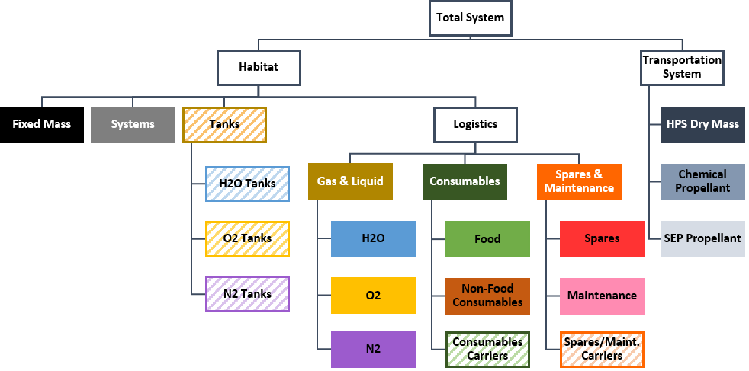
Outputs for System Mass Assessment
Total system mass broken out into several categories and subcategories for more detailed reporting
Colors associated with each category are used in all mass charts for ease of comparison

Slide 5
Methodology: Supportability and Logistics
Supportability
Spares allocations optimized to achieve desired Probability of Sufficiency (POS) while minimizing mass using model described by Owens [2]
  POS = Probability of having enough spares to cover all failures during the mission
  Optimization accounts for epistemic uncertainty in failure rate estimates
Supportability data based on data from current ISS systems, at current Orbital Replacement Unit (ORU) level of repair
  Mass
  Quantity
  Duty Cycle
  Failure Rate
Maintenance items (i.e. items used for scheduled replacements) allocated based on life limits
Logistics
Consumables, gasses, and liquids allocated to support 4 crew for entire mission duration, based on model described by Ewert and Stromgren [5]
Resource requirements adjusted to account for key parameters, including:
  ECLSS recycling capability
  Food water content
  Number of EVAs
Trash jettisoned and excess water vented before major propulsive maneuvers to reduce propellant requirements
Includes mass of carriers, i.e. Crew Transfer Bags (CTBs), to store logistics
Water, oxygen, and nitrogen assumed to be stored in large tanks integral to habitat structure
[2] Owens PhD 2019
[5] Ewert and Stromgren ICES-2019-126

Slide 6
Methodology: Transportation System and Cost
Transportation System
Assumed Hybrid Propulsion System (HPS)
  Liquid oxygen / methane chemical propulsion system
  400 kW low-thrust xenon Solar Electric Propulsion (SEP) system
  675 kW solar array
Transportation system size and propellant load optimized as a function of habitat mass at four major propulsive maneuvers
  Trans Mars Injection (TMI)
  Mars Orbit Insertion (MOI)
  Trans Earth Injection (TEI)
  Earth Orbit Insertion (EOI)
Detailed modeling and optimization approach described by Chai et al. [6]
Cost
Element development and production costs estimated using industry-standard component-level commercial cost estimating software, PRICE-H
  Developed element cost models to capture sensitivities to spares quantities, propulsion element sizing, fuel requirements, and ECLSS technologies
Launch costs captured as price per launch for SLS and a representative commercial heavy-lift vehicle, using approach described by Jones et al. [7]
Cost results are:
  Estimated probabilistically with results representing a 70% confidence level (inclusive of reserves)
  Driven primarily by component complexity, mass, and heritage (independent of architecture)
  Normalized as a ratio to the baseline open loop ECLSS case
[6] Chai et al. AIAA 2019-3961
[7] Jones et al. IAC-19-D4.5.15

Slide 7
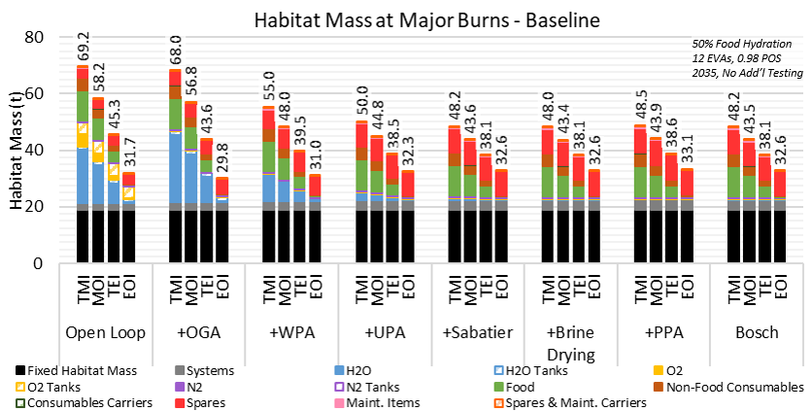
Baseline Results – Habitat Mass
50% Food Hydration, 12 EVAs, 0.98 POS, 2035, No additional testing
Habitat mass varies significantly over the course of the mission as resources are consumed and trash is jettisoned
  Lower mass at later burns reduces propellant requirements
  Trash jettisoning reduces total departure mass by 5 to 20 t, even if initial habitat mass is the same
Increased loop closure reduces initial habitat mass, to a point
  Additional loop closure beyond Sabatier does not produce significant additional mass reduction for the food hydration levels examined here (more on this later)
  Increases in system, spares, and maintenance mass must be weighed against consumables mass savings
TMI = Trans Mars Injection, MOI = Mars Orbit Insertion, TEI = Trans Earth Injection, EOI = Earth Orbit Insertion
Jettisoning trash / unnecessary mass throughout the mission is a key strategy for reducing propellant mass requirements
Once oxygen and water requirements are met, additional loop closure does not continue to reduce habitat departure mass, and can increase it

Slide 8
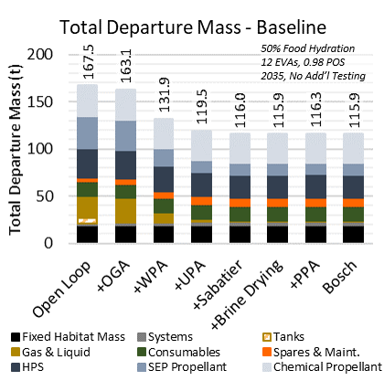
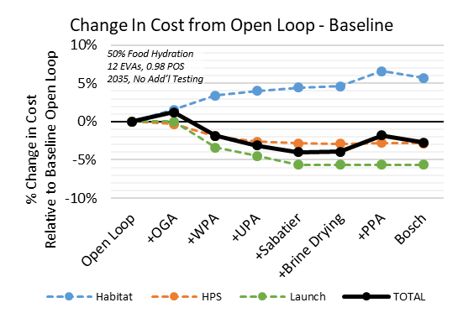
Baseline Results – Total Departure Mass and Cost
50% Food Hydration, 12 EVAs, 0.98 POS, 2035, No additional testing
Total departure mass follows similar trends as habitat mass
  For these mission assumptions, loop closure at or beyond Sabatier reduces departure mass by approx. 21 t (30%) relative to open loop
  Additional loop closure has negligible effect on departure mass
Increased loop closure reduces mass, which reduces transportation system & launch costs
However, habitat cost also increases as systems become more complex
Maximizing ECLSS loop closure does not necessarily minimize total departure mass or system cost; net effect depends heavily on other assumptions

Slide 9
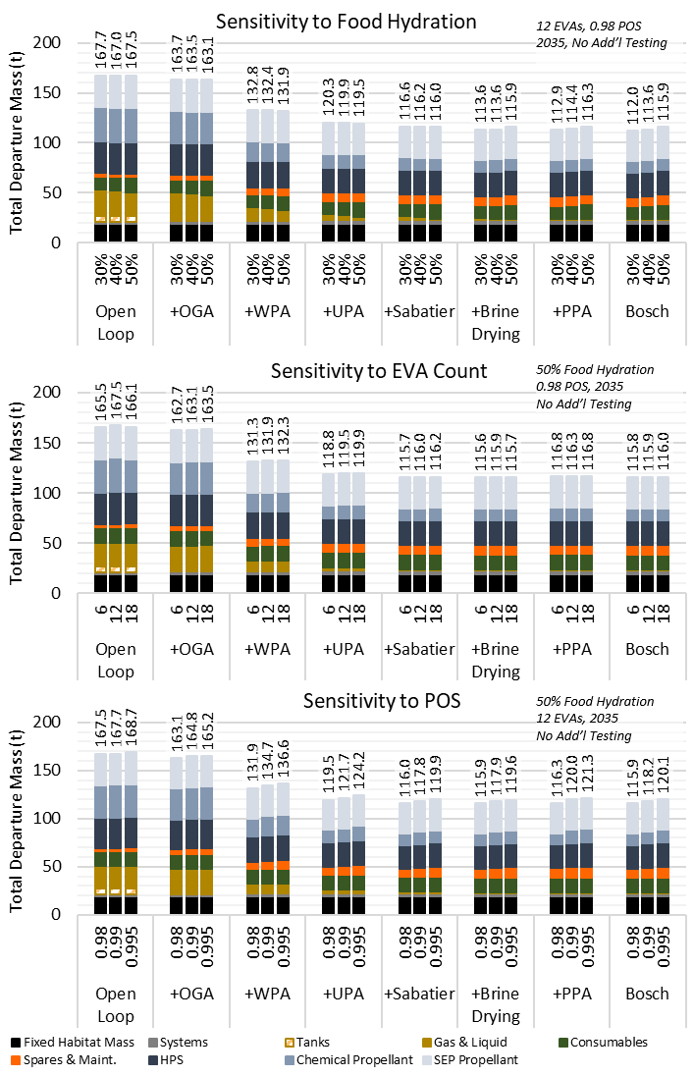
Mass Sensitivity Analysis – Food Hydration, EVA Count, and POS
Sensitivity analysis performed over a range of values
  Food Hydration: 30%, 40%, 50%
  Number of EVAs: 6 (6 month interval between EVAs), 12 (3 month interval), 18 (2 month interval)
  POS: 0.98 (1 in 50 chance of insufficient spares), 0.99 (1 in 100), 0.995 (1 in 200)
Food hydration is a primary driver of system mass and optimal loop closure levels (more on next slide)
EVA count does not have a significant impact on departure mass over the range examined here; more frequent EVAs likely to result in increased logistics needs
POS is also a primary driver of system mass; higher POS requirement increases spares mass
Higher levels of loop closure tend to be more strongly affected by changes in food hydration and POS

Slide 10
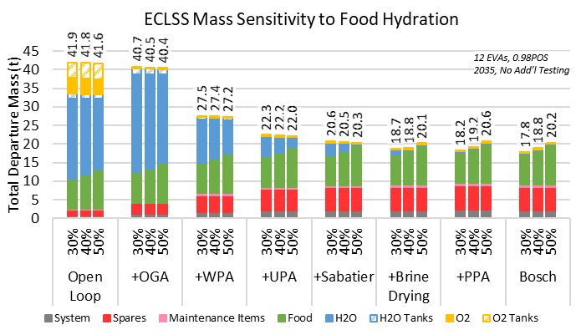
Food Hydration is a Key Driver of Logistics Mass
and Optimal ECLSS Architecture
ECLSS is a water-based economy: oxygen generation, food rehydration, and drinking
Increasing loop closure to recycle water can cut ECLSS mass in half relative to open loop
Stored food contains water, and food hydration levels impact water balance
  High food hydration: food contains significant stored water, and loop closure is less valuable
  Low food hydration: stored food mass is decreased, and recycled water can be used to rehydrate w/ higher loop closure ECLSS
Optimal ECLSS achieves a balanced water economy, rather than maximizing loop closure
  Excess water is counterproductive
  Storing excess water increases mass at later burns, which increases propellant requirements
  In current model, excess water is vented once contingency stores are filled
Reduced food hydration level coupled with higher loop closure presents opportunity to save thousands of kilograms of logistics
Initial studies show high food hydration levels (e.g. 50%) result in limited value for loop closure beyond Sabatier / Brine Drying

Slide 11
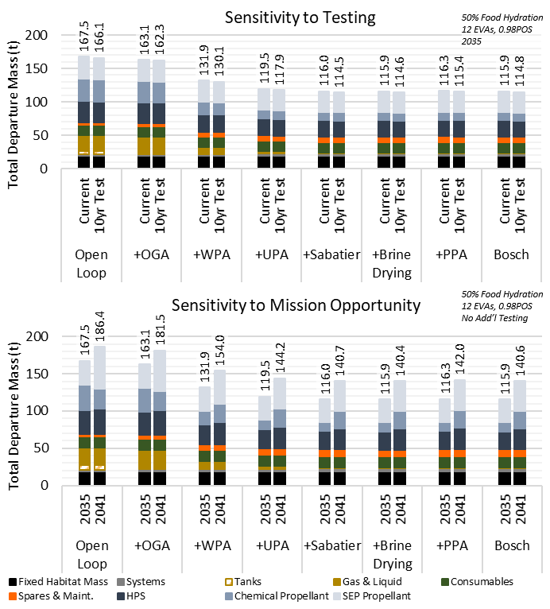
Mass Sensitivity Analysis – Testing and Mission Opportunity
Testing and operational experience are key activities required to validate failure rate estimates, reduce risk, and inform supportability planning
For initial assessment, examined 10 years of additional testing to reduce uncertainty on all systems
  Testing enables approx. 1-2 t mass savings
  Applying same testing to all systems is likely inefficient; more targeted test plans likely to produce more benefit
Different mission opportunities can have very different transit energy requirements, resulting in very different transportation system sizes
2041 mission opportunity increases transit system mass by 19 to 26 t, even though habitat mass remains the same

Slide 12
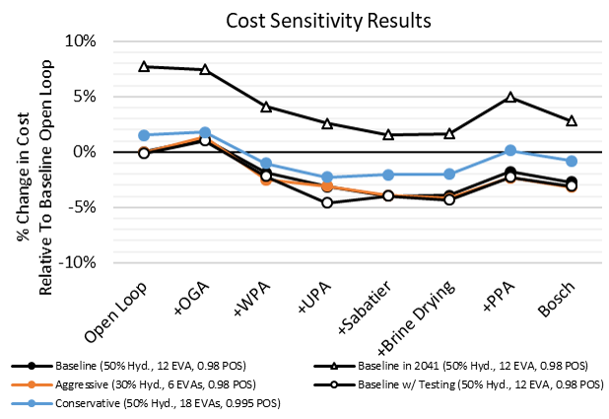
Cost Sensitivity Analysis
Examined total cost sensitivity to mission opportunity, testing, and aggressive/conservative combinations of other parameters
  Aggressive: 30% food hydration, 6 EVAs, 0.98 POS
  Conservative: 50% hydration, 18 EVAs, 0.995 POS
Does not include:
  Cost of changing food hydration levels
  Cost of additional testing
Aggressive assumptions and/or testing produce lowest costs
Increased loop closure decreases costs to a point, but lowest cost is not associated with maximum loop closure
Largest change in cost results from change in mission opportunity from 2035 to 2041

Slide 13
Choice of Objective Impacts Architecture Preferences
Subsystem-level priorities may have unintended consequences when propagated to the system and mission levels
  Optimizing loop closure is not equivalent to minimizing mass, due to the combined effects of system, logistics, and spares mass
Even similar appearing objectives can result in different preferred options
  Minimizing the total payload mass (ECLSS, logistics and spares, habitat) results in the Brine Drying case being preferred
  Minimizing the total departure mass (payload and transportation system) results in similar results from Brine Drying, Bosch, and Sabatier architectures
Relevant stakeholders must identify the objectives they value and use integrated analysis to understand how coupled design choices drive preferences among architectures

Slide 14
Isolated System Optimization May Not Lead To
Optimal Integrated Systems
Optimizing a single system can have unintended negative effects on other systems; thus, optimizing systems in isolation may not lead to an optimal integrated system
  Minimizing ECLSS cost and/or complexity would increase the mass pushed by the transportation system by ~21 t, resulting in a greater power and propulsion needs for the transportation system
  These increased power and propulsion needs correspond to larger arrays, greater vehicle dry mass, and increasing complexity of packaging within launch vehicle fairings
  This may result in more launches of the transportation system, threatening the mission schedule
ECLSS architecture decisions thus impact not only the design and operation of the crew’s habitat, but also have consequences throughout the entire mission architecture

Slide 15
ECLSS Decisions are Driven by Mission Assumptions
Assumptions and choices at the mission level may constrain options for ECLSS closure
  Additional EVAs may necessitate greater degrees of closure to makeup EVA losses
  Food hydration analyses may change the water content such that the value of water recycling shifts significantly
  Changes in propulsive requirements from one Mars opportunity to another may favor options with more or less mass at the end of mission, impacting the value of different degrees of closure
Trajectory assumptions and transportation system architecture can have much larger impact on departure mass and cost than ECLSS closure
  A desire to fly non-minimal energy trajectories to reduce trip times may increase associated transportation system costs far beyond the magnitude of changes resulting from different ECLSS choices
  High-energy trajectories are also more sensitive to habitat mass, and therefore may drive designs towards systems with low departure mass or low mass at later propulsive maneuvers

Slide 16
Future Work
This analysis only examined a very small subset of the overall mission architecture tradespace; future work will continue to examine other options
Specific additional factors to examine:
  Changes in habitat structures mass as a function of stowage requirements
  Power and thermal systems
  Spares jettisoning to reduce mass during the mission
  Optimized test plans for reliability growth and uncertainty reduction
  Variations in SEP power level
  Alternate trajectories (e.g. higher energy, faster opposition-class missions)
Further investigation required to examine feasibility of lower-hydration food from perspective of crew nutrition and palatability
More detailed examination of schedule and risk considerations alongside mass and cost

Slide 17
Summary and Conclusions
The preferred degree of ECLSS closure depends on the objective(s) by which that decision is being made
  Minimizing mass, complexity, and cost each have the potential to yield different preferences among ECLSS approaches
  Thus, the identity of the decision-maker and their associated value system will determine that preference
This choice cannot be made in absence of consideration of other systems within a space mission architecture
  Additional mass of a less closed ECLSS system can increase the burden on the transportation system, necessitating additional launches and impacting mission schedule
  However, further degrees of closure may have minimal impact on the transportation system at the expense of additional spares and added complexity
ECLSS closure likely does not lie at one or the other extreme, but depends on interrelationships between multiple systems within an architecture
  Thus, integrated analysis is necessary to assess these impacts to inform choices in the design and development process

Slide 18
References
[1] Stromgren, C., Cho, J., Owens, A., and Cirillo, W. Integrated ECLSS Metrics to Support NASA Technology and System Development Activities. Presented at the 50th International Conference on Environmental Systems, Lisbon, Portugal, 2020. ICES-2020-313 (submitted for publication).
[2] Owens, A. C. Multiobjective Optimization of Crewed Spacecraft Supportability Strategies. Doctoral Thesis. Massachusetts Institute of Technology, Cambridge, MA, 2019.
[3] Owens, A., and de Weck, O. How Much Testing Is Needed to Manage Supportability Risks for Beyond-LEO Missions? Presented at the International Conference on Environmental Systems, Boston, 2019. ICES-2019-66.
[4] Owens, A., and de Weck, O. International Space Station Operational Experience and Its Impacts on Future Mission Supportability. Presented at the International Conference on Environmental Systems, Albuquerque, NM, 2018. ICES-2018-198.
[5] Ewert, M. K., and Stromgren, C. Astronaut Mass Balance for Long Duration Missions. Presented at the 49th International Conference on Environmental Systems, Boston, MA, 2019. ICES-2019-126.
[6] Chai, P., Qu, M., Merrill, R. G., and Pfrang, K. G. Hybrid Transportation System Integrated Trajectory Design and Optimization for Mars Landing Site Accessibility. Presented at the AIAA Propulsion and Energy 2019 Forum, Indianapolis, IN, 2019. AIAA 2019-3961.
[7] Jones, C., Clark, M., Pensado, A., Ivanco, M., Reeves, D., Judd, E., and Klovstad, J. Cost Breakeven Analysis of Lunar ISRU for Human Lunar Surface Architectures. Presented at the 70th International Astronautical Congress, Washington, D.C., 2019. IAC-19-D4.5.15.
[8] Ivanco, M. L., and Jones, C. A. Assessing the Science Benefit of Space Mission Concepts in the Formulation Phase. Presented at the IEEE Aerospace Conference, Big Sky, MT, USA, 2020.
[9] Do, S., Owens, A., and de Weck, O. HabNet – An Integrated Habitation and Supportability Architecting and Analysis Environment. Presented at the 45th International Conference on Environmental Systems, Bellevue, WA, 2015. ICES 2015-289.
[10] Lange, K. E., and Anderson, M. S. Reliability Impacts in Life Support Architecture and Technology Selection. Presented at the International Conference on Environmental Systems, San Diego, CA, 2012. AIAA 2012-3491.
[11] Arney, D. C., Earle, K. D., Cirillo, W., Jones, C. A., Klovstad, J., Grande, M., and Stromgren, C. The Impact of Mission Duration on a Mars Orbital Mission. Presented at the AIAA SPACE and Astronautics Forum and Exposition, Orlando, FL, 2017. AIAA 2017-5284.

