Slide 1
ICE-RASSOR Intelligent Capabilities Enhanced
Notes:
MD

Slide 2
Mass Inference Architecture
ICE-RASSOR | FY20 KSC IR&TD | Slide 2
learning
Neural Network
RASSOR Measurements
Motor currents
Motor positions
Estimated Mass
-
Error
True Mass
(recorded on test stand)
Notes:
MD

Slide 3
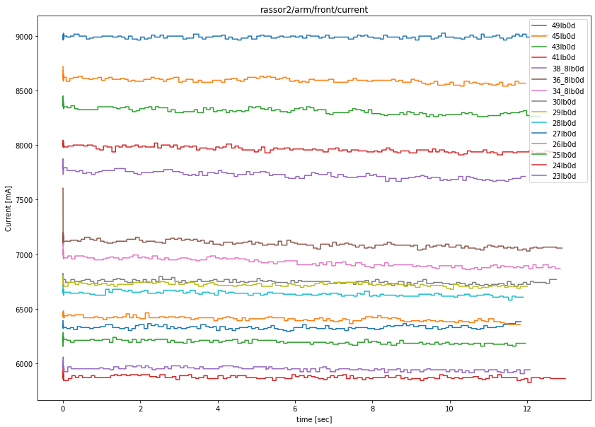
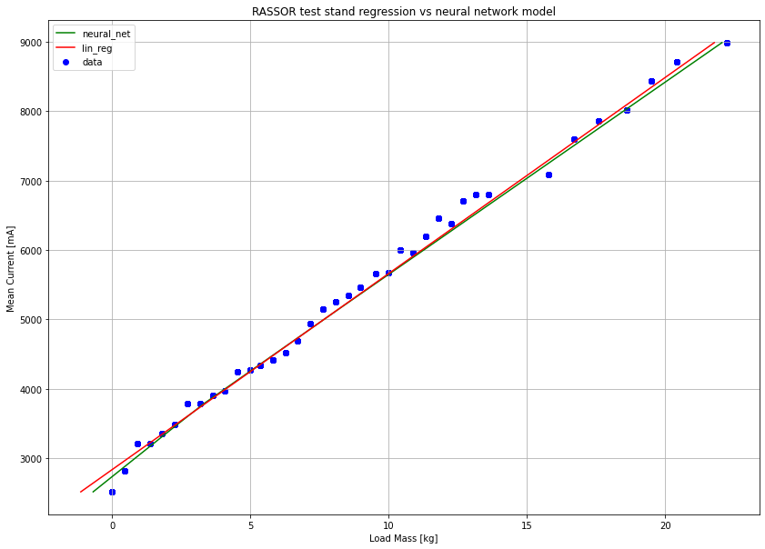
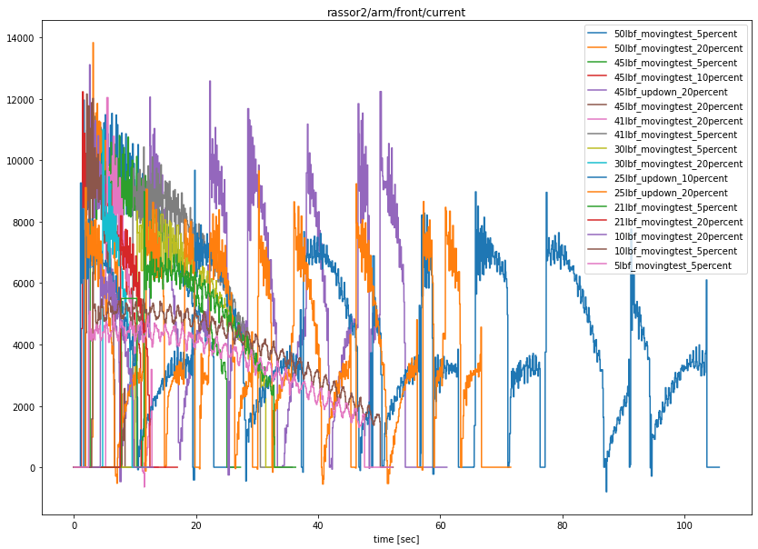
Mass Inference Training Results
ICE-RASSOR | FY20 KSC IR&TD | Slide 3
Raw Static Data
Static Data Regression/ML
Raw Dynamic Data
Notes:
JC
Be sure to give brad a bunch of props for raw data
Covid data collection timeline etc
Initial training

Slide 4
ICE-RASSOR | FY20 KSC IR&TD | Slide 4
Architecture
RASSOR Measurements
Arm positions
Wheel direction
Edge of trenches
Simulation
Environment
state
Agent
Action
reward
state’
Notes:
MD

Slide 5
Why create a custom simulation environment?
ICE-RASSOR | FY20 KSC IR&TD | Slide 5
Lack of available environments that allow interaction/modification of "ground" mesh to represent digging.
Allows finer control over how the agent interacts with the environment
Opportunity to build an Open AI Gym compatible environment from ground up, learn the API. This exercise gave us the skills to more rapidly build AI simulation environments in the future. It also provided boilerplate code for reuse.
Why 2D?
Fast and easy to get working while a 3D sim is being developed
Reduces state space and action space size significantly
Lower computational requirements
Makes initial RL agent simpler
Is extendable to 3 Dimensions. Constant cross sections
Notes:
BB

Slide 6
Soil physics and resistance
ICE-RASSOR | FY20 KSC IR&TD | Slide 6
Notes:
TM

Slide 7
ICE-RASSOR | FY20 KSC IR&TD | Slide 7
Excavation Reinforcement Learning Results
20x speed.
Notes:
JC
-doesn’t simulate need to stop/deposit regolith (future work)
- Goal is not to dig a perfect trench in this step, but to see if it can learn the operations of *digging*
-explain why it is trenching the way it is
- Levels of trenching, reward can be specified to do x

Slide 8
Partnerships
ICE-RASSOR | FY20 KSC IR&TD | Slide 8
Dr. Warren Dixon (UF Nonlinear Controls & Robotics Lab):
Integral Concurrent Learning for Bucket Drum Mass Estimation
Rolando Nieves (UB) Independent Study:
10x speed.
Notes:
MD
Rolando:
Shows output of training process
Get back gazebo / ROS2 integration work he did with RASSOR models

Slide 9
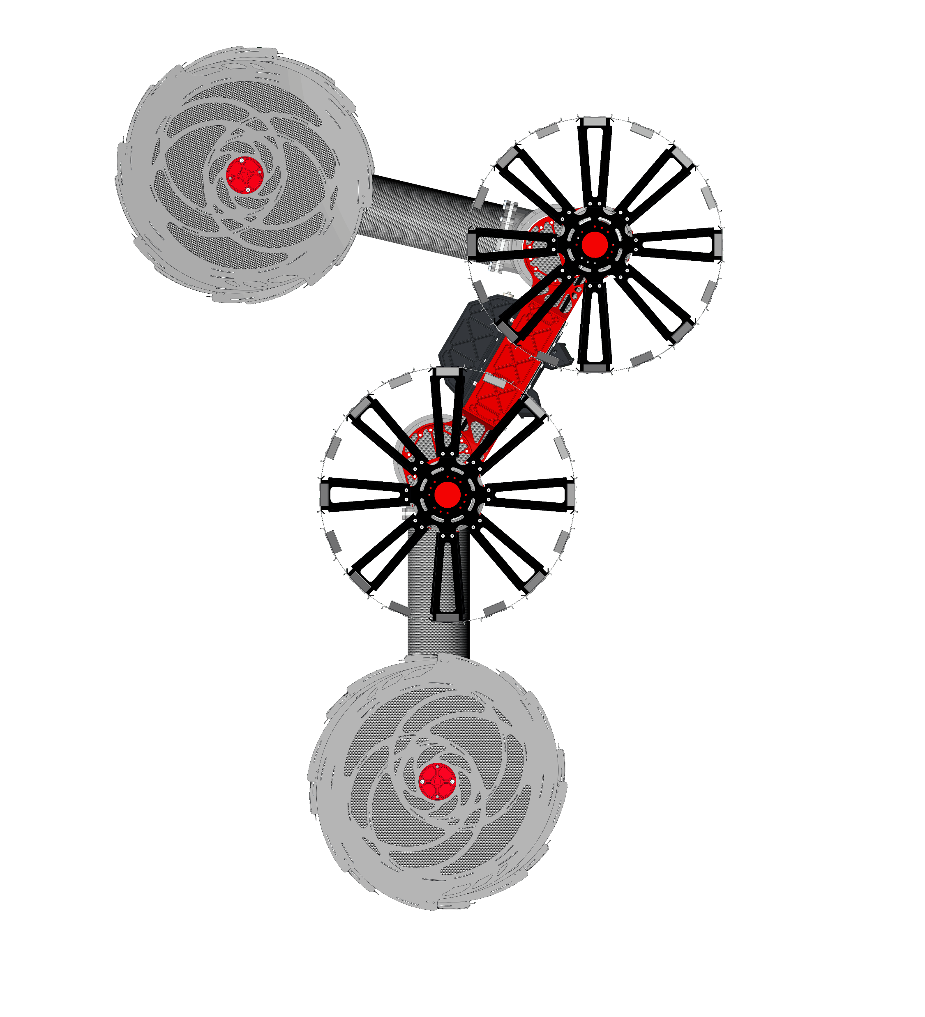
QUESTIONS
Notes:
Any Questions?
Put template back in

