Slide 1


Centennial Challenges Program
A Pathway to a Sustainable Lunar Presence
Monsi Roman
NASA Centennial Challenges
www.ascend.events

Slide 2
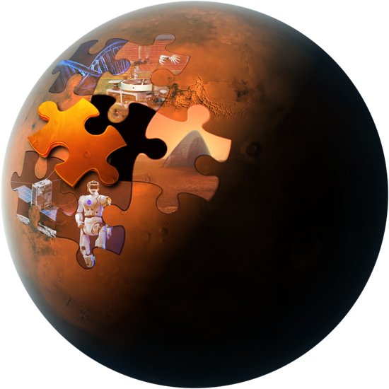
Goal:
Stimulate research and technology solutions to support NASA missions and inspire new national aerospace capabilities through public prize competitions
Objectives:
Expand the pool of potential solutions to meet identified NASA research and technology needs
Stimulate new capabilities and commercial markets for the Nation
Cultivate a broader, more diverse community of innovators contributing to NASA and aerospace activities
Notes:
17
The Centennial Challenges Program uses the objectives, agreed by HQ as a result of the Independent Assessment as a guide for the metrics of importance to the Agency and the nation.
There has been a significant increase in participation, therefore solutions presented to NASA SME/stakeholders at the same time that we have cultivated a diverse community of innovators
Space Robotics
Cube Quest
3DPH
Proven increase in new capabilities and commercial markets
3DPH
Cube Quest
Vascular Tissue

Slide 3
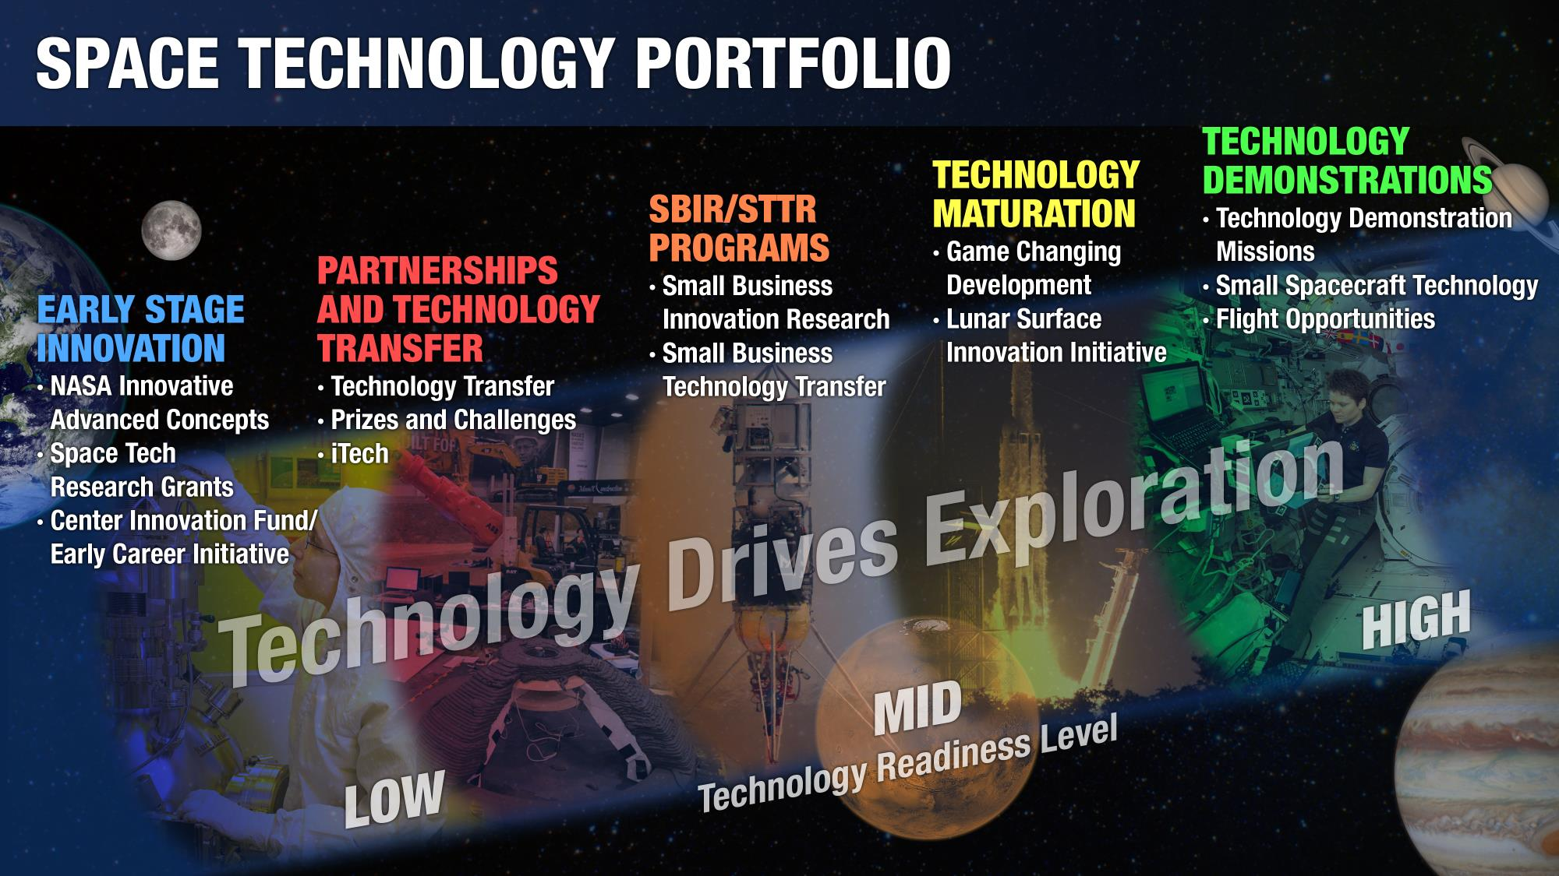
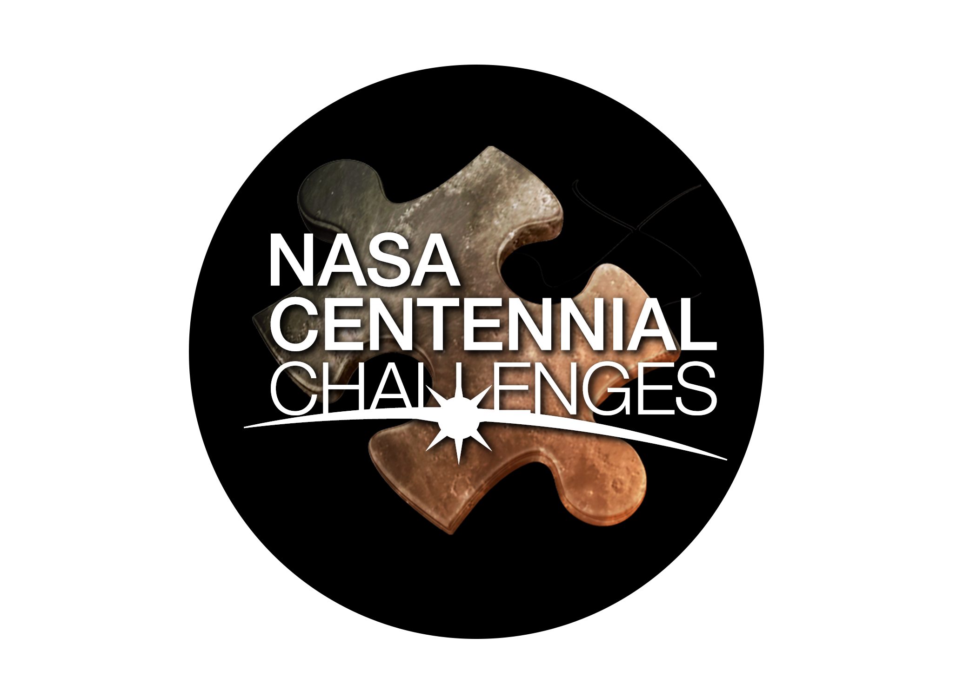

Slide 4

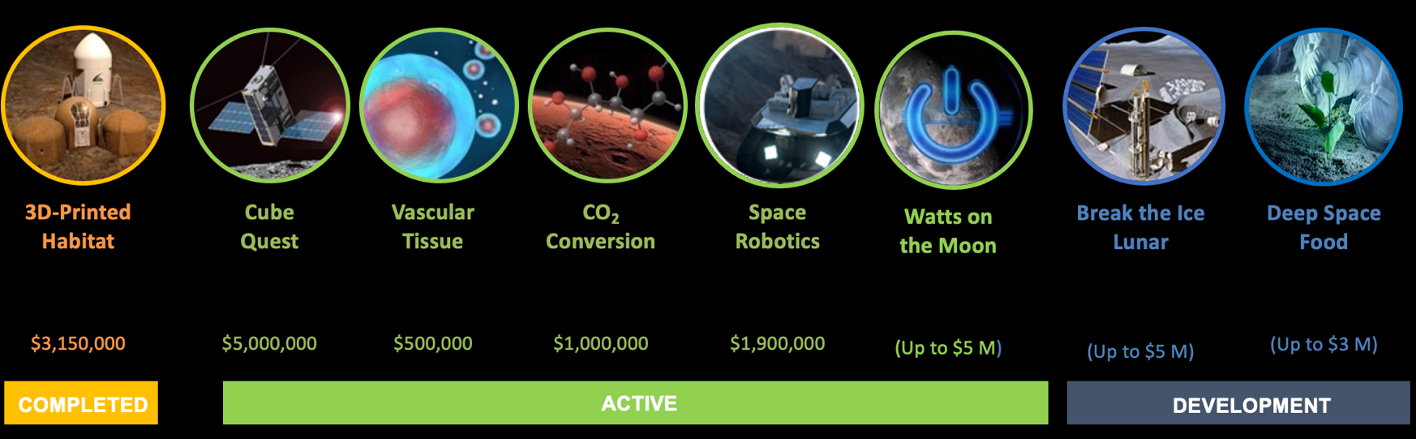
Centennial Challenges Program
Overview of Centennial Challenges Program
20 Total
Challenges
307 Teams
Participated
Participants from 42 States
24 Countries
$10.33M
Awarded
Current Challenges

Slide 5
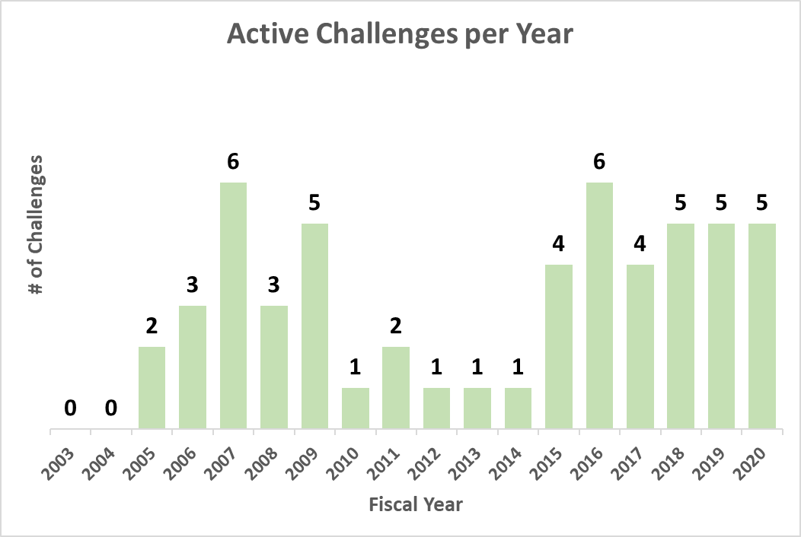
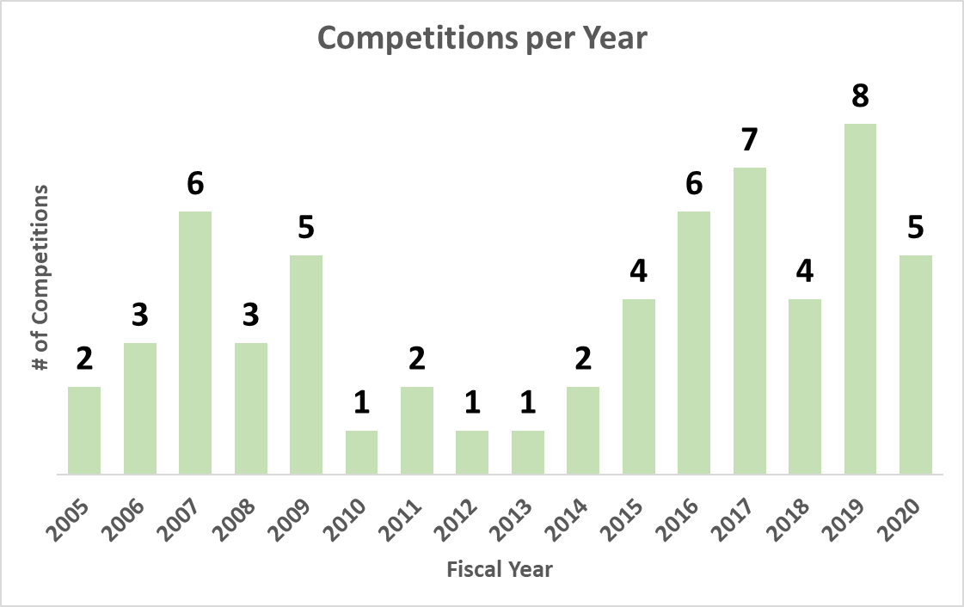
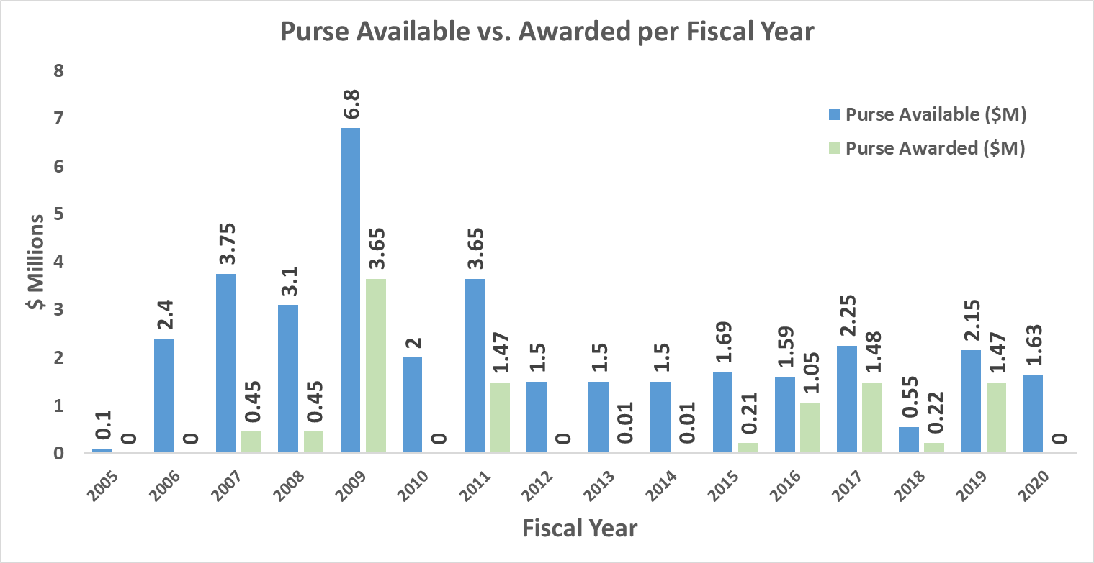
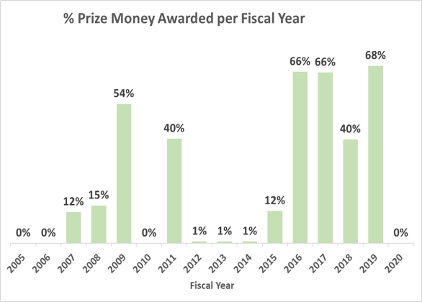
For the Past Five Years the Program has Maintained a High Level of Performance Related to Active Challenges, Competitions and Percentage (%) of Awarded Prize Purse
Notes:
In 2014 the NASA Administrator (Bolden) requested an independent assessment (IA) of the Centennial Challenges Program due to the low number of active challenges (1 or 2), and low percentage of prize awards.
The IA was conducted in 2016/17; changes implemented in 2015 started to show progress when the assessment was started and Steve Jurczyk presented to the administrator the results of the assessment and the effects of the changes seen the graphs above.

Slide 6
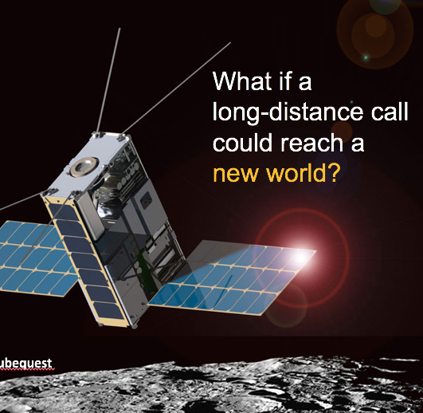
Cube Quest

Slide 7

Vascular Tissue Challenge

Slide 8

CO₂ Conversion Challenge

Slide 9
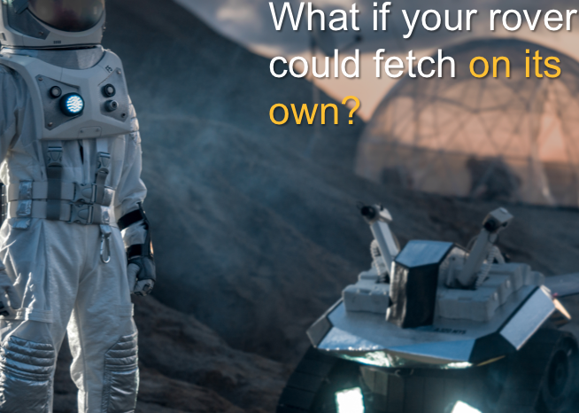
Space Robotics
Challenge

Slide 10
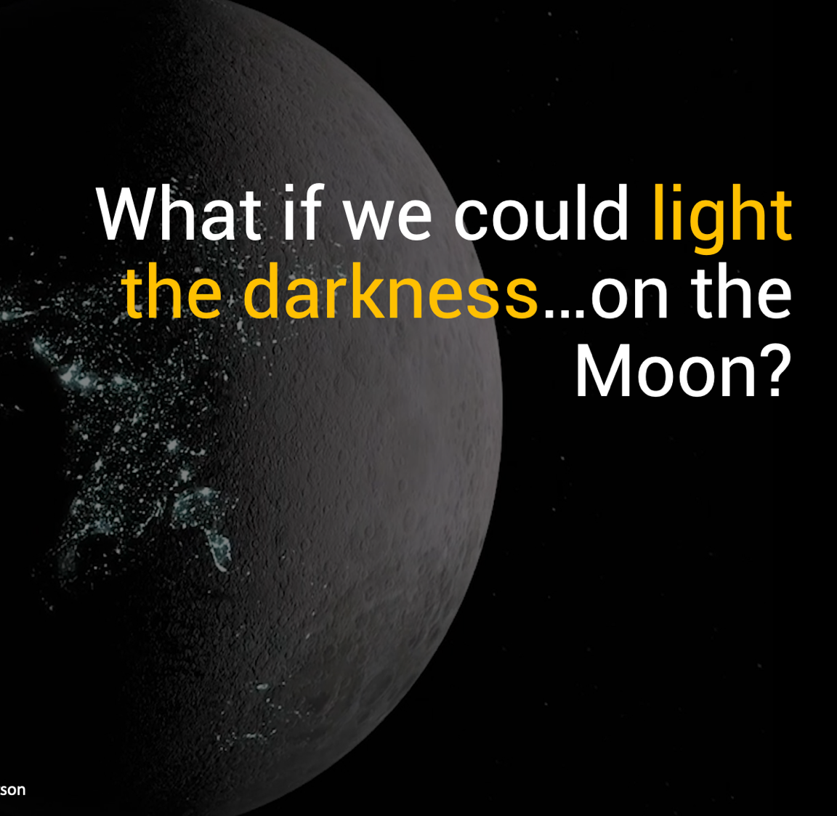
Watts on the Moon Challenge

Slide 11

Deep Space Food Challenge

Slide 12

Break the Ice Challenge

Slide 13
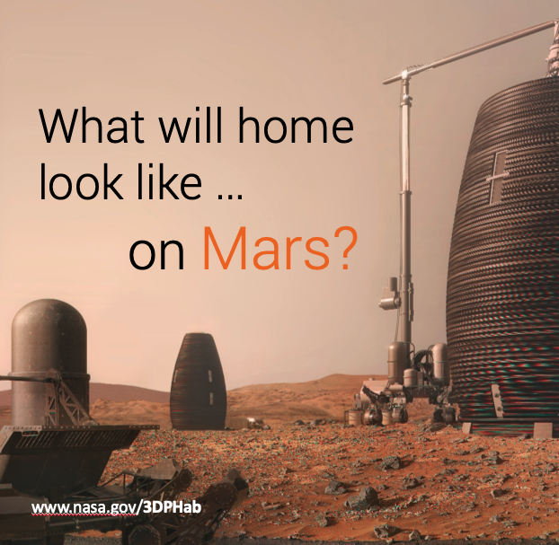
3D Printed Habitat Challenge

Slide 14
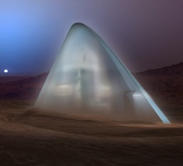
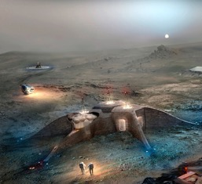
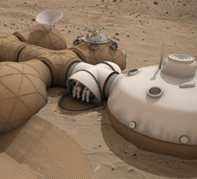
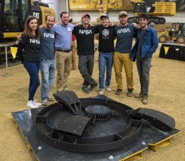
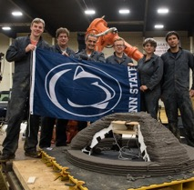

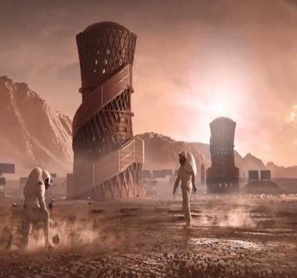
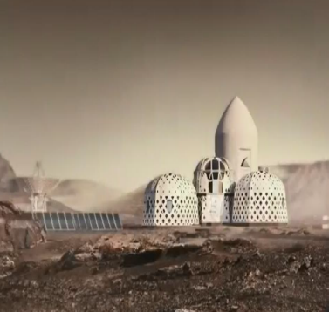
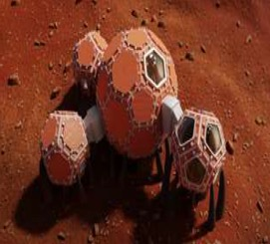
3D-Printed Habitat Challenge
3DPH Challenge Phase 1: Design
7/2015- 9/2015
Prize Purse: $50,000/$40,000 awarded
Develop state-of-the-art architectural concepts that take advantage of the unique capabilities offered by 3D printing.
1st Place
SEArch/Clouds Architecture Office
2nd Place
Team Gamma
3rd Place
Lava Hive
3DPH Challenge Phase 2: Material
6/2016- 5/2017
Prize Purse: $1,100,000/$701,000 awarded
Autonomously 3D Print structural components using terrestrial/space-based materials and recyclables.
Level 1
Level 3
Level 2
1st Place
Branch Technologies
2nd Place
Penn State
3DPH Challenge Phase 3
11/2017- 5/2019
Prize Purse: $2,000,000/$1,320,000 awarded
Level 4: Virtual Construction (Building Information Model/BIM)
1st Place
SEArch+ / Apis Cor
2nd place
Zopherus
3rd place
Mars Incubator

Slide 15
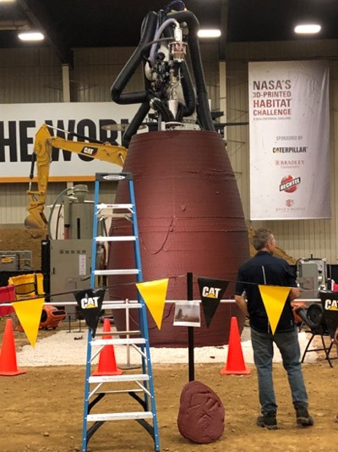
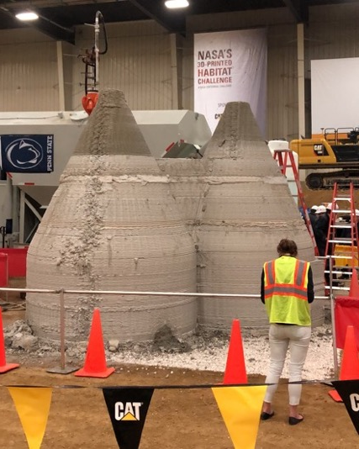
3D-Printed Habitat Challenge
1st Place – AI. Space Factory (New York City, NY)
2nd place: Pennsylvania State University (University Park)
3DPH Challenge Phase 3
Level 5: Demonstrate an autonomous additive manufacturing system to create a habitat.
Media Engagement:
Phase 3 generated 408 media features resulting in an estimated 113.5 million viewers.
The Facebook Live broadcast of the head to head competition had 1,936 views.
Media coverage included CNN, Business Insider, Fox News, Popular Mechanics, and Popular Science.
Technology Highlights
Demonstration of safe and innovative new material compositions for 3D printing pressure vessels on a large scale with application to NASA missions and Earth construction.
Demonstration of processes and equipment for large-scale vertical autonomous construction.
Diversity/innovation in viable designs of realistic planetary Habitats.
Innovative use of modeling software common to the construction industry as a more comprehensive design tool than the software commonly used by the aerospace industry for Additive Manufacturing technologies.
Demonstration of new software and control algorithms for depositing material in a non-two dimensional layer.
15

Slide 16
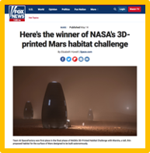
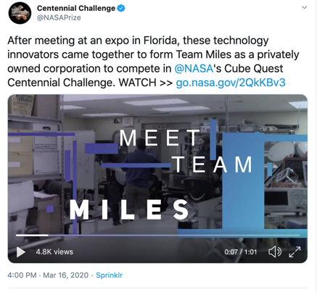
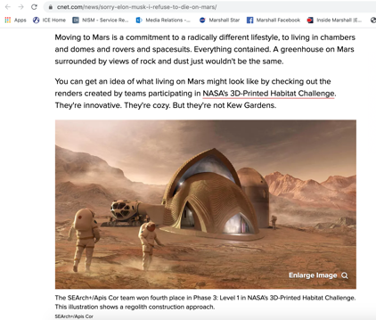
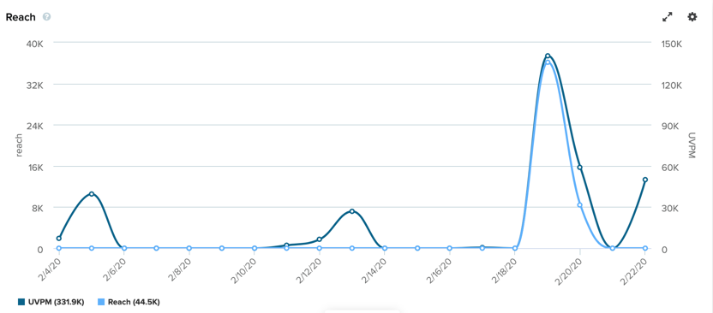

Optimized Communication and Outreach Opportunities to Maximize Number of Potential Competitors Reached; Creates Value to Competitors
Cohesive communication strategy aligns with the goals of the individual challenges as well as the overarching communications goals of NASA.
@NASAPrize social media accounts have a strong following (> 22K on Twitter).
Engaging with the teams using @NASAPrize social media accounts gives the competitors the intrinsic benefit of exposure.
Creates opportunities for Centennial Challenges to be incorporated into the broader NASA conversation.
Helps the program build relationships with past competitors, aiding recruitment.
Facilitates relationships with local media resulting in interviews and coverage of events for the program and its challenges as well as Marshall Space Flight Center.
1.1 M Views
How competitors learned of the Space Robotics Challenge Phase 2
Media Coverage for LEMC
Pass the Torch Event
38.62M views
Notes:
The importance of outreach and communication can not be emphasized enough!
Centennial Challenges Program success is tied to the diversity of participants that we can attract to compete, including out-of-discipline (experts in areas similar but not aerospace). If we do not have the tools to communicate with the potential competitors the program will not be successful.
- During the pandemic, we have had to change and adjust the way we do recruitment and outreach. In lieu of conferences that we were planning to exhibit to recruit competitors, we are changing our strategy to focus more on virtual events and rely more heavily on social media marketing for recruitment. As you can see from the chart above, just under half of the participants in the Space Robotics Challenge learned about the challenge from our online presence (web features and social media). Note: Some of those who responded with “online” could have been through social media also.
Allows for Centennial Challenges to be incorporated into the broader NASA conversation. For example, one of NASA’s priorities for 2020 is to be a part of the national conversation by telling the stories of the humans behind the missions. Centennial has been able to engage with the public in this way by telling the stories of the teams from past challenges and how the challenge has helped them become successful in their fields.
- Having in-house communications helps the program build relationships with past competitors. If the competitions were marketed by a third party or tasked out to a different communications specialist as a widget, then these relationships that help recruit competitors would be lost.

Slide 17
CENTENNIAL CHALLENGES BY THE NUMBERS (2005- 2020)
> $10 M
20
> 52
> 16
Awarded to individuals, academia and industry teams
Numbers of challenges opened
Teams awarded prize money
Small Business created or grown as a result of participation in a competition
> $8.5 M
> $11 M
> 13
> 9
Allied Organizations investments to support NASA competitions
Invested by participants in technology demonstrations at competitions
Allied Organizations that have supported NASA CC competitions
Teams under contracts to advance NASA missions (new to NASA)

Slide 18

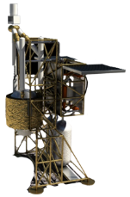
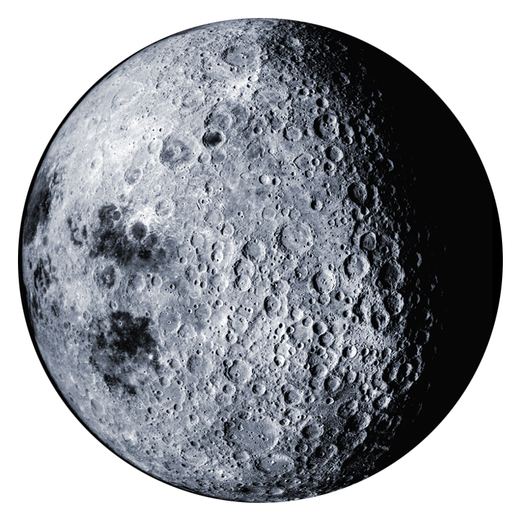
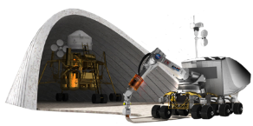
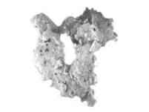
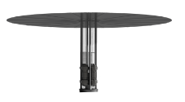
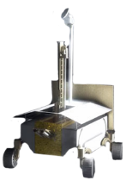
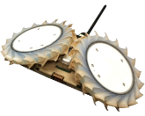
LUNAR SURFACE INNOVATION INITIATIVE (LSII) AREAS
ALIGNED WITH CENTENNIAL CHALLENGES COMPETITIONS
Surface Excavation/Construction
BTI
In-situ Resource Utilization
BTI
Collection, processing, storing and use of material found or manufactured on other astronomical objects
Enable affordable, autonomous manufacturing or construction
Lunar Dust Mitigation
WOTM
Sustainable Power
Mitigate lunar dust hazards
Enable continuous power throughout lunar day and night
Extreme Access
Extreme Environments
SR
Access, navigate, and explore surface/subsurface areas
Enable systems to operate through out the full range of lunar surface conditions
BTI
SR

Slide 19
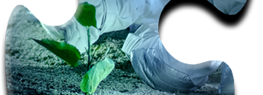
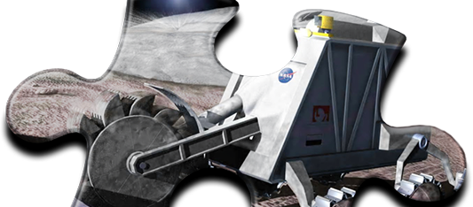
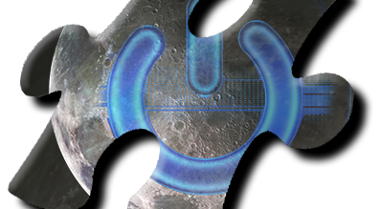
Summary
The Centennial Challenges Program (CCP) runs multi-million dollar competitions aligned with NASA needs and engages out of discipline public.
Competitions have stimulated new capabilities and commercial markets for NASA and for the Nation.
Technologies incentivized are helping shape the future of Earth and space exploration.
Crowdsourcing is playing a part in extending human presence deeper into Space and to the Moon for sustainable long-term exploration and utilization.
Notes:
17
Back up

Slide 20

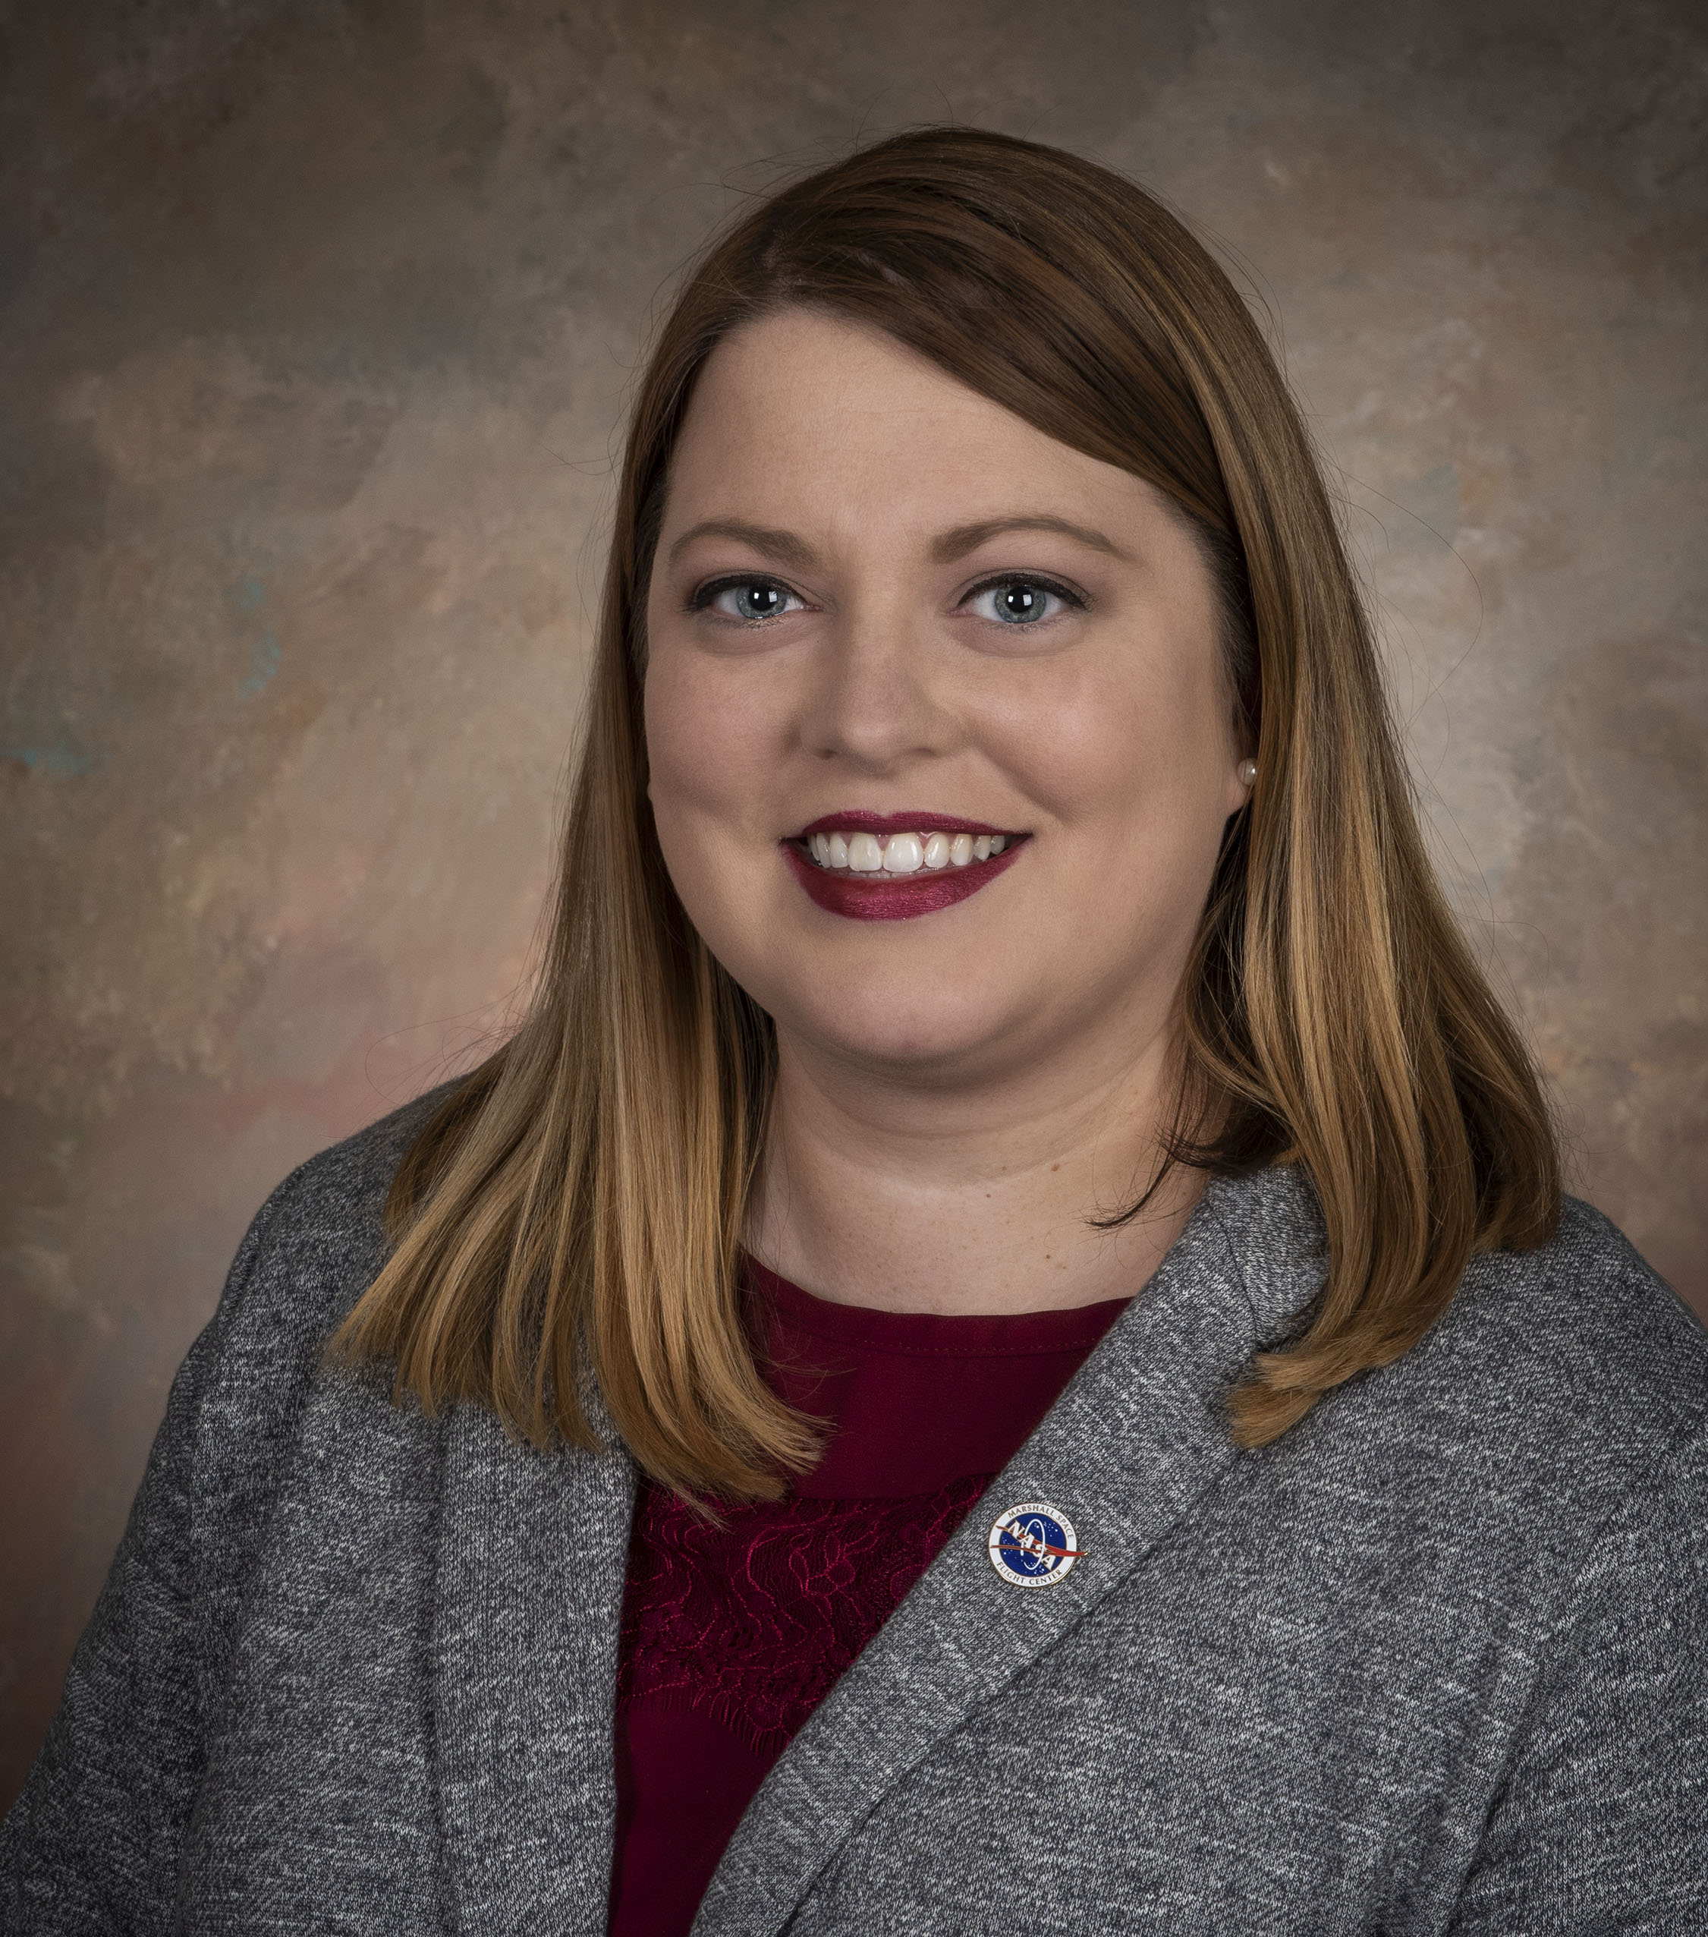

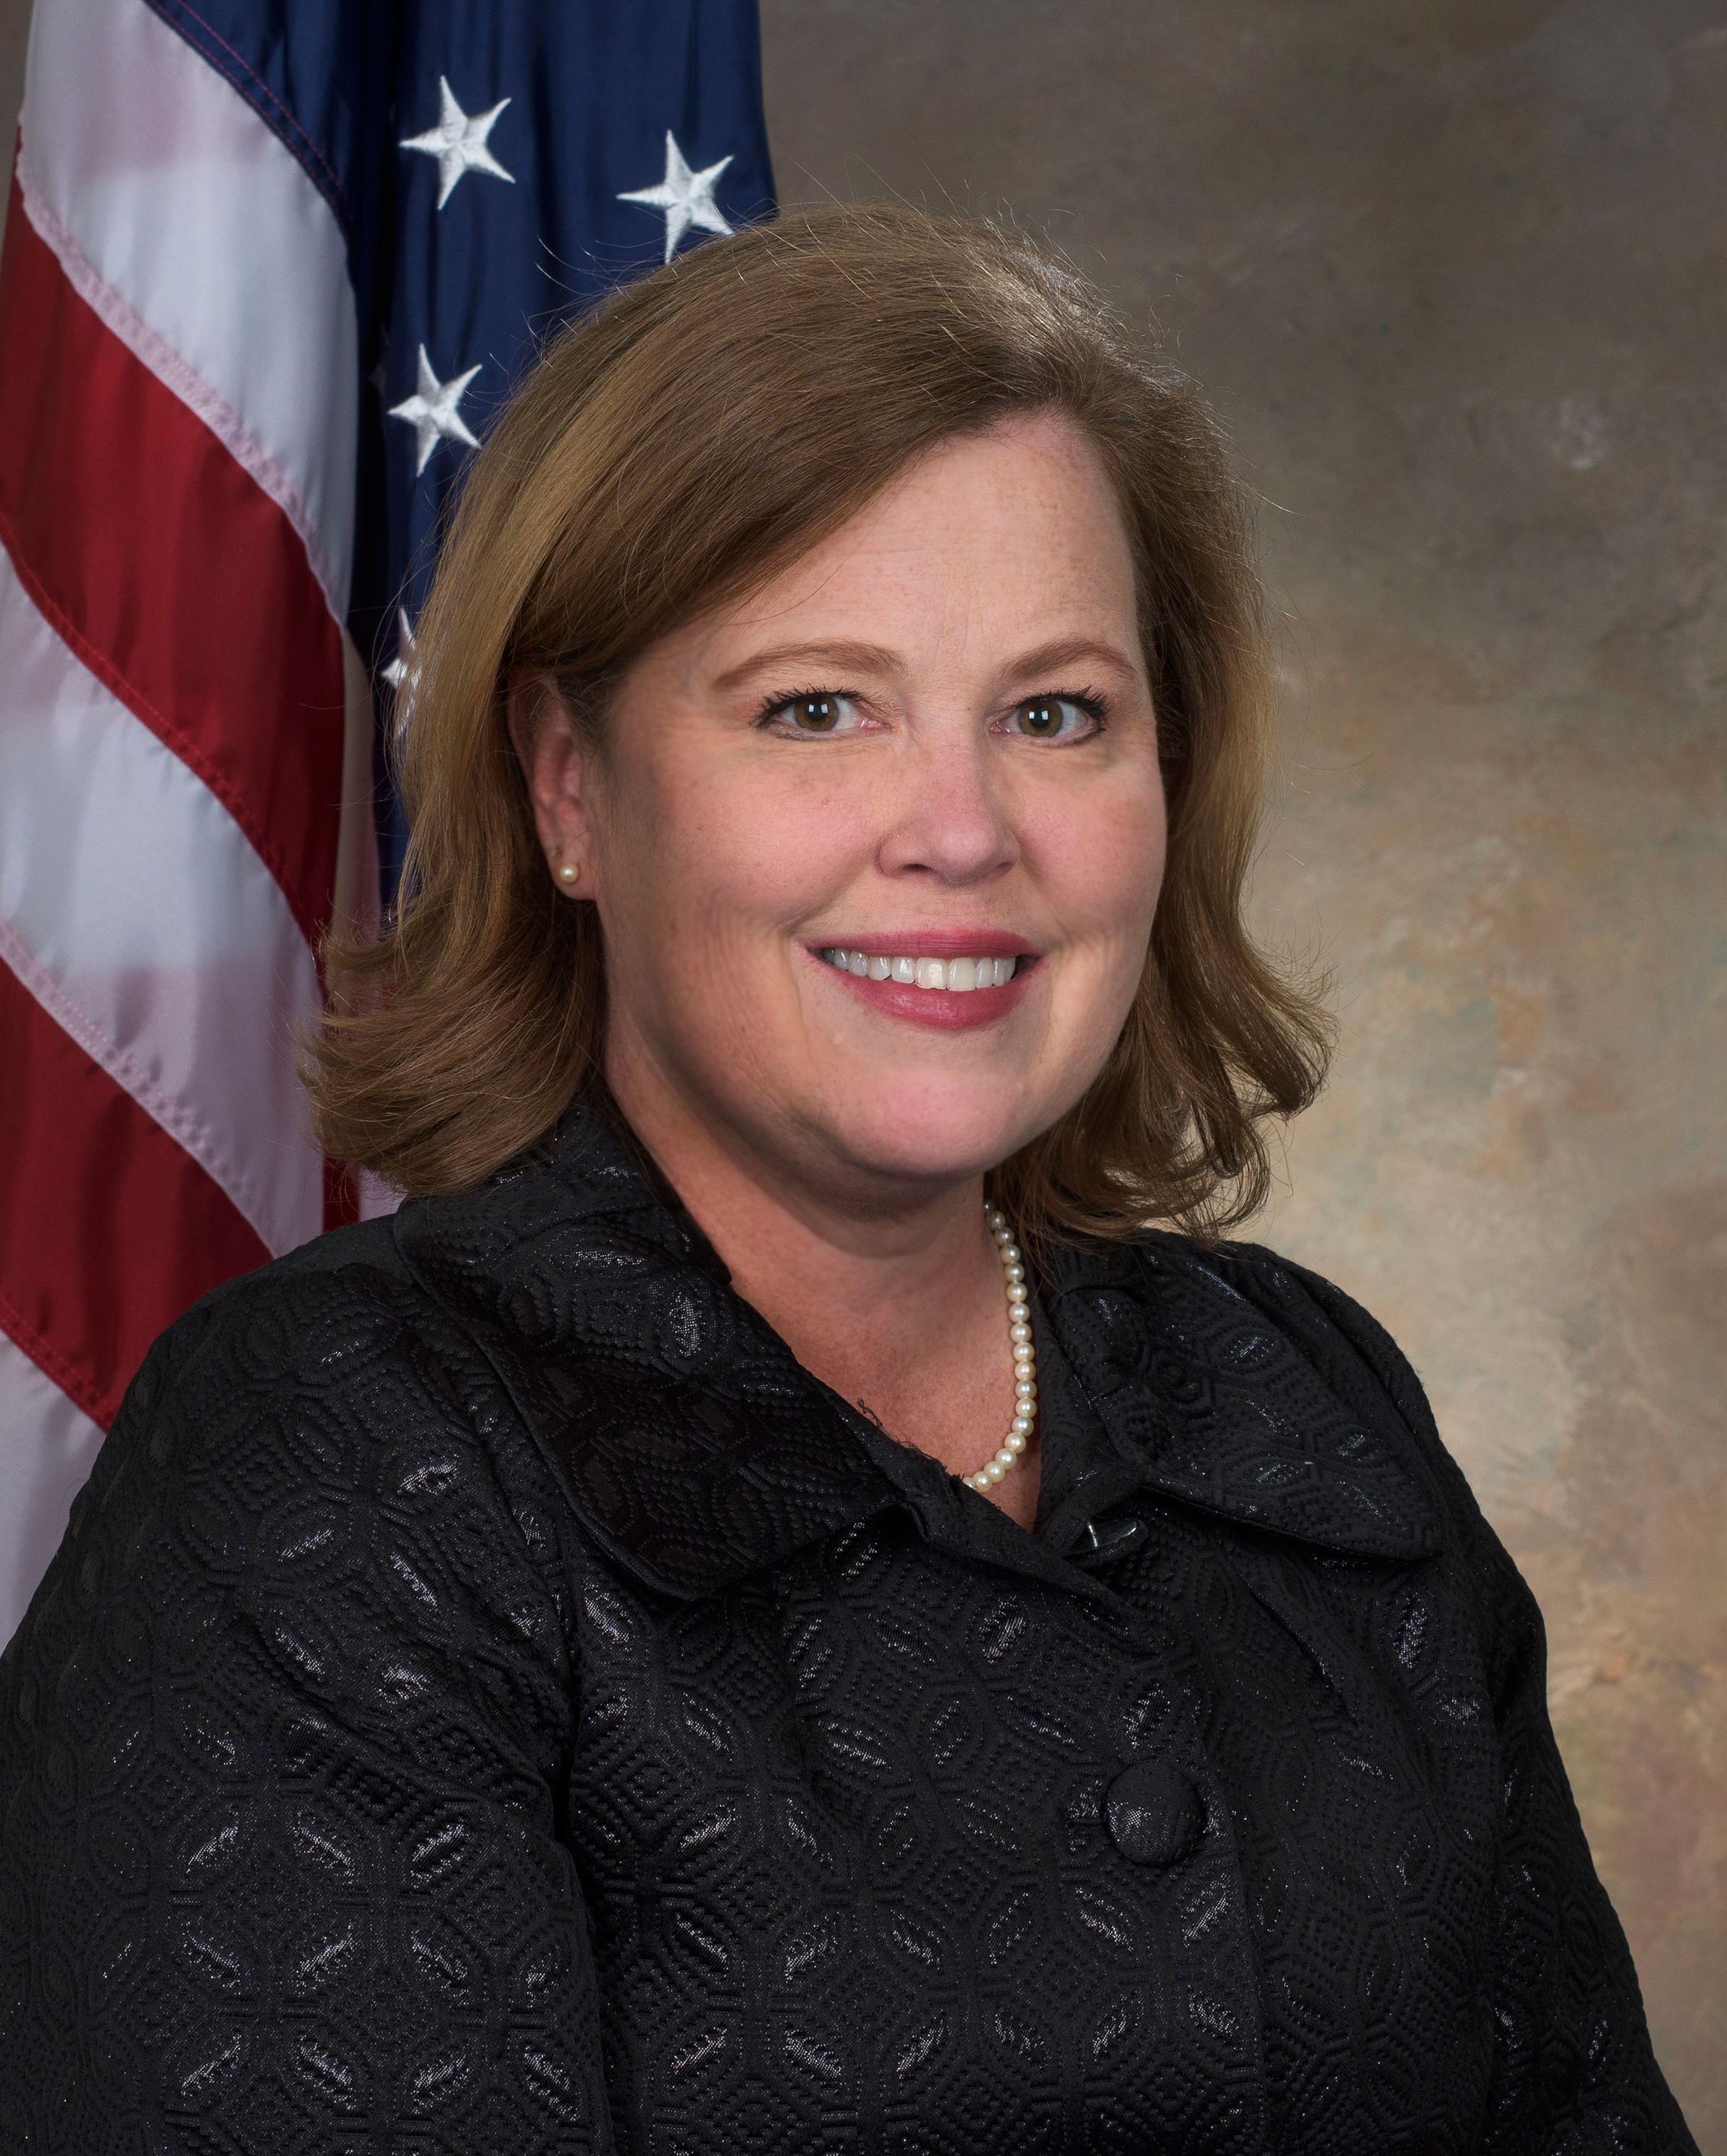



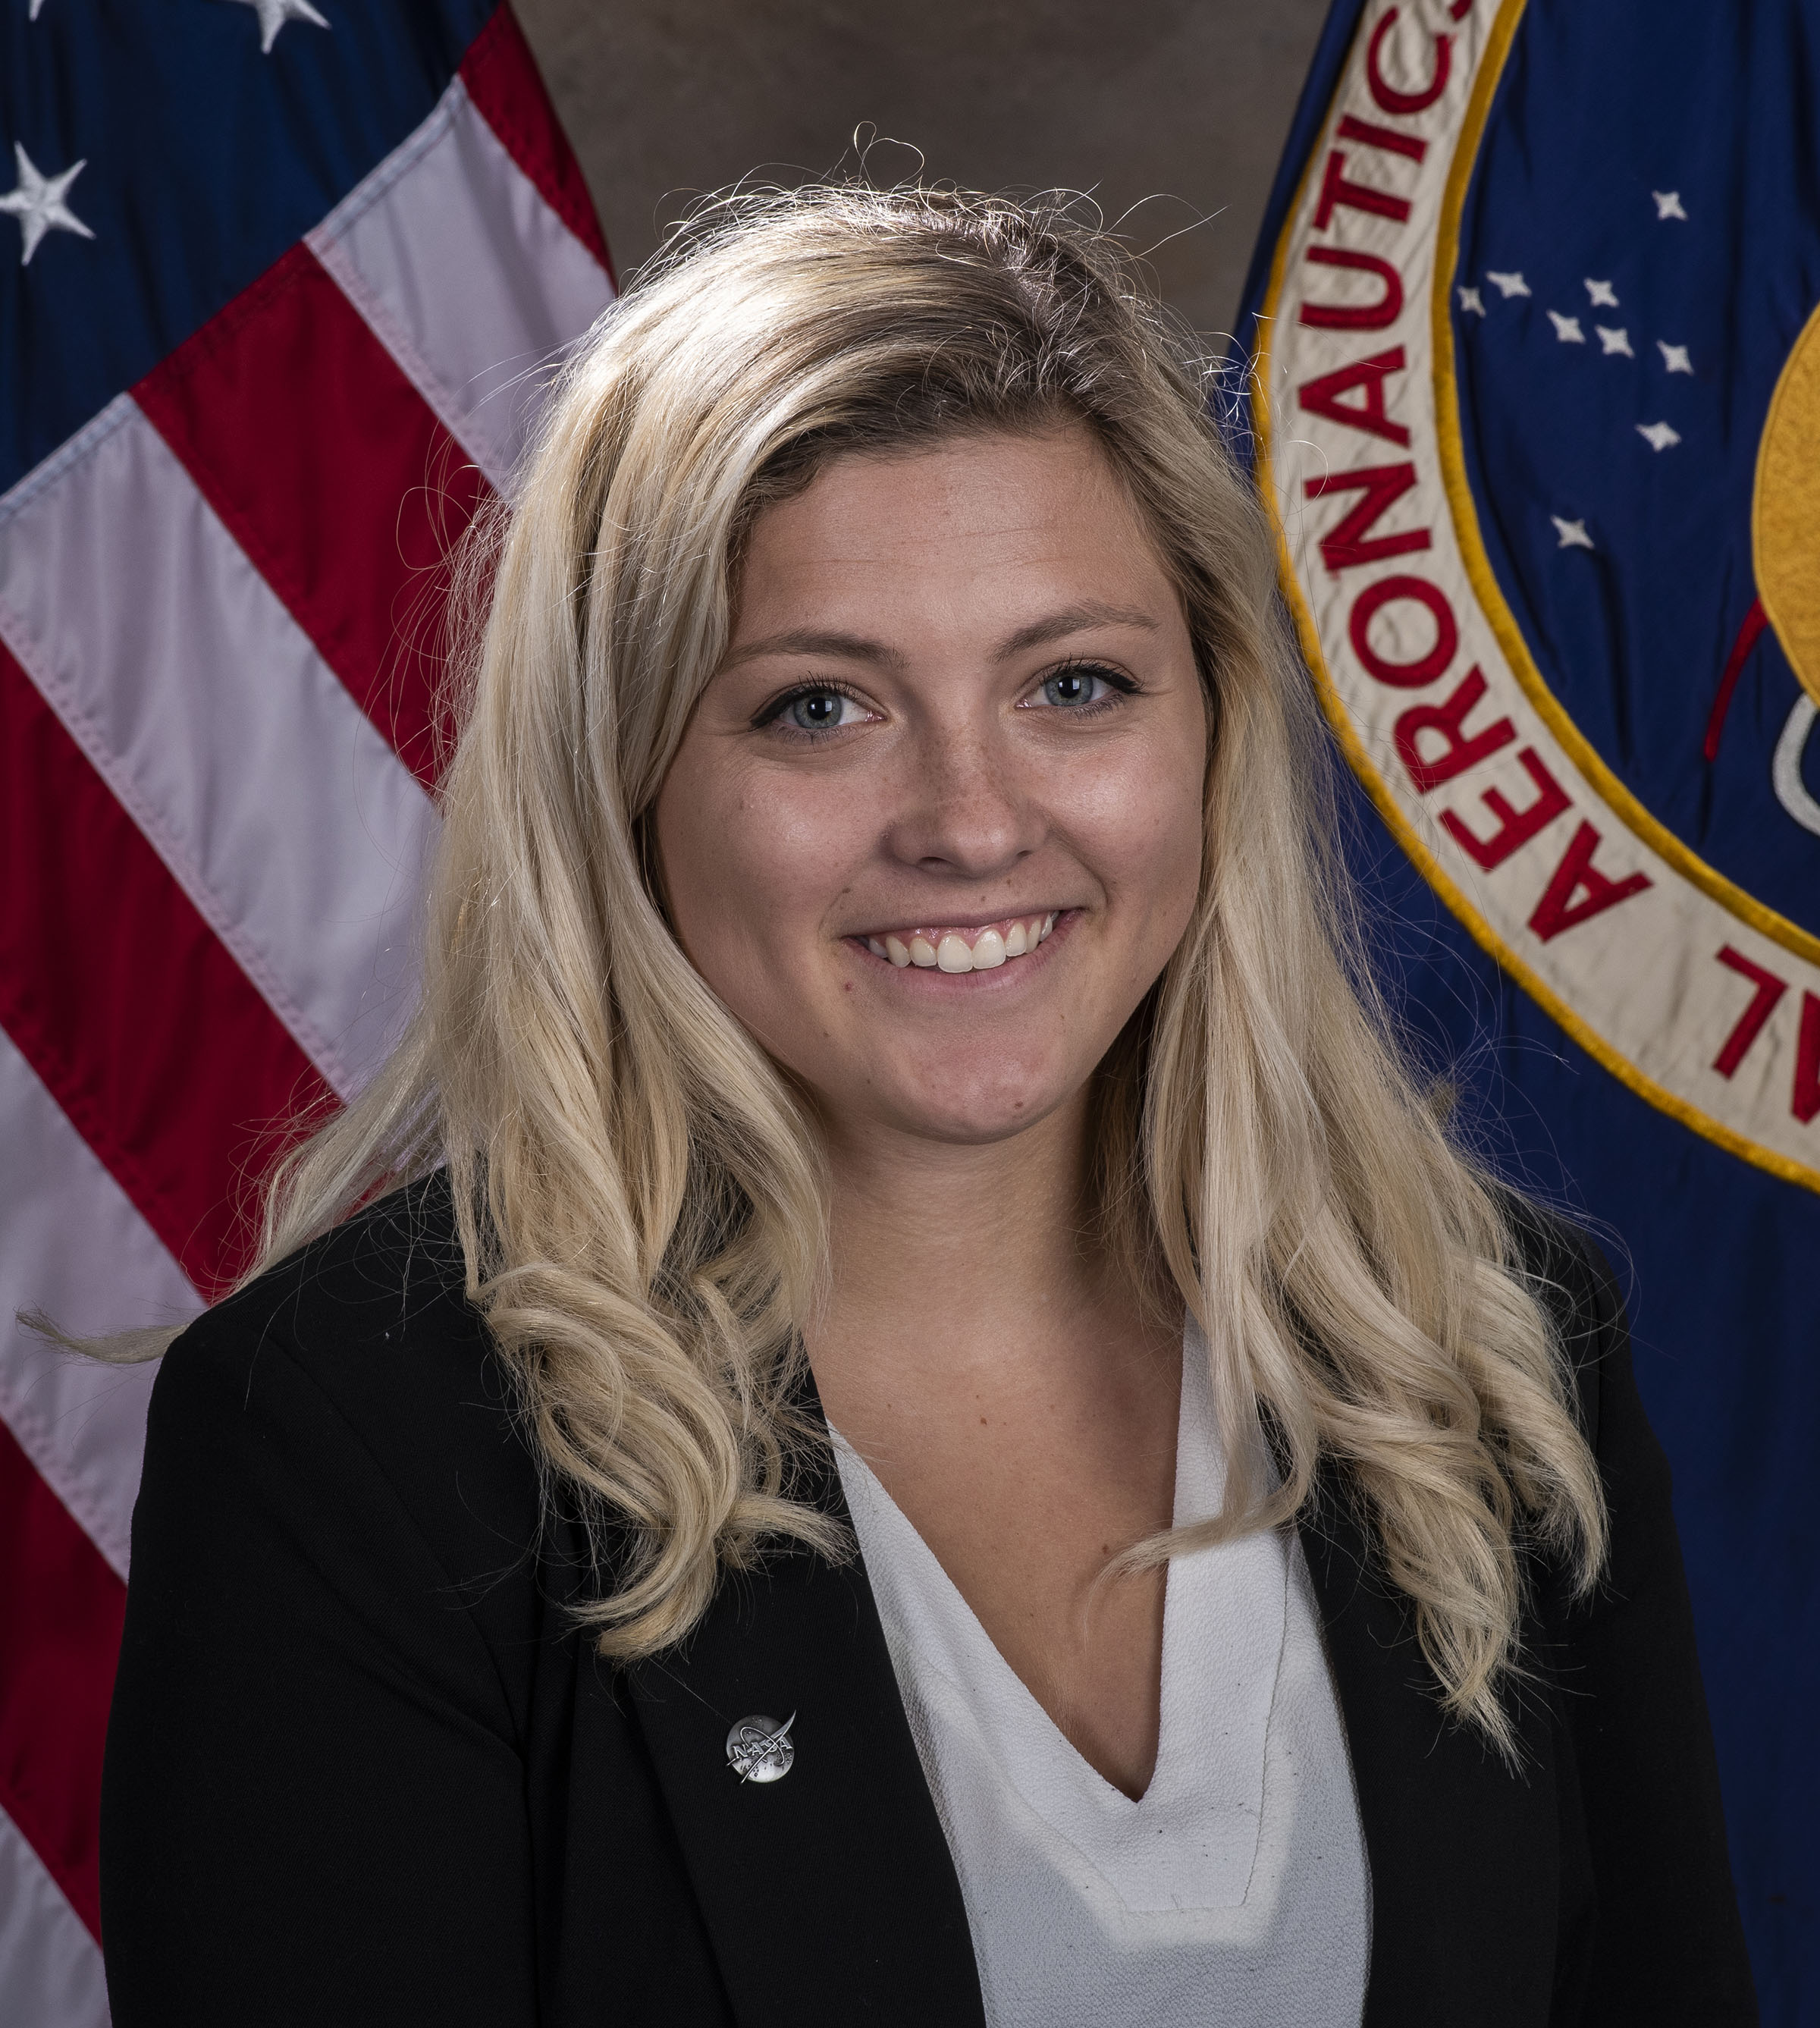


The NASA Centennial Challenge Team
 | Monsi Roman CCP Program Manager
 | Denise Morris CCP Deputy Program Manager
 | Angela Herblet Data & Information Specialist III CCP Challenge Manager
 | Dawn Turner CCP Challenge Manager
 | Amanda Adams CCP Communication Integrator
 | Naveen Vetcha CCP Challenge Manager
 | Lane Stafford CCP Project Coordinator
 | Rosalind Cylar MSFC Legal Council
 | Chris Frangione Challenge Development Consultant
 | Jen Bravo Challenge Development Consultant
 | Alisa Ferguson Challenge Development Consultant

Slide 21
Monsi Roman, Program Manager

