Slide 1

The Ejectable Data Recorder: A Lean, Risk-Informed Approach for Hardware Development
Kristina Rojdev, Jenny Devolites, and Jon Olansen
NASA-JSC
This material is a work of the U.S. Government and is not subject to copyright protection in the United States.
www.ascend.events

Slide 2

Outline
AA-2 and EDR Background
Hardware Classification and the EDR Class-1E Drivers
Tailoring and Overall Risk Posture
Flight Test Results

Slide 3

AA-2 & EDR Background

Slide 4
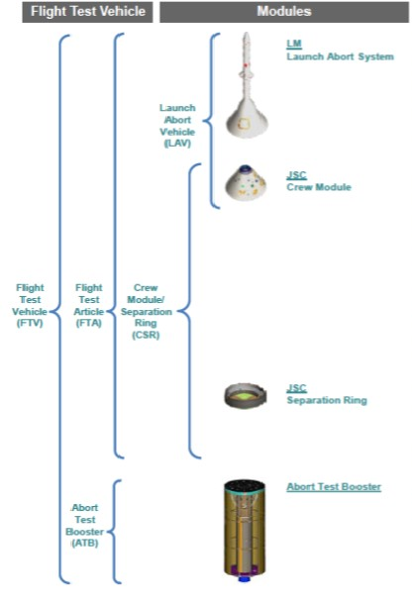
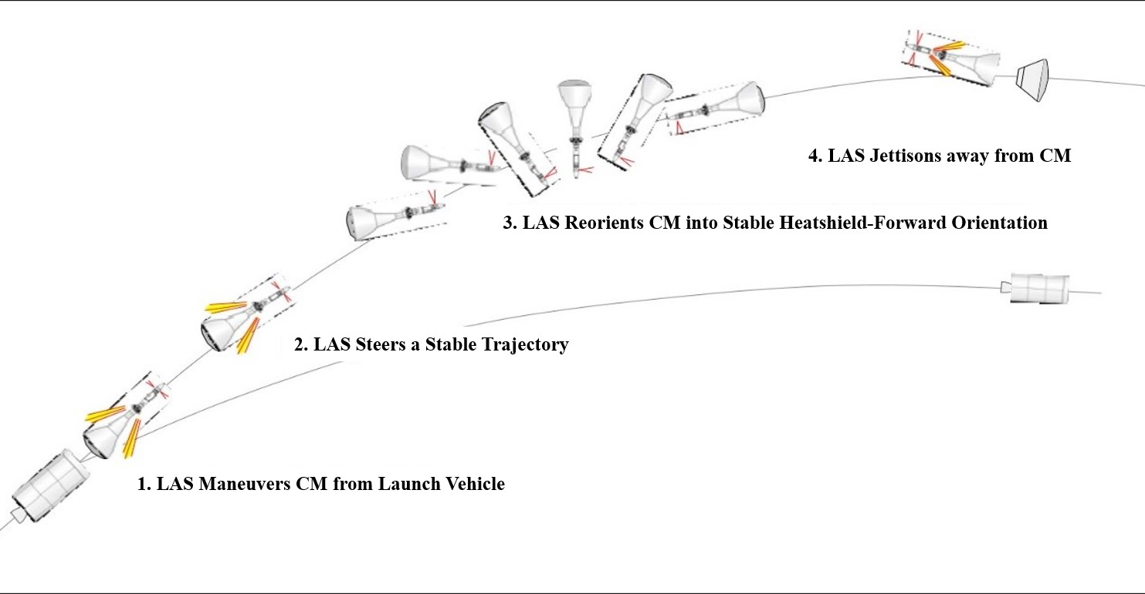
Background: AA-2 Flight Test
Purpose: to perform an ascent abort with the LAS under flight-like, high dynamic pressure conditions
Objectives:
  Primary: Demonstrate that the LAS would effectively maneuver the Crew Module (CM) away from the booster and jettison from the CM
  Secondary: Collect flight test data which will be used in Orion vehicle certification
Not human rated
Test Flight Duration: 3 min, 13 sec
Test Flight Altitude: 31,000 ft
Abort initiated

Slide 5


Background: Why EDR?
Original ConOps
CM expected to tumble after LAS jettison
Primary Downlink: LAS antenna network (single string)
LAS Jettison: loss of comm
Abort: data dropouts possible due to abort motor plume and reorientation
Risk 10 - Comm Design: Given that the comm subsystem conceptual design is a single string subsystem that ceases to function at initiation of LAS jettison, there is a possibility that mission critical data will not be captured.
DFI-001: Redundant Comm and near-field separation data trade
Options:
Redundant comm with antennae on CM
On-board recorder (hardened and/or ejectable)
DFI-002: Telemetry antenna trade
Options:
Add heat shield antenna at abort and transition from LAS antenna to CM back shell antenna (with heat shield antenna) at LAS Jettison
DFI-003: Ejectable/Jettisonable DFI on-board recorder trade
Options:
Ruggedized on-board recorder that can be ejected prior to splash down

Slide 6
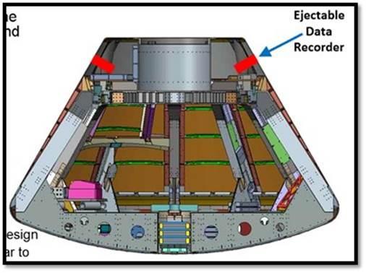
Background: EDR Design
Rojdev, K., Hagen, J., Burlone, M., et al., “An Ejectable Data Recorder Subsystem for the Ascent Abort-2 Test Flight of the Orion Launch Abort System,” IEEE Aerospace Conference, March 2020.
2 fully redundant strings
12 redundant payloads
Legend
External Interface
Ejection System
Payload (recorder/beacon)
Power & Data Distribution
Data Line
Power Line
AV-2 Pallet
CSR Flight Computer 1
Harness Splice
CSR Flight Computer 2
CSR PDU
CSR PDU
Safety Switch 1
Safety Switch 2
Sequencer 1
Sequencer 2
CSR DFI
CSR DFI
Forward Bay
Dispenser & Magazine 1
Dispenser & Magazine 2
Breakout Box 1
Breakout Box 2

Slide 7
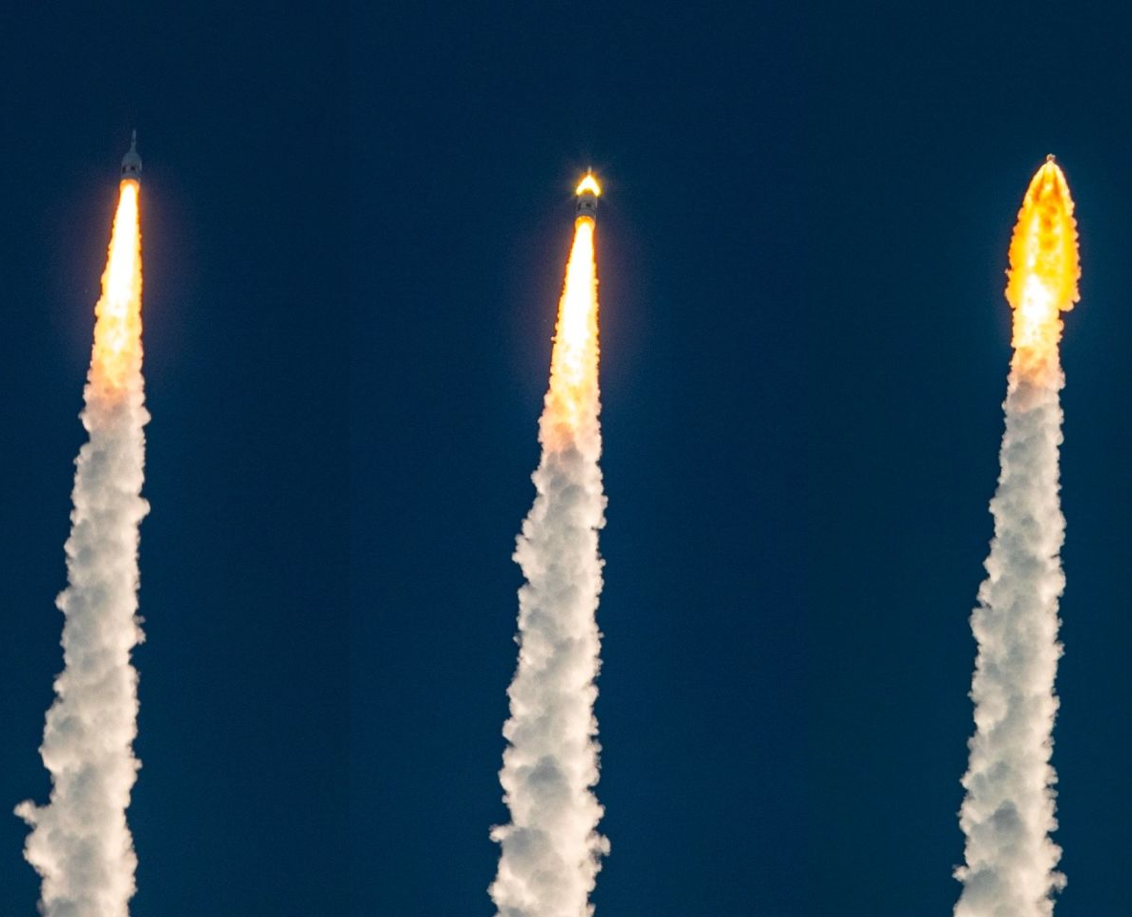
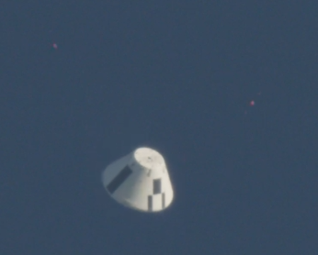

Hardware Classification & EDR Class 1-E Drivers

Slide 8
Hardware Classifications
Class 1: Full rigor for controlled flight hardware and software
  Document everything that happens to hardware from procurement through disposal
  Highest rigor of quality assurance processes
  Crew Module and Separation Ring developed as Class 1 with some tailoring
Class 3: Controlled hardware not intended for flight
  Level of rigor defined by Project Manager
  Often used for research and development projects
Class 1-E: Non-critical flight hardware with tailored rigor
  Developed for ISS payloads and technology development projects that did not need the full rigor of Class 1 to be successful

Slide 9
EDR Drivers
EDR initially started as Class 1
Challenges EDR encountered:
  CSR Project Management challenged EDR to find a more efficient way to develop hardware that is “good enough”
    Rojdev, K., Williams, A., Devolites, J., Olansen, J., “An Agile-like Approach to Hardware Development: The Ejectable Data Recorder for Orion’s Ascent Abort 2 Test Flight,” INCOSE WSRC, September 2020.
  Decision to develop a mostly COTS design
    Could not purchase everything off the shelf
    Some COTS parts could not be purchased Class 1
  Standard Human Spaceflight and JSC Processes/procedures were not equipped to handle a project with Agile-like/Lean development approach
EDR was re-classified as Class 1-E

Slide 10

Tailoring and Overall Risk Posture

Slide 11
Overall EDR Assembly & Test Process
Legend
Flight Release Drawings
EV and CV MIPs
Redlines & DRs
Standard CSR Process
Draft Drawings
Assembly TPS
EDR Risk Area
Part Procurement
Certified Technician Assembly
Functional & Environmental Testing
Detailed Upgrade Process
Design
Engineer Assembly
Class 1
Class 3
Vehicle Installation
Part Downgrade to Class 3
Secure Storage
EV and CV MIPs
Redlines & DRs
Integrated Vehicle Functional Testing
Requirements

Slide 12
Design Risks
Decision to have a mostly COTS system
Rationale | Potential Downsides | Mitigations
Generally, quick turn around | May not have C of Cs to certify what’s in them | Extensive testing for functionality
Generally, cheaper parts | May not fully meet our requirements | Verify requirement met another way Extensive testing to provide rationale for waiving a component of a requirement
 | May not have as high of quality | Extensive testing to prove functionality If the part is cheap enough, purchase a large lot to discard any bad parts

Slide 13
Procurement Risks
Mixture of Class 1 and Class 3 procurements
Rationale | Potential Downsides | Mitigations
Some parts could not be purchased as Class 1 (i.e. Raspberry Pi, USB, etc.) | Class 3 parts do not have C of Cs to certify what’s in them | Extensive testing for functionality
Some Class 1 purchases took too long to meet schedule | Class 3 parts may not have as high of quality parts | Extensive testing to prove functionality If the part is cheap enough, purchase a large lot to discard any bad parts
 | Class 3 parts do not receive inspection and are not rigorously tracked by JSC (i.e. bond) | EDR engineer performs inspection upon receiving Parts are stored in secure storage and tracked via SharePoint
 | Class 3 parts do not automatically go for testing | EDR engineer receives part and coordinates testing

Slide 14
Assembly Risks
Roadblock to Assembly
  The JSC Flight Assembly process did not know how to handle a mixture of Class 1 and Class 3 components
    Mitigation: EDR changed to Class 1E
  There continued to be confusion on the appropriate rigor for Class 1E components by EDR, CSR Project Management, and S&MA, ultimately slowing assembly
    Path Forward: all EDR parts downgraded to Class 3
      Assembly occurred with all parts at Class 3, following similar Assembly Process to CSR Project with additional tailoring
      Acceptance testing occurred at Class 3
      Components upgraded to “Flight Classification” after completing acceptance testing
Rationale | Downsides | Mitigations
Removed the roadblocks to proceeding with assembly, given the mixture of parts | More of the onus of quality lies with the EDR Subsystem | Items were meticulously tracked and documented to support the hardware upgrade

Slide 15
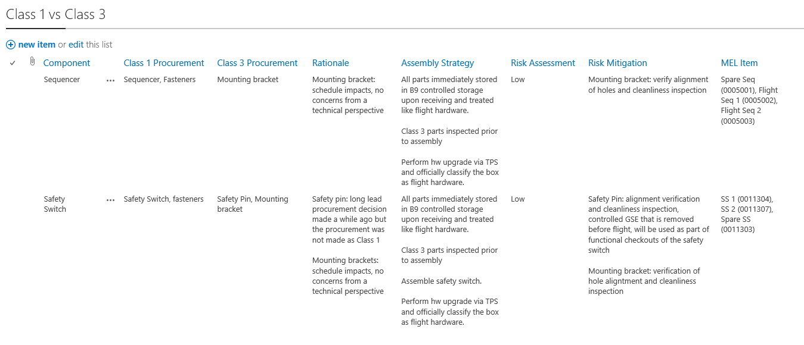
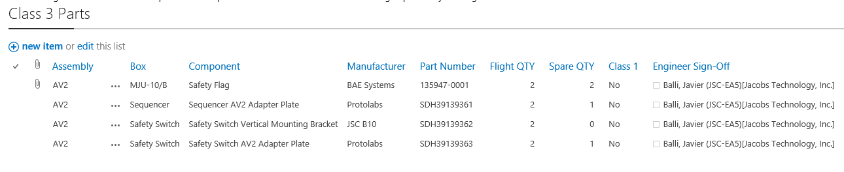
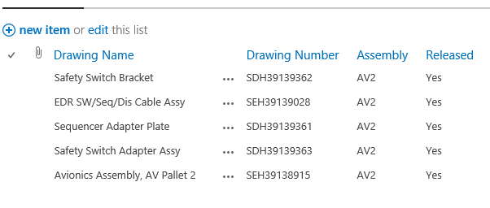
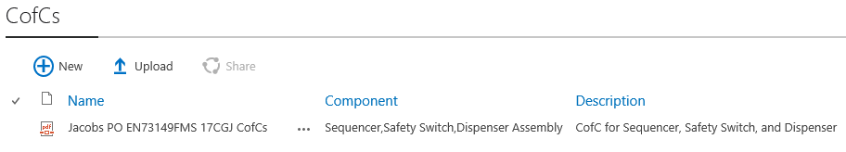
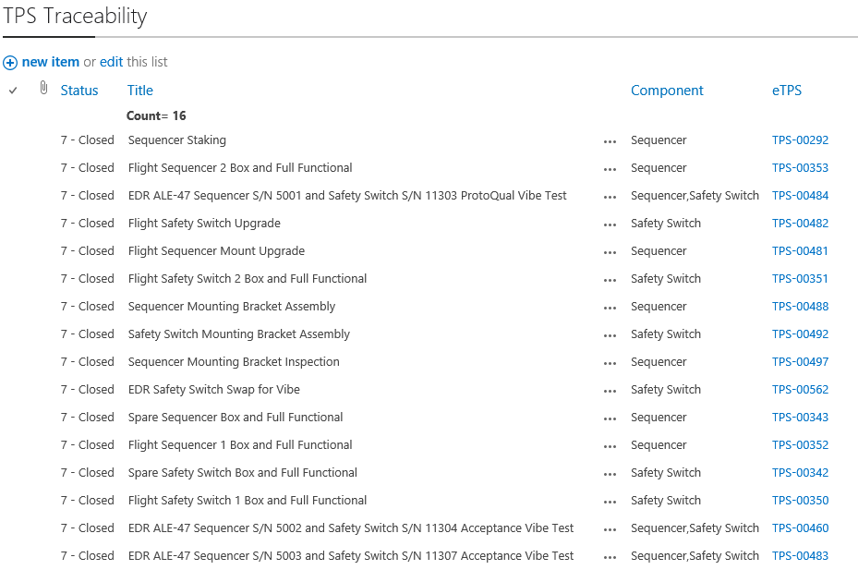
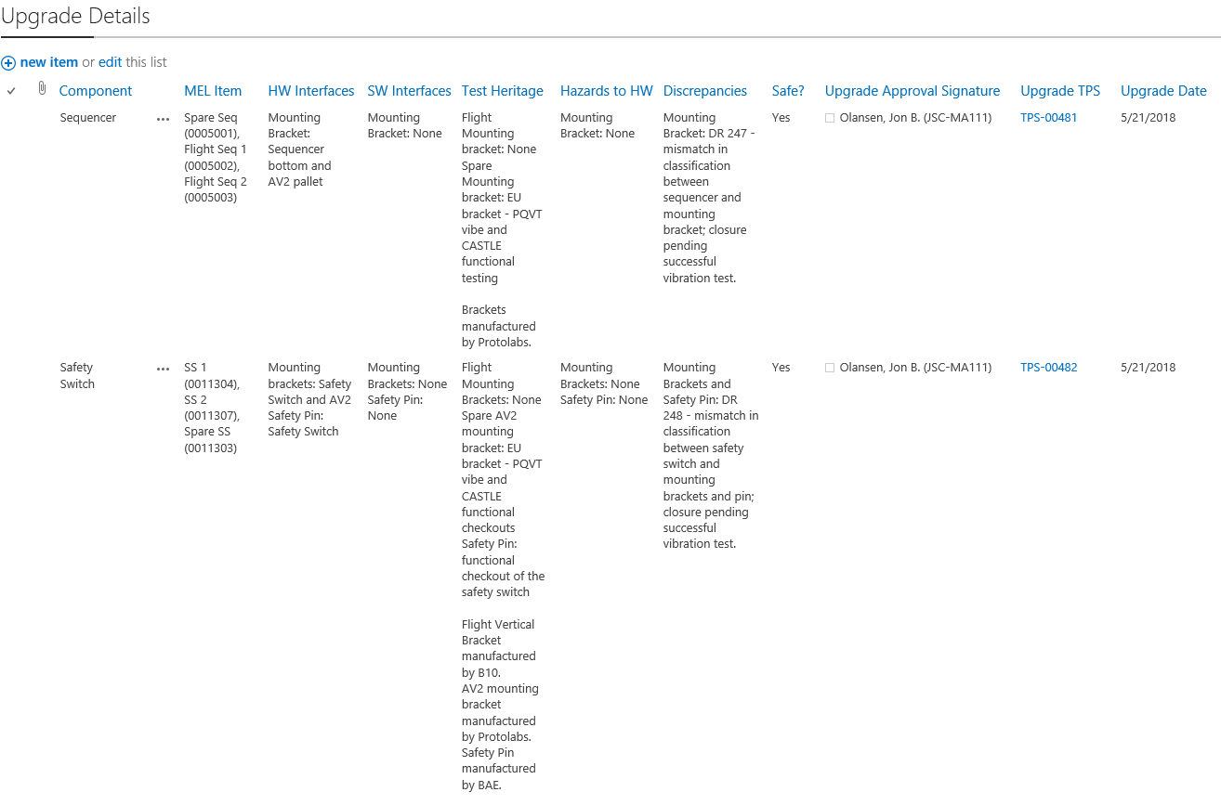
Hardware Upgrade Documentation
Procurement details and engineer inspection sign-off for all parts purchased as Class 3
Defined which components procured Class 1 vs Class 3, risk associated with Class 3 parts, and mitigations for that risk
All drawings associated with the component
All Certificates of Conformance
Interfaces, Test Heritage, HW Hazards, Discrepancies, Upgrade Approval Signature, and Upgrade Date
All procedures associated with the component

Slide 16
Testing Risks
EU/Qual Risk Reduction Testing
Acceptance Testing
Test | EU BOB | EU Dispenser | EU Seq/SS | EU/Qual Payload | Fl/Sp BOB | Fl/Sp Dispenser | Fl/Sp Seq/SS | Fl/Sp Payload
EMI Testing | Yes | Yes | Yes | No | No | No | No | No
Ejection Testing | Yes | Yes | Yes | Yes | No | No | No | No
Drop Testing | No | No | No | Yes | No | No | No | No
Pre-Launch Ops Test | Yes | No | No | No | Yes | No | No | No
Piece Part Burn-In Testing | No | No | No | No | No | No | No | Yes
Functional Testing | Yes | Yes | Yes | Yes | Yes | Yes | Yes | Yes
Thermal Testing | No | No | No | No | Yes⁴ | No³ | No³ | Yes²
Vibe Testing | Yes | Yes | Yes | Yes | Yes | Yes¹ | Yes | Yes¹
1: Vibe occurred on isolators. No minimum workmanship testing performed. Dispenser is COTS and previously certified by DOD. Payload electronics potted in syntactic foam and received no benefit from minimum workmanship screenings.
2: Only high risk components were thermally tested. Could not thermally test the entire assembly.
3: Components of the ejection system were not thermally tested. Purchased COTS and previously certified by DoD.
4: Hardware limitations necessitated that we reduced the workmanship screening temperatures. Simulations showed a low likelihood of reaching the upper temperature limits. Temperatures were monitored on launch day.

Slide 17
Requirements
Verified: 74/80
Waived: 6/80
  Several requirements could not be verified because we made the decision to purchase COTS military hardware
    We were unable to get detailed drawings to verify details or perform in-depth stress analyses
    We had to live with the design that may not have met typical NASA standards
    The vendor manufacturing processes were different from NASA manufacturing processes, but effectively made the requirement as written not applicable
Removed: 8
  Removed several requirements pertaining to ensuring pyro performance
    Ejection system and pyros were military hardware with significant heritage and quality assurance processes
    Design had 12 payloads for multiple redundancies and if one failed to fire, there were still 11 payloads available

Slide 18

Flight Test Results

Slide 19
EDR System Flight and Recovery Performance
All 12 payloads ejected as intended
All 12 payloads were recovered in 52 minutes
Data was successfully downloaded from all 12 EDRs
  All payload recordings were virtually identical
  Data from a 6th ejection payload was processed (most complete data set)
  All data was captured and clean without any dropouts
EDR Data became the primary source of data from this flight test for Orion certification

Slide 20
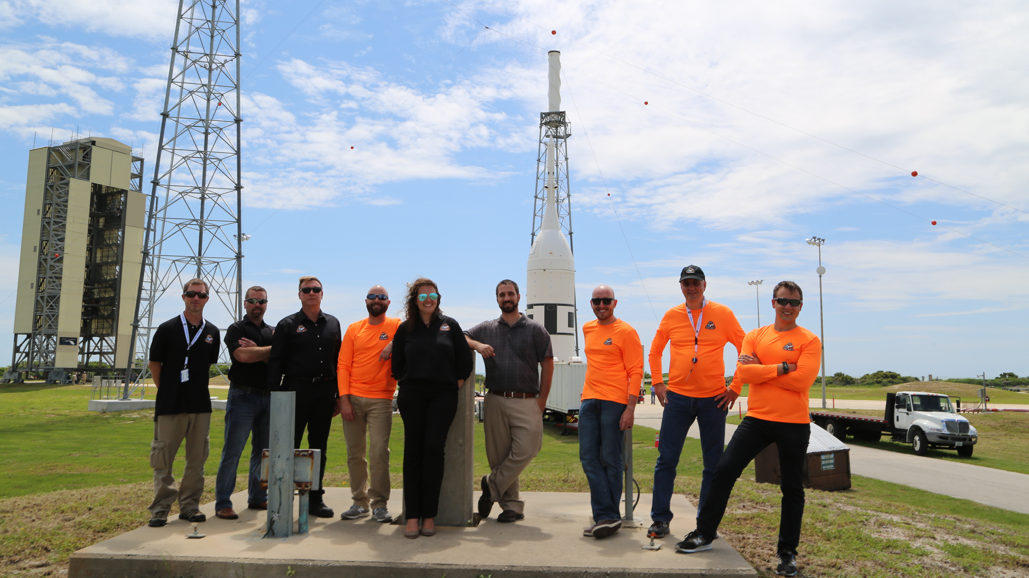
Questions
Kristina Rojdev
Kristina.Rojdev-1@nasa.gov

Slide 21

www.ascend.events

Slide 22
Backup Slides

Slide 23
Assembly Risks
Original Assembly Process | Modified Assembly Process
Use SharePoint eTPS to document assembly procedures Point to the drawing or procedural attachments whenever possible Document which parts were purchased as Class 1 vs Class 3 Include signatures from subsystem lead and quality engineering prior to proceeding QA MIPs: Conformal coating, Staking & bonding, soldering, masking, and priming CV MIPs: torqueing EV MIPs: Drawing verifications, inspections, and bake out | Use SharePoint eTPS to document assembly procedures Point to the drawing or procedural attachments whenever possible All parts listed as Class 3 Include signature from subsystem lead only prior to proceeding CV MIPs: torqueing EV MIPs: Drawing verifications, inspections, conformal coating, staking & bonding, soldering, masking, priming, and bake out
Only certified technicians used to perform assembly | Certified technicians used to perform assembly for most of the work, but reserved the capability for EDR engineers to perform assembly at subsystem lead’s discretion
Document redlines on hard copy and then attach redlines to eTPS as execution attachment | Document redlines on hard copy and then attach redlines to eTPS as execution attachment
Document DRs in SharePoint | Document DRs in SharePoint
TPS closed after work is executed, redlines updated in EDCC, DRs closed, and review by QA | TPS closed after work is executed, redlines updated in EDCC, DRs closed, and review by subsystem lead

