Slide 1
Solar Polar Imager Concept
Dan Thomas
Ken Kobayashi, Steve Sutherlin, Quincy Bean,
Keith Clements, Jay Garcia, Leo Fabisinski, Pete Capizzo
NASA Marshall Space Flight Center
16 November 2020

Slide 2
Introduction
Preliminary design of a conceptual Solar Polar Imager (SPI) mission and spacecraft to study the Sun from high heliocentric latitudes
Use solar sail technology to accomplish high orbit inclinations (at least 75 deg)
Design spacecraft bus to carry science instruments and other supporting systems
Solar sail components were not designed. Stowed and deployed geometries and masses were provided going into the study.

Slide 3
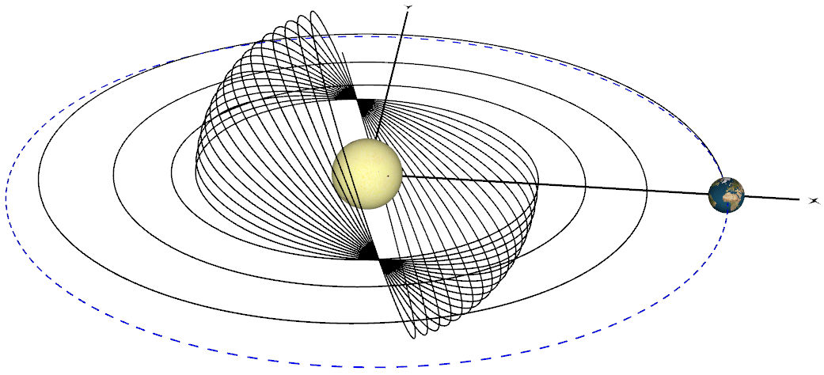
Mission Overview
Mission begins with at Earth launch
  Earth departure energy of zero (i.e. C3 = 0 km²/s²) and zero inclination
  Launch vehicle (and date) yet to be selected, so conservative C3 and inclination were assumed
Mission Phases
  Inward Spiral
    From 1 Au to 0.48 AU
    Optimal control
    Partial science
  Cranking
    Inclination increased to 75 deg
    Constant cone angle (35.3 deg)
    Constant radius
    Full science
  High Latitude Observation
    Up to 3 years
    For this study, do not drop sail
High Latitude Observation
(continued cranking)
Cranking
Earth
Departure
Inward Spiral

Slide 4
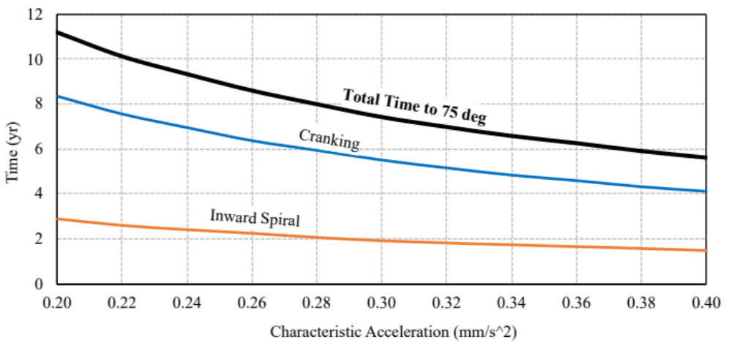
SPI Mission Phase Times
Mission Phase (in year) | Times for Sail Characteristic Accelerations (years)
 | 0.22 mm/s2 | 0.26 mm/s2 | 0.30 mm/s2
Inward Spiral | 2.6 | 2.2 | 1.9
Cranking | 7.5 | 6.4 | 5.5
Total Time to 75 deg | 10.1 | 8.6 | 7.4
Time On-station | 3.0 | 3.0 | 3.0
Total Mission Time | 13.1 | 11.6 | 10.4
a_{c} = 0.22 mm/s² (with mass margin)
= 0.26 mm/s² (without mass margin)
= 0.30 mm/s² (initial target)

Slide 5
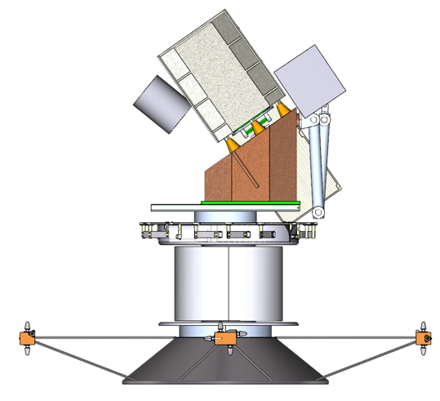
SPI Spacecraft in Launch Configuration
35.3 deg
Sail Spin-axis
Science Bus
Science Bus Centerline
SPI Bus
Launch Locks
Lower Bus
“De-spin” Platform
Sail (notional)
Fits within 4 m shroud
Spin-up Bus
1.66 m
(standard interface)

Slide 6
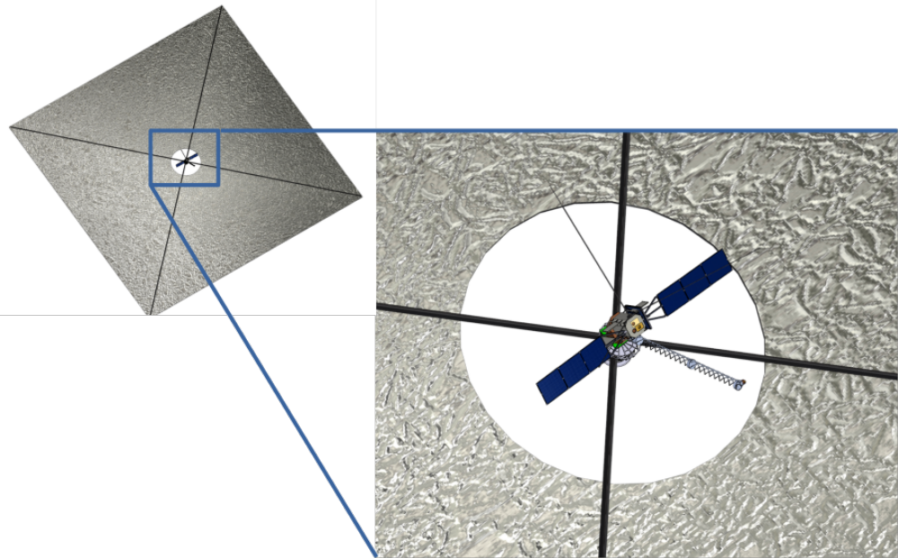
Fully-deployed SPI Spacecraft
Sail area = 7000 m² (assumed maximum)
Sail system mass (without payload) = 52 kg
10 m
Sail spinning at 1 rpm for structural rigidity

Slide 7
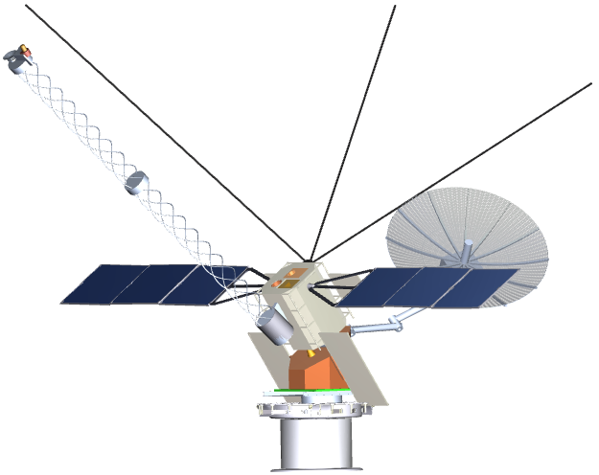
SPI Bus (deployed)
Magnetometers &
Solar Wind Instruments
Remote-Sensing
Instruments
Electric Antenna (x3)
Ka-Band Comm.
Antenna (2 m)
Solar Arrays (x2)
Radiator
(2 on SPI bus, 2 on lower bus)
De-spin
Platform
Solar Sail
Boom Attachments

Slide 8
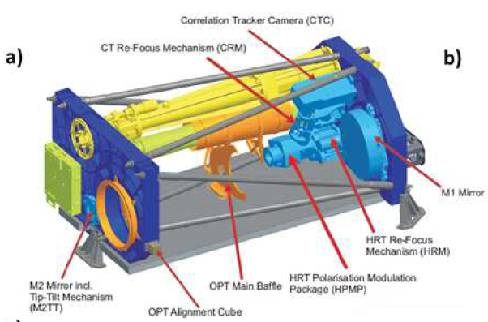
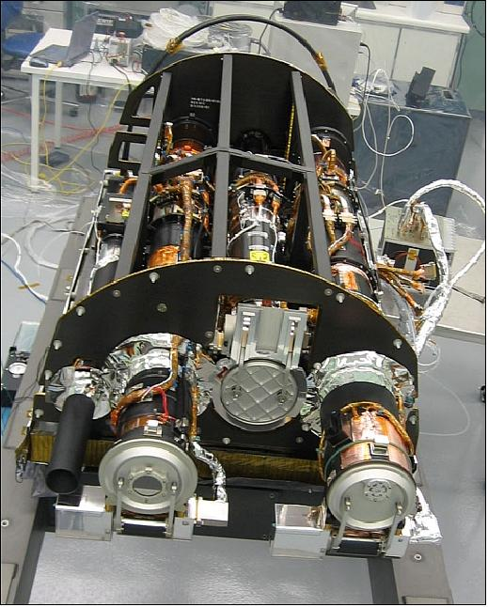
SPI Remote-sensing Instruments
Doppler & Stokes Imager (DSI)
  Estimated size 80 x 30 x 20 cm (long edge parallel to Sun/SC line), based on similar instruments previously flown.
  Internal image stabilization.
Coronagraph (COR)
  Externally occulted coronagraph
  10 arcsec stability required during exposure
  Pointing requirement has been relaxed to 2’. (Slight reduction in science – i.e. the diameter of the occulter will need to increase slightly, so the inner field-of-view will be approx. 1.75 R☉)
  Assumed 60 x 15 x 15 cm for instrument.

Slide 9
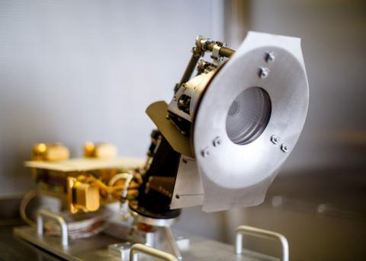
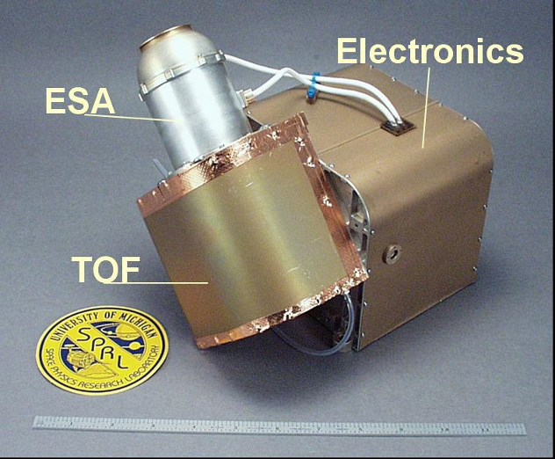
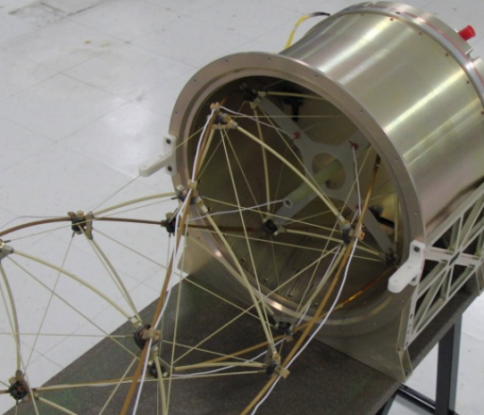
SPI In-situ Instruments
MAG (Magnetic Field Probe)
  2 magnetometers mounted along a ~5 m boom, 1.5 m apart
  Magnetically isolated (<0.2nT)
Faraday Cup
  Assumed to be identical to the Solar Probe SPC.
  Mounted on magnetometer boom.
Ion Spectrometer
  Assumed to be identical to the MESSENGER Fast Imaging Plasma Spectrometer
Radio & Plasma Wave Package
  3 monopole antennas, ~6 m long
  3-axis high-frequency magnetometer, on same boom as the MAG magnetometers
Instrument Boom
  Northrop Grumman Coilable Boom assumed, 5 m length and 10” diameter. (Smaller diameter does not appreciably change mass)
  Deployment canister 1.5 kg, boom mass 100 g/m
Solar Probe SPC
MESSENGER FIPS

Slide 10
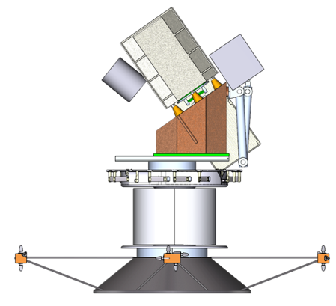
SPI Launched Components
Science Bus
SPI Bus
233 kg
Lower Bus
De-spin Platform
Stowed sail components
52 kg
Spin-up bus / LV Adapter
64 kg
Launched Mass = 349 kg
Spin-up bus dropped after sail deployment

Slide 11
dd
Subsystem | SPI Bus Masses (kg) |  |  | Spin-up Bus Masses (kg)
 | Basic | Growth | Predicted | Basic | Growth | Predicted
Structures | 49.94 | 20% | 59.93 | 23.99 | 20% | 34.54
Thermal | 29.97 | 25% | 37.46 | 1.16 | 25% | 1.45
Power | 16.92 | 25% | 20.72 | 7.80 | 20% | 9.36
Avionics | 35.26 | 22% | 37.97 | 3.75 | 10% | 4.13
GN&C | 2.96 | 3% | 3.05 | 0.01 | 3% | 0.01
Science Instrument | 44.10 | 51% | 66.43 | 0.00 | 0% | 0.00
Propulsion | 0.00 | 0% | 0.00 | 9.17 | 4% | 9.51
Mechanisms | 6.74 | 3% | 6.94 | 1.63 | 3% | 1.68
Non-prop Fluids | 0.00 | 0% | 0.00 | 0.26 | 0% | 0.26
Inert Mass | 185.88 | 25% | 232.50 | 52.57 | 16% | 60.94
Propellant |  |  | 0.00 |  |  | 3.28
TOTAL MASS | 185.88 | 25% | 232.50 | 55.85 | 15% | 64.22
Launched Items
Spin-up Bus | = | 64.2 | kg
SPI Bus | = | 232.5 | kg
Sail | = | 52.0 | kg
Total Launched Mass | = | 348.7 | kg

Slide 12
Conclusions
SPI launch mass ~ 349 kg
  After dropping Spin-up Bus, total SPI mass ~ 285 kg (with sail)
    Maximum sail size of 7000 m² can produce characteristic acceleration ~ 0.22 mm/s²
Total mission time ~ 13.1 years
  Inward Spiral: ~ 2.6 years
  Cranking to 75 deg: ~ 7.5 years
  High Latitude Observation: ~ 3.0 years
Further investigate:
  Performance degradation of solar arrays during long durations at 0.48 AU
  Higher fidelity thermal modeling of all sail and spacecraft coatings
  Sail control schemes
Further minimize mission time
  Select optimal launch date to fully-utilize 7.25 deg difference between heliographic and heliocentric coordinate systems
  Fully utilize launch vehicle’s Earth departure performance (i.e. C3) to deliver spacecraft to optimal combination of heliocentric inclination and perihelion
  Allow sail to increase inclination during inward spiral
  Every degree shaved off the total cranking inclination requirement saves 1.2 months of mission time
For more information, please see:
  “Solar Polar Imager Concept” paper, AIAA-2020-4060

