Slide 1
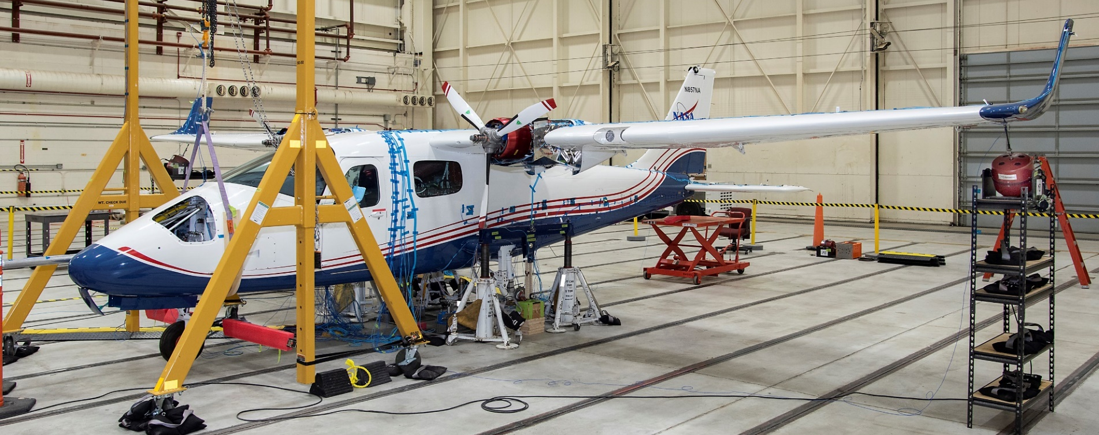
X-57 Mod II Aircraft GVT
Aerospace Flutter & Dynamics Council - 2020 Fall Meeting
10/13/2020
Natalie Spivey, Samson Truong & Roger Truax
Structural Dynamics Group
NASA Armstrong Flight Research Center

Slide 2
Outline
X-57 Background
Mod II Wing Ground Vibration Test
Objectives
Test Setup
Test Configurations
Soft Support System
Results
Other X-57 Aeroelastic Work
Mod II FEM Correlation
Mod II Flutter Analysis
Mod II Flight Testing
Mod III Wing Ground Vibration Test
2

Slide 3
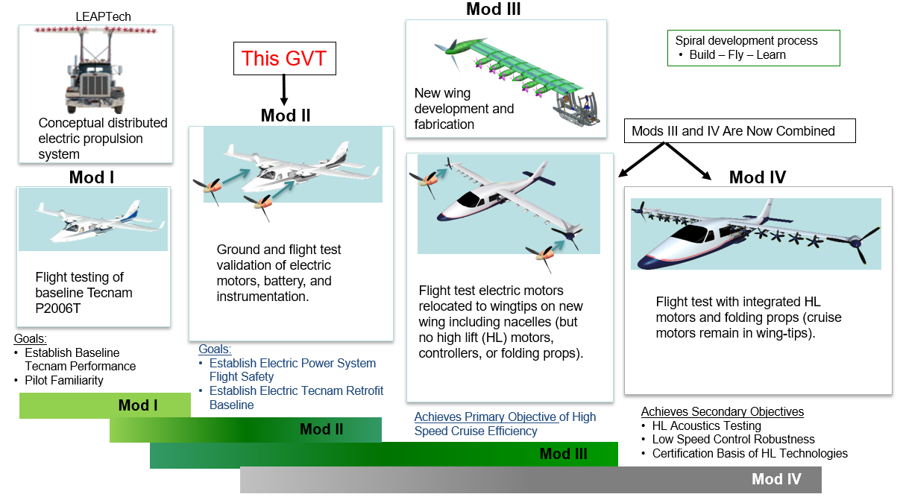
X-57 Background
Ultimate goal of the final X-57 modification is to demonstrate a 500% increase in high-speed cruise efficiency, zero in-flight carbon emissions, and 15 dB reduction in noise levels
3

Slide 4
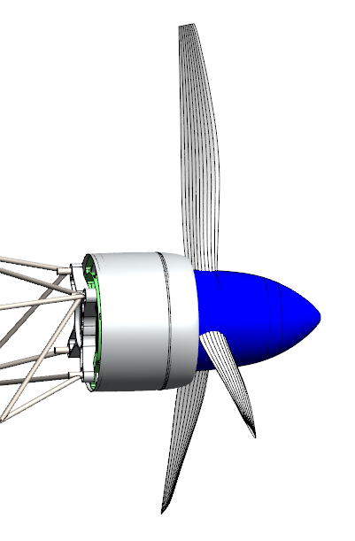
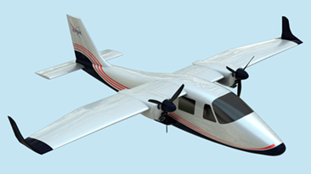
X-57 Mod II Background
X-57 Mod II aircraft is the Mod I baseline Tecnam P2006T aircraft redesigned with two electric motors powered by traction batteries
Mod II Modifications
Added: Cruise Motors/Mounts (adapters, trusses), Propellers/Hubs, Cruise Motor Controllers (CMCs) Traction Batteries and Air Data Probe
Electric motors mounted onto motor adapters and truss which has the new CMCs and then mounted onto the existing firewall
CAD of Motor Mount Truss, Adapter, Motor, Hub, Props & Spinner
X-57 Mod II Aircraft ≈ 2,780 lbs
Traction Batteries
Motor Mount Truss
Aft Batteries
Fwd Batteries
Air Data Probe
Existing Firewall
4

Slide 5
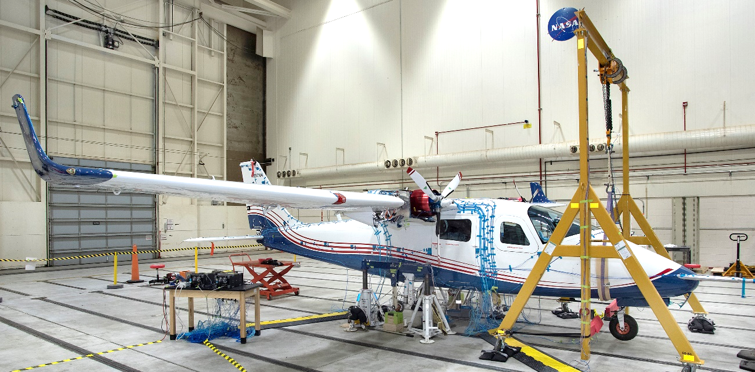
X-57 Mod II Ground Vibration Test
X-57 Mod II Ground Vibration Test (GVT) conducted at NASA Armstrong from Nov – Dec 2019
Goal: Gather modal data of a near flight ready configuration to correlate and validate the Mod II aircraft beam finite element model (FEM) to the GVT results
Two boundary conditions were tested:
Free-Free: Aircraft on soft support system to simulate free flight conditions
On-Tires: Aircraft on-tires to characterize on-ground modes for future aircraft ground motor testing safety clearance and taxi tests
Right Electric Cruise Motor
X-57 Mod II GVT, Conducted at NASA Armstrong Fall 2019
https://www.youtube.com/watch?v=wsjdk790JlI
5

Slide 6
X-57 Mod II GVT - Test Objectives
Primary Objective: Capture modes that are part of the aircraft predicted flutter & whirl flutter mechanism
Secondary Objective: Capture fuselage lateral bending & torsion modes, wing modes, and landing gear modes
Tertiary Objective: Capture higher order wing modes and control surface modes
Primary Objective | Reasoning
Stabilator Rotation Fuselage 1st Vertical Bending (F1VB) | Modes predicted in pre-test FEM that were part of Classical Flutter Mechanism
Motor Assembly Vertical Bending Motor Assembly Lateral Bending | Modes predicted in pre-test FEM that were part of Whirl Flutter Mechanism
Aircraft Rigid Body Modes | To characterize soft support system effectiveness
6

Slide 7
X-57 Mod II GVT – Test Setup Overview
X-57 Mod II GVT Test Setup on Soft Supports
Nose Gear Bulkhead Soft Support
Lt Wing Shaker
A-Frame for Nose Gear Soft Support
Lt MLG Soft Support
7

Slide 8
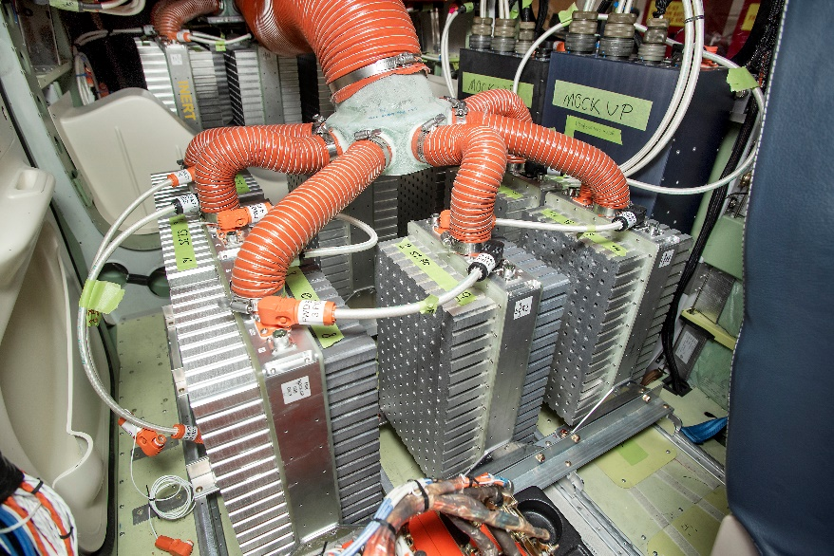
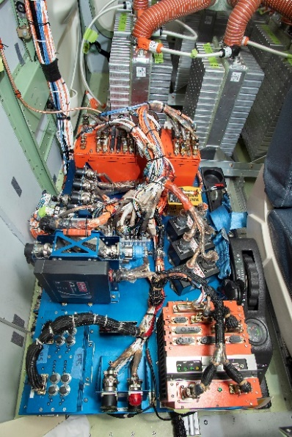
X-57 Mod II GVT – Traction Batteries
Traction batteries for electric motors compose nearly 1/3 of aircraft weight
Due to battery safety concerns, GVT used battery simulators mounted on fuselage floor with new battery mounts at a forward & aft location (previous backseat & cargo area, respectively) behind the pilot
Battery simulators were designed to match weight & CG of actual hardware
Battery power cables were connected to the simulators
Fore and aft traction battery vent covers and hoses to the aft cockpit roof exterior were installed for GVT
Two flight battery control modules (BCM) were not ready for GVT, so BCM mockup units were similarly mounted & ballasted
Aft Battery Simulators
Fwd Battery Simulators
Fwd Batteries & Instrumentation Pallet
Battery Vent Covers & Hoses
Fwd Batteries
Aft Batteries
Mockup BCM
8

Slide 9
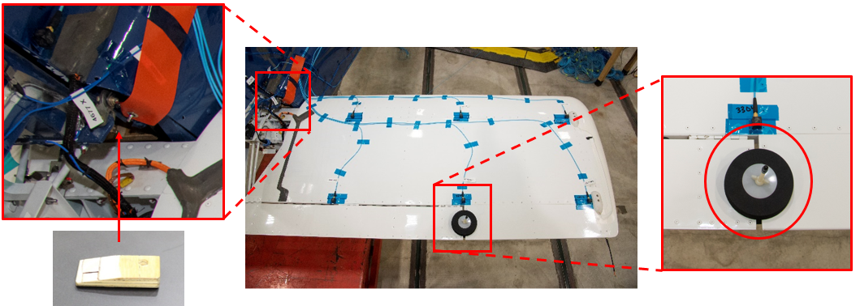
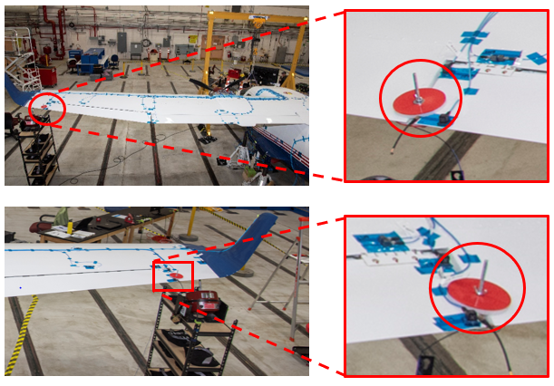
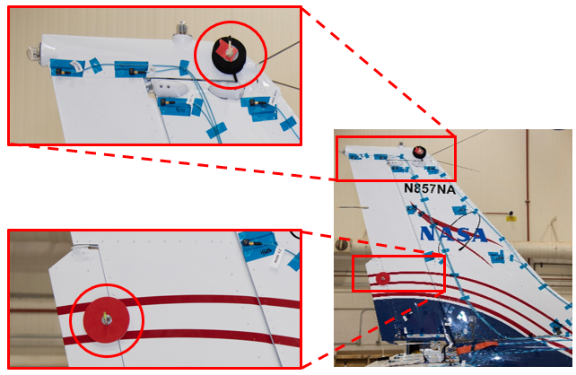
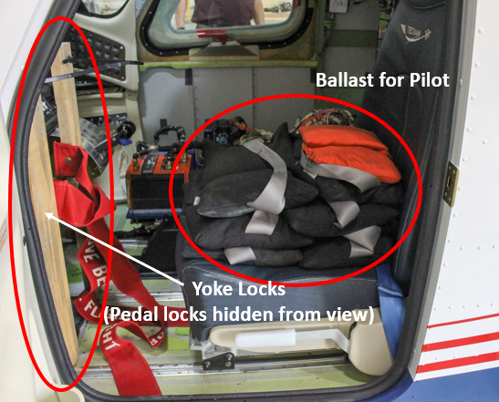
X-57 Mod II GVT – Locking Devices
Locking devices were used to constrain control surfaces which can dominate the desired structural modes, unless the control surfaces was the mode of interest
Stabilator (stab) counterweight block was used to simulate the stabilator as it would be for steady level flight to counteract the aerodynamic forces
Majority of test runs had stab block removed, which caused stabilator to rotate down slightly
Yoke & pedal locks used to simulate pilot contact with the yoke & pedals for steady level flight as well as to prevent motion in the control surfaces
Aileron Gust Locks
Stabilator Trim Tab Gust Lock
Rudder & Rudder Trim Tab Gust Locks
Stab Counterweight Block
Cockpit Locks
9

Slide 10
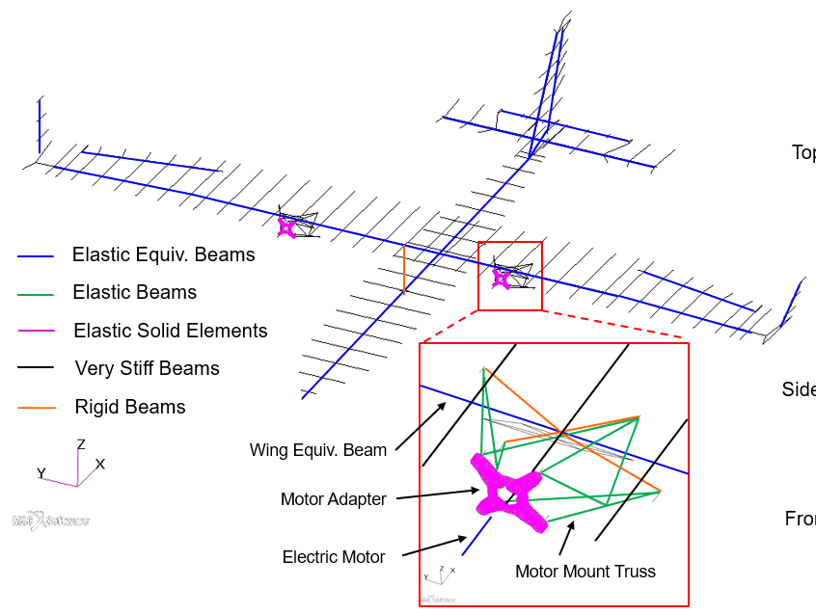
X-57 Mod II GVT – Finite Element Model (FEM)
X-57 Mod II FEM is a highly modified version of original Tecnam P2006T FEM provided by the manufacturer
Due to proprietary nature of the original FEM, Mod II pre-test FEM comparisons to GVT results are not shown in this presentation
Aircraft primary structure, control surfaces and electric motors are modelled by elastically equivalent beams while retaining the same mode shapes and frequencies
Wing and fuselage are rigidly connected
Stiff beams and springs used for visualization
X-57 Mod II FEM
10

Slide 11
X-57 Mod II GVT - Test Configurations
Free-Free: On Soft Supports
To simulate free-free boundary condition flight and to separate the aircraft rigid body modes from its elastic modes
Multiple tests were conducted on the aircraft at a variety of different shaker locations in order to excite the target modes
Yoke & pedals were locked for the most part, except for one test case that when the yoke was free in order to excite the Stab Rotation mode
Gust locks on the aileron and rudder, as well as the stab counterweight, were either installed or removed from time to time depending on the target mode to be excited
On-Tires
To verify the taxi ground modes prior to flight and cross-check with the on soft support modes for any significant differences
Also to obtain the baseline characterization of the motor assembly modes for safety clearance of near-term ground motor testing before flight
Yoke & pedals were locked, all gust locks were removed, and stab counterweight was off
For the motor test, aileron & rudder gust locks were installed as well as the stab counterweight
Additional last minute configuration was added during the GVT by exciting on the A-Frame lifting device directly in order to ensure there was no coupling to the aircraft modes of interest
11

Slide 12
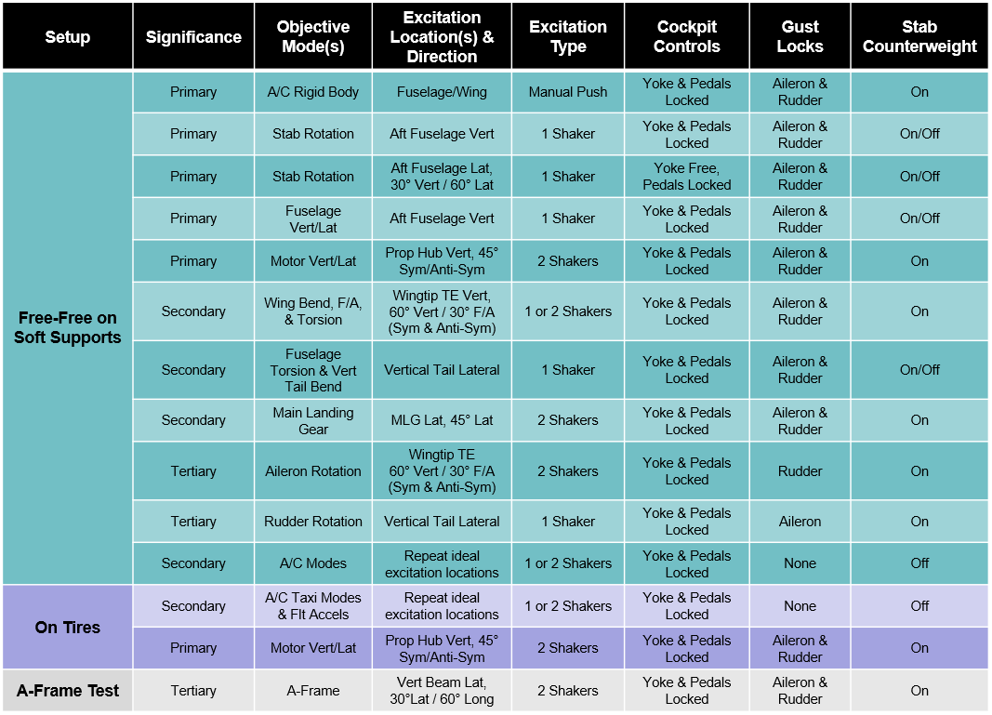
X-57 Mod II GVT - Test Matrix
12

Slide 13
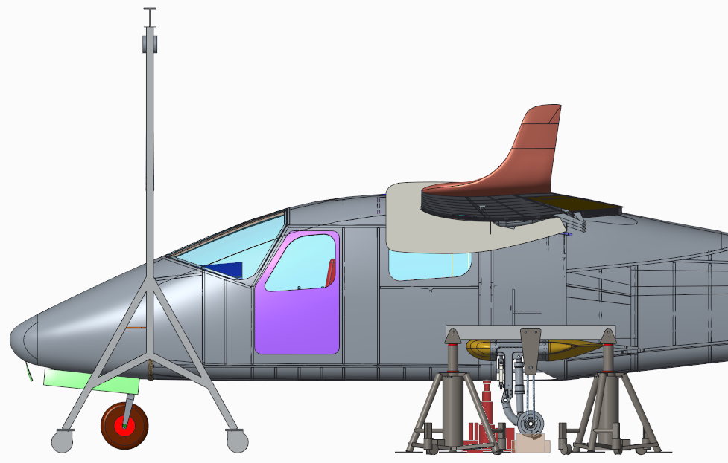
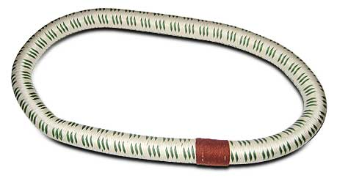
X-57 Mod II GVT - Soft Supports
To create the GVT Free-Free boundary condition, the Mod II aircraft was suspended around the nose bulkhead with the 2-ton A-Frame (via a single bungee, chain hoist, & lifting strap) and at each of the main landing gears (3 bungees on each MLG suspended on bungee support beams supported by two 5-ton jacks)
MIL-C-5651B, Type II bungees (1080HD loops) produced by SBC Industries (Huntsville, AL)
Bungees were characterized prior to GVT ≈ 1 Hz
Aircraft modes did not couple with soft supports
Soft support system eliminated the need for overhead crane support and a critical lift
Soft supports easy & efficient to come on/off – took crew ≈ 10 minutes
Used same bungees throughout GVT with no need to swap out any bungees
X-57 Soft Support System
1080HD Bungee Loop
13

Slide 14
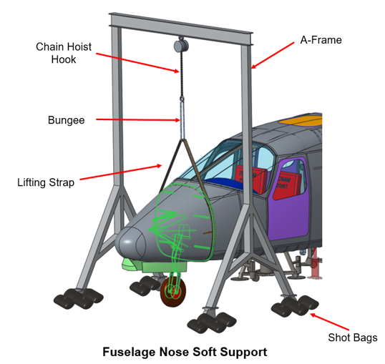
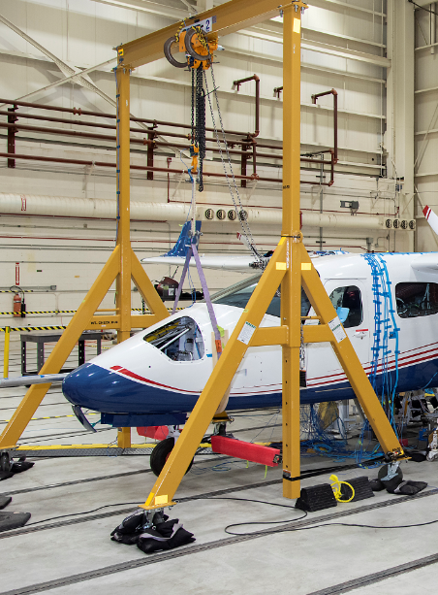
X-57 Mod II GVT - Fuselage Nose Soft Support
X-57 Nose Soft Support
Single bungee attached to chain hoist hook, and top of lifting strap, using two 6.5-ton shackles
Lifting strap wrapped around aircraft nose bulkhead
High-friction material placed in between lifting strap and fuselage surface to guard against slippage
A-frame wheels chocked using shot bags and mechanical wheels locked to prevent castoring
Nose wheel remained on and nose gear strut unlocked
14

Slide 15
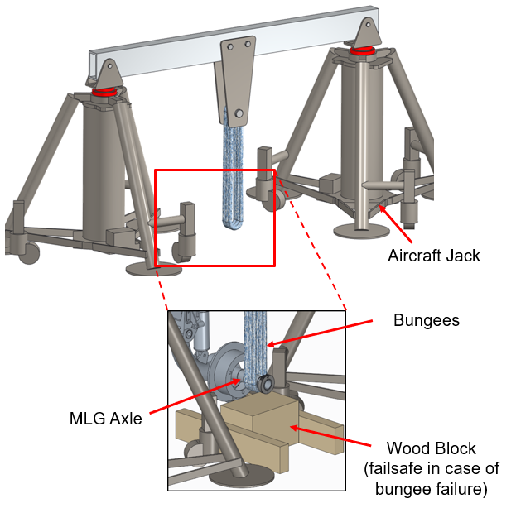
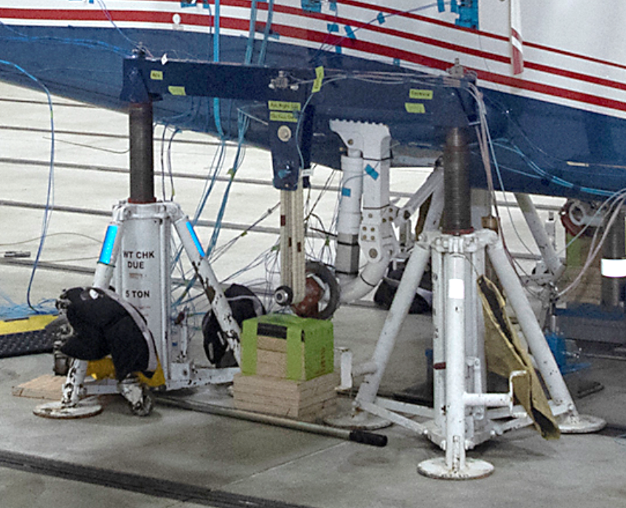
X-57 Mod II GVT - Main Landing Gear Soft Support
X-57 Main Landing Gear (MLG) Soft Support
Two 5-ton Regent Model 985S jacks were positioned on each side of the aircraft around the axle and interfaced to the MLG soft support beam
Three bungee loops were linked between the jack soft support beam to MLG axle
MLG soft support setup was duplicated on both axles
15

Slide 16
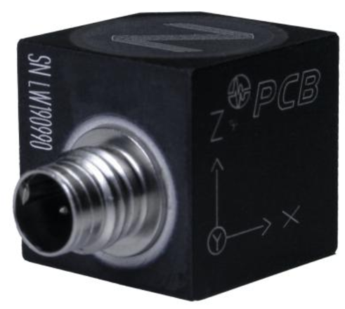
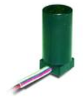
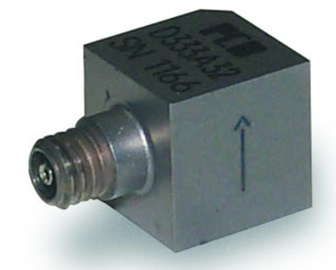
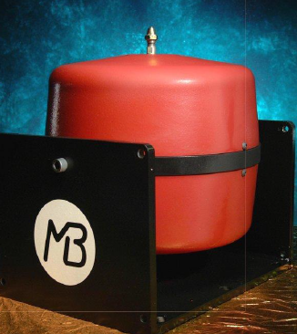
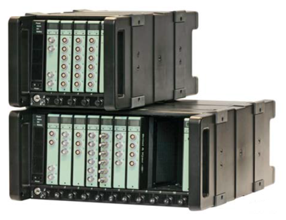
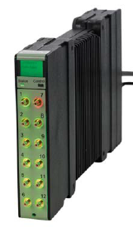
X-57 Mod II GVT - GVT Equipment
Accelerometers (100 mV/g)
PCB T356A16 triaxial accels
PCB T333B32 uniaxial accels
PCB T333B uniaxial accels
Excitation System
Shaker: MB Dynamics Electromagnetic Modal 110, 3 qty
Data Acquisition (DAQ) system: Brüel & Kjær LAN-XI DAQ
Mainframes – Daisy chained together thru network switch
LAN-XI 11-slot Main frame, 2 qty
LAN-XI 5-slot Main frame, 2 qty
Modules - Capable of recording 344 channels
LAN-XI 4-ch Input + 2-ch Output 3160 Module, Qty 2
LAN-XI 12-ch Input 3053 Modules, 27 qty
LAN-XI 6-ch Input 3060 Modules, 2 qty
GVT Software
BK Connect
PCB T356A16
Triaxial Accel
PCB T333B32
Uniaxial Accel
PCB T333B
Uniaxial Accel
MB Modal 110 Shaker
B&K LAN-XI Main Frame
LAN-XI Module
16

Slide 17
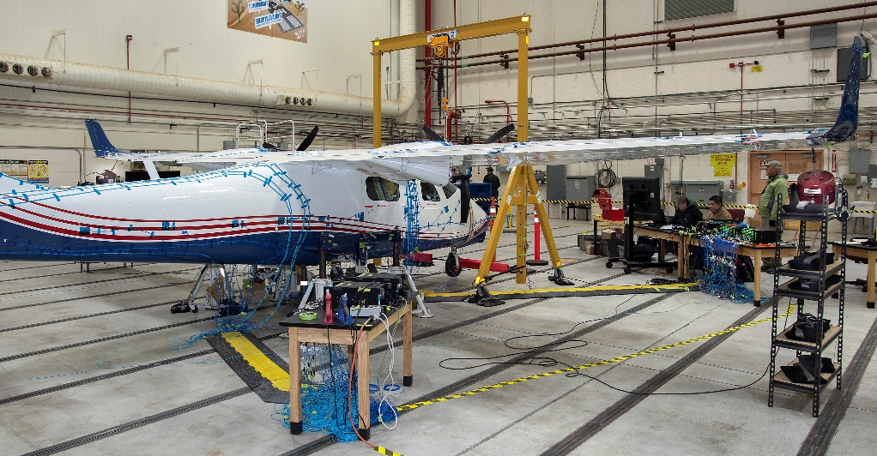
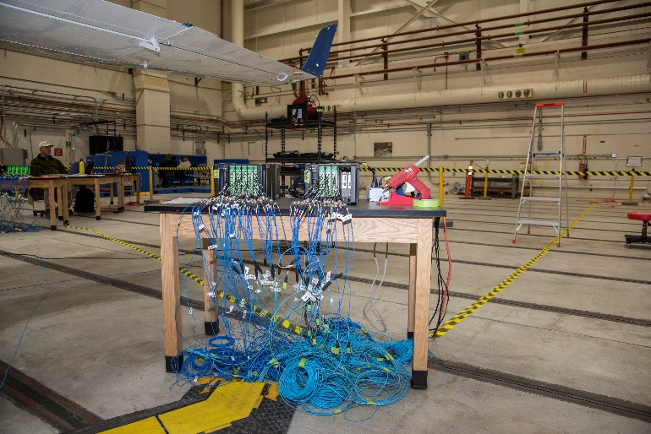
X-57 Mod II GVT – LAN-XI DAQ Setup
LAN-XI DAQ frontend setup: Four mainframes (two 11-slot & two 5-slot) capable of driving 4 shakers & recording 344 channels with network switch daisy chaining modules
Fwd aircraft setup
MF#1: two source module (3160) & nine 12-channel input module (3053)
MF#2: eleven 12-channel input module (3053)
Aft aircraft setup
MF#3: five 12-channel input modules (3053)
MF#4: three 12-channel input modules (3053)
LAN-XI DAQ Aft Aircraft Setup
LAN-XI DAQ Fwd Aircraft Setup
MF #3
MF #4
MF #2
Network Switch
MF #1
For fwd aircraft accels & A-frame
For MLG soft support & aft aircraft accels
17

Slide 18
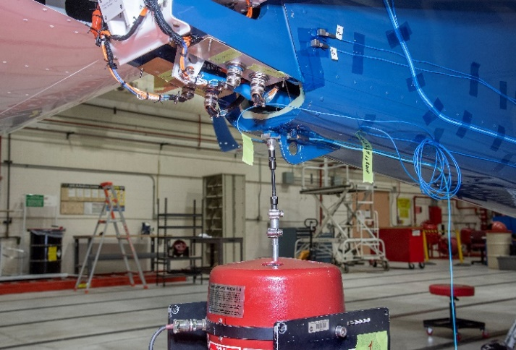
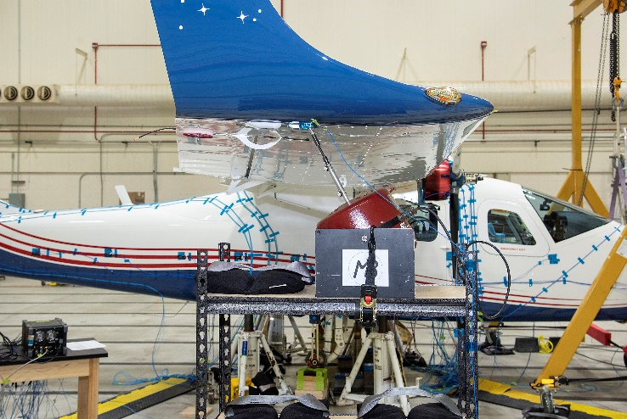
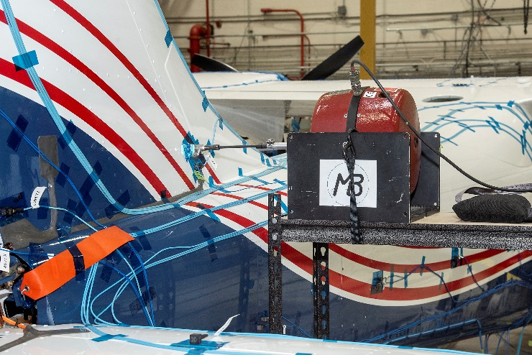
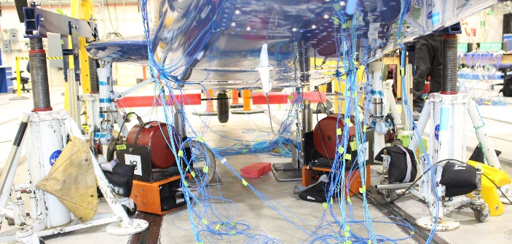
X-57 Mod II GVT – Shaker Setup
Motor Prop Hub
Aft Fuselage
Right Wingtip
Vertical Tail
Main Landing Gear
18

Slide 19
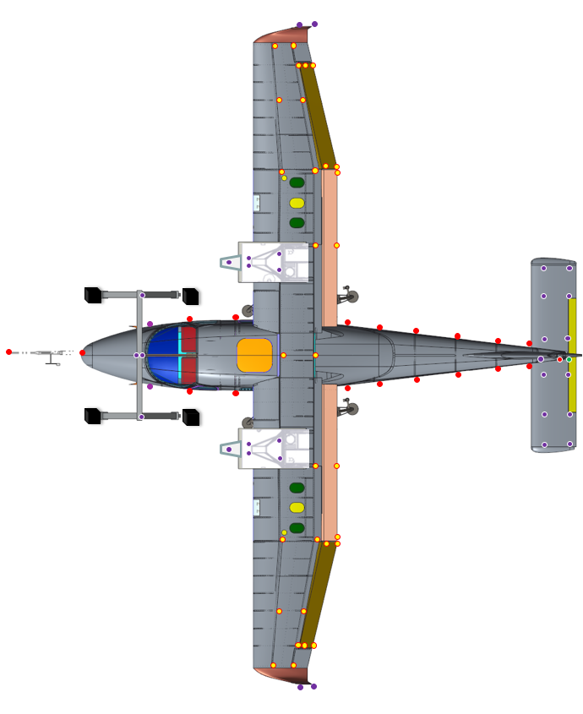
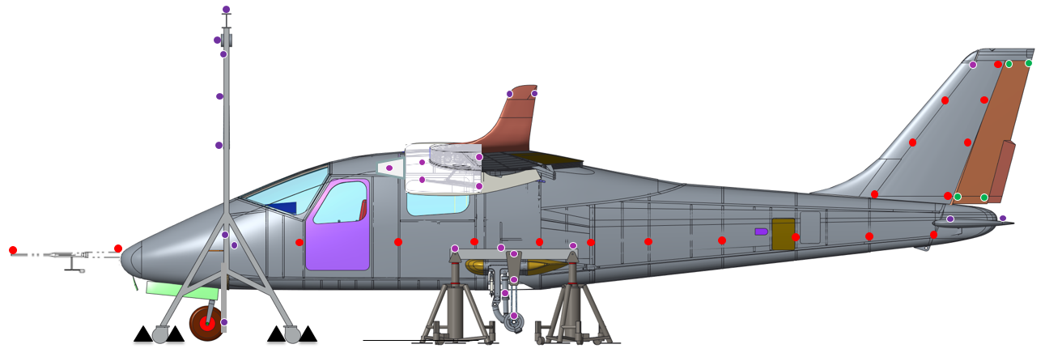
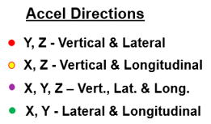
X-57 Mod II GVT – Accelerometer Locations
Free-Free
127 accelerometer locations measuring 318 degrees of freedom (DOF)
On-Tires
Soft support accelerometers removed
113 accelerometer locations measuring 276 DOF
X-57 Mod II GVT Accel Locations
Front View
Top View
Left Side View
19

Slide 20
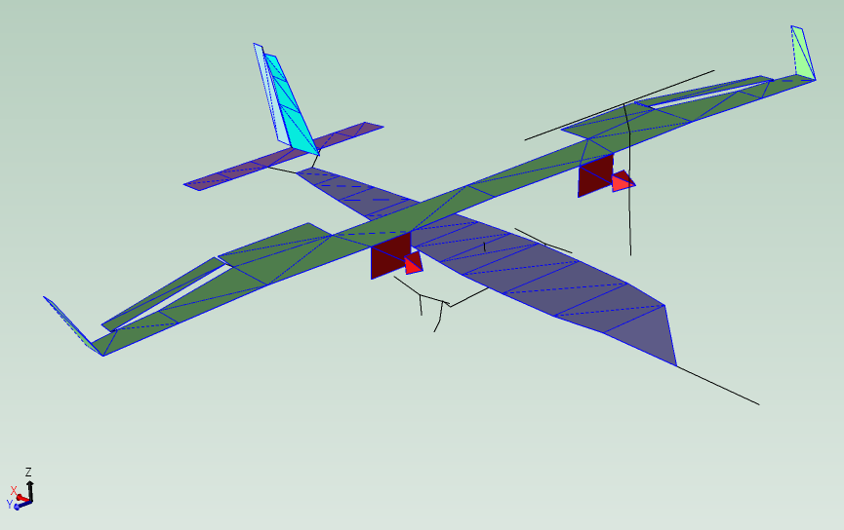
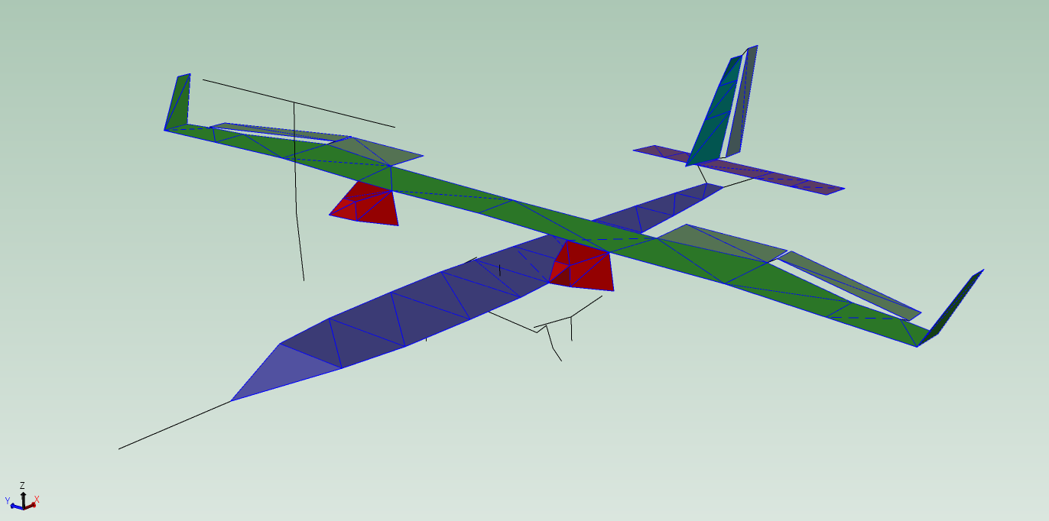
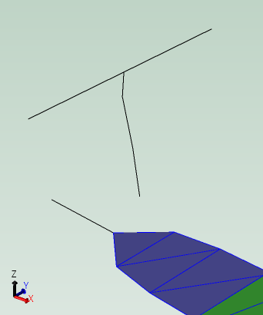
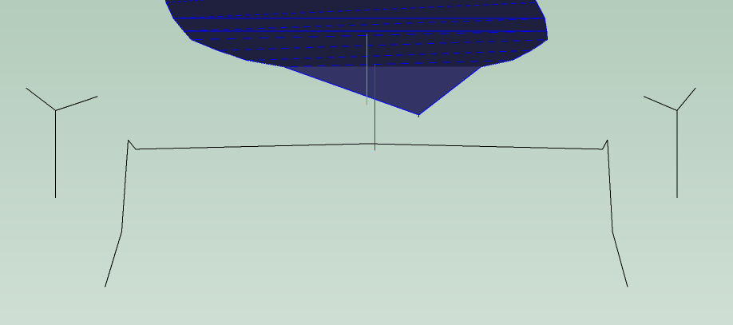
X-57 Mod II GVT – Test Display Model
Test Display Model (TDM) was created in BK Connect using a combination of quad & triangular elements and trace lines for Nose Boom, MLG, Fwd/Aft Batteries & A-Frame
X-57 Mod II Aircraft GVT Model
Motor Model Modified Post-Test
Additional elements added to motors during post-processing to better capture the behavior of the motor modes
Fwd Battery
Aft Battery
Fuselage Nose
A-Frame Soft Support
Nose Boom
Rt MLG Soft Support
Lt MLG Soft Support
MLG Area (Looking Fwd)
MLG
20

Slide 21
X-57 Mod II GVT – Aircraft Results
Aircraft results will focus on comparisons of the two main setups: Free-Free vs. On-Tires
Stab counterweight block removed and cockpit locks (yoke & pedals) on
GVT results performed in BK Connect with different parameter estimation techniques
Primarily used Polyreference Time method which helped in dictating how much time after the peak response to include in the curve fit calculation
Many modes were found during the GVT that were missing in the pre-test FEM
Asymmetries were seen between the left and right sides of the vehicle, particularly in the control surfaces, and was seen in all of the test configurations
GVT modes for On-Tires setup do not necessarily follow the order in the Free-Free setup, with several of them not observed or missing
Several modes from the Free-Free setup are coupled together in the On-Tire setup case
21

Slide 22
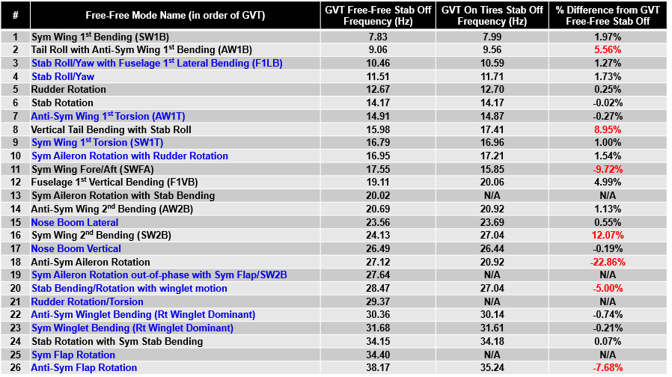
X-57 Mod II GVT – Aircraft Results (cont.)
Mode names highlighted in blue were not predicted with pre-test FEM and frequency differences of over 5% are highlighted in red
22

Slide 23
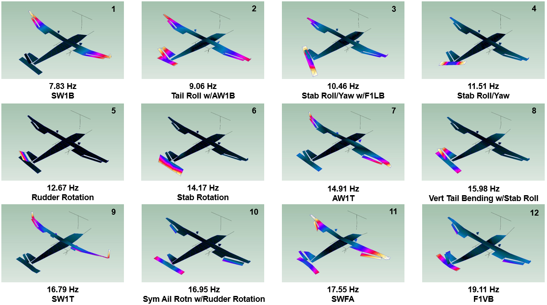
X-57 Mod II GVT – Free-Free Mode Shapes
23

Slide 24
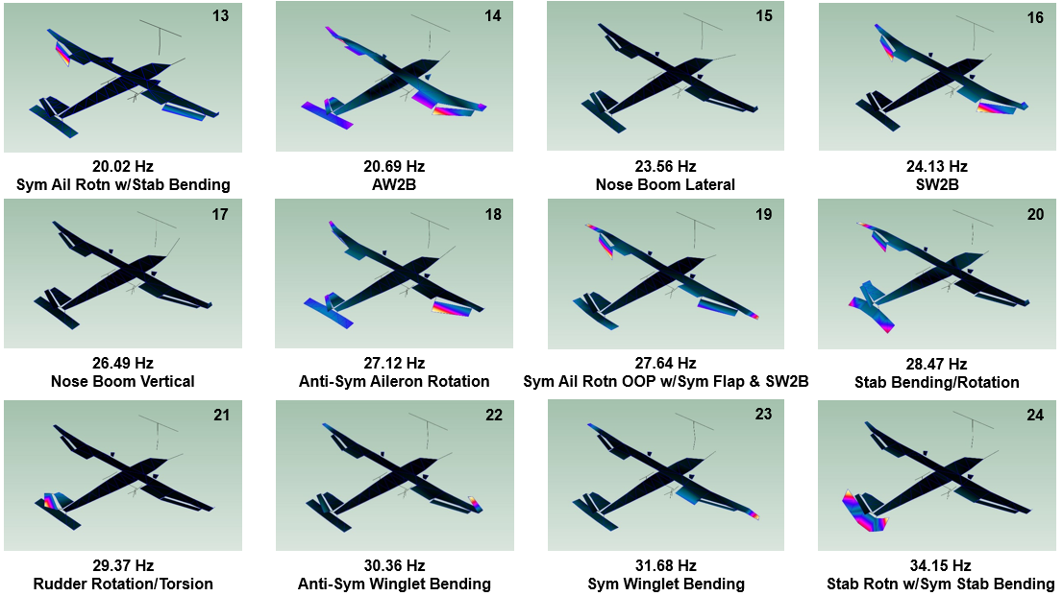
X-57 Mod II GVT – Free-Free Mode Shapes
24

Slide 25
X-57 Mod II GVT – Free-Free Mode Shapes
25

Slide 26
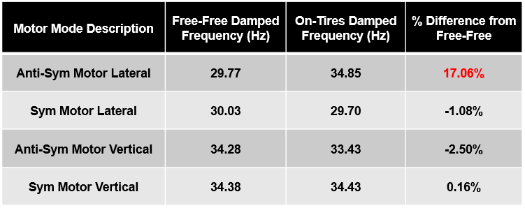
X-57 Mod II GVT – Motor Results
Motor results will focus on comparisons of the two main setups: Free-Free vs. On-Tires
Stab counterweight block installed, all control surfaces locked and cockpit locks (yoke & pedals) on
Post-processing a bit tedious as motion from the wings and control surfaces tend to dominate over any motion from the motor assemblies
Motor modes fell between 29 – 35 Hz for both setups, with the anti-symmetric motor lateral mode being the most different between setups
Similar to the aircraft results, asymmetries were observed again between the left and right motor assemblies
Tight clearance around the motors prevented installation of additional accelerometers to capture any of higher-order lateral and vertical motor modes
26

Slide 27
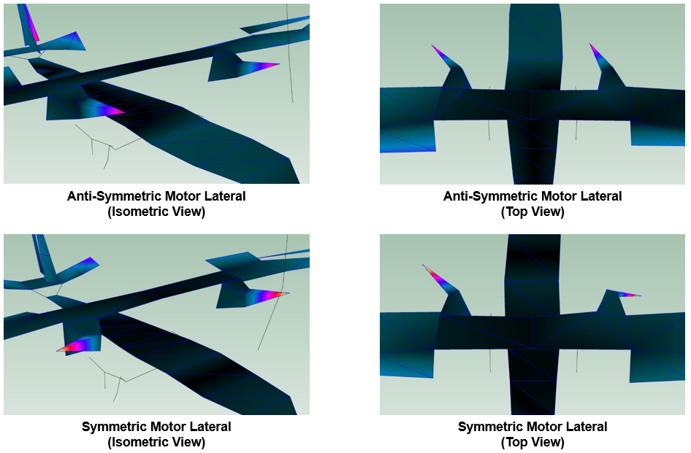
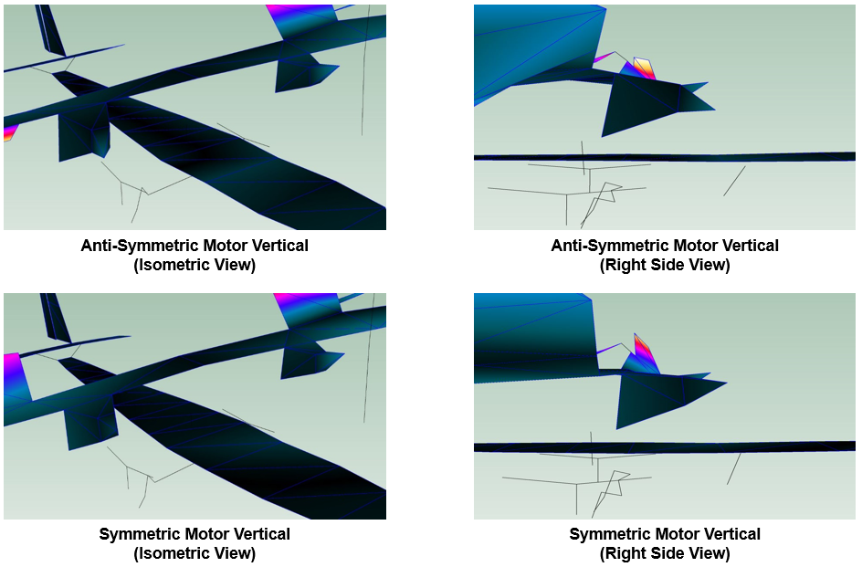
X-57 Mod II GVT – Motor Mode Shapes
Lateral Motor Modes
Vertical Motor Modes
27

Slide 28
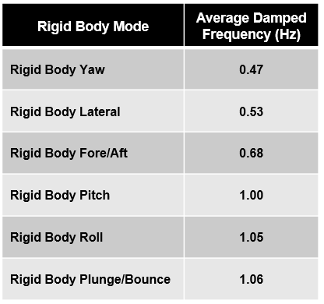
X-57 Mod II GVT – Rigid Body Results
Aircraft rigid body tests were performed while the aircraft was installed on soft supports in order to identify the approximate frequencies of the 6 different rigid body modes and to evaluate the frequency separation between the highest rigid body mode (1.06 Hz) and the first aircraft elastic mode (7.83 Hz)
Manual excitation was provided from test engineers and shakers were not used for rigid body tests
28

Slide 29
X-57 Mod II GVT – Rigid Body Video
29

Slide 30
X-57 Mod II GVT - Summary & Path Forward
GVT assisted in understanding Mod II vehicle’s modal characteristics
Pre-test FEM did not capture all modes that appeared in GVT
Asymmetries were present on both sides of the aircraft and were particularly visible in the control surfaces and motor assemblies
On-Tires config. showed some coupling of modes that were not seen in the Free-Free config.
Follow-on tasks include:
Updating post-test Mod II FEM to match the GVT results
Performing both Mod II classical and whirl flutter analyses to verify flight envelope flutter margins
Prepping for Mod II flight testing next year ≈ Spring/Summer 2021
30

Slide 31
X-57 Other Aeroelastic Work
X-57 Mod II FEM Correlation
X-57 Mod II Flutter Analysis
X-57 Mod II Flight Testing
X-57 Mod III Wing Ground Vibration Test
31

Slide 32
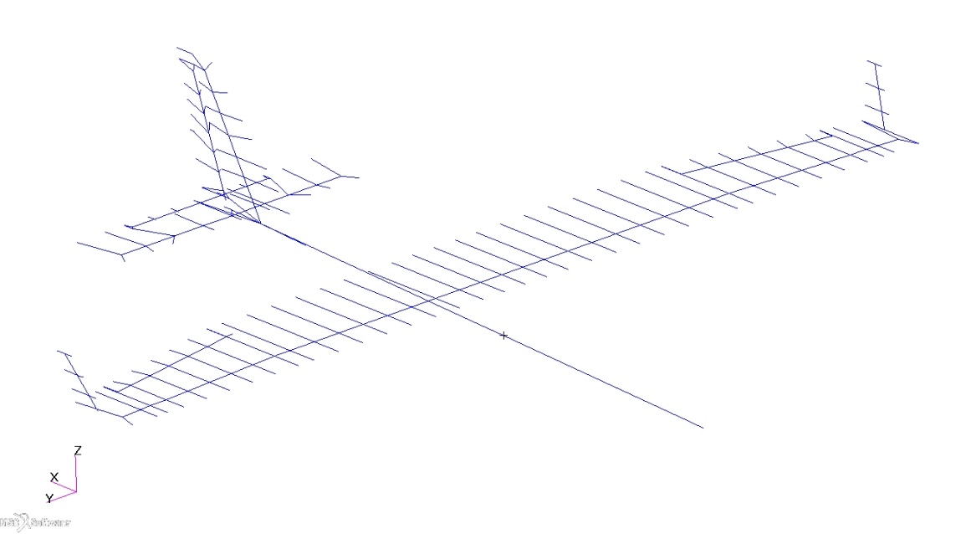
X-57 Mod II FEM Correlation
Mass and CG correlation/scrub, 90% complete
Project CAD, weight and balance
Flight configuration mass and CG correlation
Individual primary structure (wing, fuselage, stab, vertical tail, winglets, ailerons, rudder)
Non-structural mass and mass moment of inertias (secondary structure, batteries, electronics, wiring…)
Remove/add mass for GVT configuration
Remove tires, main gear doors, motor cowlings, nose cover…
Add cockpit and control surface constraints
Modal frequency and shape correlation, following mass correlation
Free-free FEM to soft support GVT results
Adjust existing modes, introduce new modes (wing rock, stab roll/yaw)
Create simple nose boom beam
Modify beam element stiffnesses (bending, torsion, yaw)
Modify point spring stiffnesses (control surface rotations)
Start with primary large structure (W1B, F1B, F1T, W1T, Wing Rock)
Proceed to control surfaces (stab roll/yaw, stab rotn, aileron and rudder rotations)
Iterate to 5% frequency difference for primary modes, visual mode shape comparisons
X-57 Mod II FEM
32

Slide 33
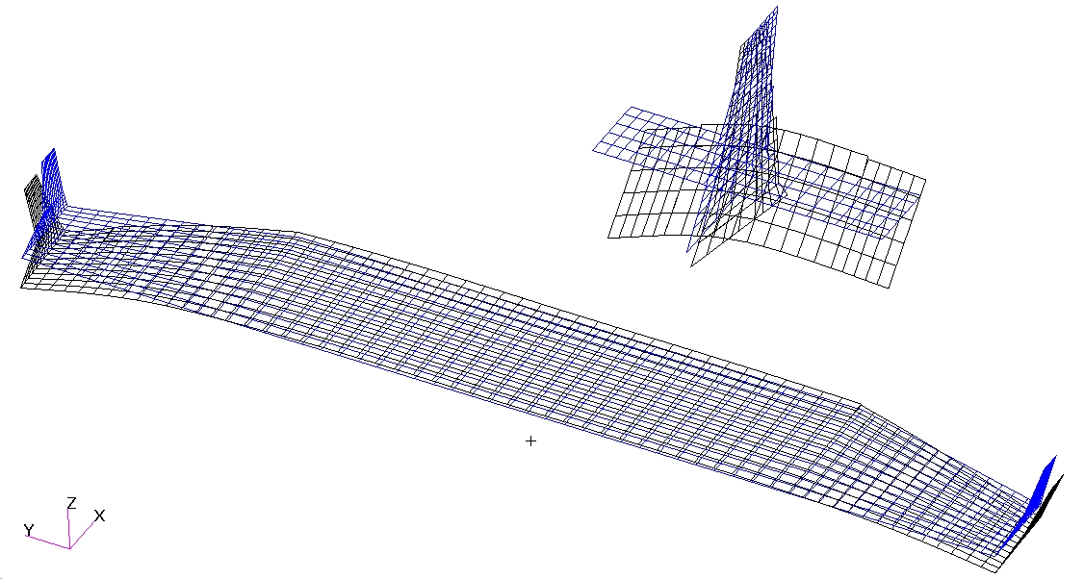
X-57 Mod II Flutter Analyses
Classical aircraft flutter analysis
ZAERO Linear Panel Model using Matched Point Solution
Mach 0.3
~25 Total Modes Used, Up to ~60 Hz
Perfect Rigid Body Shapes, 0.0 Hz Each
Cockpit controls “Fixed” FEM (Not Free)
2% Structural damping crossing
Expecting similar results outside of flight envelope
Fuselage weight sensitivity, hump modes
Not expecting results inside of flight envelope
Flying fleet is aeroelastically incident-free
Whirl flutter analysis
Using CAMRAD II as analysis tool
No instabilities currently indicated for Mod II
Analyzing isolated motor+motor mount system as well as coupled with full vehicle
Preliminary analyses show large whirl flutter margins even with large parametric variations
Updating motor FEM using GVT data to include 2nd pitch and 2nd yaw modes of motor mount systems
X-57 Mod II
ZAERO Aerodynamic Model
Flutter Mechanism
Stab Rotation & Fuselage 1st Vertical Bending
33

Slide 34
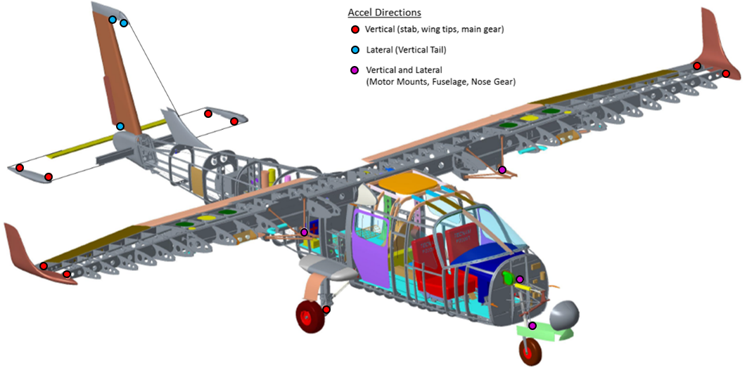
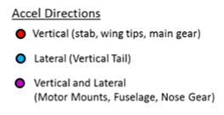
X-57 Mod II Flight Testing
Mod II Flight Testing Objectives
Clear flight envelope for later research flights
Clear flight for potential emergency descent maneuver (high velocity, negative AOA)
Taxi Testing
Low and high speeds
Motor RPM buildup
Blade pitch angle variations (automatic with airspeed & RPM)
Up to just below Vr (aircraft rotation velocity)
Flight Testing ≈ Spring/Summer 2021
One flight altitude (4k or 6k ft MSL)
Dynamic pressure and Mach variations are limited from top to bottom of envelope
Dynamic discipline test points
Two flights, repeat previous high test point - flight time limitation
1st flt: 100, 120, 140, 150 KCAS
2nd flt: 150, 160, 170 KCAS
Note: V_{ne} is 172 KCAS, Velocity never exceed (V_{ne})
Control surface raps (sharp input): pitch, roll and yaw
Real-time visual analysis of flutter stability (response decay time)
Limited flight time
Post-flight data analysis will be more extensive
Atmospheric and local turbulence
Excite higher frequencies above limitation of raps
Aerodynamic discipline test points (211, POPU, beta sweep, wind turns, prop wind milling, decel/accel in higher turbulence, tower flyby)
Loads discipline test points (wind up turns)
X-57 Mod II
Flight Accelerometers
17 Accel Locations with 23 DOFs
34

Slide 35
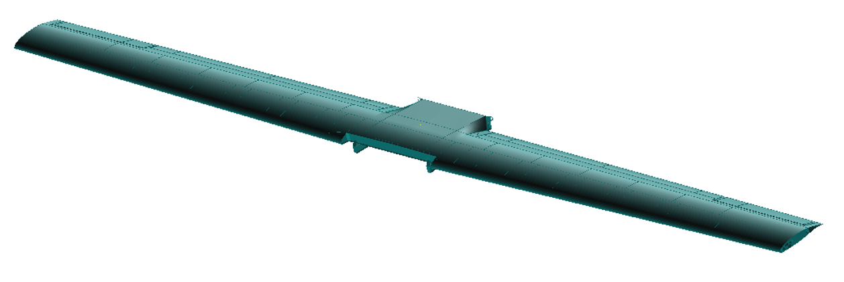
X-57 Mod III Wing Ground Vibration Test
X-57 Mod III Wing GVT conducted at NASA Armstrong in June 2019
Goal: Gather X-57 Mod III wing modal data to correlate the fundamental wing modes to the FEM without any complicated wing structure
Objectives: Measure & characterize the target modes to understand the wing’s aeroelastic behavior
Benefits
Early characterization of basic Mod III Wing structure for FEM updates
Early update to classical and whirl flutter analysis
Reduces programmatic risk, otherwise would have been added to later GVTs, thus complicating future test efforts
GVT Configurations
Config. A: Clean Wing + Cruise Nacelle Simulators
Conf. A: Flaps Stowed, Ailerons Locked
Conf. A: Flaps Deployed, Ailerons Locked
Conf. A: Flaps Slightly Deployed, Ailerons Locked
Config. B: Clean Wing
Conf. B: Flaps Stowed, Ailerons Locked
Conf. B: Flaps Deployed, Ailerons Locked
NASA LaRC updated Mod III Wing FEM with GVT data
X-57 Mod III Wing GVT, June 2019
Config B
Clean Wing
Config A
Clean Wing + Cruise Nacelle Simulators
35

Slide 36
Questions?
X-57 Mod II GVT
Test Team
36

Slide 37
Backup Slides
37

Slide 38
X-57 Mod III Wing GVT - Test Article
Wing Properties
AR | 15
MAC | 2.13 ft
Span (b) | 31.63 ft
Wing Area (S) | 67 ft²
λ | 0.7
c_{t} | 1.74 ft
c_{r} | 2.48 ft
Wt_{Clean Wing (includes} _{H-Frame)} | 313.5 lbs
WtClean Wing (H-Frame + Wingtip Plates) | 352.5 lbs
WtClean Wing + Cruise Nacelles (×2) | 581.5 lbs
Wt_{Cruise Nacelle (×1)} | 134 lbs
X-57 Mod III Wing
Wingtip Plate for Mounting Cruise Nacelle Mass Simulator
Note: Plate was removed for Conf. B – Clean Wing test runs
Note: Based on April 2019 weights from ESAero
38

Slide 39
X-57 Mod III Wing GVT - Test Configurations
Configuration A: Clean Wing + Cruise Nacelle Simulators
At the time of the GVT, the cruise nacelle motors were not fabricated yet and as a result, mass simulators were used to simulate the mass & CG of those cruise motors.
Conf. A: Clean Wing + Cruise Nacelle Simulators
Cruise Nacelle Mass Simulator with Wingtip Mounting Plate
FEM for Config A
39

Slide 40
X-57 Mod III Wing GVT - Test Configurations
Configuration B: Clean Wing
Mod III wing without any nacelles, motors, nor internal wiring
Cruise nacelle mass simulators & mounting plates were removed after Config A testing was complete
Conf. B: Clean Wing
Cruise Nacelle Mass Simulator Removed
FEM for Config B
40

