Slide 1
Satellite Data Assimilation at the GMAO
Will McCarty, Bryan Karpowicz, Min-Jeong Kim, and Kris Wargan
Global Modeling and Assimilation Office
NASA Goddard Space Flight Center
30 September 2020
Community Meeting on NOAA Satellites

Slide 2
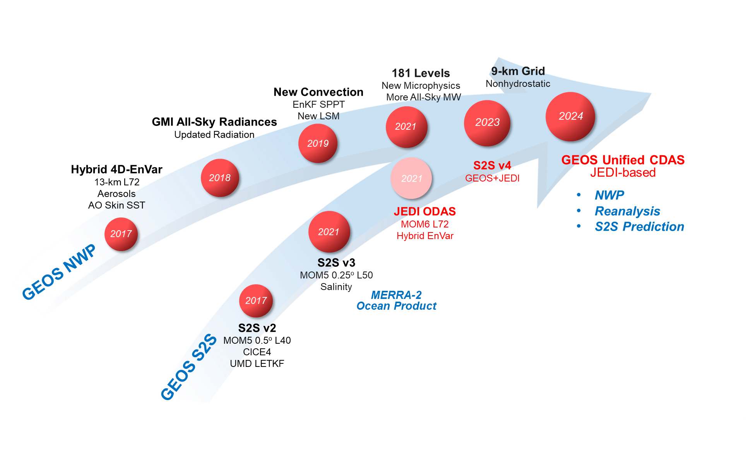
Introduction
GMAO’s core mission is to enhance the value of NASA’s observations to understand, analyze and predict changes in the physics, chemistry and biology of the Earth system
We do this:
  Historically: Reanalysis
  Currently: Forward Processing (FP); S2S
  Future: Targeted research, e.g. OSSEs as
  a decision support tool
Our goal is to collapse the earth system components to a common modeling and assimilation infrastructure
  Fundamental to this goal is the capability of analyzing the four-dimensional atmospheric state

Slide 3
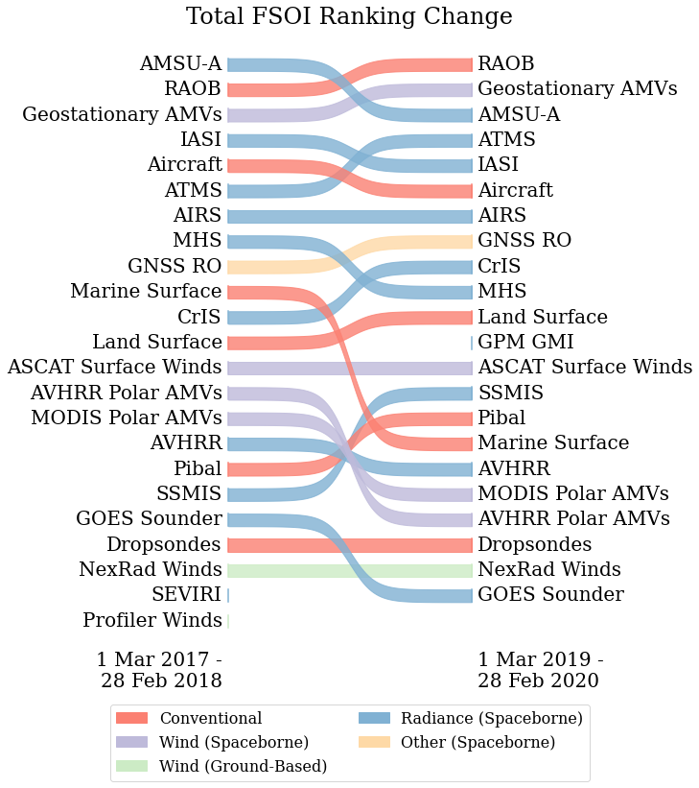
Current State of Radiance Assimilation
Forward processing developments
  ‘New observations’ – and system developments – are considered ‘updates’
  Ultimately constrained by near-real-time availability
  Many of the forthcoming slides are recent or upcoming FP updates
Advances in the observing system are apparent through FSOI metric
  Observing System resilience
  Notable differences:
    Increase in Geo AMVs with GOES-16/17 data streams
    Drop in AMSU-A, rise in ATMS (addition of NOAA-20)
Increased Impact

Slide 4
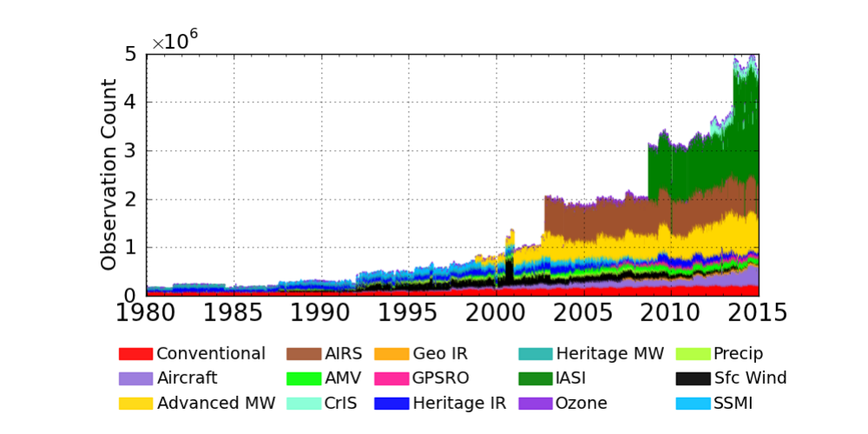
Applying Current Methods to Historical Observations
FP development is motivated by a transition to reanalysis
  FP advancements are performed with reanalysis in mind
    New data not only feeds FP, but also adds to the retrospective observation baseline
    The FP starting point is implicitly the beginning of baseline
    Evaluate feasibility of backfilling observation to include entire data record
  Reanalysis systems do not have a NRT constraint
    Provides additional motivation to consider observations beyond the scope of operational systems
  The hyperspectral IR still accounts for the largest single type of data
    Only to increase w/ MTG-S IRS; IASI-NG; NOAA-21, etc.
Next reanalysis slated to be a 21st (ish) century reanalysis
  Drive chemistry reanalyses, serve as prototype GPM Level 4 product
  ¼°, 4D-EnVar (both updates from MERRA-2)

Slide 5
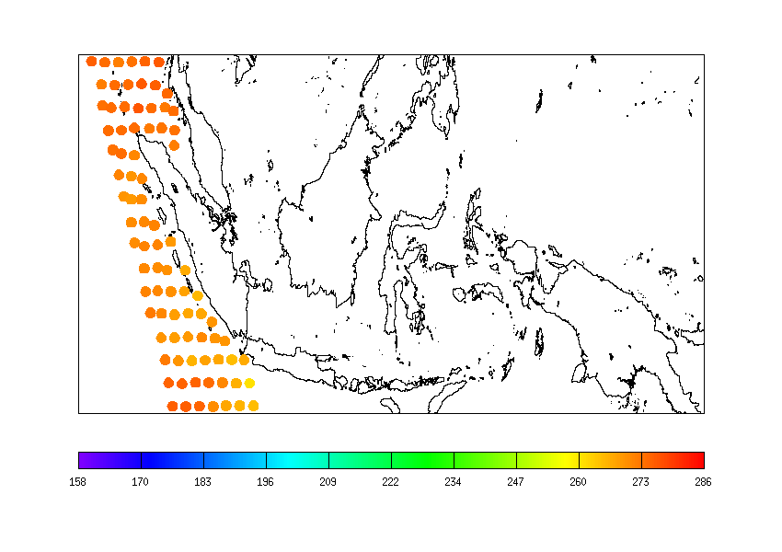
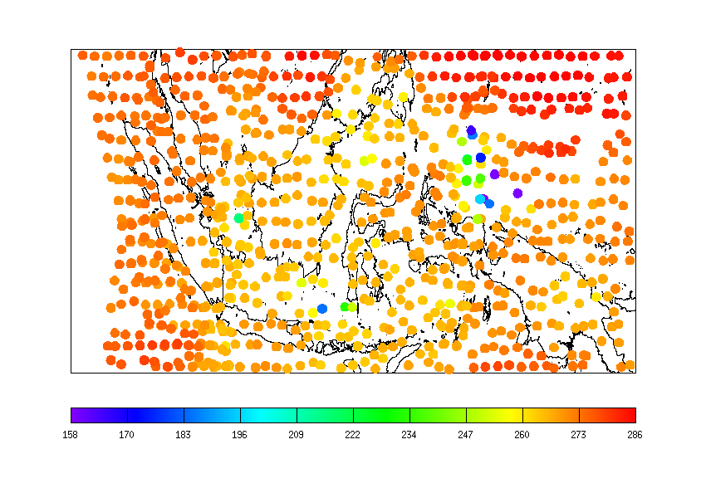
All-Sky Assimilation of MHS Radiances
GMAO has extended their all-sky implementation to include MHS
  Second instrument class after GPM Microwave Imager
  Methods similar for 183 GHz bands
Methodology:
  Extend forward operators to cloud and precipitation-affected radiances
    New CRTM cloud scattering lookup tables
  Extend assimilation solution to include cloud liquid, ice, rain, and snow
  Situational observation error model
    Function of cloud index
  Extensions to variational bias correction and new QC for all-sky measurements
GMI Only
GMI + MHS

Slide 6
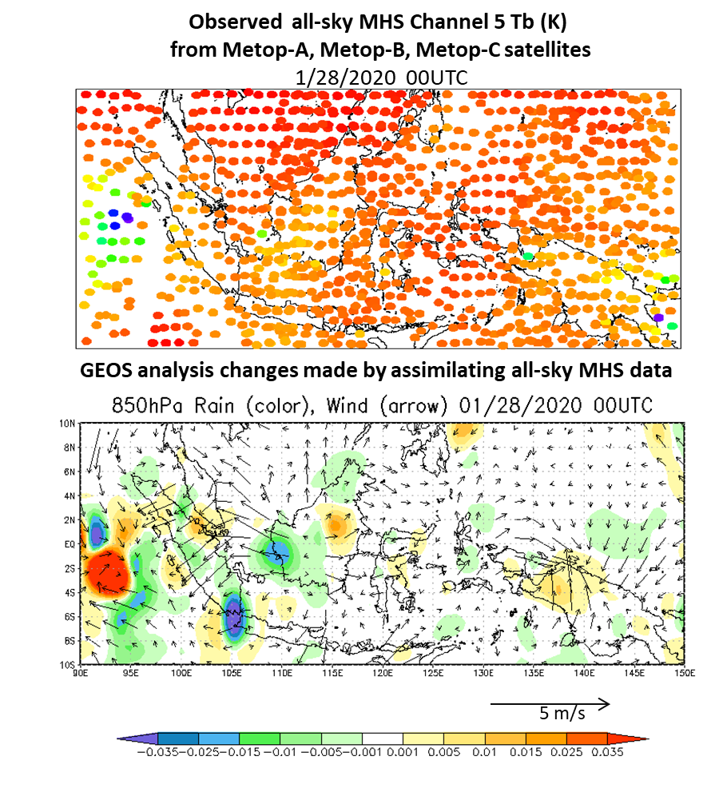
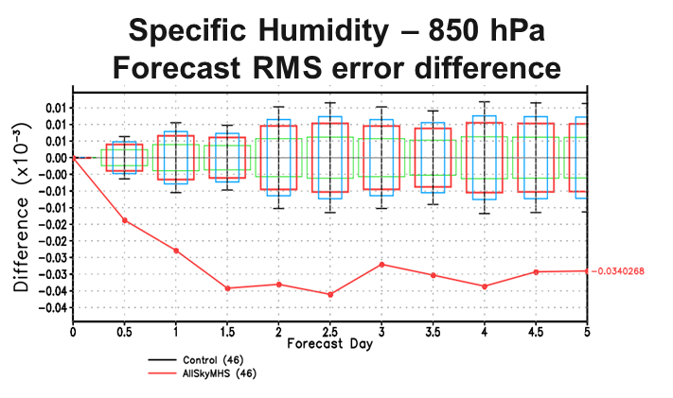
All-Sky Assimilation of MHS Radiances
Results show that the system is capable of making the necessary wind responses to compensate for changes in the water fields
  Figure to the right shows wind responses in regions of added convection
Largest forecast improvements seen in SH, Tropical lower tropospheric humidity
  Both improved analysis and transport
MHS All-Sky has passed testing and will be included in our next upgrade

Slide 7
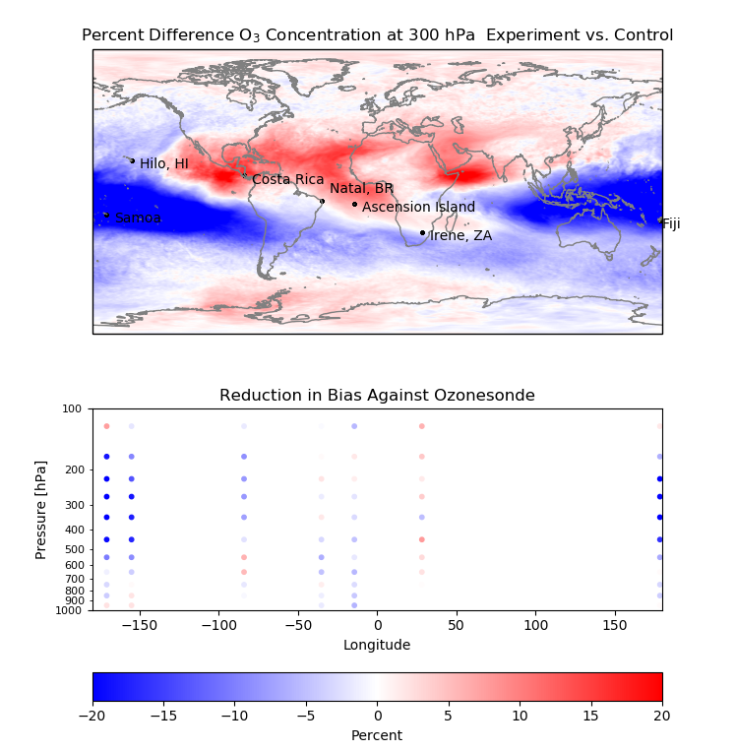
Ozone Radiance Assimilation
Infrared channel selections were extended to include radiances in the 9.6 µm ozone band for CrIS, AIRS, and IASI
  Added to system including MLS, OMI and OMPS-NM
Radiances were shown to enhanced, improved resolution of tropical wave-1 ozone signal at 300 mb
  August 2018 monthly mean percent difference against control
These changes reduced systematic errors against ozonesondes
  Reduction of bias compared against SHADOZ ozonesondes
Additional testing has shown similar improvements without MLS, OMI, or replacing MLS with OMPS-LP
O₃ radiance assimilation has passed testing and will be included in our next upgrade

Slide 8
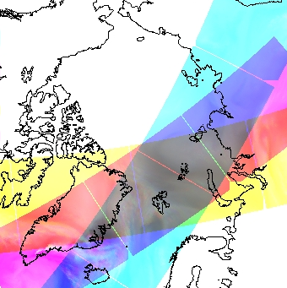
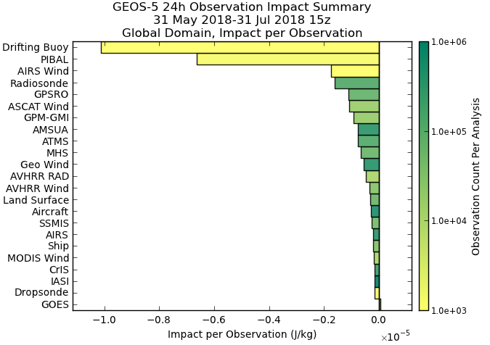
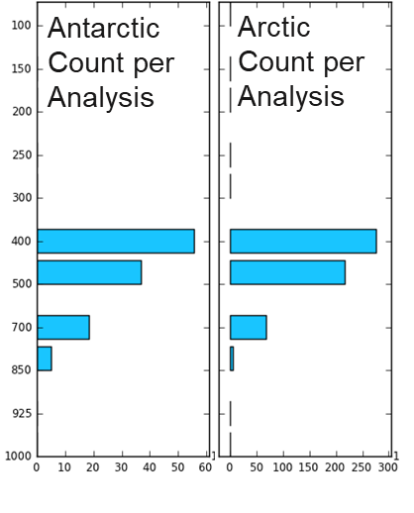
AIRS Atmospheric Motion Vectors
The utility of using atmospheric sounders to perform feature tracking in retrieval space has been investigated using the AIRS instrument
  Observations are few in count
    Poor spatial resolution
    Poor temporal overlap (satellite period)
  Observations did show a large per-observation FSOI
    These AMVs are filling a mid-tropospheric data gap that is missed from MODIS and AVHRR-derived AMVs
  These results are applicable to future constellation approaches being considered
Being extended to CrIS shortly under NASA ROSES/TASNPP funding (PI: Dave Santek, U. Wisc./SSEC)
Global FSOI per Observation
1 June 2018 – 31 July 2018

Slide 9
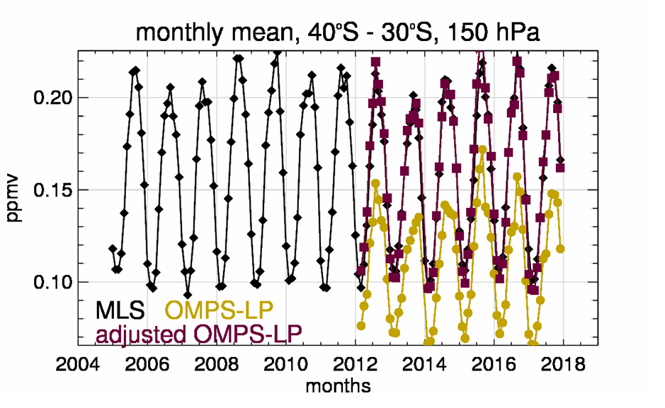
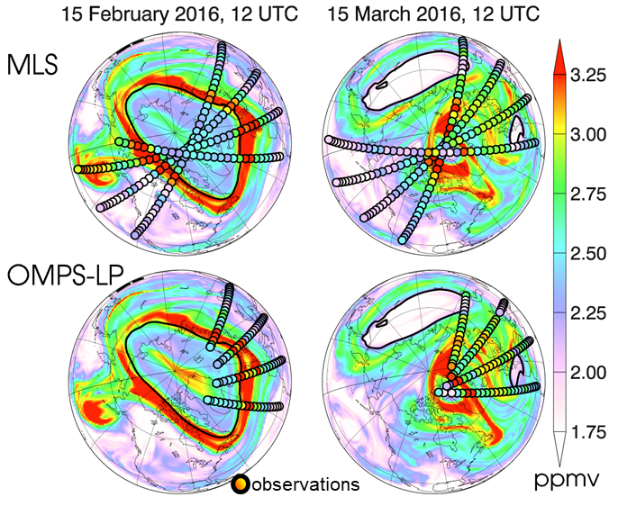
Assimilation of OMPS-LP Profiles
In addition to the OMPS Nadir Mapper, the GMAO has investigated the utility of assimilating profiles from the OMPS Limb Profiler
  The Microwave Limb Sounder on NASA EOS Aura has long been leveraged at the GMAO in FP and reanalysis
    OMPS-LP can serve to extend the MLS record as it nears the end of its life
  Limb profilers are essential for the detection and monitoring of ozone recovery
    Recovery trends highly altitude dependent but are conflated with significant interannual variability
Experimentation shows similar results between MLS and OMPS-LP assimilation
  Requires homogenization correction between MLS and OMPS-LP
  Ozone concentration on 480 K potential temperature surface show similar results from two instruments

Slide 10
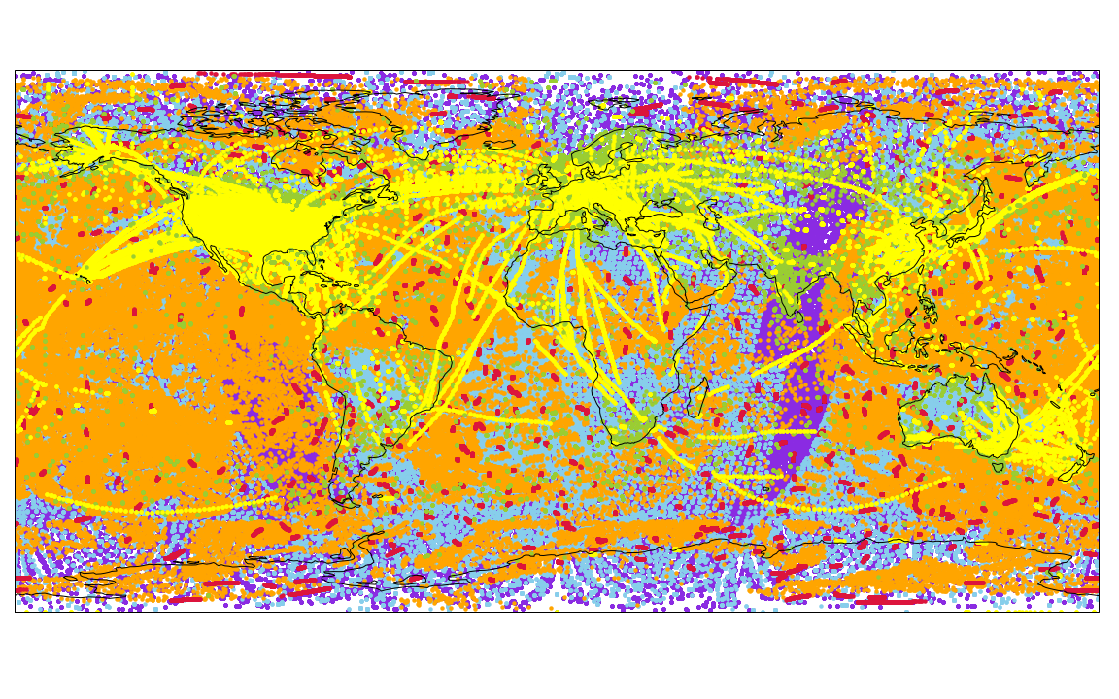
The Future of Radiance Assimilation
The GMAO has a broad OSSE capability, which can serve as a tool (in a toolbox of tools) to investigate future observing system architectures
  A full NWP OSSE system based on a 2017 observing system
    Hybrid 4D-EnVar
    C180 (~0.25°) spatial resolution, 72 model layers
    Everything up to and including Metop-B
    Still lacking NOAA-20, Metop-C, All-Sky measurements
  Additionally, the GMAO has supported simulated OSSE studies for PACE, GEO-CAPE, TEMPO outside of the NWP context
OSSEs however are limited
  Today’s approaches
  Today’s (yesterday’s) observations
  Simulated data – and thus experimental results – are too perfect
  Errors difficult to model

Slide 11
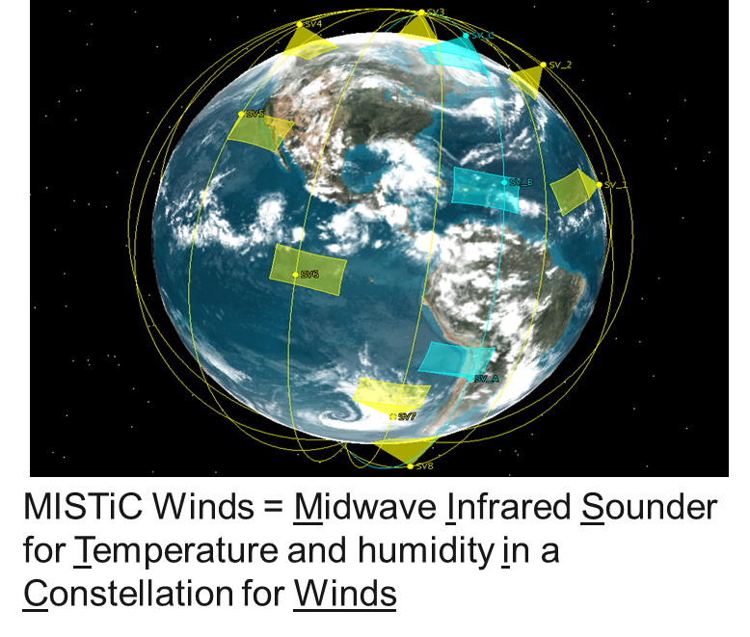
Investigating the Utility of LEO Infrared Sounder Constellation
MISTiC™ Winds provide High Spatial/Temporal Resolution Temperature and Humidity Soundings of the Troposphere
  The observing strategy is to retrieve atmospheric state and motion via LEO Constellation of MicroSats
    Infrared spectrometer sampling the midwave
    With the constellation approach, temporally subsequent sets of retrievals can then be used to perform feature tracking and retrieve atmospheric motion vectors (AMVs)
  Main goal of the study is to investigate the potential impact of these observations of both the wind and radiance information from the constellation

Slide 12
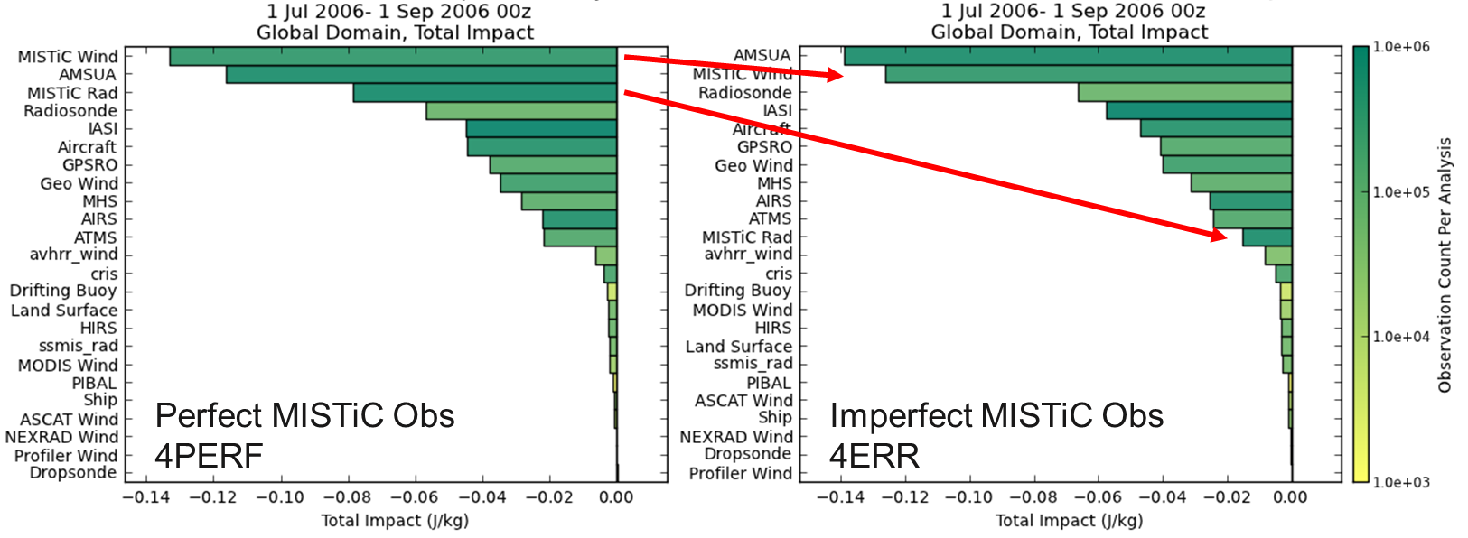
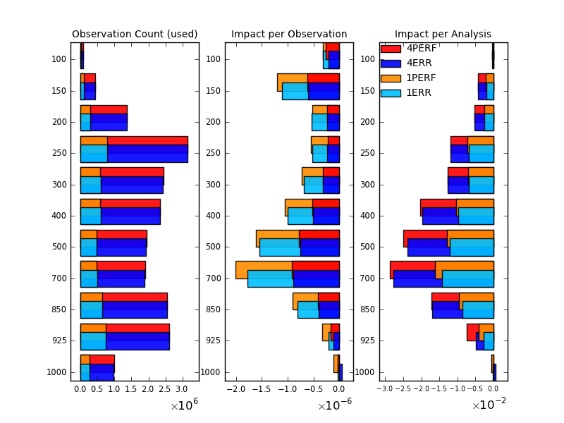
Investigating the Utility of LEO Infrared Sounder Constellation
Results showed that by including realistic
errors, much of the radiance impact was
lost in the 4.3 µm CO2 temperature
sounding channels
  Assimilation shortcomings
  Corresponds well to NESDIS TMP work to exploit this band
Simulated AMVs showed that largest FSOI was seen in the mid-troposphere
  Filling a data void that is sparsely observed by the baseline geostationary imagers
The OSSE illustrates that if the proposed observing strategy can fill the mid-troposphere AMV gap that there will be an impact
  Agrees with real data results seen using AIRS AMVs and ESA Aeolus

Slide 13
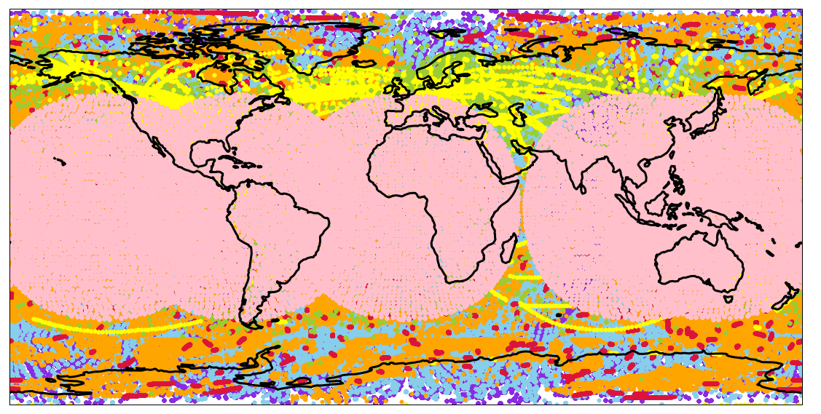
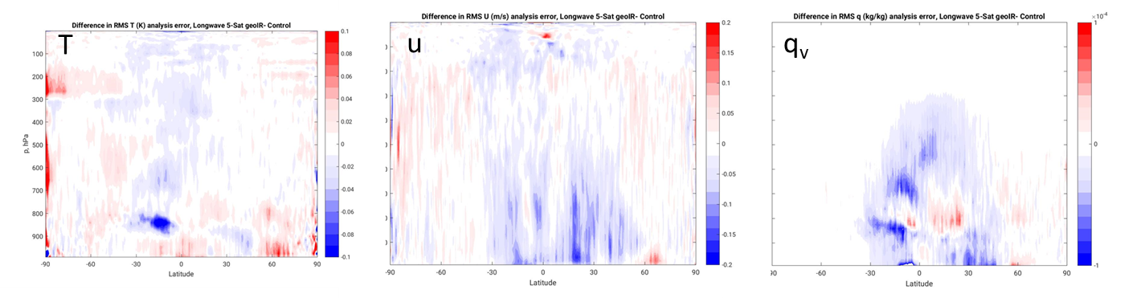
Investigating the Utility of Geostationary Infrared Sounders
A set of OSSEs considering the impact of a constellation of hyperspectral IR sounder from GEO were performed
  Considered MTG-S-like instrument (SRF, temporal sampling)
  Analysis error reductions show that the most coherent signals were in wind and water vapor
Considering the existing polar fleet of IR sounders, the new information content is temporal
  Validation of the ‘tracer effect’, the 4D analysis procedure extracts wind information from the sequential temporal sampling
Error Reduction
Good Bad

Slide 14
Other NESDIS Community-Relevant Updates
Correlated Errors in Hyperspectral Infrared
  Upcoming implementation of CrIS-FSR will be accompanied by spectrally-correlated observation errors
Extending GEOS Aerosol Analysis beyond MODIS
  Current aerosol assimilation depends on Aeronet and two MODIS instruments
  Extending the aerosol assimilation to include both VIIRS and ABI/AHI imagers
Extending fire emissions to VIIRS
  Currently depends on MODIS instruments
Currently supplies tailored products to CERES Science Team for algorithm processing

Slide 15
Looking Forward
What is the future of all-sky assimilation?
  New frequencies are coming/here
    118 GHz: NASA Tropics, Orbital Micro Systems GEMS
    > 200 Ghz: Metop-SG ICI, NASA IceCube
  All-sky in the Visible and Infrared
The Role of Legacy Instruments
  GMAO (R. Todling) is participating in multi-agency assessment of NOAA-15 to -19
  The role of these instruments in filling the Late AM/Early PM orbits
Spatial/Spectral/Temporal Resolution in the infrared
  How much spectral information is too much spectral information?
  Spatial thinning/hole hunting/etc.
    A renewed emphasis on cloud-clearing?
  Chemistry radiance assimilation in the future
There are still many opportunities to better utilize satellite data
  JEDI hopefully leads towards improved science
    Better cross-agency and extra-agency collaboration
    Better code portability
    More innovative science by disentangling the engineering and the science

