Slide 1
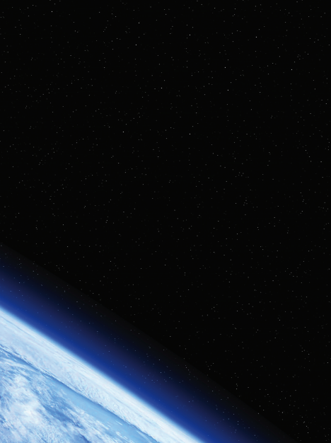

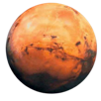
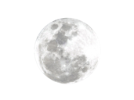

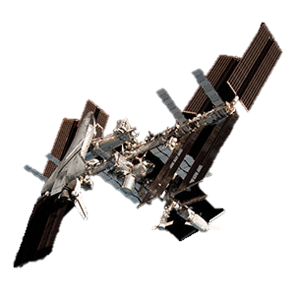
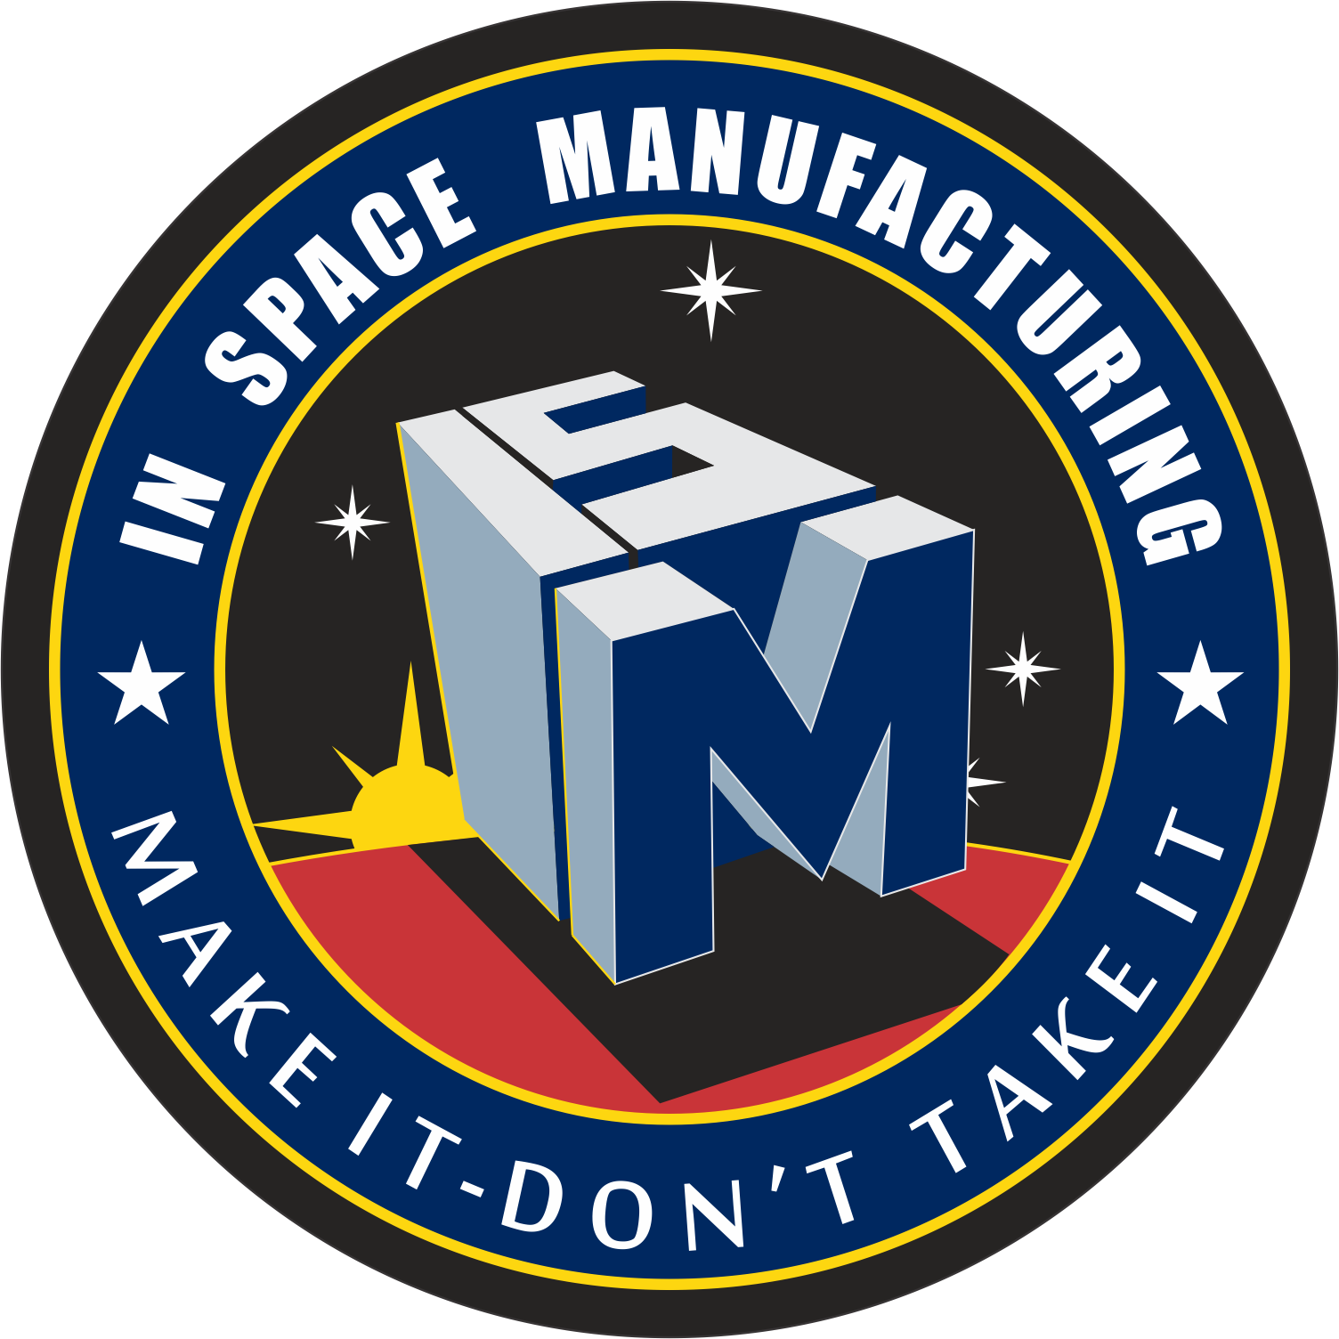
3D Printing at NASA
Maryland STEM Festival
Tracie Prater, Ph.D. NASA Marshall Space Flight Center (MSFC)
Susan Martinez, NASA MSFC

Slide 2
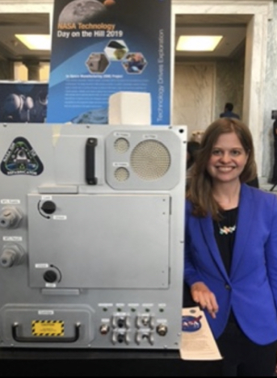
Tracie Prater
I attended Eastern Kentucky University (B.S.) and Vanderbilt University (M.S., Ph.D)
I am a Materials and Processes Engineer at NASA MSFC
I have a dog (Laika)
I am also a SCUBA diver

Slide 3
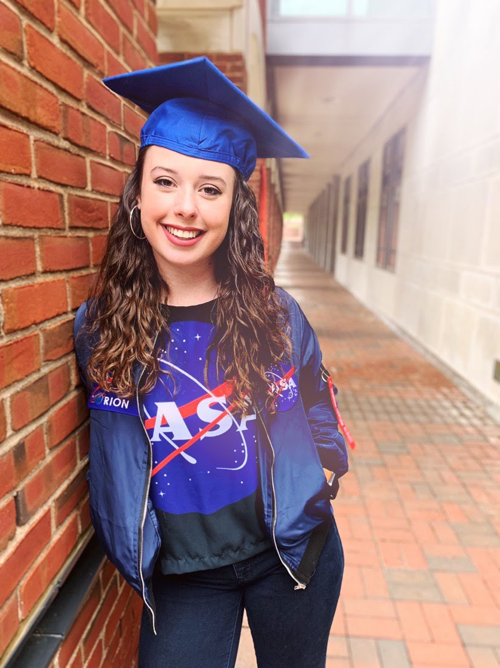
Susan Martinez
I attended the University of Kentucky (BSME)
I am an Additive Manufacturing Engineer at NASA MSFC
I have a dog (Jupiter) and a cat (Juno)

Slide 4
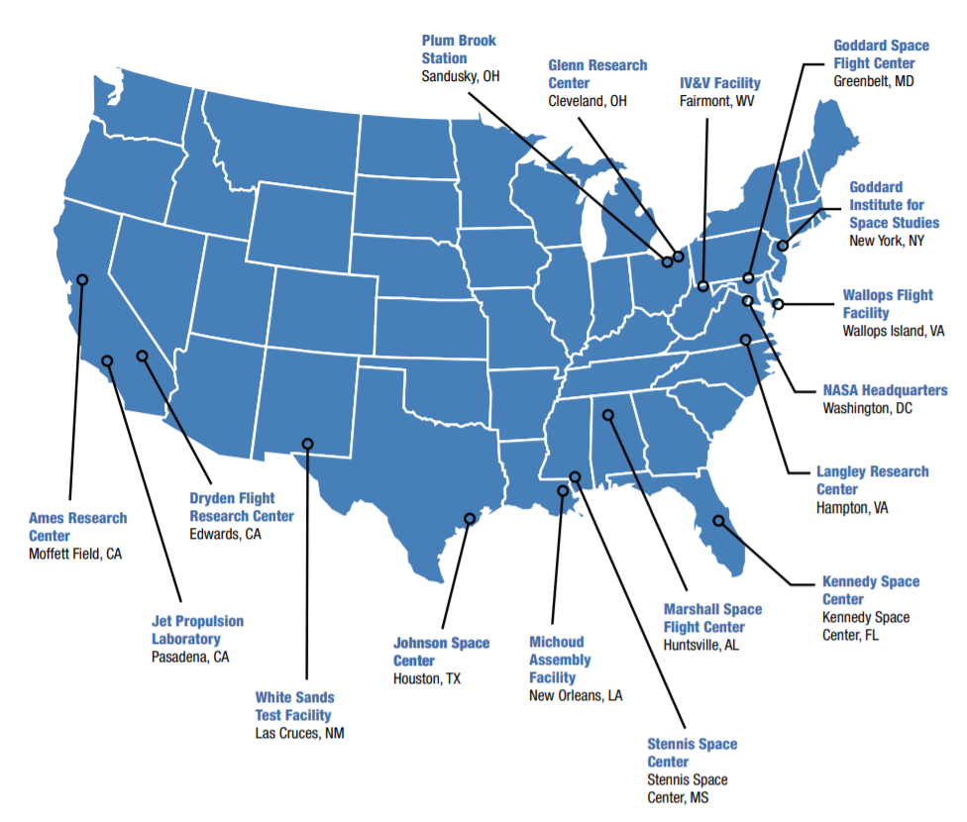
Where is NASA?
Map of NASA Field Centers and Facilities
Goddard Space Flight Center
Glenn Research Center
NASA
Headquarters
Kennedy Space Center
  Ground Operations
Marshall Space Flight Center
  SLS Program
Johnson Space Center
  Orion Program

Slide 5
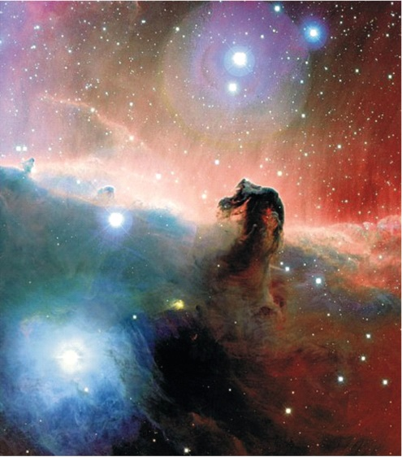
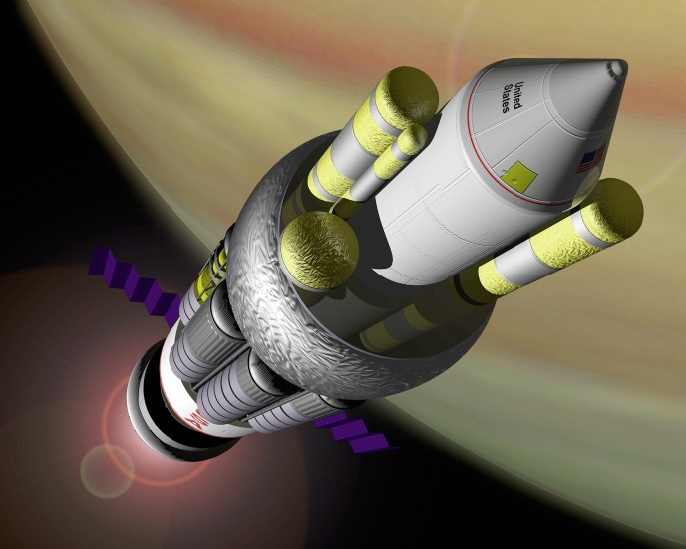
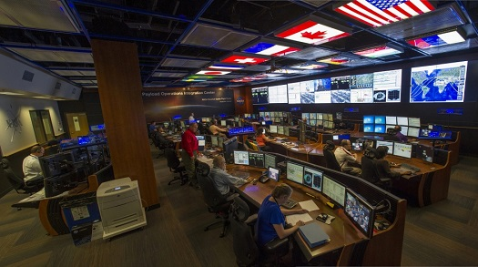
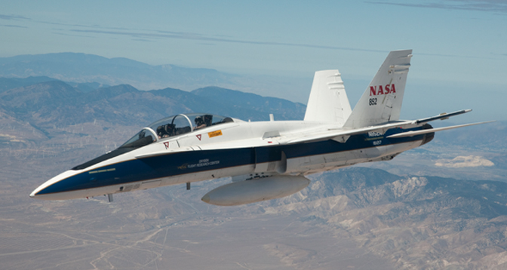
What does NASA do?
Science
Space Technology
Human Exploration and Operations
Aeronautics

Slide 6
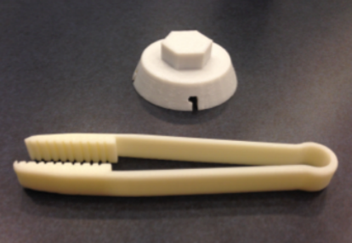
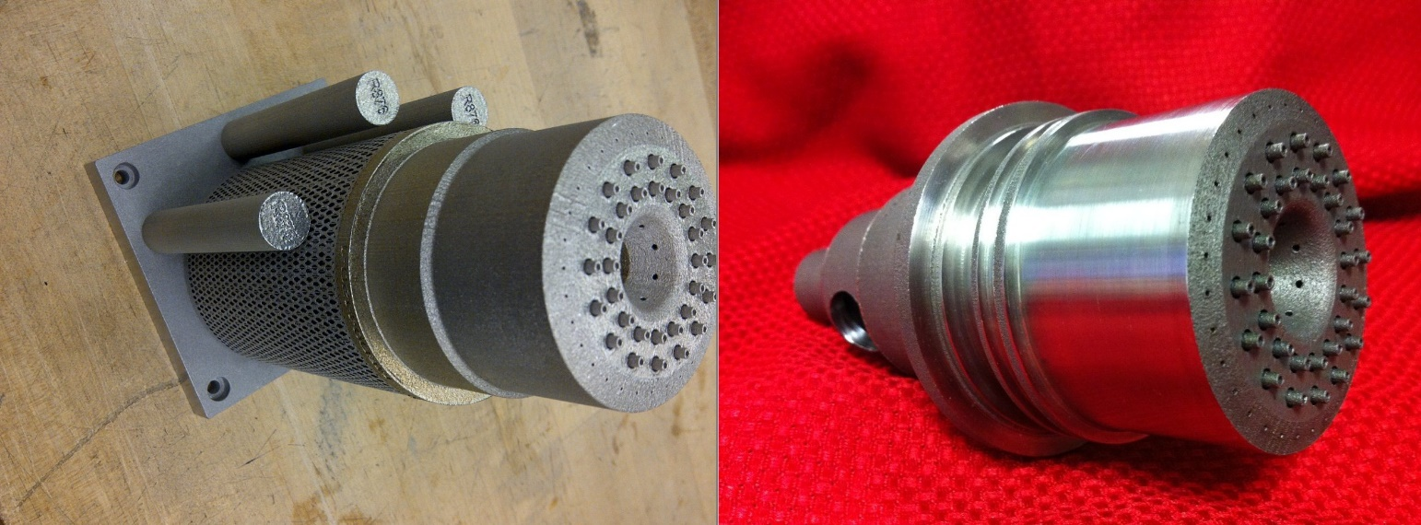
What is 3D Printing?
3D Printing is the process of depositing materials to make objects from 3D model data, layer by layer.
3D Printers can produce plastics or metals.

Slide 7
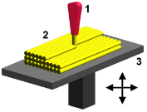
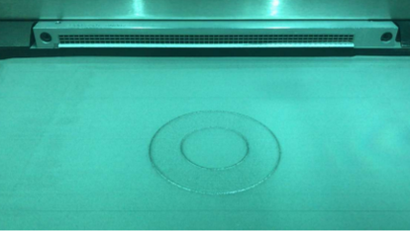
How does 3D printing work?
Step 1: A three dimensional model of a part is sliced into layers
Step 2: Software generates a code that drives the movements of a machine to deposit material exactly where it is needed for a particular geometry within each layer
Step 3: Once a layer is complete, the platform the part is being built on moves down (like an elevator) and another layer of material is deposited
Two examples of 3D printing processes are shown below.
Fused filament fabrication:
1) nozzle ejecting molten plastic or metal/plastic blend in the form of a wire
2) deposited material (modeled part)
3) controlled movable table
Selective laser melting:
1) Metal powder is deposited on a platform
2) Laser selectively melts material in a specific pattern
3) Platform moves down and additional powder is deposited for a new layer

Slide 8
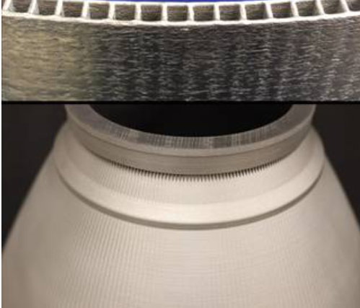
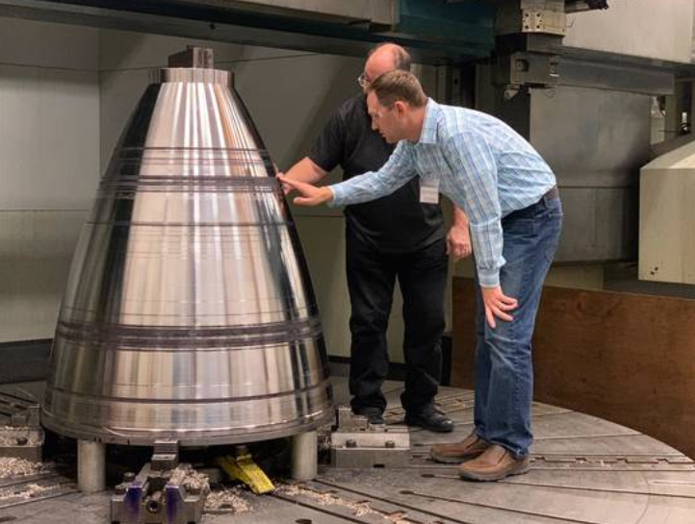
Why do we use 3D printing?
Affordability
Freedom in design (ability to build complex shapes and geometries)
Reducing time from “art to part”
Make what you need, when you need it
Rocket engine components made with 3D printing

Slide 9
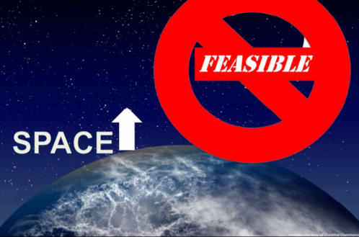
Why do we want to 3D print in space?
The International Space Station (ISS) is only 200 miles above the earth. ISS also has a large volume for habitation and storage space (size of a 5-bedroom house on earth).
For missions that are farther out in space, our ability to resupply spacecraft becomes more limited and available storage space decreases.
3D printing can reduce the amount of material and parts we have to take with us on future long duration missions.

Slide 10
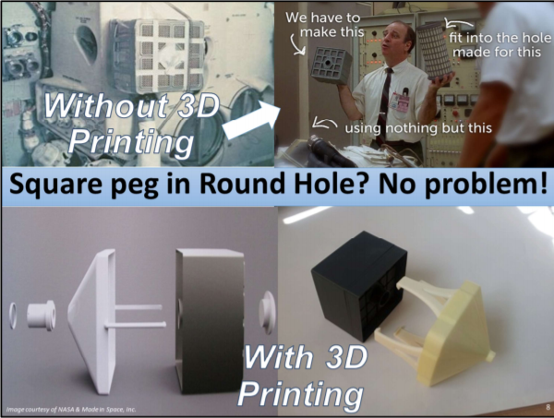
Why do we want to 3D print in space?
3D printing can also enhance crew safety by enabling a rapid response to unforeseen scenarios.

Slide 11

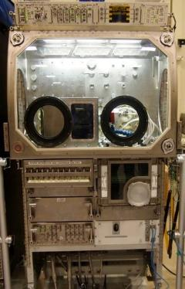





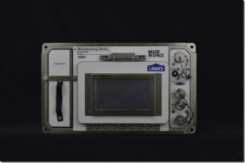
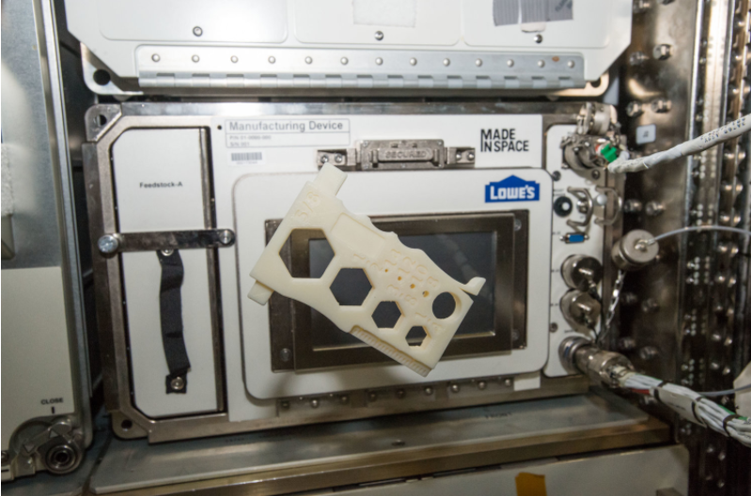
3D Printers in Space
The 3DP in Zero G tech demo delivered the first 3D printer on the ISS and investigated the effects of consistent microgravity on fused filament fabrication by printing 55 specimens.
The Additive Manufacturing Facility (AMF) is a next generation, multimaterial printer for plastics currently on ISS from Made in Space.

Slide 12
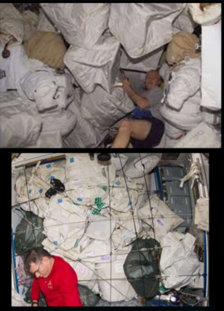
Recycling in Space
On ISS, astronauts manage trash (primarily launch packaging materials) by squeezing it into “trash footballs”, which are packed into a module that burns up on reentry into the earth’s atmosphere.
ISS can store up to 2 metric tons of trash onboard!
There are currently two recycling experiments on ISS:
ReFabricator (NASA/Tethers Unlimited)
Made in Space Recycler
What if we could repurpose trash into filament for 3D printing?

Slide 13
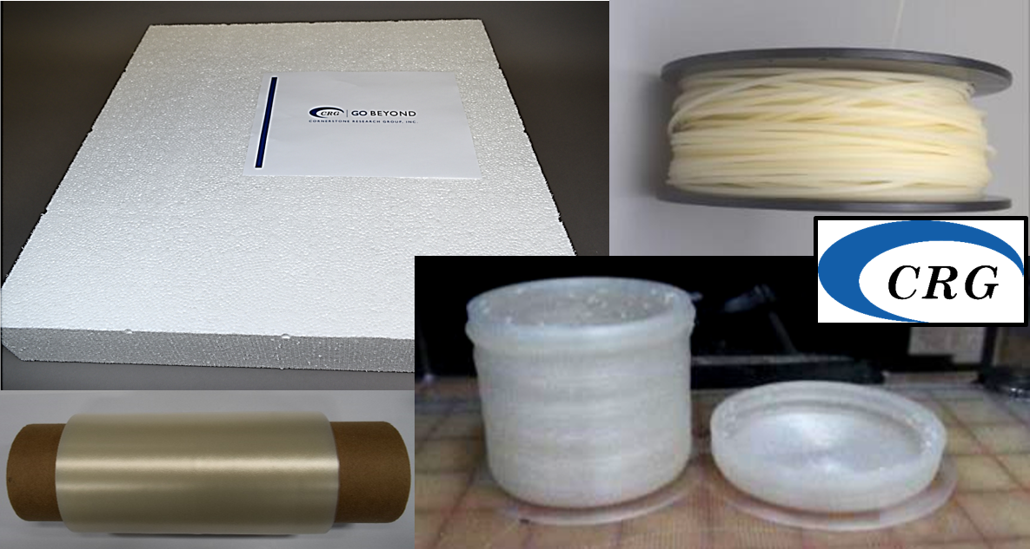

Recycling in Space
In addition to developing recycling systems, we will also need packaging materials that are intended to be recycled.
Cornerstone Research Group (CRG) developed a material for foams and films that can be recycled into filament for 3D printing.
Film, foam, and filament material designed for recycling (image from CRG)

Slide 14
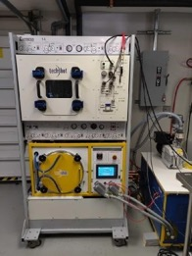
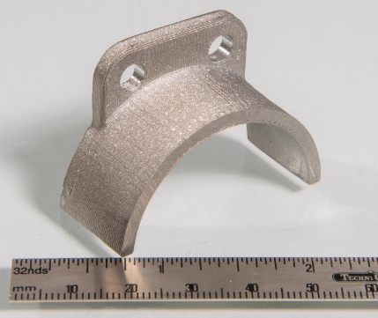
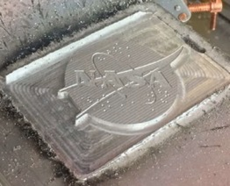
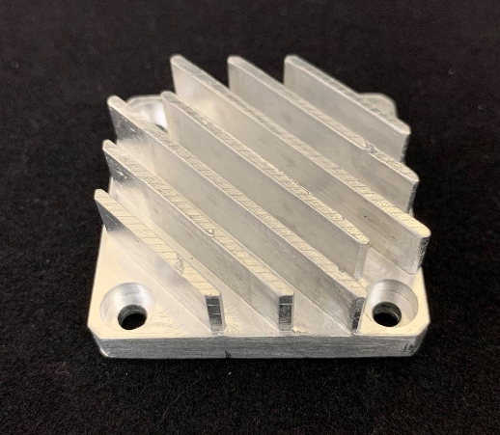
Coming Soon: Metal 3D Printing In Space
NASA is working with companies to develop systems for 3D printing of metal parts on future space missions. Initially, these systems will be demonstrated on ISS.
Techshot Fabrication Laboratory (image credit: Techshot, Inc.)
Examples of parts produced with the Vulcan system from Made in Space, Inc. (image credit: Made in Space, Inc.)

Slide 15
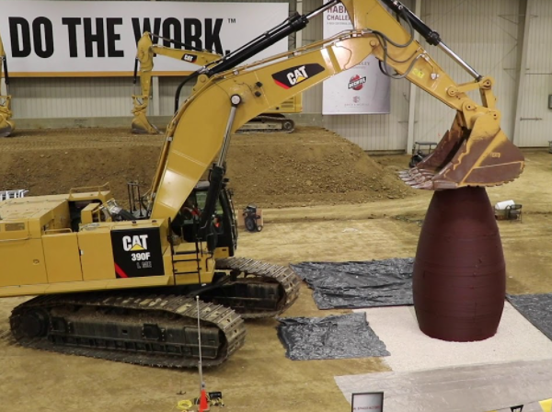
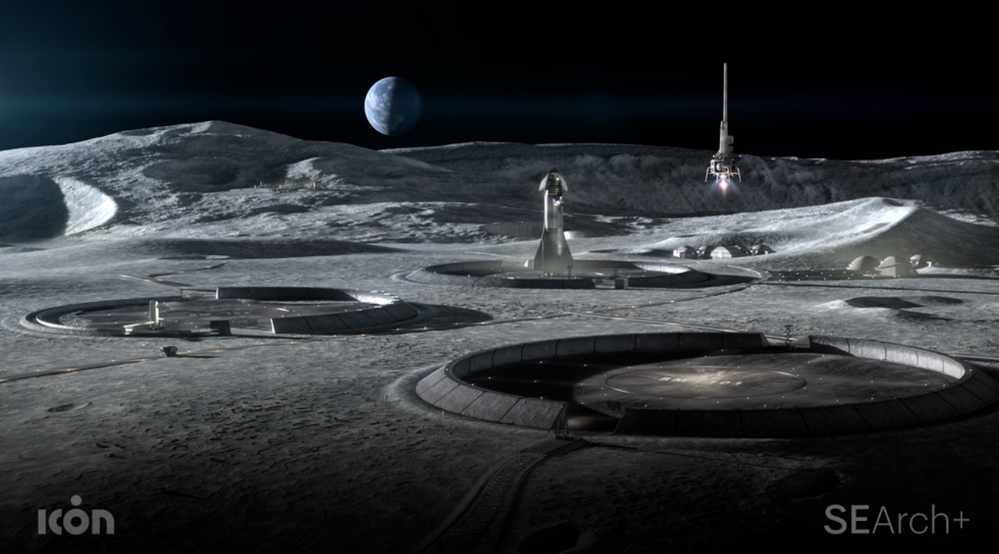
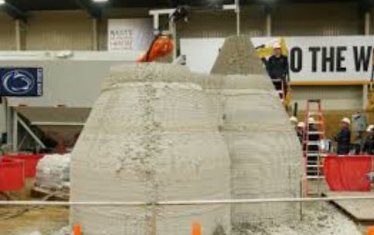
3D Printing of Habitats
3D Printing can be scaled up to produce larger structures.
3D printing could even be used to produce habitats and infrastructure in advance of the arrival of crew on planetary surfaces.
NASA’s 3D Printed Habitat Challenge (2019)
Image from SEArch+, ICON

Slide 16

“Every revolutionary idea seems to evoke three stages of reaction:
It’s completely impossible.
It’s possible, but it’s not worth doing.
I said it was a good idea all along.”
-Arthur C. Clarke
Tea.
Earl Grey.
Hot.
“If what you’re doing is not seen by some people as science fiction, it’s probably not transformative enough.” -Sergey Brin

