Slide 1
A Modified Delphi Method to Accelerate Consensus Building in Expert Judgment Elicitation
Marie L. Ivanco, Christopher A. Jones, Shaun A. Deacon

Slide 2
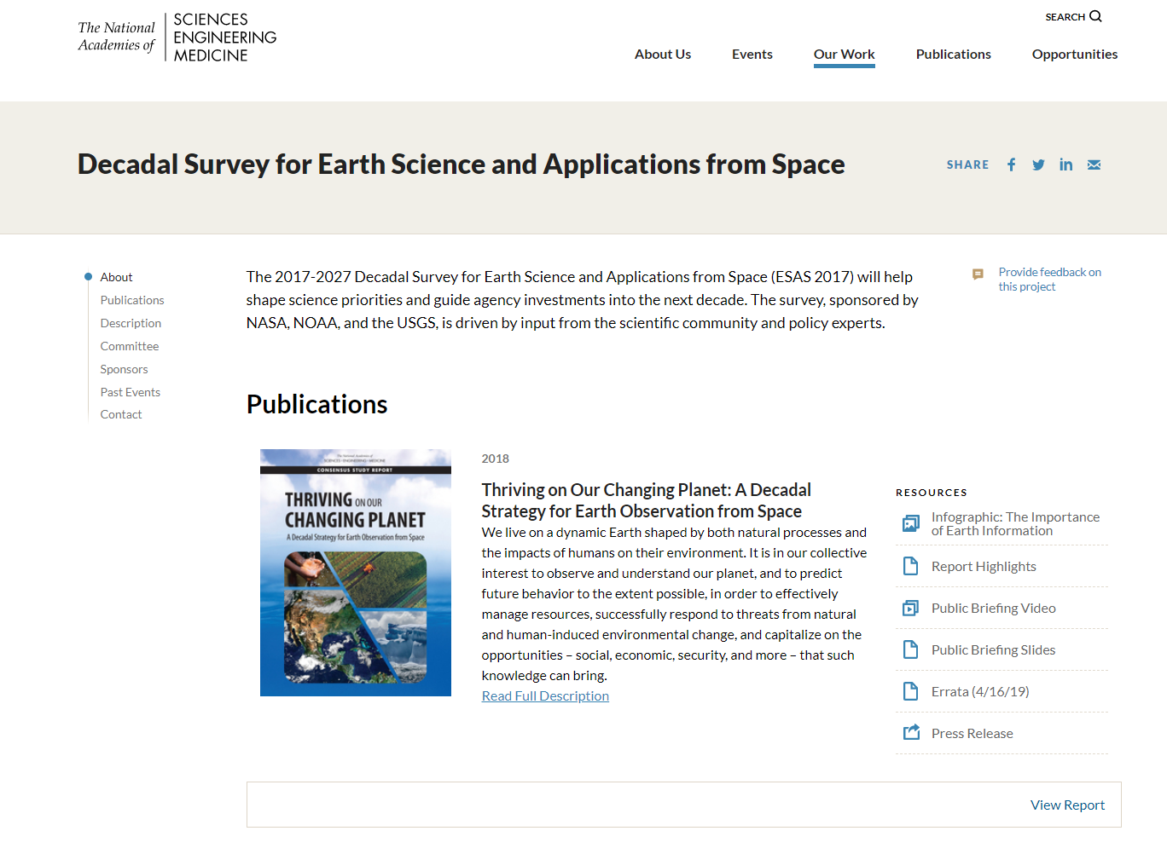
2017 Earth Science Decadal Survey
Released in January 2018. Effort started in 2015 with study panels and a steering committee.
Published by the National Academy of Sciences
Objective of ESAS 2017 is:
“to generate recommendations for the environmental monitoring and Earth science and applications communities for an integrated and sustainable approach to the conduct of the U.S. government’s civilian space-based Earth-system science programs.”
ESAS 2017 recommended 22 Targeted Observables:
290 Community RFI responses
35 Science and Applications Questions
103 Science and Applications Objectives, organized in tiers (Most Important, Very Important, Important)
22 Targeted Observables, with suggested measurement approaches
Notes:
Earth Science and Applications from Space decadal survey for 2017-2027: “ESAS 2017”

Slide 3
The Aerosols, Clouds, Convection, and Precipitation Study
The Aerosols, Clouds, Convection, and Precipitation study was tasked with defining and evaluating candidate observing system concepts. A Value Framework was developed to enable scientists and engineers across multiple NASA centers, academia, and international partners to collaborate on the study team.
A structured, traceable, and transparent approach to be responsive to a complex decision landscape:
A holistic approach that informs the decision-making process:
Comprehensive examination of all elements of the decision space to enable trade-offs (science, applications, programmatic factors, cost, and risk)
Common terminology to enable productive conversations across a large, diverse group
Data-driven, consistent evaluations augmented by structured expert judgement
Independent team that facilitates but does not provide input into the assessment
8 science objectives
27 applications
Multiple programmatic considerations
Lidars
Polarimeters
Radiometers
Radars
Spectrometers
Cameras
Multi-Objective Decision
Many Alternatives
Mission-level Trades
2 Science Communities
Many Stakeholders
Aerosols
CCP
Different communities and priorities, leveraging synergies
Integrated Value Analysis
6 NASA Centers
4 International Partners
Academia

Slide 4
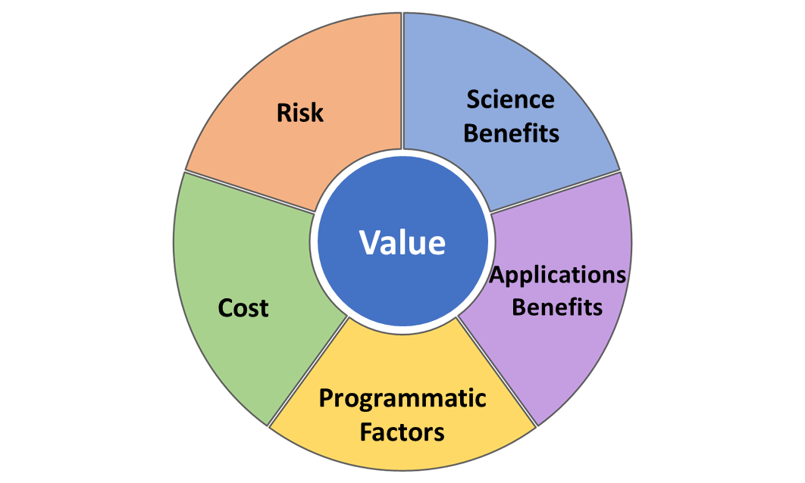
Defining Value for the ACCP Study
Value: For ACCP, Value is the relative worth of science benefits, applications benefits, and programmatic factors with respect to cost and risk.
Reporting Format: Benefits, cost, and risk are intentionally not rolled up into a single value score to avoid:
Losing discriminators
Combining uncertainty
Anchoring cognitively on an initial value
Science Benefits are expressed in terms of Utility, Quality, and Sampling:
Utility quantifies how important a Geophysical Variable (GV) is to address a Science Objective, assuming the GV is measured perfectly
Provided by science team
Architecture-independent
Quality quantifies how often an architecture meets the uncertainty targets defined in the Science Traceability Matrix
Provided by assessment teams
Architecture-dependent
Sampling quantifies where and when the measurements are obtained
Joint effort
Instrument-independent, except for coverage characteristics
Mission characteristics-dependent
Science Benefits are expressed in terms of Utility, Quality, and Sampling:
Utility quantifies how important a Geophysical Variable (GV) is to address a Science Objective, assuming the GV is measured perfectly
Provided by science team
Architecture-independent
Quality quantifies how often an architecture meets the uncertainty targets defined in the Science Traceability Matrix
Provided by assessment teams
Architecture-dependent
Sampling quantifies where and when the measurements are obtained
Joint effort
Instrument-independent, except for coverage characteristics
Mission characteristics-dependent

Slide 5
Delphi Method Overview
Elicitation Questionnaire
Scoring Round 1
Summary and Review
Anonymous scores
Supporting comments
Performed by facilitator
Preserved anonymity
Scoring Round 2
Summary and Review
Anonymous edits
Supporting comments
Performed by facilitator
Preserved anonymity
Scoring Round N
…
Pre-defined consensus criterion is met
The unique needs of the ACCP study for score traceability and for an accelerated consensus building process prompted the modification of the method for the purposes of the study.
Anonymous edits
Supporting comments

Slide 6
Need for a Modified Delphi Method
The unique needs of the ACCP study:
Traceability:
The study bridges two communities, as well as many stakeholders who are transitioning from an competitive environment to a culture of collaboration.
The Decadal Survey set out a $1.6B notional budget for ACCP, therefore warranting that the team carefully quantifies and documents how the assessment of the science benefit of the candidate observing systems was conducted.
Speed of execution:
A significant number of activities has to be conducted in the timeframe of the study, making the efficiency of the chosen approaches a priority.
Opportunities for face-to-face meetings are limited, also emphasizing the need for productive and streamlined processes.
Modifications implemented to be responsive to these needs:
The anonymity requirement was lifted:
Satisfied the need for traceability
Enabled the identification of areas of disagreement, therefore allowing the facilitator to focus on scores that require discussion to reach convergence and directly soliciting feedback from experts who are not in alignment
Scoring rounds were limited to one asynchronous and one synchronous round:
Satisfied the need for an accelerated process, avoiding numerous iterative asynchronous rounds
Accelerated the consensus building process by combining live discussions in the second round and the lifted anonymity requirement
Visual representation of dispersion was provided:
Plotted the dispersion of scores and the mean for each Geophysical Variable to enable the identification of scores with the greatest disagreement, therefore optimizing the time dedicated to the discussion
Provided plots of individual scores as well to facilitate discussions between experts least aligned and therefore accelerating the consensus building process

Slide 7
Modified Delphi Method
Independent, asynchronous, non-anonymous
(2 weeks)
Expert Selection
and
Practice Run
Elicitation Questionnaire
Scoring Round 1
Summary and Review
Anonymous scores
Supporting comments
Performed by facilitator
Preserved anonymity
Includes visualization of dispersion
Scoring Round 2
Summary and Review
Live discussion until convergence is met
Anonymous edits
Supporting comments
Performed by facilitator
Preserved anonymity
Includes visualization of dispersion
Face-to-face, synchronous, non-anonymous
(1 day)

Slide 8
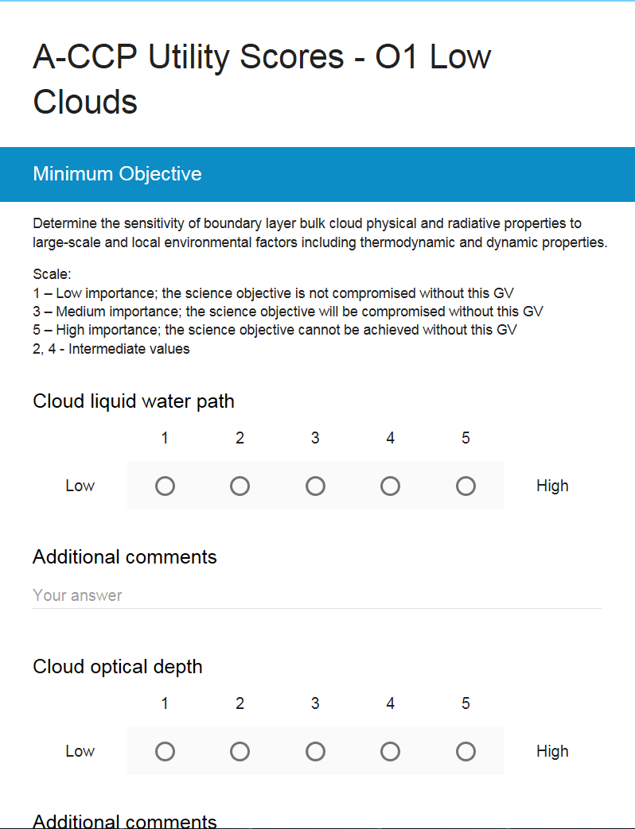
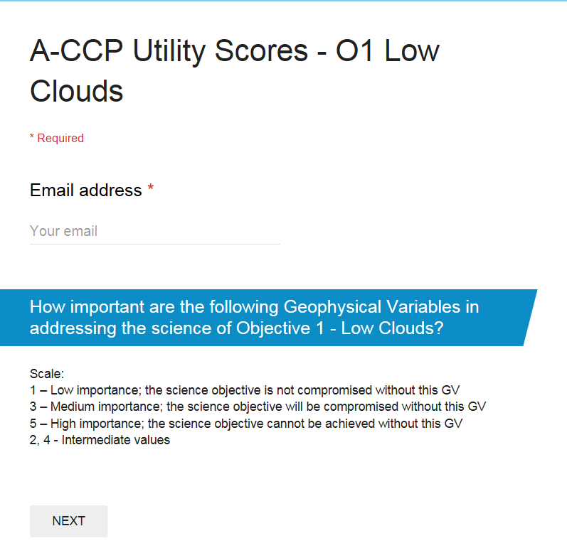
Example Questionnaire
Objective definition from Science Traceability Matrix
Email address to identify respondent
Question and rating scale to use for all GVs
Geophysical Variable name and place to select score
Place to input additional comments on the scoring for the Geophysical Variable

Slide 9
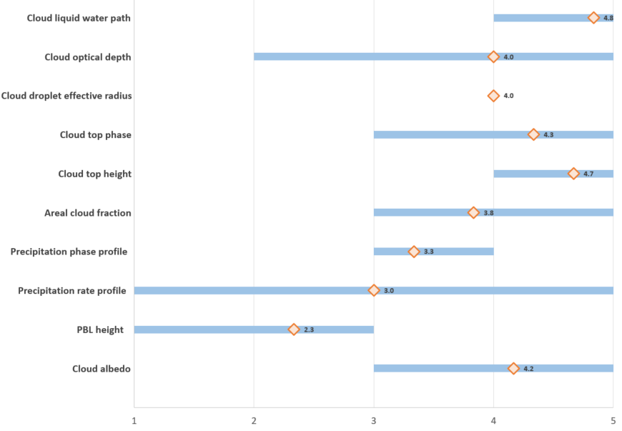
Visualization of Dispersion
For each Geophysical Variable, the dispersion plot illustrates the spread of scores, as well as the mean score from the questionnaire.
Individual scores were shown both in bar char format across experts, and were also reported separately with traffic light shading.
Detailed comments from the experts were included for all to consult.
The discussion was focused on Geophysical Variables with greatest disagreement in scores, and real-time adjustments were made as experts converged.
Notional scores for illustrative purposes only
Notional scores for illustrative purposes only

Slide 10
Adjustments for the COVID-19 Pandemic
Utility scores were to be elicited for Geophysical Variables that will be obtained from the Program of Record (PoR), a subsequent activity conducted after the Utility scoring of the Geophysical Variables obtained from the mission instrumentation.
Due to COVID -19, the team had to make adjustments to the modified Delphi method in order to implement it in a virtual setting and accelerate the process even more.
Given that the team could build on the experience of the first successful implementation of the method, and that the number of PoR variables was limited, the team decided to attempt both rounds in a synchronous, non-anonymous, live setting.
Scoring Round 1
Summary and Review
Scoring Round 2
Live discussion until convergence is met
Virtual, synchronous, non-anonymous
(2 hours)
Used Google Forms built-in histogram feature to support the discuss, as opposed to the custom visualization used previously.

Slide 11
Benefits of the Approach and Lessons Learned
Modified Delphi Method, as designed initially:
The approach was successful and all objectives were achieved: the team converged on a set of scores, traceability was realized, and time spent on the elicitation activity was minimal.
Custom visualization products were intuitive and supported the resolution of disagreements well.
Modified Delphi Method, adjusted for use during the pandemic:
Google Forms built-in histograms are not intuitive to read; custom visuals supported the discussion much more efficiently and intuitively.
The facilitation of the reconciliation discussion is easier in person than virtually. It is more challenging to engage with the audience virtually, and some experts tend to dominate the conversation.
The ability to score in a live setting requires that experts do individual pre-work prior to the virtual meeting; this needs to be accounted for and communicated.
Traceability was reduced: while scores were captured, the comments and discussion was not captured as well as with the initial approach. If someone is designated as note taker, this person should be a substantive expert in the field in order to capture the nuances in reasoning.

Slide 12
Questions?
Marie Ivanco
marie.l.ivanco@nasa.gov

