Slide 1
NASA’s Current Optical Communications Efforts
Bernard L. Edwards
NASA Goddard Space Flight Center
October 2020

Slide 2
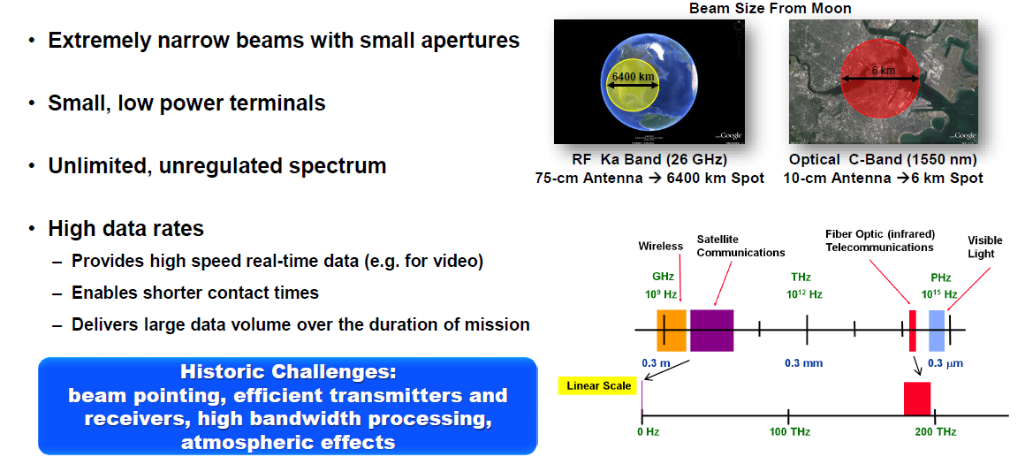
Benefits of Optical Communications
NASA wants to build upon the success of the 2013 Lunar Laser Communications Demonstration (LLCD) and previous efforts
2
Notes:
The optical band has thousands of times more bandwidth than the RF band, it is unregulated. The short wavelength also allows very high gain with small apertures, and thus small terminals.

Slide 3
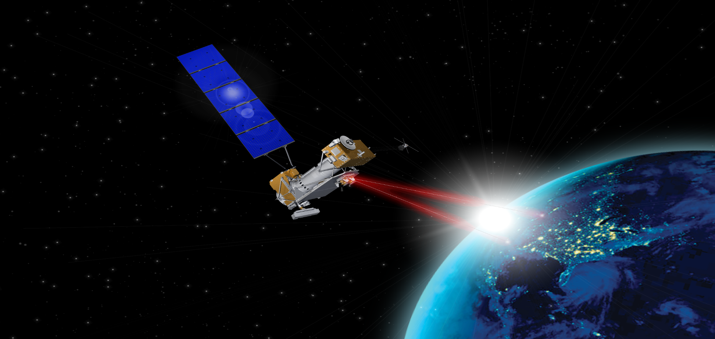
2021 Laser Communications Relay
Demonstration (LCRD)
Scheduled launch: February 2021
Mission duration:
Two year ops demo
Six years ops
Hosted payload: US Air Force’s
Space Test Program Satellite – 6 (STPSat-6)
Ground stations:
California
Hawaii
Partnership:
NASA Goddard Space Flight Center
NASA Jet Propulsion Laboratory
MIT Lincoln Laboratory
STMD/Technology Demonstration Missions
Space Communications and Navigation
Flight payload:
Two 10.8 cm Optical Modules and Controller Electronics Modules
Two software-defined DPSK Modems with 2.88 Gbps data rate (1.244 Gbps coded user rate) that can also support PPM
622 Mbps Ka-band RF downlink
New High Speed Switching Unit to interconnect the three terminals
Guest investigators welcome!

Slide 4
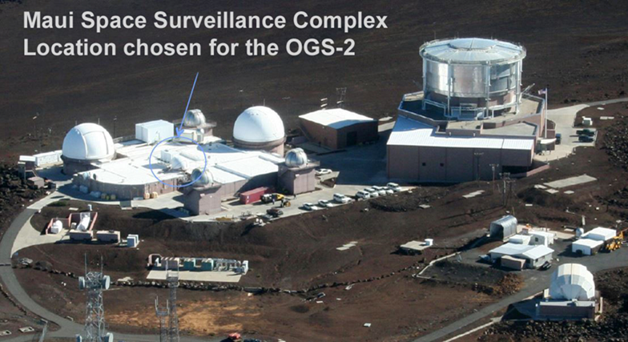
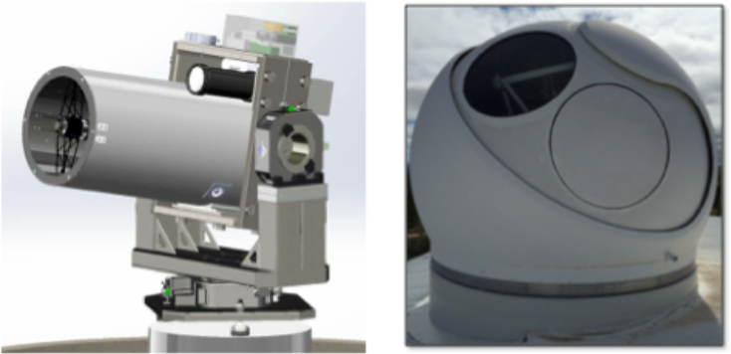
LCRD Optical Ground Stations
The LCRD baseline includes two Optical Ground Stations (OGS)
  Supports optical comm relay demonstrations before user terminals are available
  Allows for future handover demonstrations
OGS-1 is the Optical Communications Telescope Laboratory (OCTL) on Table Mountain, California
  1 Meter Receive Aperture
  This was used in the Lunar Laser Communication Demonstration (LLCD)
OGS-2 is at the Maui Space Surveillance Complex on Haleakala, Maui
  Single 5.5 m Diameter Dome on the roof contains:
    60 cm Receive Aperture
    15 cm Transmit Aperture
    5.4 W of Transmit Optical Power (outside the dome)
4

Slide 5
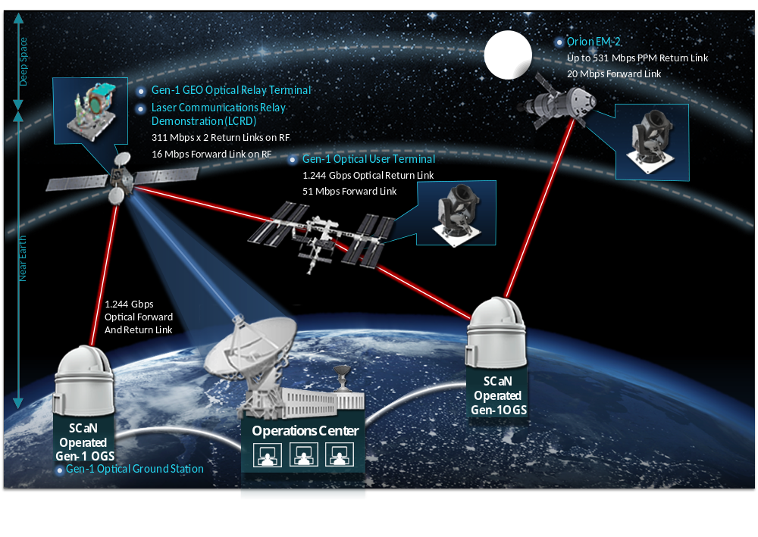
NASA’s Optical Plan Forward:
User Terminals for LEO and the Moon
User Terminals for ISS
and Orion EM-2
Limited to 80 Mbps
5

Slide 6

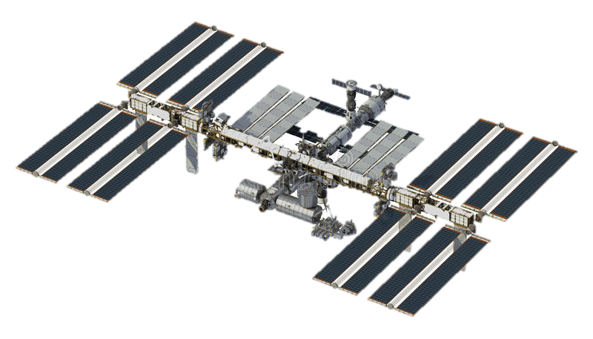

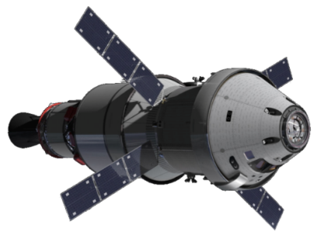

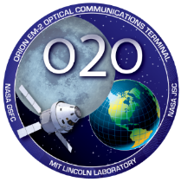









Laser Communications for Human Space Exploration
ILLUMA-T
(Integrated LCRD LEO User Modem and Amplifier Terminal)
O2O
(Orion AM-2 Optical Comm)
1.2 Gbps return
51 Mbps forward
To ground via LCRD relay
Feb 2021 delivery to GSFC
Nov 2021 Launch on SpaceX Dragon
~6 Month Mission
80 Mbps return
20 Mbps forward
Direct to ground (WSC, TMF)
8-21 day mission on first crewed
Artemis Mission (AM-2)
November 2020 delivery to KSC
2022 Launch on Orion/SLS
8 – 21 Day Mission
6

Slide 7
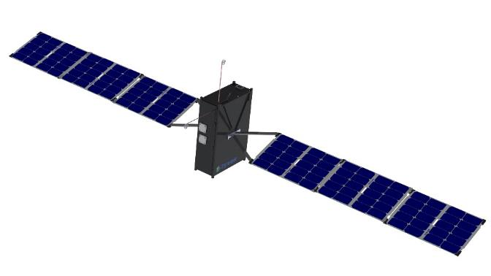



NASA’s Optical Plan Forward:
LEO Direct to Earth: TeraByte InfraRed Delivery (TBIRD) in 2021
200 Gbps optical link enables delivery of many TeraBytes/day from low-Earth orbit
Space terminal based on telecom optical components, small enough for CubeSat
~Foot-class ground terminal aperture is low cost and widely deployable
MIT
Lincoln Laboratory
7

Slide 8
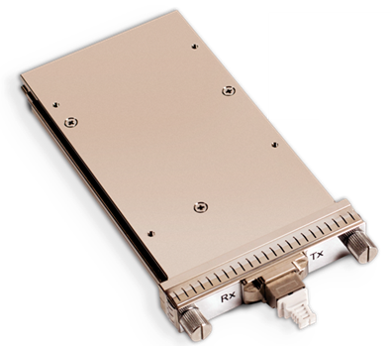
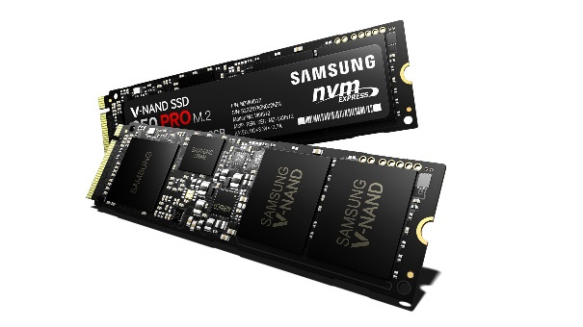
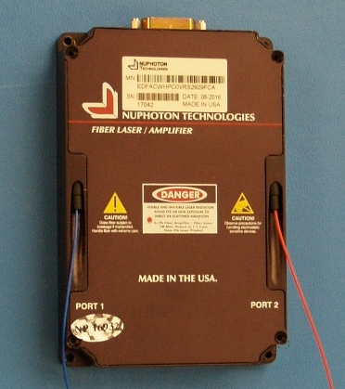

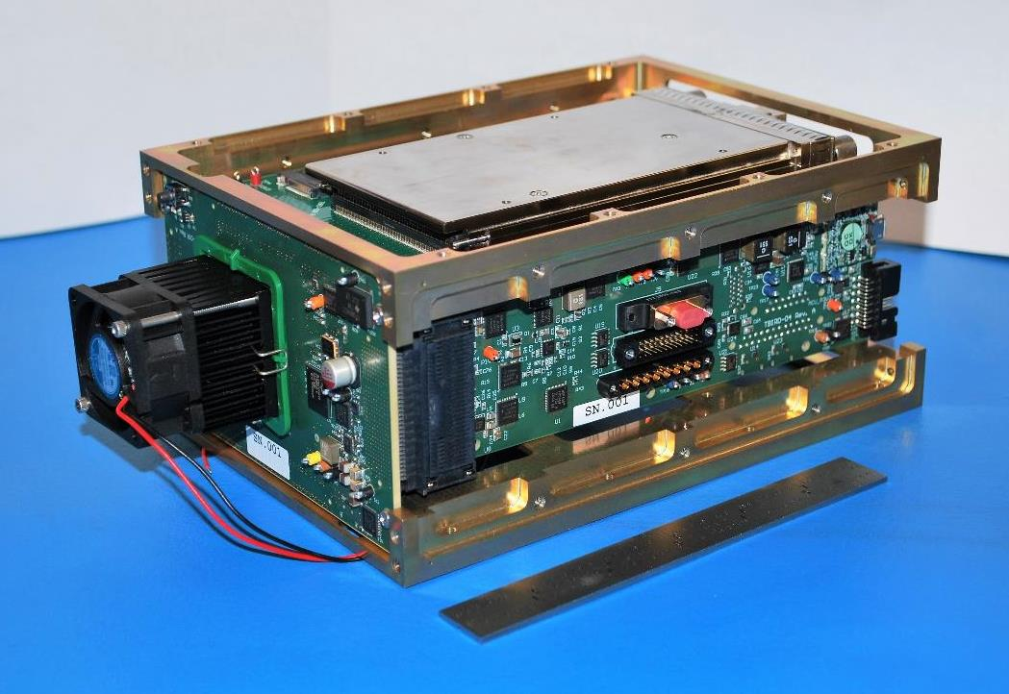
TBIRD: Highly Integrated COTS Components Enable
Small, Low-Power Space Terminal Designs
High-Rate Optical Modem
Large, High-Speed Storage
Optical Amplifier
100 Gbps Fiber Telecom Transceiver
Compact Form Pluggable (CFP)
>500 GB, >25 Gbps Readout
Solid-State Drive (SSD)
~1W Erbium Doped Fiber Amplifier
Optical C-Band (~1550nm)
TBIRD Proto-Flight HW
Mass: 2.24 kg
Power: 120W
(5 minute ops)
Volume: 1.8 U
MIT
Lincoln Laboratory
8

Slide 9

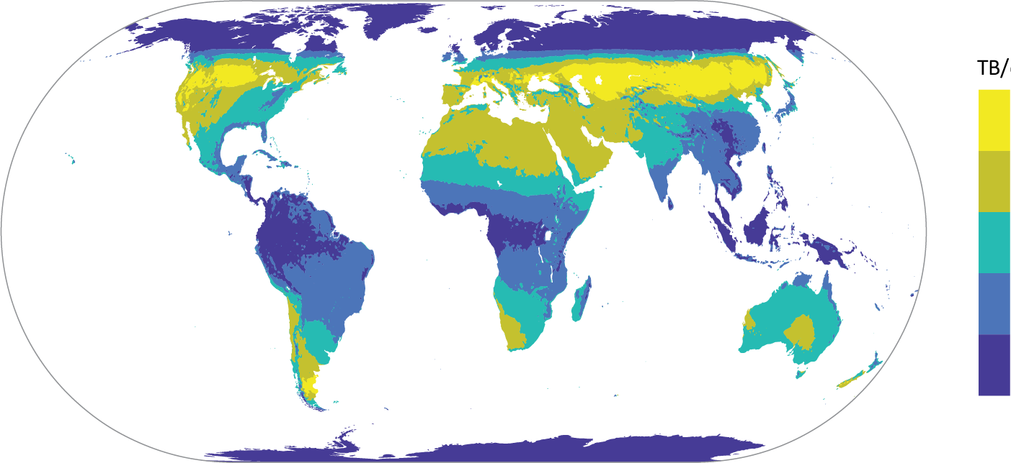
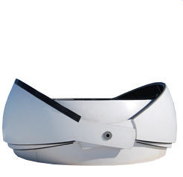
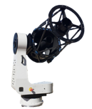
TBIRD Data Volume Performance Example
Example Geometry
Average Terabytes per day from LEO to Earth
600-km LEO
51° inclination
TB/day
8-10
6-8
4-6
2-4
<2
Single ground terminal
Link analysis accounts for cloud statistics
The TBIRD system is capable of delivering many TBytes per day from LEO to a delay-tolerant ground user
MIT
Lincoln Laboratory
9

Slide 10
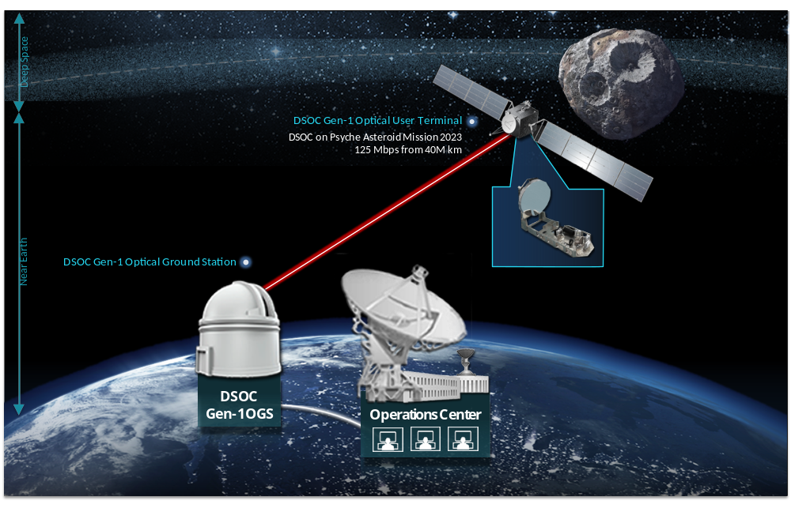

NASA’s Optical Plan Forward:
Deep Space Optical Communications (DSOC in 2022)
PPM Transmitter
With Photon
Counting Receiver
10

Slide 11
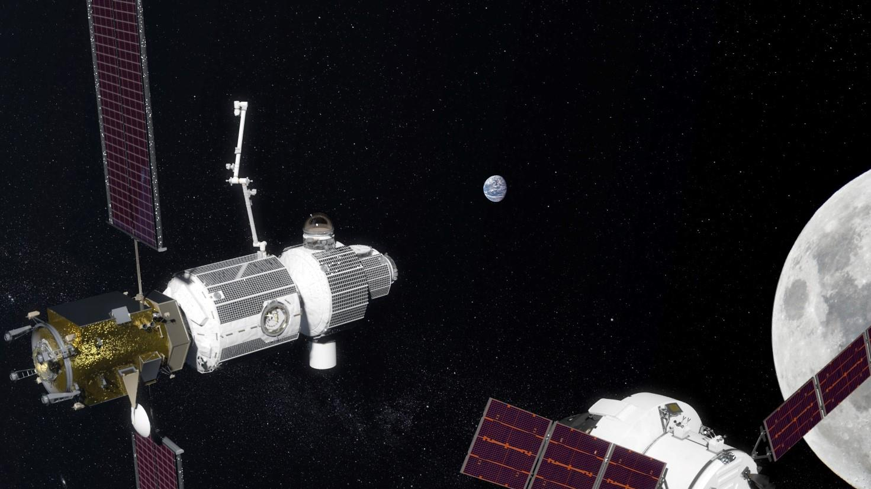
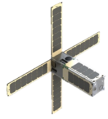

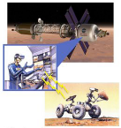
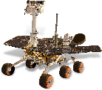

Laser Communications from the Moon
for Future Artemis and Science Missions
Optical Data Trunk to/from Earth
Gateway-Enabled Lunar Network
20+ Mbps Forward
1000+ Mbps Return
High-rate, low-latency data
Positioning, navigation and timing
CubeSat
4 – 500 Mbps
e.g. high-res multi-spectral imaging
e.g. low-latency tele-robotics;
In-situ analysis
Lunar Surface
100 Mbps – 2.1 Gbps
Orion MPCV
233 Mbps – 2.1 Gbps
NASA is studying different optical communications scenarios to enable data returns from the Moon comparable to today’s ISS, including high-rate proximity optical links

Slide 12

NASA’s Optical Plan Forward: Optical Communication Standards in CCSDS
TBIRD Demo
GEO
Lagrange
Next Gen IOC
MOON
1 AU
100
Gbps
(1/R² Loss)
DSOC design 20 cm 6 W Tx
10
Gbps
Commercial
LEO
Crosslinks
Or Direct-to-Earth Using OOK
To Commercial OGS
100X
More Loss so PSK
LOP-G
1,000,000X
More Loss so PPM, Large OGS
100X
More Loss
so PPM
1 Gbps @
1 AU SCaN
Goal
1
Gbps
DSOC
Psyche
LCRD
EDRS
JDRS
Gen 2 DSOC
100
Mbps
O2O
CCSDS
Optical On-Off
Keying
CCSDS
High Data
Throughput
CCSDS
High Photon
Efficiency
10
Mbps
NEAR-EARTH
SATS
MARS
SATURN
URANUS
NEPTUNE
LEO SATS
MOON
Lagrange
MERCURY
JUPITER
VENUS
PLUTO
Km
10²
10³
10⁴
Km
10⁵
10⁶
10⁷
10⁸
10⁹
10¹⁰
light second
light minute
light hour
Range of Communication Link (km)
12

Slide 13
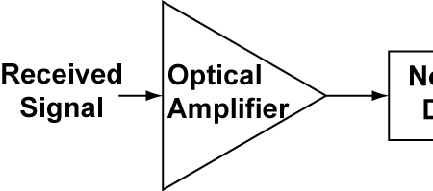
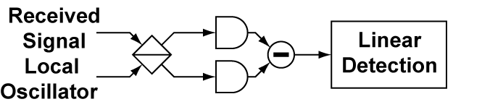
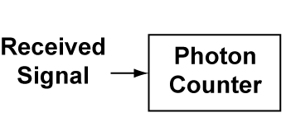
Detection Sensitivity in Optical Communications
10
Optically
Preamplified
CCSDS
Optical On-Off
Keying
Power
Detection
ASE noise limited
Received
Signal
Local
Oscillator
Coherent
CCSDS
High Data
Throughput
Photons per bit
1
LO shot noise limited
Photon
Counting
CCSDS
High Photon
Efficiency PPM
Quantum
Limit
“noiseless”
0.1
Unknown architecture
13

Slide 14
Questions?
Please feel free to contact:
Bernie Edwards
NASA Goddard Space Flight Center
Bernard.L.Edwards@NASA.gov

