Slide 1



Additive Manufacture Development, Applications, and Lessons Learned
Omar Mireles, Travis Belcher, Carlos Gomez
NASA Marshall Space Flight Center
ASTM International Conference on Additive Manufacturing (ICAMM) 2020
17 November 2020
Youping Gao
Castheon Inc.
Owen Hildreth
Colorado School of Mines
Kavan Hazeli
University of Alabama-Huntsville
Maryna Ienina
EOS North America

Slide 2
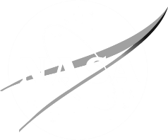
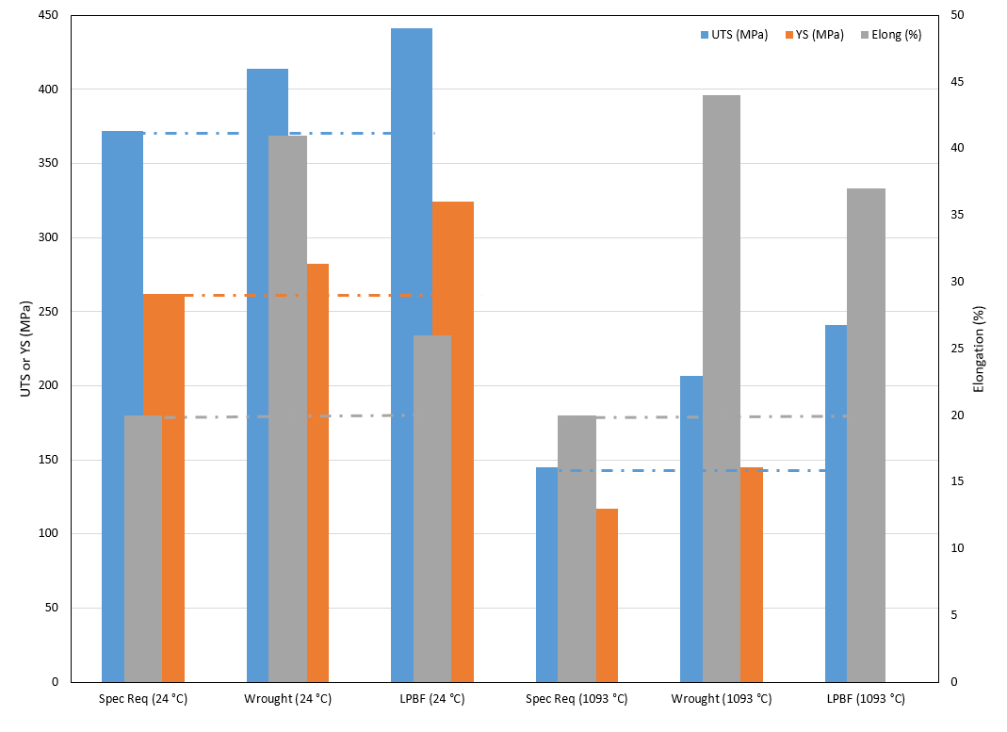
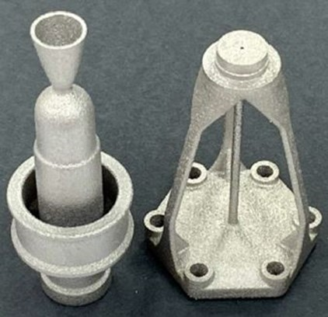
AM of C103 (Nb10Hf1Ti)
Traditional Manufacture Constraints
  C103 bar stock Ø_{max} = 102 mm (4 in), if larger fails ASTM B655.
  Significantly limits design options.
  Wrought min order of 45 kg (100 lb) with variation in $/mass.
  20:1-50:1 buy-to-fly = few $k for part and several $10k waste.
Objectives
  Investigate C103 AM to improve design flexibility, cost, & availability.
  Produce, characterize, and supply C103 powder (ATI).
  L-PBF parameters, post-processing, characterization (Castheon & MSFC).
Results
  AM powder is ~33% more expensive than wrought feedstock.
  AM waste ~10% (1.1:1) = Few $k for part and few $0.1k waste.
  Order of magnitude cost reduction.
  Improved mechanical properties over wrought.
  AM minimizes machining to interface surfaces (C103 is difficult to machine).
  Surface finishing available via chemical etch, Micro-Tek, and electro-polish.
  RCS thruster, in-space propulsion, and hypersonics now leverage AM C103.
C103 mechanical property comparison. Possible that fine distributed oxides from the L-PBF acts as a strengthener and stabilizer.
Live video feed to appear here; do not place any content in
this space
AM C103 MSFC Green Propulsion Thruster and Stand-off.

Slide 3
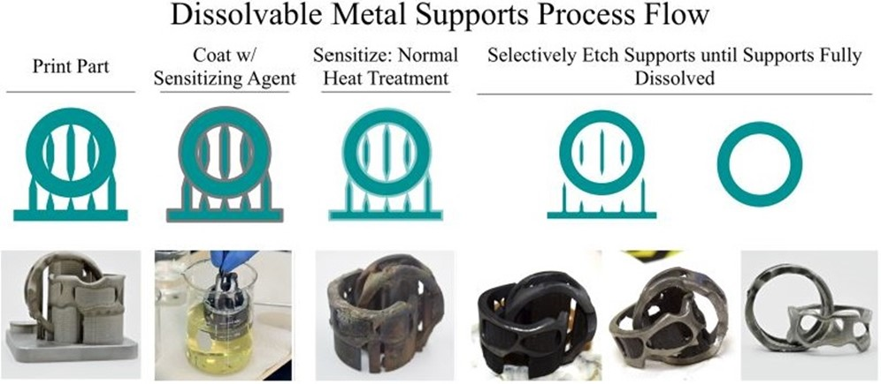
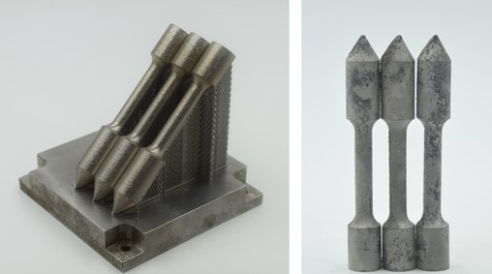
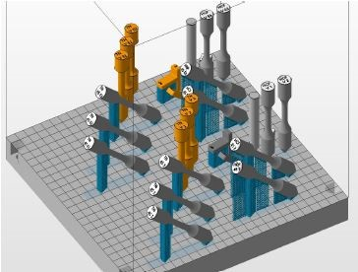
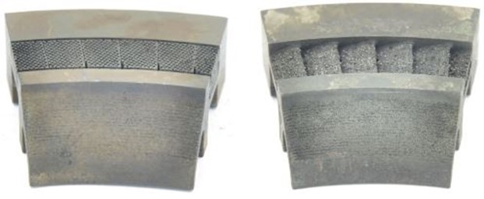
Dissolving AM IN718 Support Structures
Process
  Sensitizing agent applied to AM part.
  During stress relief heat treatment the sensitizing agent diffuses 100-200 μm into the part altering surface chemical composition.
  Sensitized region dissolved in an electrochemical process.
  Supports and surface material <100 μm is removed.
Objectives
  Demonstrate viability to dissolve AM IN718 support structures.
  L-PBF AM specimens produced and heat treated (MSFC).
  Sensitization agent and acid development to remove supports (CSM).
  Microstructural characterization and mechanical tests (MSFC).
Results
  Electrochemical dissolution of AM IN718 shown feasible.
  Self-terminating reaction allows for support removal with minimal part impact.
  No statistically significant impact on microstructure or mechanical properties.
  Process should be limited to geometries that cannot be optimized for AM such as aerodynamic surfaces, thin features, and inaccessible passages.
AM IN718 Concept feasibility and specimen array build layout.
IN718 stator segments pre-etch (left) and post-etch (right). Supports dissolved sufficiently to remove via grit blasting.
Live video feed to appear here; do not place any content in
this space

Slide 4
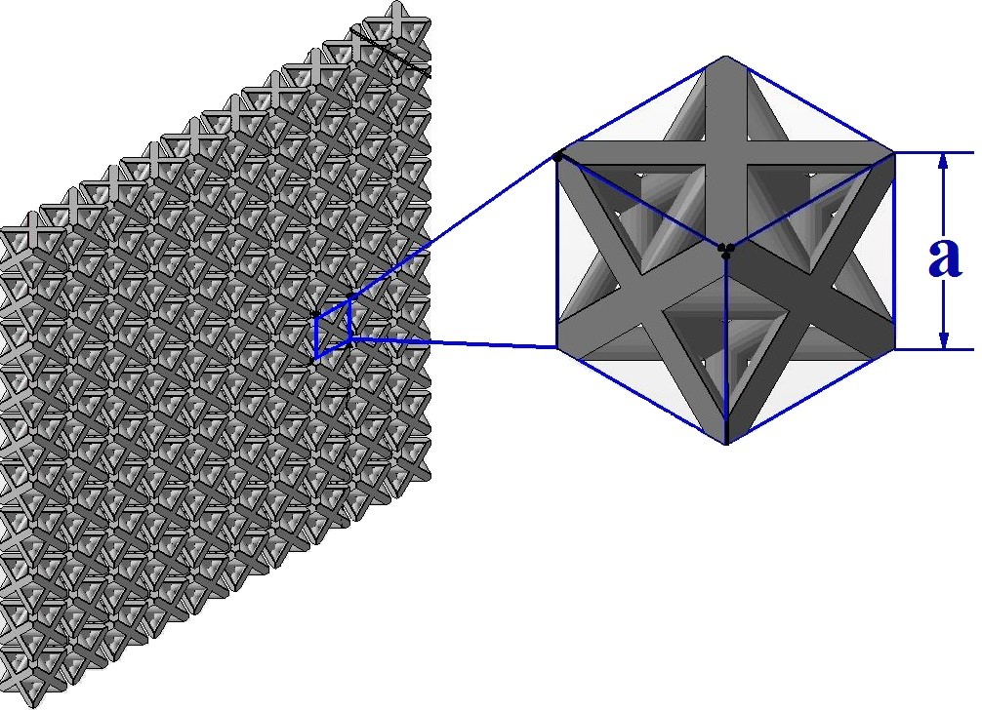
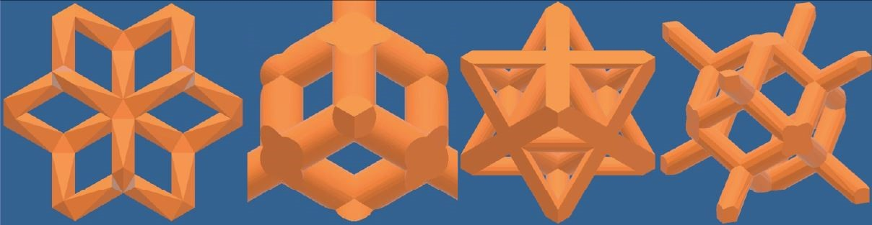
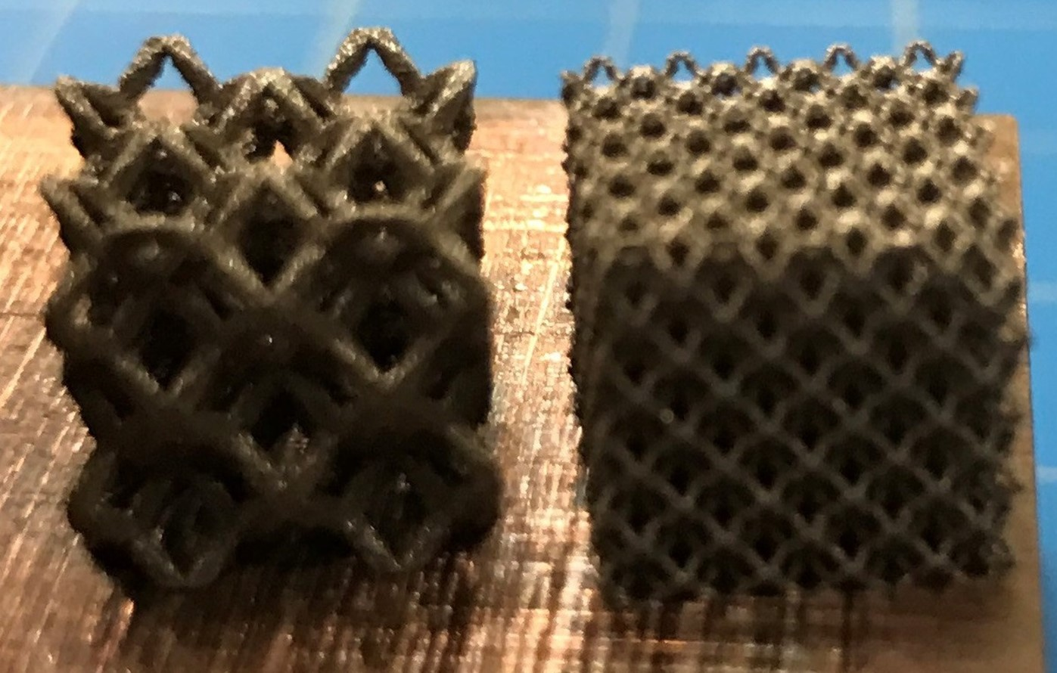

Lattice Structure Development & Application
Applications
  Reduce weight, retain stiffness.
  Variable relative density & surface area.
  Permeable solid: porous foam replacement.
  Metal matrix composite (back infiltration).
  Custom properties: mimic properties of different materials in the same part using the same material in adjacent regions.
Limitations
  Computationally expensive.
  Inadequate property data.
Terminology
  Topology (lattice shape)
  Unit cell (a)
  Strut thickness (t)
  Relative Density (ρ_{rel})
NODE
Lattice structure: repeating topology of unit cell (a).
VOID SPACE
Dode Medium-13%RD
Diamond-20%RD
Octet Truss-30%RD
Rhombic Dodecahedron
-20%RD
STRUT
Optical micrograph of Octet-Truss (30 %RD) lattice with 4 mm unit cell from AM IN718.
Live video feed to appear here; do not place any content in
this space
$ρ_{rel}=\frac{V_{solid}}{V_{solid}+V_{void}}$ x 100 (%RD)
GRCop84 trial cubes (L) a = 5 mm, (R) a = 2 mm.

Slide 5
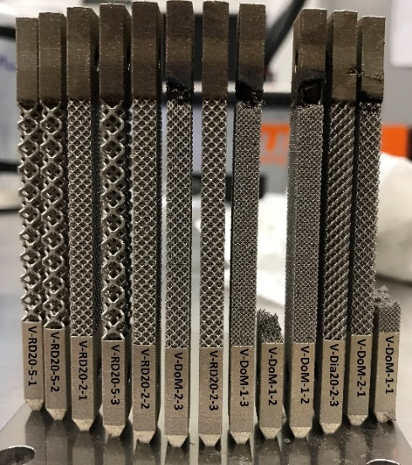
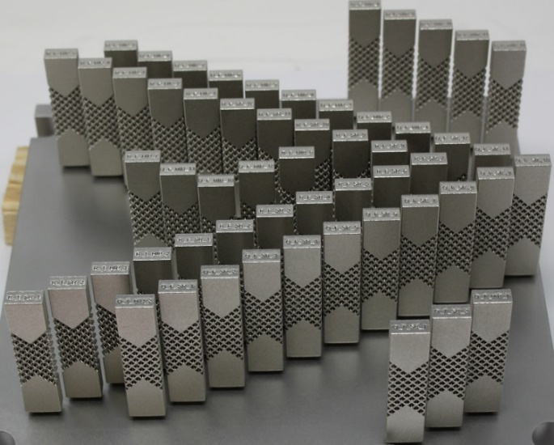
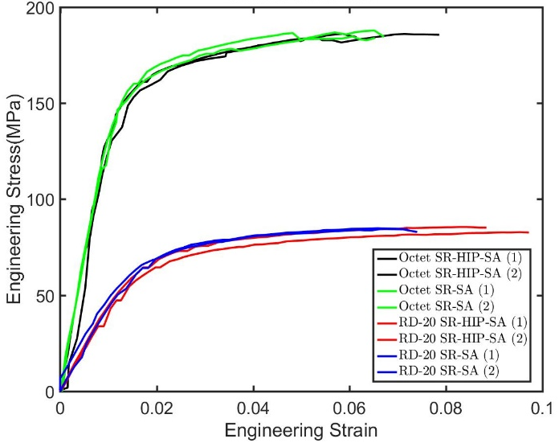
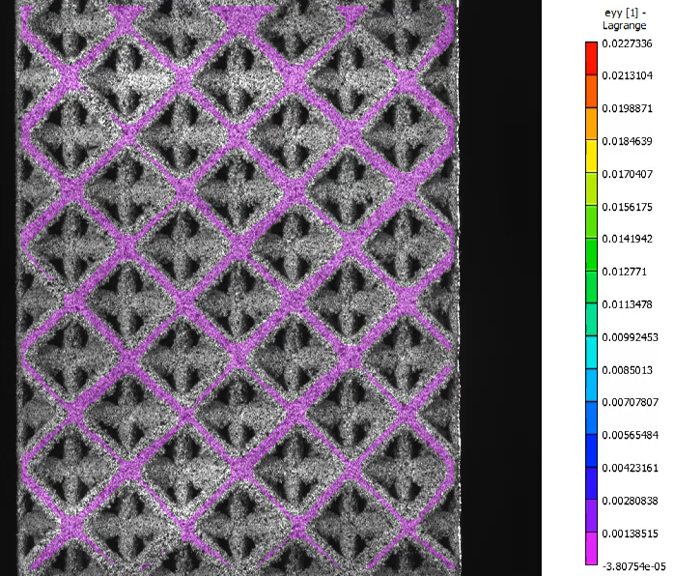
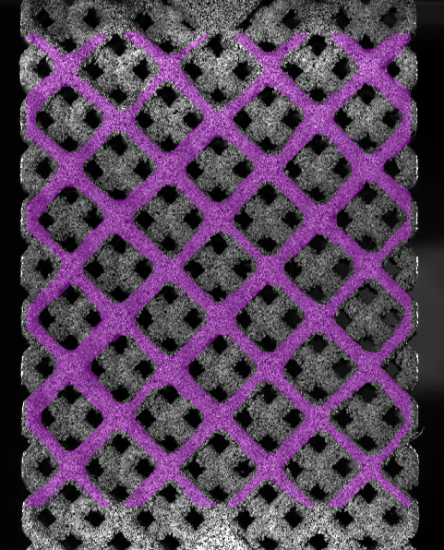
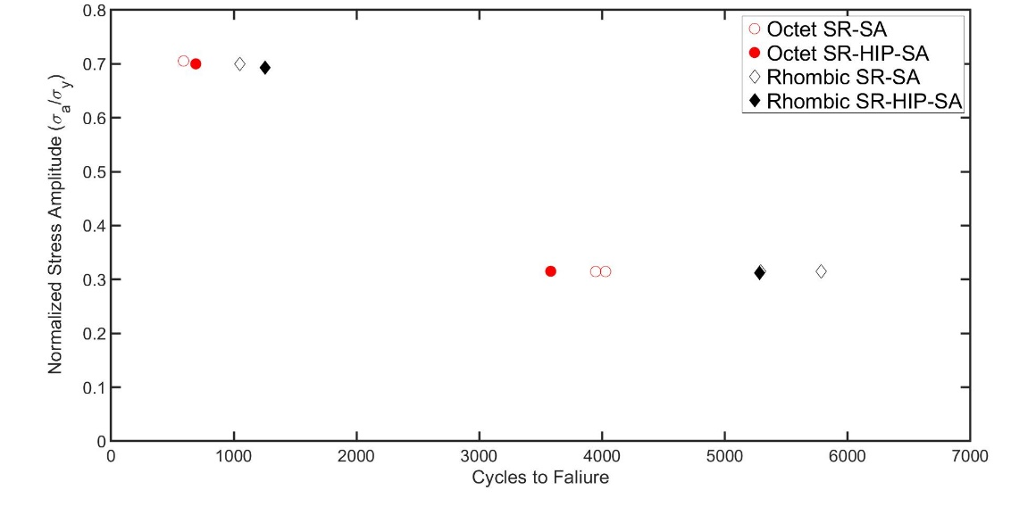
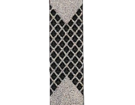
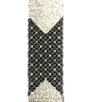
Mechanical Properties
L-PBF IN718 vs. heat treatment at quasi-static strain rates.
Lattice-to-solid transitions (discrete vs. gradient).
Conditions: As-Built (AB), Stress-Relieved (SR), SR+Hot Isostatic Press (HIP), SR + HIP + Solution/Age (SA), SR+SA.
Discrete transition burn-out (IN718).
Gradient transition optimized specimens (IN718).
Octet Truss (30 %RD)
Reversible Testing
SR=-1
RD (20 %RD)
Tension-Tension Testing
SR= 0.1
Stress-Strain curve of Octet-Truss (30 %RD) and Rhombic Dodecahedron (20 %RD), a = 4 mm, IN718.
Node strain localization of Octet-Truss-30%RD (left) and Strut strain localization of Rhombic Dodecahedron (20 %RD), a = 4 mm, IN718 in SR+HIP+SA condition.
S-N curve of Octet-Truss (30 %RD) & Rhombic Dodecahedron (20 %RD), a = 4 mm, IN718, as-built surface finish.
Live video feed to appear here; do not place any content in
this space
Mechanical properties influenced by ρ_{rel}, then lattice topology, then unit cell size (thicker struts = stronger lattices).
Node or strut failure mode is topology dependent, not necessarily microstructure.
Lattice structures are stress concentrators and utilization in fatigue environments should be limited.
HIP does add cycle life before failure in either topology.

Slide 6
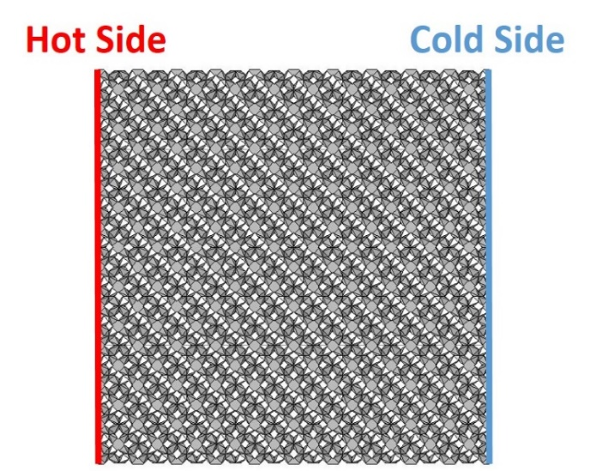
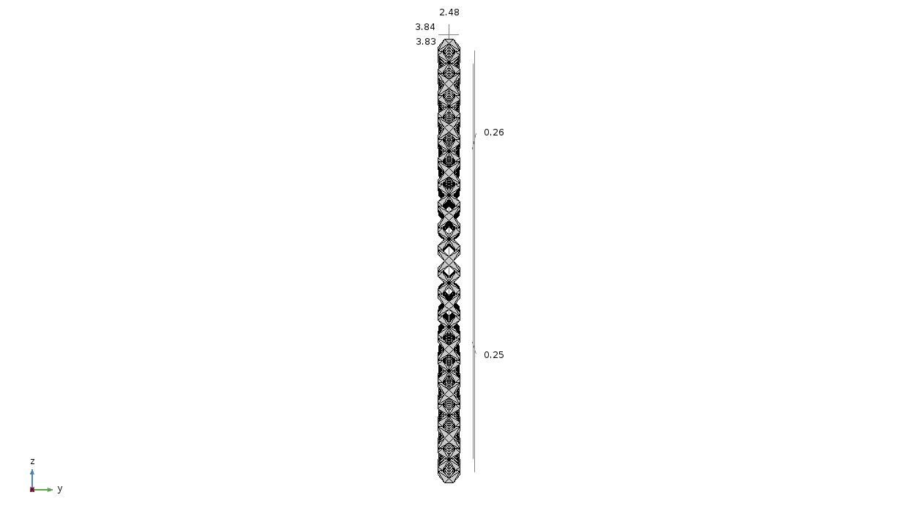
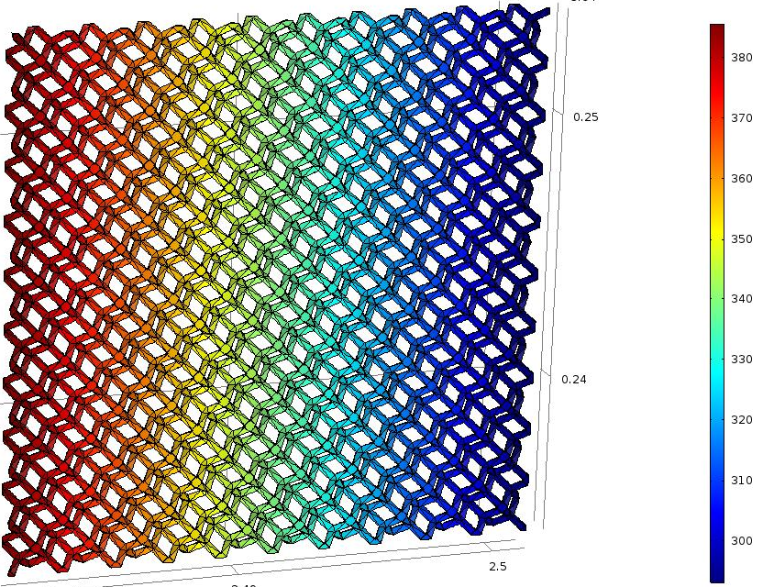
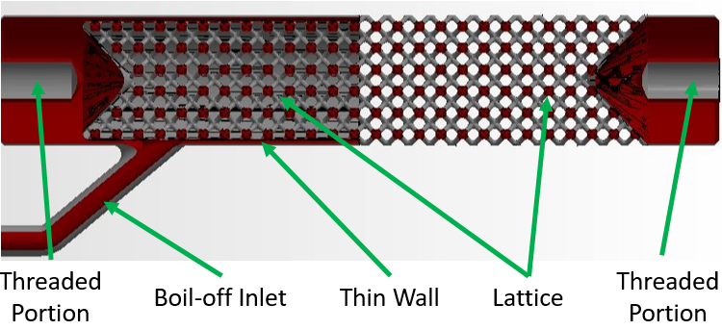
Thermal Simulation
W = 20 mm
Insulated
Heated
Area
1 W
T=293.15 K
h = 20 mm
Insulated
t=0.98 mm
Dode-Medium (13 %RD) lattice thermal conduction model.
Cryogenic Strut CIF: reduce mass 30-40%, reduce thermal conductivity to 10% of fully dense material.
Live video feed to appear here; do not place any content in
this space
Effective thermal conductivity proportional to %RD (solid volume dominated).
Dependent more on a and t not necessarily topology.

Slide 7
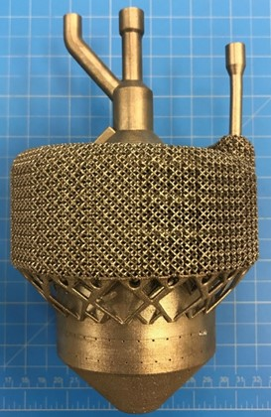
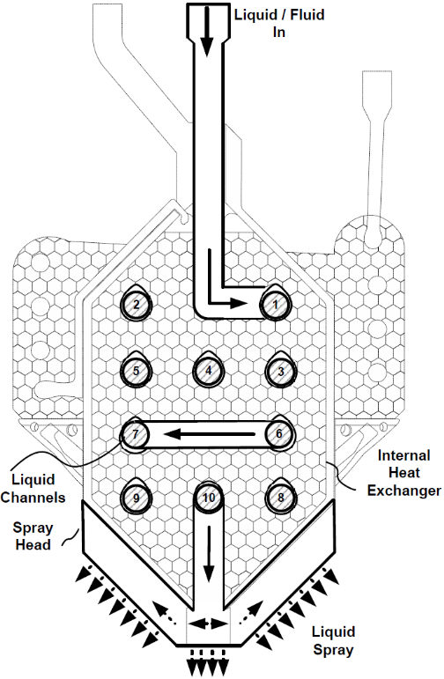
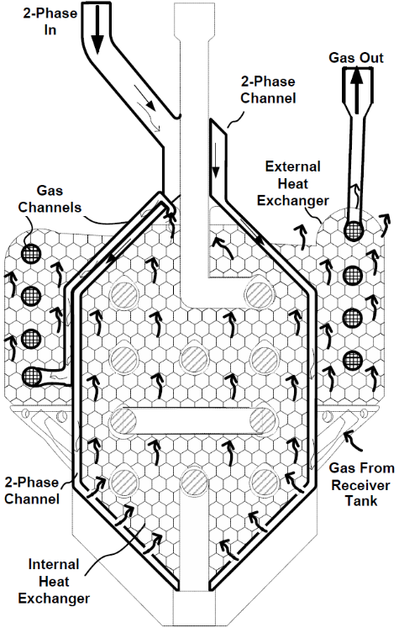
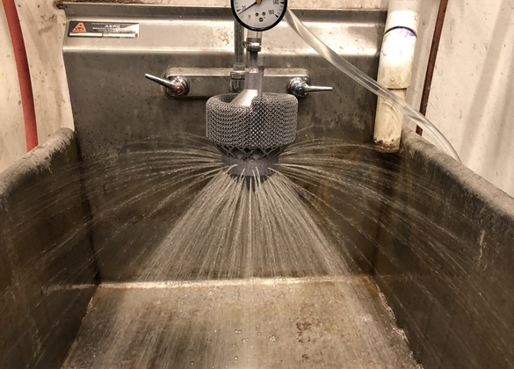
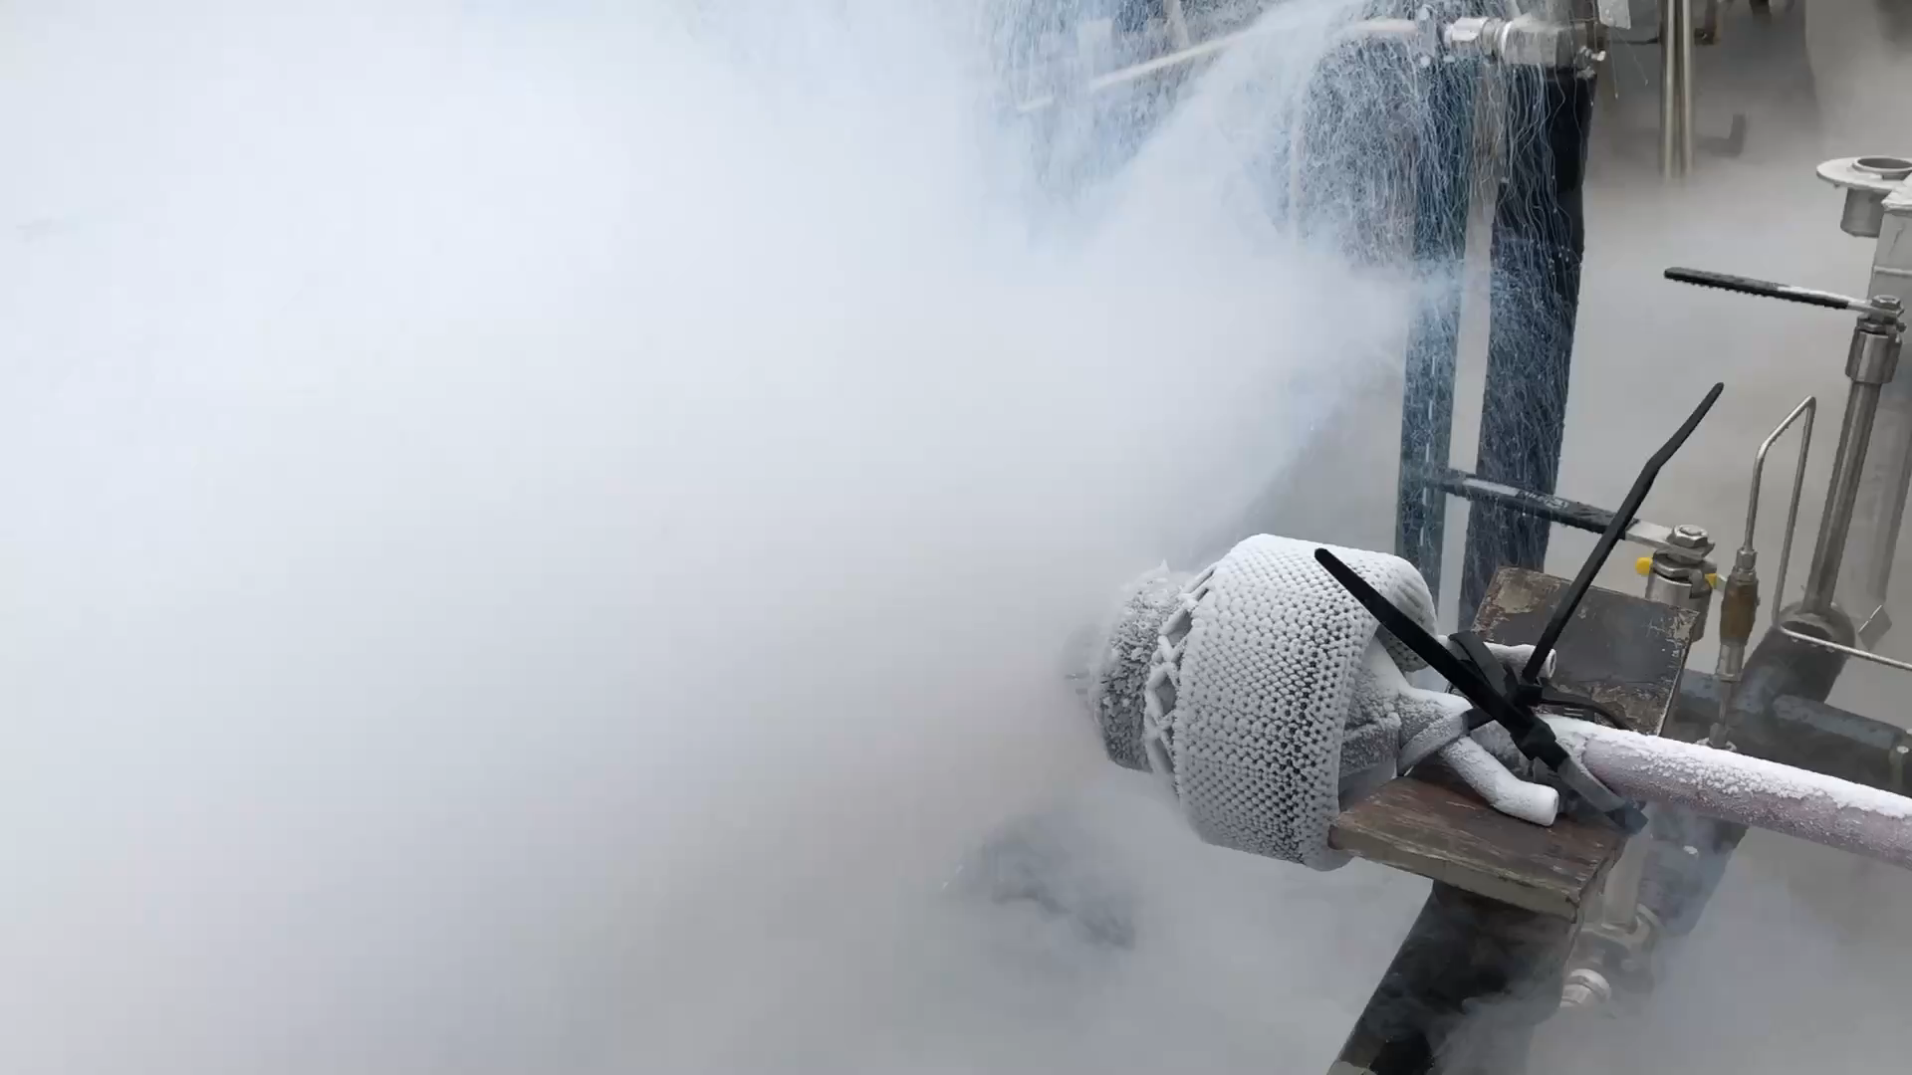
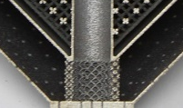
TVS Augmented Injector
Design: 3 functions in 1 part
  Liquid to gas heat exchanger
  Liquid spray injector head
  External condenser heat exchanger
Function
  Fluid spray promotes tank ullage condensation, drops pressure, and maintains fill flow.
  Tank vent closed early in fill process (before fluid introduced). In some cases vent may not be opened.
  Long-term storage pressure control: if fluid pumped back through the injector to reduce pressure or connected to a closed loop cryo-cooler circuit.
TVS Augmented Injector V4 (IN718), liquid circuit, 2-phase/gas circuit. Inner & outer lattice Dode-Medium (13 %RD)
Live video feed to appear here; do not place any content in
this space
Flow distributor lattice structure (Octet-Truss 30%RD) to improve radial flow spatial distribution.
TVS Augmented Injector V4 (AlSi10Mg) water flow test and LN₂ tests.

Slide 8
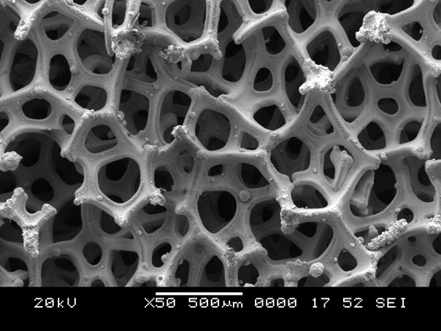
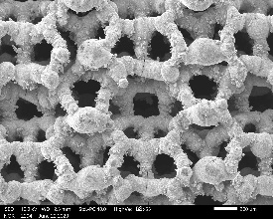
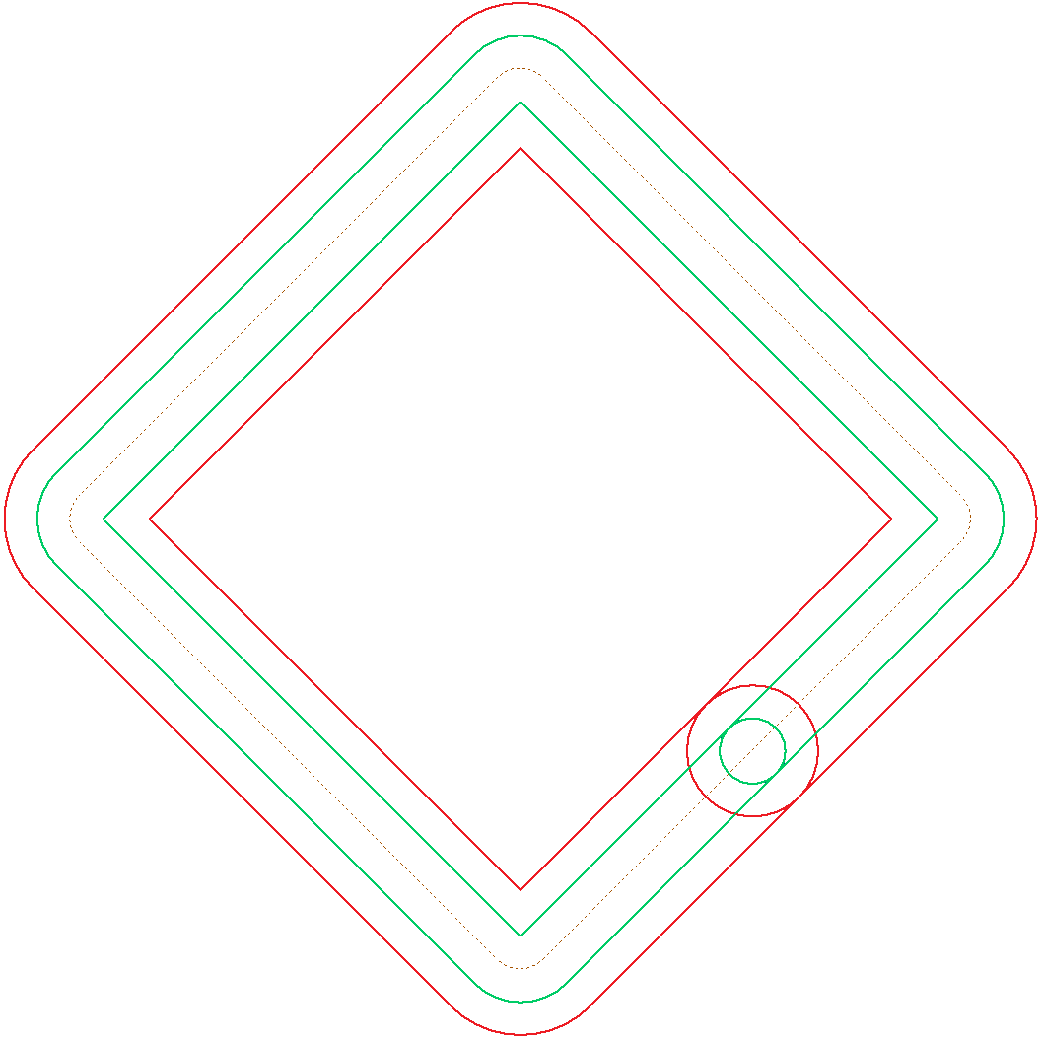
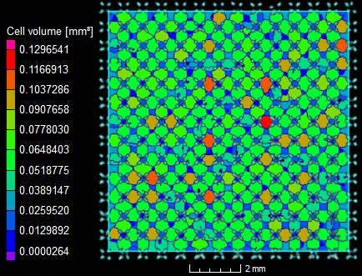
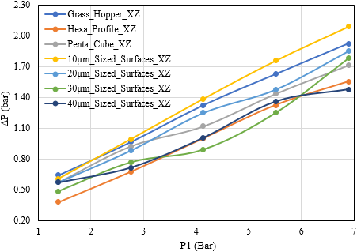
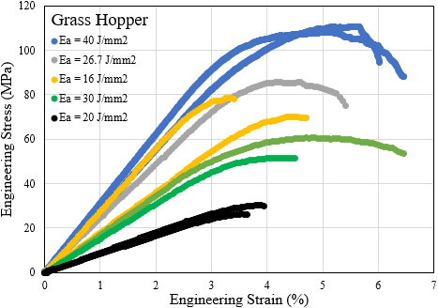
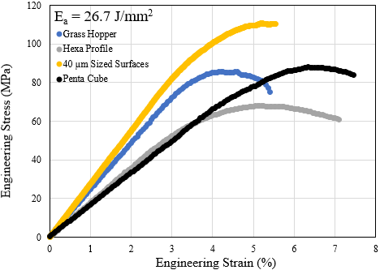
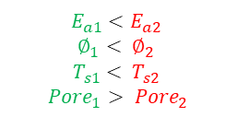
Ultra-Fine Lattice Structures of Green Prop Catalyst
Reticulated Vitreous Carbon (RVC) or ceramic (SiC) foams coated with platinum group metal (PGM).
  Anisotropic (stochastic) properties.
  High cost and long lead times.
Objectives
  Replace foams with AM ultra-fine lattices.
  High spatial symmetry, repeatable (non-stochastic) and custom properties.
  Reduce cost/schedule.
  Increase commercial availability.
Tasks
  Identify lattice designs (MSFC).
  Parameter development (EOS).
  Metallography (MSFC).
  µ-CT (3D Engineering Solutions).
  Compressive strength (MSFC).
  ΔP characterization (UTEP).
SEM micrograph of carbon foam with 400 µm median cell.
SEM micrograph of Hexa Profile AM W ultra-fine lattice.
$$E_{a1}<E_{a2}$$
$$∅_{1}< ∅_{2}$$
$$T_{s1}< T_{s2}$$
$${Pore}_{1}> {Pore}_{2}$$
Scan path, E_{a}, melt pool diameter, strut thickness, & pore size.
µ-CT image of Ti6Al4V Hexa specimen cell volume.
ΔP for GN₂ of Ti64Al4V specimens in XZ plane.
Live video feed to appear here; do not place any content in
this space
Compressive stress-strain diagrams of as-built AM W DOE 6 lattice structures.

Slide 9
Acknowledgements
The authors would like to thank Marvin Barnes, Zack Jones, John Peugeot, Noah Rhys, Omar Rodriguez, Pat Salvail, and William Tilson of NASA MSFC; Noah of ATI Philips of Specialty Metals, Ankit Saharan of EOS North America, 3D Engineering Solutions; Jake Rickter of Pinnacle X-ray Solutions; Devon Burkle and Charles Stansberry of Volunteer Aerospace Inc., Edel Arrieta, Raul Cuevas, Pilar Gonzalez, Frank Medina, Jaclyn Mejia, and Jonathan Navarrete of UTEP.
This work was funded by the under NASA Cooperative Agreement Notice #80MSFC18M0012, #80MSFC19M0022, #80MSFC19M0002, and Cryogenic Fluid Management Project.
The opinions expressed in this presentation are those of the author and do not necessary reflect the views of NASA or any NASA Project.
Live video feed to appear here; do not place any content in
this space

Slide 10
