Slide 1



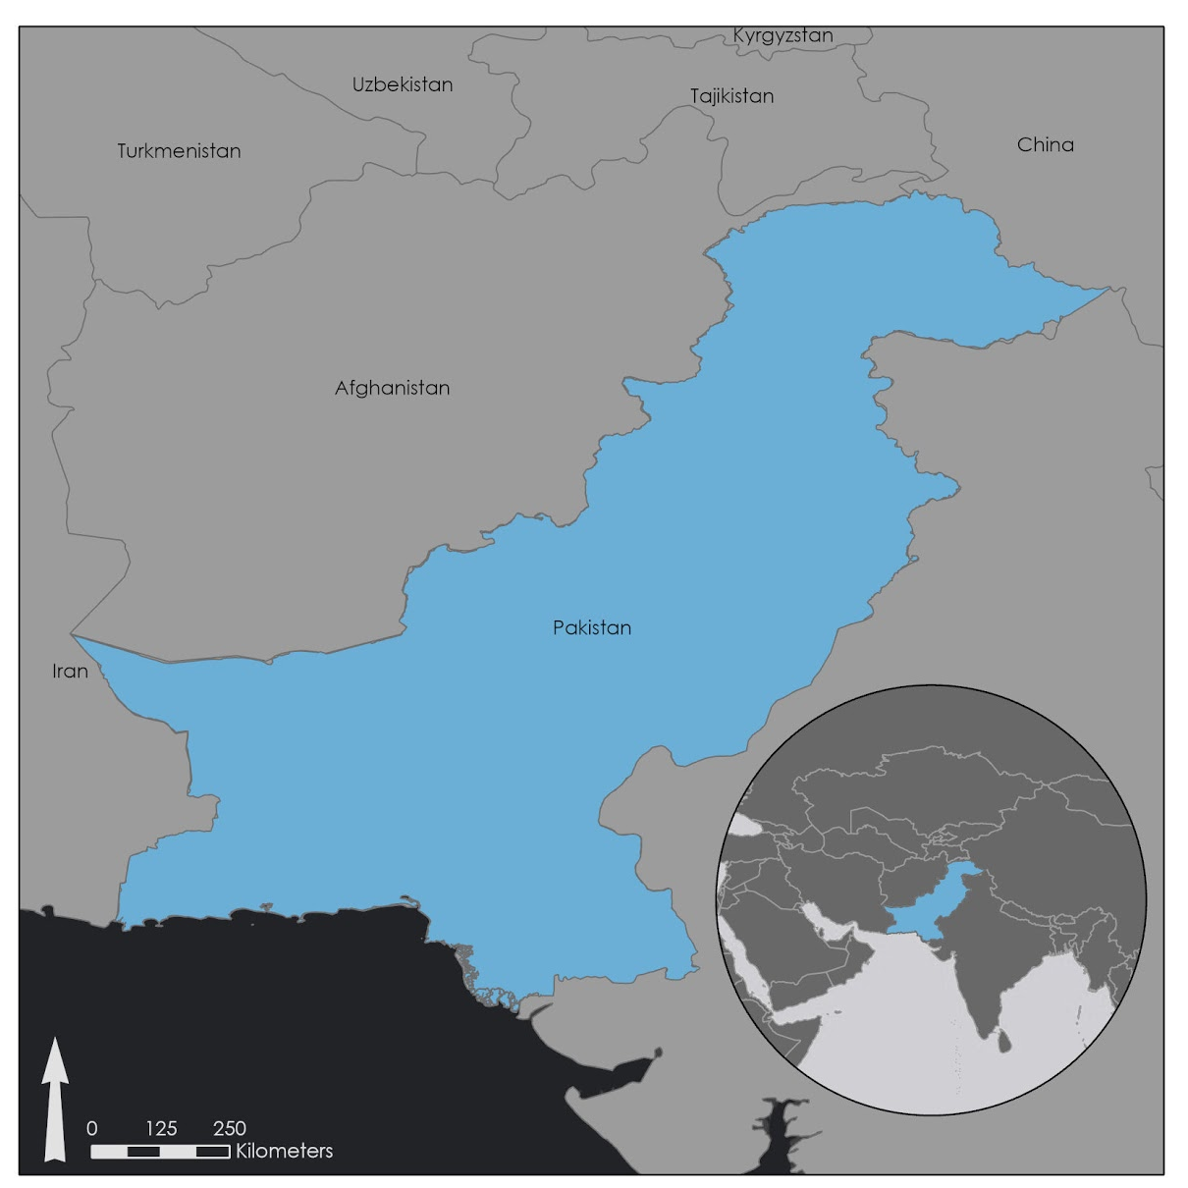
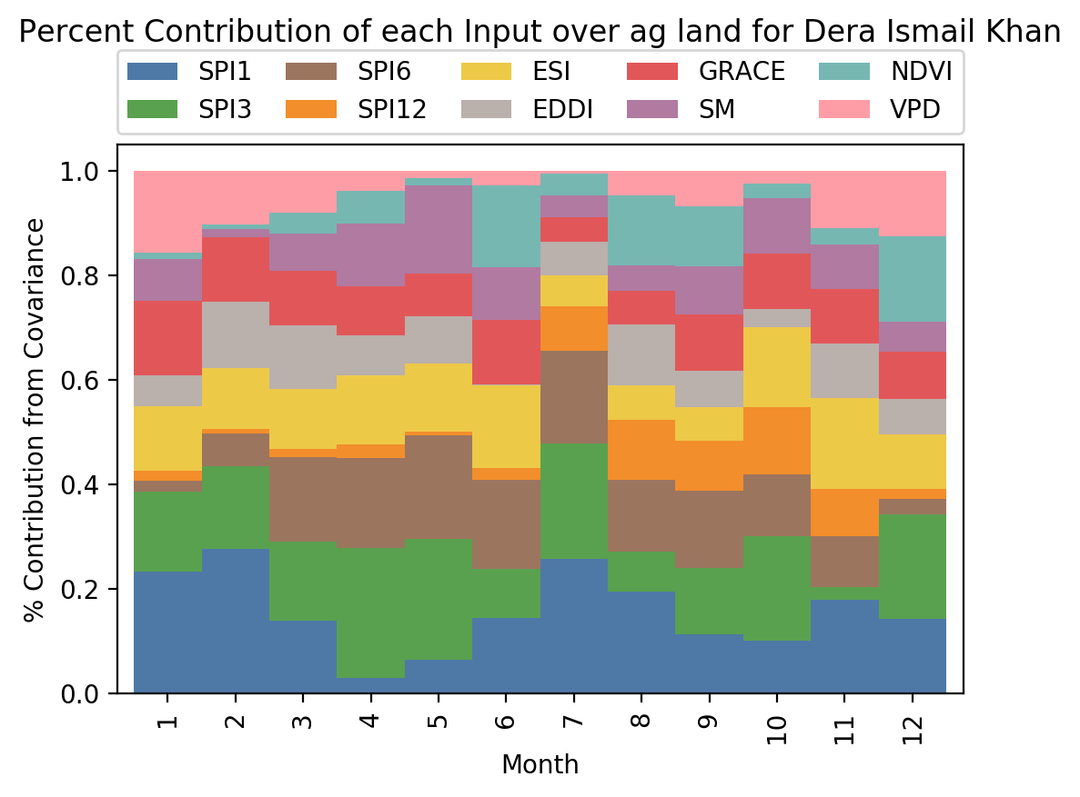
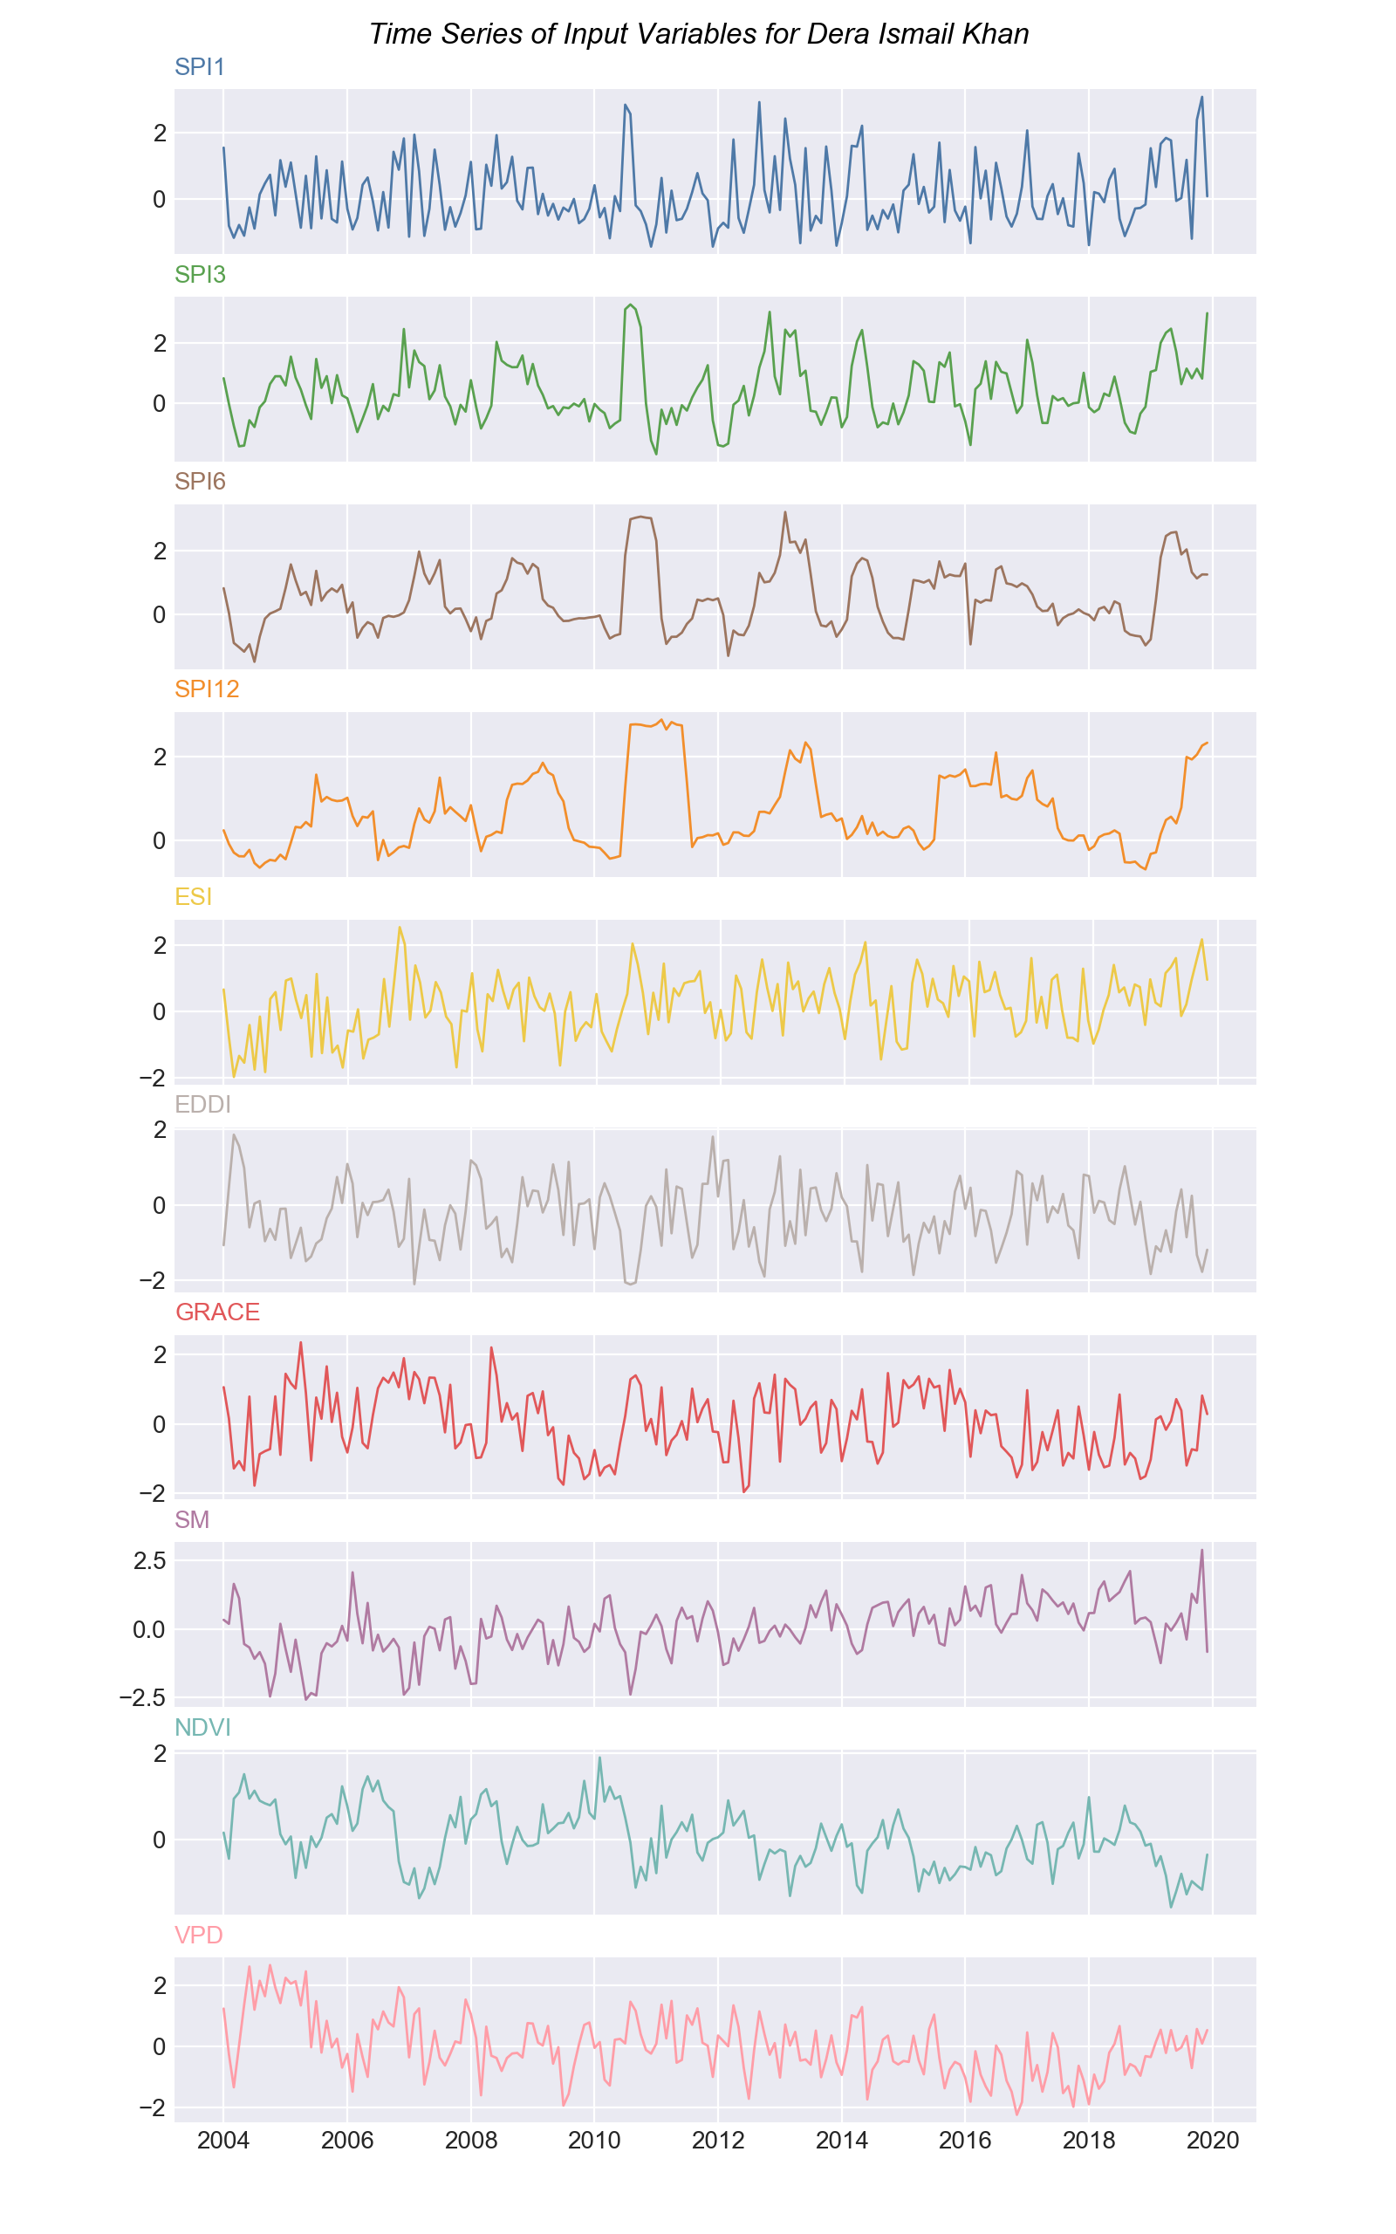
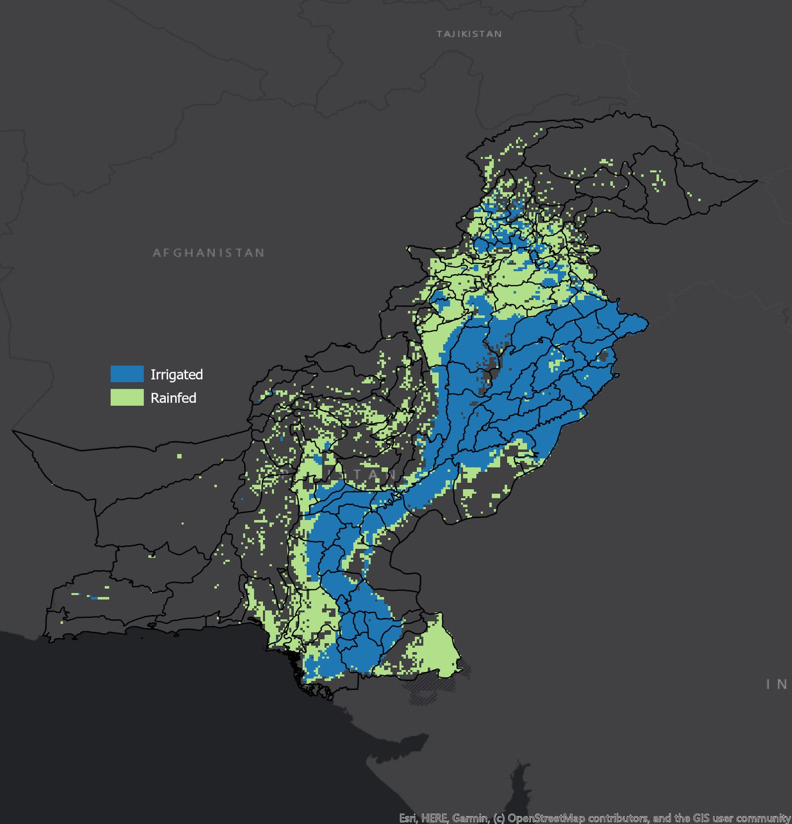
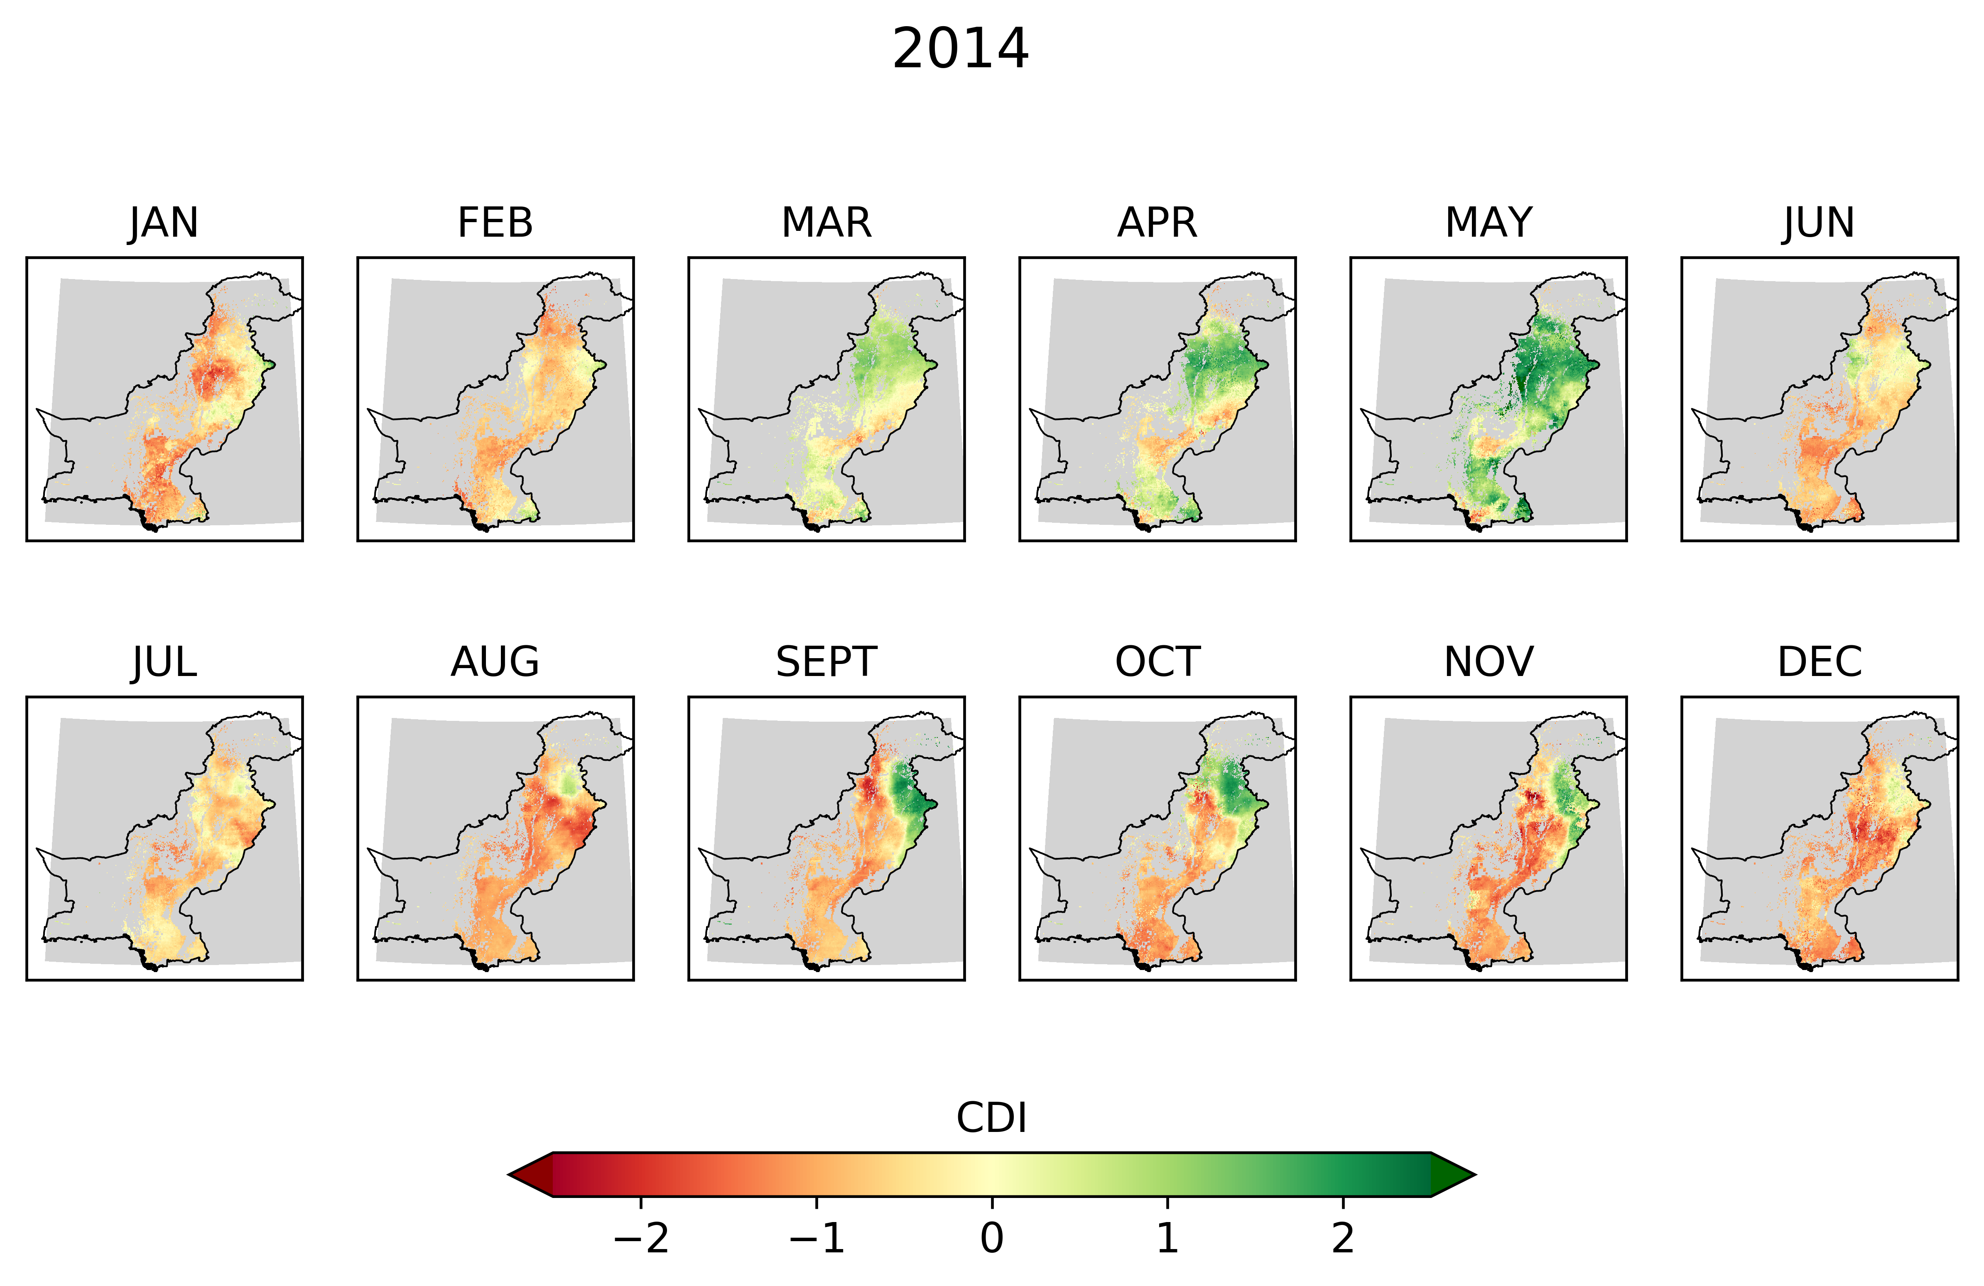
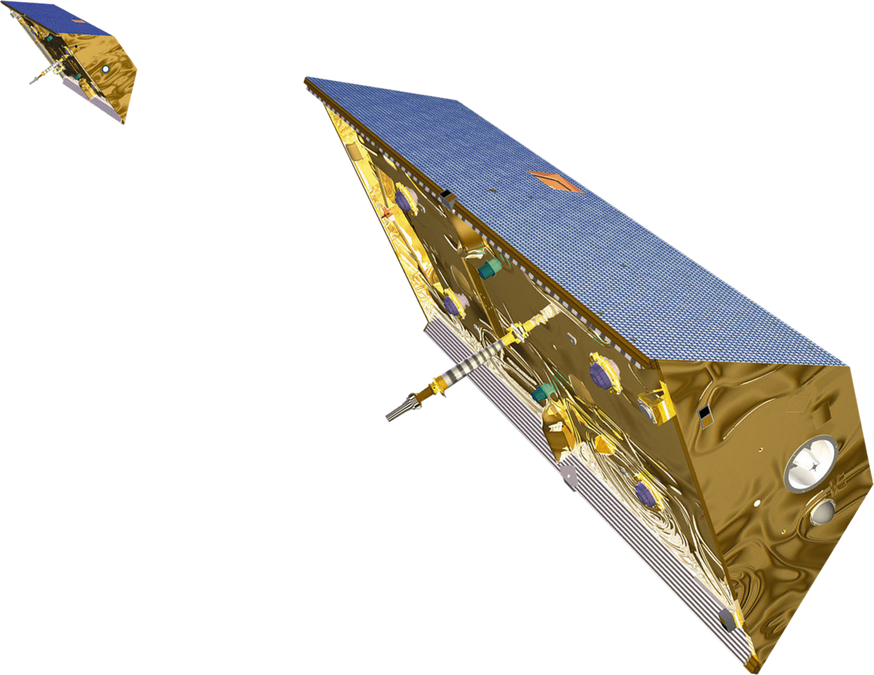
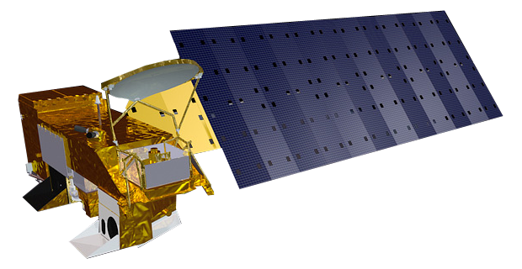



13th Wernher von Braun Memorial Symposium
October 26 – 28, 2020
Developing a Customized Composite
Drought Index for Pakistan
Caily Schwartz¹, Robert Griffin¹, Lee Ellenburg², Vikalp Mishra², Tim Mayer², Faisal Qamer³, Mir Matin³, Tsegaye Tadesse⁴ Atmospheric and Earth Science Department
Overview
Objectives
Preliminary Results
Around the world, drought impacts millions of people every year and causes economic damage to the agricultural sector. The persistence, intensity, and duration depend on many physical characteristics that work together to create a drought event. In Pakistan (Fig.1), many communities and families depend on agriculture for their livelihoods. This project focuses on agricultural drought, when the absence of moisture impacts crop growth and sustenance.
Identify the most important variables for determining drought in Pakistan by district
Determine how these variables differ between rainfed and irrigated regions
This study aims to identify historical agricultural droughts between 2004-2019 using 10 geophysical variables (Table 1) and determine what variables have little importance in this identification. Satellite data products or model outputs are used for all input variables. Understanding the interactions between the data will provide information on temporal and spatial patterns of how drought is presented in irrigated and rainfed areas (Fig. 2). This knowledge will assist in creating a Customized Composite Drought Index in future work.
Figure 1: Study area, Pakistan
Figure 4: Bar chart visualizing each input variable’s weight in determining the CDI value for the district, Dera Ismail Khan.
Source | Processed Data Product (Variable name)
CHIRPS | Standard Precipitation Index – 1 month (SPI1)
CHIRPS | Standard Precipitation Index – 3 month (SPI3)
CHIRPS | Standard Precipitation Index – 6 month (SPI6)
CHIRPS | Standard Precipitation Index – 12 month (SPI12)
ClimateServ | Evaporative Stress Index (ESI)*
NOAA | Evaporative Demand Drought Index (EDDI)*
GRACE | Root Zone Soil Moisture Percentile (GRACE)
SLDAS | Soil Moisture (SM)
MODIS | Normalized Difference Vegetation Index (NDVI)
SLDAS | Vapor Pressure Deficit (VPD)*
 | * Indicates model output
GRACE
(NASA)
Figure 2: Map illustrating rainfed (green) and irrigated (blue) agriculture land in Pakistan
AQUA MODIS
(NASA)
Figure 3: Visualization of monthly time series for each input variable for the district of Dera Ismail Khan
Figure 5: Visualization of monthly Full CDI of the year 2004. Red indicates dry conditions.
Methodology
Impact & Future Work
INPUT
PROCESS
EVALUATE
OUTPUT
The framework developed to identify and remove the least important variable by location will allow for the enhancement of existing drought monitoring and forecasting systems in the region. A customized drought index will use only the most influential variables while still identifying the onset, persistence and intensity of drought to the full extent. The next step of this research will be to use the R package, VSURF, to eliminate the least important variables. This will create a customized CDI by district. An evaluation between the Full CDI and the Customized CDI will be completed to determine if the Customized CDI captures drought to the full extent.
Calculate percent contribution (weights)
Full CDI
10 Input Variables found in Table 1
Customized CDI
Monthly CDI customized by district
Remove least important variables
Crop Production
Individual input variables
Acknowledgements
Thank you to Robert Griffin of the Department of Atmospheric and Earth Science, for being my faculty advisor, and to Lee Ellenburg, Vikalp Mishra, Tim Mayer and Helen Parache of SERVIR SCO for also advising and contributing to this research, also thank you to my colleagues at ICIMOD and the National Drought Mitigation Center for providing expert opinions and feedback. Funding for this research is provided by NASA SERVIR through NASA Cooperative Agreement NNM11AA01A. Contact information: caily.schwartz@uah.edu
¹The University of Alabama in Huntsville, Atmospheric and Earth Science, ²NASA SERVIR Science Coordination Office, ³International Centre for Integrated Mountain Development (ICIMOD), ⁴The University of Nebraska – Lincoln, National Drought Mitigation Center

