Slide 1
Artemis Program Vision
Dr. David Korsmeyer
Associate Center Director for
Research and Technology
September 29, 2020
NASA Ames-JAXA B2B Forum for Space Innovation

Slide 2
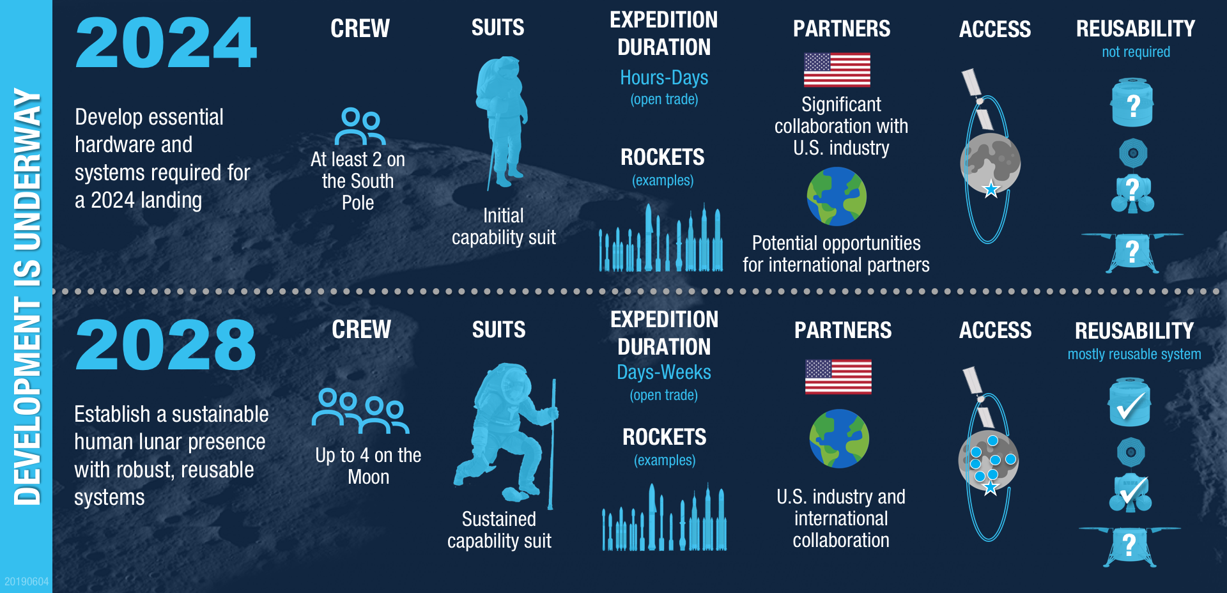
9/29/2020
NASA Ames-JAXA B2B for Space Innov
2

Slide 3
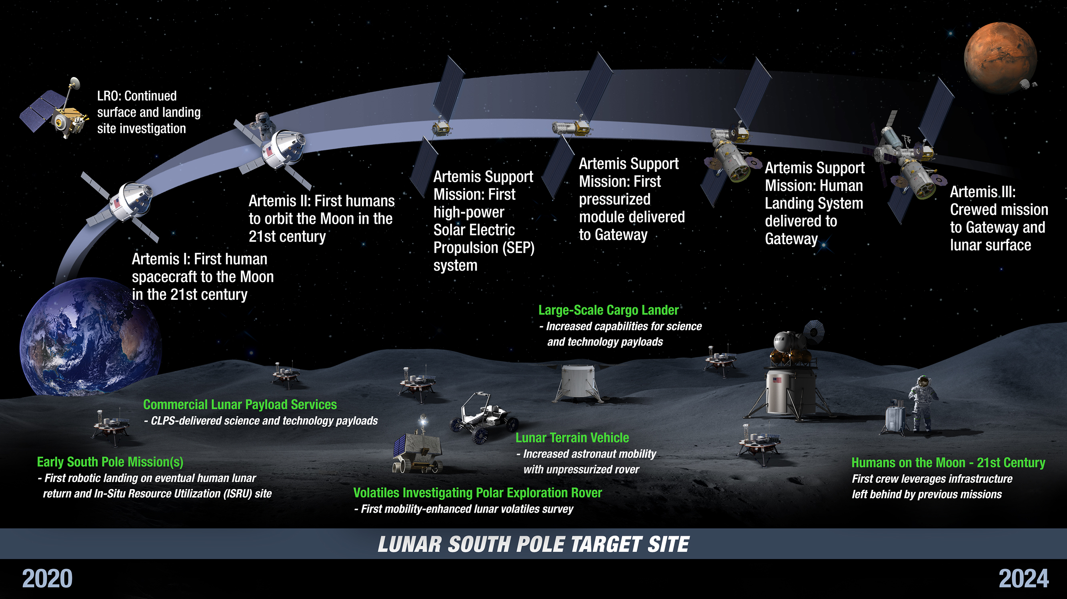
Artemis Phase 1: To the Lunar Surface by 2024
3
9/29/2020
NASA Ames-JAXA B2B for Space Innov
3

Slide 4
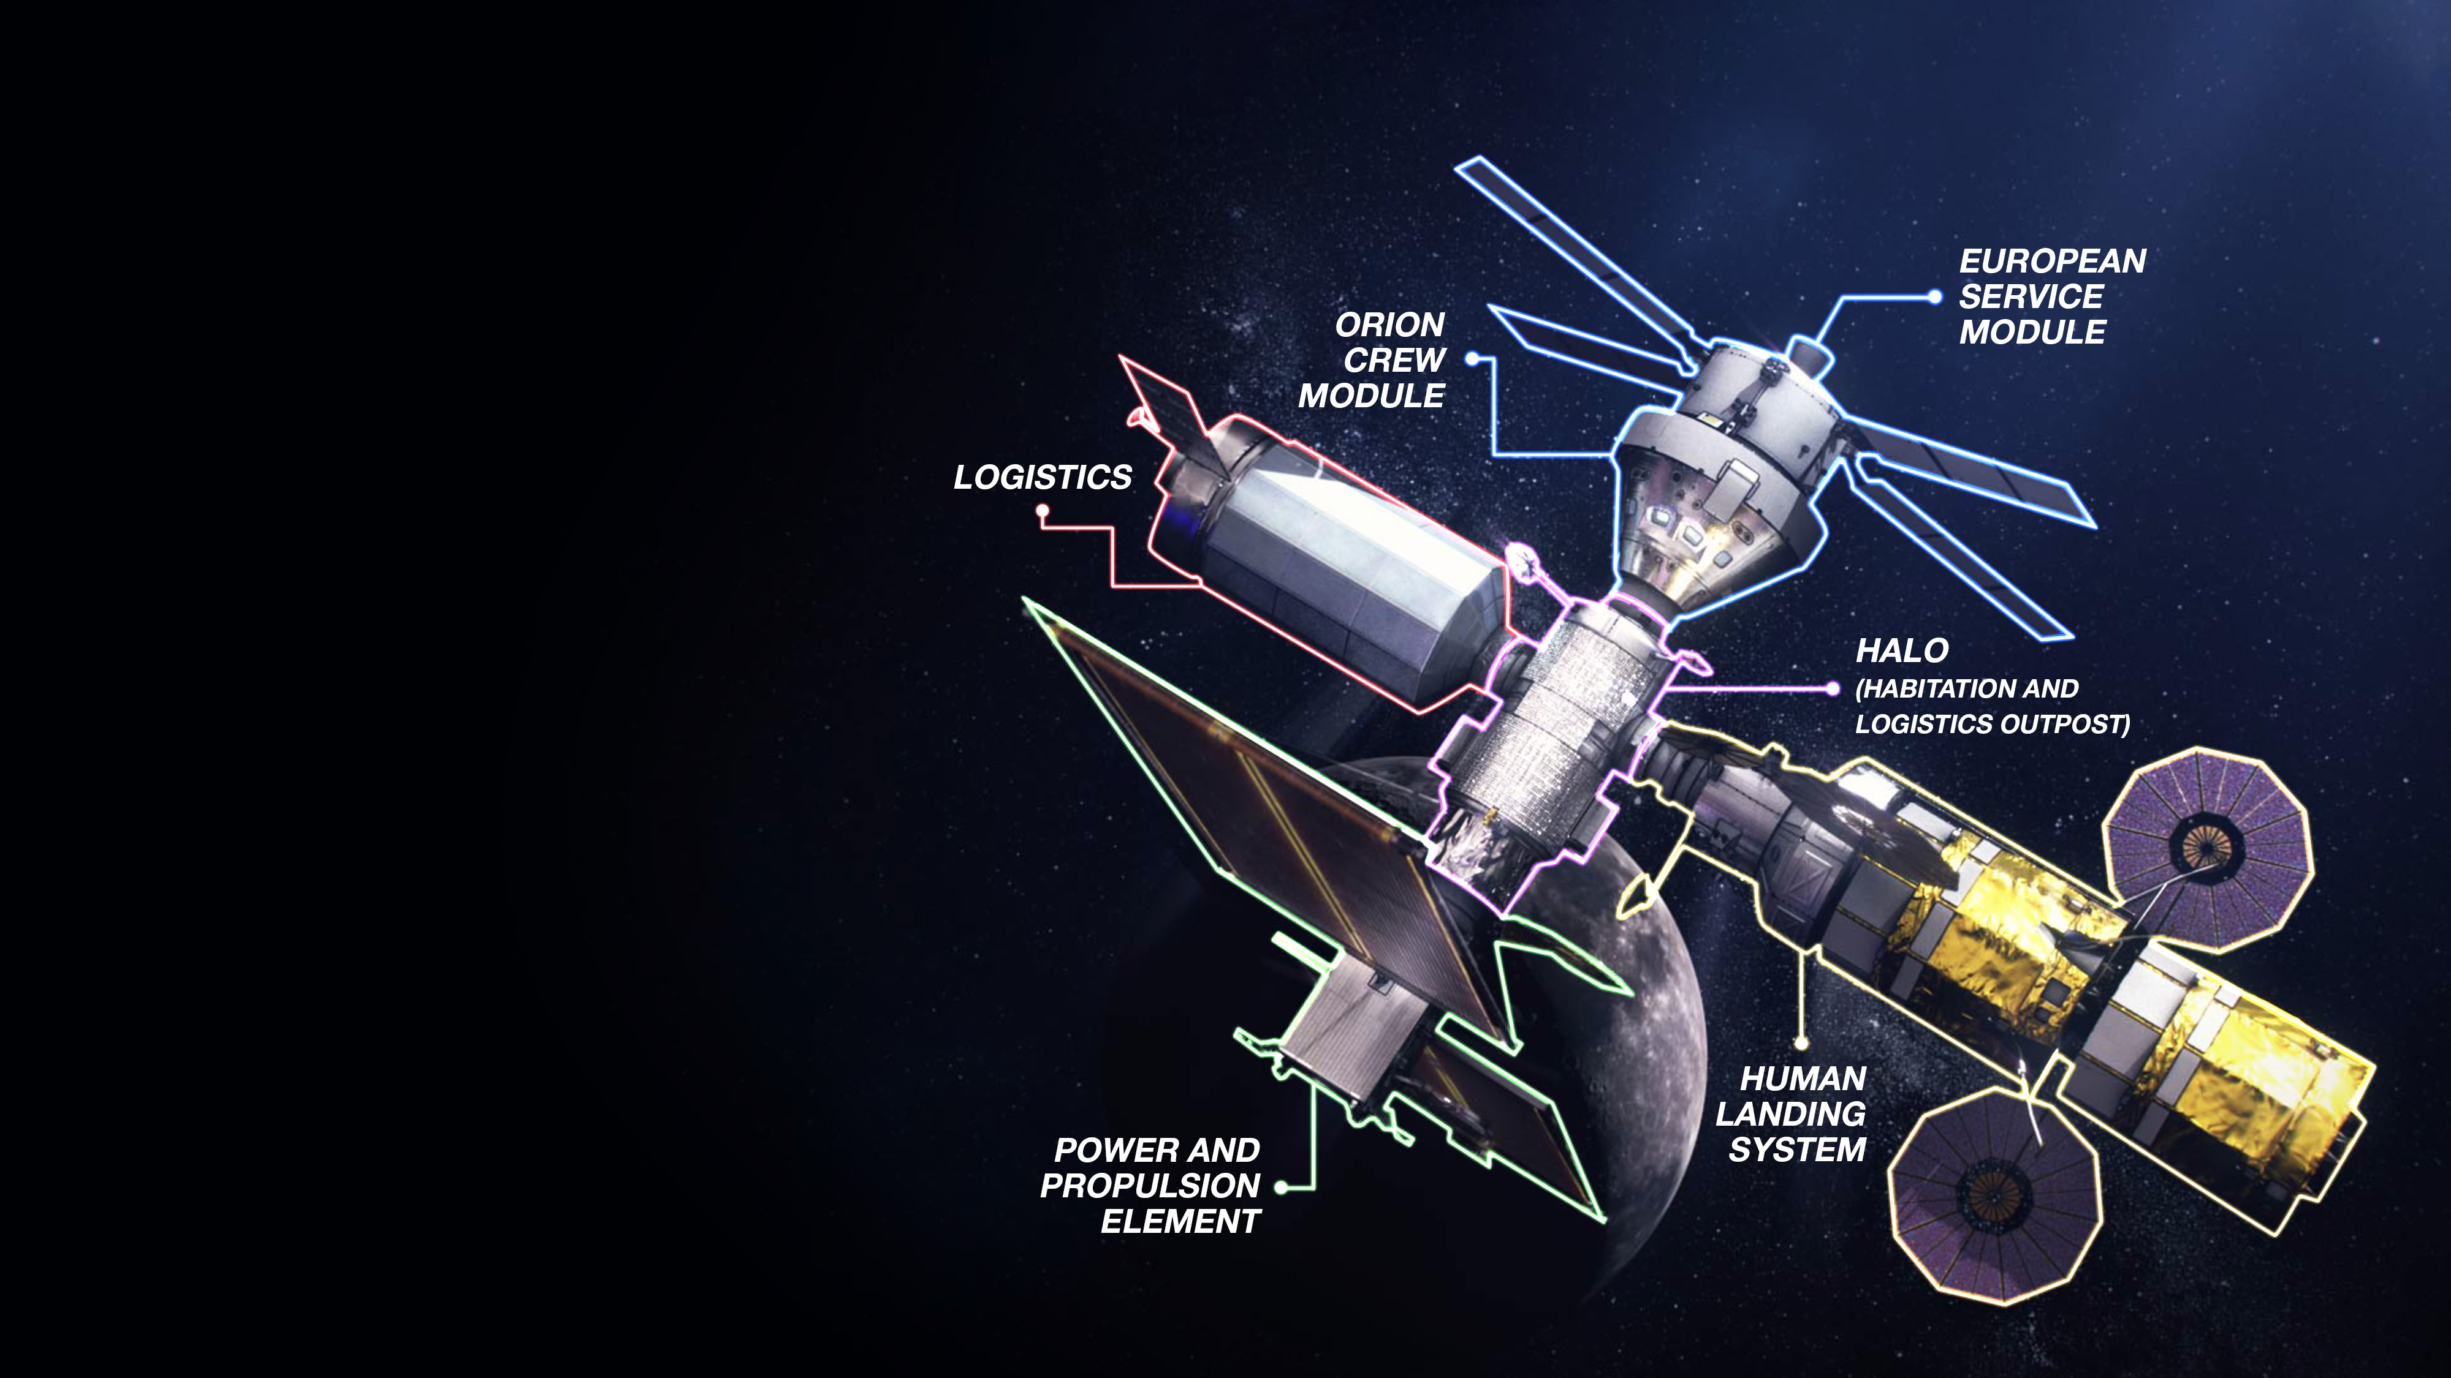
Gateway Enables Lunar and Mars Exploration
Strategic presence around
the Moon
Resilience, sustainability and robustness in the lunar architecture
Open architecture and interoperability standards are building blocks for partnerships and future expansion
9/29/2020
NASA Ames-JAXA B2B for Space Innov
4

Slide 5
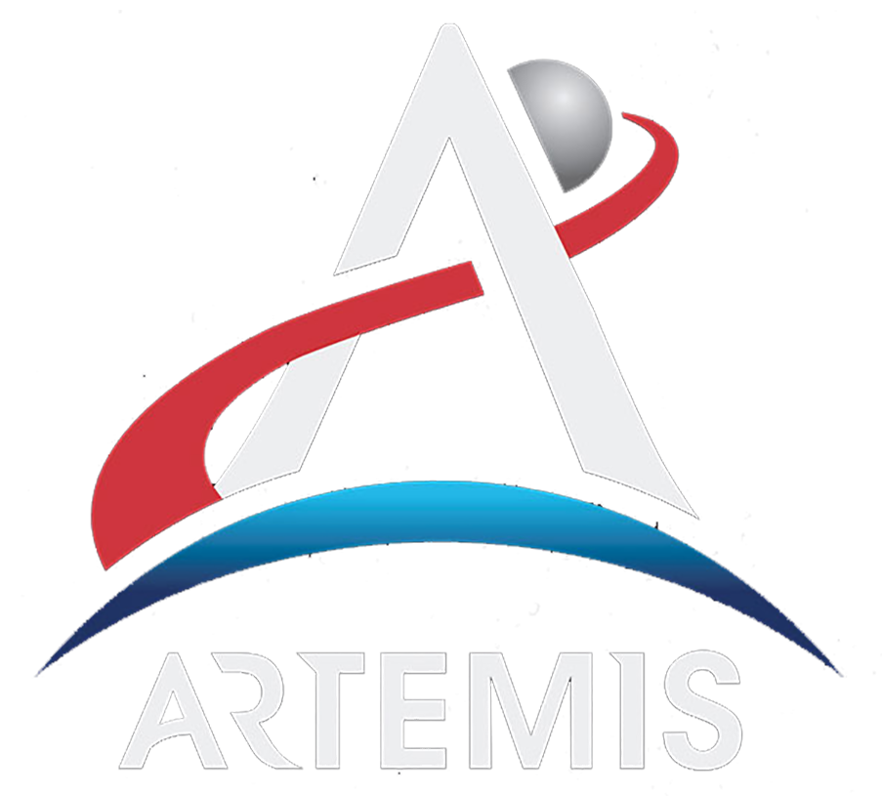
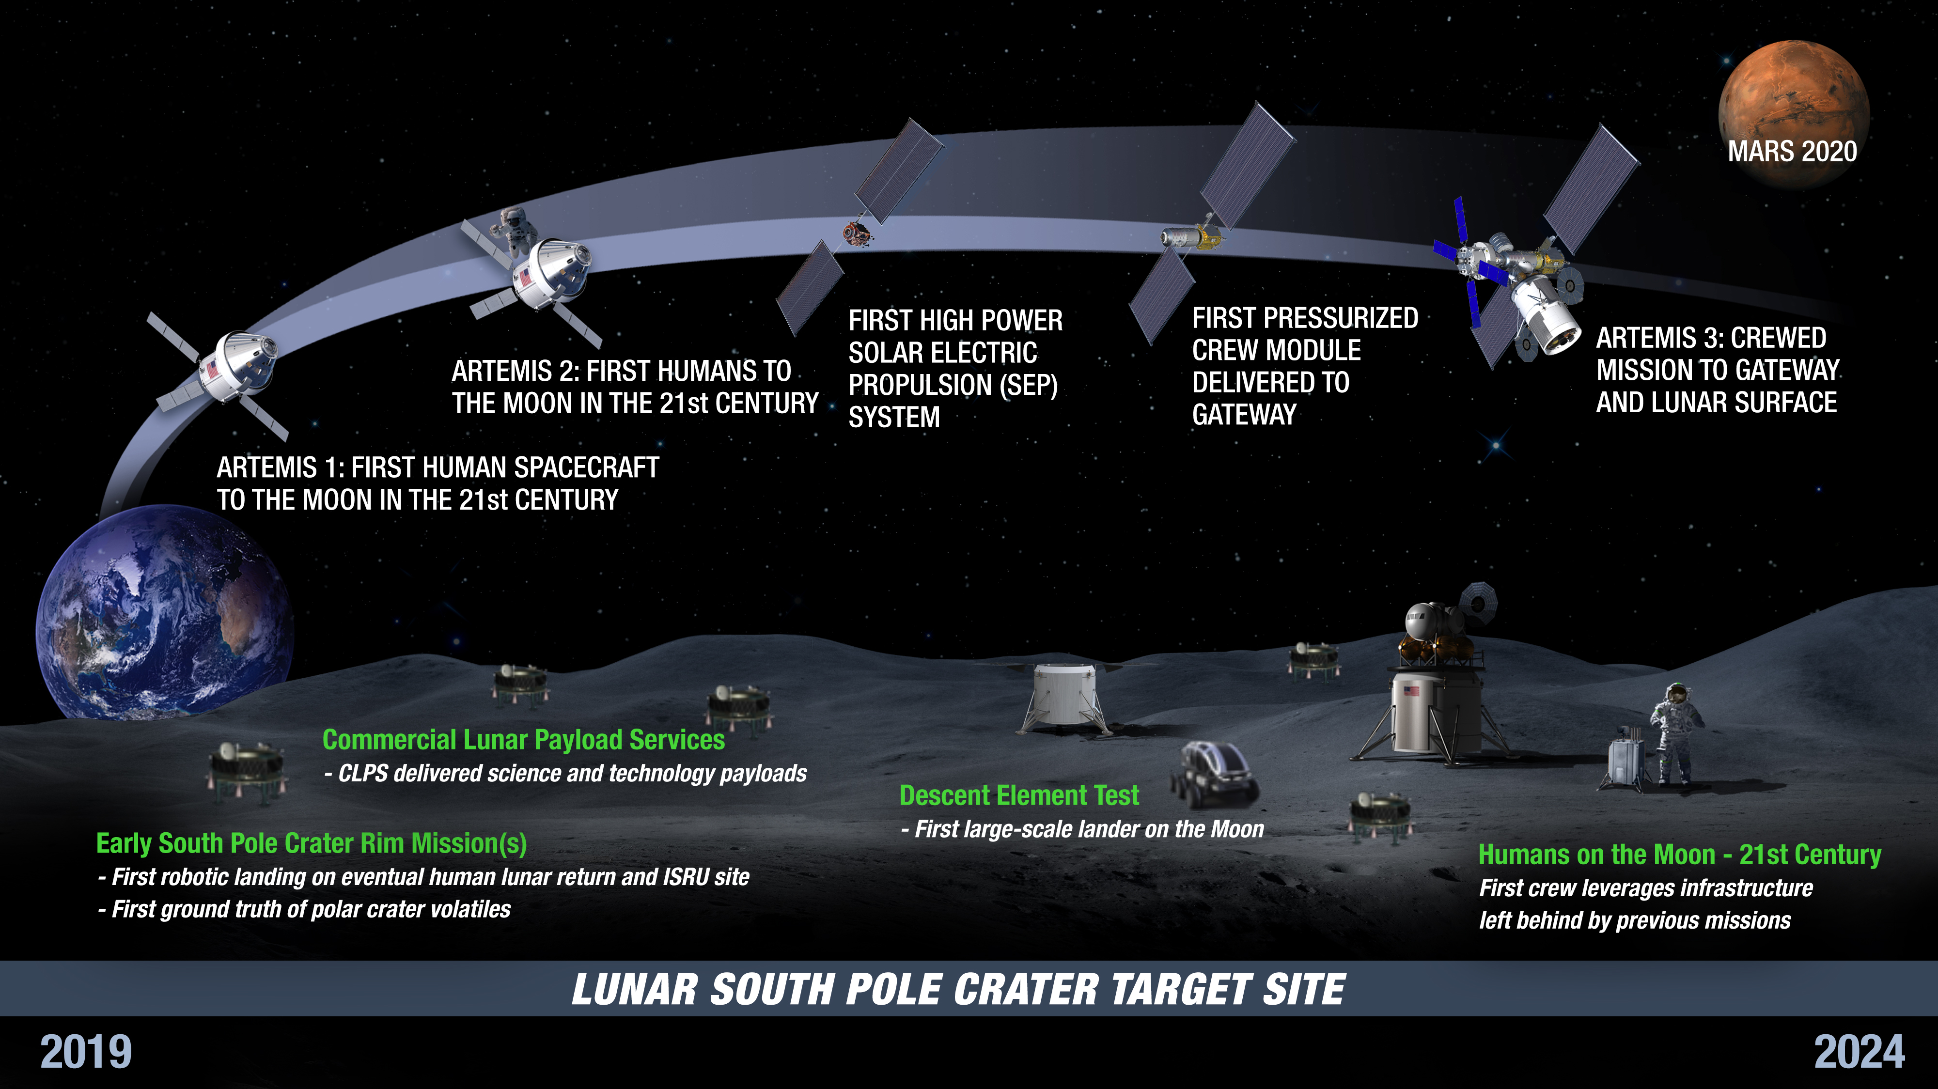
Ames for Artemis Phase 1: Lunar Surface by 2024
List of some Enabling Capabilities
Autonomy for Artemis Program (Gateway & HLS)
- SW V&V, Caution & Warning, AI Ops
Gateway Science & CubeSats
HLS Engineering Risk Assessment
Entry Tech & Arcjet Test
Ultra Hi-Fi Lunar Lander Surface Simulator
Human-System Integration for Artemis Program
Orion Launch Abort Simulations
SLS & Orion Wind Tunnel Tests and aero-database generation
Cross Program Data Systems
Lunar science enabled by SSERVI
2022 VIPER Prospecting Rover Mission (SMD)
2019-24 LunarCOTS concepts
2019-24 CLPS Instruments (SMD)
2024 VMS Training & Flt Control Dev for Lunar Lander
9/29/2020
NASA Ames-JAXA B2B for Space Innov
5

Slide 6

Human Landing System
Broad Agency procurement for rapid development and crewed demonstration to return humans to the lunar surface by 2024
Leveraging commercial capabilities to the maximum extent possible
NASA will not take ownership of the HLS hardware/software
HLS will launch as commercial cargo; checkout and testing will occur on orbit prior to any crew launch and egress
NASA provides certification and technical expertise
The HLS plan is to leverage the speed and operating models of the commercial space industry while applying NASA expertise to ensure safety and mission success
6
9/29/2020
NASA Ames-JAXA B2B for Space Innov
6

Slide 7
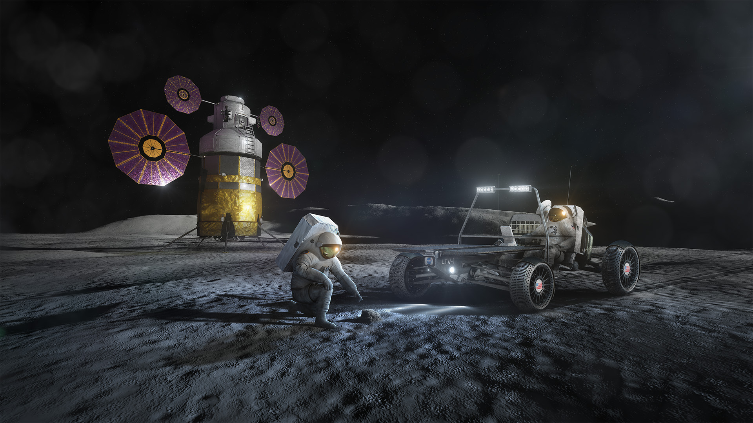
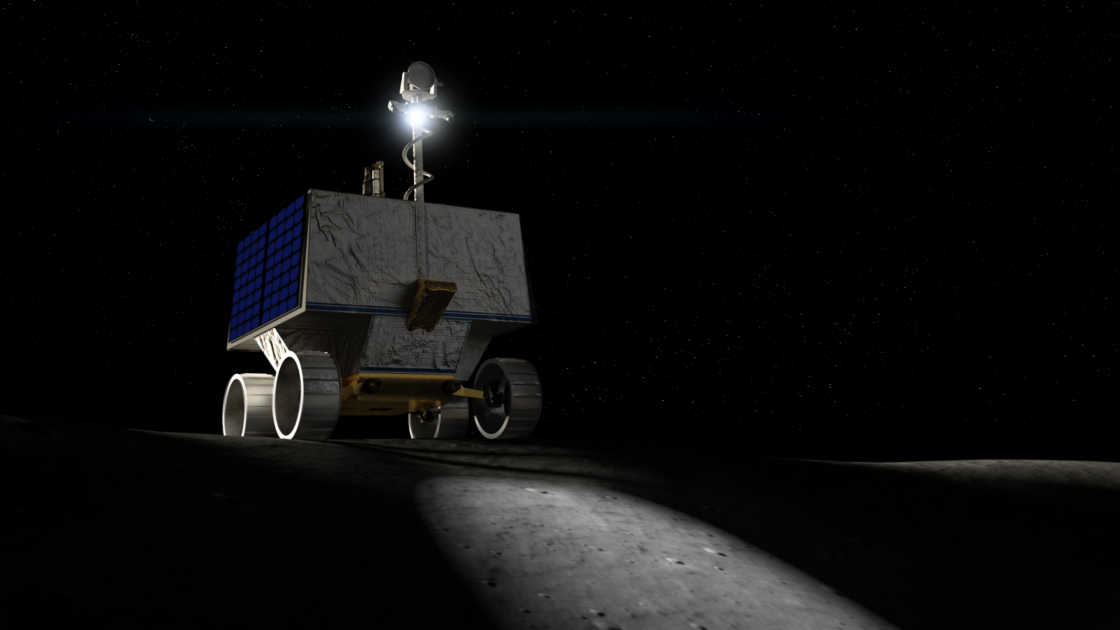
Ideas for Lunar Human and Robotic Rovers
Lunar Terrain Vehicle (LTV)
Lunar Surface Science Mobility Systems (LSSMS)
Human-rated, to move two suited astronauts across the lunar surface
Robotic vehicles to transport instruments across the lunar surface
9/29/2020
NASA Ames-JAXA B2B for Space Innov
7

Slide 8
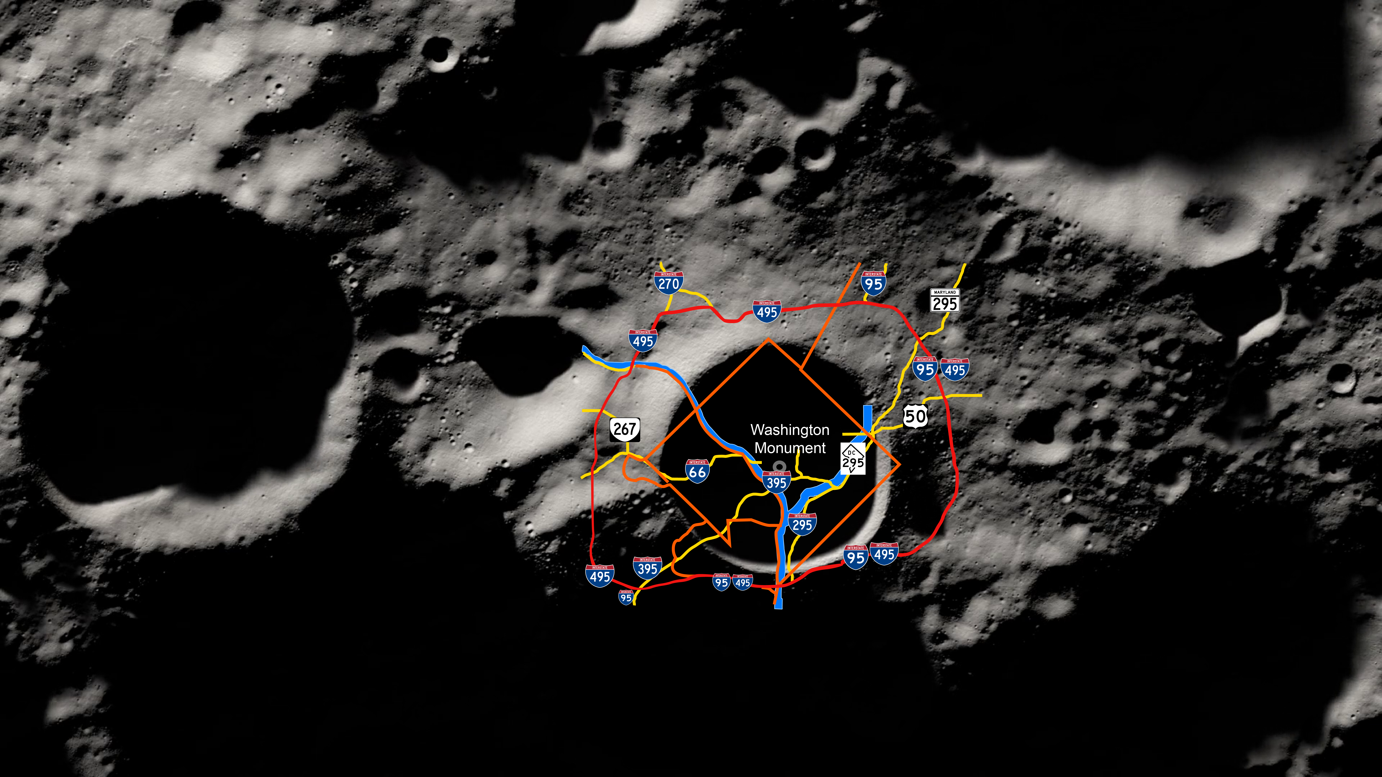
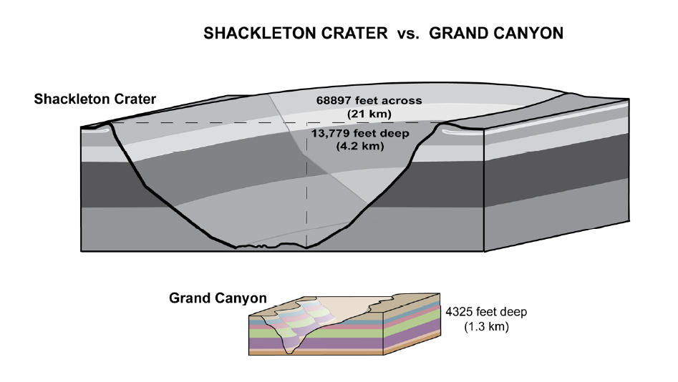
The Lunar South Pole relative scale
29400 feet across
(8.96 km)
Shackleton Crater: ~20 km in diameter, ~4 km deep and ~3x deeper and wider than the Grand Canyon
9/29/2020
NASA Ames-JAXA B2B for Space Innov
8
8

Slide 9
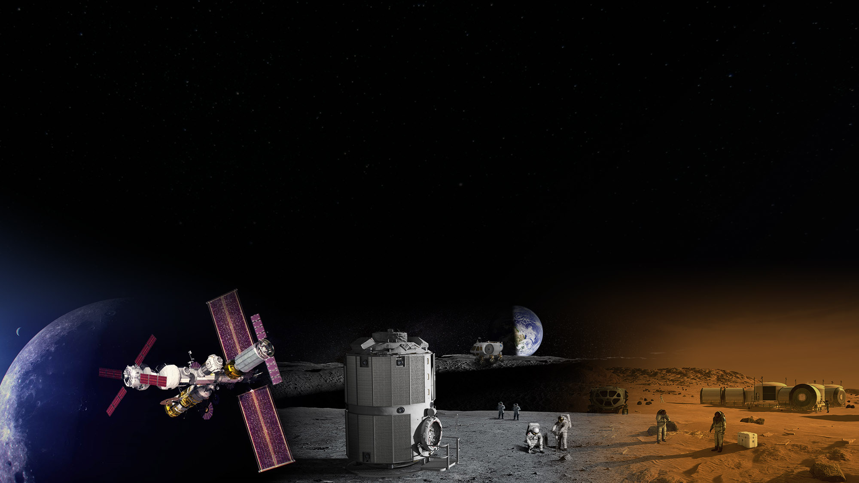

PHASE 2 LIVING, LEARNING AND WORKING ON THE MOON
VISION: A coalition of NASA, industry, and partner nations will establish an enduring human and robotic
presence at the Moon in order to meet the agency’s science and exploration goals. The Orion spacecraft will deliver crew to the lunar-orbiting Gateway where landers will ferry the
astronauts to and from the surface of the Moon. NASA and its partners will expand the Gateway’s capabilities, allowing for longer stays aboard the orbiting outpost.
The Artemis Base Camp will establish our first foothold on the lunar frontier with a rover and habitat for extended expeditions. Artemis astronauts will advance new technologies, and increase our knowledge of Earth, the Moon, and our history in the solar system. Together, the Gateway and the Artemis Base Camp will enable mission simulations to prepare for the next step – sending astronauts to Mars.
Gateway | Artemis Base Camp | Preparation for Mars
9/29/2020
NASA Ames-JAXA B2B for Space Innov
9

Slide 10
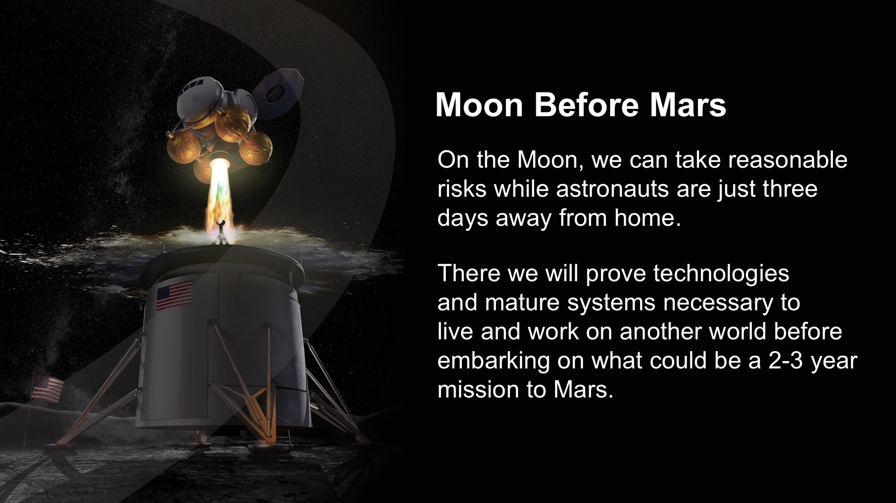
9/29/2020
NASA Ames-JAXA B2B for Space Innov
10
10

Slide 11
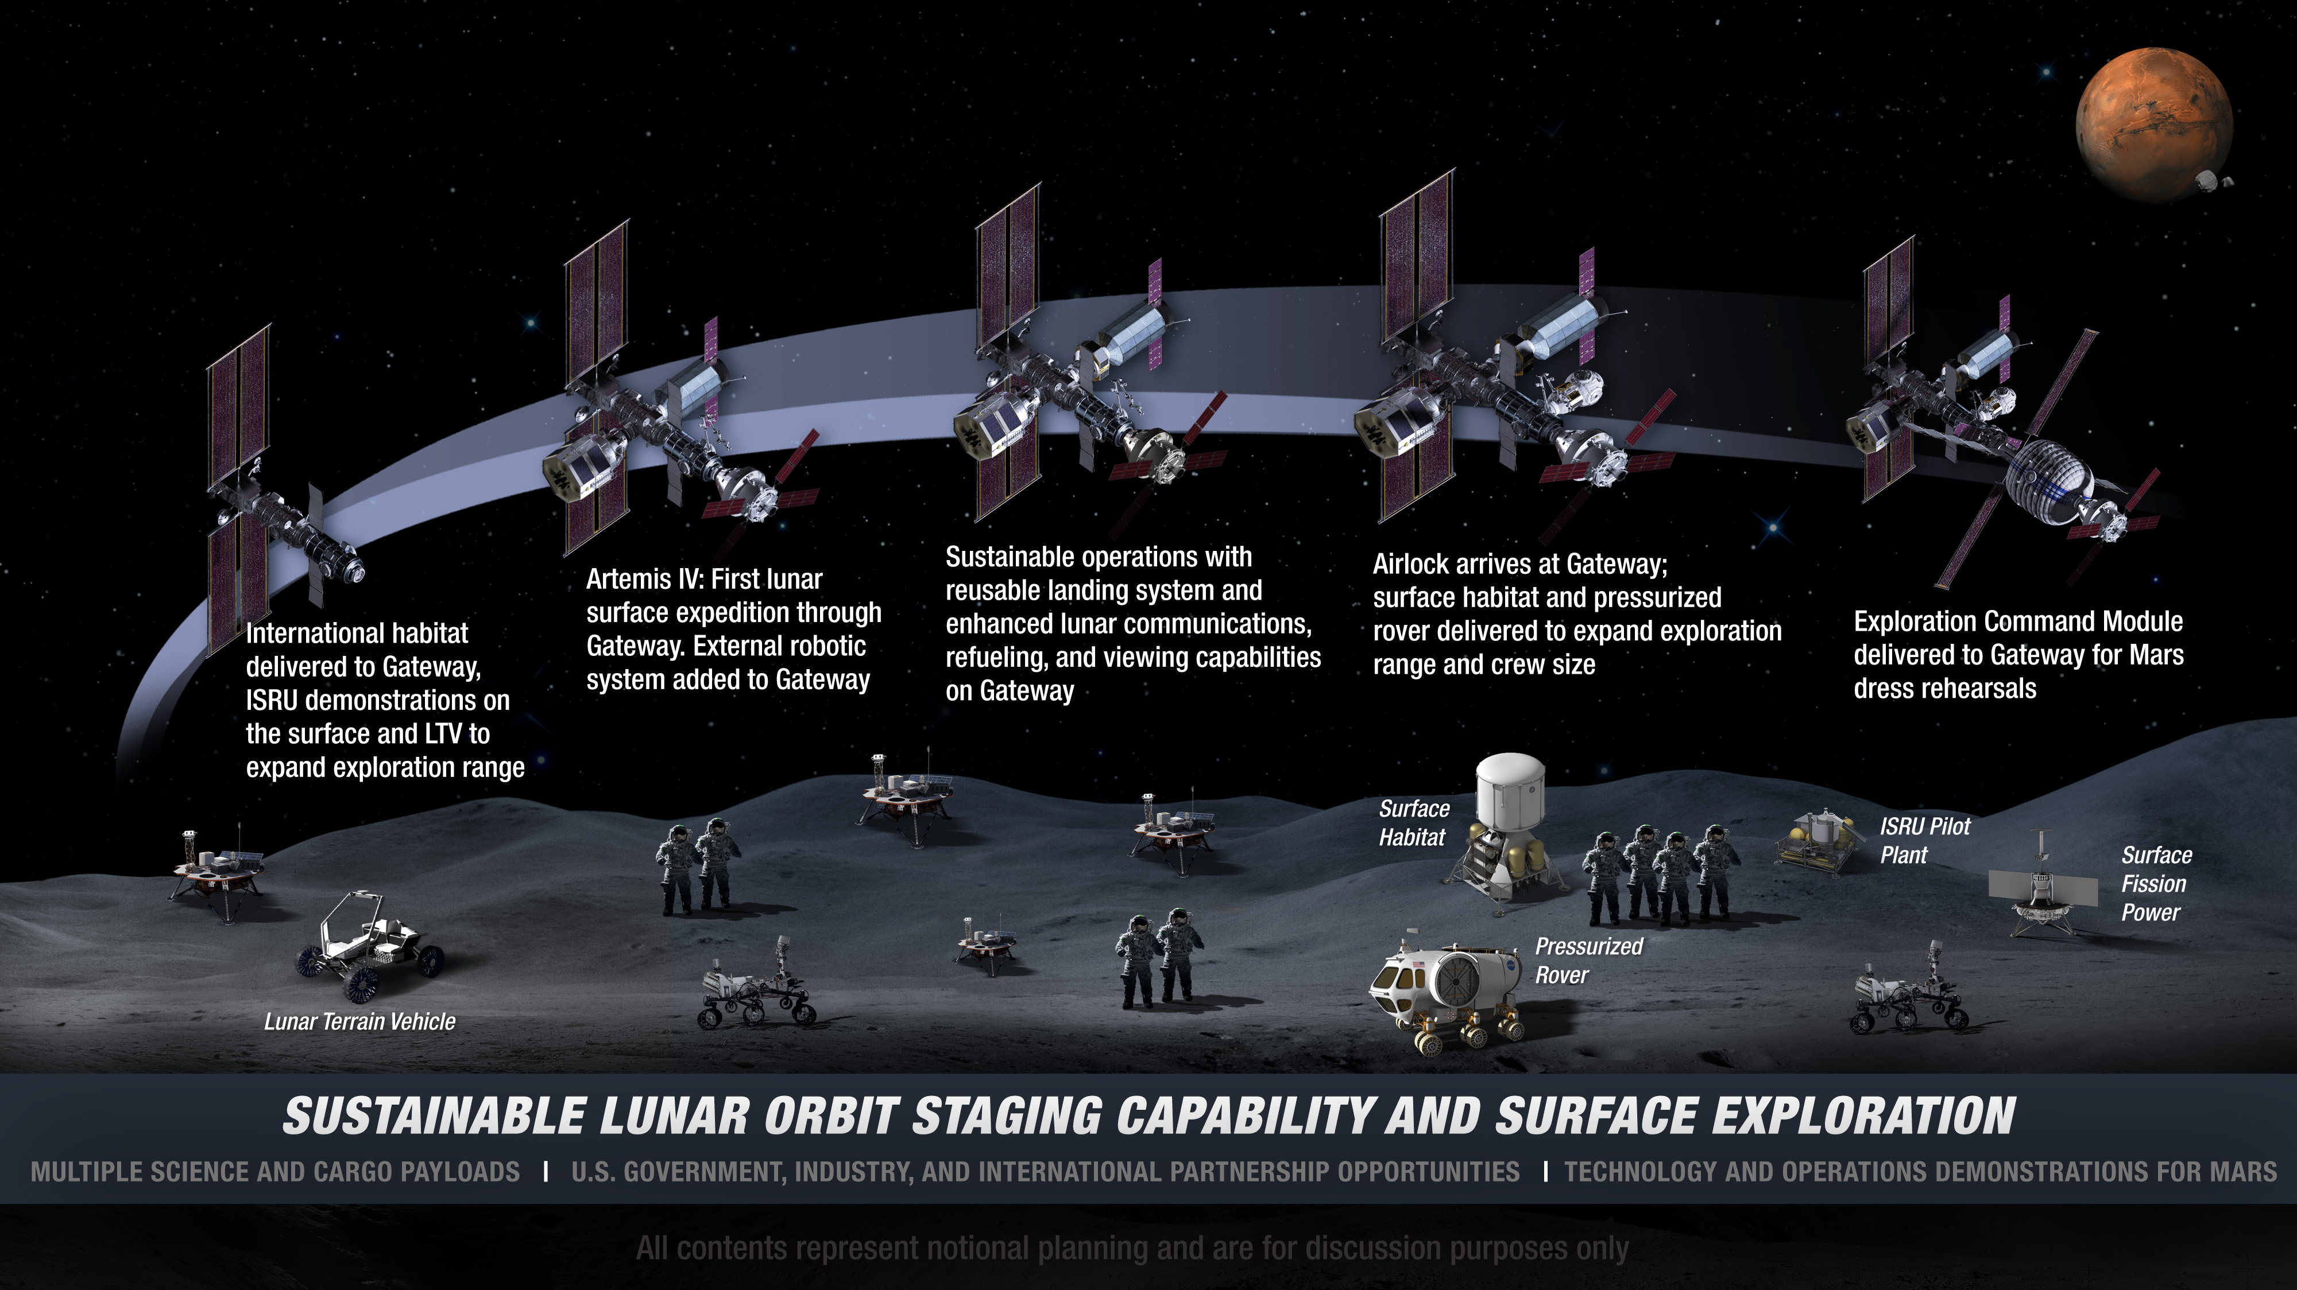

: Extending Lunar Missions to Prepare for Mars
9/29/2020
NASA Ames-JAXA B2B for Space Innov
11

Slide 12
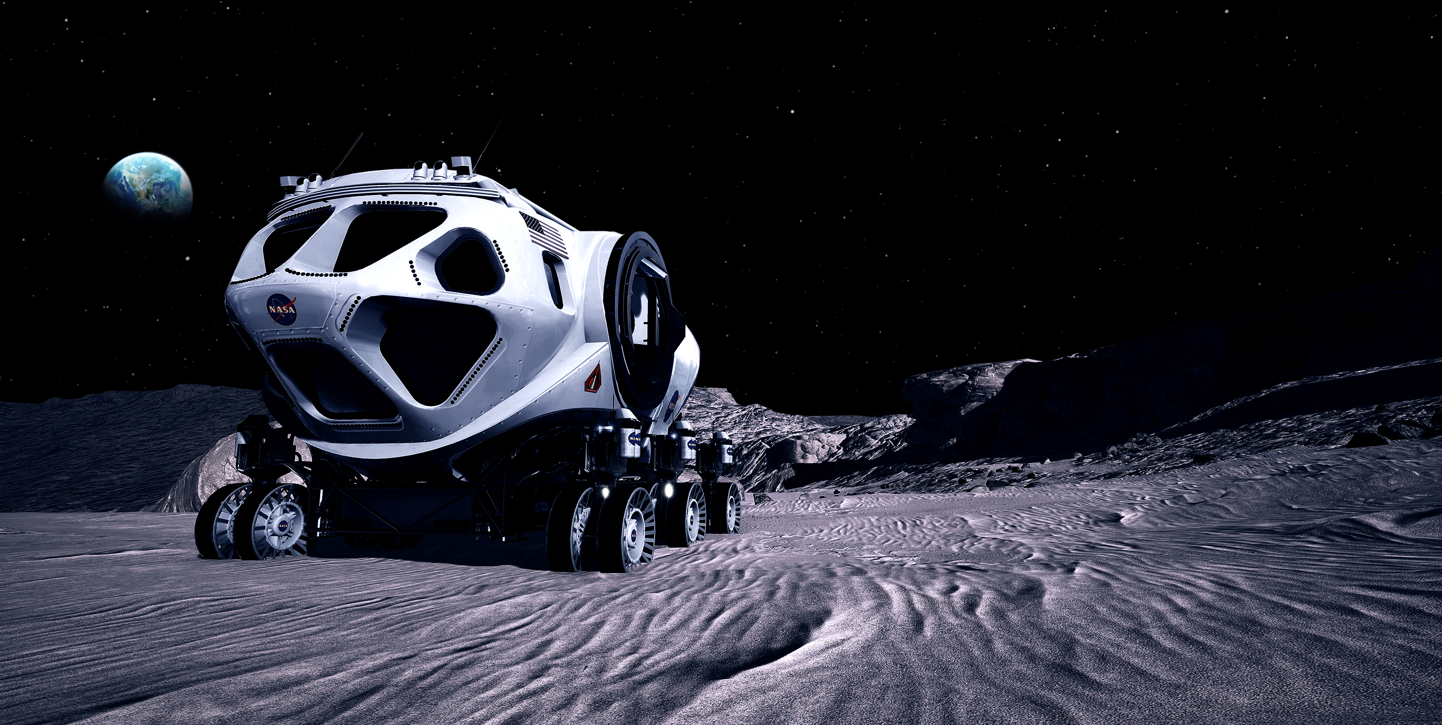
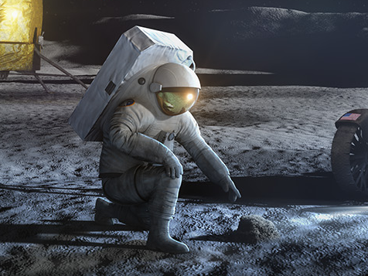
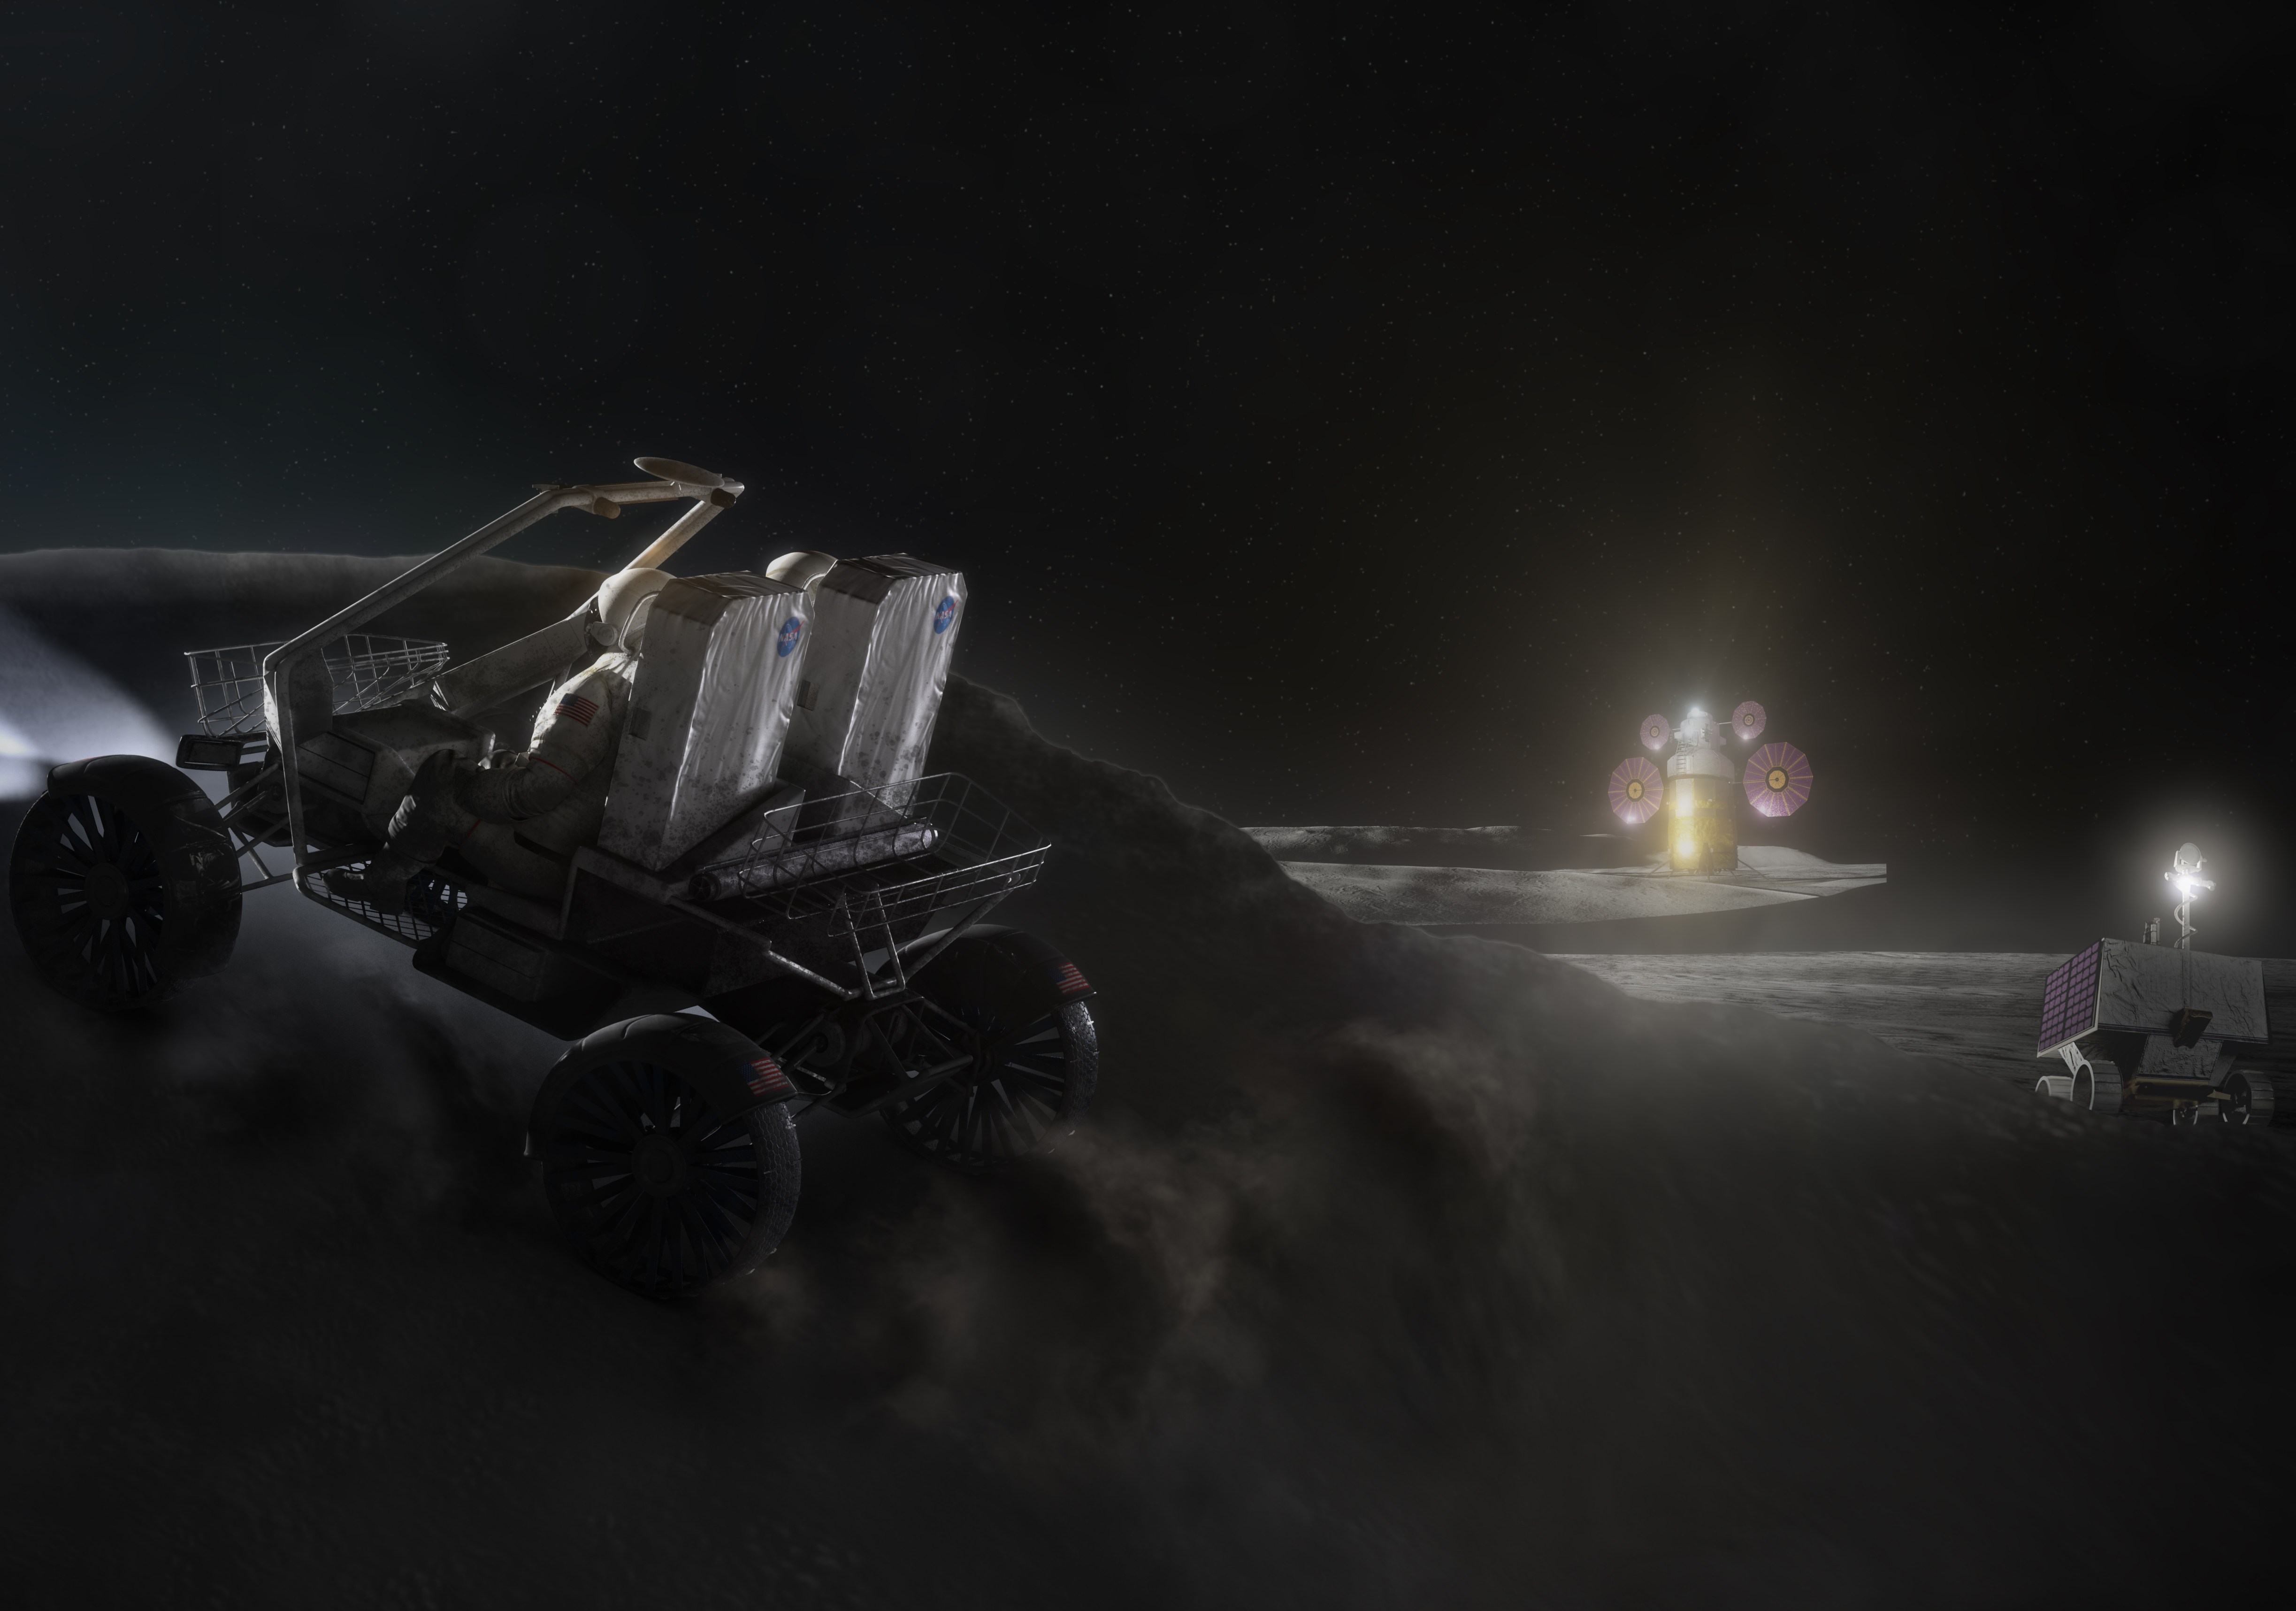
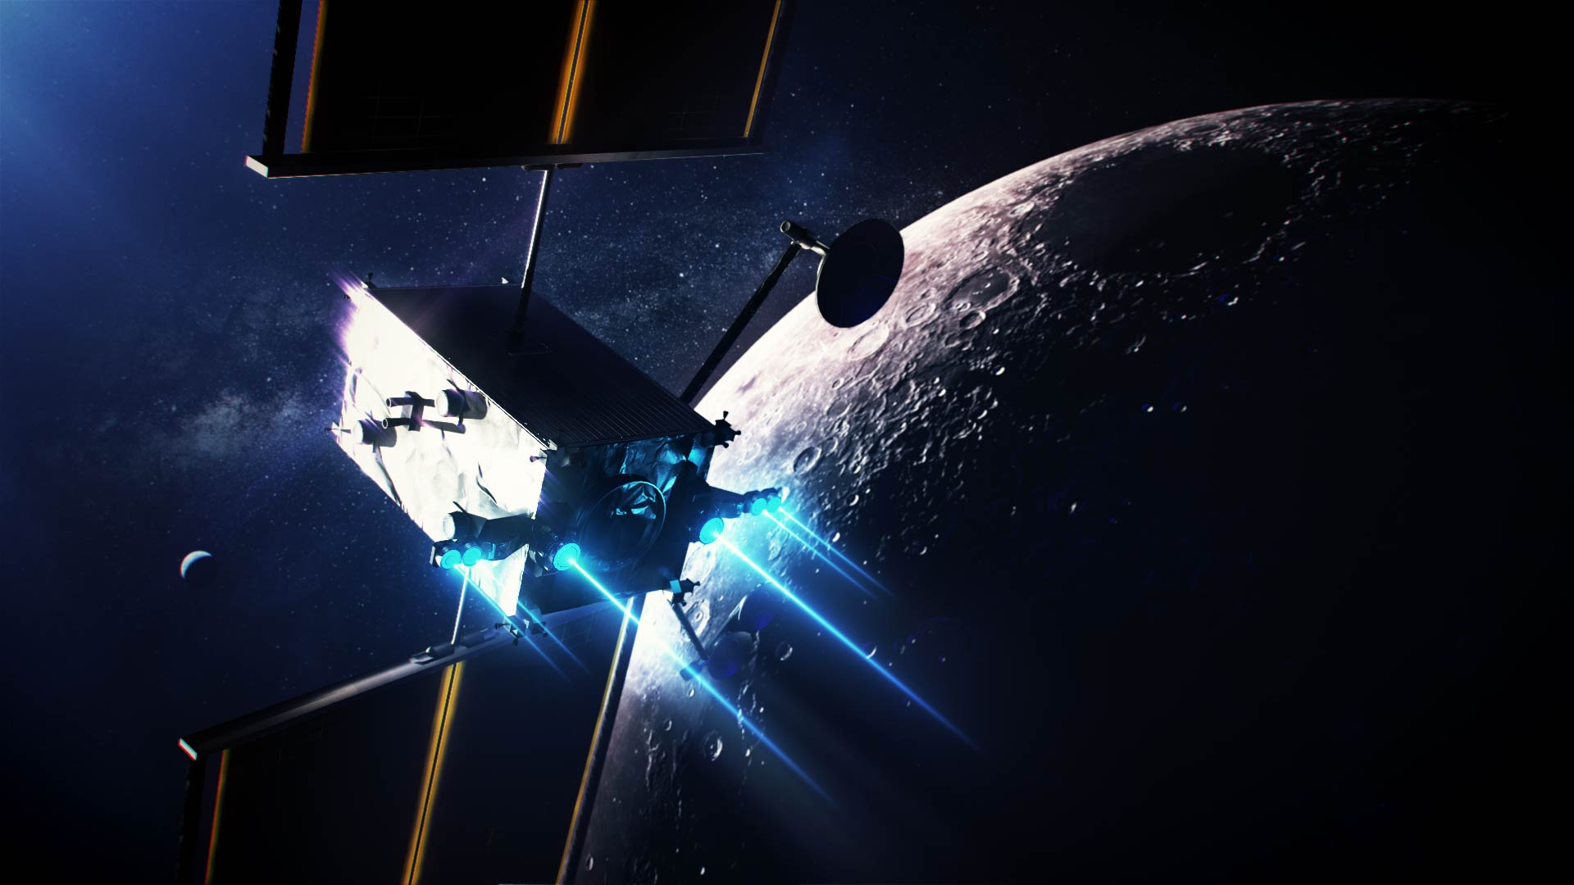
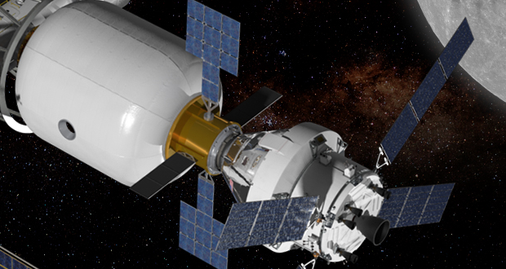
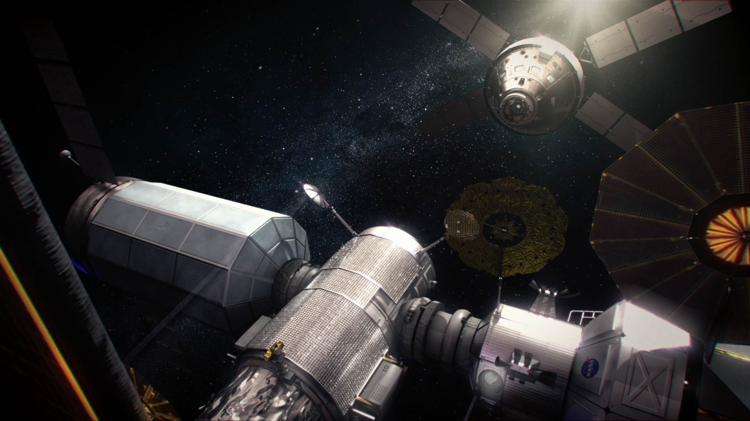
Common Moon/Mars Systems and Operations
MOBILITY
SUITS
ASCENT SYSTEMS
PROPULSION
HABITATION SYSTEMS
DEEP SPACE AGGREGATION
9/29/2020
NASA Ames-JAXA B2B for Space Innov
12
Notes:
12

Slide 13


Slide 14


