Slide 1
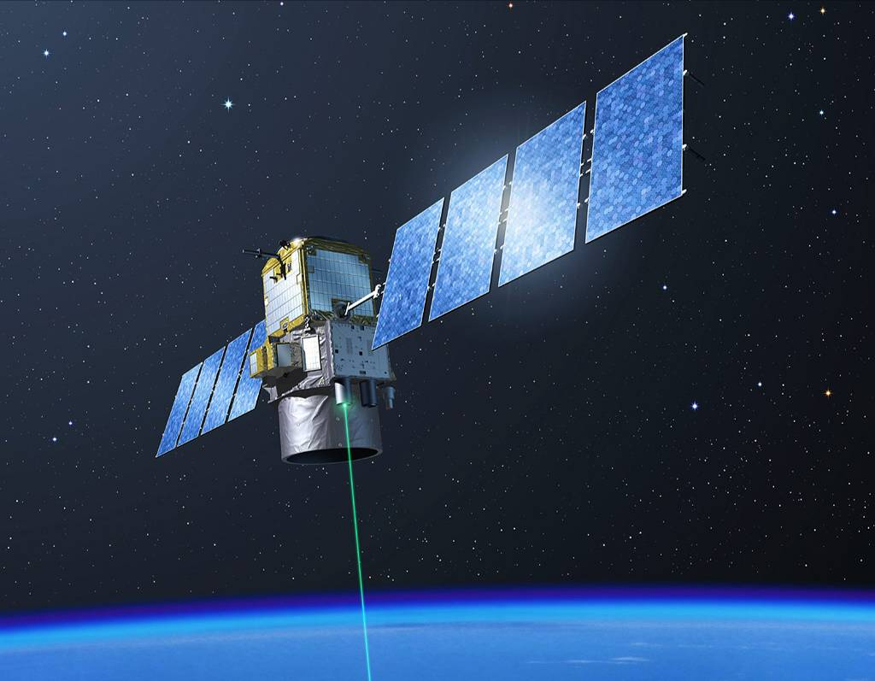
The CALIPSO Mission
Dave Winker
NASA LaRC
Hampton, Virginia
ESSP Forum, 14 October 2020

Slide 2
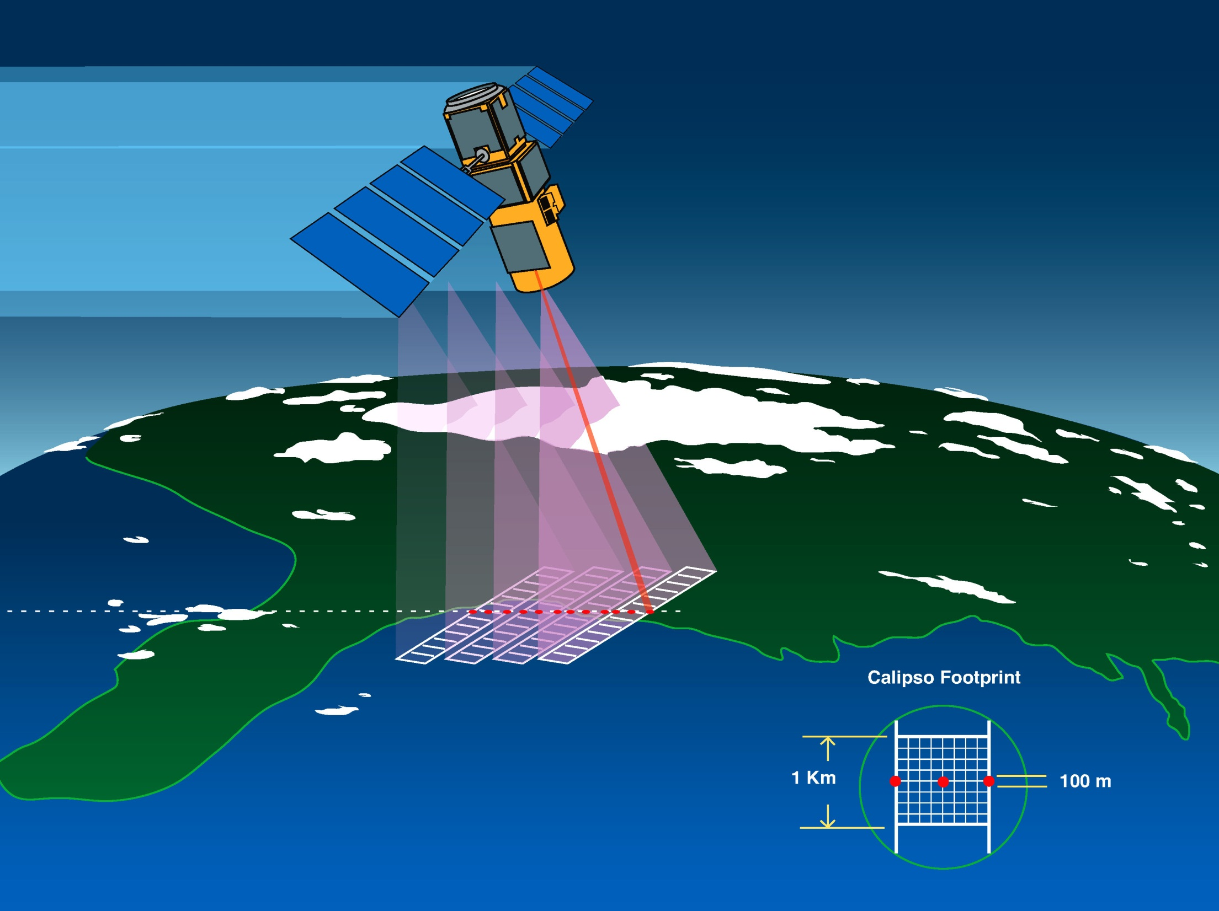
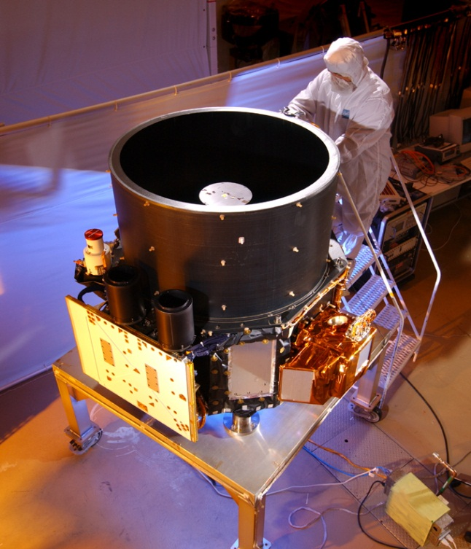
CALIPSO Satellite
First light: 7 June 2006
Three co-aligned instruments:
CALIOP: polarization lidar
  30 m vertical resolution
  90 m footprint
Imaging IR radiometer
  8.6, 10.5, 12.0 um
  60 km swath
Wide-Field Camera
  650 nm
  60 km swath

Slide 3
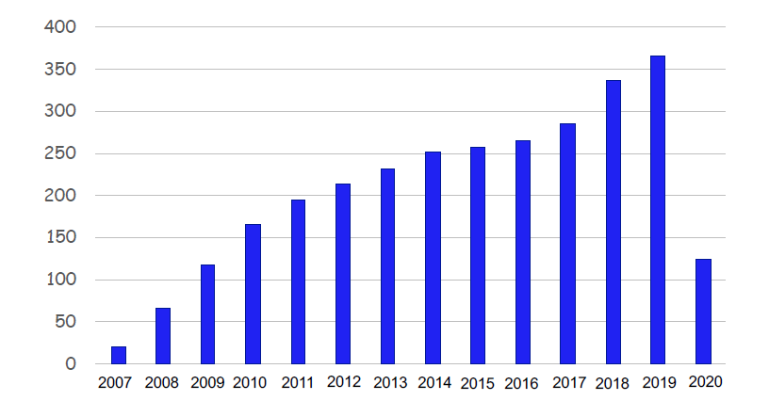
The CALIPSO Mission
Launched April 28, 2006
  Initial orbit
    705 km altitude
    In formation with A-train
  Orbit lowered to 685 km in 2019
Nominal mission: 3 years
  Now on orbit 14.5 years
Science data:
  640 TB produced
  > 6,300 TB distributed
More than 3000 scientific publications
CALIPSO scientific publications by year

Slide 4
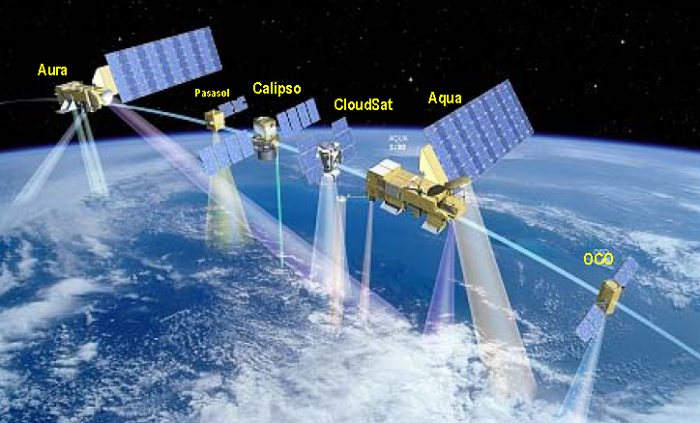
Mission Science
Primary mission objectives are to provide vertically resolved aerosol and cloud measurements to:
Quantify impacts of atmospheric aerosols on Earth’s radiation budget
Enable improved estimates of the radiation budget at Earth’s surface
Provide improved understanding of the response of clouds to global warming
A-train circa 2015

Slide 5
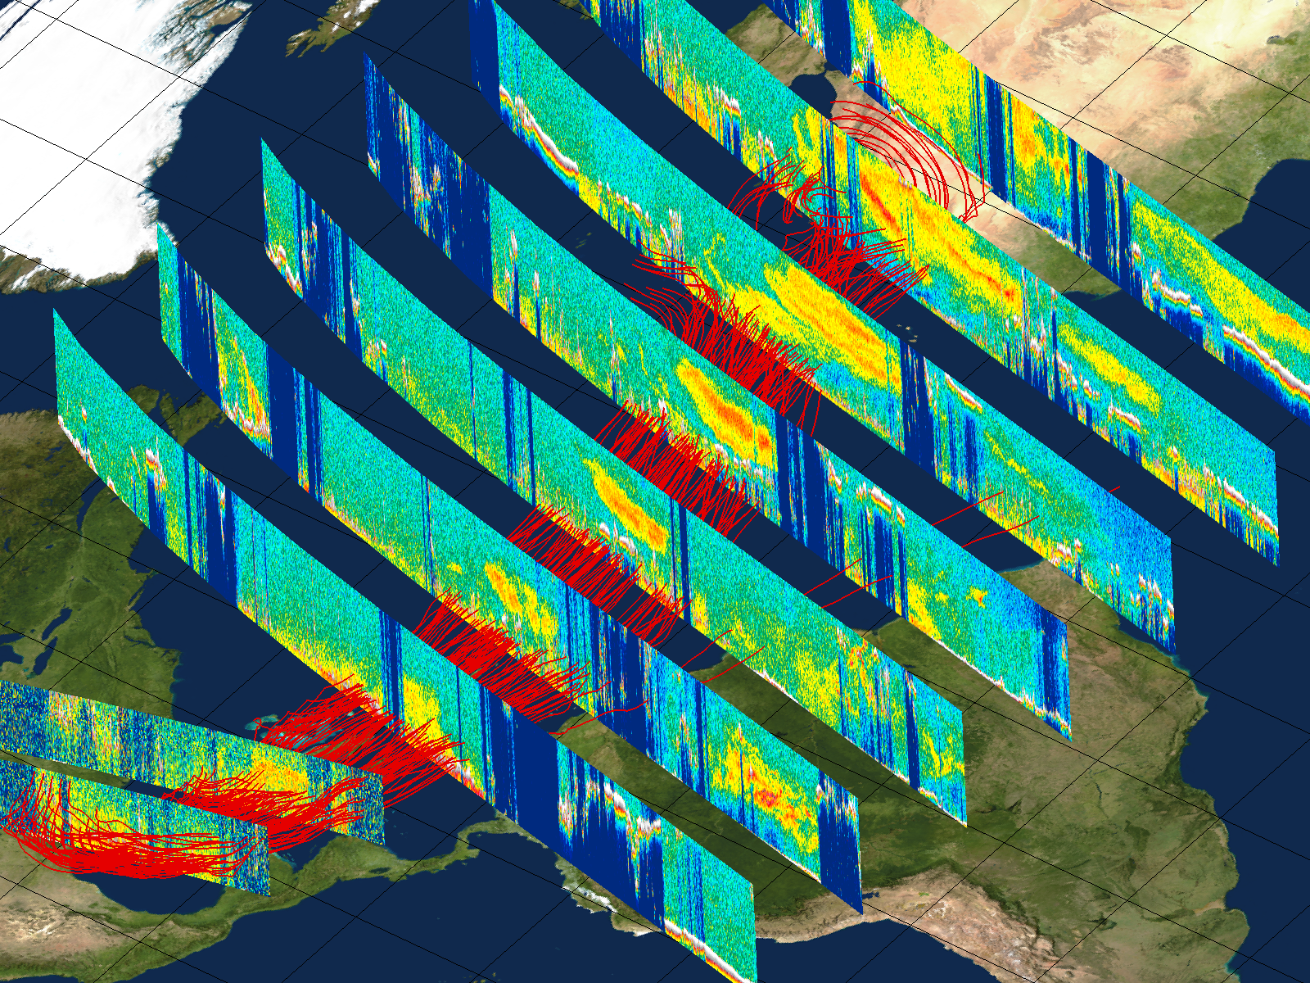
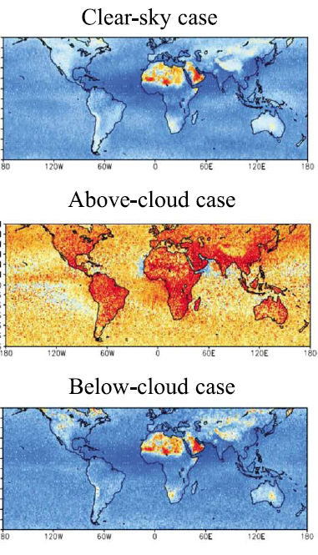
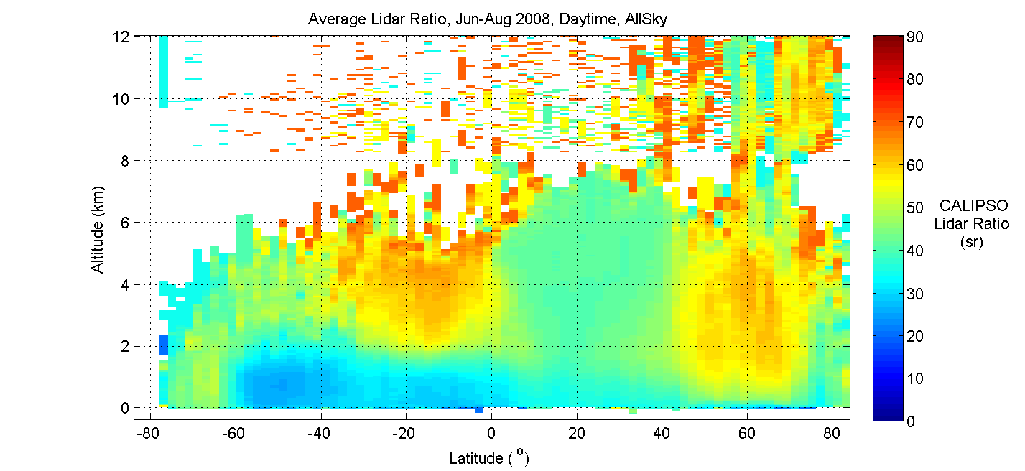
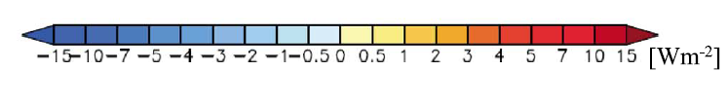
Science Capabilities
Aerosol Transport
Aerosol Radiative Effects
Sahara dust outbreak, Aug 2007
Liu et al, JGR, 2008
Aerosol Composition
dust
smoke
Zonal mean distribution of aerosol types, June through August
smoke
marine
SW DARF (Oikawa et al. 2018)

Slide 6
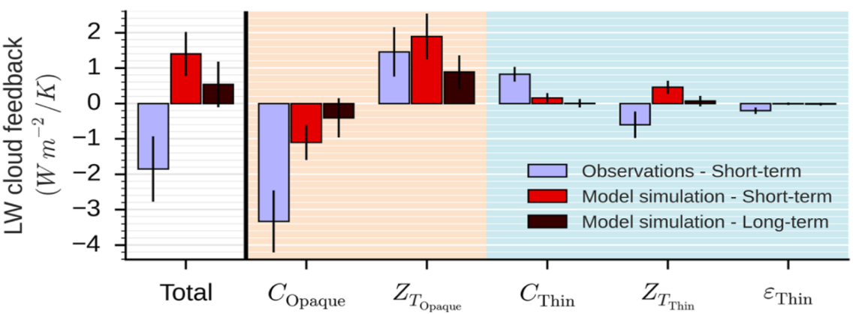
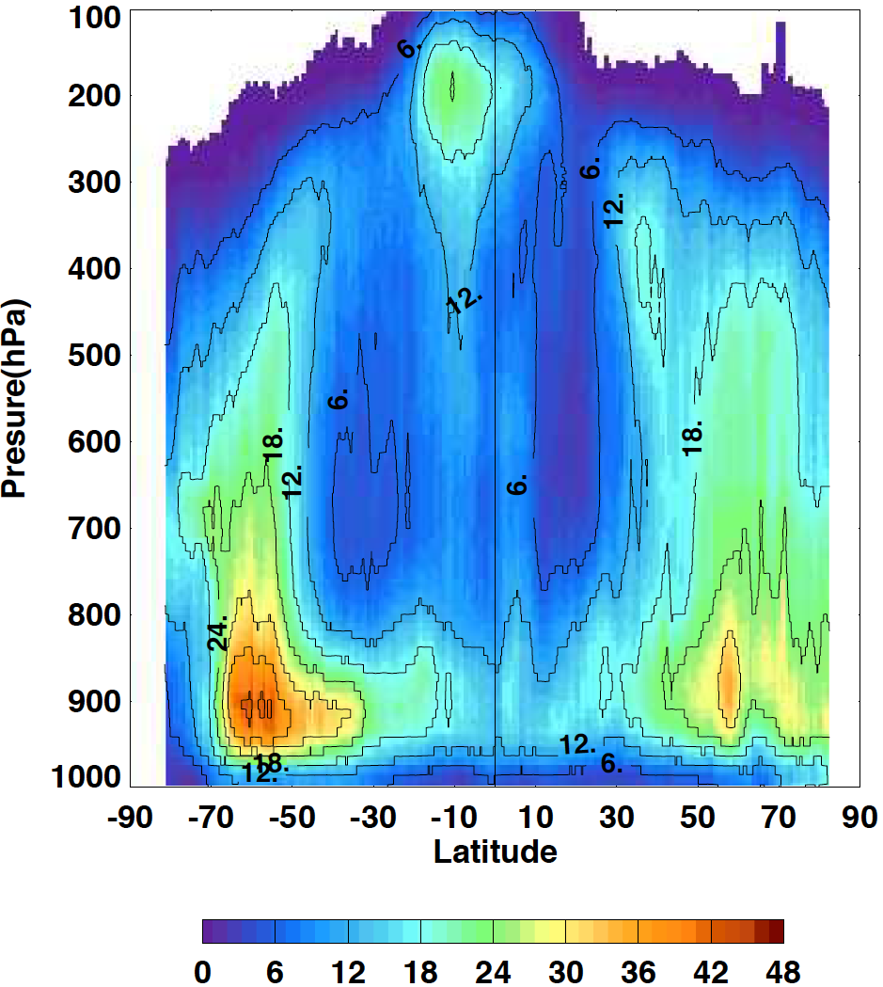
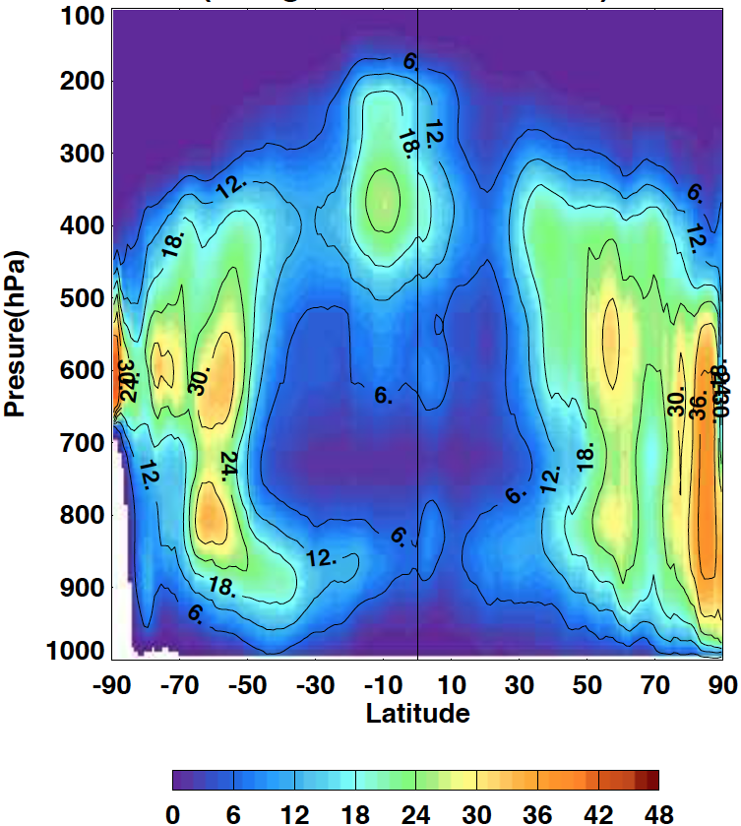
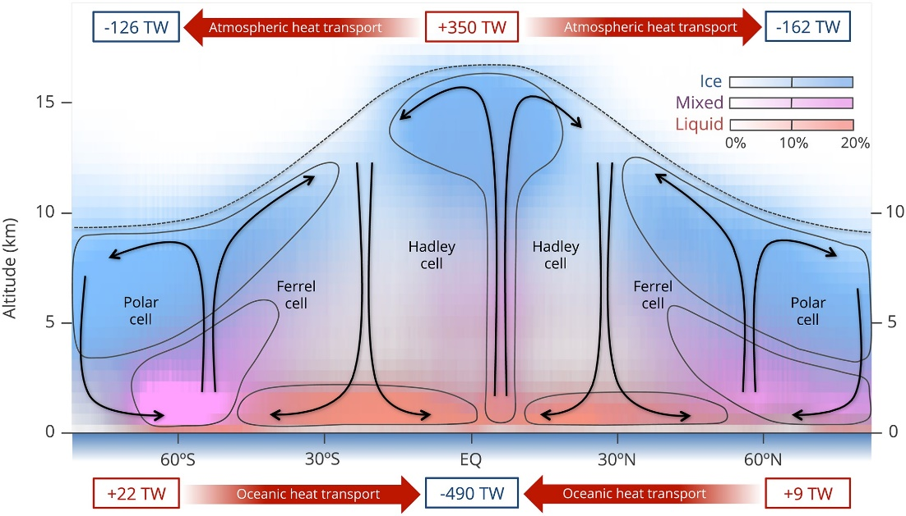
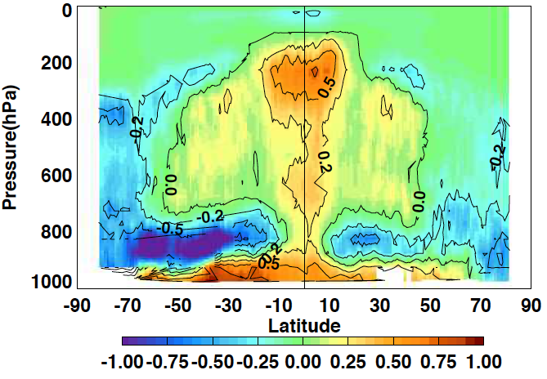
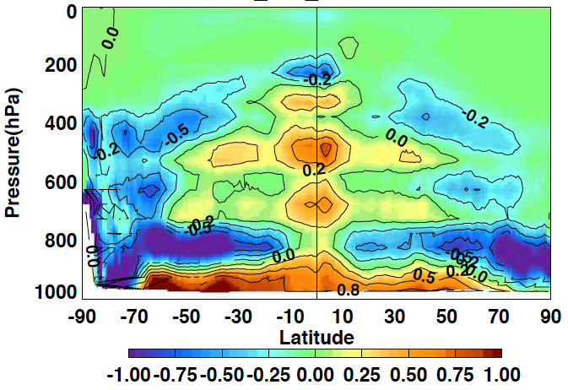
From Cloud Occurrence to Cloud Heating
Cloud Radiative Feedbacks
CALIOP-CloudSat MODIS + GEO
Vertical Cloud Fraction
Cloud Radiative Effect
(K/day)
Decomposition of LW cloud feedback from CALIOP, and comparisons with the LMDZ climate model (from Vaillant de Guelis et al., 2018).
Global Energy Flows
(Kato et al. 2019)
Notes:
CALIPSO/CloudSat: How these new datasets are being used and what we’re learning

Slide 7
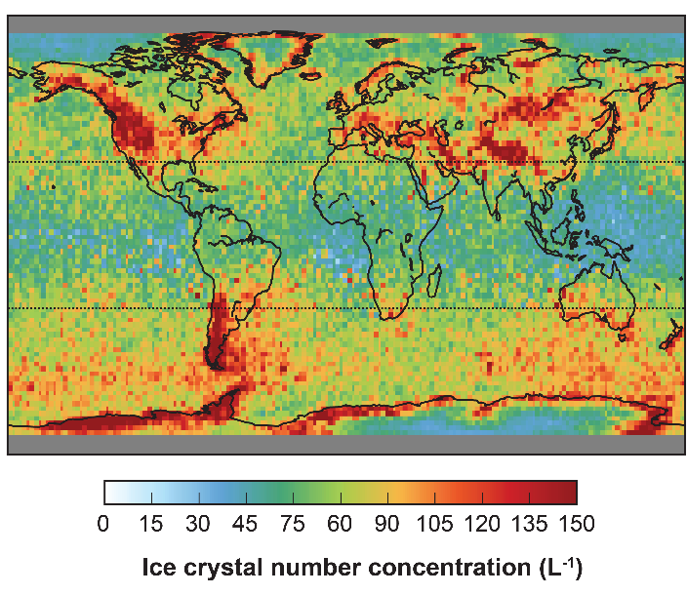
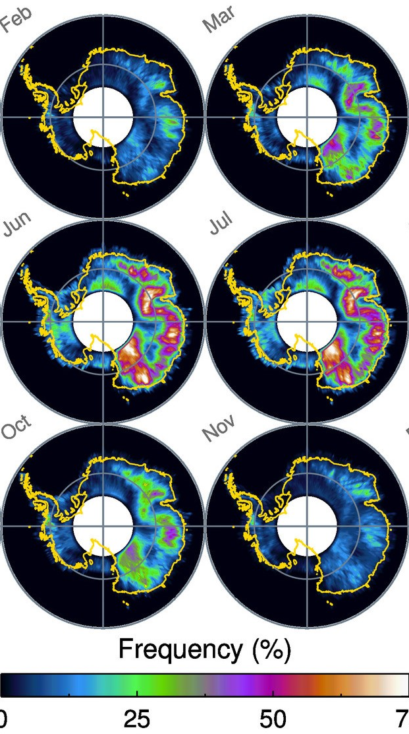
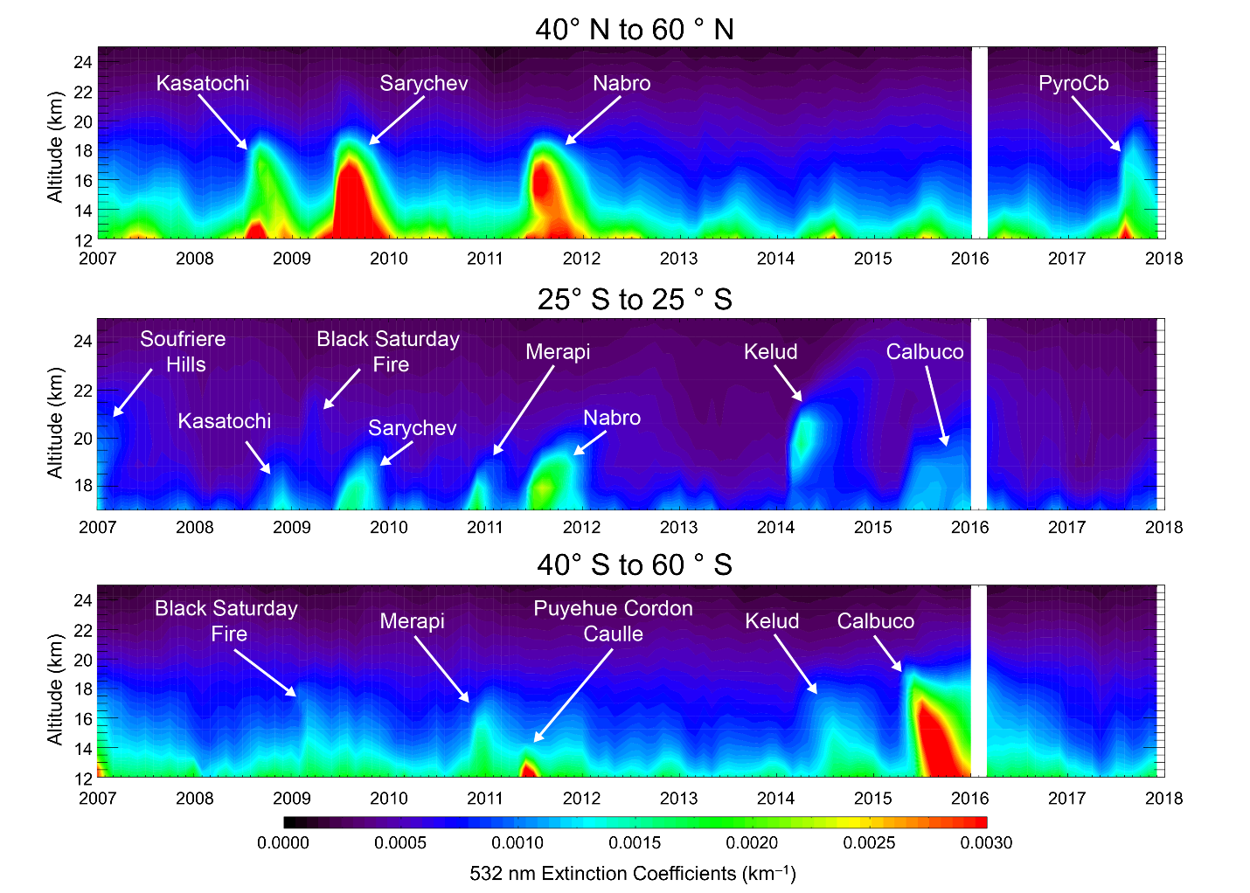
CALIPSO has also provided a wide variety of unanticipated results
Global distribution of ice particle concentrations for cirrus below -40 C (adapted from Gryspeerdt et al., 2018)
Time-height cross sections of CALIOP stratospheric aerosol extinction (Jan 2007 to Dec 2017) (Kar et al., 2019):
Average monthly blowing snow frequency over Antarctica, 2006-2017 (courtesy of Steve Palm)

