Slide 1
Jeff Gramling
Director, Mars Sample Return Program
Presentation to IMEWG
October 21, 2020
Notes:
STILL

Slide 2



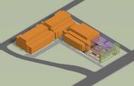
MSR Campaign
Mars Sample Return Program
1 2 3 + 1
Sample Caching Rover
(Mars 2020) Operations
Sample acquisition/caching
Sample (subset) delivery
Sample Retrieval Lander
Fetch Rover
Orbiting Sample (OS) container
Mars Ascent Vehicle
Earth Return
Orbiter
Capture/Containment System
Earth Return Vehicle
Mars Returned Sample Handling
Sample Receiving Facility
Curation
Sample science investigations
“Initiates the Campaign” “New Element” “New Element” “New Element”
Ground Element
to be reviewed at a future date
The MSR Campaign spans three launches and one ground element
The MSR Program manages development and operations of elements 2 and 3 above and interfaces to elements 1 and 4; program concludes with recovery/containment of OS for transfer to SRF
The MEP Program manages M2020 Phase E operations & will be the home of the future SRF Project

Slide 3

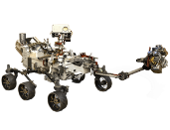
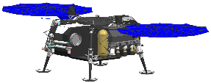

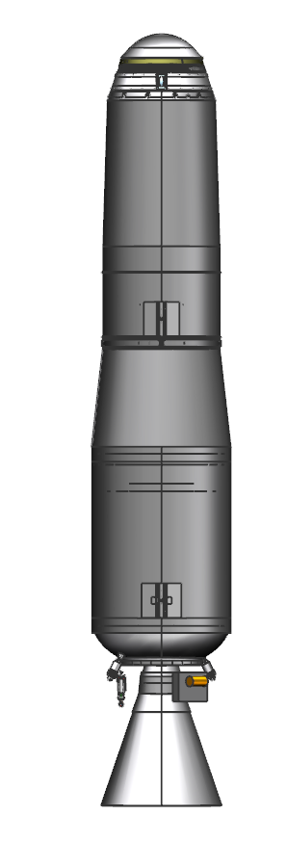




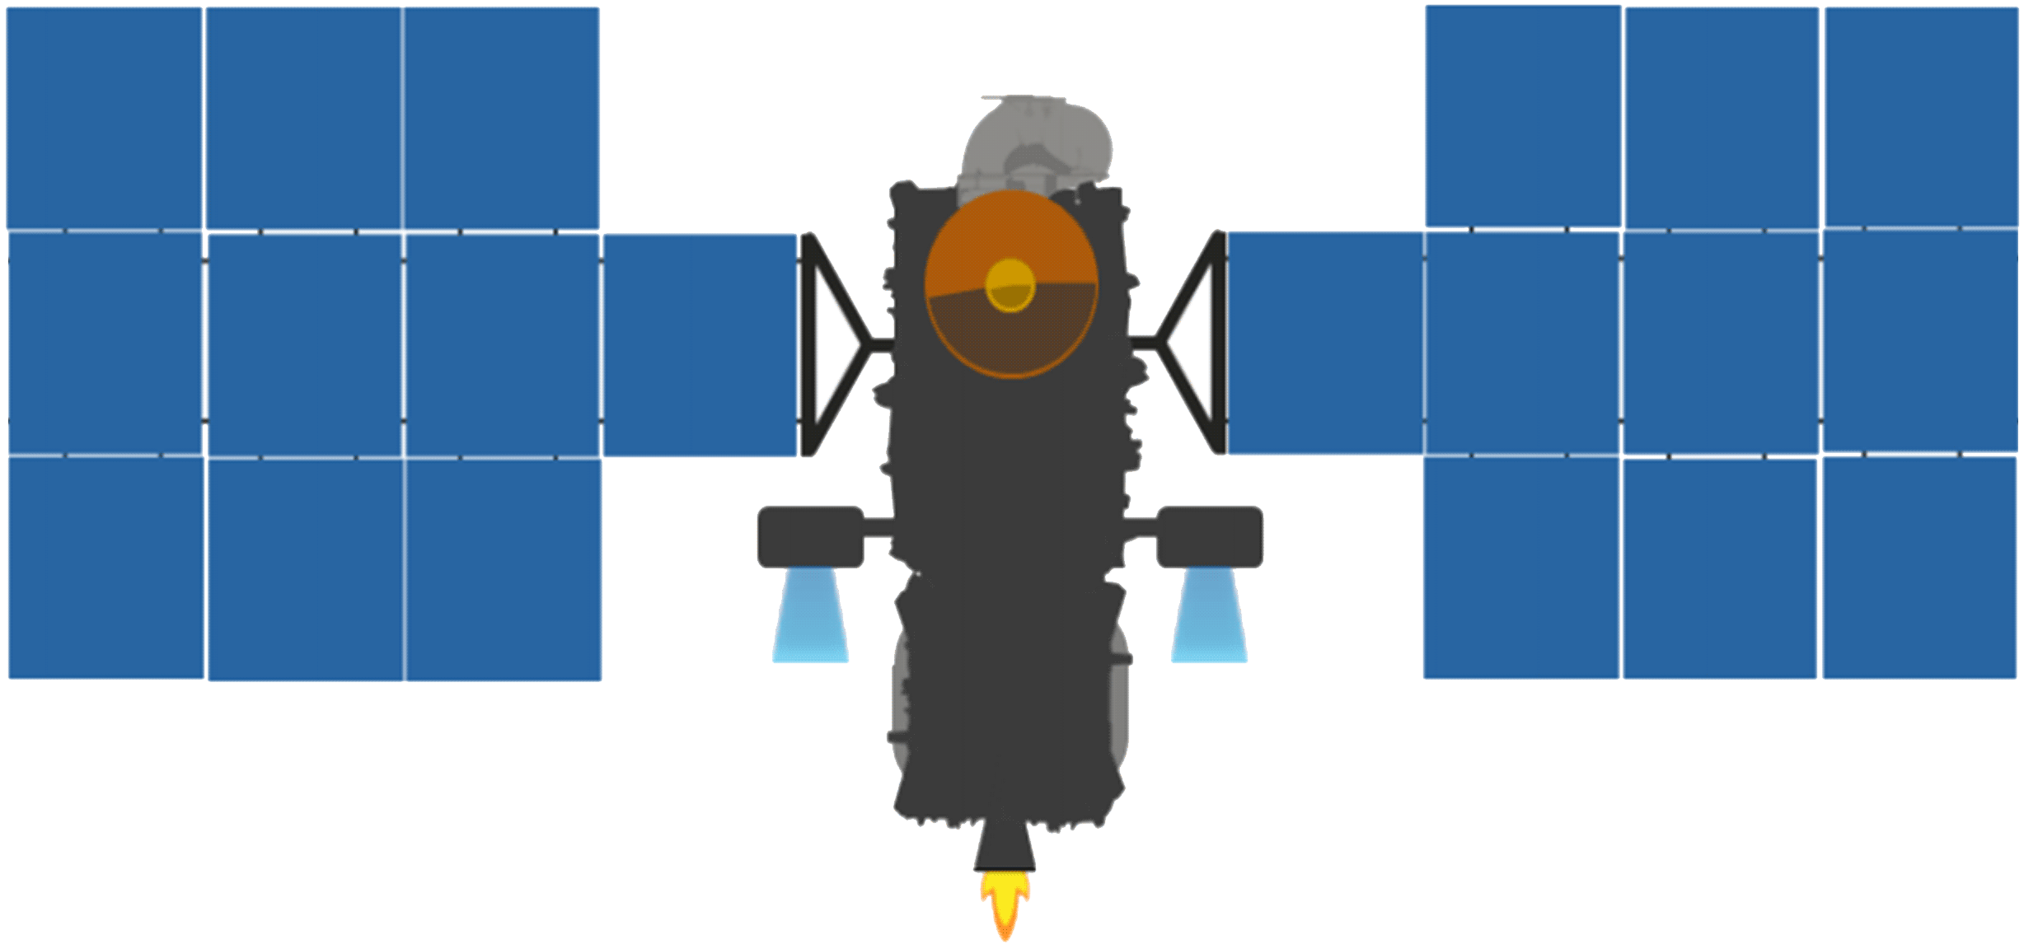





MSR Architectural Overview
Mars
Mars 2020
Tube Delivery
SRL
Mars Ascent
Vehicle
Tube Retrieval
Sample Fetch Rover
Tube Collection & Depot
Orbiting Sample
ERO with Capture, Containment and Return System payload
Retrieve OS
Break-the-Chain
Avoid Earth
Earth Entry Vehicle
Earth
Earth Return Orbiter (ERO)
Sample Retrieval Lander (SRL)

Slide 4
MSR Architecture Elements

Slide 5


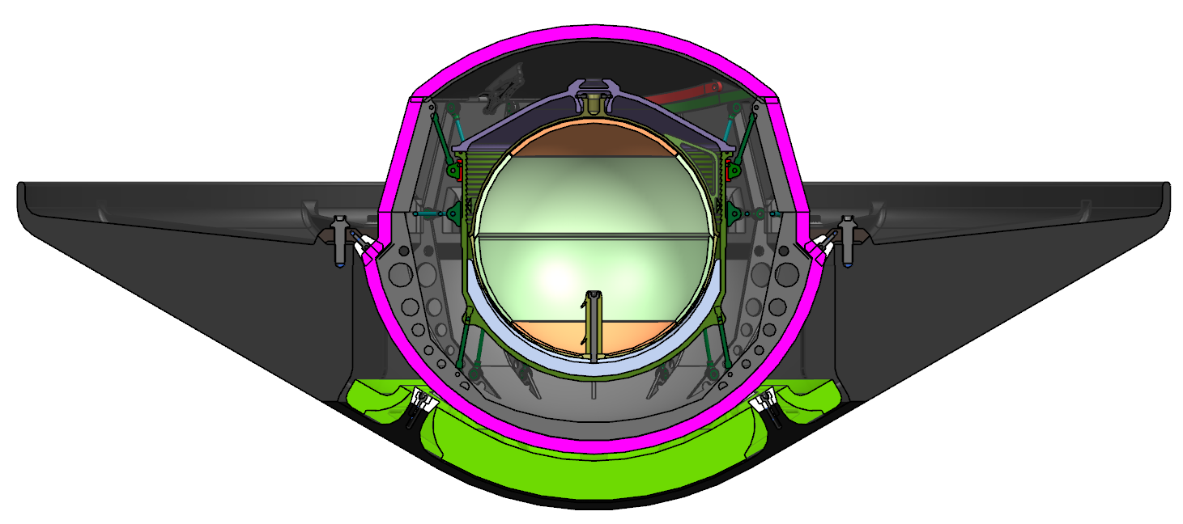
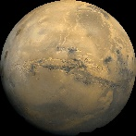


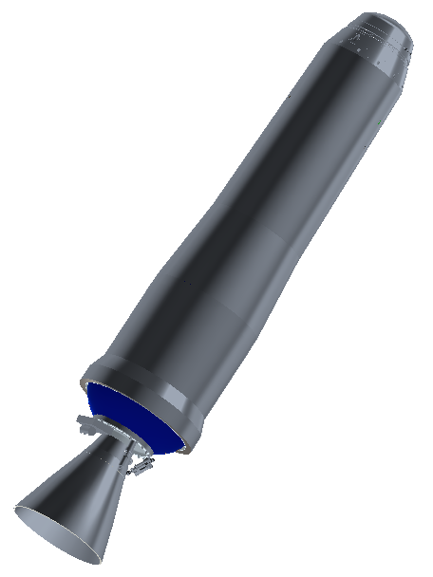
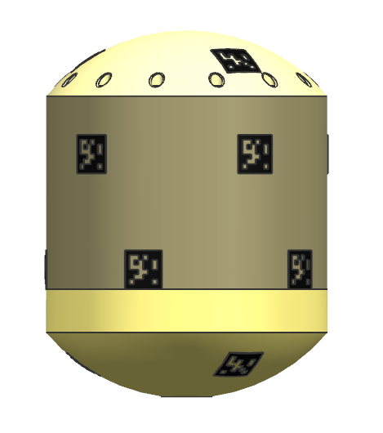



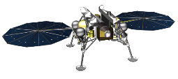
Campaign Timeline Overview
*Illustrates an example scenario
2026 |  |  |  |  |  |  |  |  |  |  |  | 2027 |  |  |  |  |  |  |  |  |  |  |  | 2028 |  |  |  |  |  |  |  |  |  |  |  | 2029 |  |  |  |  |  |  |  |  |  |  |  | 2030 |  |  |  |  |  |  |  |  |  |  |  | 2031
J | F | M | A | M | J | J | A | S | O | N | D | J | F | M | A | M | J | J | A | S | O | N | D | J | F | M | A | M | J | J | A | S | O | N | D | J | F | M | A | M | J | J | A | S | O | N | D | J | F | M | A | M | J | J | A | S | O | N | D | J | F | M | A | M | J | J | A | S | O | N | D
 |  |  |  |  |  |  |  |  |  |  |  |  |  |  |  |  |  |  |  | Reg. |  | Dust Storm Season |  |  |  |  |  |  |  | Reg. |  |  |  |  |  |  |  |  |  |  |  | Reg. |  | Dust Storm Season |  |  |  |  |  |  |  | Reg.
 |  |  |  |  |  |  |  |  |  |  |  |  |  |  |  |  |  |  |  |  |  |  |  | N Winter |  |  |  |  |  |  |  |  |  |  |  |  |  |  |  |  |  |  |  |  |  | N Winter
 |  |  |  |  |  |  |  | Earth to Mars |  |  |  |  |  |  |  |  |  |  |  |  |  | Spiral Down |  |  |  |  |  |  |  | Low Mars Orbit (Relay) |  |  |  |  |  |  |  |  |  |  |  |  |  | RDV and Contain |  |  | Spiral Up |  |  |  |  |  |  |  | Mars to Earth
 |  |  |  |  |  | Earth to Mars |  |  |  |  |  |  |  |  |  |  |  |  |  |  |  |  |  |  |  |  |  |  |  |  |  | Surface*
Conj
Conj
26-26-31
ERO
MOI
EES
EDL
M2020
MAV
OS
SRL
SFR
*See zoomed diagram for surface phases
26 – 26 – 31
SRL Launches in 2026
Samples are returned in 2031
ERO launches in 2026
Sample Retrieval Lander (SRL) avoids winter and global dust storm season, enabling all-solar SRL/SFR
SRL EDL occurs in a favorable season, maximizing landed mass
ERO can provide all relay services needed for MSR (SRL, SFR, M2020, Mars Ascent Vehicle (MAV))
SRL and ERO fit on available launch vehicles and trajectories are feasible

Slide 6
Progress to Date and
Near-Term Events
Mars Sample Return Campaign Concept Review
NASA conducted an Acquisition Strategy Meeting (ASM) in July 2019 and made Center roles/responsibilities assignments
ESA obtained approval for MSR at Nov 2019 Ministerial Council
Campaign Reference Architecture Stakeholders Peer Review (CRASPR) in January 2020
MSR was included in President’s FY2021 budget request and has been called out in FY21 House CJS report language
ESA selected Earth Return Orbiter (ERO) contractor in March 2020
ESA selected Sample Fetch Rover (SFR) contractor in June 2020
NASA/ESA MOU signed October 5th
Formulation Authorization Document (FAD) signed October 9th
SMD commissioned Independent Review Board for MSR
  Briefing to Dr. Zurbuchen on October 16th
Mission Concept Review (MCR), October 9th through 19th
Key Decision Point-A, December 16th

Slide 7
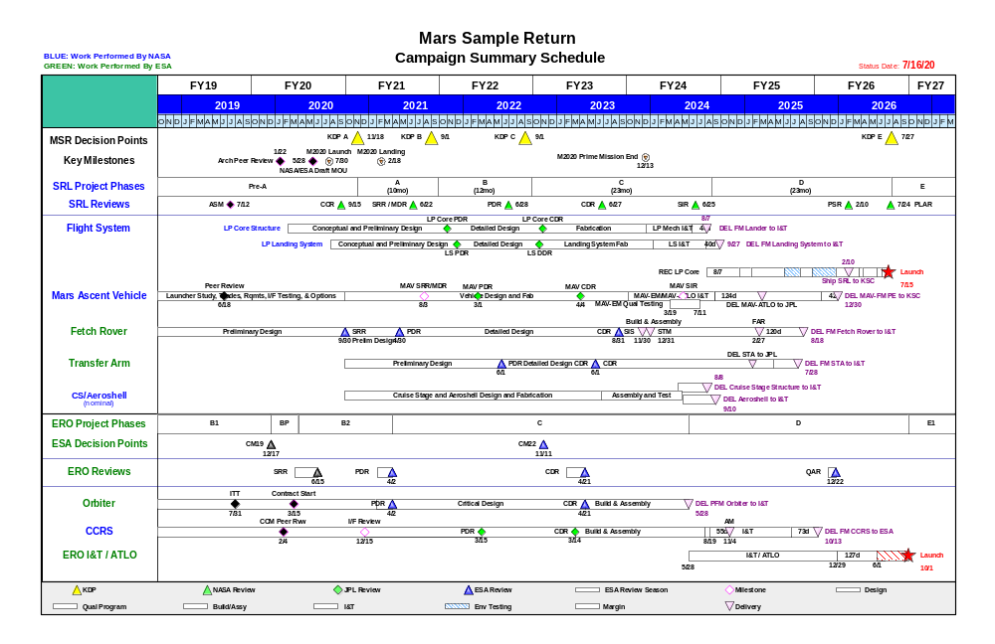
Mars Sample Return
Mission Summary Schedule
BLUE: Work Performed by NASA
GREEN: Work Performed by ESA
Status Date: 7/16/20

Slide 8


with us

