Slide 1
Hybrid Gas Electric Propulsion Summary Report
Brief Summary of Completion / Accomplishment: A confluence of aircraft system studies, component and subcomponent development, and integrated testing have been orchestrated to demonstrate feasibility of electrified aircraft propulsion for commercial transport aircraft up to the narrow body/single aisle size class. Investment in this technology area has grown significantly beyond the investment of this subproject; this broad investment shows that the challenge of showing viability has been met.
Final TRL 2

Slide 2
Hybrid Gas Electric Propulsion Publications
Bowman, C. et al. (2018), “Turbo- and Hybrid-Electrified Aircraft Propulsion Concepts for Commercial Transport,” in proceedings of AIAA/IEEE Electric Aircraft Technologies Symposium, AIAA Propulsion and Energy Forum, AIAA, Reston, VA, 2018-4984.
Density Aerospace Electric Machines”, in proceedings of AIAA Propulsion and Energy 2019 Forum, AIAA, Reston, VA, AIAA 2019-4509.
Dyson, R. (2018), “NASA Electric Aircraft Testbed (NEAT) Single-Aisle Transport Air Vehicle Hybrid Electric Tail-Cone Thruster Powertrain Configuration and Test Results” , in proceedings of 2018 AIAA/IEEE Electric Aircraft Technologies Symposium, AIAA Propulsion and Energy Forum, AIAA, Reston, VA, AIAA 2018-5004.
Dyson, R. et al. (2019), “High Efficiency Megawatt Machine Rotating Cryocooler Conceptual Design”, in proceedings of AIAA Propulsion and Energy 2019 Forum, AIAA, Reston, VA, AIAA 2019-4515.
Garrett, M. et al. (2019), “Development of an 11 kW Lightweight, High Efficiency Motor Controller for NASA X-57 Distributed Electric Propulsion Using SiC MOSFET Switches”, in proceedings of AIAA Propulsion and Energy 2019 Forum, AIAA, Reston, VA, AIAA 2019-4400.
Hybrid Gas Electric Propulsion (HGEP) Study”, NASA CR, submitted.
Jansen, R. et al. (2019), “High Efficiency Megawatt Motor Preliminary Design”, in proceedings of 2019 AIAA/IEEE Electric Aircraft Technologies Symposium, AIAA, Reston, VA, AIAA 2019-4513.
Jansen, R. et al., “NASA Electrified Aircraft Propulsion Efforts”, submitted 2019 NATO conference proceedings.
Lawson, E. et al., “NASA Advanced Air Transport Technology (AATT1) Project:
O’Brien, M. Single Aisle Hybrid Gas-Electric Aircraft Concept for Advanced Air Transport Technology (AATT1) Final Report”, NASA CR, submitted.
Woodworth, A. et al. (2019), “Thermal Analysis of Potted Litz Wire for High-Power-
Yoon, A. and Haran, K. (2018), “High Frequency Electric Machines for Boundary Layer Ingestion Fan Propulsor”, in proceedings of 2018 AIAA/IEEE Electric Aircraft Technologies Symposium, AIAA Propulsion and Energy Forum, AIAA, Reston, VA, AIAA 2018-4990.
Zhang, D. et al. (2018), “Development of Megawatt-Scale Medium-Voltage High Efficiency High Power Density Power Converters for Aircraft Hybrid-Electric Propulsion Systems”, in proceedings of AIAA/IEEE Electric Aircraft Technologies Symposium, AIAA Propulsion and Energy Forum, Reston, VA, 2018-5007.

Slide 3
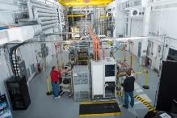
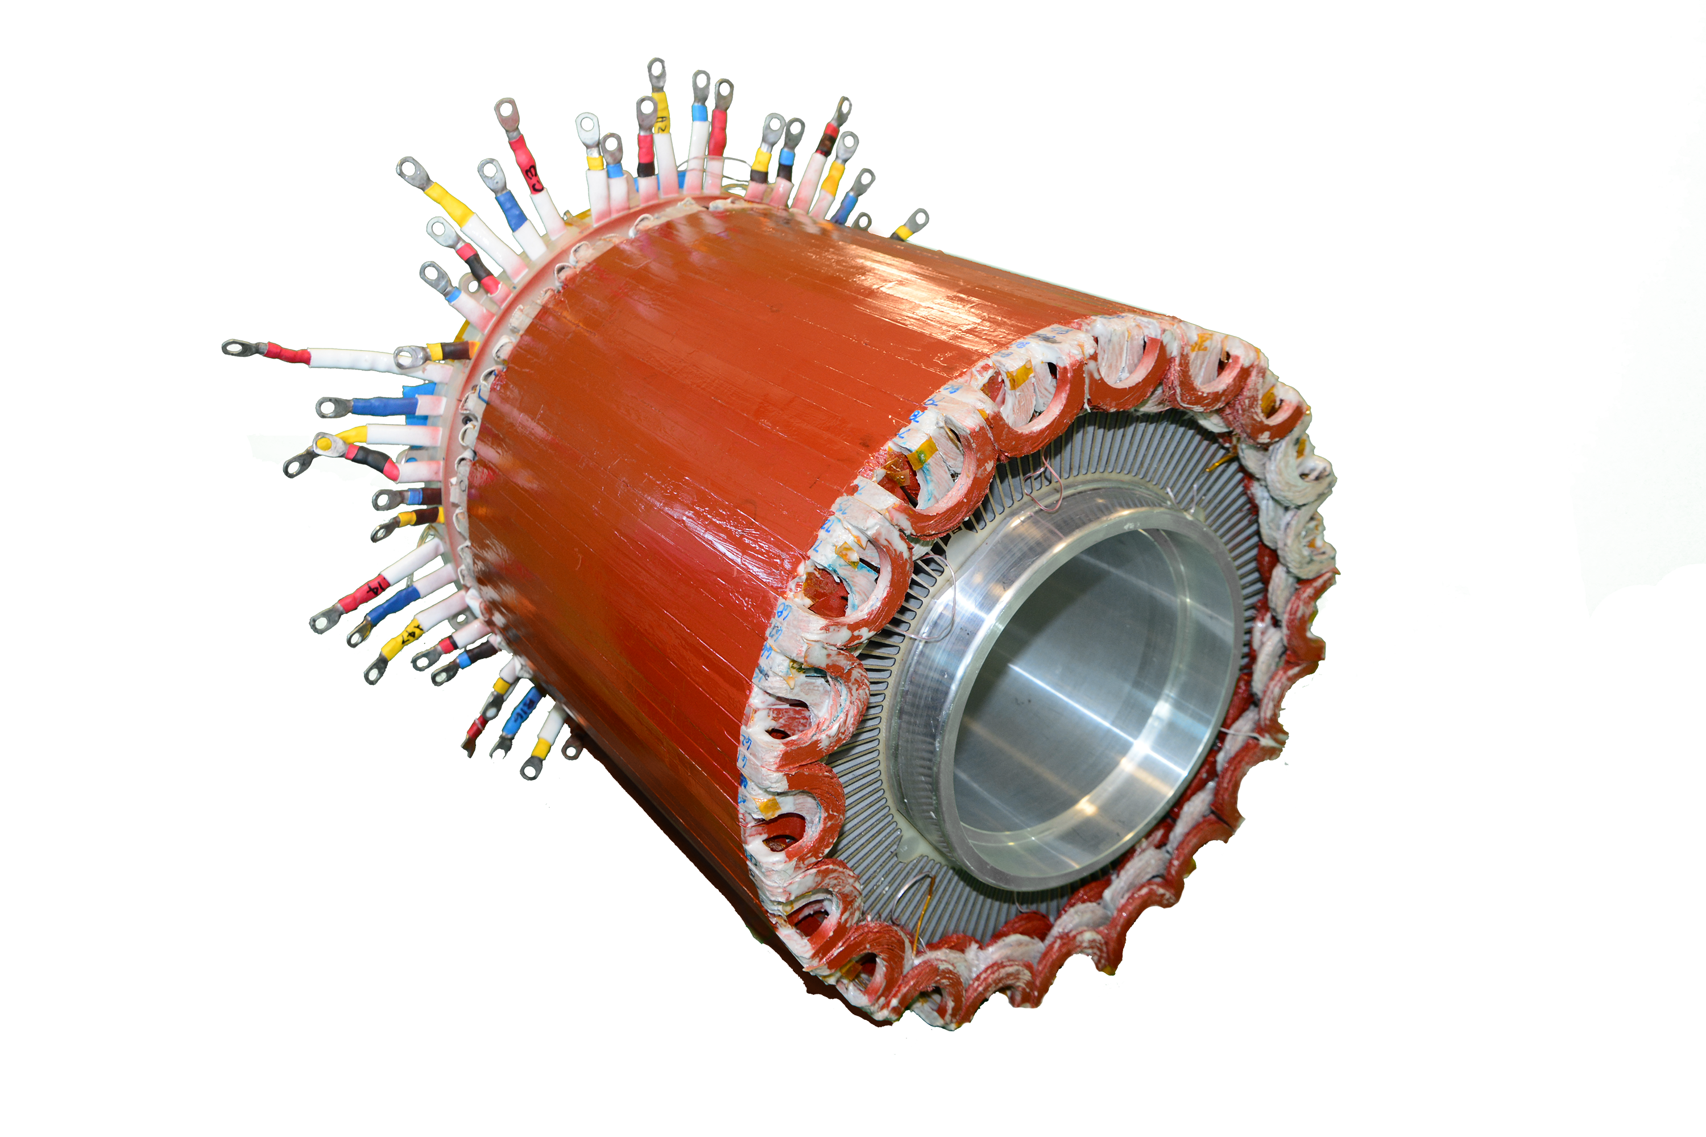
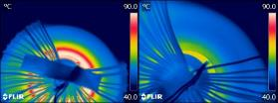
Electrified Aircraft Propulsion (EAP) Viability
Problem
Establish a single-aisle class concept that achieves viable reductions in fuel burn, emissions and noise using a hybrid gas-electric propulsion system
Objective
Perform detailed assessment of reference design concepts, mature key enabling materials and subcomponents, demonstrate representative components at the 1-2 MW level, and establish crucial testbeds focused on system-level testing.
Results
Multiple aircraft design concept studies indicate that hybrid propulsion systems can lead to block fuel savings
A EAP-relevant, soft-magnetic alloy class was matured from laboratory demonstration to component application
NRA sponsored machines and inverters demonstrated substantial improvements in specific power and efficiency
Simplified, subscale powertrains and full-scale components tests completed in NEAT testbed
Significance
Several aircraft system studies anchored with notable technology maturation from the material level up through system demonstration have established a path forward. NASA and industry investment in EAP has expanded beyond this subproject with considerable momentum.
Design and Technology Demonstrations have greatly expanded EAP potential

